Slide 1
Introduction To Hematology
READ:
Chapter 12 A&P
Chapter 2 Lab Pro

Slide 2
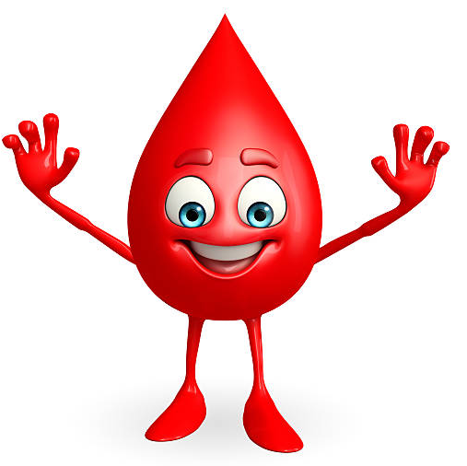
Learning Objectives
Formation and maturation of blood
Composition of blood
Functions of blood
Hemoglobin structure
Staining procedures

Slide 3
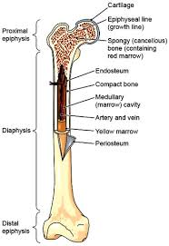
Where does blood come from?
* Hematopoiesis is the production of ALL blood cells that occur as a continuous process throughout an animal's life.
  Where does that happen?
    Fetus:
    Liver and spleen
    Newborn animal:
    Red bone marrow
    Adult:
    Red bone marrow (skull, ribs, sternum, vertebra, pelvis, proximal femurs
Notes:
Hematopoiesis
Liver and spleen
Red bone marrow
Red bone marrow (skull, ribs, sternum, vertebral column, pelvis, proximal ends of femurs.)

Slide 4
Where do ALL blood cells come from?
Pluripotential or multipotential stem cells are primitive stem cells that have the potential to replicate and differentiate into many different types of unipotential stem cells.
These stem cells then commit to one of three maturation processes.
  erythropoiesis
  leukopoiesis
  thrombopoiesis
Notes:
Erythropoiesis
Leukopoiesis
Thrombopoiesis

Slide 5
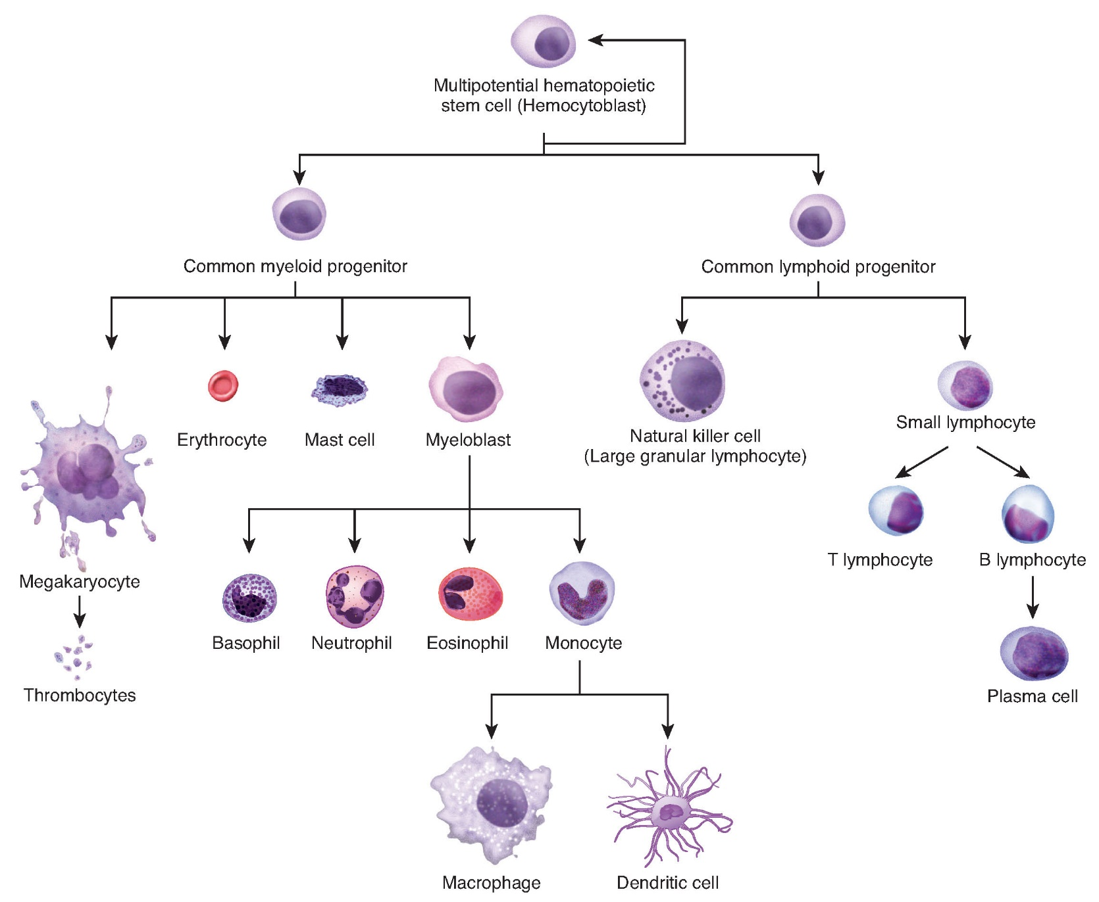

Slide 6
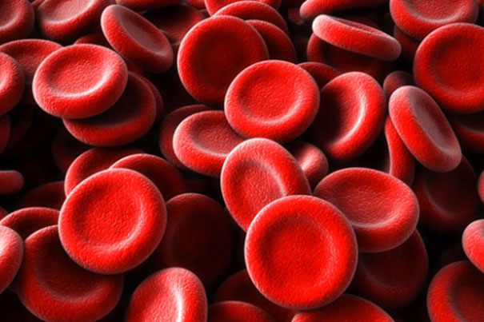
Erythropoiesis

Slide 7
Erythropoiesis
This is the process by which RBCs are created.
  Unipotential stem cells are stimulated to differentiate into proerythroblasts.
  The rate at which this happens is controlled by hormones, mainly Erythropoietin; EPO and the availability of the materials needed to make RBCs: iron, folic acid, vitamin B12 and protein
  Where is EPO produced? kidneys
  To consider: What does hypoxia have to do with this process??
  Regulated by blood O2 levels in the kidney
Notes:
Erythropoietin; EPO;
kidneys (peritubular interstitial cells)
Regulated by the blood oxygen levels in the kidney

Slide 8
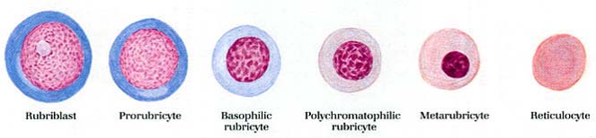
Maturation cycle of a RBC

Slide 9
Morphological Changes During Maturation
Rubriblast
  Very large with royal blue cytoplasm
  Contains a large purple nucleus in a loose chromatin pattern
Prorubricyte
  Slightly smaller, with a basophilic cytoplasm
  Chromatin composing the nucleus is slightly smaller and denser and stains purple

Slide 10
Morphological Changes During Maturation, continued…
Rubricyte
  Smaller still with either a basophilic or slightly purple cytoplasm as it begins to acquire the hemoglobin molecules
Metarubricyte
  Cytoplasm is similar in color to mature RBC
  Nucleus is now considered pyknotic (more dense) and stains dark blue
  Polychromasia may be seen here

Slide 11
Morphological Changes During Maturation, continued…
Reticulocyte
  Nucleus is ‘pushed out’ of cell, leaving behind reticulum composed of RNA
  Cytoplasm stains slightly blue, and Howell-Jolly bodies may be seen if stained with Wright’s stain.
  Mature RBC is seen after ALL reticulum is lost from reticulocyte.

Slide 12
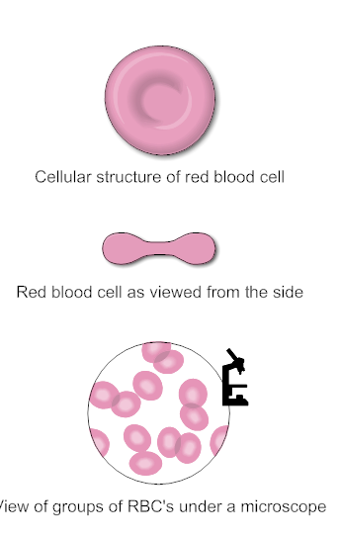
Structure of a mature RBC
Lack a nucleus, mitochondria and ribosomes
Contain:
  Water
  Hemoglobin
  Other structural elements
When viewed microscopically, mature RBCs appear as non-nucleated, biconcave discs with a central zone that is thinner and appears lighter ( central pallor ) on a stained blood smear.
Since they have no mitochondria, RBCs utilize glucose from plasma for energy
Hemoglobin dissolved in RBC cytoplasm makes them stain red
Notes:
Central pallor

Slide 13
Structure of a mature RBC, continued…
An RBCs membrane is ‘deformable’, it can change shape to move through vessels, but it is not elastic
The bioconcave shape provides more surface area to allow for gas exchange to take place
Disk shape allows for shorter diffusion distance in and out of the cell, compared to a spherical shape
  Animals with less bioconcave shape usually have higher number of RBCs on average.
Notes:
Central pallor

Slide 14
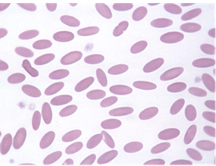
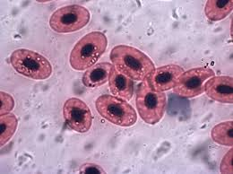
RBC differences among species
Dogs have the largest red blood cells with a prominent central zone of pallor
Cats, horses, cow, sheep, and goats have smaller RBCs
Cats and horses do not have a prominent central zone of pallor
Camelids (llamas, camels, and their relatives) have elliptical or oval RBCs
Deer have sickle-shaped RBCs
Birds, fish, amphibians, and reptiles have elliptic RBCs that are nucleated even when mature

Slide 15
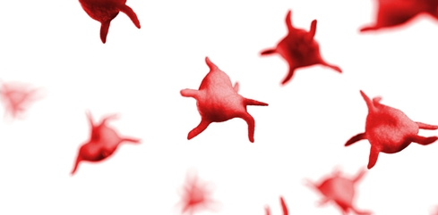
Thrombopoiesis

Slide 16
Thrombopoiesis
This is the process where platelets are created.
Production starts when there is a specific stimulant acting upon a unipotential stem cell in the red bone marrow. The first phase of growth is called a megakaryocyte.
The megakaryocyte is a large multinucleated cell that never leaves the bone marrow.
Pieces of cytoplasm from the megakaryocyte are released into the peripheral blood as platelets.
Thrombopoiesis can take up to 7 days to reach completion
Notes:
Platelets
7

Slide 17
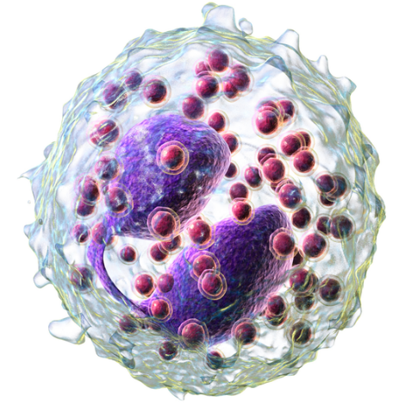
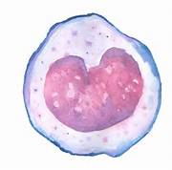
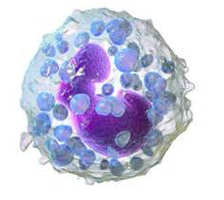
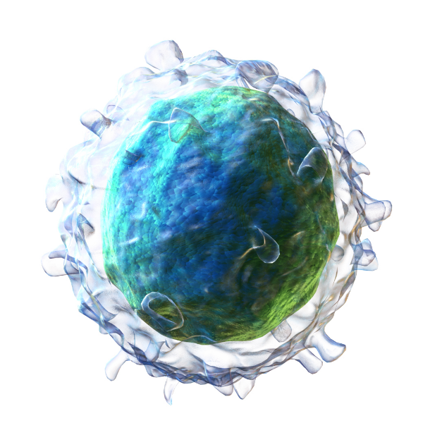
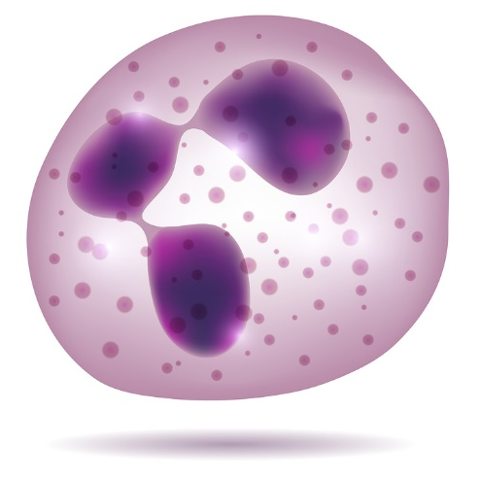
Leukopoiesis

Slide 18
Leukopoiesis
This is the general term for the formation of WBCs. They all start out with the same pluripotential stem cells, but then each WBC has its own stimulus for production.
Granulopoiesis
Neutrophils
Eosinophils
Lymphopoiesis
Lymphocytes
Monopoiesis
Monocytes
Basophils

Slide 19
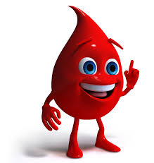
Blood 101: Quick facts
Blood is a fluid connective tissue that flows throughout the entire body
Whole blood is contained within the cardiovascular system
Peripheral blood is whole blood circulating in blood vessels carrying oxygen, nutrients, and waste materials.
  Blood samples are taken from peripheral blood sites
Notes:
Connective tissue
Whole blood
Peripheral blood
This is where you will obtain your animals blood samples from

Slide 20
What is in that blood?
Liquid portion: Plasma
  What is it made of?
  Primarily water and solutes
  Cellular portion contains:
  Erythrocytes, leukocytes and platelets
Notes:
Plasma
Primarily water and various solutes
RBCs erythrocytes, leukocytes, platelets

Slide 21
Composition of Blood Chart
Whole blood
_____93__% fluids and tissues
_____7____ % blood
Percentages based on body weight
Plasma
___55___%
Formed elements __45____%
Percentages based
On volume
Lets talk first about plasma
Notes:
93/7
55/45

Slide 22
Formed elements, what’s are they?
60-77%
12-30%
3-10%
2-10%
rare
Notes:
Platelets 200-500 thousand
Leukocytes 6-17 thousand
Neutrophils
Lymphocytes
Monocytes
Eosinophils
Basophils
Erythrocytes 5.5 – 8.5 million

Slide 23
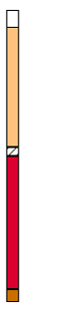
What happens when you take whole blood and centrifuge it down?
plasma
Buffy coat
erythrocytes
Notes:
Plasma
Buffy coat (leukocytes)
RBCs

Slide 24
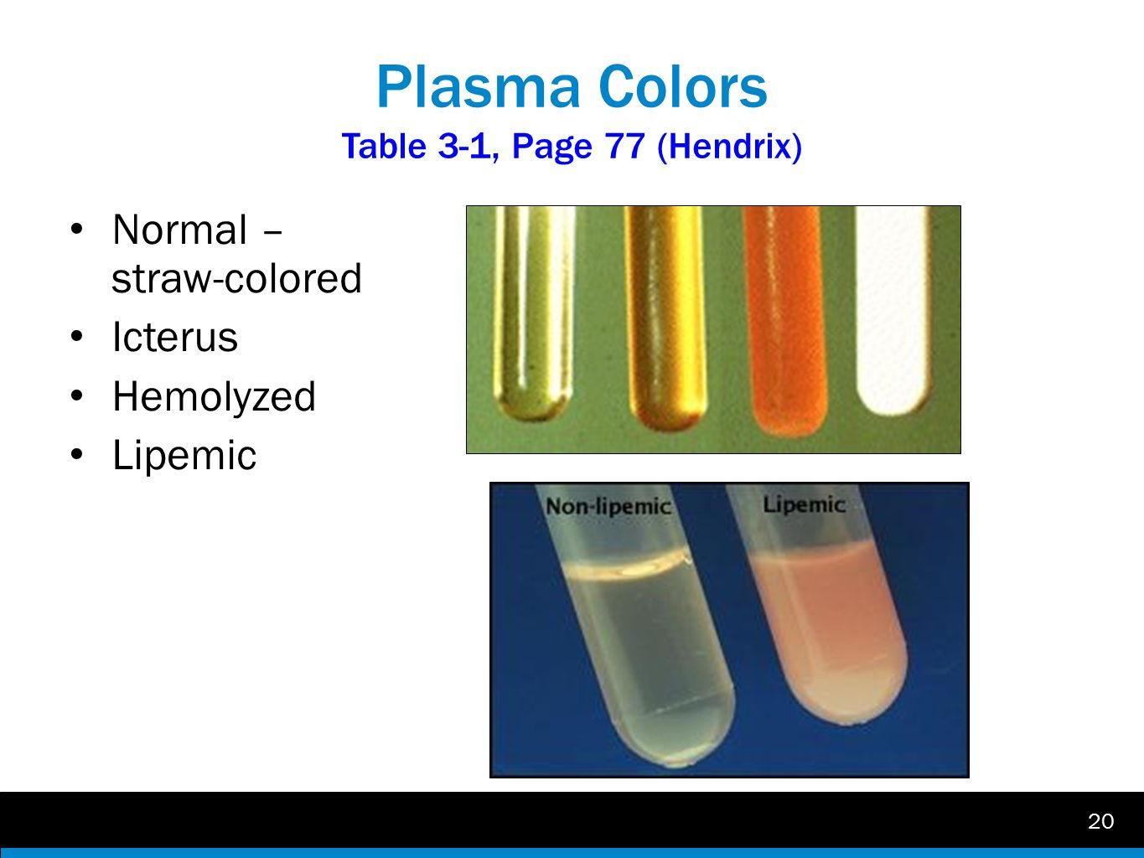
Plasma Colors
Notes:
Normal
Icteric
Hemolyzed
Lipemic

Slide 25
Close up of a lipemic sample

Slide 26
Functions of the Blood

Slide 27
Blood Functions
Blood has three main functions
Transportation
Regulation
Defense
Notes:
Transportation
Regulation
Defense

Slide 28
Transportation
Erythrocytes contain _______hemoglobin_____ which carry oxygen to every cell in the body. They do this by using hemoglobin.
Hemoglobin is made up of _____4___________ heme units associated with one globin chain. Each heme unit is the pigmented portion of hemoglobin.
Each heme unit contains an iron atom to which _____1_______ molecule of oxygen molecule can attach.
Therefore, one hemoglobin molecule can carry ____4______ molecules of oxygen.
  What is oxyhemoglobin? Hemoglobin with O2 bound
  What is deoxyhemoglobin? When hemoglobin gives up its oxygen
Notes:
Hemoglobin
Four
One
Four
Hemoglobin with oxygen bound to it
When hemoglobin gives up its oxygen

Slide 29
Transportation, continued…
Nutrients and other essential elements are dissolved in the blood plasma and transported to tissues via arteries and capillaries
Blood carries waste from cellular metabolism via veins to the lungs and kidneys
Blood transports hormones from the endocrine glands to target organs as well as WBCs to various sites
Blood transports platelets to sites of damage in blood vessel walls to form a plug to control bleeding, this is a mechanism called hemostasis. They are also involved in the activation of blood-clotting cascade
Notes:
Nutrients
Waste

Slide 30
Regulation
Blood aids in regulation of body temperature. Where are your body temperature regulators? _________brain_____________
Blood plays a part in tissue fluid content.
  What is hemoconcentration? Less plasma in the bloodstream, cells are more concentrated (vomiting, diarrhea, profuse sweating, other pathologic conditions
  What is hemodilution? Extra plasma in the bloodstream; excessive SQ fluids
Notes:
Brain
Less plasma in the bloodstream, cells are more concentrated (vomiting, diarrhea, profuse sweating, other pathologic conditions
Extra plasma in the bloodstream; excessive SQ fluids

Slide 31



Regulation, continued…
Blood aids in the regulation of blood pH (acid-base balance)
    What is the normal pH range?7.35 – 7.45
    Which part of the blood is slightly more alkaline because most of the acidic waste products are carried there? Arterial blood
Normal
pH
Death
Acidosis
Alkalosis
Death
6
7
7.35
7.45
7.8
9
Notes:
7.35-7.45
Arterial blood

Slide 32

Defense
Blood carries WBC to tissues exposed to foreign invaders.
Blood carries platelets to sites of vessel damage to aid in hemostasis so that the animal does not bleed excessively.
Notes:
WBCs
Platelets

Slide 33
Hemoglobin

Slide 34
Hemoglobin and how it assists the RBCs
Attaches to erythrocytes to carry __________oxygen______________
___heme______ = pigment portionheme
Produced in mitochondria
globin = protein portion
Produced by ribosomes
Notes:
Oxygen
Heme
Globin

Slide 35
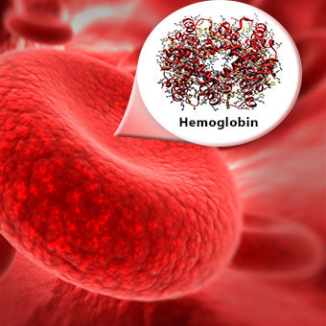
Hemoglobin Types
Each type of hemoglobin is found during different stages of development of the animal
  Embryonic hemoglobin (HbE)
  Fetal hemoglobin (HbF)
  Adult hemoglobin (Hb)

Slide 36
Embryonic and Fetal Hemoglobin
Embryonic hemoglobin (HbE) is found in early developing fetuses
Fetal hemoglobin (HbF) is present in fetal blood during mid to late gestation
  It is also present up to a couple of months after birth
  Highest concentration of HbF is at birth
Adult hemoglobin (Hb) is found in the RBCs of all animals beginning a couple of weeks to months after birth
  They gradually replace HbF as primary type being produced by the body
  Inside normal RBCs, Hb is conjugated

Slide 37
Adult Hemoglobin Function
Transporter of ______oxygen__________ to the tissues
Exists in two normal physiological states:
Oxyhemoglobin: carrying O2
    One oxygen molecule is associated with each iron molecule
    pH, temperature, and O2 and CO2 levels influence ability of Hb to carry O2
  Deoxyhemoglobin: having given up O2
    Also known as empty hemoglobin
    CO2 is transported directly and indirectly in the RBC and is dissolved in the plasma
Notes:
Oxygen
Oxyhemoglobin: carrying O2
Deoxyhemoglobin: having given up O2

Slide 38
Senescence

Slide 39
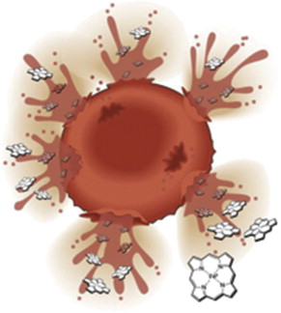
Erythropoietic Cycle: Senescence
What is senescence? The process of aging
What is the average lifespan of a RBC in a dog? _____120__________________
  What is the average lifespan of a RBC in a cat? ______68__________________
  What happens as RBCs wear out, age and die? They are replaced by young RBCs from the red bone marrow
Notes:
The process of aging
120
68
They are replaced by young RBCs from the red bone marrow

Slide 40
Senescence, continued…
When an RBC membrane ruptures in the blood vessel, hemoglobin is released directly into the blood.
Unconjugated (unbound) Hb is picked up by a transport protein called haptaglobin
Haptaglobin carries the unconjugated Hb to macrophages in the liver
Once in the liver, extravascular hemolysis continues
Notes:
Hemoglobin
Unconjugated
Haptaglobin
Liver

Slide 41
Senescence, continued…
Extravascular Hemolysis
About 90% of the destruction of senescent RBCs occurs by extravascular hemolysis.
Once inside a macrophage, the membrane of the RBC is destroyed.
Contents are recovered from the macrophages and iron is transported back to the red bone marrow
Heme is eliminated from the body, but is converted to bilirubin and carried to the liver by albumin (plasma protein), it is called unconjugated or ‘free’ bilirubin
  Bilirubin: The yellow breakdown product of normal heme catabolism, caused by the body clearing out aged RBCs which contain Hb
  Serum albumin: Globular protein that helps important molecules attach to the cell.
Notes:
Iron
Bilirubin
Bilirubin

Slide 42
Senescence, continued…
Extravascular Hemolysis
Once in the liver, bilirubin is conjugated to flucuronic acid, making the combination water soluble
Conjugated bilirubin is excreted as bile pigment into the intestines.
  Some conjugated bilirubin is converted into urobilinogen by bacteria and eliminated in the urine as urobilin (yellow)
  Other conjugated bilirubin is converted into stercobilinogen and excreted in the stool as stercobilin (brown)
Notes:
Urobilinogen
Urobilin
Stercobilin

Slide 43
Senescence, continued…
Intravascular Hemolysis
About 10% of normal RBC destruction takes place by intravascular hemolysis. Meaning that the destruction takes place within blood vessels.
When a RBC membrane ruptures within a vessel, hemoglobin is released directly into the bloodstream.
The hemoglobin released is unconjugated, and is quickly picked up by haptaglobin, which is a transport protein in plasma, to form haptoglobin-hemoglobin complex
This complex travels to the macrophages in the liver for further breakdown, similar to what happens in extravascular hemolysis.
Notes:
Haptoglobin

Slide 44
Senescence, continued…
Intravascular Hemolysis
When haptoglobin is filled with unconjugated hemoglobin, as in cases of severe hemolysis, excess unconjugated hemoglobin appears in the plasma, making it pink, red or brown in color. This is referred to as hemoglobinemia
The excess of unconjugated hemoglobin has no way to get to the liver, so it is carried to the kidney, where it is eliminated in the urine, making it red in color. This is referred to as hemoglobinuria
Notes:
Hemoglobinemia
Hemoglobinuria

Slide 45
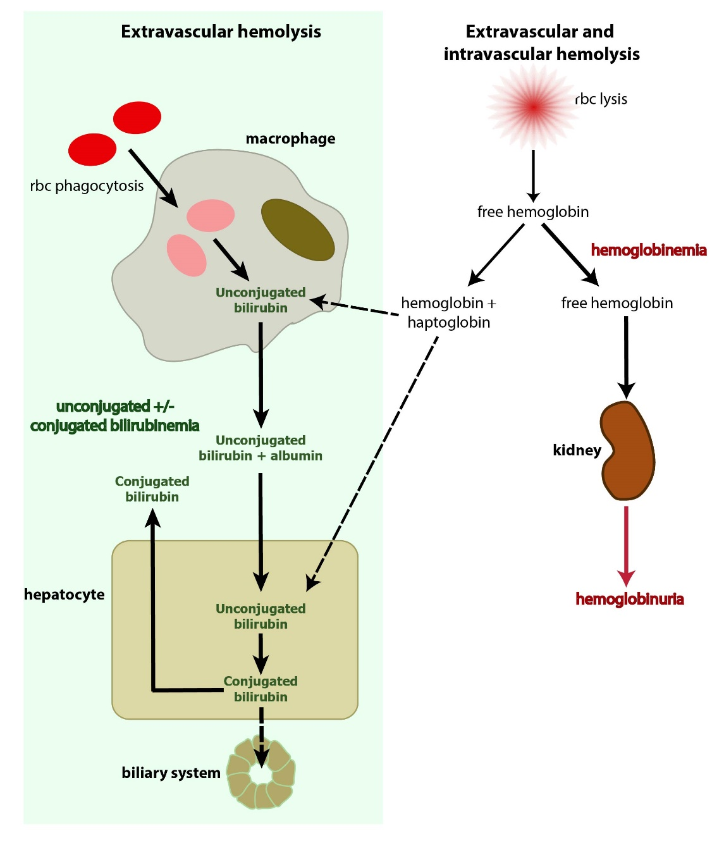

Slide 46

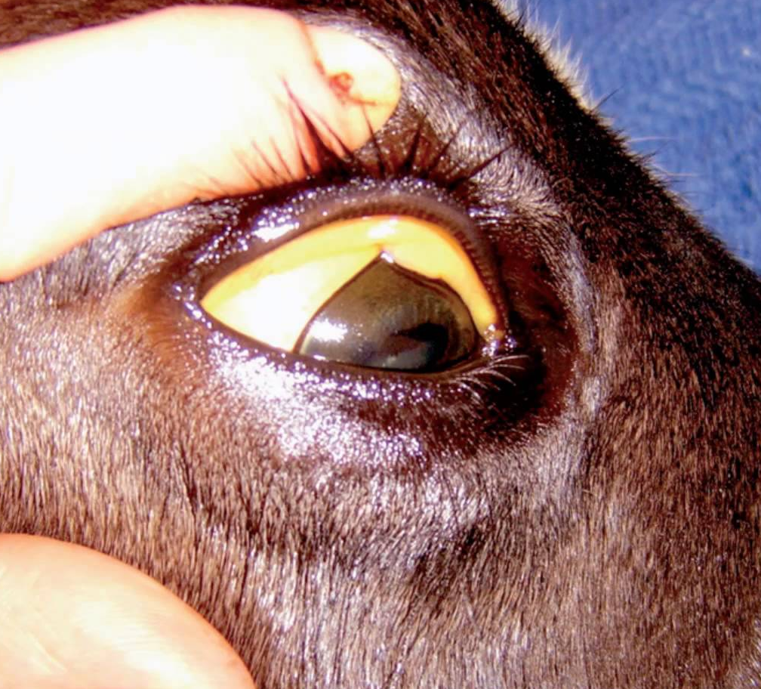
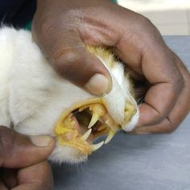
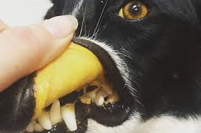
What will you see in your patient when excess RBCs blood cells breakdown?
Patient will exhibit jaundice or icterus. This can be associated with liver diseases. If the bile ducts are obstructed the conjugated bilirubin can’t be passed with bile into the intestines, conjugated bilirubin will eventually back up into the blood stream and then the tissues.

Slide 47
Staining of Blood

Slide 48
Staining of Blood
Different structures within the cell stain specific colors
There are many different hematology stains
Different names but have similar staining characteristics
Many are Romanovsky-type stains (Wright’s stain, Giemsa, Leishman’s, Wright-Giemsa, and May-Grunwald)
All are polychromic stains
Combination of basic blue and acidic red dyes dissolved in ethyl alcohol
Allows acidic structures to stain _______red________
Allows alkaline structures to stain _______blue_________
Supervital stain is a type of stain used when components of a cell need to be visualized, but cannot be picked up by the Romanovsky-type stains
Notes:
Red
Blue

Slide 49
Staining of Blood
Stain depends on what test you are doing
Each test we do here will have specific staining instructions
Wright’s stain is the most widely used hematology stain
  Alkaline part is methylene blue
  Acidic part is eosin
Modified Wright’s stains offer faster staining times, but don’t stain some cellular structures as effectively
  Diff-Quick is a Modified Wright’s stain
Notes:
Blue
Red

Slide 50
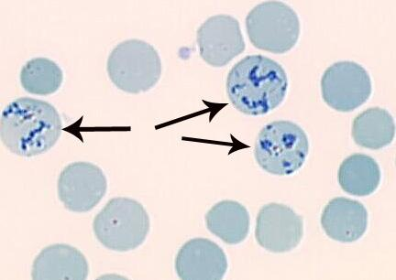
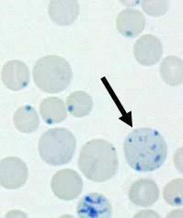
Staining of Blood
Reticulocytes are immature erythrocytes that contain organelles that are lost as the cell matures
Most species have just an aggregate form, except the cat, which has a unique punctate form of reticulocyte
The punctate form contains just 2-8 small basophilic granules.
Notes:
Punctate

Slide 51
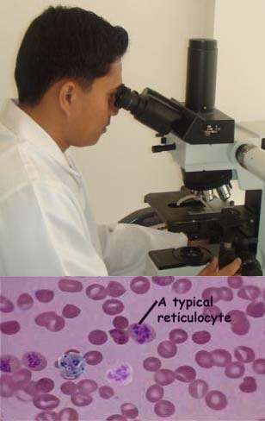
Staining of Blood
Performing a reticulocyte count:
  Purpose: Performed on the blood of all anemic domestic animals (except horses). This count is useful in assessing the bone marrow’s response to anemia
  Procedure: Prepare two blood films and count 500 RBCs on each slide, keeping track of how many out of the 500 cells are reticulocytes (if you have a cat, you do not count the punctate reticulocytes as a reticulocyte)
  Results: Reticulocyte count is an expression of the percentage of RBCs that are reticulocytes.
Notes:
Blue
Red

Slide 52
