Slide 1
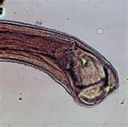
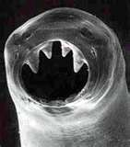
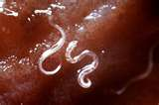
Laboratory Procedures
Introduction to Parasitology

Slide 2
Symbiosis: living together
There are 5 types of symbiotic relationships

Slide 3
1) Predator/prey
This is a short term relationship where one being benefits at the expense of the other.

Slide 4
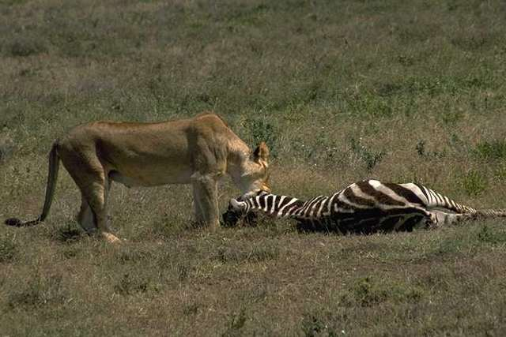

Slide 5
2) Phoresis:
The smaller member of the relationship is mechanically carried about by the larger.

Slide 6
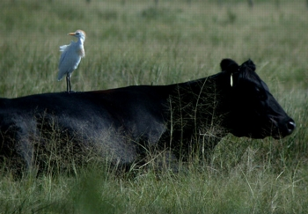
Notes:
Bacteria that causes keratiitis, ulceration and ultimately rupture of cornea,

Slide 7
3) Mutualism:
Both organisms benefit.

Slide 8
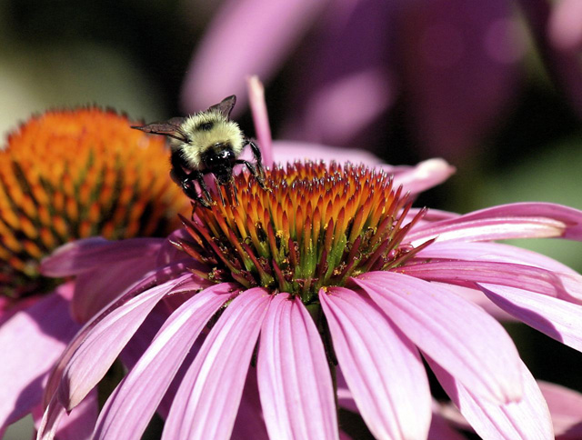

Slide 9
4) Commensalism:
One being benefits and the other neither benefits nor is harmed

Slide 10
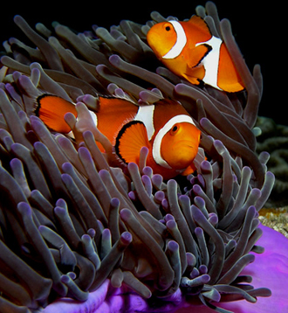
Notes:
Most difficult to observe. Cattle egret eats insects stirred up by cow, but then also feeds on insects (like ticks) on hide, so there is a benefit to some degree. Barnacles may be an example as well, but it can’t be proven that the weight of the barnacle impedes the scallop’s movement or competes with it for food.

Slide 11
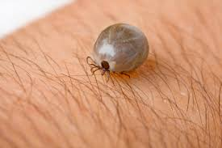
5) Parasitism:
An association exists between two organisms of different species in which one member lives on or in the other member and may cause harm.

Slide 12
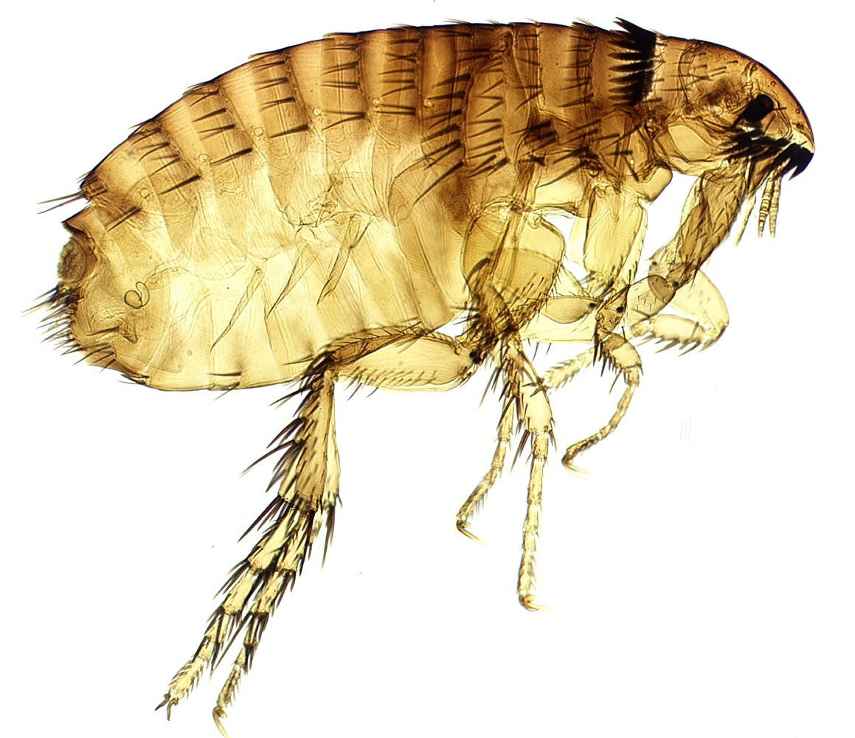
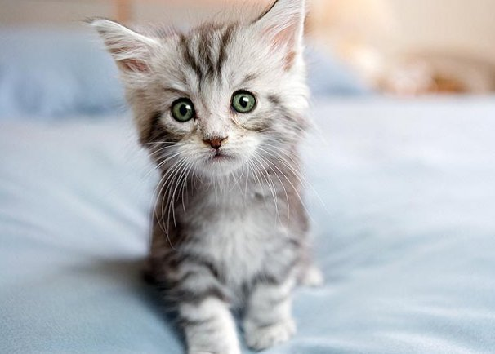
So What is a Parasite?
A smaller organism that lives on or in and at the expense of a large organism called the host.

Slide 13
Infection vs. Infestation:
An infection may be caused by a parasite within the body.
An infestation is outside/on the body or in the environment.

Slide 14
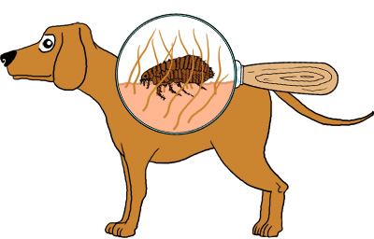
Ectoparasite:
The parasite lives outside/on the body of the host.

Slide 15
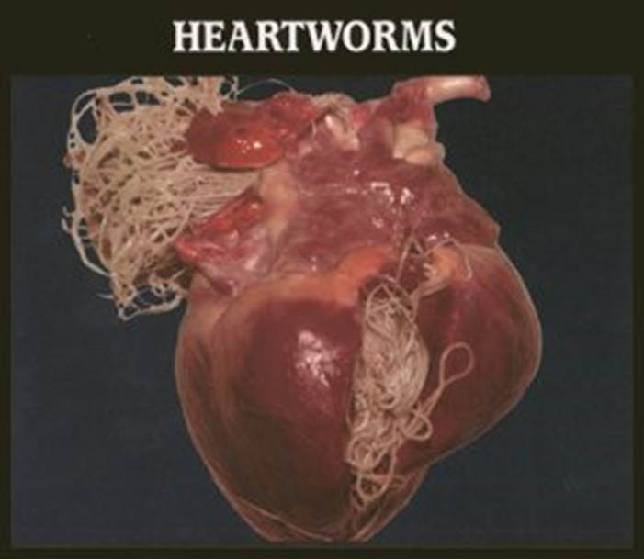
Endoparasite:
The parasite lives within the body of the host

Slide 16
How is the Host Affected?
Host’s expense may be trivial, substantial, or even unbearable.
Host’s expense is determined by:
  The number of parasites
  The kind and degree of damage the parasites inflict
  The vigor or nourishment of the host (overall health of host)

Slide 17
Classifications of Parasitism
Infestation or infection with parasites
Multiple parasitism: A condition in which parasites of different species infest/infect the animal.
Superparasitism: Excessive parasitization of the same species.

Slide 18
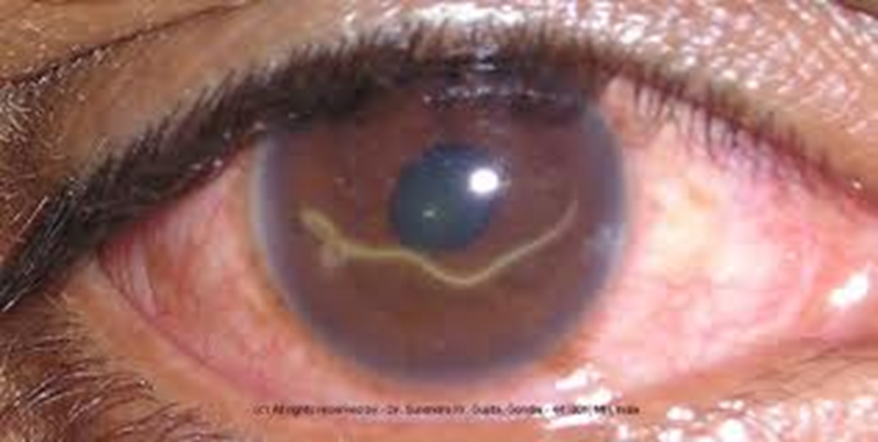
Erratic or Aberrant parasite:
When a parasite wanders from its usual site of infection into an organ or location in which it doesn’t normally live.

Slide 19
Aberrant Parasites
Most parasites are host-specific
If enter wrong animal, may not be able to survive or migrate abnormally.
When this occurs, the parasite is called aberrant.
May cause an over-reaction in the body of the wrong host and serious disease can result

Slide 20
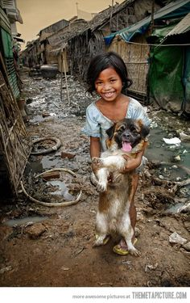
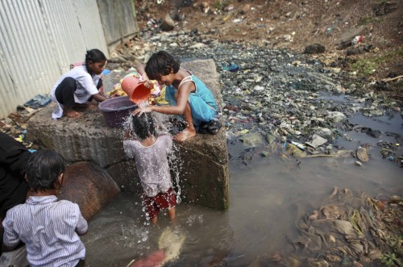
Incidental Parasite:
When a parasite occurs in a host that it normally does not live.

Slide 21
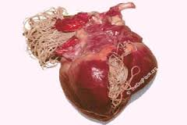
Obligatory Parasite:
A parasite that must lead a parasitic existence. These are not capable of leading a free living existence

Slide 22
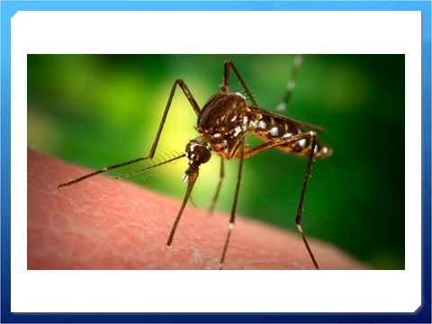
Periodic Parasite:
A parasite that does not have to live on or in a host but must make short frequent visits to obtain nourishment.

Slide 23
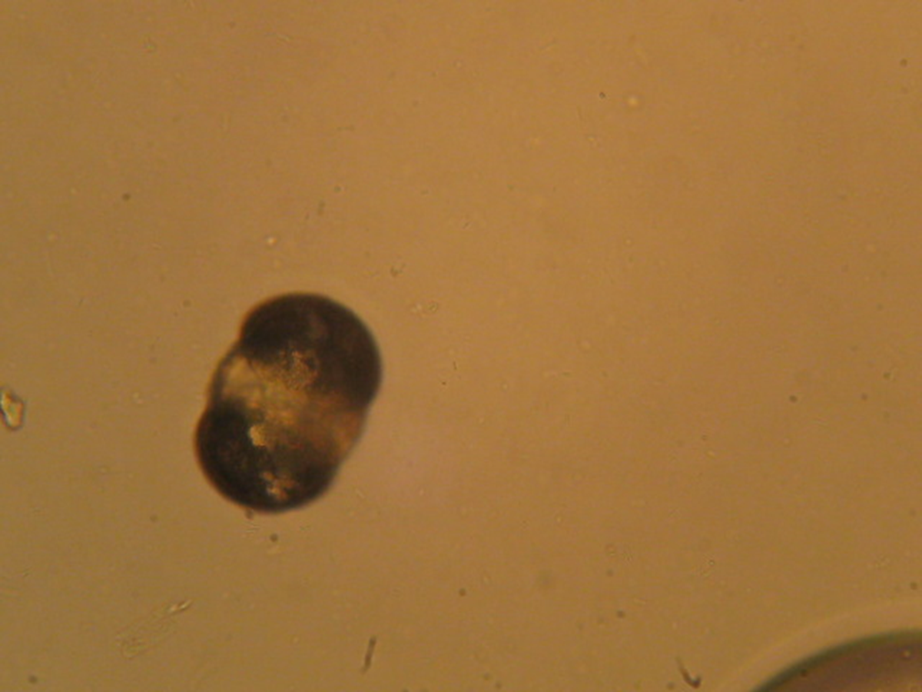
Pseudoparasite:
Living creatures or objects that are not parasites but may be mistaken for parasites

Slide 24
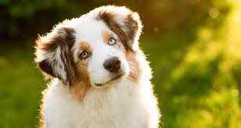
Definitive host:
The host that harbors the adult, sexual or mature stages of the parasite.

Slide 25
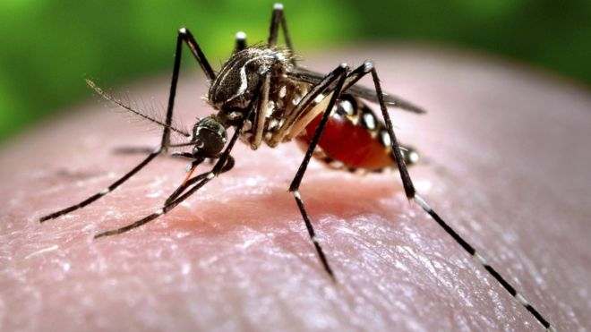
Intermediate Host:
The host that harbors the larval, juvenile, immature or asexual stages of the parasite.

Slide 26
Each parasite has its own Life Cycle.
This is the development of the parasite through its various life stages.

Slide 27
Life Cycles and Transmission of Parasites
Life cycle describes how an organism develops from the immature stage to the adult.
Some parasites produce live young and others produce eggs
Some one-celled parasites may even reproduce by dividing into two identical parts

Slide 28
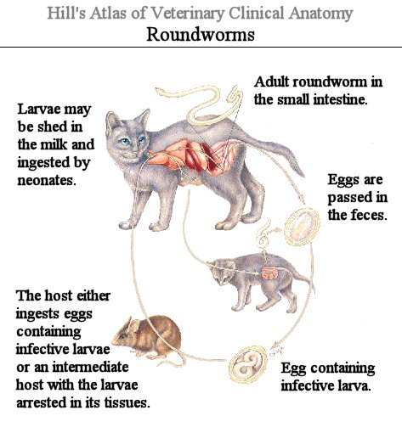
Direct Life Cycle
The immature form of the parasite can infect the same host it came from
  Ex. Roundworms

Slide 29
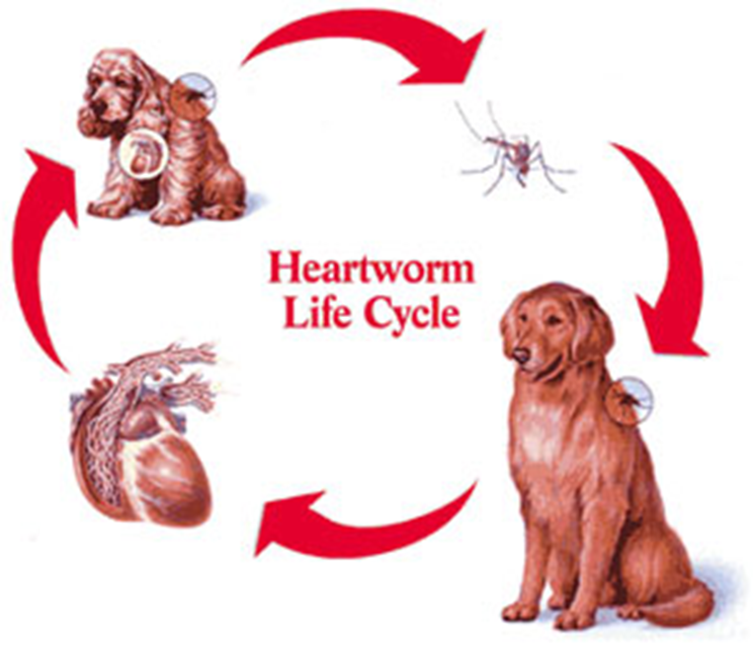
Indirect Life Cycle
The immature form must pass through a different type of host before it can re-enter and infect the host it came from.
  Intermediate host is the host in which the immature form of the parasite lives
  Definitive host is the host in which the adult form lives.
    Ex. Heartworms

Slide 30
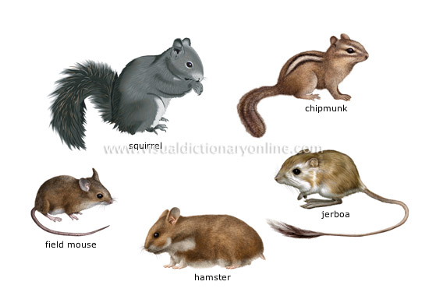
Transport Hosts
Some life cycles incorporate a transport host
Is an intermediate host where no development occurs.
Is a way for the parasite to get from one host to another.
  Rodents can transport roundworms to dogs and cats

Slide 31
Migration
Many parasites have life cycles that include a phase of migrating through the body.
  Ex. Hookworms

Slide 32
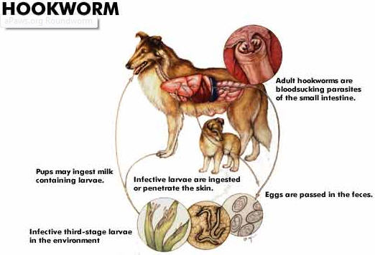
Somatic/Tracheal Migration

Slide 33
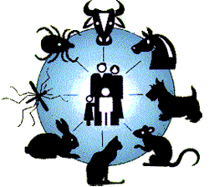
Zoonoses
Infections that can be passed from animals to humans
Sometimes humans will have same symptoms of dog and cat
  Ex. Roundworms, Hookworms, Toxoplasma

Slide 34
Prepatent Period
The time interval between when the parasite enters the host and the subsequent form of the parasite can be recovered from the host. (Infection to detection)
  Ex: Heartworms is 6 months
  Ex. Whipworms is three months

Slide 35
Incubation Period
Represents the time from when the parasite enters the host and the development of signs or symptoms of disease.
Usually longer than prepatent period

Slide 36
Major Classes of Parasites
Helminths
  Nematodes
  Tapeworms
  Flukes
Arthropods
  Insects
  Arachnids
Protozoa

Slide 37
Helminths
Fancy word for “worm”
Is actually the grouping together of nematodes, tapeworms, and flukes

Slide 38
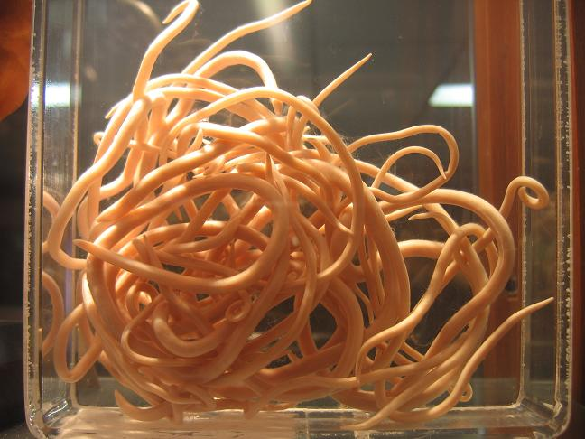
Nematodes
In general are round in cross section, longer than they are wide and are unsegmented.
Can be in a variety of lengths.
Significant cause of disease in dogs and cats
Have varied life cycles
  Example is Roundworms

Slide 39
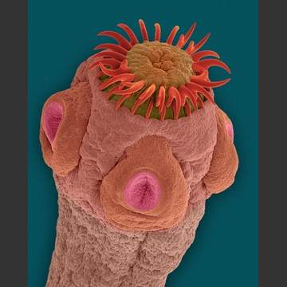
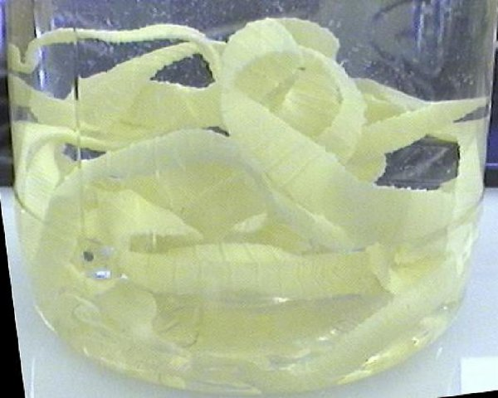
Tapeworms
Flat worms that are segmented
Head usually has suckers or muscular grooves that enable it to attach itself to the animal’s intestine
Each segment has own reproductive organs.
Have no digestive system
Life cycle includes an intermediate host

Slide 40
Flukes
Flat, leaf shaped, unsegmented worms that look similar to leeches.
Have suckers, hooks, or clam-like appendages which they attach themselves to host’s organs.
Fluke eggs have a trap door called an operculum
Dog and cat flukes have indirect life cycles
Generally do not cause serious issues in dogs and cats unless in high numbers

Slide 41
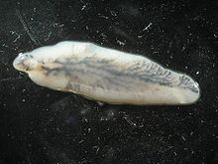
Fasciola hepatica

Slide 42
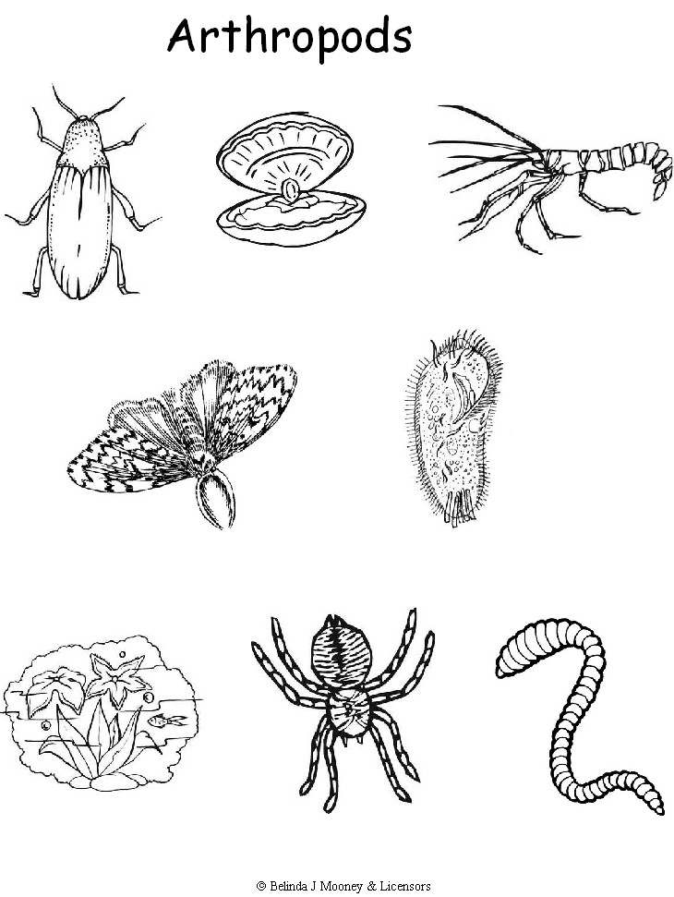
Arthropods
Means joint foot and refers to fact that all members have jointed legs
Include insects and arachnids

Slide 43
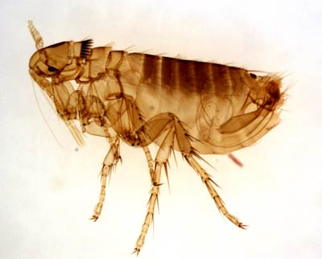
Insects
Make up to 70% of all known species of animals of all kinds
Have antennae, compound eyes and body
Many have wings
Fleas and lice

Slide 44
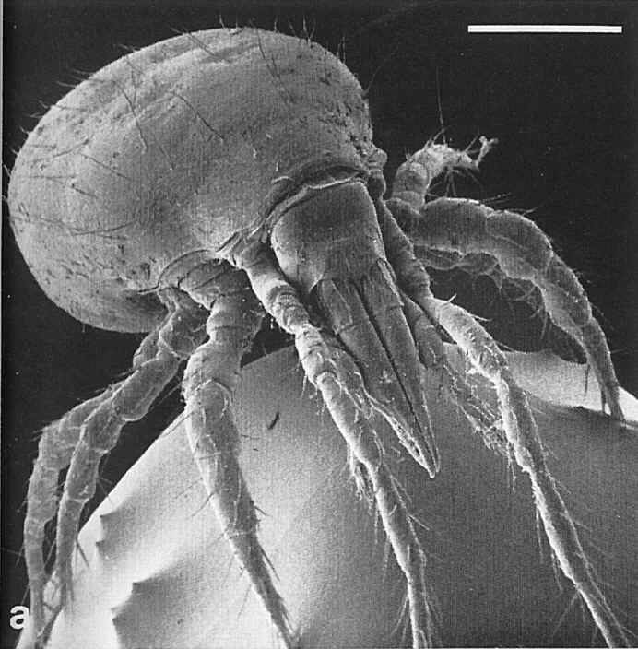
Arachnids
Include ticks and mites
Are carnivores by feeding on tissue and blood.

Slide 45
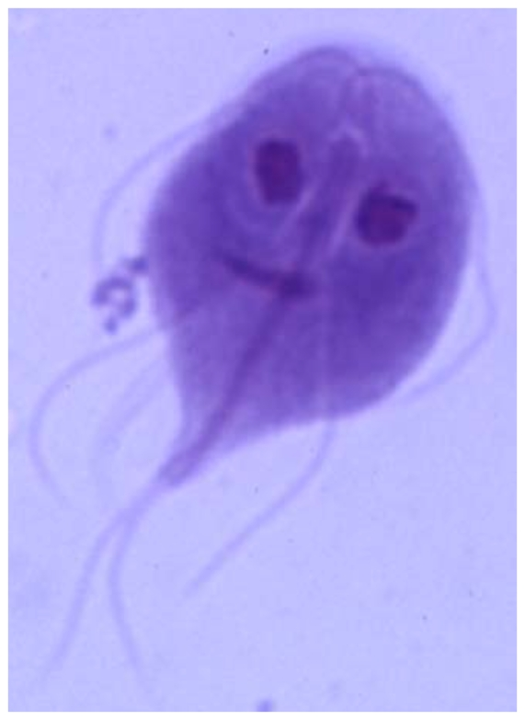
Protozoa
Over 450,000 species of Protozoa
Composed of nucleus and cytoplasm
May move with assistance of flagella.
Giardia is an example of a protozoa

