Slide 1
Cytology Tests – Types & Preparation Techniques

Slide 2
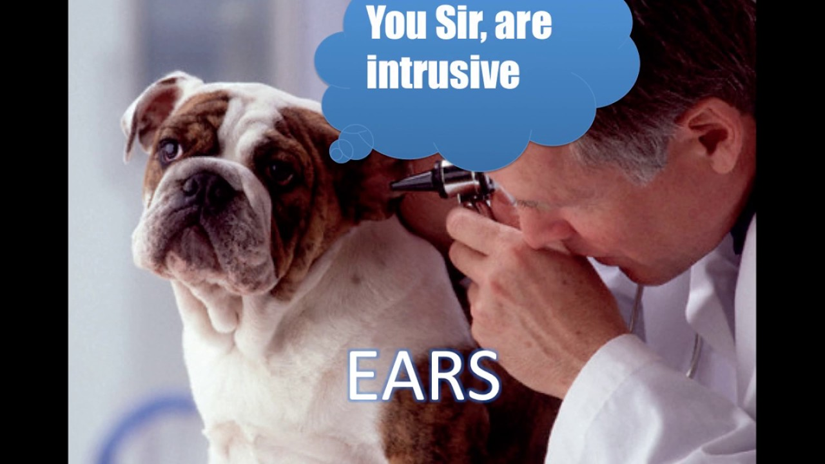
Sample Collection and Handling

Slide 3
The Basics
Cytology: the study of the microscopic appearance of cells, especially for the diagnosis of abnormalities and malignancies.
Allows us to differentiate between inflammation and neoplasia
Best samples are
  Collected quickly
  Prepared properly
  Stained properly
Notes:
the study of the microscopic appearance of cells, especially for the diagnosis of abnormalities and malignancies.

Slide 4
The Basics
Cytology samples from solid masses on an animals body, or obtained from a surgical procedure can be collected by:
Swab
Scrape
Imprint technique
Fine needle biopsy can be used for both solid and fluid samples
Centesis is used for collection of fluid from body cavities
Notes:
Swab
Scrape
Imprint technique
Fine needle biopsy
Centesis

Slide 5
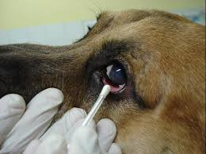
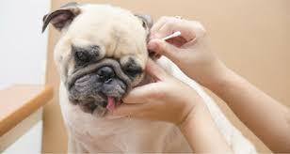
Swabs
  * Should be moistened with sterile saline before collection of samples
  * Gently roll the sample along the flat surface of a microscope slide
  * MAY USE HEAT FOR SOME TESTS*

Slide 6
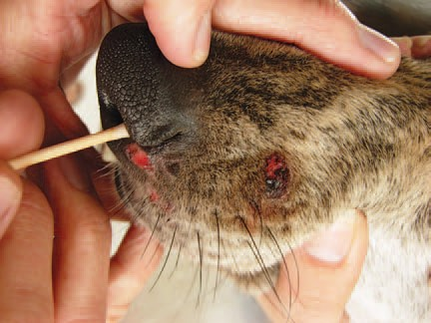
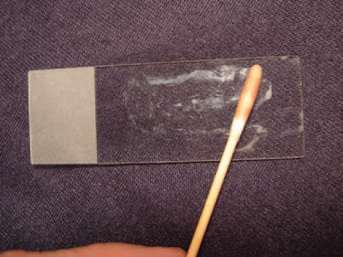
Swabs
Really should only be used when imprints, scrapings, and aspirates cannot be done
Moistening the swab will help minimize cell damage during the collection process
Make sure you do NOT rub the sample onto the slide. Gently roll only. Why? Can damage cells
Notes:
Can damage cells

Slide 7
Swabs
When doing an ear cytology, the swab may have excess wax
To minimize the interference with the assay, we gently heat the sample to dissolve the wax
  How? Lighter CAUTION! Remember, this is the only time other than Gram staining that it is okay to heat a slide
Notes:
Heat
Lighter
This is the only test you can do this on

Slide 8
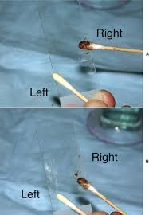
The Basics
When doing an ear cytology, BOTH samples can be put on one slide

Slide 9
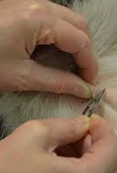
Scrapings
Scrapings
  First localize the lesion
  Gently scrape the lesion several times with a scalpel blade , perpendicular to the lesion’s surface
  Transfer collected material to glass microscope slide

Slide 10
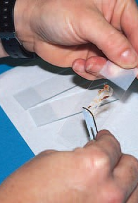
Scrapings
Smears of scrapings may be made from tissues collected during necropsy, surgery, or from external lesions on the animal.
Advantages? Collection of many cells from firm lesions
Disadvantages? More difficult to collect
Only collects superficial cells
May reflect only a secondary bacterial infection or inflammation, but may hinder diagnosis of neoplasias
Notes:
Collection of many cells from firm lesions
More difficult to collect
Only collects superficial cells
May reflect only a secondary bacterial infection or inflammation, but may hinder diagnosis of neoplasias

Slide 11
Imprints
Impression smears may be prepared from an external lesion or from a tissue removed during surgery or necropsy
This technique is the easiest to collect and requires minimal restraint
Disadvantages? Few cells collected
Large amount of contamination
Only reflect secondary bacterial infections or inflammations
Hinders neoplasia diagnosis
Notes:
Few cells collected
Large amount of contamination
Only reflect secondary bacterial infections or inflammations
Hinders neoplasia diagnosis

Slide 12
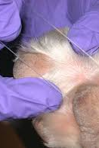
Imprints
If collected from surgery or necropsy
  Blood and tissue should be removed by blotting (excessive blood and fluid will skew results)
  If there is a delay in imprinting, use a scalpel blade to expose fresh surface of wound
  Touch tissue to the middle of the slide
  Several slides should be made if special staining is required
Notes:
Middle

Slide 13
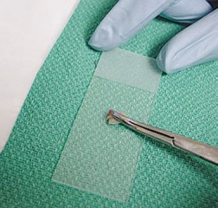
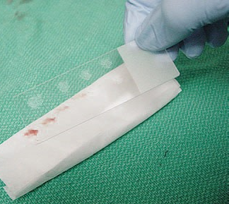
Imprints

Slide 14
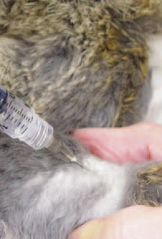
Fine Needle Biopsy
These are samples collected from masses including
Lymph nodes
Nodular lesions
Internal organs
Why is this beneficial?
Avoids superficial contamination from cutaneous lesions
Notes:
Lymph nodes
Nodular lesions
Internal organs
Avoids superficial contamination from cutaneous lesions

Slide 15
Fine Needle Biopsy (FNB/FNA)
Preparation of the site:
  Surgical preparation is required if you are doing microbiologic testing, which means, collected from a body cavity
Peritoneal
Thoracic
Joints
  If this is not the case, an alcohol preparation similar to vaccination or venous puncture will suffice
Notes:
Peritoneal
Thoracic
Joints

Slide 16
Fine Needle Biopsy (FNB/FNA)
Supplies
  21- to 25- gauge needle
  3- to 20- mL syringe
  NOTE: The softer the tissue, the smaller the needle and syringe
  If larger needles are used, tissue cores tend to be aspirated
    Poor yield of free cells
    Greater blood contamination
Notes:
The softer the tissue, the smaller the needle and syringe

Slide 17
Fine Needle Biopsy (FNB/FNA)
Aspiration Procedure
  Hold the mass firmly to aid in penetration and to control direction of the needle
  The needle, with syringe attached, is introduced into the center of the mass
  Draw back the plunger until about ¾ of the volume of the syringe
  Redirect the needle to collect sample regions of the mass – maintaining negative pressure
  YOU MAY NOT SEE ANYTHING IN THE SYRINGE
  Remove from mass after removing negative pressure and removing the needle from the syringe
  Draw air into the syringe and replace the needle
  Expel needle contents onto slide
  Several preparations should be made if possible

Slide 18
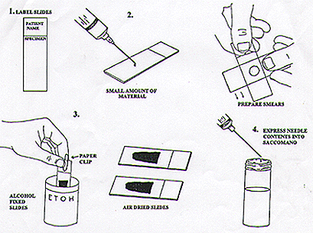

Slide 19
Nonaspirate Technique (Capillary Technique, Stab Technique)
Easier to perform than an FNA
There is NO redirecting the needle or pulling back the plunger
Simply hold the mass firmly to help direct the needle
Using a 22-gauge needle, leave the syringe attached to help handle the needle
Move needle rapidly back and forth (5-6 times along the same tract)
Sample is collected by shearing and capillary action
When complete, rapidly expel the material on the slide with your syringe.

Slide 20
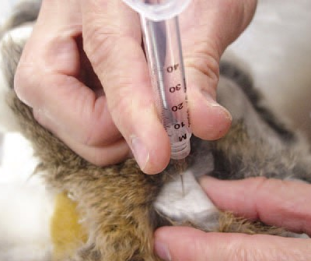
Nonaspirate Procedure (Capillary Technique, Stab Technique

Slide 21
Tissue Biopsy
This is a sampling of a piece of tissue
Gentle abrasion with a blade, needle aspiration, and excision, punch biopsy and endoscope guided biopsy are often the means to collecting the sample
To determine HOW to collect, consider the following
  Consider location, accessibility and nature of the animal
  Clip hair carefully to avoid abrasion
  No need to cleanse the site

Slide 22
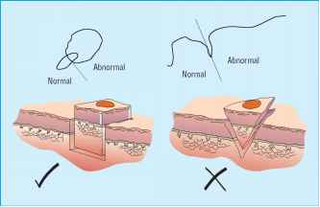
Wedge Biopsy
Procedure:
  Obtain sample with a scalpel
  Advantages
    A large, variably sized specimen
    Either a portion of the lesion or the entire lesion is obtained
    Trim specimen on it’s long axis to provide the pathologist with a slide showing abnormal tissue, a transition zone, and a normal zone.

Slide 23
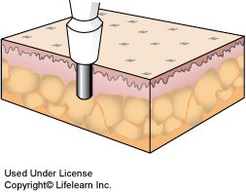
Punch Biopsy
Advantages over wedge biopsy
  Ease and speed of the procedure
  Different sizes
  3-, 4-, 6- and 8-mm disposable skin biopsy punches
  4mm specimens require no sutures
  6 or 8 mm specimens require sutures Local anesthetic required
  Rotate in one direction until punch blade has sectioned the tissue – less tissue damage
  Fix in 10% neutral phosphate buffered formalin
Notes:
4 mm
6 or 8 mm
Local anesthetic required

Slide 24
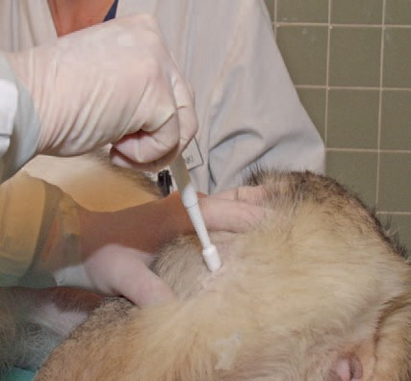
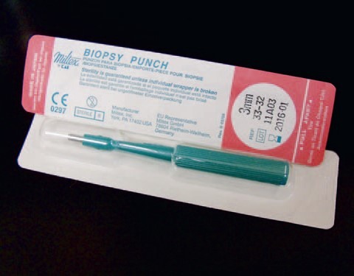

Slide 25
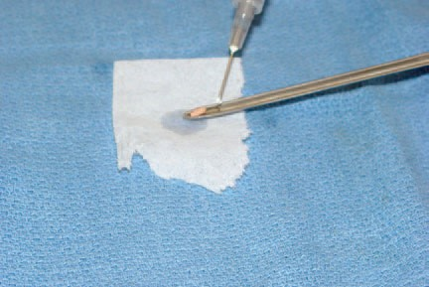
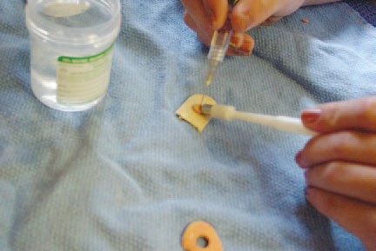
Endoscopic Biopsy
Specimens collected by endoscopy can be gently flushed from the tip of the endoscope
Specimen is then blotted gently on a paper towel and placed on a small piece of tongue depressor to create a splint
After dried it should be placed in a fixative

Slide 26
Centesis
This is the introduction of a needle into a body cavity to collect fluid
  _____________________________ or paracentesis
  _______________________________
  _______________________________
  _______________________________
Aseptic preparation
Prepare smears quickly and save a portion in EDTA
21-gauge needle and a 60-ml syringe
Notes:
Abdominocentesis
Thoracocentesis
Cystocentesis
Arthrocentesis
EDTA

Slide 27
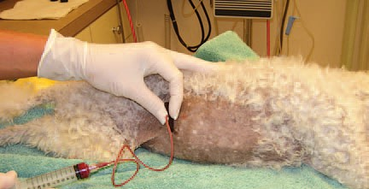

Slide 28
Centesis, continued…
Ease of collection depends on the following
  The volume of fluid present
  Pressure within the body cavity
  Technical proficiency of the operator
  Cooperation of animals
Record
  Total volume collected
  Gross characteristics of fluids: color and turbidity
Notes:
Color and turbidity

Slide 29
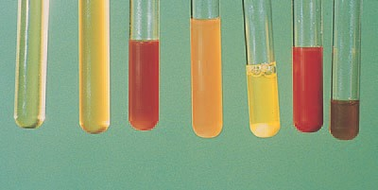
Color and Turbidity During a Centesis Procedure
Influenced by protein concentration and cell numbers
Gross discoloration
  Occurs with increased with turbidity
  Contamination of peripheral blood in sample
  Inflammation present

Slide 30
Transtracheal/Bronchial Wash
Cytologic evaluation of samples obtained from the trachea, bronchi, or bronchioles may assist with diagnosis of pulmonary disease
Tracheal wash
  Passage of catheter through an endotracheal tube in an anesthetized patient
  Through the nasal passages
  Through skin or trachea
Transtracheal route minimizes pharyngeal contamination of the specimen

Slide 31
Percutaneous Technique for Transtracheal Wash
18- or 20-gauge through the needle catheter
Clip hair of laryngeal area and aseptically prepare
Lidocaine for local anesthesia
Needle inserted into trachea through cricothyroid membrane and catheter advanced into the lumen of the trachea
Sterile saline is infused through catheter
When animal coughs, pull back plunger to collect fluid
Process samples immediately

Slide 32
Orotracheal Technique for Transtracheal Wash
Similar to percutaneous technique except animal is _______________________ and sample collected through endotracheal tube
Animal will not cough so must withdraw as soon as fluid is injected
Notes:
anesthetized

Slide 33
Cytology Preparation Techniques

Slide 34
What Kind of Techniques?
Processed by a variety of techniques
  Impression smears
  Compression or modified compression preparations
  Line smears
  Starfish smears
  Wedge smears
Type of preparation depends on characteristics of the sample

Slide 35
Cytology Preparations
Some samples may require centrifugation
Fluid samples may need an anticoagulant or preservatives
Several different preparations are usually made from each sample
  Allows for diagnostic testing without additional collection
  A variety of stains are available
  Some samples may require multiple stains

Slide 36
Smear Preparation
Preparation of smears from solid masses
  Several methods can be used
    Compression
    Combination technique
    Starfish Smear
    Line Smear
    Wedge Smear
  Experience of the person preparing the smears and characteristics of the sample influence the choice of technique

Slide 37
Smear Preparation
Preparation of smears from solid masses
  Several methods can be used
  Experience of the person preparing the smears and characteristics of the sample influence the choice of technique

Slide 38
Compression Preparation
Compression preparation
  Squash prep
  Can yield excellent cytologic smears
  Expel contents of aspirate onto the middle of slide
  Gently place a second slide at right angles to the first slide
  The spreader slide is quickly and smoothly slid across the prep slide
  Downward pressure should not be placed on the spreader slide
    Excessive cell rupturing
  Modification
    Rotate second slide 45 degrees and lift upward

Slide 39
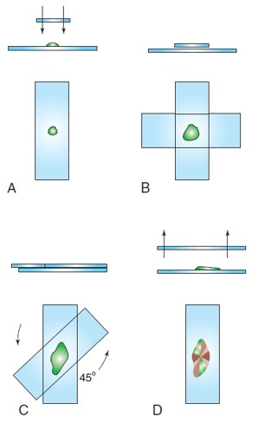
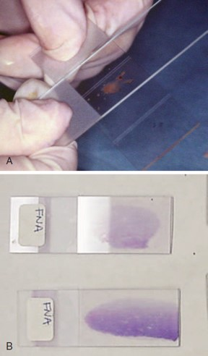
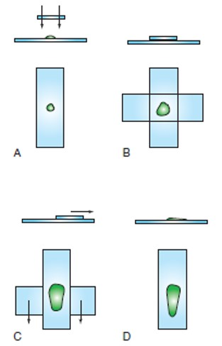

Slide 40
Combination Technique
Place aspirate on the middle of slide
Place prep slide on flat surface
Pull spreader slide backward at 45-degree angle until it makes contact with approximately one third of the aspirate
Then smoothly and rapidly move spreader slide forward
Next place spreader slide horizontally over back third of aspirate at a right angle
Quickly slide the spreader slide across the prep slide

Slide 41
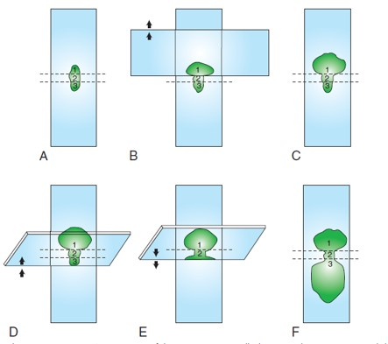
Combination Technique, continued…
This preparation leaves three different types of areas to evaluate

Slide 42
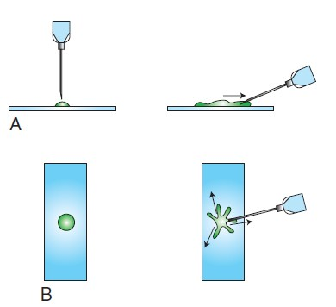
Starfish Smear
Drags the aspirate peripherally in several directions with the point of a needle
Tends not to damage cells, but leaves a thick layer
Ideal for viscous samples

Slide 43
Preparations of Smears from Fluid Samples
Should be prepared immediately after collection
If possible, should be collected with EDTA
Cellularity, viscosity, and homogeneity of the fluid influence the selection of smear techniques

Slide 44
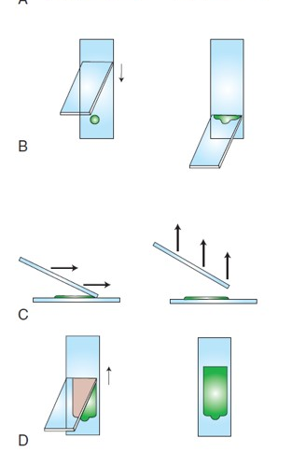
Line Smear
Low cellularity or small volume
A drop of fluid is placed on the slide and a blood smear technique is used except
  The spreader slide is raised directly upward approximately three fourths of the way through the smear, creating a line containing a higher concentration of cells

Slide 45
Wedge Smear (or Blood Smear)
A drop of fluid is placed on the slide about 1 to 1.5 cm from the end
Second slide is pulled backward at a 30- to 40- degree angle until it makes contact with the drop
The fluid spreads across the width of the spreader slide
The spreader slide is then quickly and smoothly pushed forward until all fluid is drained away
Creates a feathered edge

Slide 46
Fixing & Staining the Cytology Sample
This step ensures the highest quality preparation
Sample MUST be fixed before staining
Preferred fixative is 95% methanol
  Must be fresh and not contaminated
  Protect from evaporation and dilution
  Prepared slides should remain in fixative for 2 – 5 minutes
Notes:
95% methanol
2 to 5 minutes

Slide 47
Romanowsky Stains
Four Kinds: wright, giemsa, diff-quik .dip stat
Inexpensive, readily available, and easy to prepare, maintain, and use
Stain organisms and the cytoplasm of cells
Slide must be air dried
  Preserves and fixes the cells to the slide
Acceptable for staining cytologic preparations
Each type of stain has a unique staining procedure
Notes:
Wright
Giemsa
Diff-Quik
DipStat

Slide 48
New Methylene Blue
Useful adjunct to Romanowsky stain
Stains cytoplasms weakly, but gives excellent nuclear detail
Remember!!!! RBCs do not stain with NMB

Slide 49
Staining Problems
Poor stain quality can be perplexing
Can be avoided if:
  Always use clean (new) slides
  Fresh, well-filtered stains and fresh buffer solution should be used
  Cytologic preparations should be fixed
  The surface of the slide should not be touched by human hands
  Avoid contamination with foreign substances

Slide 50
Submitting Cytological Preparations and Samples to Outside Laboratories
Submit 2 to 3 air dried unstained smears and 2 to 3 Romanowsky-stained smears
Fluids – direct smears and concentrated smears and EDTA and red-top tube should be submitted
Protect slides when mailing
Do not mail unfixed slides with formalin-containing samples

Slide 51
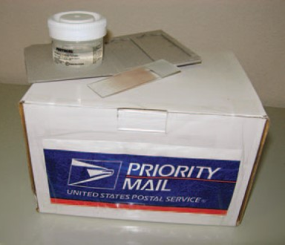
Special Note:
  Formalin fumes alter the staining characteristics of smears and water causes cell lysis

Slide 52
Submitting Samples To Outside Laboratories
Label!!
  ID name, number, species
    Species, age and sex
    Brief history
    Relevant exam date
    Previous therapies, test results (if relevant)
    Differential diagnosis
  Sample Data
    Site sample was taken from
    Mass description

Slide 53
