Slide 1
Erythrocyte Morphology and Abnormalities
M. Regalia, LVT

Slide 2
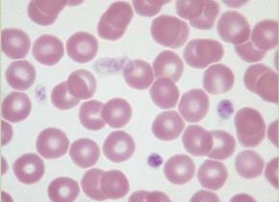
Erythrocyte Morphology
Different species have different sized RBCs with varying degrees of central pallor
Dogs have largest RBCs ( ̴7 μm in diameter)

Slide 3
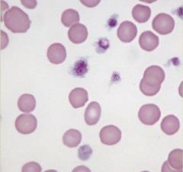
Erythrocyte Morphology
Cats have no consistent central pallor and vary can vary more in shape

Slide 4
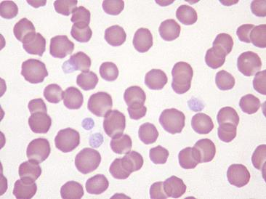
Erythrocyte Morphology
Equine Erythrocytes are of similar size to the feline erythrocytes, and also lack a central pallor
So ID between cats and horses can be difficult.
The best way to tell the difference is by noting if the patient has rouleaux formation If the blood is from a healthy animal, and has this formation, then you know you have a horse as a patient.
Notes:
Rouleaux formation

Slide 5
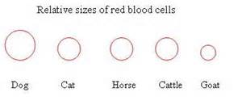
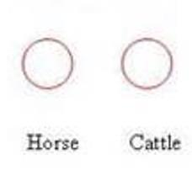


Relative sizes of RBCs
Generally speaking, normal RBC size in order of size is:
  Dog ̴7 μm in diameter
  Cat ~5.8 μm
  Horse ~5.7 μm
  Cattle ~5.5 μm
  Goat 2.5-3.9 μm

Slide 6

Classification of Erythrocytes
What were the five ways we learned how to classify erythrocytes as normal or abnormal??
Arrangment on a blood film
Color
Size
Shape
Structures in/on the erythrocyte
Notes:
Arrangement on a blood film
Color
Size
Shape
Presence of structures on/in erythrocyte

Slide 7
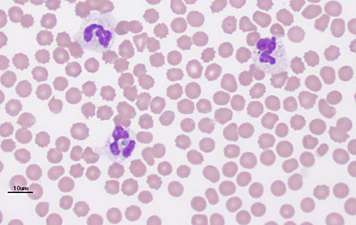
Arrangement on a Blood Film
How cells should appear on a film
Abnormal formation
Rouleaux formation
Agglutination
Notes:
Rouleaux formation
Agglutination/auto-agglutination

Slide 8
Rouleaux Formation

Slide 9
Rouleaux Formation
What is it?
  Grouping of RBCs that appear stacked
Normal in horses. When might you see this in a dog or a cat? Seen with increases fibrinogen concentration.
May appear as an artifact. How can this happen?
  If blood has been held too long before preparation
Notes:
Horses
Seen with increased fibrinogen or globulin concentration in blood
Refrigerated blood that is not allowed to return to room temperature
May be seen if blood has been held too long before preparation

Slide 10
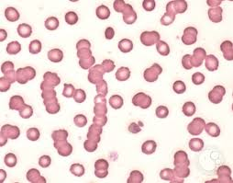
Rouleaux formation on a smear

Slide 11
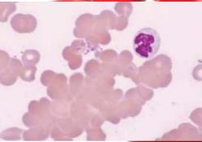
Agglutination/Auto-agglutination

Slide 12
Agglutination/
Auto-agglutination
When does this occur?
  Caused by antibody that coats the RBC causing clumping
  Typically occurs in immune mediated disorders
Agglutination MAY appear as rouleaux on occasion
So how can we tell the difference? Add saline and re-centrifuge
Notes:
Agglutination is caused by an antibody that coats the RBC causing bridging or clumping of the cells
Add saline and re-centrifuge sample

Slide 13

Adding Saline to Confirm
Rouleaux Formation
When rouleaux is suspected, re-centrifuge all tubes in question
Carefully remove plasma/serum with transfer pipette, leaving the cells undisturbed. Discard or use plasma/serum
Add 2 drops of saline to test tube and mix well
Re-centrifuge the tube
Gently re-mix the red cells and perform smear
Rouleaux will disperse, agglutination will NOT

Slide 14
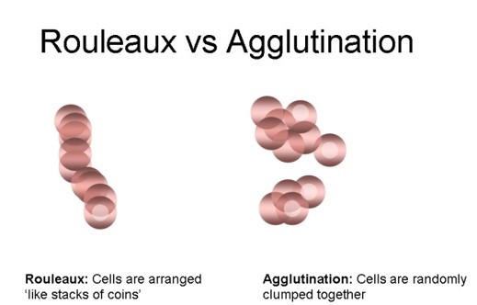
What’s the difference???

Slide 15
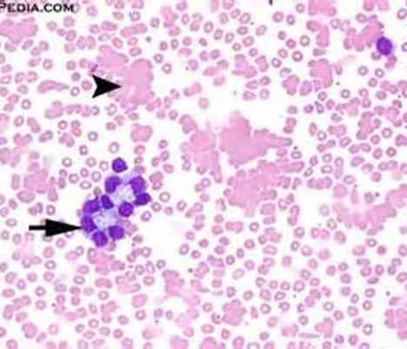
Question: Can agglutination affect WBCs?
Yes!!

Slide 16
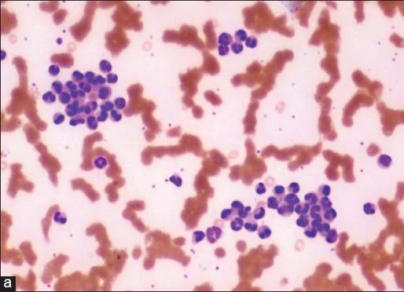
When can WBCs agglutinate?
Can occur in response to diseases such as leukemia
Medical treatments that use chelation therapy to treat cholesterol build up in blood vessels
Cooling off the blood sample too quickly can cause a false agglutination of WBCs

Slide 17
Variation in Color
What are the 3 variations in color we have discussed?
  Polychromasia, hypo/hyperchromasia
Calculated through the MCHC
What does MCHC stand for? Mean corpuscular hemoglobin concentration
Classifies cells as normochromic or hypochromic
Notes:
Polychromasia
Hypochromasia
Hyperchromasia
MCHC = Mean corpuscular hemoglobin concentration

Slide 18
So how do you calculate MCHC?
MCHC Formula: (Hb (g/dL) x 100) / Hct (%) = MCHC
Unit’s are g/dL
Collect whole blood with an EDTA tube.
REMEMBER!!!! MCHC is unstable, it can either decrease or increase, dependent on how the blood is stored.

Slide 19
Normal MCHC ranges
The normal range in dogs is 31-36 g/dL
The normal range in felines is 30-36 g/dL

Slide 20
MCHC calculation example
You have a feline patient that has a hematocrit of 40% and a hemoglobin concentration of 12 g/dL. What is their MCHC? Is this normal?
Notes:
12 g/100ml x100 / 40 = 30; yes

Slide 21
MCHC calculation example
You have a canine patient that has a hematocrit of 20% and a hemoglobin concentration of 10 g/dL. What is their MCHC? Is this within normal range?
Notes:
10 g/dL x 100/ 20 = 50 g/dL ---no

Slide 22
Polychromasia
Variation in color usually associated with nRBCs and Reticulocytes
Hemoglobin production begins right before cell loses nucleus
Blue intensity decreases as reticulocytes decrease
Red increases in intensity as Hb increases
Notes:
nRBCs = nucleated RBCs
Reticulocytes decrease
Hb increases

Slide 23
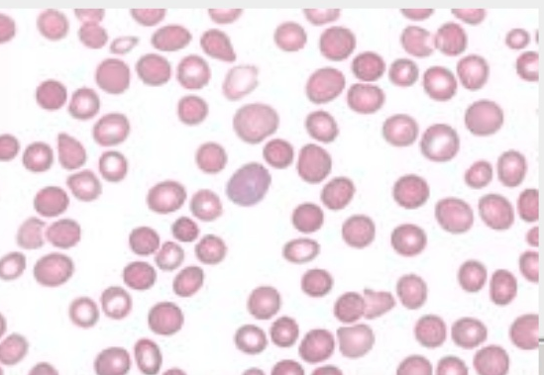
Polychromasia

Slide 24

Polychromasia
Why would a patient have Polychromasia?
  Blood loss
  Recovering anemia
Notes:
Blood loss
Recovering anemias

Slide 25
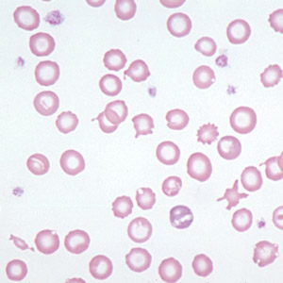
Hypochromasia

Slide 26
RBC size and what MCV means
What is MCV? Mean corpuscular volume
So what does that mean? Indicates size
Notes:
Mean corpuscular volume
Indicates size

Slide 27
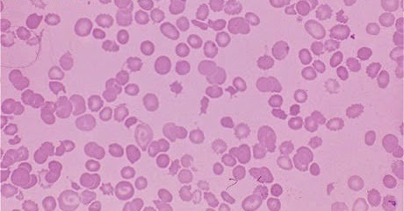
Remember anisocytosis?

Slide 28
How do we calculate MCV?
MCV = (PCV/RBC)10 fL
Most practices have automated machines to do this… but, let’s say we have to calculate it ourselves…
Normal Ranges:
  Canine 60-77 fL
  Feline 40-55 fL

Slide 29
MCV calculation
We need to divide the patients PCV by the RBC concentration, then multiply by 10 to get the unit of fL (femtoliter)
For example, a dog has a PCV of 42% and a RBC count of 6.0 million/mL, the MCV would be 70 fL.
  42 x 10 = 70 fL
  6

Slide 30
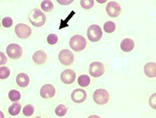
Hyperchromasia/Spherocytes

Slide 31
Poikilocytosis
Variations in the shapes of RBCs
(poikil = irregular)
Not a diagnosis
A general term to encompass nondescript variations in shapes of erythrocytes that are scattered throughout the blood film

Slide 32
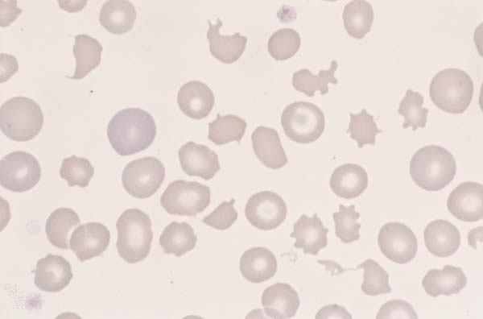
Poikilocytosis
Notes:
Poikilocytosis, anisocytosis, and polychromasia are all present on this slide

Slide 33
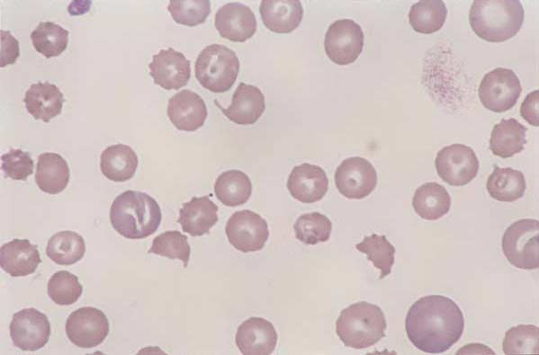
Schistocytes

Slide 34
Schistocytes “Fragment Cell”
What causes them?
  RBC fragments resulting from shearing of red blood cell by intravascular trauma
  May be seen with Disseminated Intravascular Coagulopathy (DIC) or with iron deficiency
  Expect to also see thrombocytopenia on blood film of animals with DIC
  Can be caused by excess fibrin deposition, malformation of vasculature, or excessive turbulence in the blood

Slide 35
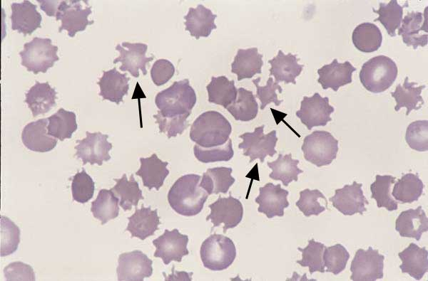
Acanthocytes

Slide 36
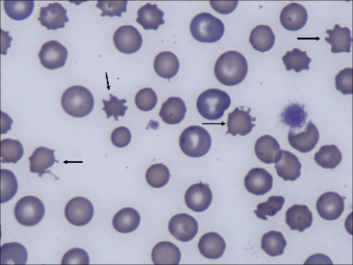
Acanthocytes “Spur Cells”
How would we describe them?
  Have irregular membrane projections of variable length and diameter with rounded tips
  Unevenly sized and spaced

Slide 37
Acanthocytes
Patients that might have an increased number of acanthocytes:
  Cats with hepatic lipidosis
  Dogs with liver disease
  Hemangiosarcoma of the liver

Slide 38
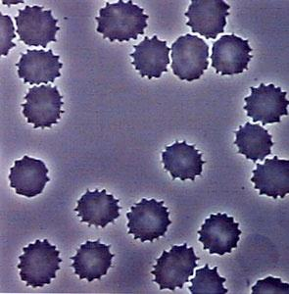
Echinocytes ‘Burr Cells’

Slide 39
Echinocytes “Burr Cells”
In-vivo change
Resulting from osmotic change in blood, altering cell membranes
May appear elongated or ruffled, with relatively evenly sized and spaced, short, blunt projections

Slide 40
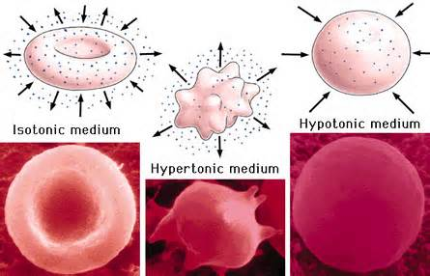
Echinocyte formation due to fluid therapy

Slide 41
Echinocytes
Possible reasons a patient may have an increased number of echinocytes:
  Associated with renal disease
  Lymphosarcoma
  Rattlesnake envenomation in dogs
  Can be also artifacts if excess of EDTA is present

Slide 42
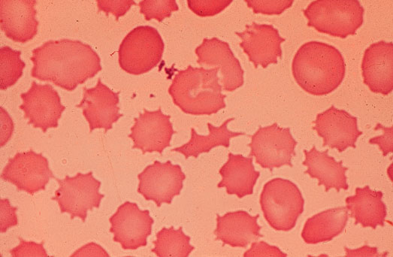
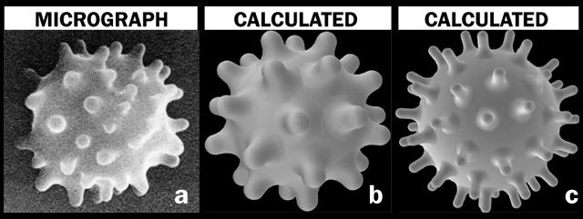
Echinocytes

Slide 43
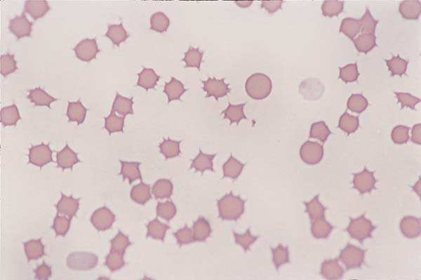
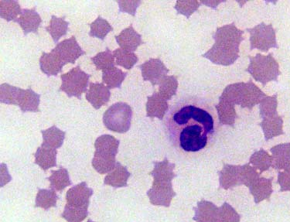
Crenation

Slide 44
Wait… So crenation looks like acanthocytes and echinocytes?
Acanthocytes and echinocytes may arise from abnormalities of the cell membrane lipids or proteins, or from other disease processes, or as an ex vivo artifact
What can affect the OUTSIDE of a cell, causing it to crenate? Hypertonic solutions
Notes:
Hypertonic solutions

Slide 45
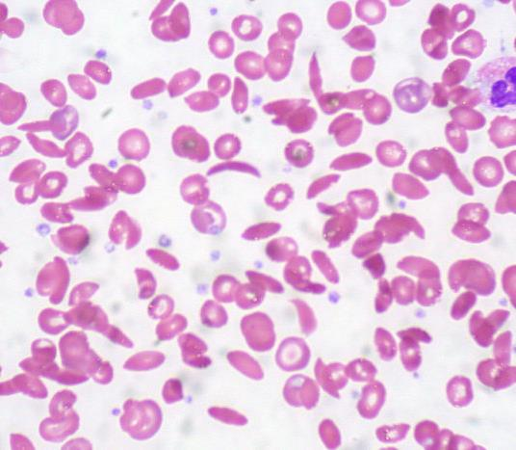
Drepanocytes “Sickle Cells”
How to describe them:
  Crescent shaped with pointed ends

Slide 46
Drepanocytes
Illnesses that can cause drepanocytes:
  Result of alteration in hemoglobin due to low oxygen tension
  Normal finding in deer, Angora goat, and some sheep

Slide 47
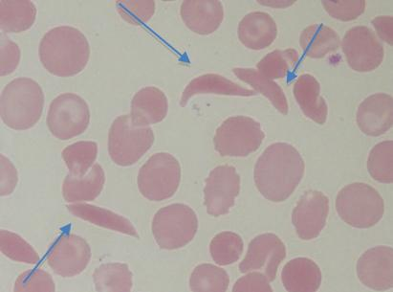
Drepanocytes

Slide 48
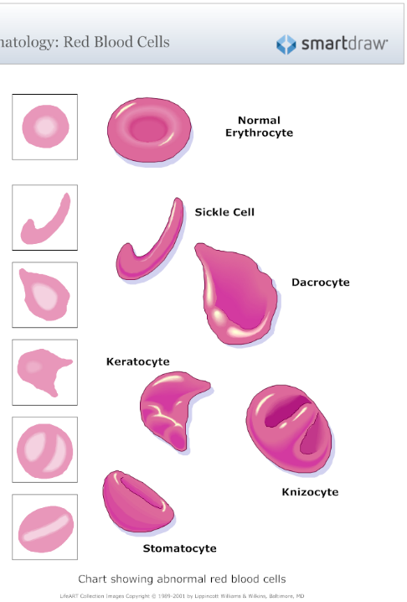

What the Cell is Actually Doing

Slide 49
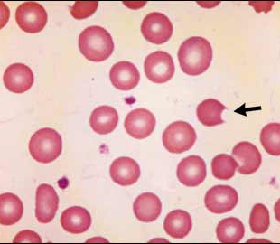
Keratocytes “Helmet Cells”
Also called “Bite cells”
What is their precursor called? Prekeratorcyte or blister cell
Keratocytes are believed to result from intravascular trauma
Can also result from oxidative injury found with iron deficiency
Presence of keratocytes has also been associated with hemangiosarcoma, neoplasia, glomerulonephritis, and various hepatic diseases
Notes:
Precursor called prekeratocytes or “Blister cells”

Slide 50
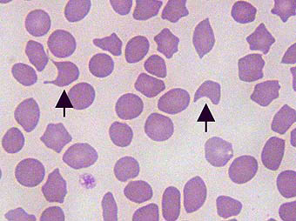
Keratocytes and Pre-keratocytes

Slide 51
Anulocytes “Punched-out cells”
How to identify:
  Bowl shaped RBCs that form as a result of a loss of the membrane flexibility
Cell cannot return to normal shape after passing through a narrow capillary

Slide 52
Anulocytes
What can cause anulocytes?
  May be seen in any acute disease
  Can also occur due to low hemoglobin concentration or as an artifact

Slide 53
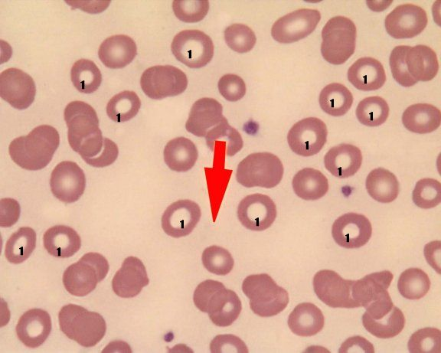
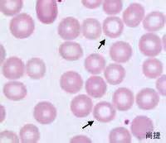
Anulocytes (Punched-out cells)

Slide 54
Dacryocyte “Teardrop cells”
How to identify:
  Teardrop shaped RBCs with a single elongated or pointed ends
Can be an artifact; check to see if the “tails” are all pointing in the same direction

Slide 55
Dacryocytes
Diseases that can cause Dacryocytes
  Kidney and splenic disorders
Notes:
May be seen in myeloproliferative diseases or kidney and splenic disorders of dogs

Slide 56
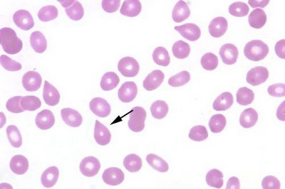
Dacrocytes (Tear-drop cells)

Slide 57
Codocyte (target cell)
How to identify:
  Resembles a target with a bulls-eye
  Have central area of hemoglobin surrounded by area of pallor
  Periphery of cell contains band of hemoglobin

Slide 58
Codocytes
  What diseases will codocytes be present in:
    A few may be seen in normal smears
    May be associated with iron deficiency
    IMHA
    Liver diseases
    Some inherited disorders

Slide 59
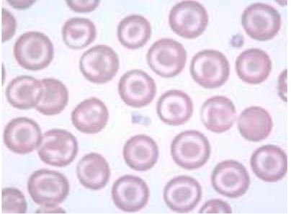
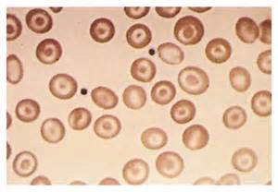
Codocytes (Target Cells)

Slide 60
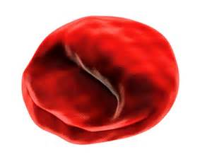
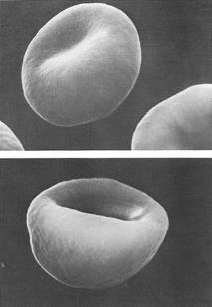
Stomatocytes (Folded Cell)
How to identify:
  Rectangular appearing central pallor
  Stomatocytes have a transverse, raised fold extending across the center of the cell and a clear, slit-like pale region in the center

Slide 61
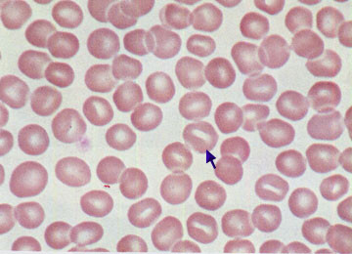
Stomatocytes

Slide 62
Knizocytes “Barr Cells”
How to identify
  Appear to have a bar of Hb through the central pallor
Caused by an alteration in the lipid content of cell membrane

Slide 63
Knizocytes
What diseases can Knizocytes be seen?
  Commonly observed in chronic liver disease
  May be observed in any acute liver dysfunction

Slide 64
Presence of Structures on/in Erythrocytes
Many different abnormalities caused by variety of different conditions:
Howell-Jolly Bodies
Basophilic stippling
Heinz Bodies
Reticulocytes
Blood parasites
  Babesia spp.
  Mycoplasma spp.
  Cytauxoon felis

Slide 65
Howell-Jolly Bodies
Basophilic nuclear remnants observed in young RBCs during their response to regenerative anemia
Normally, as cells containing nuclear remnants pass through the spleen, phagocytic cells remove the remnants
Therefore, HJBs may be seen with splenic disease or in an animal with the spleen removed

Slide 66
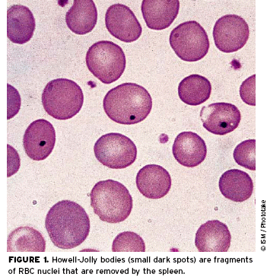
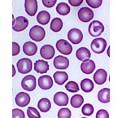
Howell-Jolly Bodies

Slide 67
Basophilic Stippling
How to identify:
  Observed in RBCs that contain abnormal, residual RNA.
  Small, dark blue “freckles” within the RBC

Slide 68
Basophilic stippling
What diseases could you see basophilic stippling in?
  Occasionally seen in immature RBCs in anemic cats
  Characteristic finding with lead poisoning in dogs
Notes:
Lead poisoning

Slide 69
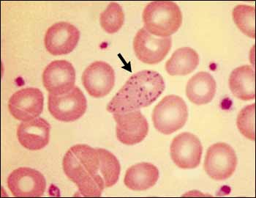
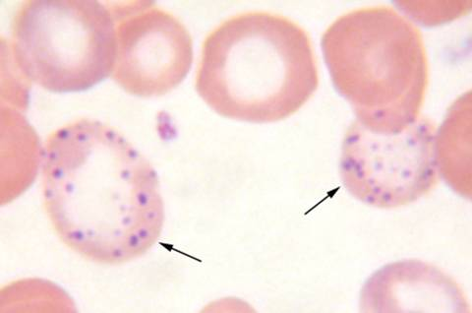
Basophilic stippling

Slide 70
Heinz Bodies
Particles of denatured hemoglobin resulting from oxidative injury; attach to RBC membrane
Stain blue with NMB and appear as a pale area with Diff-quik stain

Slide 71
Heinz bodies
When might you see Heinz bodies?
  Seen in acetaminophen and onion ingestion in cats and dogs
  Are often increased in concentration with diseases such as lymphosarcoma, hyperthyroidism, and diabetes mellitus in cats
  Normal cat blood may have up to 5%

Slide 72
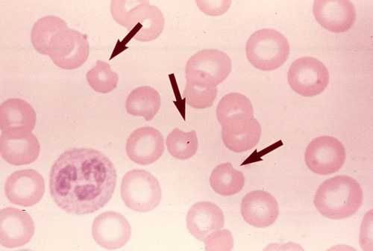
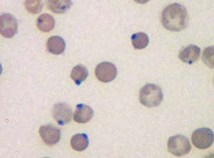
Heinz Bodies
Which was stained with NMB and which was stained with DiffQuick?
Notes:
Right = stained with NMB
Left = stained with DiffQuik stain

Slide 73
Reticulocytes
Immature RBCs; contain organelles (ribosomes) and residual RNA that are lost as the cell matures
AKA “polychromatophilic RBC” (when stained with DiffQuik and not NMB)
NMB causes clumping of residual organelles, referred to as reticulum
Cats have two forms: Aggregate and Punctate
Notes:
Aggregate and punctate

Slide 74
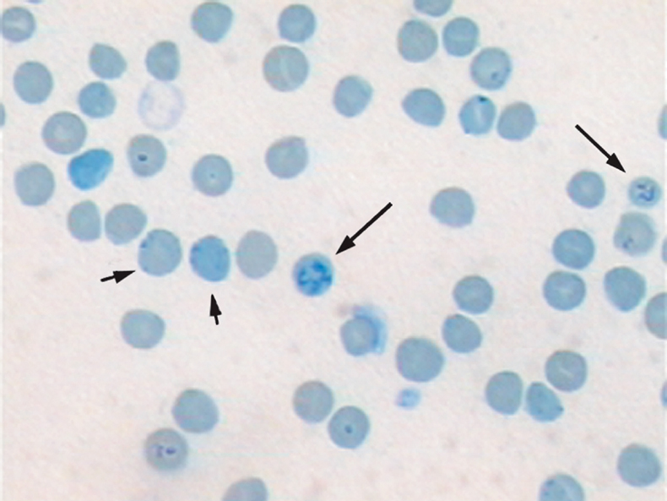
Reticulocytes

Slide 75
Blood Parasites that Affect RBCs
Parasites may be present within or on the surface of RBCs
Stain precipitate and drying artifacts are sometimes confused with RBC parasites

Slide 76
Babesia spp.
Tear-drop or ring shaped, intracellular, paired inclusions
Transmitted via ticks
Causes hemolytic anemia
Commonly identified at feathered edge of blood smears
Seen in dogs, cats, horses, cattle, and sheep
Notes:
ticks

Slide 77
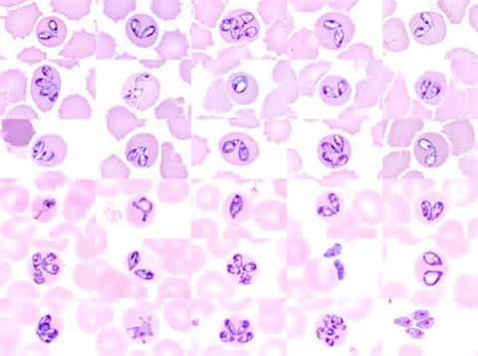
Babesia spp.
Notes:
Babesia bigemina = top 3 rows (cattle)
Babesia canis = bottom 3 rows (dogs)

Slide 78
Mycoplasma
Haemofelis
Formerly known as: Haemobartonella felis
Disease = Feline Infectious Hemolytic Anemia
Small, coccoid, rod-shaped, or ring-like structures that usually appear as short, dark purple rods on the periphery of RBCs
Organisms usually detach from the RBC when placed in anticoagulant
Cyclic parasitemia: organisms may be numerous, scarce or not found in a given blood sample – examine blood at different times of the day
May be transmitted by fleas
Notes:
fleas

Slide 79
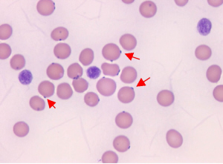
Mycoplasma haemofelis

Slide 80
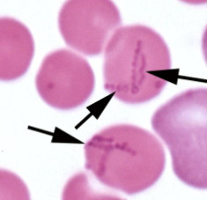
Mycoplasma haemocanis

