Slide 1
Taxonomy Explained
M. Regalia, LVT

Slide 2
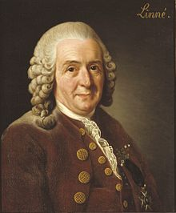
Carl Linnaeus
This is the Swedish botanist, physician and zoologist who formalized this modern naming and classifications system.

Slide 3

Most of his writings were in Latin, which has carried over today

Slide 4
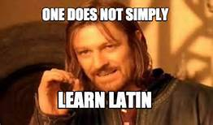
Don’t worry, I’m not making you learn Latin…. Today

Slide 5
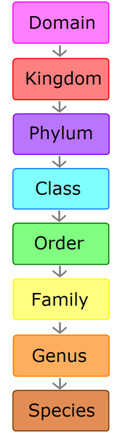

Slide 6
Domain
There are three domains of life recognized
  Archaea
  Bacteria
  Eukarya (this is where you’ll find humans and animals)

Slide 7
Kingdom
Most textbooks now list 6 kingdoms
  Animal
  Plant
  Protists (amoebas)
  Fungi
  Bacteria
  Archaebacteria (extremophiles

Slide 8
Phylum
There are more than 30 phyla in the Animal Kingdom and 9 or 10 in the plant kingdom
Phylum Chordata is the one we are most familiar with because it includes humans, fish, birds, and all other vertebrates
Phylum Arthropoda includes insects, spiders, and lobsters. These creatures have a hard exoskeleton that sheds and regenerates as the animal grows.

Slide 9
Class
The various phyla are now divided into classes
  Phylum Chordata for example, is divided into amphibians, birds, mammals, reptiles and fish

Slide 10
Order
This is the area that can cause some dispute as to where an animal belongs among scientists.

Slide 11
Family
This is a relatively new scientific concept.
This is how scientists group similar genuses together

Slide 12
Genus
Two or more species that share a unique body structures or other characteristics are considered to be closely related and are placed together in a genus.
Sometimes a genus might include only a single species if there is nothing else in the world that has similarities with it.
The genus is the first part of the scientific name of a species.
The genus is always spelled with a capital letter and in italics

Slide 13
Species
Group of individuals that breed together to produce fertile offspring.
Individuals of a cannot breed with other groups. It is sometimes possible for different species to breed, but the offspring will be sterile (i.e.: A mule is the sterile offspring of a donkey and a horse. The mule can never mate and reproduce)
The species is the second part of the scientific name of the species.
The species is ALWAYS spelled with a lower case letter and in italics

Slide 14

So how do we remember this? Well let’s drop the Domain and concentrate on what’s important

Slide 15
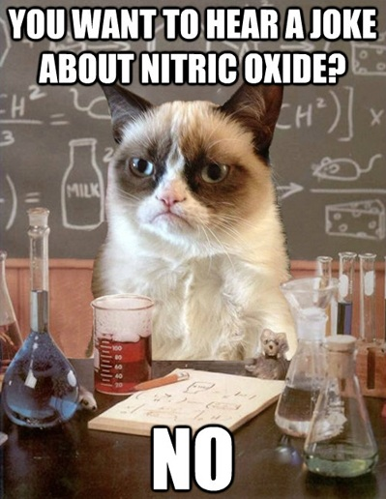
Keeping Precious Creatures Organized For Grumpy Scientists

Slide 16

Example: YOU!
Kingdom: Animalia
Phylum: Chordata
Class: Mammalia
Order: Primata
Family: Hominidae
Genus: Homo
Species: sapiens

Slide 17
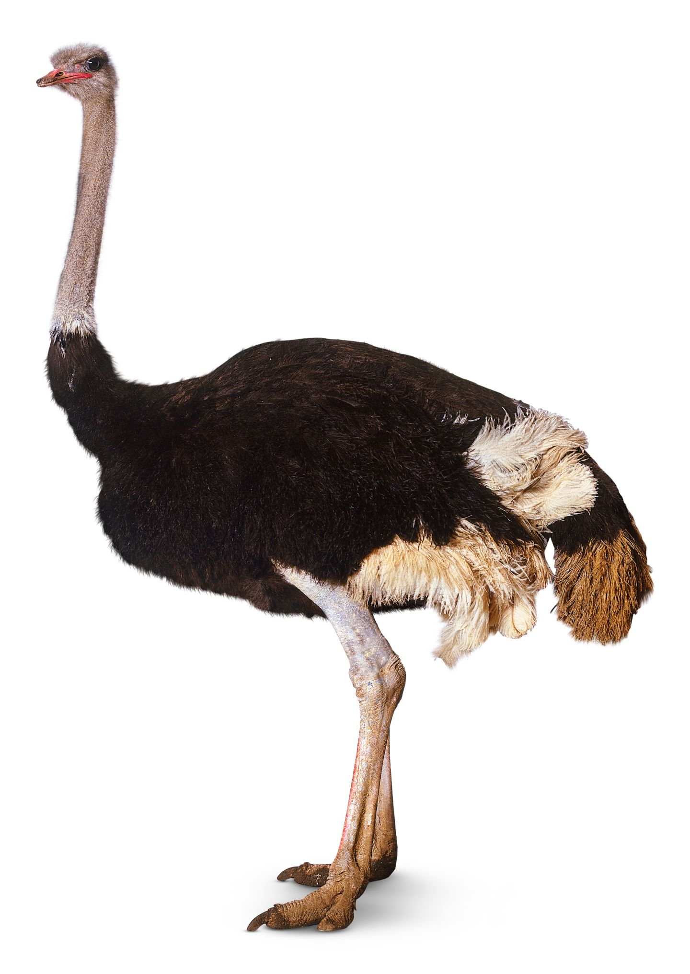
Example: Ostrich
Kingdom: Animalia
Phylum: Chordata
Class: Aves
Order: Struthioniformes
Family: Struthionidae
Genus: Struthio
Species: camelus

Slide 18
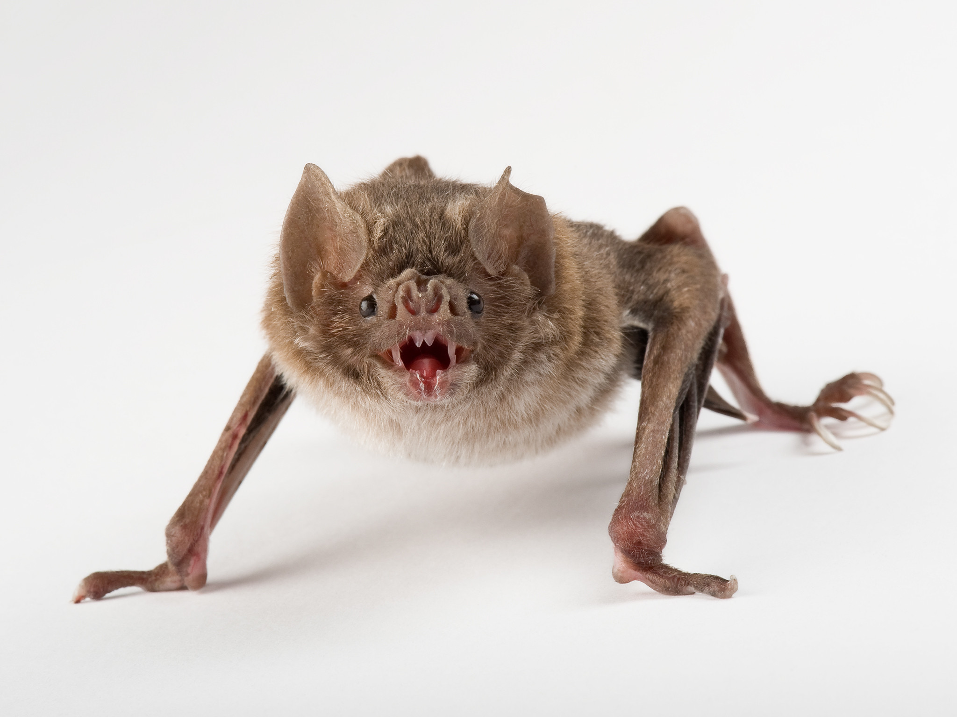
Common Vampire Bat
Kingdom: Animalia
Phylum: Chordata
Class: Mammalia
Order: Chiroptera
Family: Phyllostomidae
Subfamily: Desmodontinae
Genus: Desmodus
Species: D. rotundus

