Slide 1
Nematodes

Slide 2
ROUNDWORMS

Slide 3
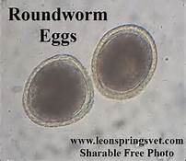
Roundworms

Slide 4
Phylum Nematoda
Commonly called roundworms
  Cylindrical body shape
  Multicellular
    Cuticle – a body wall composed of an external, acellular, protective layer
    Hypodermis – cellular layer beneath the cuticle
    A layer of longitudinal somatic muscles that function in locomotion
    Digestive tract
      Tubular and suspended in the pseudocoelom
      One straight tube from mouth to anus
    Reproductive organs
    Nervous system
    No respiratory system

Slide 5
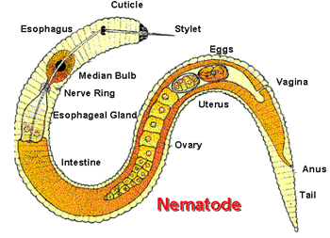

Slide 6
Life Cycle
Developmental stages
  Egg
  Four larval stages (wormlike)
  Sexually mature adult
Infective stage
  Egg containing a larva, free-living larva, or larva within an intermediate host

Slide 7
Life Cycle (cont.)
Direct
  No intermediate host needed for development to the infective stage
Indirect
  An intermediate host is needed for development to the infective stage

Slide 8
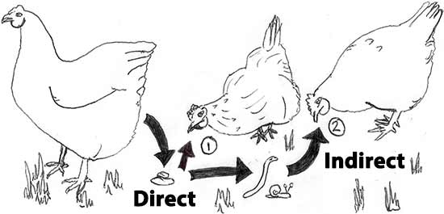

Slide 9
Life Cycle (cont.)
Once a nematode gains entry to a new host:
  Development may occur in the area of its final location or may occur after extensive migration through the body of the definitive host
Diagnostic stages
  Most found in feces, blood, sputum, or urine
  Some in lungs, kidney, urinary bladder, or heart

Slide 10
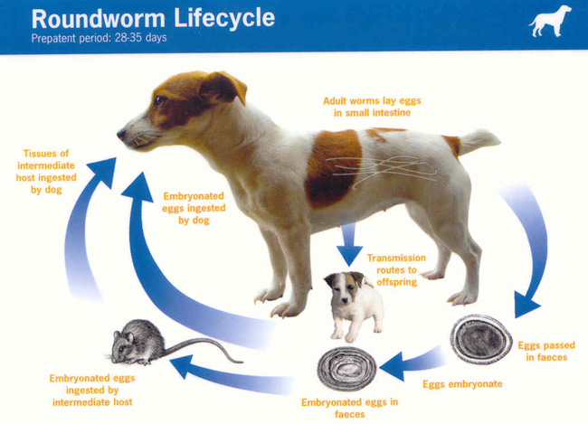

Slide 11
Ascaroidea (AKA: Roundworms)
Ascarids of dogs and cats
  Toxocara canis, T. cati, and T. leonina
  Found in the intestinal tract of dogs and cats around the world
  Toxocara sp. common name is Roundworm
  All puppies and kittens should be examined for large robust nematodes
  Adult ascarids – 3 to 18 cm in length
  Prepatent period for T. canis – 21 to 35 days; T. leonina is 74 days

Slide 12
Roundworms cont.
Methods of transmission:
Direct (fecal/oral)
Transplacental
Transmammary
Predation of foreign hosts
ZOONOTIC

Slide 13
Roundworm Patterns of Migration
Tracheal Migration Route
Dog consumes 2nd stage larvae (The eggs of Toxocara spp. can survive on the soil for several years. (Fresh feces are NOT infective)
Larvae penetrates the stomach and enters the hepatic portal circulation
Larvae migrates through the liver tissue
Larvae enters the vena cava and goes to the lungs
Larvae will migrate up the trachea and are swallowed into the esophagus.
Molts to 3rd stage in stomach and matures in small intestine, copulates and produces eggs.

Slide 14
Roundworm Patterns of Migration cont.
Somatic Migration Route
Dog consumes 2nd stage larvae
Larvae penetrates the stomach and enters the hepatic portal circulation
Larvae migrates through the liver tissue
Larvae enters the vena cava and goes to the lungs
Larvae will travel to assorted sites (muscles, kidneys, mammary glands, etc.) and encyst as a 2nd stage larvae.

Slide 15
Toxocara sp. Clinical Signs
Heavy infections can produce abdominal cramps and distention, and obstruction of the intestinal tract.
Pulmonary edema, coughing, nasal discharge, and increased respiratory rates may also be seen.
Vomiting, diarrhea, emaciation, dull hair coat and restlessness are also often seen.

Slide 16
Toxocara Zoonosis
Toxocara larvae can cause:
Visceral larval migrans (VLM)
Ocular larval migrans (OLM)
Neural larval migrans (Baylisascaris procyonis)

Slide 17
Roundworm Treatment
Your vet can provide a quality dewormer that will safely and effectively get rid of the worms.
Your vet can provide a monthly heartworm medication for your dog that will also include ingredients to prevent and control roundworms on a continuing basis.

Slide 18
HOOKWORMS

Slide 19
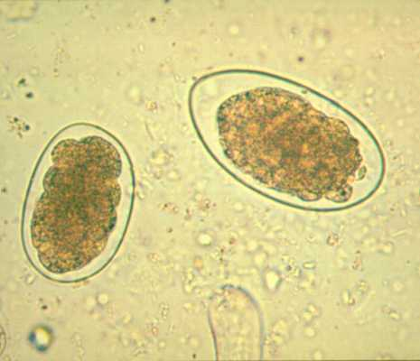
Hookworm

Slide 20
Strongyloides
Small intestine nematode
  Ancylostoma caninum – canine hookworm
  Ancylostoma tubaeforme – feline hookworm
  Ancylostoma braziliense – canine and feline hookworm
  Uncinaria stenocephala – northern canine hookworm
Hookworms are found throughout the world and are common in tropical and subtropical areas of North America
Produce severe anemia in puppies and kittens

Slide 21
Hookworm Life Cycle
Live in the small intestine
Feeds on the mucosa blood
Methods of transmission:
Skin penetration
Direct (fecal/oral)
Transplacental
Transmammary
Predation of foreign hosts

Slide 22
Hookworm Life Cycle cont.
Tracheal Migration Route
Dog consumes 3rd stage larvae OR the 3rd stage larvae penetrates the skin of the animal.
Larvae penetrates the stomach and enters the hepatic portal circulation
Larvae migrates through the liver tissue
Larvae enters the vena cava and goes to the lungs
Larvae will migrate up the trachea and are swallowed into the esophagus.
Matures to adult in the small intestine, copulates and produces eggs.

Slide 23
Hookworm Life Cycle (cont.)
Somatic Migration Route
Dog consumes 3rd stage larvae OR 3rd stage larvae penetrates the skin of the animal.
Larvae penetrates the stomach and enters the hepatic portal circulation
Larvae migrates through the liver tissue
Larvae enters the vena cava and goes to the lungs
Larvae will travel to assorted sites (muscles, kidneys, mammary glands, etc.) and encyst as a 3rd stage larvae.

Slide 24
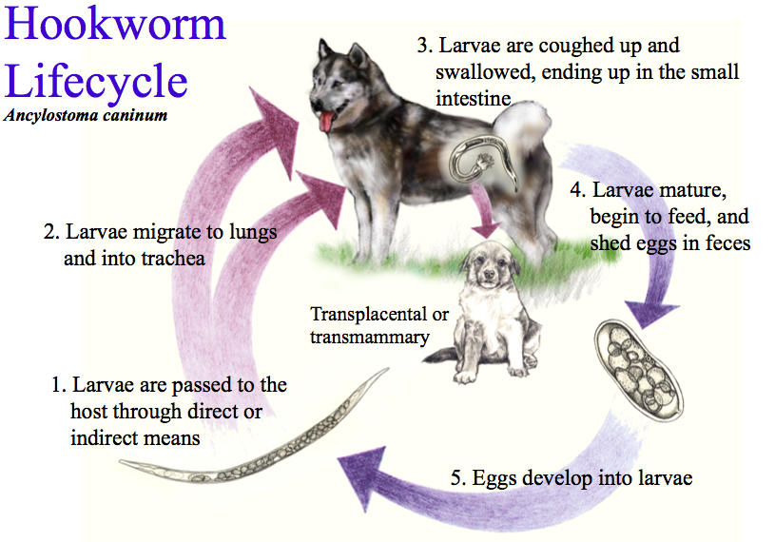

Slide 25
Strongyloides (cont.)
Eggs are oval or ellipsoid with thin walls
Eggs larvate rapidly in the external environment
Fresh feces needed for diagnosis
Standard fecal flotation can detect their presence

Slide 26
Ancylostoma Clinical Signs
Major signs are associated with blood loss and GI irritation.
Weakness, anemia, diarrhea, bloody or tarry stools, anorexia, depression, and death may also occur.
Larvae may wander into other organs causing secondary signs of hepatitis and pneumonia

Slide 27
Hookworm Treatment
There are several effective drugs, called anthelmintics, which will eliminate hookworms.
Most are given orally and have few side effects. However, these drugs only kill the adult hookworms.
So it is necessary to treat an infected dog again in about two to four weeks
Therefore, it is necessary to treat an infected dog again in about two to four weeks to kill any newly formed adult worms that were larvae at the time of the first treatment.
In rare cases, a blood transfusion may be necessary in dogs with severe anemia.
Since the dog's environment can be infested with hookworm eggs and larvae, it is critical that you remove any feces from your yard promptly.
Use gloves to place the feces in plastic bags and discard in your trashcan.
There are currently no approved available products to eliminate hookworm larvae from your yard.
The best prevention is to remove feces from your yard daily and have your pets on a monthly heartworm preventive that also protects against hookworm infection.

Slide 28
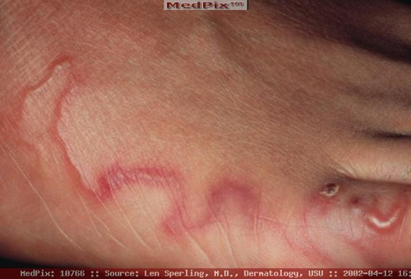
Ancylostoma Zoonosis
Infective larvae can penetrate the skin causing cutaneous larval migrans

Slide 29
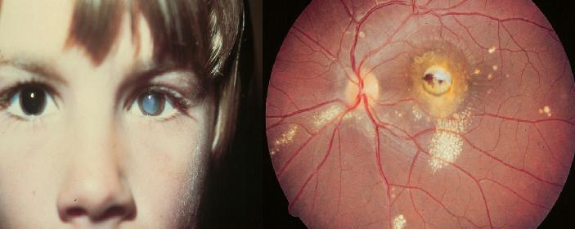
Ocular Migrans

Slide 30
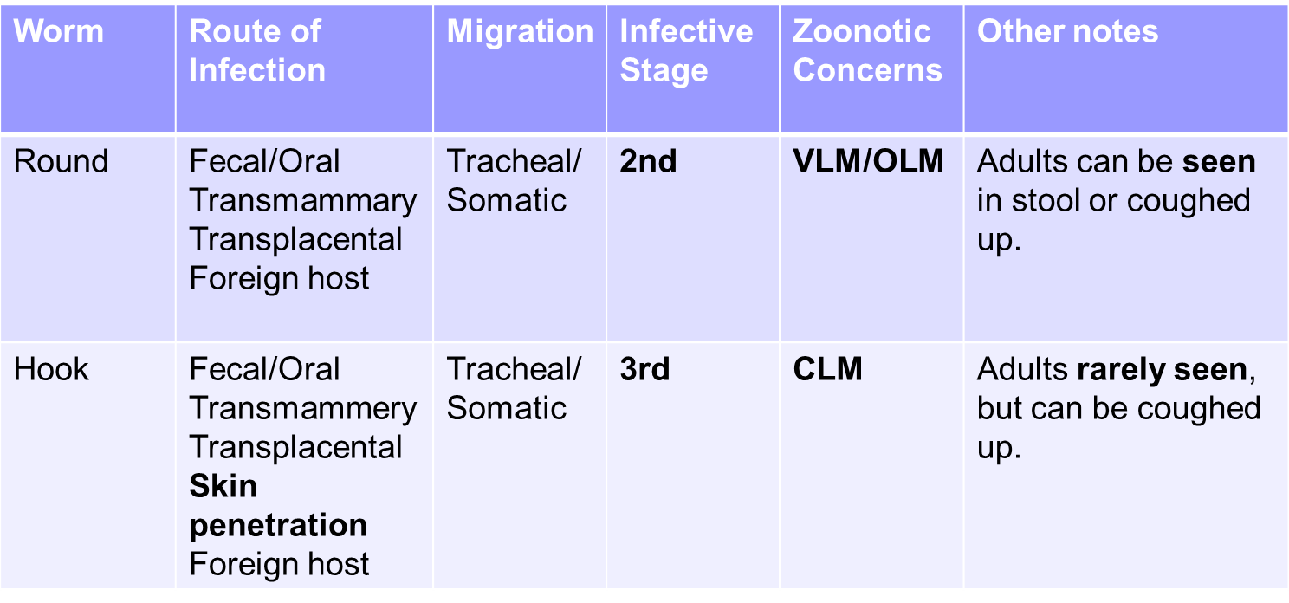
Roundworm vs. Hookworm

Slide 31
Whipworms

Slide 32
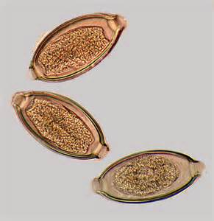
Whipworm

Slide 33
Trichuroidea
Found in the cecum and colon
Canine whipworm - Trichuris vulpis
    Common
Feline whipworm – T. campanula and T. serrata
    Rare in North America and diagnosed sporadically around the world
Adults have a thin, a thick caudal end that is whiplike
Eggs – thick, yellow-brown symmetrical shell with polar plugs “Operculum” at both ends

Slide 34
Trichuroidea (cont.)
Common in young and adult dogs (not often seen in very young (prepatent period of 70-90 days).
Rare in cats
Can live in the environment for years
Live in cecum and large intestine of the host
Blood suckers
Method of transmission:
Primarily fecal/oral (direct)

Slide 35
Whipworm Life Cycle
1. Eggs are passed in the stool and the larva goes through two molts within the egg (2nd stage is infective).
2. Infective eggs are ingested by host and hatch in small intestine.
3. Larvae migrate to the cecum and large intestine where they mature, copulate and lay eggs.

Slide 36
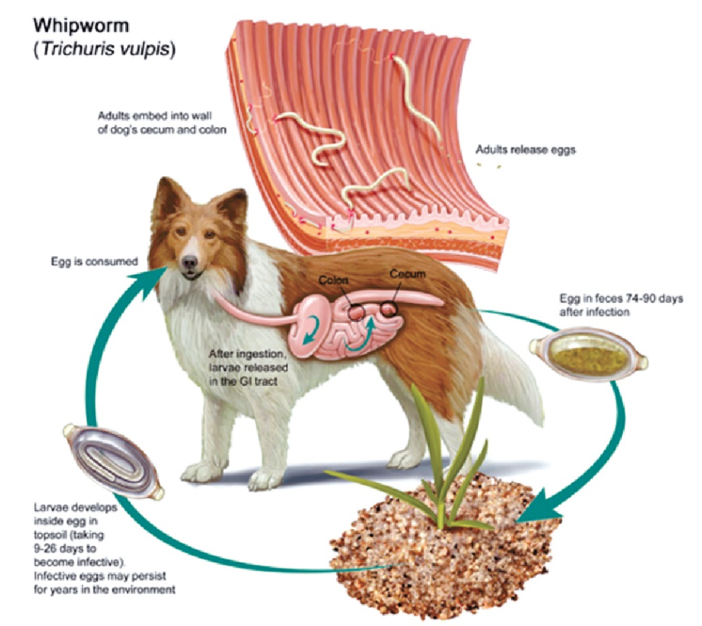

Slide 37
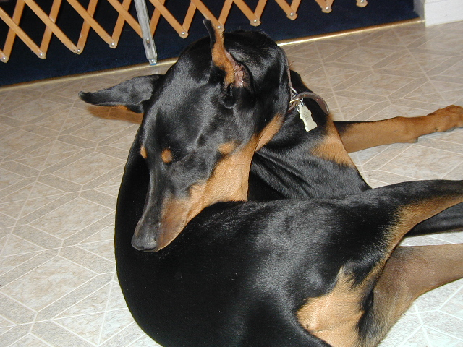
Clinical Signs of T. vulpis
Depend on the number of parasites present, but can include:
Intermittent diarrhea, weight loss, emaciation, anemia, abdominal pain, flatulence, and left side “flank suckling”.

Slide 38
Whipworm Treatment
Common dewormers are effective against whipworm infestation. Another good preventions is by using a heartworm preventive.
Immature whipworms in the cecum or intestine are somewhat resistant to dewormers. For that reason, treatments often need to be repeated for several months, until all the larvae have matured into adults.

Slide 39
Heartworms

Slide 40
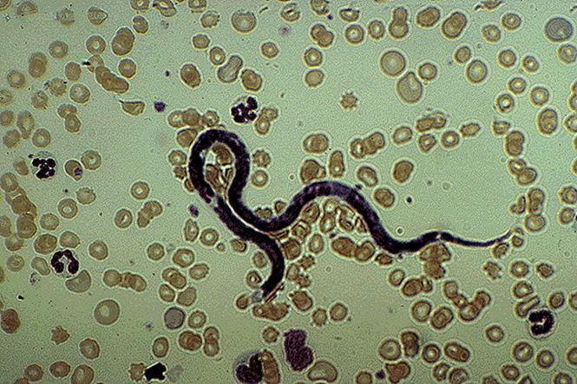
Microfilaria-Immature heartworm

Slide 41
Filaroidea
Microfilaria-Immature heartworm
Dirofilaria immitis – canine heartworm
  Most important parasite of the vascular system in domestic animals in the United States
  Also known to parasitize cats and ferrets
  Adult heartworms – right ventricle, pulmonary artery, and the fine branches of that artery
    Can be recovered from other sites like brain, eye, etc.
  Prepatent period is 6 months
  Pseudoheartworm exists that is not pathogenic (Acanthocheilonema reconditum)

Slide 42
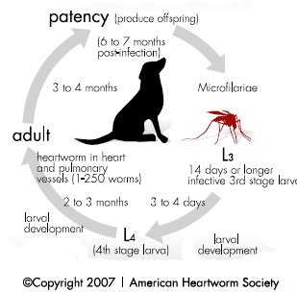
Heartworm Lifecycle

Slide 43
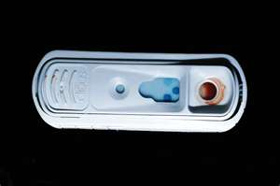
Filaroidea (cont.)
Diagnosis
  Observing microfilariae in blood samples
  SNAP test
  Detects the hormone from the adult female worm
  Once diagnosed, disease state is classified
  (graded from 1-4)

Slide 44
Filaroidea (cont.)
Diagnosis
Class 1 (Mild)
Occasional cough, fatigue with exercise, or mild loss of condition
Class 2 (Moderate)
Occasional cough, fatigue with exercise, or mild to moderate loss of condition
Class 3 (Severe)
General loss of condition: fatigue with mild activity; occasional or persistent cough
Class 4 (Very Severe) Caval Syndrome

Slide 45
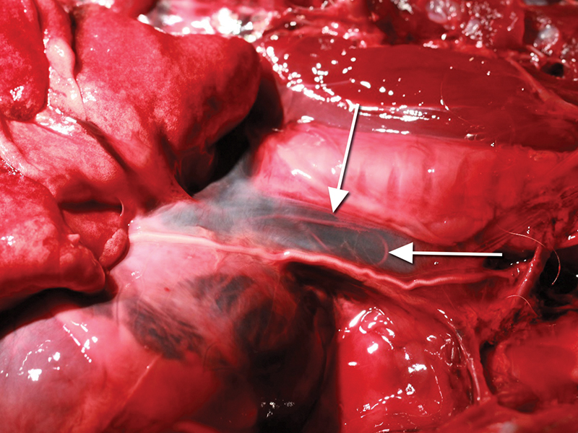
What is Caval Syndrome?
CS is a specific condition that develops when a mass of heartworms becomes situated in the right ventricle, right atrium, and often, the vena cava

Slide 46
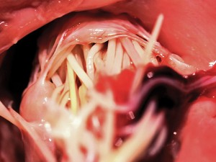
These worms partially obstruct the inflow tract to the right ventricle, interfering with closure of the tricuspid valve and consequently resulting in:
Significant tricuspid regurgitation
Compromised right ventricular filling
In some patients, the onset of circulatory collapse.

Slide 47
Heartworm Treatment
Canine Heartworm Treatment
Treatment for heartworm involves an adulticide given by injection into the dog followed by several weeks of rest (4 to 6 weeks). After treatment a preventative is used to avoid future problems. Treatment is highly effective. In severe cases surgery is used to physically remove the worms.
Canine Heartworm Prevention (BEST METHOD!!)
Veterinarians where mosquitoes live will recommend that dogs take a heartworm preventative. Most have the added benefit of also helping dogs either avoid other worms (Heartgard Plus, Interceptor). Both are given orally via a flavored chewable 1x a month. Other products such as Sentinel help to avoid fleas. Revolution heartworm protection also protects against fleas. There is also 1x every 6 month injection that is available called ProHeart 6, however it only protects against heartworms.

Slide 48
Dirofilaria v- Acanthocheilonema
Acanthocheilonema are usually non-pathogenic
There are 3 main physical differences between the two:
Head
Tail shape
Type of movement

Slide 49
Dirofilaria v- Acanthocheilonema
Dirofilaria:
Straight tail
Tapered head
Undulating movement (no forward mvmt.)
Acanthocheilonema:
Button-hooked tail
Blunt head
Definite forward movement

Slide 50
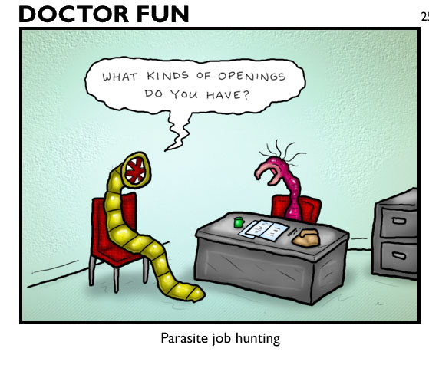
The end

