Slide 1
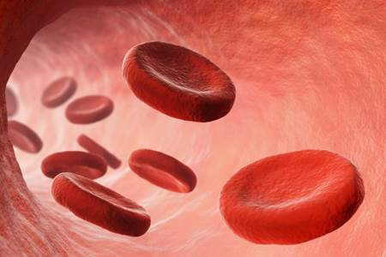
Reticulocytes and Anemia

Slide 2

Time to classify anemia!

Slide 3
What is polycythemia?
This is a condition that results in the animal’s PCV to be higher than normal, or increased above normal in the number of RBCs
There are three types:
  Relative polycythemia – loss of fluid
    Examples? Vomiting, diarrhea, bleeding
    Compensatory polycythemia – result of hypoxia
  Polycythemia rubra vera – rare bone marrow disorder, characterized by increased production of RBCs for an unknown reason
Notes:
vomiting, diarrhea, bleeding,

Slide 4


Classification of anemia
RBC Indices: MCv
MCV: mean corpuscular volume
  What does it measure? Average volume or size of a RBC
  Calculation formula:
  PCV RBC concentration 10
  (RBC count)
Notes:
Mean corpuscular volume/ average volume or size of a RBC

Slide 5

Classification of anemia
RBC Indices: mcv
What are the normal MCV ranges for:
  Dog: 60 – 77 fL
  Cat: 40 – 55 fL
Decreased MCV: microcytic
Normal MCV: normocytic
Increased MCV: macrocytic
Notes:
60-77 fL
40-55 fL
Normocytic
Macrocytic
Microcytic

Slide 6
Classification of anemia
RBC indices: MCV interpretation
What could be some possible causes of increased MCV?
  Increased bone marrow activity (most common)
    Polycythemia vera : Myeloproliferative disorder that over produces erythroid precursor cells
    Relative polycythemia: Splenic contractions or dehydration
    Congenital (poodles, miniature schnauzers
    Possible causes of decreased MCV
      Iron deficiency (most common reason)
      Congenital disorders (Akita and Shiba Inu)
Notes:
Polycythemia vera
Relative polycythemia

Slide 7
Classification of anemia
RBC Indices: MCH
What is MCH? Mean corpuscular hemoglobin
Measures the mean weight of Hb contained within the RBC. The most accurate unit of measurement is in picograms (pg).
CALCULATION
(Hb Concentration RBC Concentration) 10
Hemoglobin concentration is approximately 1/3 of the PCV

Slide 8
Example:
A dog has a Hb concentration of 42 g/dL and a RBC concentration of 22 mL. What is this animals MCH?
(42/22)x10 = 19.09
Notes:
42/22x10=19.09

Slide 9
Classification of anemia
RBC Indices: MCHC
What is MCHC? Mean corpuscular hemoglobin concentration
This measures the concentration of Hb in the average erythrocyte. The unit of measurement is in g/dL.
Canine normal
CALCULATION
Hemoglobin concentration x 100 / PCV (HCT)

Slide 10
Example:
A dog has a hemoglobin concentration of 14 g/dL and a PCV of 42%, this would make the MCHC
14x100/42 = 33.33
Notes:
14x100/42 = 33.33

Slide 11
Test | Canine | Feline | calculation
MCV | 60 – 77 fL | 40 – 55 fL | (HCT/RBC)x1000
MCH | 21.0 – 26.2 | 12.5 – 17.5 | (Hb/RBC)x10
MCHC | 32 – 36.3 | 30 – 33.5 | (Hbx100)/HCT
(Hct [in L/L]/RBC [in x10¹²/L]) x 1000.
femtolitre (US femtoliter) is the metric unit of volume equal to 10⁻¹⁵ litres,

Slide 12
Classification of anemia
RBC indices: RDW
What does RDW mean? Red cell distribution width
This is a numerical expression of the variation in RBC size
Variation in size among cells term: Anisocytosis
Marked cases are often seen in severe anemia where the bone marrow is pumping out RBCs at such a high rate, that they don’t have time to mature fully.
Notes:
Red cell Distribution Width
Anisocytosis

Slide 13
So let’s start our testing procedure
We must count immature RBCs (____________________________) that contain the organelles
Types:
  Aggregate: Large clumps/strands seen when stained with NMB
  Punctate: Unique to cats. Seen as large dots in the cell
  Expressed as a % of the RBCs present
  Bone marrow should replace 1% of the RBCs daily so the reticulocyte count should be 0.5-1.5%
Notes:
Reticulocytes

Slide 14
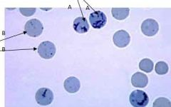
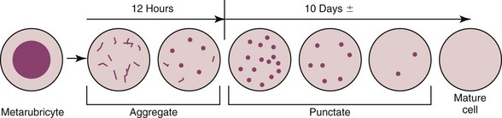
Which are aggregate and which are punctate?

Slide 15
Reticulocyte count: standard procedure
Mix
Gently mix 4 drops of blood with 4 drops of NMB in a test tube
Let stand
Let stand 15 minutes
Use
Use 1 drop of mixture to prepare 2 blood smears and observe under high power, oil immersion field
Count
Count 500 RBCs on each smear while separately keeping track of the number of reticuloyctes (ONLY AGGREGATE FORM)
Divide
Divide the reticulocyte number by 1,000 and convert to a percentage

Slide 16

Example
You counted 10 reticulocytes on the first slide and 15 reticulocytes on the second slide.
What is the math?
Add your reticulocytes 10 + 15 = 25
Divide 25/1000 = 0.025
Multiply to get your percentage 0.025 x 100 = 2.5%

Slide 17
Reticulocyte count:
CORRECTED COUNT
Why would you do a corrected count?
  You must take in to account the reduced number of circulating RBCs in an anemic animal.
  This calculation is necessary because the standard reticulocyte count is misleading in anemic patients because the reticulocyte count is not really a count, but rather a percentage. This means it reports the number of reticulocytes as a percentage of the number of RBCs
  In anemia, the patient RBCs are reduced, creating an elevated reticulocyte count.

Slide 18
Reticulocyte count:
CORRECTED COUNT
Calculation:
  Observed reticulocyte % x PCV Normal PCV
    (Normal PCV: use 45% for dogs and 35% for cats)
  Example:
    2.5% x 30% 45% = 1.67%
Notes:
1.67%

Slide 19
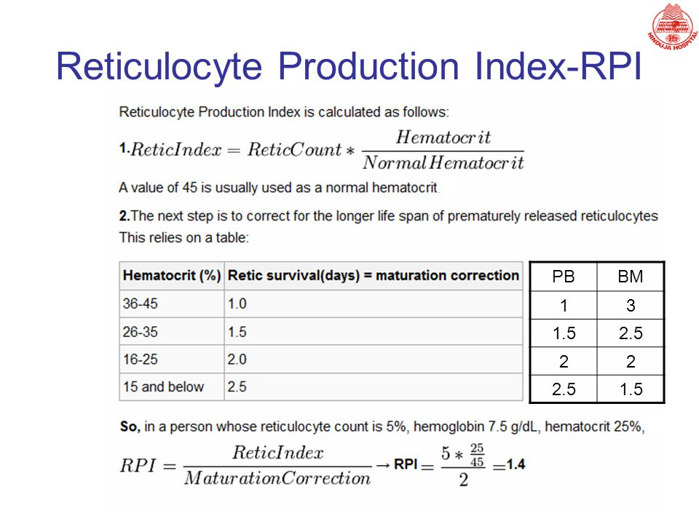
Reticulocyte count:
CORRECTED COUNT
Some practices may prefer to use the reticulocyte production index.
This is a calculated by dividing the corrected reticulocyte percentage by the maturation time of the reticulocyte for the observed patients PCV

Slide 20
Reticulocyte count:
CORRECTED COUNT
So how do you use that chart???
So lets say a dog has a corrected reticulocyte count of 5% with a PCV of 15%, then the reticulocyte production index is 5/2.5 = 2
This indicates that the patient is producing reticulocytes at a rate that is 2 times greater than normal.

Slide 21

Types of

Slide 22
How is the bone marrow responding?
This classification is most clinically applicable because we need to determine if the anemia is regenerative or non-regenerative
If the bone marrow is responding, we should see an increased number of polychromatophilic RBCs or reticulocytes in a blood film
Notes:
Regenerative/non-regenerative
Reticulocytes

Slide 23
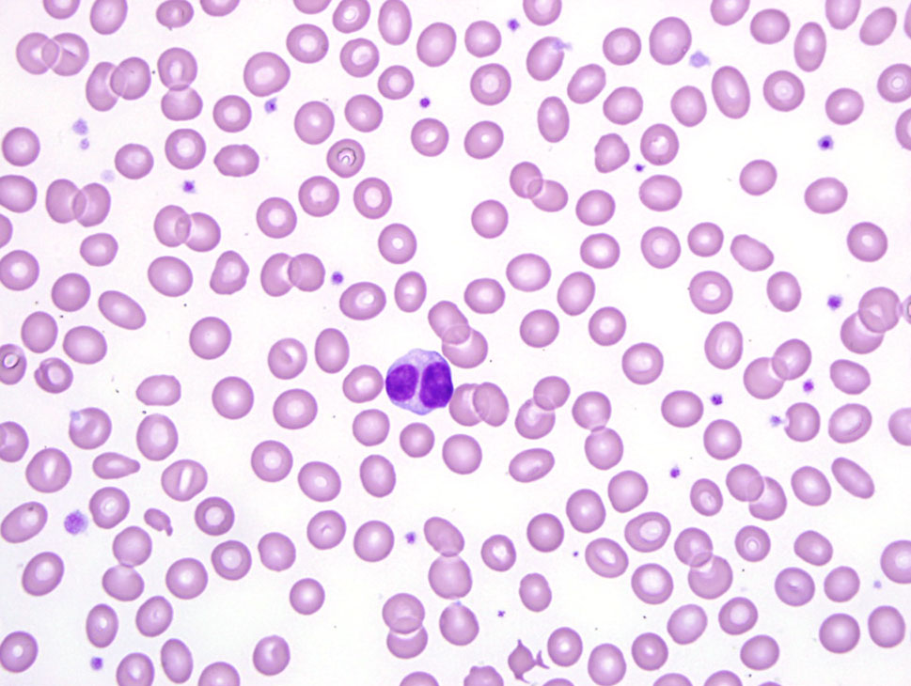
Classifications of anemia by etiology-
Hemolytic
What is happening to the RBCs within the blood? Being destroyed
During the initial stages, this type of anemia is usually normocytic and normochromic, but it becomes macrocytic as a result of the bone marrow’s release of reticulocytes.
List six potential causes for a normocytic normochromic type of anemia.
Hemorrhage
Early iron deficiency
Chronic renal disease
Endocrine deficiencies
Lead toxicity
neoplasia
Notes:
Being destroyed.
Hemorrhage
Early iron deficiency
Chronic renal disease
Endocrine deficiencies
Lead toxicity
Neoplasia

Slide 24
Classifications of anemia by etiology-
Hemorrhagic
What is happening to the RBCs? Acute or chronic blood loss
The patient’s history and clinical signs can often help with the determination of the cause of anemia
List six potential causes for a hemorrhagic type of anemia.
Trauma
Parasites
Coagulopathy
Neoplasia
Cystitis
GI ulceration
Notes:
Acute or chronic blood loss
Trauma
Parasites
Coagulopathy
Neoplasia
Cystitis
GI ulceration

Slide 25
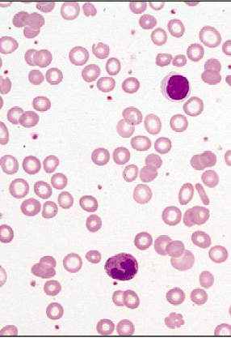
Classifications of anemia by etiology-
Iron deficiency
Iron deficiency can be the result of a nutritionally deficient diet, or from chronic blood loss.
How would RBCs appear? Microcytic and hypochromic
What would happen to the MCHC? It would be low
Notes:
Microcytic and hypochromic
It would be low

Slide 26

Classifications of anemia by etiology:
Production Disorders
Reduced rates of erythropoiesis or defective erythropoiesis will generally result in a normocytic anemia
Types of conditions include:
Chronic renal dz
Hypothyroidism
Hypoadrenocorticism
Bracken fern poisoning
Iron and/or copper deficiency
Parvo
Lead toxicity
Notes:
Chronic renal dz
Hypothyroidism
Hypoadrenocorticism
Bracken fern poisoning
Iron and copper deficiency
Parvovirus
Lead toxicity

Slide 27

Classifications of anemia by etiology:
Aplastic anemia
This is a disease condition in which the bone marrow is unable to replenish the blood cells.
This is a life-threatening condition
What is happening to the bone marrow? The bone marrow is replaced by adipose
This does NOT just affect the RBCs, it also affects the platelets and WBCs
What do you think some symptoms might be?
Recurrent infections, fever, petechial hemorrhage, epistaxis, melena, pale mm, weakness, lethargy
Notes:
The bone marrow is replaced by adipose tissue (fat)
Recurrent infections Fever
Petechial hemorrhage (red or purple spots on skin due to tiny hemorrhages)
Blood in urine (hematuria) Nosebleed (epistaxis)
Black-colored feces (melena) Pale mucous membrane
Weakness Lethargy

Slide 28
What is AIHA and IMHA?
Autoimmune hemolytic anemia, immune mediated anemia
In general terms, what does it do? Causes the immune system to attack and destroy rbc
The antibodies are clinging to the RBC membranes, and they cause the cells to clump together
Once the clumps of cells are detected by the tissue macrophages in the spleen, they are removed and destroyed, causing anemia if done in large amounts.
Notes:
Autoimmune hemolytic anemia
Causes the immune system to attack and destroy it’s RBCs

Slide 29
IMHA and AIHA symptoms
Pale, weak, lethargic
Depressed
Fever
Diarrhea, bloody stool, dark urine
PU/PD
Dyspnea
Tachycardia
icterus
Notes:
Pale/weak/lethargic Depressed
Fever Lack of appetite
Vomiting Diarrhea
Bloody stool Dark urine
Polydypsia Polyuria
Dyspnea Tachycardia
Icterus

Slide 30

WEEEE Done!!

