Slide 1
White Blood Cells Part 1-
Neutrophils
M. Regalia, LVT

Slide 2

Refresher: What are the leukocytes?
___Neutrophils_____
  bands
  segmented
  hypersegmented
basophils
eosinophils
Monocytes/macrophage
_________lymphocytes___
  B cell
  T cell
  NK cell (natural killer)
Notes:
Neutrophils: Band, Segmented, hyper segmented
Basophils
Eosinophils
Monocytes
Lymphocytes: B cell, T cell, NK cell

Slide 3

Refresher: Granulocytes & Agranulocytes
Granulocytes
  neutrophil
  basophil
  eosinophil
Agranulocytes
  monocyte
  lymphocyte
Notes:
Neutrophil, basophil, eosinophil
Monocyte, lymphocyte

Slide 4
Refresher
Where does all leukocyte production begin? Red bone marrow
All leukocytes differentiate and develop in the bone marrow except for the lymphocytes. They start in the bone marrow, but develop elsewhere.
The production of white blood cells is called leukopoiesis
All leukocytes look alike in the bone marrow until they begin to mature
Notes:
Red bone marrow
Lymphocytes
Leukopoiesis

Slide 5
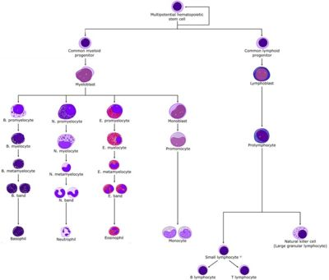
Refresher

Slide 6
Classification of Leukocytes
Classification can be done in three different ways:
  Classification of defense function
  Shape of nucleus
  Presence or absence of cytoplasmic granules
What does it look like?
What is it doing?
What is inside of it?
Notes:
Type of defense function
Shape of nucleus
Presence or absence of staining cytoplasmic granules

Slide 7
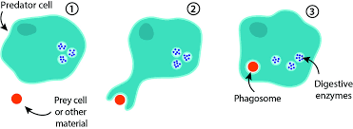
Types of Defense:
Phagocytosis
Phagocytosis: engulfing of a solid particle, bacteria or other material, to form an internal compartment known as a phagosome.
  Which of the leukocytes perform phagocytosis?
    All except lymphocytes
Notes:
Neutrophils, basophils, eosinophils, monocytes

Slide 8
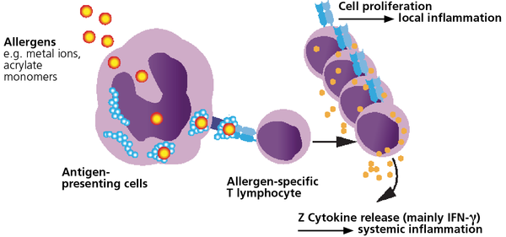
Types of Defense:
Antibody Production & Cellular Immunity
The lymphocytes are the leukocytes that provide the body with the cellular immunity and produce antibodies to protect the body from foreign invaders.

Slide 9
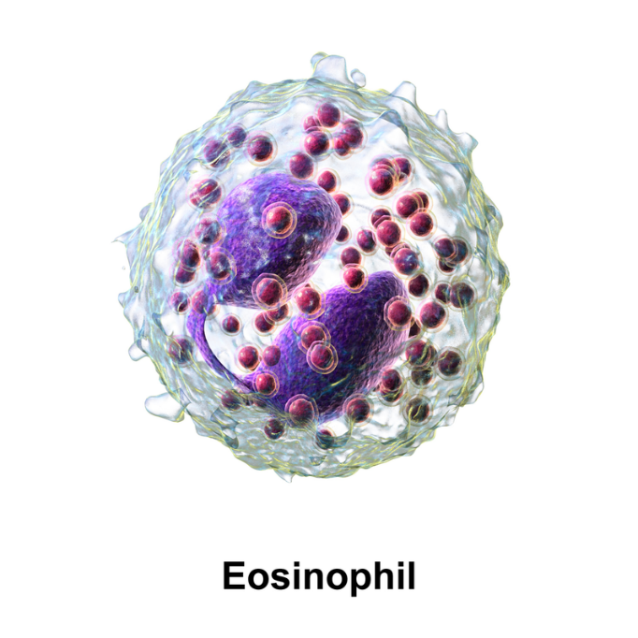
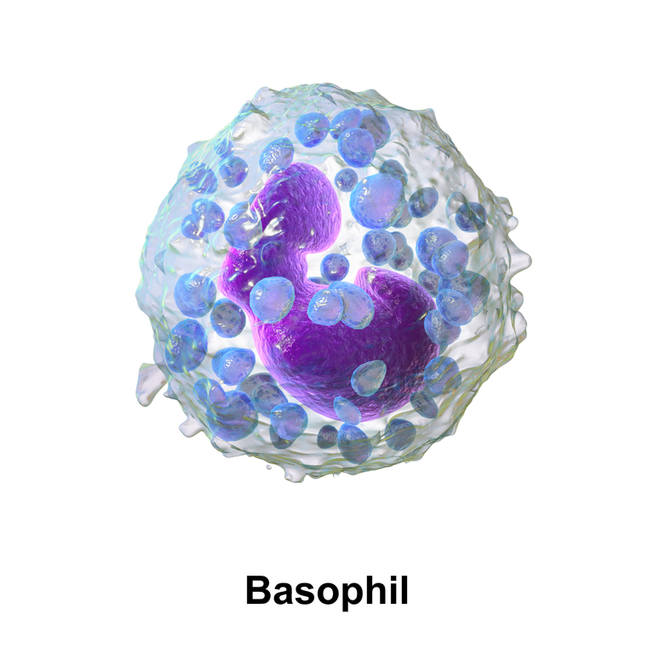
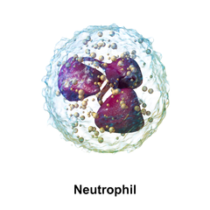
Classification By Nucleus Shape:
Polymorphonuclear
This is a nucleus that is multi-lobed or segmented
  Which of our leukocytes does this apply to?

Slide 10
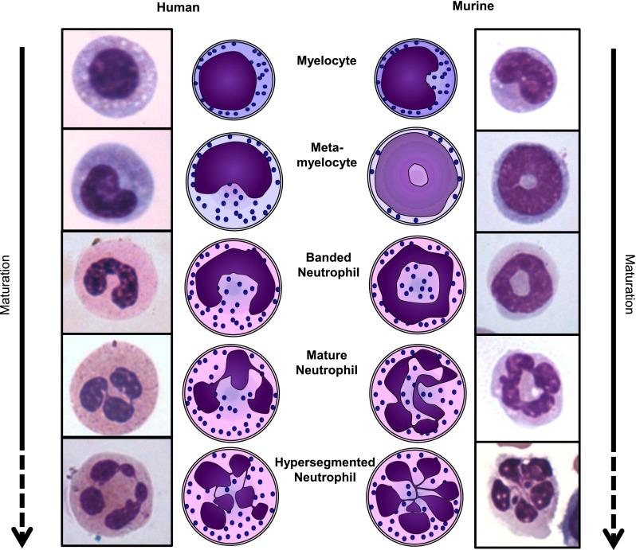
Polymorphonuclear cells
The lobes of the nucleus take on different shapes as the cell ages
  Remember the maturation timeline of the neutrophil!
    Myelocyte
    Meta-myelocyte
    Banded neutrophil
    Mature neutrophil
    Hypersegmented neutrophil

Slide 11
Classification By Nucleus Shape:
Mononuclear and Pleomorphic
Mononuclear leukocytes have a single, rounded nucleus
  Which one does this apply to? lymphocyte
Pleomorphic leukocytes have a nucleus that varies in shape but are non-segmented
  Which one does this apply to? monocyte
Notes:
Lymphocyte
Monocyte

Slide 12
Type of Granules
Granulocytes
Neutrophils granules are NOT attracted to stain so they stain a light purple color
Eosinophils granules are attracted to acid stain so they stain red
Basophils granules are attracted to alkaline/basic stain so they stain blue
Notes:
Acid
Alkaline

Slide 13
Functions of the Granules
Specific granules contain different substances depending on the type of cell they are.
  Neutrophil granules contain lysosomal enzymes.
    What does this aid the leukocyte in doing? Kill microorganisms after phagocytosis
  Eosinophil granules contain anti-inflammatory substances.
    What does this allow the cells to do? Degranulate at the site of allergic reaction to reduce swelling
  Basophil granules contain histamine and heparin.
    histamine reduce inflammation
    Inflammation draws eosinophils to the site
    heparin acts as a local anticoagulant to keep blood flowing to injured or damaged areas.
Notes:
Killing microorganisms after phagocytosis
Degranulate at the site of allergic or anaphylactic reaction to reduce swelling
Histamine
Heparin

Slide 14
Specific Leukocytes
Neutrophils

Slide 15
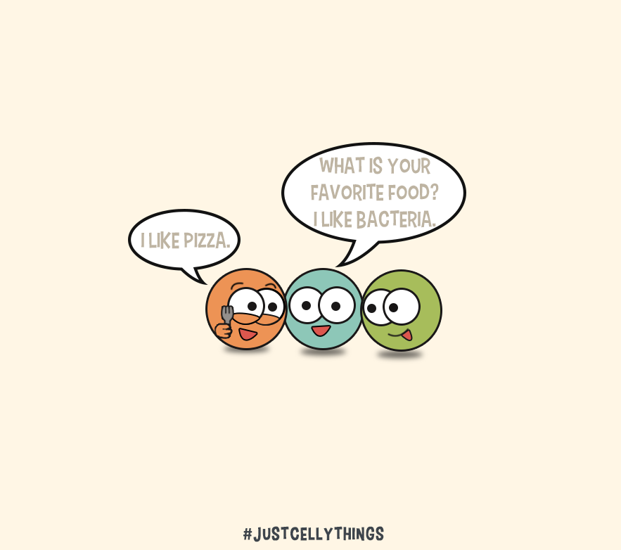
Specific Leukocytes:
Neutrophil

Slide 16
Fast Facts about the Neutrophil
This is the most abundant leukocyte. Makes up about 45-70% of circulating WBCs in dogs, cats and horses.
Granules are considered to be neutral because they stain neither red or blue
Often identified on a blood smear based on the shape of the nucleus
Adult cells contain 2-4 lobes that are connected by thin strands of chromatin
Hypersegmented neutrophils contain 5+ lobes
Notes:
Neutral
Chromatin

Slide 17
Neutrophil Life Cycle
Neutrophils spend 10 hours in circulation before entering the tissues
Once in the tissue, they do not re-enter circulation, therefore the circulating neutrophils need to continually be replaced at least 2.5 times a day
They will stay in tissue until they die or are destroyed by microorganisms.
Tissue macrophages pick up and phagocytize the dead or abnormal cells
Under normal circumstances, they should be replaced by mature neutrophils reserved in the bone marrow
Notes:
2.5
Bone marrow

Slide 18
Neutrophil Function
Involved with early stages of inflammatory response
  Leave vessels via diapedesis (pass through capillary walls, typically accompanying inflammation
  Attracted to the site of infection by chemotaxis (movement in response to chemical signal), allowing the neutrophil to ‘recognize’ what it ingests
Always are found in the tissues of the lungs and GI tract
They have the ability to phagocytize
  Granules contain digestive enzymes capable of destroying bacteria and viruses
  Lysosomal enzymes are released to kill the bacteria or destroy the virus
Notes:
Diapedesis
Chemotaxis

Slide 19
Neutrophil Pools
Circulating pool: Found toward the center of blood vessels.
  Blood samples obtained from laboratory analysis contains neutrophils from this pool
Marginal pool: Found in the lining of the wall of small bleed vessels, mainly in the spleen, lungs, and abdominal organs. These are not circulating
Notes:
Circulating
Marginal

Slide 20
Band Neutrophils
When found in a smear, these are neutrophils that have been released from the bone marrow prior to maturity
When found in peripheral blood smears, it indicates an increase in the demand for neutrophils beyond what the bone marrow can supply
If band cells run out, then the bone marrow starts releasing progressively more immature cells
Left shift: A condition of band neutrophils in the peripheral blood
Notes:
Left shift

Slide 21
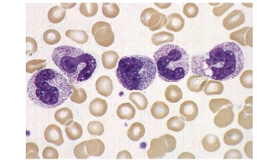
Left Shift

Slide 22
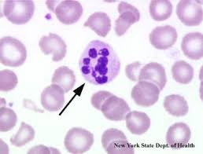
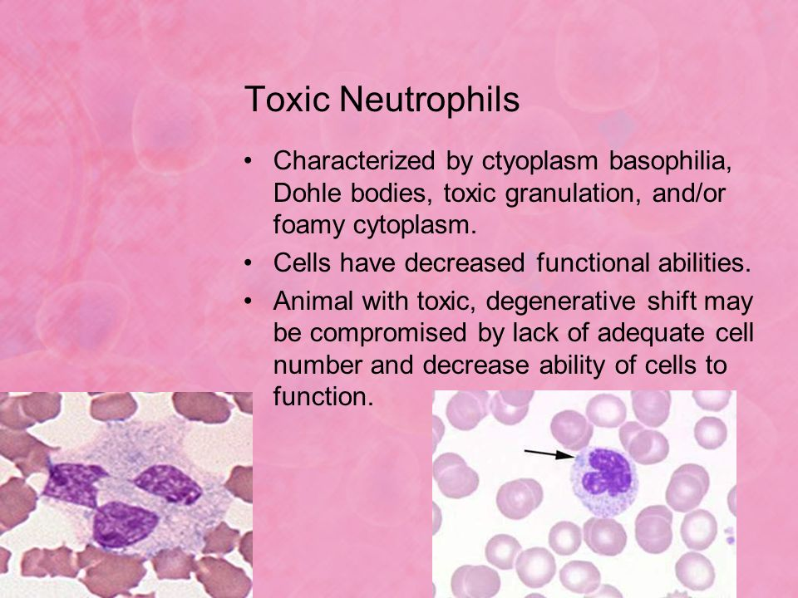
Three Types of Abnormalities in Neutrophils
Nuclear hyper-segmentation
  5+ lobes
  Attributed to aging or pathological condition
Toxic Neutrophils
  Most commonly found in disease induced animals.
  Changes are due to cytoplasmic toxic changes.
  Cells will have decreased functioning
  Characterized by cytoplasmic basophilia, Dohle
  bodies, toxic granulation, and/or foamy cytoplasm

Slide 23
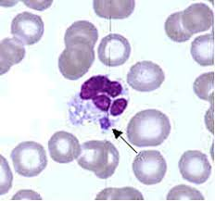
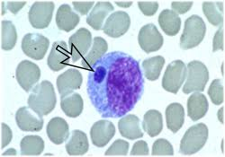
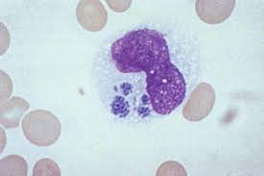
Three Types of Abnormalities in Neutrophils, continued…
Erlichia Morula: Erlichia causes formation of morula in the cytoplasm of the neutrophil.
  What ectoparasite spreads Erlichiosis? Tick (lonestar and black legged)
Notes:
tick

Slide 24
Clinical Chemistry of Neutrophils
Neutrophil counts in peripheral blood is noted to be within a specific range
  Dogs: 3000 - 11400 cells/uL (microliter)
  Cats: 2500 - 12500 cells/uL
What controls the amount of neutrophils present?
  The bone marrow releases mature neutrophils from the storage pool into the peripheral blood
  How quickly they move from the peripheral blood to the tissue
  Entrance of increased numbers of PPSCs into the neutrophil production line, causing a potential increase in neutrophils
Notes:
3,000-11,400
2,500-12,500

Slide 25
Factors That Can Influence Neutrophils Being Released:
STRESS!!!!
Physiologic Leukocytosis:
  Neutrophils can move freely between circulating and marginal pools
  Cells can detach from the marginal pool and move into the circulating pool when an animal is experiencing stress, leading to a temporary transfer of neutrophils
  This predictable neutrophil response is called stress response or stress leukogram
Notes:
Stress response
Stress leukogram

Slide 26
Neutrophilia
Definition: An increase in the number of neutrophils
Possible causes of neutrophilia:
  Inflammation: mild inflammation yields a response to stress
  Bacterial infections
  Extensive tissue damage
    burns
    necrosis
    trauma
    Extensive surgery
    neoplasia
  Cancer/parasitic infections
Notes:
Inflammation: milid inflammation yields a response similar to stress
Bacterial infections
Extensive tissue damage
Burns necrosis trauma extensive sx neoplasia
Cancers/parasitic infections

Slide 27
Neutropenia
Definition: a decrease in the number of circulating neutrophils
What would this indicate?
  The infection is out of control and all reserves of neutrophils are used faster than the bone marrow can create them
(What is it called if we have a total WBC count decrease? leukocytopenia
If a critically ill patient has both neutropenia and leukocytopenia, what is their probable prognosis? poor
Notes:
The infection is out of control, and all reserves of neutrophils can be used up faster then the bone marrow can create them
Leukocytopenia
Poor

Slide 28
Neutropenia
What are some potential reasons a patient can have neutropenia?
  Excessive tissue demand or destruction of neutrophils
    Destruction can be immune-mediated
  Reduced or ineffective granulopoiesis
Name some specific conditions:
  Overwhelming bacterial infections
  Drug reactions (penicillins, cephalosporins, sulfonamides (dogs) chloramphenicol (cats)
  FeLv
Notes:
Overwhelming bacterial infections (septicemia)
Drug reactions (penicillins, cephalosporins, sulfonamides in dogs, chloramphenicol in cats)
Feline Leukemia Virus

