Slide 1
White Blood Cells Part 2, Eosinophils, Basophils, Monocytes & Other Leukocytic Cells

Slide 2
Key Terms
Agranulocyte
PPSC
Diapedesis
Chemotaxis
Enzymes
Lysosomes
Macrophage
Granulocyte
Polymorphonuclear
Neutropenia
Phagocytosis

Slide 3
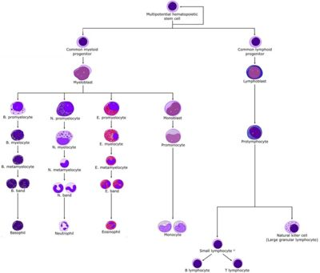
Leukopoiesis

Slide 4
Granulopoiesis
Granulopoiesis (or granulocytopoiesis) is hematopoiesis of granulocytes
It occurs primarily within the bone marrow and involves the following stages:
Pluripotential hemopoietic stem cell
Myeloblast
Promyelocyte
Eosino/neutro/basophilic myelocyte
Metamyelocyte
Band cell (Stab cell)
Granulocytes (Eosino/neutro/basophil)
Notes:
hematopoiesis of granulocytes
Bone marrow

Slide 5
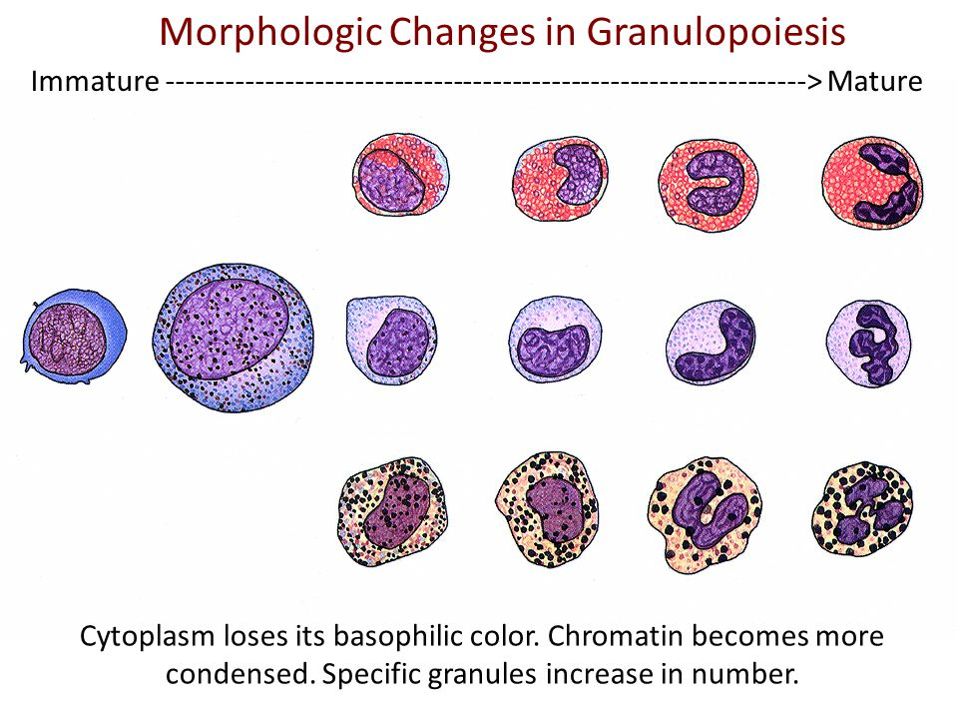
Granulopoiesis
Eosinophil
Neutrophil
Basophil

Slide 6
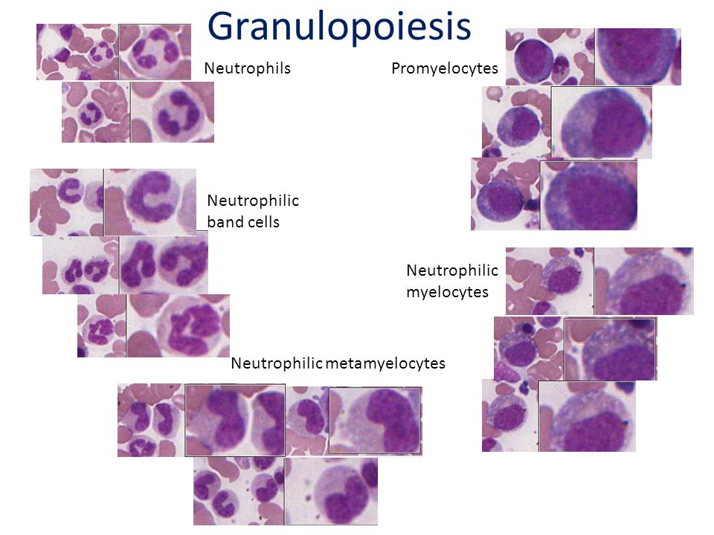
Granulopoiesis

Slide 7
Eosinophils

Slide 8
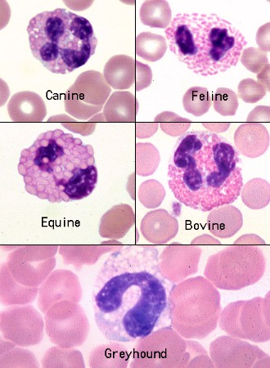
Eosinophils
Eosinophils
  Will stain red in the cytoplasm of mature cells
  Appearance of granules will vary among species
  Most adult cells may contain 2 lobes connected by thin strands of chromatin
Notes:
Red
Chromatin

Slide 9
Eosinophils
Eosinophils in the dog have round granules and a light blue cytoplasm
. Eosinophils of the cat have small rod-shaped orange granules that fill the cytoplasm

Slide 10
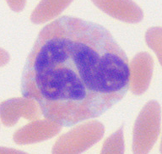
Eosinophils
Horses have very large globular orange granules.
Ruminant and camelid eosinophils have many small very round orange granules. Camelid granules resemble those of ruminants.

Slide 11
A “vacuolated” eosinophil from a Greyhound is also shown. This lacks visible granules (granules also lack myeloperoxidase) and mimics a monocyte or a toxic band neutrophil, except that the cytoplasm contains far more vacuoles than is typical for either of the latter cells. Such eosinophils can also be seen in other sighthounds and golden retrievers
Notes:
Golden retrievers

Slide 12
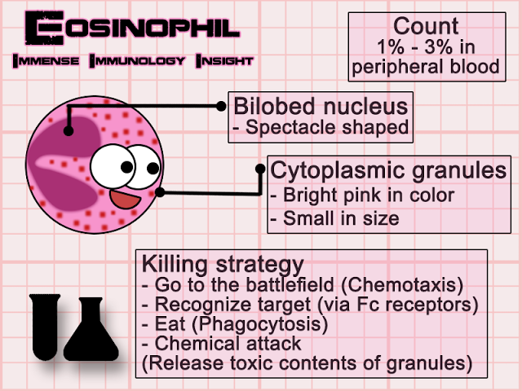
Eosinophils

Slide 13
Eosinophil Lifecycle
These spend 3 – 8 hours hours in circulation before entering the tissue.
Make up only 1-6% of leukocytes
Once in the tissue, they do NOT return to circulation. They will either age and die, or will be destroyed by microorganisms
Tissue macrophages will come and phagocytize the dead
An increased number of eosinophils in the peripheral blood is called eosinophilia
A decreased number of eosinophils in the peripheral blood is called eosinopenia
Notes:
3-8 hours
Eosinophilia
Eosinopenia

Slide 14
Functions of the Eosinophil
Eosinophils have three major jobs:
  Inflammatory response
  immunity
  phagocytosis
Where do you think you would find large numbers of eosinophils?
  GI
  Skin
  lung
Notes:
Inflammatory response
Immunity
Phagocytosis
GI SKIN LUNG

Slide 15
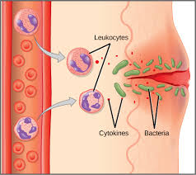
Function 1-Inflammatory Response of the Eosinophil
Are attracted to and inhibit allergic and anaphylactic reactions
They release antihistamines to decrease inflammation
Notes:
Antihistamines

Slide 16
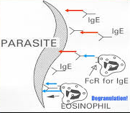
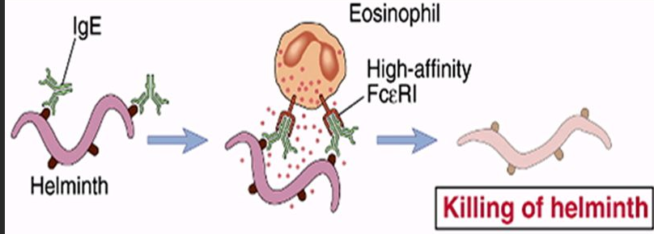
Function 2-Immunity
Eosinophils will phagocytize substances associated with humoral immunity response

Slide 17
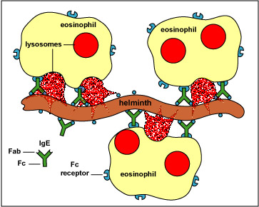
Function 3-Phagocytosis
Eosinophils have limited phagocytic and bactericidal functions
The contents of the eosinophil granules are highly toxic to large pathogenic organisms

Slide 18
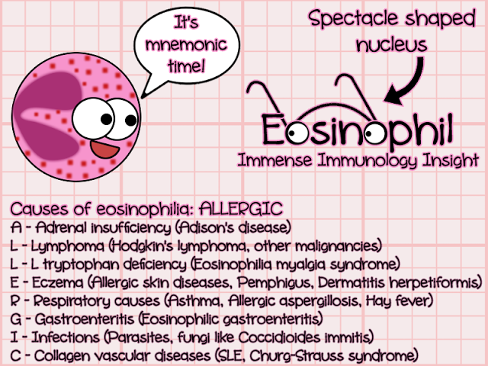
Eosinophilia

Slide 19
Basophils

Slide 20
Basophil Characteristics
Granules will stain blue and are multi-lobular
Least common leukocyte, making up less than 1% of circulating white blood cell population
Difficult to determine between basophilia and basopenia
  Why? Very few seen in circulation
Notes:
Basophilia basopenia

Slide 21
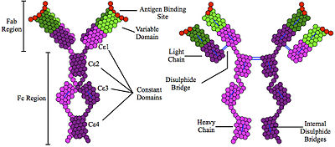
Basophil Function
Granules contain histamine and heparin
  Histamine is released to initiate immune response and allergic response
  Heparin is an anticoagulant that helps to increase blood flow during the inflammatory response
Contains immunoglobulin E: This binds to allergens and triggers the histamine release from the basophil
Notes:
Histamine and heparin
Immunoglobulin E (IgE)

Slide 22
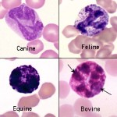
Canine Basophil
Canine basophils are difficult to recognize since many do not have readily apparent granules. This is because the granules are a pale lavender versus purple. The major identifying features of canine basophils are the long and folded nucleus, described as “ribbon-like”, and the unusual gray to lavender hue of the cytoplasm.
Some basophils contain a few obvious light purple granules (granules are more easy to see in cells that are ruptured). Basophils are rare in blood of healthy dogs.

Slide 23
Feline Basophil
Feline basophils are packed with small, slightly oval granules that are pale lavender rather than deep purple. The nucleus in many appears to have vacuoles, which are actually granules lying on top of the chromatin. Basophils are rare in blood of healthy cats.

Slide 24
Equine and Bovine Basophils

Slide 25
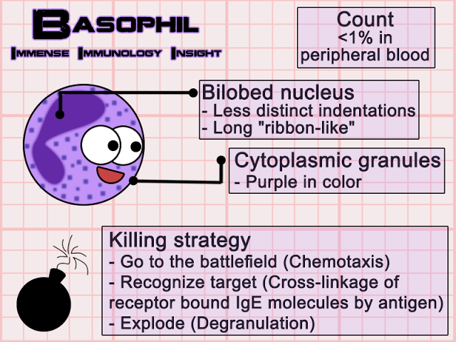
Basophils

Slide 26
Monocytes

Slide 27
Monocyte Facts
Make up about 5-6% of circulating white blood cells
Largest of the white blood cells
Contains vacuoles
Monocytosis: Increase in monocytes
Monocytopenia: Decrease in monocytes
Notes:
Monocytosis
Monocytopenia

Slide 28
Monocyte Identification
Monocytes are the leukocyte that is the most problematic for identification, because they can be fairly variable in size and appearance.
They are often larger than neutrophils and are usually the largest leukocyte, but there are no consistent species differences.
The nucleus can be round to kidney-shaped to pseudo-lobulated (can mimic a neutrophil).
It can even occasionally be band-shaped, especially in dogs, and may be confused with band neutrophils.
However, the chromatin of monocytes is less dense than neutrophils, and is described as lacey to slightly clumped.
The cytoplasm is usually smooth and blue-grey and may contain a few variably-sized vacuoles, and occasionally a few very fine pink-red granules. Some, like the equine monocyte, resemble lymphocytes. The texture of cytoplasm in a monocyte is slightly grainy or coarse compared to lymphocyte cytoplasm, which is very smooth and glassy.

Slide 29
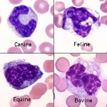
Monocyte Identification

Slide 30
Monocyte Function
The participate in the inflammatory response
Clean up cellular debris and remains
Can present antigens to lymphocytes
They do not spend much time in the bone marrow or circulation before moving to the tissues where they can live up to 100 days.
Collectively, the monocytes and macrophages are termed the mononuclear phagocytic system (MPS)

Slide 31
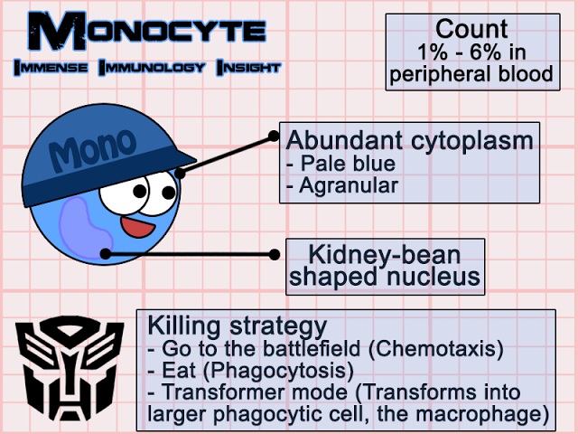
Monocytes

Slide 32
Other Leukocytes

Slide 33
Histiocytes
Histiocytes is an umbrella term comprising monocyte-derived macrophages and dendritic cells.
These cells are not normally in blood, but cells resembling macrophages (eccentric round nuclei, abundant vacuolated cytoplasm, phagocytic activity) can be seen in blood in both reactive and neoplastic conditions.
Reactive conditions include inflammation, immune-mediated hemolytic anemia, and infectious agents (e.g., protozoal infections, such as cyatauxzoonosis).
Histiocytes or macrophages can also be observed in blood in histiocytic and non-histiocytic neoplasia, such as lymphoma and hemangiosarcoma.
Large numbers of histiocytes, particularly those with abnormal nuclear features, should raise suspicion for underlying histiocytic sarcoma or dendritic leukemia (a rare variant of leukemia)
. Macrophages can also be an artifact of storage (monocytes can become activated over time in vitro and resemble macrophages).
Notes:
cyatauxzoonosis

Slide 34
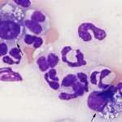
Histiocytes

Slide 35
Mast Cells
Similar to histiocytes, mast cells are not usually seen in blood of non-diseased animals.
Mast cells (mastocythemia) can be seen in the blood of dogs in both reactive (particularly severe inflammation), allergic and neoplastic conditions, including lymphoma and mast cell tumors.
Buffy coat smears to evaluate for the presence of circulating mast cells are frequently requested in dogs with documented mast cell tumors.
More mast cells are seen in the blood of dogs with allergies, inflammation and non-mast cell neoplasia than those with mast cell neoplasia.
Mast cells are rarely observed in the blood of cats without mast cell tumors, but the presence of low numbers of circulating mast cells in blood (1-2 cells/smear) are not diagnostic for a mast cell tumor in cats either.

Slide 36
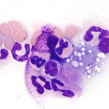
Mast Cells

Slide 37
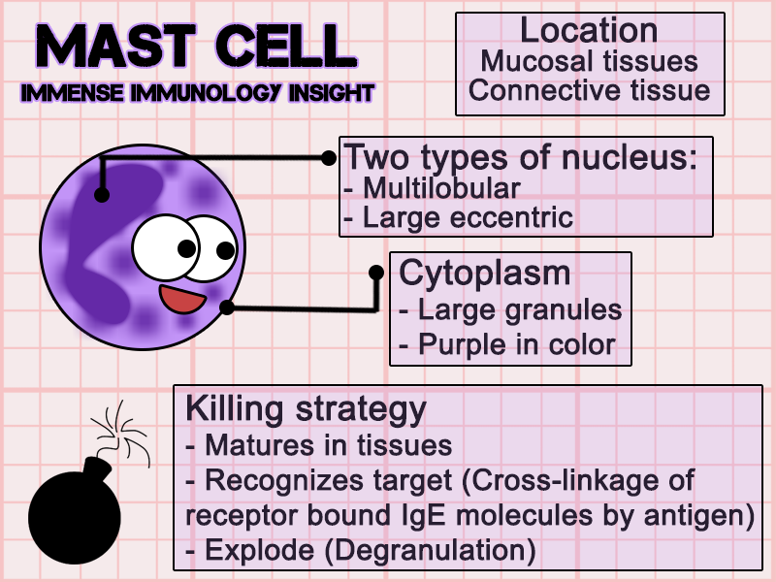
Mast Cells

Slide 38

Your face when you realize, the slide show is over!!!

