Slide 1
Lymphocytes & Immunity

Slide 2
How Does Your Body Organize the Immune System?
There are three major lines of defense.
  1. skin
  2. Spleen & Lymphatic System
    Lymph nodes
    MALT (mucosa associated lymphoid tissue)
    Tonsils
    Peyer’s Patches
    Appendix
    Thymus
  3. red bone marrow
Notes:
Skin
Lymph nodes
Red bone marrow

Slide 3


What is the job of the immune system?
It’s the security system of the body so it has two major roles
  1. recognize foreign material
  2. protect from anything not part of the body
There are two major systems involved in this security
  Innate - Which has your first line of defense by using external barriers as well as the second line of defense that uses cellular and chemical components
  Adaptive - Which is your third line of defense and targets specific pathogens.
Notes:
Recognize foreign material
Protect the body from anything that is not part of the body
Innate
Adaptive

Slide 4
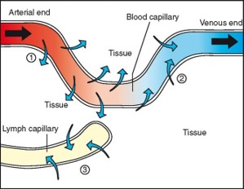
First Line of Defense – Internal Protection
Your lymphatic system is first line of defense internally.
  This system is responsible for collecting and returning excess interstitial tissue fluid to the cardiovascular system
Notes:
Lymphatic system

Slide 5

Lymphatic System
What are the functions of your lymphatic system?
  Remove excess fluid
  Waste material transport
  Filtration of lymph fluid (nodes)
  Protein transport (large proteins)
Notes:
Lymph nodes
MALT
Thymus
Peyer’s Patches
Tonsils

Slide 6
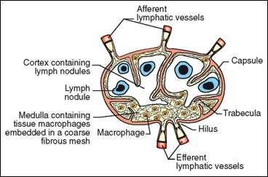
Lymphatic System
Lymph flows through at least one lymph node as it returns from peripheral limbs
  Lymph from specific areas of the body always pass through the same node(s)
  This is thought to aid in determining the location of inflammatory response, infection, or tumor

Slide 7
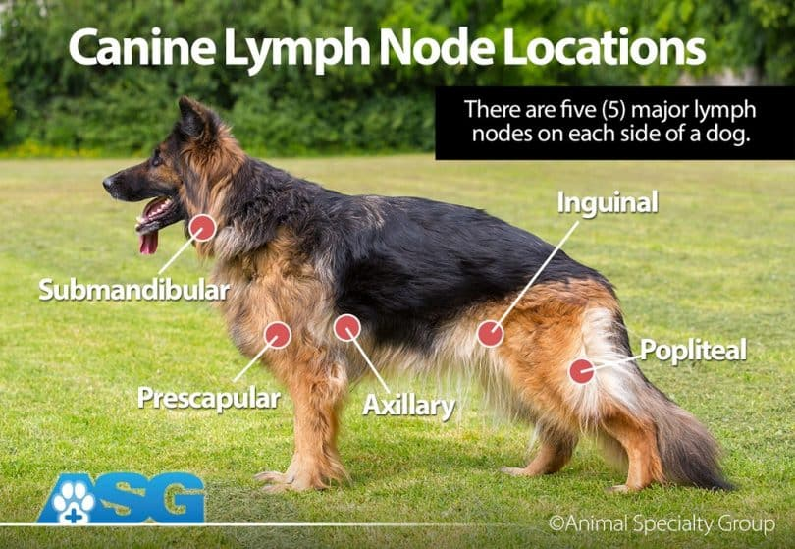

Slide 8
Lymphatic System
What happens to the lymph nodes when they are near infected areas?
Notes:
Become enlarged; increased lymphocyte action

Slide 9
MALT
What is MALT?
  Mucosa-Associated Lymphatic Tissue (MALT)
  Clusters of lymphoid tissue in various areas throughout the animals body
  They are located near mucosal surfaces
  There are three kinds:
    CALT (conjunctiva associated lymphoid tissue
    NALT (nasopharynx associated lymphoid tissue
    GALT (gut associated lymphoid tissue)
  Not encapsulated like a lymph node
  What is their function?
    Identify antigens
    Mount immune response
Notes:
CALT: Conjunctiva-associated lymphoid tissue
NALT-Nasopharynx-associated lymphoid tissue
GALT- Gut-associated lymphoid tissue
Identify antigens
Mount immune response

Slide 10
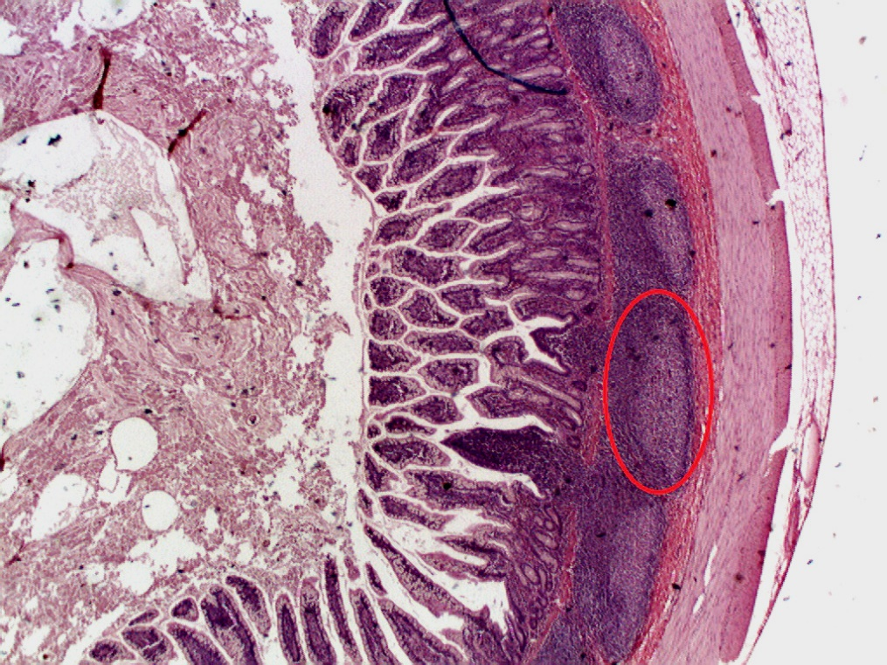
Peyer’s Patches
Peyer’s patches are aggregations of lymphoid tissue in the small intestines of only the following species
  bovine
  ovine
  porcine
  equine
  canine
The majority of Peyer’s patches are found in the lining of the ileum
A smaller percentage can be located in the jejunum
Notes:
Bovine
Ovine
Porcine
Equine
Canine

Slide 11
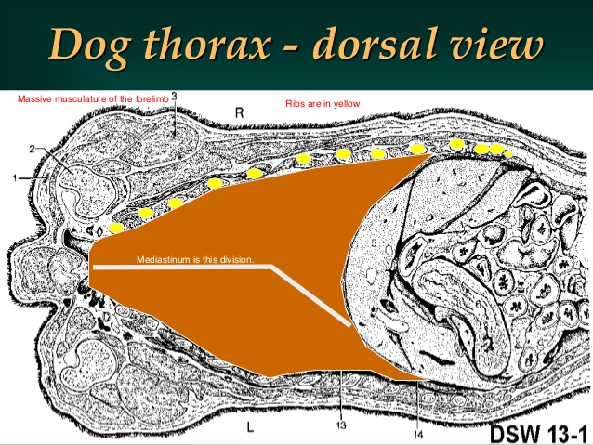
Thymus
The thymus is an organ in front of the heart in the rib cage in which T lymphocytes mature and multiply
Young animals
  The lymphoid tissue is found in the mediastinum
  Atrophies as the animal matures
Notes:
mediastinum

Slide 12
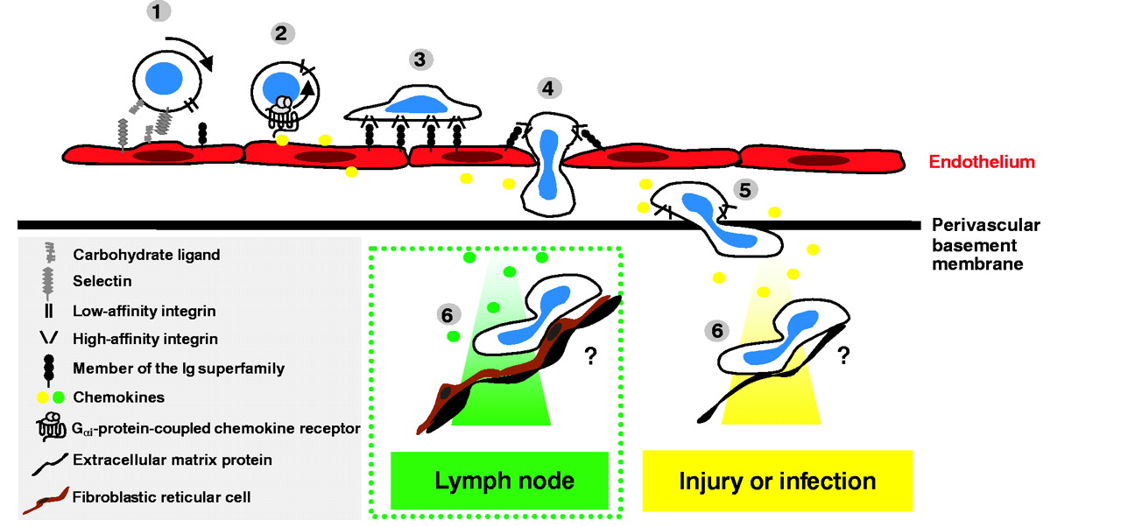
Thymus
T lymphocytes will mature in the thymus and then migrate to other lymphoid tissues and the blood

Slide 13
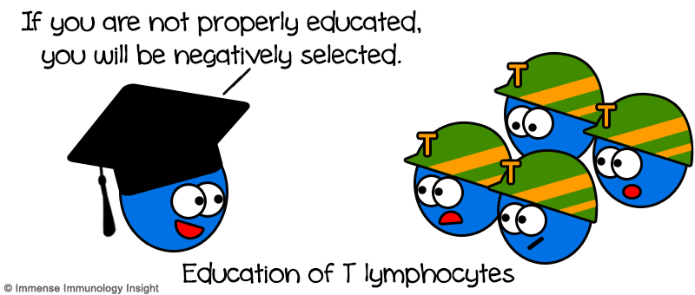
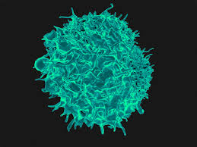
T-Lymphocytes (T-Cells)
What do they do?
  Fight specific antigens
What are they responsible for? Cell mediated immunity (no antibody production involved)
They activate which other lymphocytes? B-cells
Most of the Lymphocytes found in the peripheral blood are T-cells.
Notes:
Programmed to fight specific antigens
Cell mediated immunity (no antibody production involved
B-Cells

Slide 14
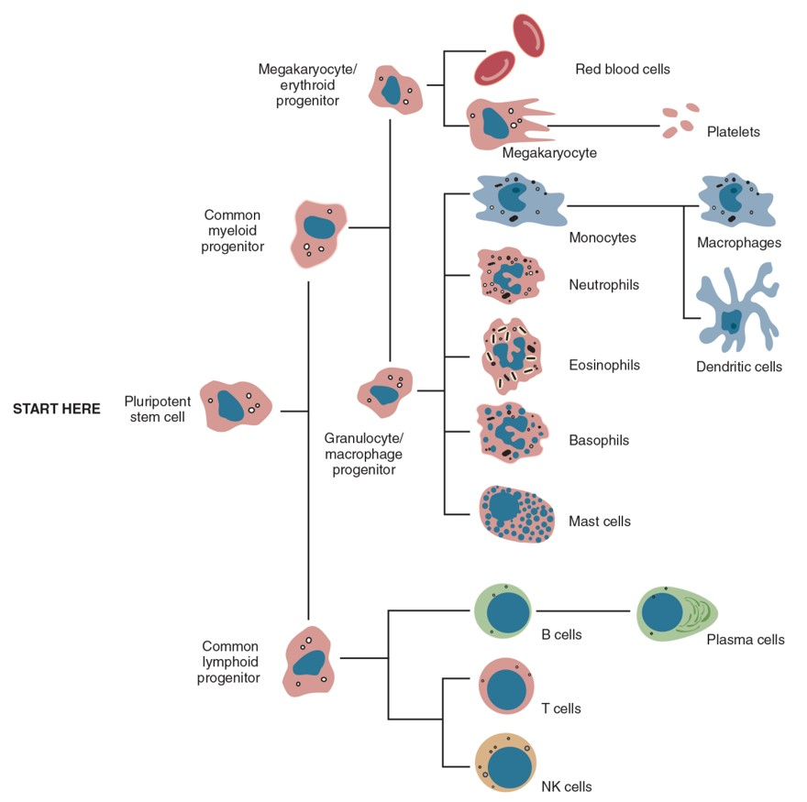
Internal Protection
Now let’s go inside…
  Your red bone marrow is responsible for the production of all white blood cells.
  So now let’s talk about the job of some of the major players in immunity.

Slide 15
Functional Organization of the Immune System

Slide 16
Quick Chart
Innate immunity
Microbe introduced >
Epithelial barriers >
Phagocytes >
Dendritic Cells >
Complement >
NK Cells
Adaptive Immunity
B-cells
Activated B-cells
Antibodies created
T-Cells
Activated T-Cells
Effector T-Cells

Slide 17
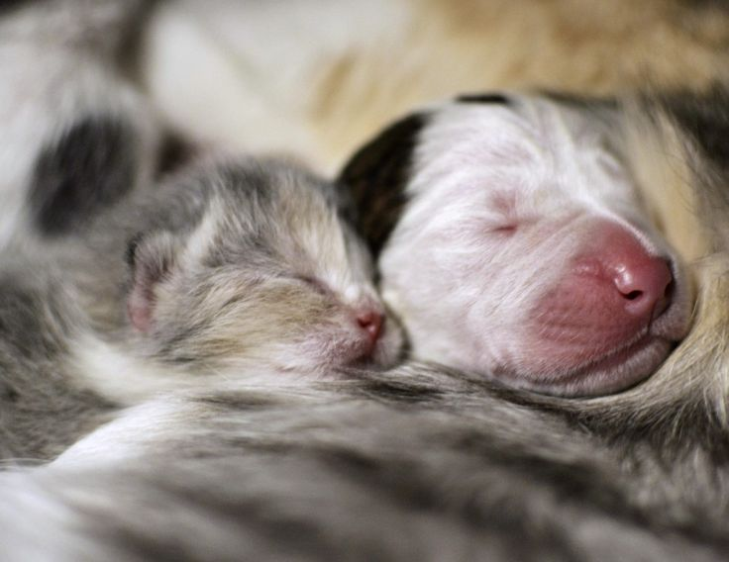
Innate Immune System – Basic Facts
This is a very rapid and nonspecific defense system
It is present at birth
What does it destroy? Non self invaders
It uses physical, chemical, and cellular components to protect the body.
Notes:
‘non-self’ invaders

Slide 18
Innate Immunity - External
This is your first line of defense
What are the anatomical barriers of your body?
  epithelial
  MM
    respiratory
    digestive
    urinary
    repro
  Tears, Saliva, and nasal discharge productions
  Acidic environment of the stomach
Notes:
Keratinized epithelial tissue of skin
Mucous membranes
Respiratory
Digestive
Urinary
Repro systems

Slide 19
Innate Defense - Internal
Second line of defense
If a pathogen can make it past the physical barriers, the body will control the spread of any infection through acute inflammation
What is going on during this phase?
  Fever (as a symptom of the body fighting infection)
  Phagocytosis (of invader to the body)

Slide 20
Chemical Players of Inflammation
Histamine: Causes vasodilation
Heparin: Increases blood flow
Prostaglandins: Hormone like substances that exert effects on the body tissues (example: GI Inflammation)
Complement system: Group of plasma proteins that trigger inflammation. They alter microbial cell membranes by opsonization (coat antigens to make them more visible to phagocytes)
Leukotrienes: Sustain inflammation
Cytokines: Signal molecules responsible for cell movement
  Chemokines: Stimulate molecules responsible for cell movement
  Interleukins (IL): Control leukocyte growth, differentiation and activation
  Interferons: Proteins produced by a cell to prevent further development or spread of a virus.
Notes:
Histamine
Heparin
Prostaglandins
Complement system
Leukotrienes
Cytokines

Slide 21
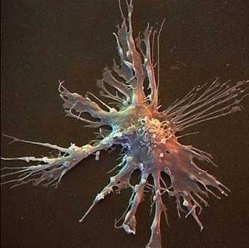
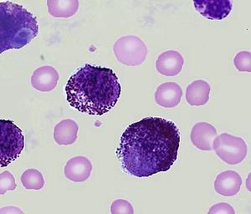
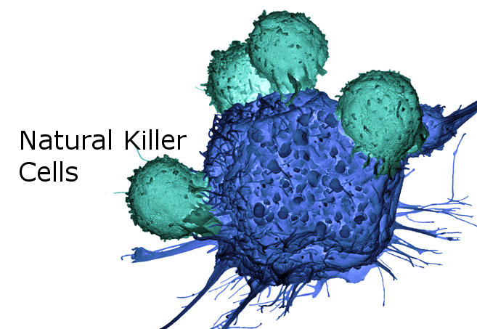
Cellular Players of Inflammation
In addition to the white blood cells previously discussed, the following are key players in both innate and adaptive immunity
  Dendritic cells: Messengers between innate and adaptive immune systems. Process antigens and present it to the T-Cells
  Mast cells: A cell found in connective tissue that contains heparin and histamine. Resembles basophils, but do NOT circulate in the blood
  Natural Killer Cells (NK): Lymphocyte that binds and induces apoptosis (programmed cell death)

Slide 22
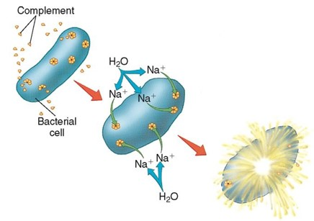
The Complement Cascade
When one complement protein is activated, it activates the next complement protein in the series
Final result is antigen cell lysis, or body cell apoptosis

Slide 23
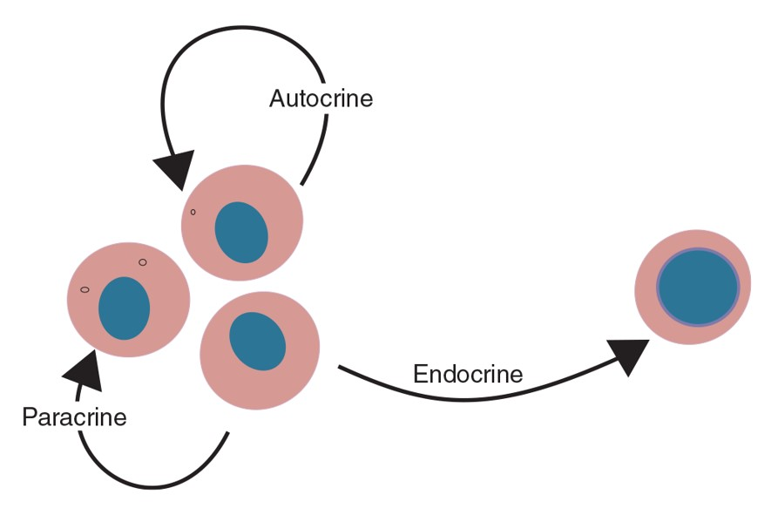
Cytokines
Cytokines are the communication portion of the innate immune system
They attract immune cells to a specific site
Three specific sites:
  Autocrine
  Paracrine
  Endocrine

Slide 24
Cytokines
Functions
  Attract immune cells to a specific site
  Act as inhibitor molecules
  Enhance the immune processes
  Play a major role in hematopoiesis
  Three types:
      Interleukins
      Interferons - produced in response to viral infections
      Chemokines – stimulate movement of leukocytes from blood to the injury/inflammatory site

Slide 25
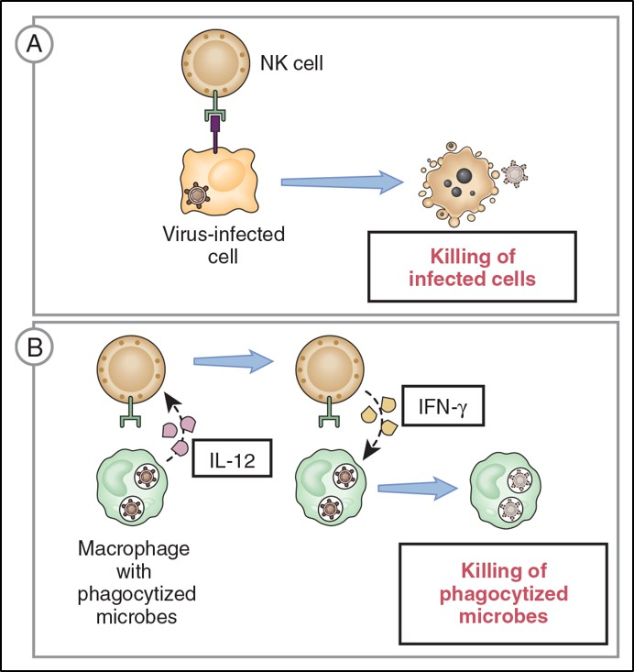
Natural Killer (NK) Cells
These can be found in the blood and lymph
They are part of BOTH the innate and adaptive immune systems
They do not ingest a target cell
They bind to induce cellular changes leading to apoptosis

Slide 26
Natural Killer (NK) Cells
They have two types of receptors on their cell membranes
  KIR- killer inhibitory receptor
    binds to MHC-1 molecules on normal autogenous nucleated cells
    NK cell is inhibited from killing healthy cells
  KAR – killer activating receptor
    virus-infected and tumor cells have altered MHC-1 molecules
    KIR receptor cannot bind
    NK cell releases perforins and proteolytic enzymes
    apoptosis caused in virus-infected/tumor cells
Notes:
killer inhibitory receptor (KIR)
killer-activating receptor (KAR)

Slide 27
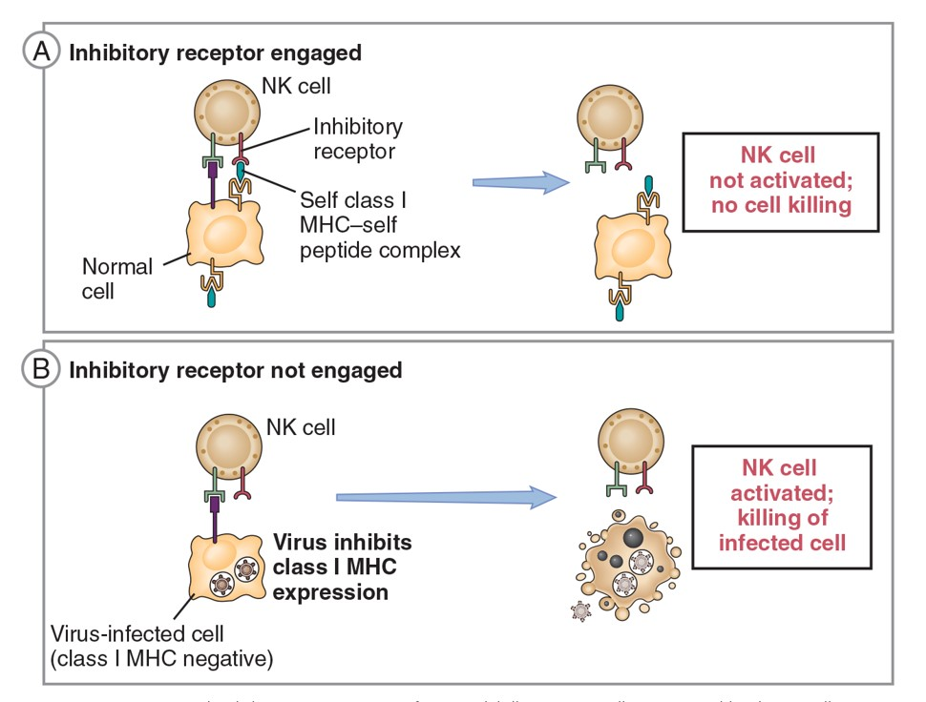
Natural Killer (NK) Cells
Healthy host cells express self MHC-1
This ensures that the NK cells do NOT attack normal host cells

Slide 28
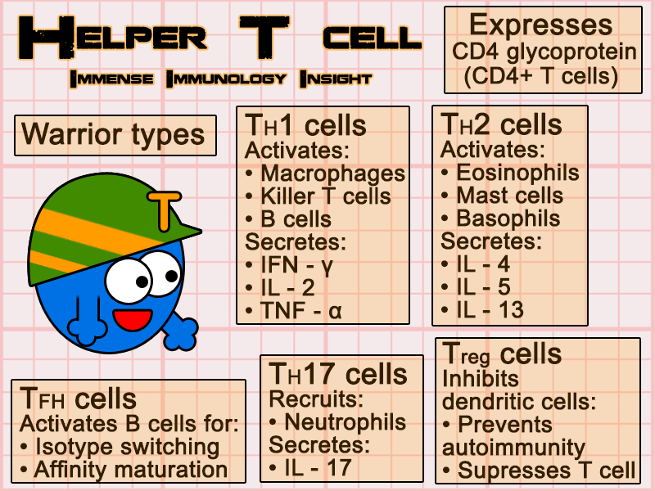
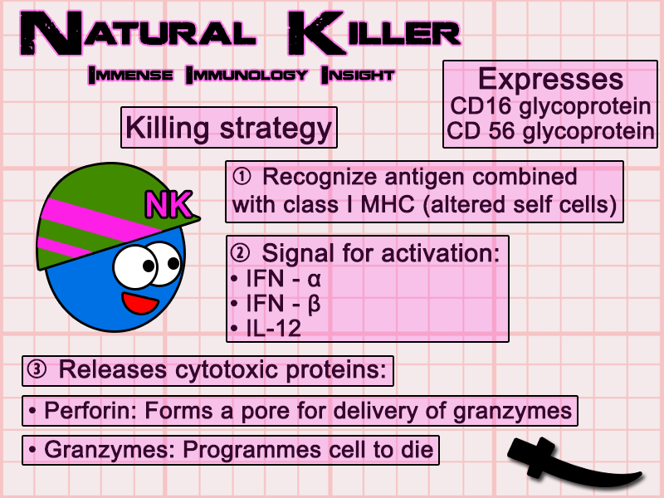
Specialized T Cell Flashcards

Slide 29
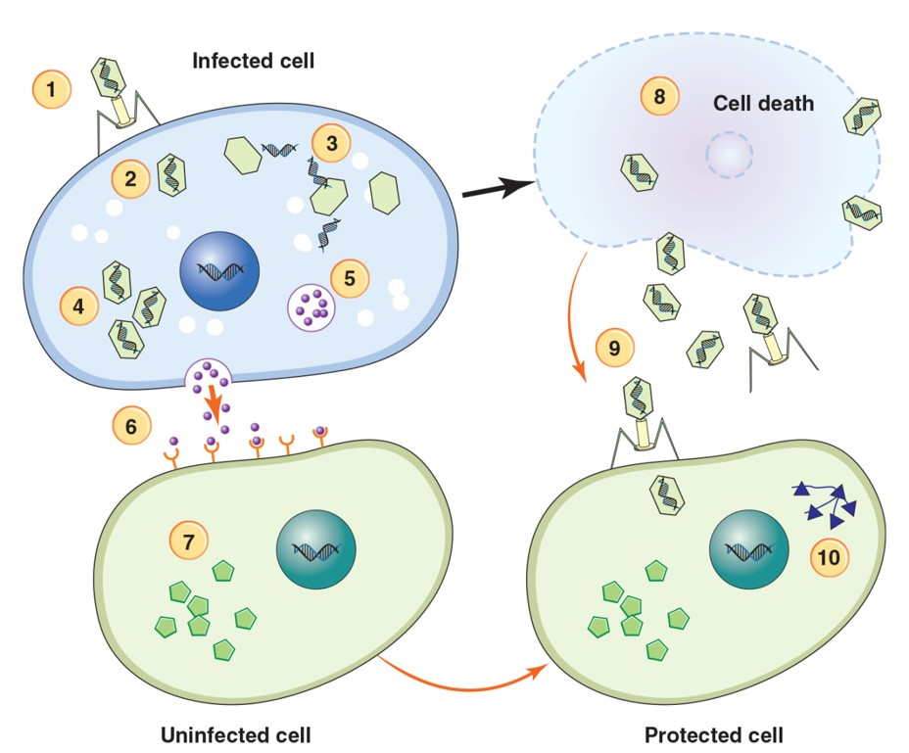
Interferons
These are proteins produced in response to presence of viruses, bacteria, cancer, and other foreign invaders

Slide 30
Interferons
Interferons are produced by animal’s immune system cells in response to presence of viruses, bacteria, cancer, and other foreign objects
They bind to membrane-bound receptors on surrounding non-infected cells
They send a relay signal to the inner portion of non-infected cells to produce inactive anti-viral particles (AVPs)
  when virus enters cell, AVPs are activated
  virus replication is inhibited in the cell

Slide 31
Adaptive Acquired Immunity

Slide 32

Adaptive Immune System
Third line of defense to target specific pathogens and antigens
Slower to respond
Not present at birth
Targets specific organisms only
Develops and adapts as the animal matures and is exposed to different antigens
What do they use as their defense tools?
  Antibodies
  Memory Cells
  B cells
  T cells
  Plasma cells
Notes:
Antibodies
Memory cells
B cells
T cells

Slide 33
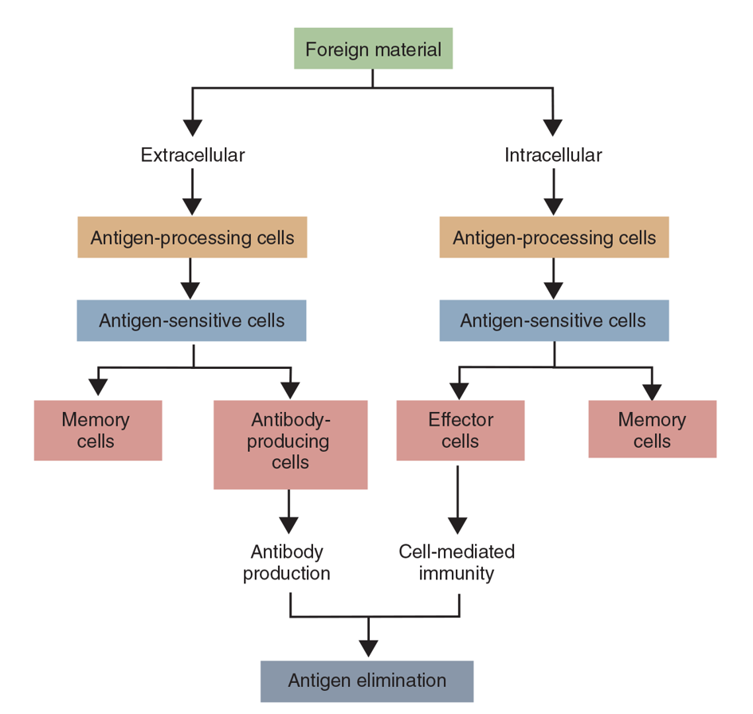
Adaptive Acquired Immunity
Your B lymphocytes and T lymphocytes are programmed to remember and to respond to only specific pathogens

Slide 34
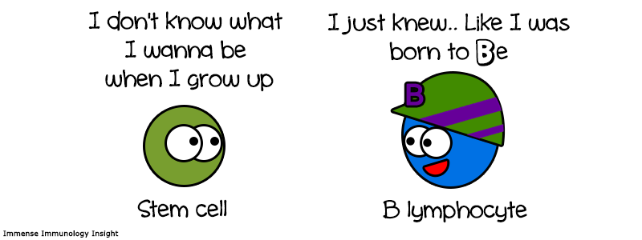
B Lymphocytes
Formed in the bone marrow
Programmed to secrete a specific antibody, Immunoglobulin, that lead to the phagocytosis and destruction of pathogens
They migrate to the lymph nodes and spleen when they are stimulated by a specific antigen
  They will differentiate into plasma cells and memory cells
  They are responsible for the actual production, storage, and release of the antibodies
Notes:
Immunoglobulin

Slide 35
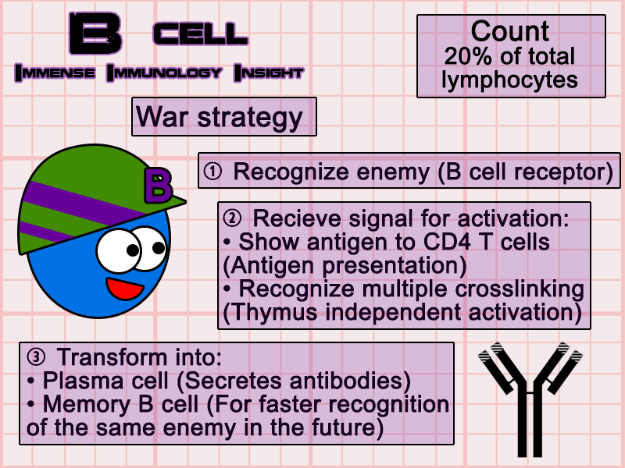
B Cell Flashcard

Slide 36
T Lymphocytes
These are precursors to the Thymocytes
  They originate in the red bone marrow and migrate to the thymus to mature and multiply
When they enter the bloodstream, they are T cells
  They can migrate to the lymph nodes and spleen
  They coordinate cell-mediated immunity and activate the B Cells
There are three kinds
  Helper T cell: Secrete cytokines
  Cytotoxic T cell: Effector/Killer T cells
  Regulatory T cell: Inhibit Helper T, cytotoxic T & plasma cells
Notes:
Thymocytes
Helper t cell
Cytotoxic t cell
Regulatory t cell

Slide 37
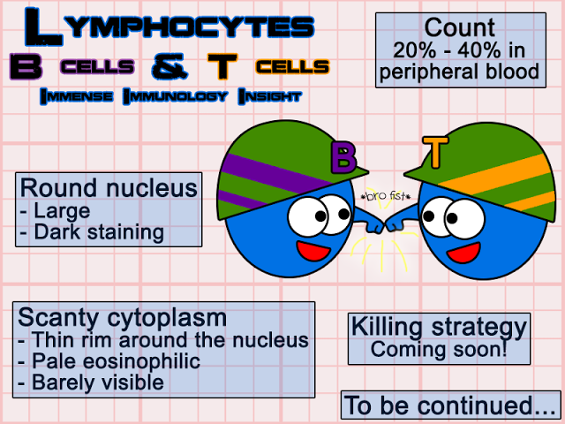

Slide 38
Memory Cells
These are clones of the T cells and B cells that have been activated in an immune response
They will stay in the lymph nodes or circulate in the blood
  They look for the antigen that triggered their activation
  When they find the antigen, the immune response is activated
    RESPONSE WILL BE STRONGER AND QUICKER THAN THE INITIAL RESPONSE

Slide 39
Adaptive Immune System
Humoral
  Triggered by extracellular pathogens
  Results in the production of immunoglobulins by the B cells/plasma cells
  Targets specific antigens for destruction
Cell Mediated
  Provides immunity against intracellular pathogens
    Does NOT depend upon antibody production
  T cells attach directly to antigen markers on surfaces of phagocytes that have already processed the pathogen

Slide 40
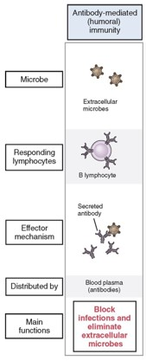
Humoral Immunity
Antibody-mediated immunity

Slide 41
Immunoglobulins
IgM
  The largest of the antibodies
  Temporary
  Only produced when the animal is first exposed to an antigen
IgG
  Smallest and most common
  Produced and released by plasma cells during bacterial or viral infections
  Indicative of chronic infection
  Can produce passive immunity to a fetus

Slide 42
Immunoglobulins
IgA
  Protects the body surfaces from foreign substances (example: mucosal surfaces of the intestines and lungs)
IgE
  Binds to allergens and triggers histamine release from mast cells and basophils
  Protects against parasitic helminth infections
IgD
  Activates basophils and mast cells

Slide 43
What Controls Cell-Mediated Immunity?
The T cells are responsible for mediating the immune response in cells
They do not depend on antibody production
Provides immunity against intracellular pathogens
T cells attach directly to antigen markers on surfaces of phagocytes that have already processed the pathogen

Slide 44
T Cells
Where did we say they mature? Thymus
They develop specific antigen receptors on their cell membranes
Each receptor is unique to one specific antigen marker
They circulate throughout the blood and lymph
They cannot recognize antigens on their own, they must first be stimulated by an Antigen presenting cell
Notes:
Thymus
APC Cell – antigen presenting cell

Slide 45
Cells formed from Sensitized T Cells
Memory Cells
  Or
Helper Cells (TH)
  Help the immune system by secreting cytokines
Cytotoxic T Cells (TC)
  Also known as effector cells, killer cells, killer T cells
  They attach to the antigenic markers on cells and destroy them
Regulatory T Cells (TS)
  Inhibit helper T Cells and cytotoxic T Cell function
  Prevent the B Cells from transforming into plasma cells

Slide 46
Active Immunity

Slide 47
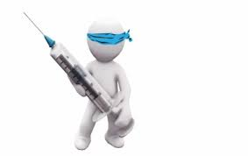
Active Immunity
Active immunity is the result of an active immune process
  Natural immunity
  Vaccines
    Modified live (attenuated)
    Killed Virus

Slide 48
Passive Immunity
This comes from receiving antibodies from an external source
  Maternal antibodies received from
    Placenta
    Colostrum
  Offers protection
    There is no activation of the immune system
  Protection will be lost once the antibodies disappear from the animal’s system
Notes:
Placenta
Colostrum

Slide 49
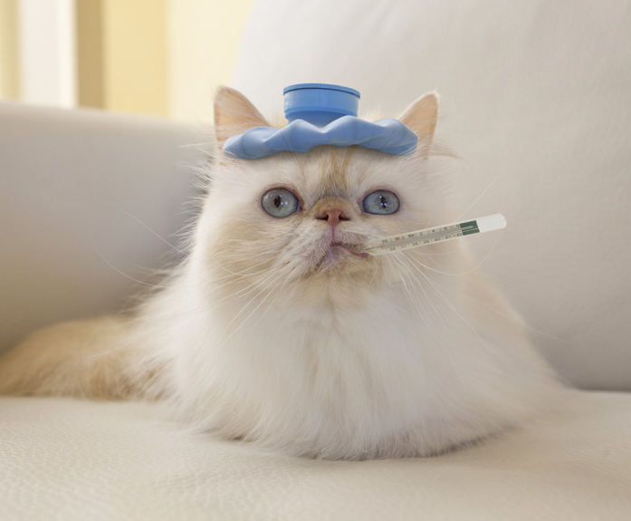
Factors in Determining Likelihood of Disease
Exposure
Mode of infection/transmission
Virulence
Immune system strength
Resistance
  Acquired resistance
    Via exposure or vaccine
  Species resistance

Slide 50
Hypersensitivity Reaction
This is an overreaction on the part of the immune system
Type I
  Animal is sensitized – the antigens bind to the IgE antibodies
  Second exposure to the same antigen is severe – fatal without immediate medical intervention
Type II
  Occurs when infection is present
  Immune system is the causes of the disease, rather than the cure
    Cross-reactive antibodies form
    Body’s own cells are destroyed

Slide 51
Hypersensitivity Reaction
Type III
  Antibody and antigens form an immune complex and become trapped in small blood vessels
  Activated complement cascade sends the chemicals to site and the tissue is damaged
Type IV
  These are cell-mediated reactions
  They create a systemic inflammatory response syndrome (SIRS)

Slide 52

Fin

