Slide 1
Urinalysis
Name

Slide 2
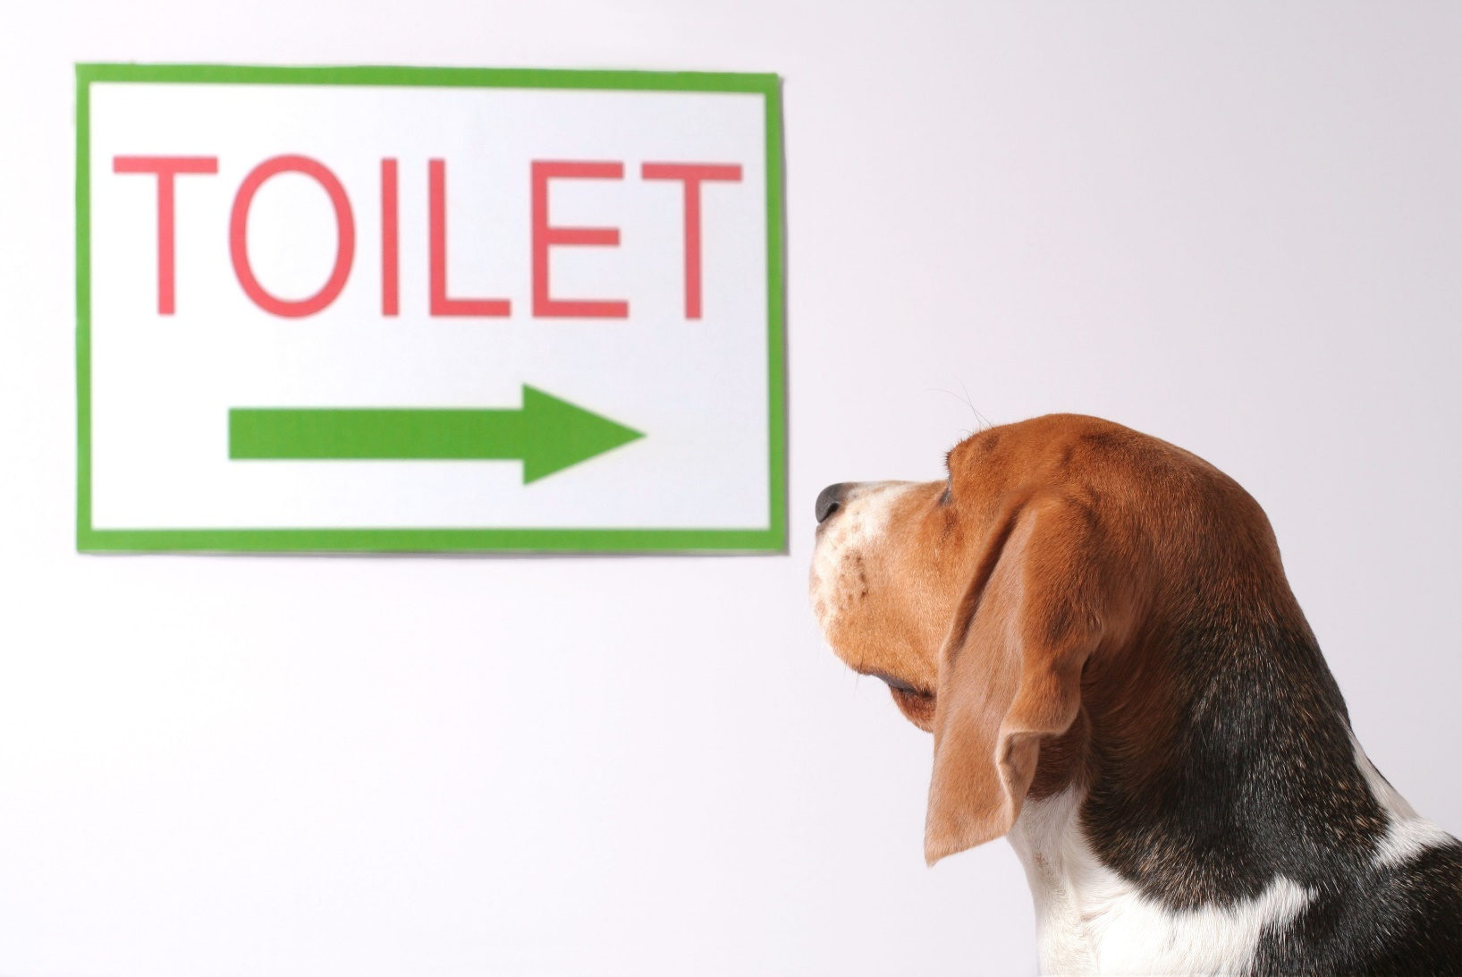
Sample Collection & Handling

Slide 3
Urine Collection
This is your first step in performing a urinalysis
  Make sure you choose the proper and most appropriate collection technique
  Always collect your sample before administering therapeutic agents
  The best samples are typically in the morning, or after several hours of water deprivation

Slide 4
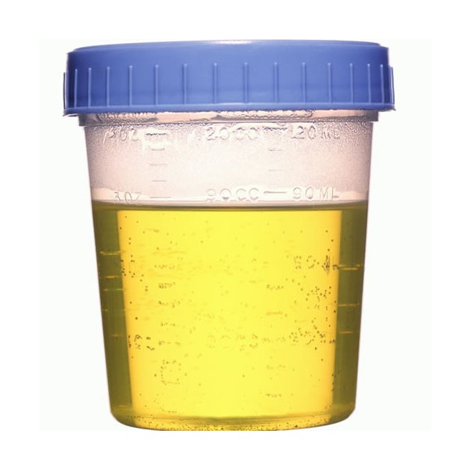
Types of Collection Techniques
Free catch/Voided
Bladder expression
Catheterization
Cystocentesis

Slide 5
Free Catch/Voided Samples
________________________________________________________
They have limited diagnostic value for several reasons
  Contamination by the distal genital tract
  Not recommended for any bacteriologic examinations
  Increased WBC counts
    (typically due to inflammation in the distal tracts)
Notes:
Easiest to collect

Slide 6
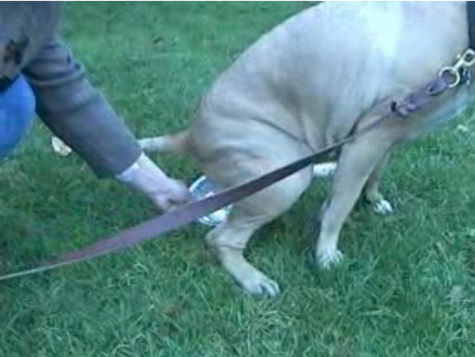
Free Catch/Voided Sample Collection Procedure
Obtain a clean sterile container for sample
If possible, clean the vulva or prepuce to decrease the contamination of the sample
Collection during midstream is best
  There is often less contamination
  May need to collect early stream to ensure collection occurs at all

Slide 7
Free Catch/Voided Urine Collection, continued…
Stimulation:
  DOGS - Ladles or cups on poles are useful tools
  CATS – Very difficult
    Non-absorbent granules in the litter box might be used
  CATTLE – Rub straw or hand ventral to the vulva in a circular fashion
  SHEEP – Occlude the nostrils
  HORSES – Warm cloth rubbed on ventral abdomen, then place in a clean stall with fresh hay

Slide 8
Bladder Expression
This is the manual compression of the bladder for collection
Not recommended for Bacterial culturing
Technique:
  Animal should be standing or in lateral recumbency
  Palpate for bladder
  Use gentle but steady pressure
  Use care as to not rupture the bladder
  May take a few minutes for the sphincter to relax
NEVER DONE ON WHICH PATIENTS? _____Obstructed urethras (blocked tom’s)

Slide 9
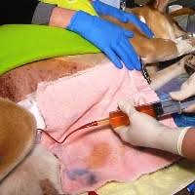
Catheterization
This technique may require sedation
The area must be cleaned and sterilized before this procedure
STERILE PROCEDURE!!!!
A polypropylene or rubber catheter is inserted into the bladder via the urethra
Take care as to not cause trauma to the urinary tract
Lubrication of the catheter is required
The distal end of the catheter will have your syringe for urine collection

Slide 10
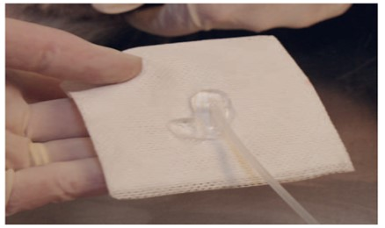
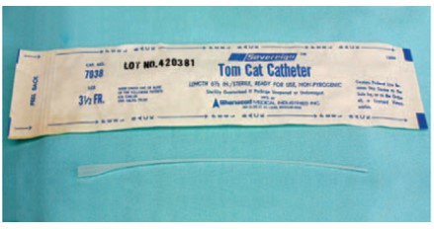
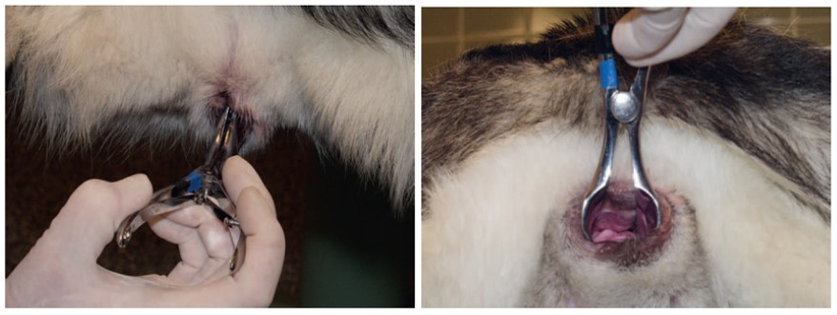
Tom Cat Catheter

Slide 11
Catheterization, continued…
Always avoid testing on the first portion collected. Why? Sample may have increased RBCs and epithelial cells
Most commonly used catheter in dogs: 4- to 10- Fr polypropylene catheter
Most commonly used catheter in male cats:3.5 Fr

Slide 12
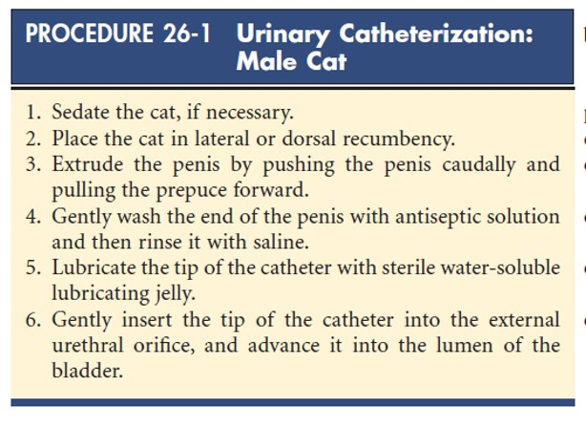
Urinary
Catheterization Protocol -
Male Cat

Slide 13
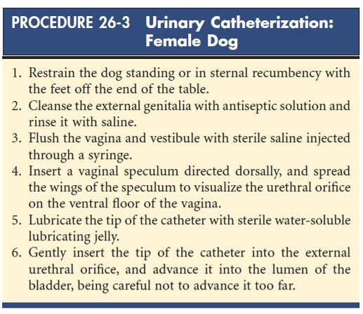
Urinary Catheterization Protocol – Female Dog

Slide 14
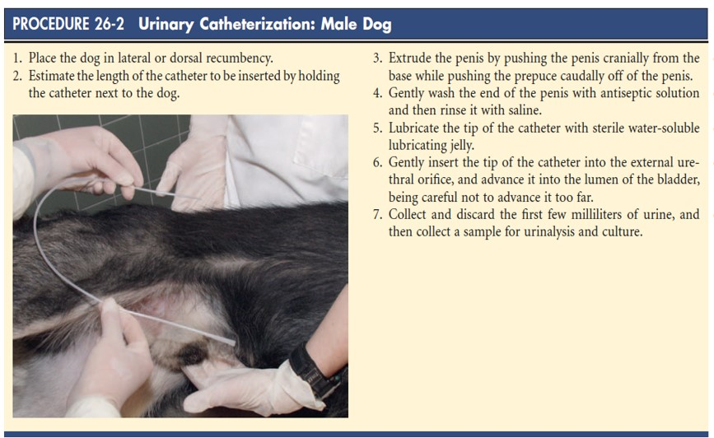
Urinary Catheterization Protocol –
Male Dog

Slide 15
Cystocentesis
These are sterile samples
  What do we use them to test? Culture and sensitivity testing
  These animals must have a sufficiently distended bladder, and you must be able to palpate the bladder before you begin the procedure
Can be done on calm or easily restrained awake patients
An ultrasound machine can be used as a guide
Patient can be standing, or in ventral or lateral recumbency
Should be noted you may have RBCs
present in your sample, due to the needle insertion

Slide 16
Cystocentesis
Equipment required
  22- or 20-gauge needle (1 – 1 ½ inch)
  10-mL syringe
  Procedure:
    NEVER redirect once through the skin. Why? Could damage internal organs
    Gently aspirate to obtain urine
    Label label label!!
Notes:
Could damage internal organs

Slide 17
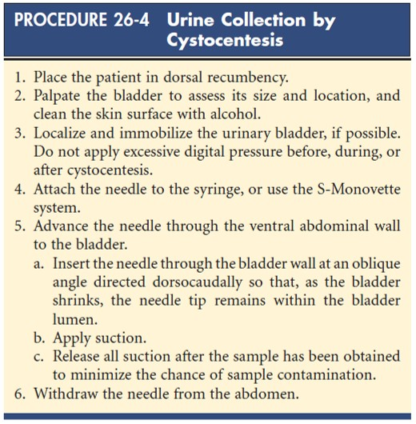
Cystocentesis Procedure

Slide 18
Specimen Storage & Handling

Slide 19
Specimen Storage and Handling
Analyze within the first 30 minutes to 1 hour
  This will avoid artifacts and degeneration
  If this is not possible, you should refrigerate the sample for up to 6 – 8 hours
  Possible problems with refrigerated samples
      Specific gravity may be affected
      Make sure you have a tight fitted lid to prevent evaporation
      Sample could develop crystals when cooled
      You must warm back to room temperature before evaluating
      Gently mix before evaluation
Notes:
6-8 hours

Slide 20
Specimen Storage and Handling
If a sample is NOT refrigerated and is NOT examined within the first 30 minutes to 1 hour
  You will have Decreased glucose and bilirubin concentrations
  Increased pH
  Breakdown of RBCs and casts
  Bacteria growth will Increase

Slide 21
What About Samples That Cannot Be Processed In-House?
In order to preserve the sample for sending off to a reference laboratory you can add either of the following:
  1 drop of 40% formalin in 1 oz of urine
    RUN GLUCOSE TEST PRIOR
    Best preservative
  Toluene to form a layer on top of the sample
  One thymal crystal
    1 part 5% to 9 parts urine

Slide 22
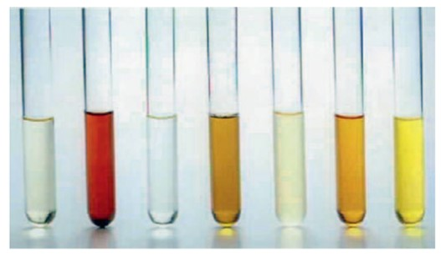
Physical Examination of Urine

Slide 23
Routine Analysis
Routine analysis of urine includes the following physical properties and include those made without a microscope or chemical reagents
Volume
Color
Odor
Transparency
Specific gravity
Notes:
Volume
Color
Odor
Transparency
Specific gravity

Slide 24
Urine Volume
Owners may confuse:
  Pollakiuria –Frequent urination
  Polyuria –Increased production
  Many factors involved
  Fluid intake, external losses, temperature and humidity, amount and type of food, activity level, size of animal and species
  Cannot evaluate on one urination
  Need 24-hour urine volume collection
    Valuable but not practical
    May need to observe in cage or outdoors to get an estimate

Slide 25
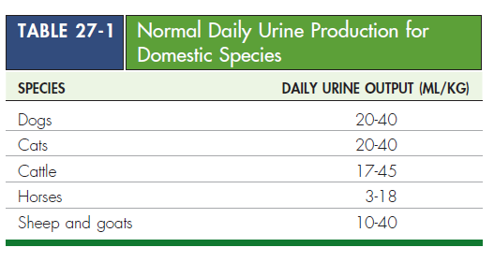
Daily Urine Production by Species

Slide 26
Polyuria
Polyuria is often accompanied by polydipsia Increased water intake
  Urine usually pale or light yellow with low SG
  Occurs with
    Nephritis
    Diabetes mellitus
    Diabetes insipidus
    Pyometra
    Liver disease
In certain medications
Diuretics
Corticosteroids
Fluids

Slide 27
Isosthenuria
When the urine SG approaches that of glomerular filtrate (1.008 and 1.012)
Not concentrated or diluted by kidneys
Chronic renal disease
The closer to the isosthenuria, the more kidney function is lost

Slide 28
Oliguria
Decrease in urine output
  High SG
  Very concentrated
May occur with
  Restricted water access
  Environmental temperature increases
  Acute nephritis
Fever
Shock
Heart disease
dehydration

Slide 29
Anuria
Absence of urine production
Occurs with
  Urethral obstruction
  Urinary bladder rupture
  Renal shutdown

Slide 30
Color
Normal
  Light yellow to amber
  Pigments = urochromes
Darker yellow = more concentrated urine
  Higher specific gravity
Lighter color = less concentrated
  Lower specific gravity
Yellow-brown or green
  Contain bile pigments
Red or brownish
  Presence of RBCs (hematuria) or hemoglobin (hemoglobinuria)
    Due to muscle cell lysis
Some drugs affect urine color
Place against a white background for proper evaluation

Slide 31
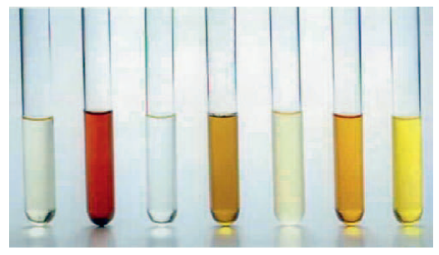
Color (cont.)

Slide 32
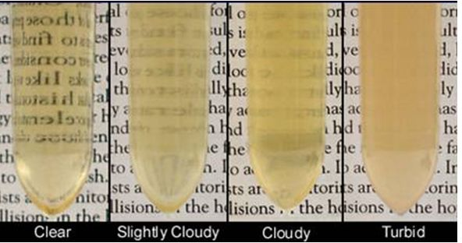
Clarity or Transparency
In most species:
  Clear or transparent
  Equine normally cloudy and rabbits normally milky
    High concentration of calcium carbonate crystals and mucus
Observe against a letter print background
Noted as clear, slightly cloudy, cloudy, or turbid (flocculent)

Slide 33
Odor
Not a highly diagnostic evaluation but helpful
Species have distinctive odors
An Ammonia odor may occur with
  Cystitis
    Bacteria that produce urease metabolize urea to ammonia
  A sample left standing too long
Sweet or fruity odor
  Ketones
    Diabetes mellitus
    Ketosis in cows
    Pregnancy in ewes

Slide 34
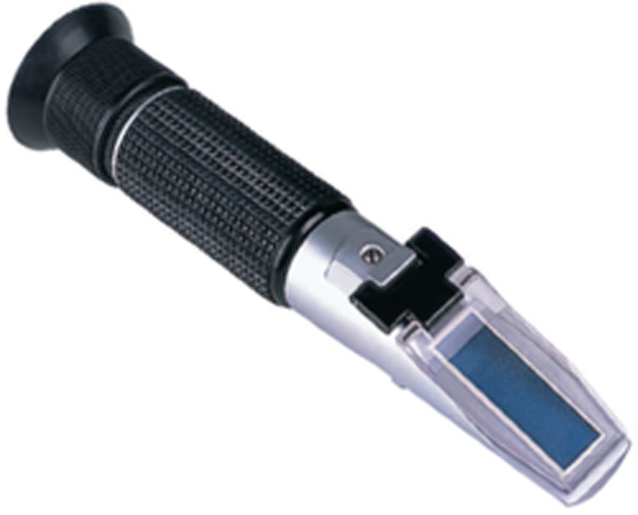
Specific Gravity
Weight (density) of a quantity of liquid compared with that of an equal amount of distilled water
The number and molecular weight of dissolved solutes determine the SG of urine
Can be measured before or after centrifuging
Particles that settle have no effect on SG

Slide 35
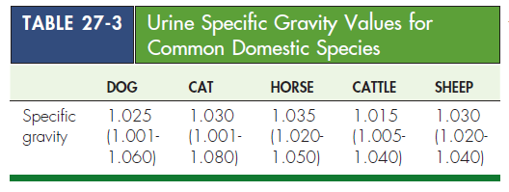
Specific Gravity, continued…

Slide 36
Specific Gravity, continued…
Equipment
  Refractometer
    Preferred
  Urinometer
    Uncommon
    Requires a large amount of urine (10 ml)
    Not reproducible
  Reagent strips
    Least reliable

Slide 37
Causes of Altered Urine SG
Increases
Decreased water intake with normal renal function
Fluid loss through sweating, panting, diarrhea
Increased excretion of urine solutes
Acute renal failure, dehydration, and shock
Decreases
Kidneys cannot absorb water
Pyometra, diabetes insipidus, psychogenic polydipsia, liver diseases, renal disease, diuretics

