Slide 2
Classification of Arrhythmias
Normal sinus impulse formation
  Normal sinus rhythm
  Sinus arrhythmia Usually seen with P Wave
Disturbances of sinus impulse formation
  Sinus bradycardia
  Sinus tachycardia
Disturbances of supraventricular impulse formation
  Atrial premature complexes Before the SA node was expected to fire
  Atrial tachycardia
  Atrial flutter
  Atrial fibrillation

Slide 3
Disturbances of ventricular impulse formation
  Ventricular premature complexes- ectopic focus in ventricles fires independently
  Ventricular tachycardia
  Ventricular systole- contraction
  Ventricular asystole- no contraction
  Ventricular fibrillation
Disturbances of impulse conduction
  Sinus arrest or block
  Atrial standstill
  Ventricular pre-excitation
  First-degree AV block
  Second degree AV block
  Third degree AV block
  Left bundle branch block
  Right bundle branch block

Slide 4
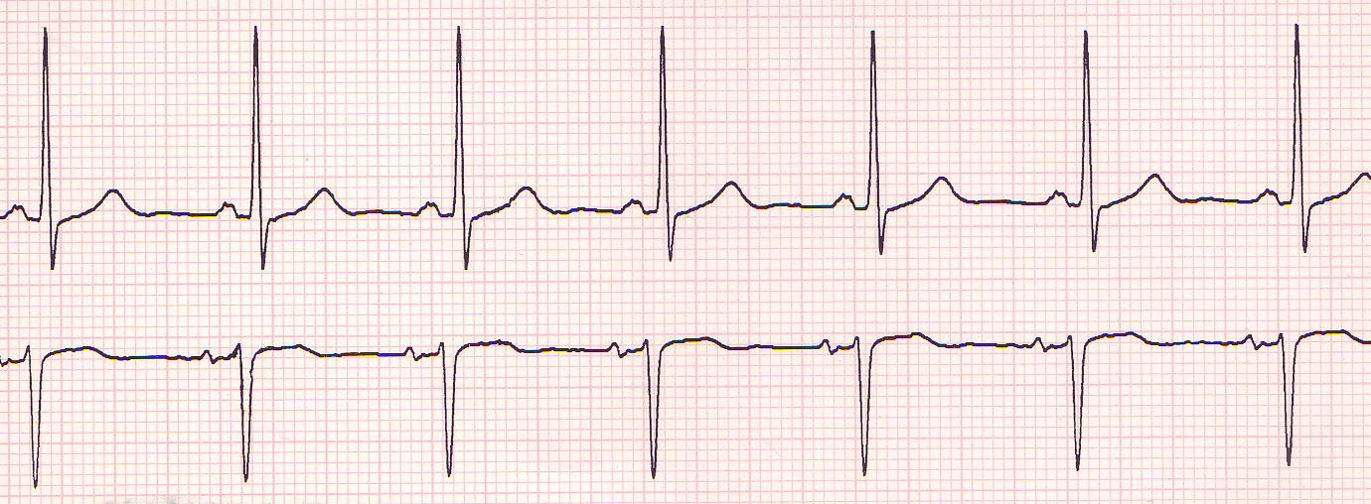
Normal Sinus Rhythm
Normal ECG tracing depicting a normal rhythm of electrical conductivity through the heart

Slide 5
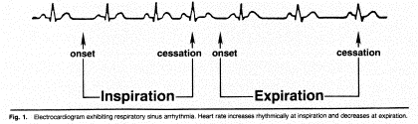
(Respiratory) Sinus Arrhythmia
All criteria of normal rhythm except heart and pulse rates increase with inspiration and decrease with expiration
Normal finding in brachycephalic breeds and in chronic respiratory disease
Increased number of cardiac cycles during inspiration; decreased number during expiration
Originates in the SA node

Slide 6

What is the normal HR for dogs and cats?
Dogs:
70 – 160 BPM
Cats:
150 – 210 BPM

Slide 7
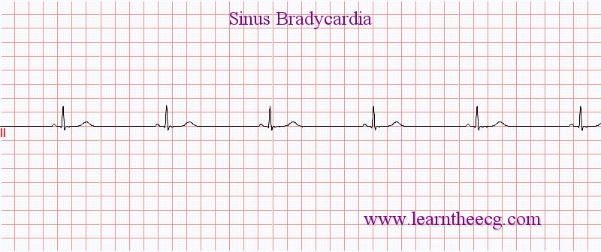
Sinus Bradycardia
Regular sinus rhythm but heart rate is below normal
Dogs under 45 lb: HR less than 70 bpm
Dogs >45 lb: HR < 60 BPM
Cats: 100 BPM or less
CS: weakness, hypotension, syncope

Slide 8
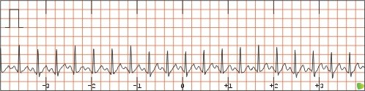
Sinus Tachycardia
Regular sinus rhythm with increased ventricular rate
Dogs less than 45 lb; HR >180 BPM
Dogs more than 45 lb; HR >160 BPM
Cats: HR greater than 240 BPM
Causes include: pain, fever, anemia, excitement, hyperthyroidism

Slide 9
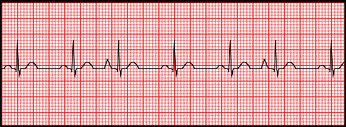
Atrial Premature Complexes
Premature atrial impulses originating from ectopic atrial site other than SA node
Seen in dogs and cats with atrial enlargement, electrolyte disturbances, drug reactions, congenital heart disease, and neoplasia; a normal variation in older animals
Premature P wave
QRS complexes are normal unless the P wave is so immature that it overlaps to varying degrees
PAC’s cause the regular wave to depolarize and reset the sinus node

Slide 10
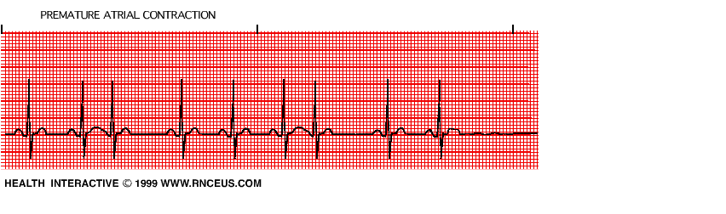
Atrial Premature contraction/complexes
Represent premature P wave/s

Slide 11
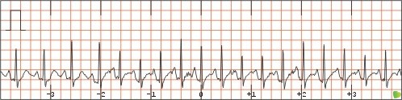
Atrial Tachycardia
Rapid regular rhythm originating from an atrial site other than the sinus node
May be seen in dogs with severe heart disease and in cats with cardiomyopathy or hyperthyroidism
P wave can overlap the T wave

Slide 12
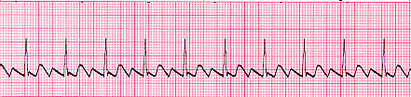
Atrial Flutter
Appears as a regular, “sawtooth” formation between the QRS complexes
Occurs when the ventricular rate differs from the atrial rate
Single ectopic focus in atrium starts to beat fast
AV node “gatekeeper” only allows some impulses through to Ventricles
Atrial flutter is the precursor to atrial fibrillation

Slide 13
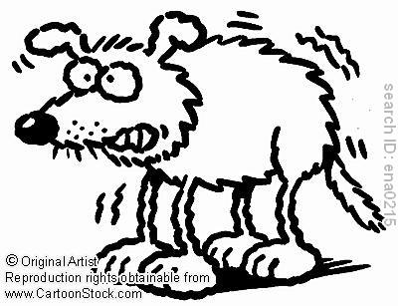
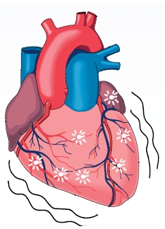
Fibrillation is the rapid, irregular, and unsynchronized contraction of muscle fibers

Slide 14
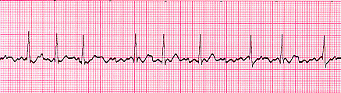
Atrial Fibrillation
Caused by numerous disorganized atrial impulses frequently bombarding the AV node
Ventricular depolarization rate is irregular and rapid
NO P waves are evident; replaced by numerous f (fibrillation) waves
QRS complexes may be normal or wide and of varying amplitude

Slide 15
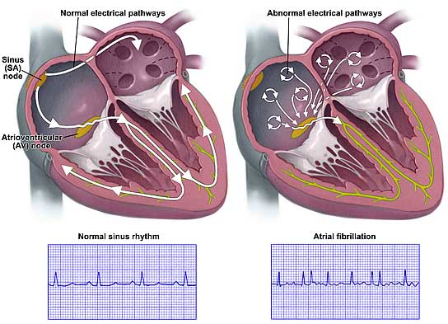
Atrial Fibrillation
Treatment: Defibrillation

Slide 16
Premature Ventricular Complexes (PVCs)
“Premature beats” - Cardiac impulses initiated within the ventricles instead of the sinus node
Ventricle discharges before the arrival of the next anticipated impulse from the SA node
Can occur at any rate but pose a greater danger with tachycardia
Associated with congenital defects, cardiomyopathy, GDV, drug reactions, cardiac neoplasia, anemia, acidosis, hyperthyroidism, hypokalemia

Slide 17
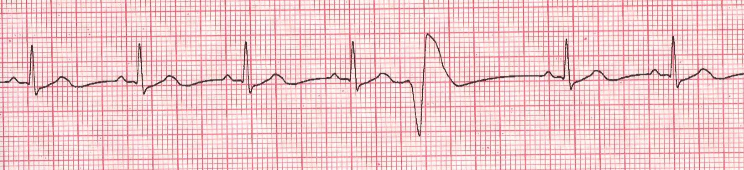
PVCs (cont’d)
The P wave is often not seen on the ECG tracing
A wide, distorted QRS complex is also evident
The beat preceding the PVC and the beat following are usually equal to the time of two normal beats

Slide 18
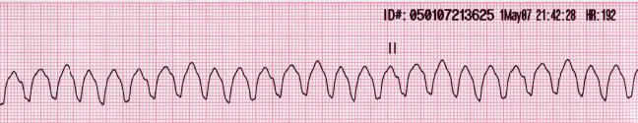
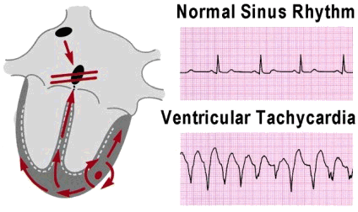
Ventricular Tachycardia “V-Tach”
One strong Ventricle ectopic focus that hijacks the conduction system of the heart. Patient may be “stable” with a pulse or unstable with “no pulse”
AV node is on its own and SA node is not working
A series of four or more PVCs in a row
Potentially life threatening
Treatment is reset heart via defibrillation

Slide 19
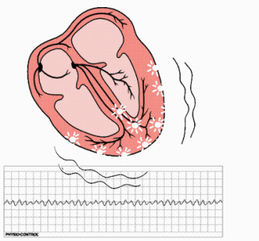
Ventricular Fibrillation
The mechanical pumping of the heart is not evident on the ECG
Many weak ectopic foci present in ventricles
The ECG has bizarre baseline with prominent undulations due to weak and uncoordinated ventricular contractions
Low to absent cardiac output
Associated with shock, trauma, electrolyte imbalances, drug reactions, electric shock, hypothermia, cardiac surgery
Rapidly fatal

Slide 20
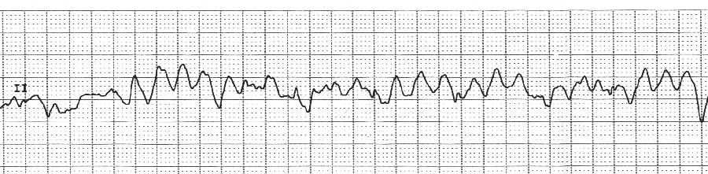
Ventricular Fibrillation
There are no recognizable P or QRS complexes
Irregular, chaotic, deformed reflections of varying width, amplitude, and shape
Unless controlled immediately, ventricular fibrillation will result in cardiac arrest

Slide 21
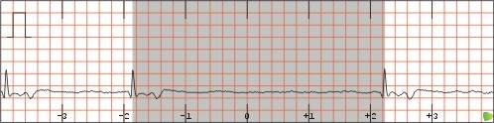
Sinus Arrest or Block
Conduction disturbance in which normal sinus rhythm is interrupted by an occasional, prolonged failure of the impulse generated by the SA node to reach the atria or SA does not initate an impulse at all

Slide 22
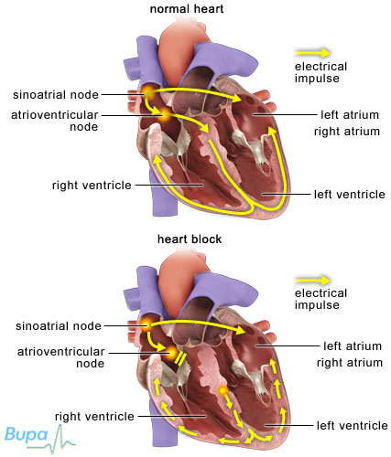
Heart Block
Electrical impulse is not transmitted through the heart

Slide 23
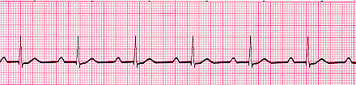
First Degree AV Block
Delay in conduction of an impulse through the AV junction and Bundle of His
The PR interval is longer than normal
This type of heart block is a result of a minor conduction defect
Seen in older patients secondary to degenerative changes in the conduction system

Slide 24
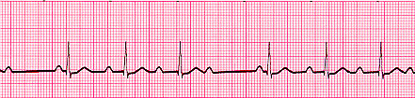
Second Degree AV Block
Some atrial pulses are not conducted through the AV node and therefore do not cause depolarization of the ventricles
There are two types:
  Type I (Mobitz type I or “Wenckebach” AV block): progressive lengthening of the PR interval until no complex is conducted
  P waves occurring without QRS complexes “dropped beats”

Slide 25
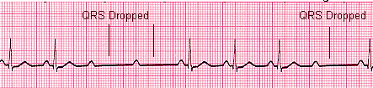
Second Degree AV Block (cont’d)
Type II: A intermittent block at the AV node, that conducts some impulses but blocks others
A constant PR interval that is usually of normal duration with random dropped beats
  In the case of type 2 block, atrial contractions are not regularly followed by ventricular contraction

Slide 26
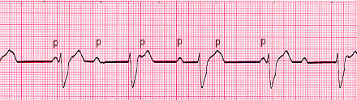
Third degree AV block
(Complete Heart Block)
The cardiac impulse is completely blocked in the region of the AV junction and/or all bundle branches
The most severe heart block
No relationship between P waves and QRS complexes; atria and ventricles each beat independently and do not communicate at all
Atrial rate is normal

Slide 27
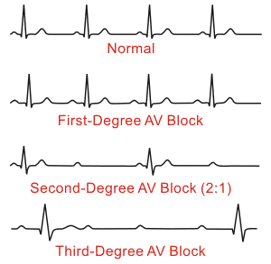
Heart Blocks

Slide 28

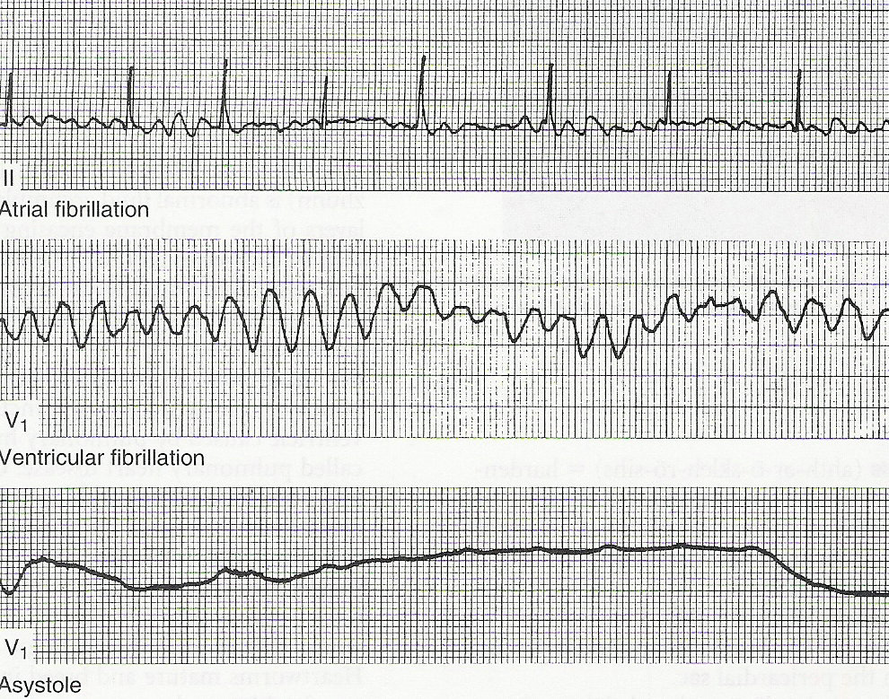
Asystole (Flat line)
Cardiac Arrest: No cardiac electrical activity,
no cardiac output
or blood flow. At this point the heart will
not respond to defibrillation
Causes: hypoxia, hypothermia,
hypoglycemia,
or an electrode has fallen off (hopefully)

Slide 29
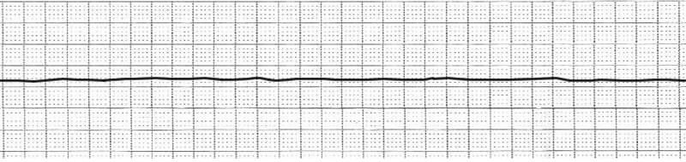
Asystole (Flat line)
Medications of choice: Epinephrine or Atropine
along with manual chest compressions.

Slide 30
Tetralogy of Fallot
It occurs in about 5 out of every 10,000 babies
Ventricular septal defect (hole between the right and left ventricles of the heart)
Narrowing of the pulmonary outflow tract (tube that connects the heart with the lungs)
  Often times pulmonary valve needs replacenment
An aorta (large artery that carries oxygenated blood to the body) that grows from both ventricles, rather than exclusively from the left ventricle
A thickened muscular wall of the right ventricle (right ventricular hypertrophy)
Together, these defects cause oxygen deficient blood to flow out of the heart and into the rest of the body

Slide 31
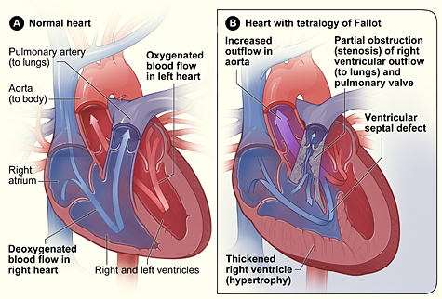

Slide 32
Artifacts
The word artifact is similar to artificial in the sense that it is often used to indicate something that is not natural (i.e. man-made). In electrocardiography, an ECG artifact is used to indicate something that is not "heart-made." These include (but are not limited to) electrical interference by outside sources, electrical noise from elsewhere in the body, poor contact, and machine malfunction. Artifacts are extremely common, and knowledge of them is necessary to prevent misinterpretation of a heart's rhythm

Slide 33
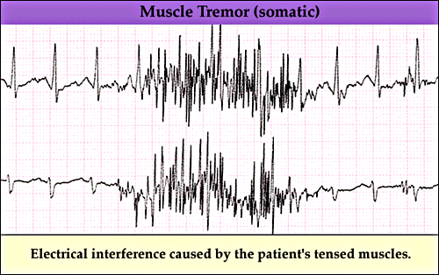
Muscle Tremor Interference
If your patient is not calm and comfortable, or just really nervous and shaky…the reading may look like this. Also caused by happy, purring feline friends
Reapplying or readjusting the clips may help
A towel or blanket can be placed on patient to help calm them
You can also place your hand on the chest of the patient, taking care not to apply too much pressure (will interfere with reading)

Slide 34
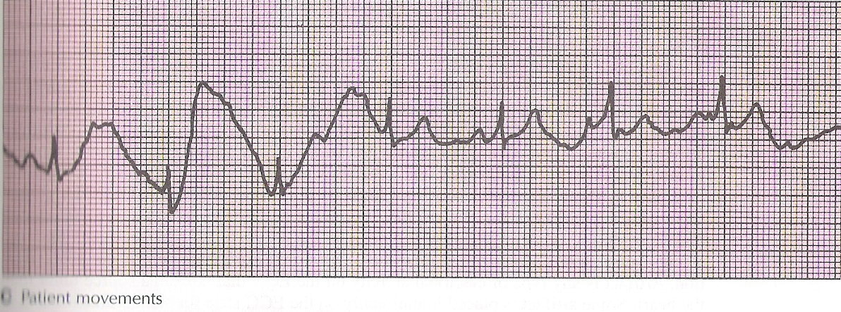
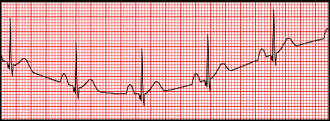
Patient Movements

Slide 35
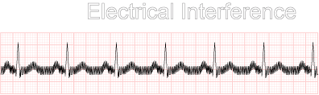
Electrical Interference
Remember that rubber mat and how you checked your machine for causes of bad ground?
Interference can be caused by other machinery such as a pulse oximeter or BP monitor that is hooked up to animal; even fluorescent lighting

Slide 36
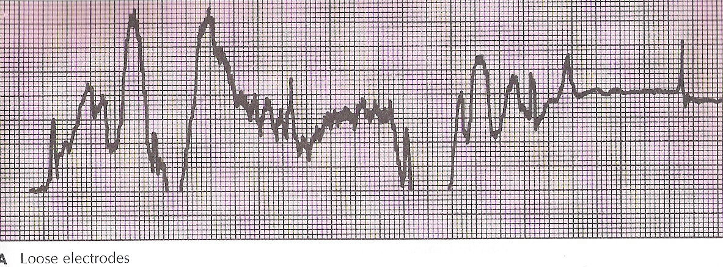
Loose Electrodes

