Slide 1
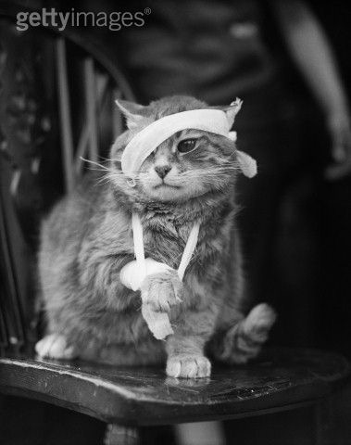
Bandaging

Slide 2
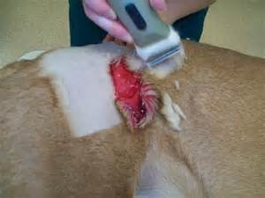
Bandaging Purpose
Soft Tissue Wounds
Protect
Debride
Extract exudate
Retain moistness
Deliver medications

Slide 3
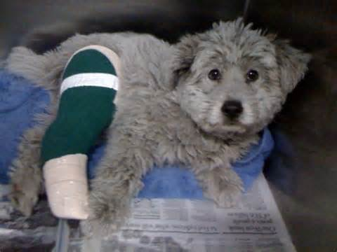
Bandaging Purpose
Orthopedic Wounds
Stabilize joints and bone fractures
Hold splint in place
Restrict movement
Prevents weight bearing

Slide 4
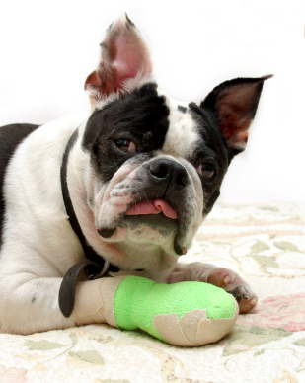
Bandaging Purpose
Compression
  Hemostasis
  Prevent excessive post-op edema
  Decreases hematoma formation
    Decreases dead space

Slide 5
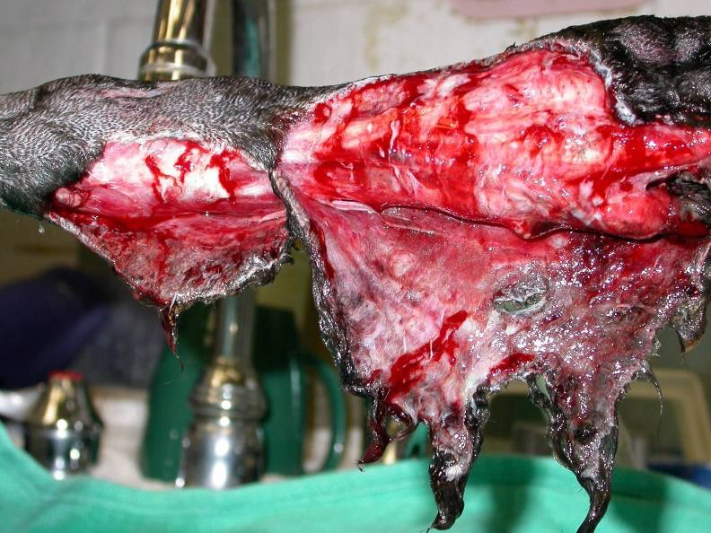

Slide 6
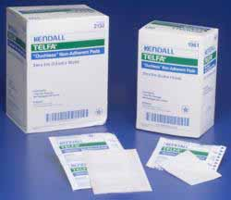
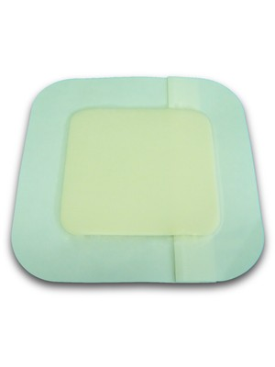
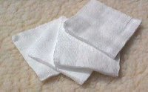
Bandage Layers
  Primary (contact layer)
The first layer; it’s in direct contact with the wound
Telfa Pads Gel/film Gauze Sponges

Slide 7
Primary Layer Functions
Debridement
Deliver medication
Transmit exudate to 2nd layer
Protect wound

Slide 8
Primary Layer: Adherent
Adherent primary layer promotes debridement in the inflammatory stage
Uses sterile gauze, allowing tissue to become incorporated into the bandage.
  This tissue is then removed when the bandage is removed!
Dry to Dry: not highly recommended due to unselective debridement and damage during the proliferative (repair) stage of wound healing
Painful to remove
Must be changed daily

Slide 9
Primary: Non-adherent
Moist wound care is the most important management principle
A non-adherent bandage is usually a fine mesh, nonstick material. This layer promotes moisture retention and epithelialization with minimal disruption of granulation tissue.
  Enhances natural SELECTIVE debridement within the wound by drawing the exudate from the wound
Either occlusive or semiocclusive

Slide 10
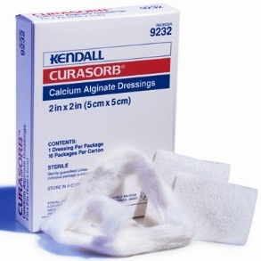
Primary: Non-adherent
  Semiocclusive
  Allows air and moisture to move through the dressing
    Ex. Gauze with calcium alginate product
  Keeps wound moist yet draws exudate and debris form the wound
  Indicated for moderate to copious exudate
  Must be changed frequently
    (q 1 – 3 days, depending on
    exudate production)

Slide 11
Primary Non-adherent
  Occlusive
  Impermeable to moisture
    Allows some air transfer
  Indicated for minimal to no exudate
  Promotes epithelialization
  Changed infrequently (every 4-7 days)
  Can be used as a protective layer for new epithelium preventing desiccation and abrasion of the fragile tissue.
  What phase of healing will you see this in most?

Slide 12
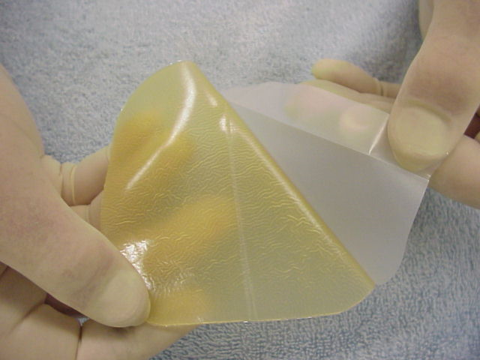
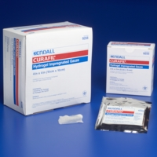
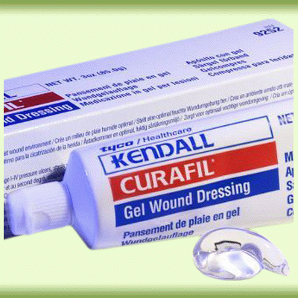
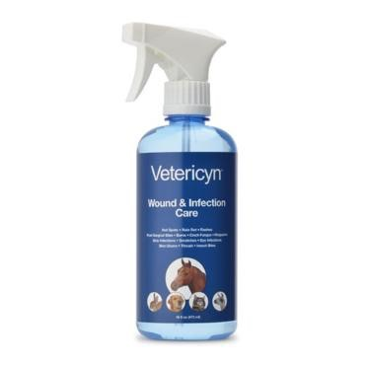
Primary Non-adherent Occlusive
Hydrogel
Hydrocolloid
Polyurethane film

Slide 13
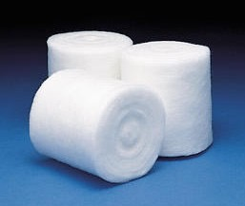
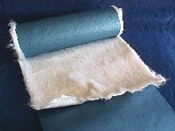
Bandage Layers
Secondary
Covers the primary layer and supports the wound
Purpose is to be able to absorb and store fluids expelled from the wound
Materials: cast padding or cotton roll.
This layer should not be applied with excessive pressure, but snug enough to keep the primary layer in.

Slide 14
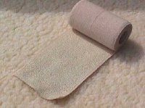
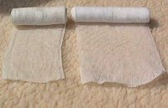
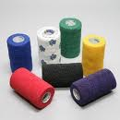
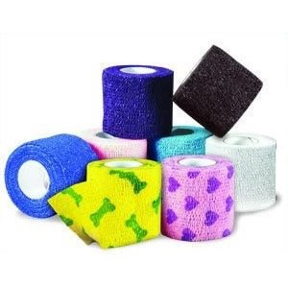
Bandage Layers
  Tertiary layer
This is the final, protective layer that holds the bandage in place
Usually consists of two layers
2 inch, 3 inch, 4 inch
Vet Wrap
Elastakon
Cling gauze

Slide 15
Tertiary Layer
Should always be non-occlusive to allow air transfer
Strike-through = outer layer becomes wet, allowing moisture (and bacteria) to wick through the rest of the bandage
  MUST CHANGE IMMEDIATELY!
Occlusive tertiary layer is always contraindicated (traps excessive moisture leading to tissue maceration)

Slide 16
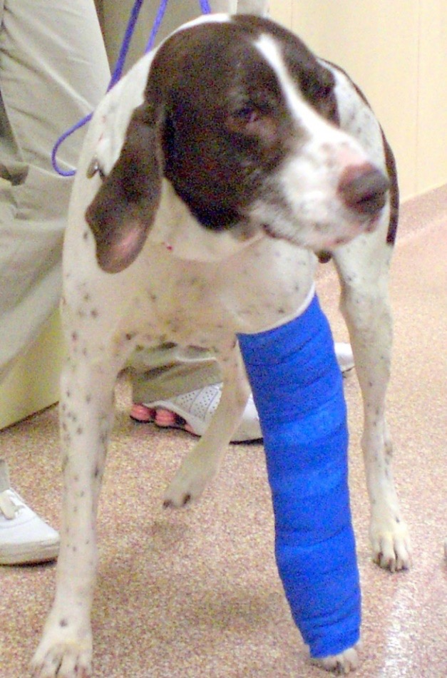
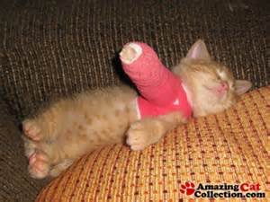
Technician Note
Extremity Bandages:
The middle two toes of a bandaged limb should always be exposed to allow for assessment of color, warmth, and swelling

Slide 17
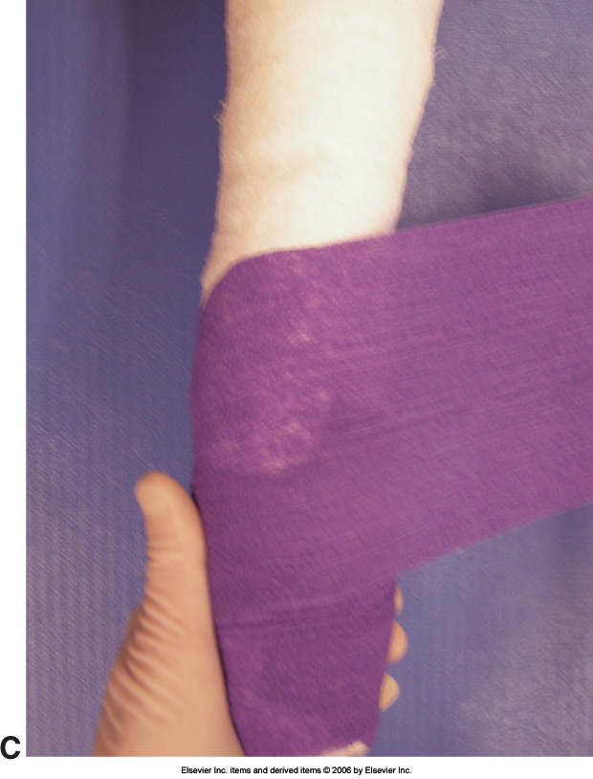
Technician Tips
Wrap distal to proximal
While making your way up, overlap 50% of the previous layer each time
Unroll a portion of material
from the roll first, then wrap
around area
  Helps to not place it too tightly
    (especially Vet wrap)

Slide 18
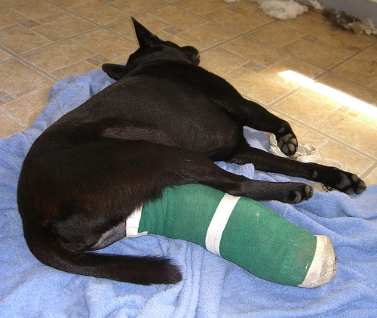
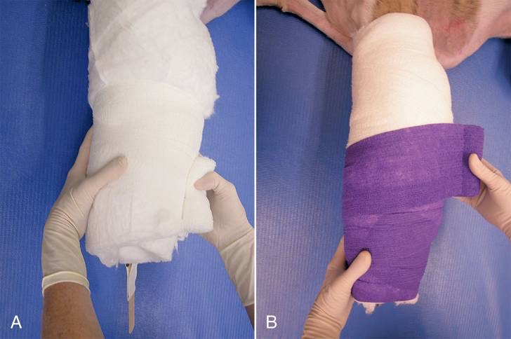
Bandage Types
  Robert Jones Bandage (old school)
Used for temporary immobilization of fractures distal to the elbow or stifle before surgery
Must extend one joint above and below the structure you wish to immobilize
Large, bulky bandage that provides rigid stabilization

Slide 19
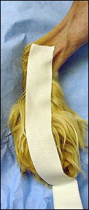
Adhesive tape stirrups are initially placed on the patient's foot
Will function to hold end of roll gauze in place

Slide 20
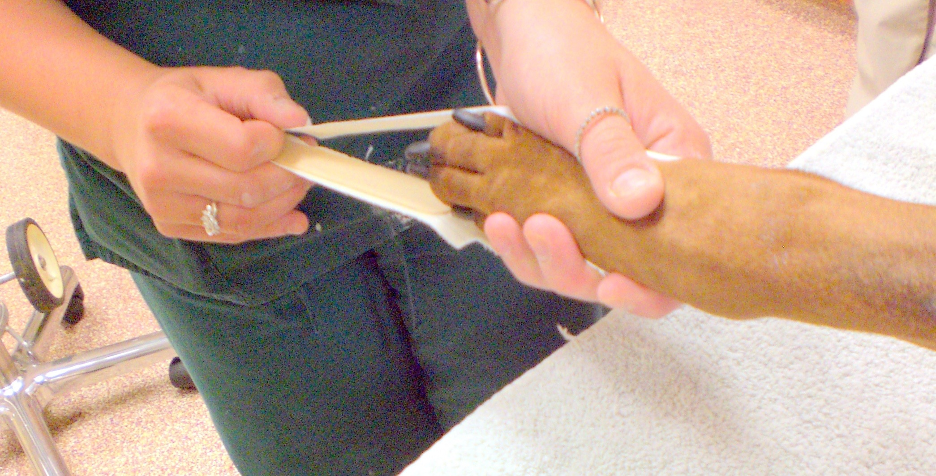
A tongue depressor is placed between them to prevent adherence of the stirrups to each other during secondary layer application.

Slide 21
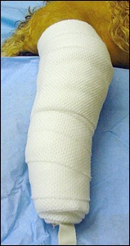
Roll cotton is wrapped along the length of the limb.
Cotton cast padding can be used to create a thicker bandage if necessary

Slide 22
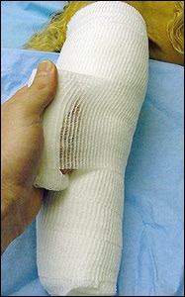
Elastic roll gauze is wrapped over the cotton and pulled fairly tight to compress it
Not Shown:
The stirrups are reflected on top of the gauze

Slide 23
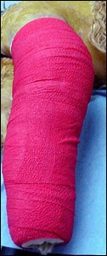
Protective layer, nonocclusive is then firmly applied. Elastic Vetrap® forms the outer layer of the bandage
Can use Elastikon to protect edges (beige tape, very sticky)

Slide 24
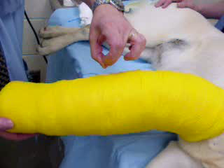
The completed bandage should feel solid, and a “ping” should be heard when flicked
C

Slide 25
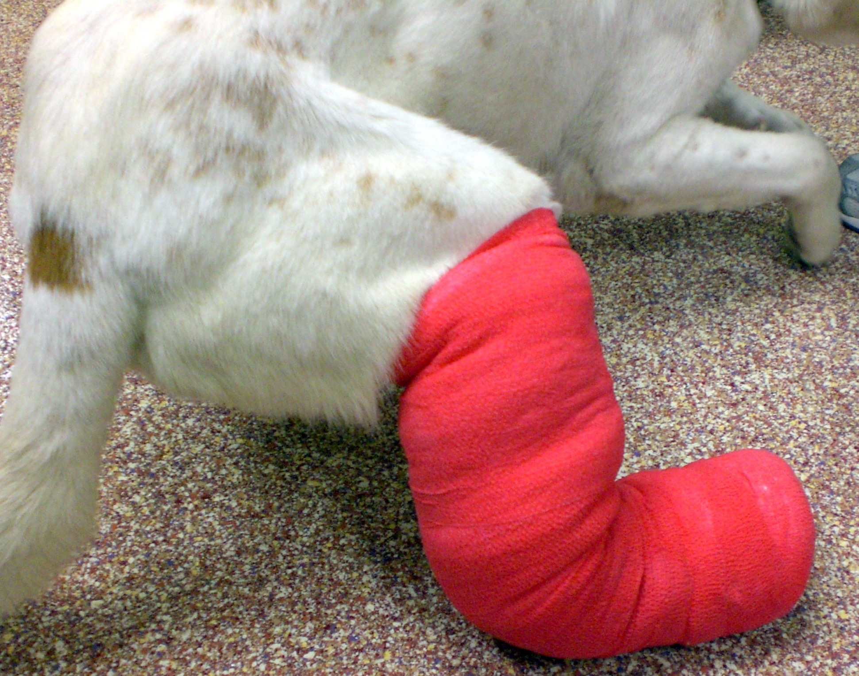

Slide 26
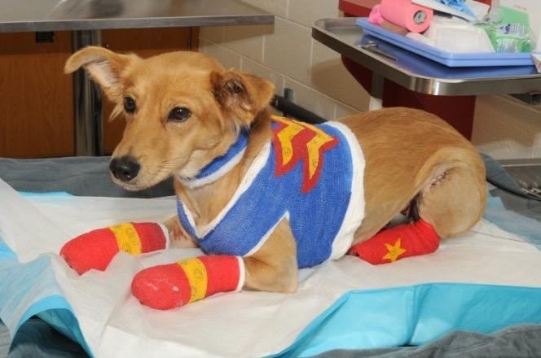
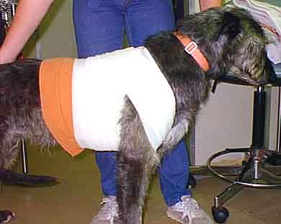
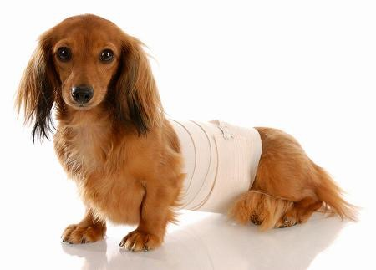
Bandage Types
  Chest or abdominal bandage
Applied firmly but without constriction of the chest or abdomen; use figure 8 pattern
Applied in the standard three layers as described previously
Ex. Temporarily post surgery, cover drains

Slide 27
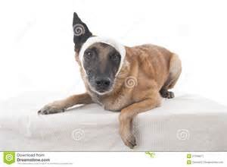
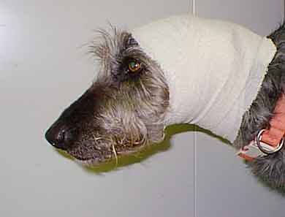
Bandage Types
Head/ear bandage
Auricular hematomas, mass removal
Pinna is laid over the top of head
Can draw where the ear is on the outside to aid in removal

Slide 28
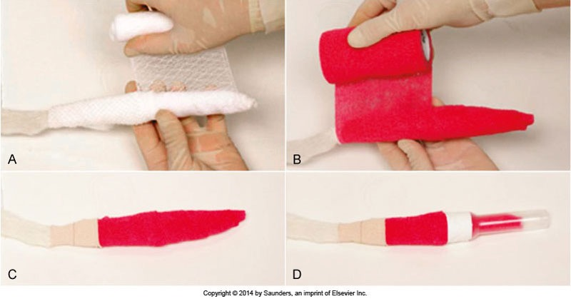
Bandage Types
Tail bandage
Degloving, breaks, amputation
Elastikon to hold to body

Slide 29
Splints
Distal limbs
Can be made with tongue depressors, pre-made aluminum or fiberglass splints
Orthopedic/joint purposes
Placed between secondary and tertiary bandage layers
Used for temporary immobilization pre or post surgery or definitive stabilization
Forelimb splint- usually on caudal aspect
Hind limb- caudal or lateral aspect

Slide 30
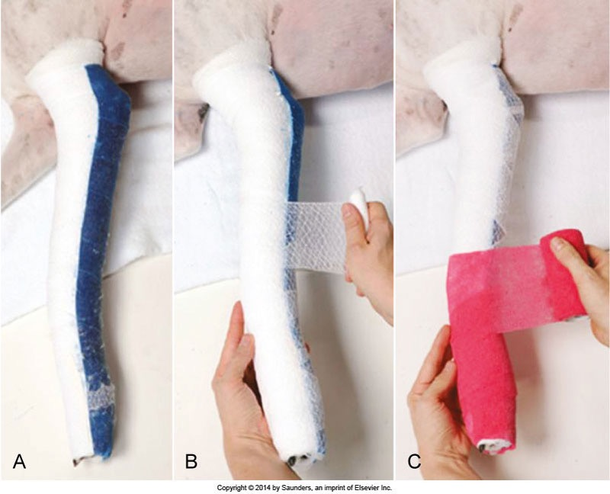

Slide 31
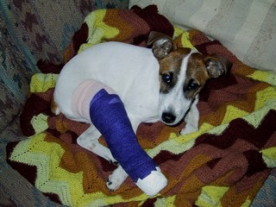
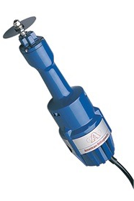
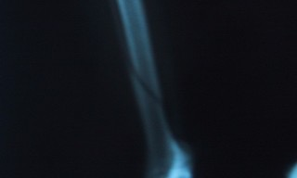
Cast Application
Stabilization of fractures at or distal to the elbow or stifle
Immobilization of limbs to protect ligament or tendon ruptures
Must extend one joint above and below the structure you wish to immobilize
Between secondary and tertiary layers
Requires: gloves, fiberglass casting tape, water, time to harden, cast cutters to remove

Slide 32
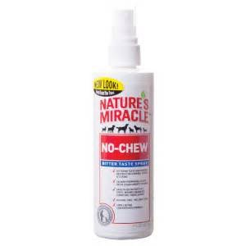
Aftercare of Bandages, Casts, Splints
Close monitoring of patient!
  Minimum twice daily in hospital
Wetness, odor, dirt/debris →change immediately
Slippage, rubbing, chafing → fix immediately
Chewing → E collar, spray/deterent
Toes need to monitored for:
  Warmth
  Color
  Swelling
Casts must not get wet!
Client education is essential

Slide 33
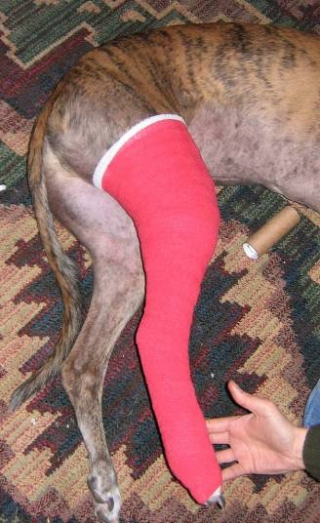
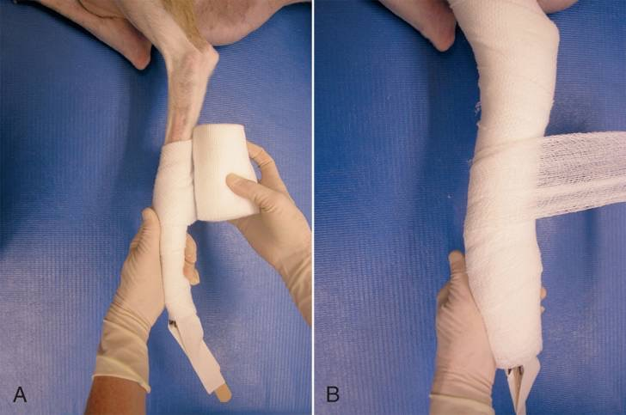
Bandage Types
  Modified Robert Jones bandage
Less bulky; much more common
Protects wounds
Reduce post operative swelling of limbs
Provides little or no splinting or immobilization
Fore or hind limbs

Slide 34
Modified Robert Jones
Tips
  Always work distal to proximal
  Maintain constant pressure
    We want it tight, but not impeding circulation
  50 % overlap
  Place the limb in functional position
  Avoid wrinkles
  Visualization of middle toes

Slide 35
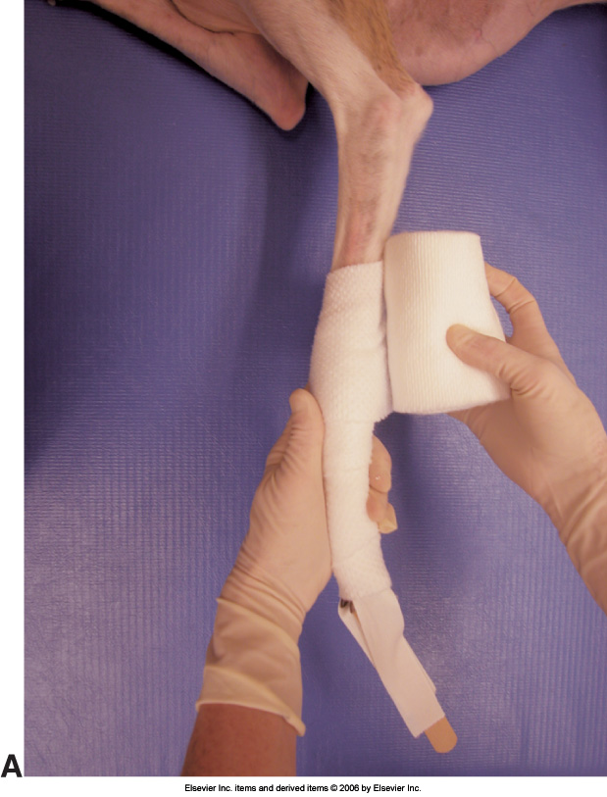
Modified Robert Jones or simple padded bandage
Once your primary layer is applied, tape stirrups and then a padded secondary layer are applied to the limb
*Much less padding than Robert Jones

Slide 36
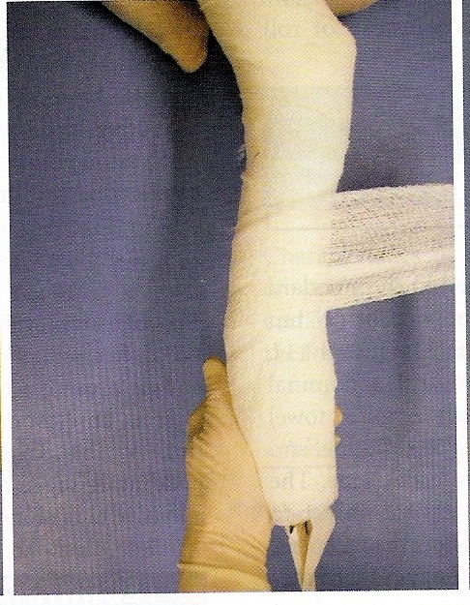
The stirrups are reflected to adhere to the gauze
This is followed by application of a roll gauze tertiary layer

Slide 37
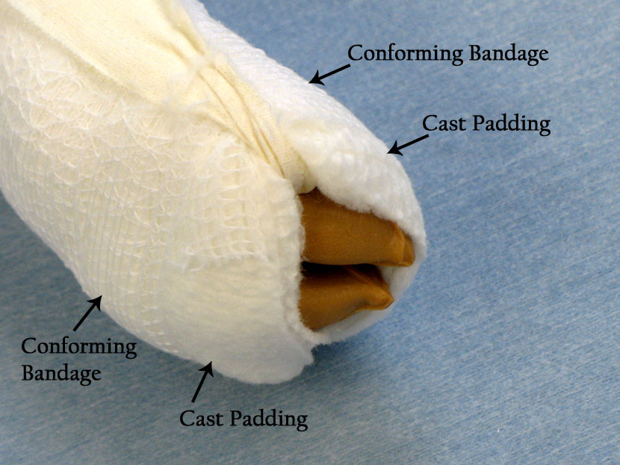
Make sure at least 2 toes are visible!

Slide 38
The bandage is covered and held in place by another part of the tertiary layer.
Can be secured with Elastikon on edges

Slide 39
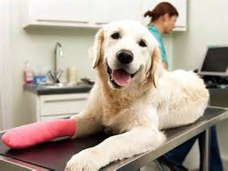
Important Points to Remember
The bandage must serve the purpose for which it was intended
The bandage must be applied firmly, but not so tightly that circulation is impaired
It must be as comfortable as possible for the patient.
It must look professional
  Take pride in its appearance!

