Slide 1
Canine & Feline Blood Transfusions
VTDRG 367-374
CTVT 1172-1177

Slide 2
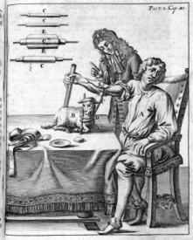
History of Blood Transfusions
The first human blood transfusion was performed in 1492. Pope Innocent VIII was transfused with blood from 3 young boys. All three boys died (and so did the pope)
The first recorded successful canine blood transfusion was done by Richard Lower in 1665 between a Mastiff and a mixed breed dog
  A silver tube was connected to the donor’s artery and the recipient’s vein

Slide 3

Question …
How long do canine & feline RBC’s
remain in circulation?
Dog - 110 days
Cat - 68-70 days
Humans – 120 days

Slide 4
Blood Transfusion
Ultimately, the purpose of a blood transfusion is to provide a means of temporarily providing oxygen to an animal that has lost enough RBCs to compromise oxygenation to a degree that is life threatening
  Once the underlying condition is corrected, the animal is able to produce an adequate number of their own RBCs to sustain life
In addition, transfusions may serve to replace intravascular volume where blood loss has left an animal in a state of life-threatening cardiovascular depression

Slide 5
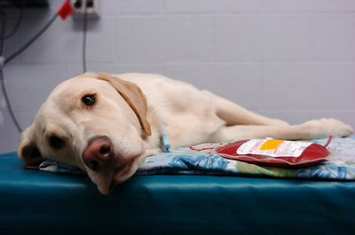
Indications for Blood Transfusions
Severe blood loss (trauma, acute hemorrhage during surgery)
Chronic anemia with respiratory distress and weakness
Coagulation defects (Hemophilia, VonWillebrand disease)
  Sometimes better to use platelet rich plasma than whole blood
Autoimmune Hemolytic Anemia (AIHA)

Slide 6
Anemia/ Non- Regenerative Anemia
Anemia- A decrease in red blood cells
  Bone marrow will respond to this decrease by increasing red blood cell production
Non-regenerative anemia- the bone marrow response is inadequate when compared to the increased need

Slide 7

Question…
Would a blood transfusion be beneficial to a patient with a non-regenerative anemia?

Slide 8
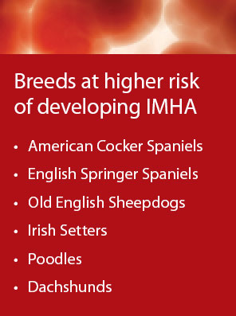
Autoimmune Hemolytic Anemia
The animal’s immune system actually attacks its own red blood cells leading to their destruction-hemolysis. The antibodies attack the cell membrane
RBC transfusion is needed for this condition if it becomes a life-threatening condition

Slide 9
Indications for Blood Transfusion
PCV levels should not dictate giving a blood transfusion
PCV can remain normal for as long as 6 hrs after acute blood loss
Better to use clinical signs to determine need for transfusion
  Temp, pulse pressure, depth and rate of respiration, mucous membrane color, CRT, CVP and arterial blood gases = best indicators

Slide 10
Blood Products
Blood products are used to treat a variety of conditions including: anemia (hemmorrage, hemolysis, coagulopathies, DIC)
RBC products – provide the recipient with additional red cell mass to increase the O2-carrying capacity of the blood, and thus improve O2 delivery (FWB, Packed RBCs)
Plasma products –a source of coagulation factors and various plasma proteins (FFP, SFP)

Slide 11
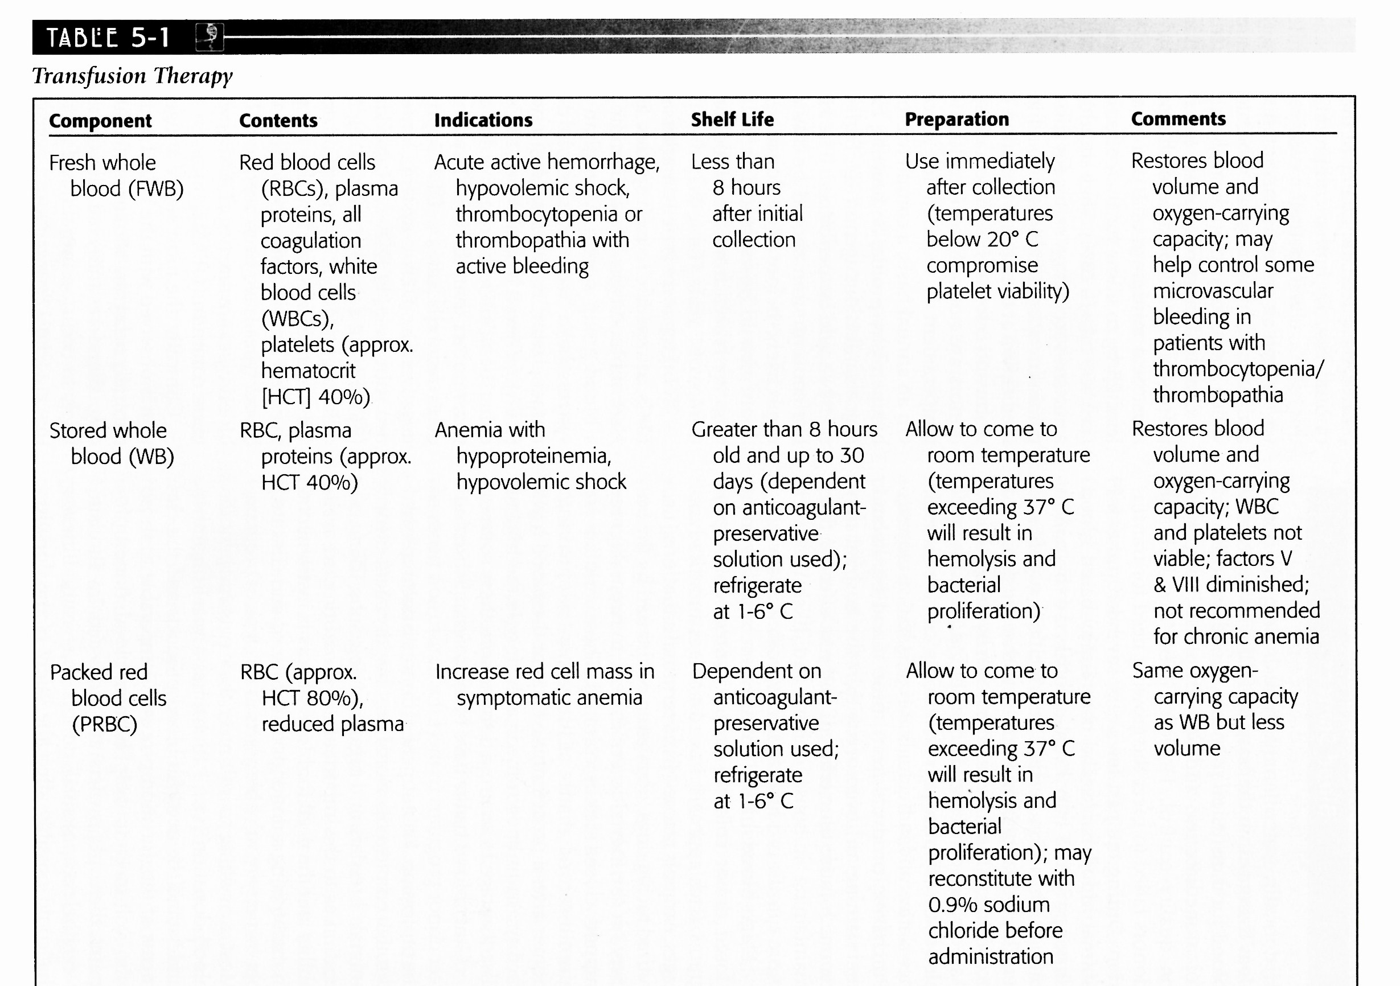
Blood Products

Slide 12
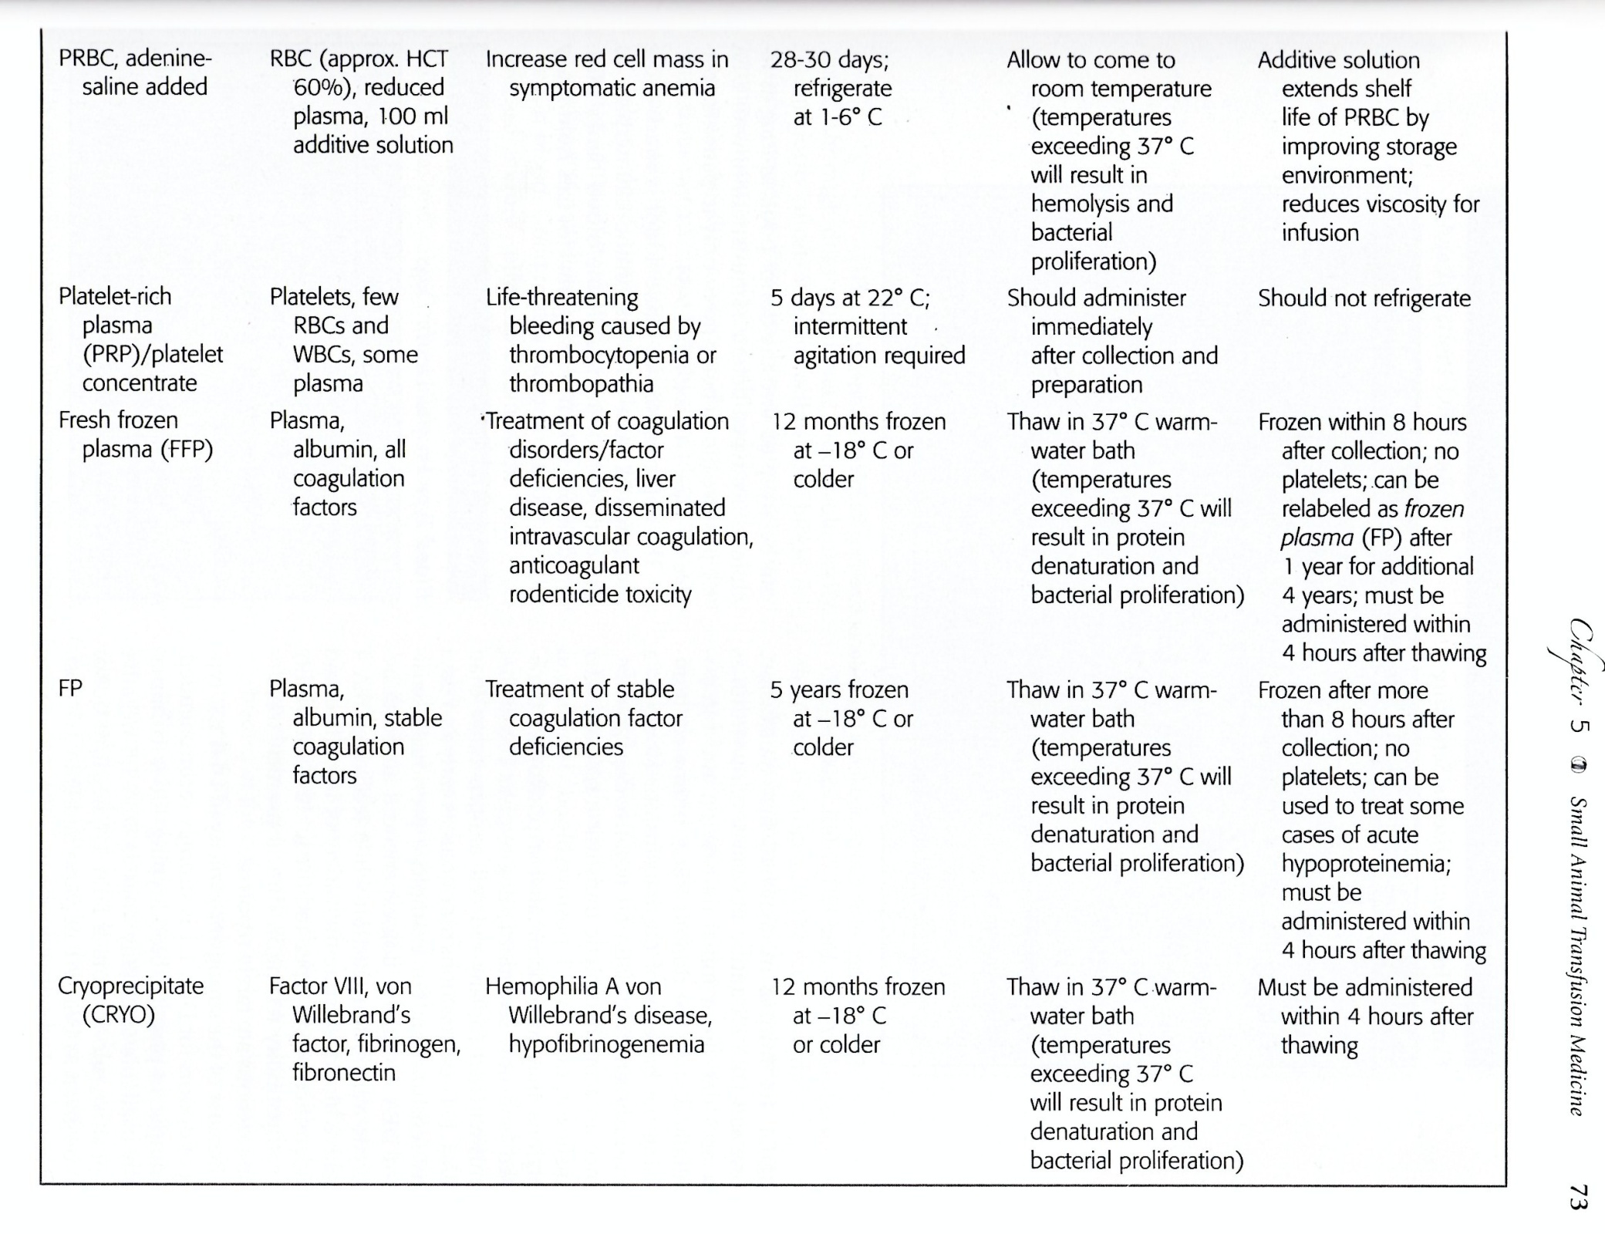
Blood Products

Slide 13
Packed Red Blood Cells (PRBC)
Red blood cell transfusion is only administered in life-threatening situations, as the patient’s immune system will also attack and destroy these RBCs as well
However, transfusions should never be withheld if needed. Several transfusions may be needed before disease is under medical control
If transfusion is necessary as a life-saving measure, only the absolute minimum number of RBCs should be administered (12ml/kg of body wt.)‏

Slide 14
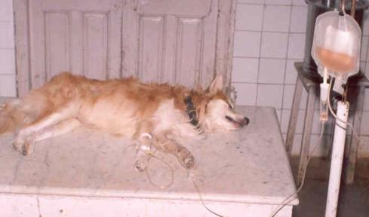
Plasma
Contains all of the clotting factor except platelets
Indications : inherited coagulation factor deficiencies, vitamin K deficiency, DIC, severe liver disease

Slide 15
Disseminated Intravascular Coagulation (DIC)
Pathological activation of coagulation (blood clotting) mechanisms that happens in response to a variety of diseases
Leads to the formation of small blood clots inside the blood vessels throughout the body
Small clots consume coagulation proteins and platelets, normal coagulation is disrupted and abnormal bleeding occurs
  from the skin, gastrointestinal tract , the respiratory tract, surgical wounds, and organs

Slide 16
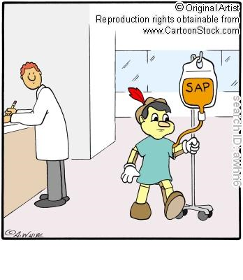
Platelet Rich Plasma
Harvested from a unit of FWB that is less than 8 hours old and has not been cooled below 20 degrees C (68 degrees F)
Indications : to stop severe, life-threatening bleeding in patients with thrombocytopenia

Slide 17
Thrombocytopenia
Decrease of platelets in blood
Platelets
Circulate in the blood and are involved in hemostasis (causing bleeding to stop) leading to the formation of blood clots
Average lifespan is 5-9 days

Slide 18
Whole Blood
Initial collection called “Fresh Whole Blood” (FWB)
Called FWB for up to 8 hours after collection
  Storage life of 14-45 days (dependent on type of anticoagulant used
FWB = RBCs, WBCs, platelets, plasma proteins and coagulation factors
Builds “volume” of blood, not one specific component
Indications : Actively bleeding animals, hypovolemia (decreased blood volume; decrease in volume of blood plasma) secondary to acute hemorrage

Slide 19
The total blood volume in ml of canine and feline donors can be calculated as :
Canine = 99 x lean body weight in kg
Feline = 66 X lean body weight in kg
Generally, 10% of a donor’s blood volume can be collected without causing the donor harm

Slide 20
Leukopenia and Hypoproteinemia?
NO
Blood transfusions are impractical for low protein or low WBC count
WBCs comprise such a relatively small amount of the total blood volume, it is impractical to transfuse blood in order to raise leukocyte count
There are simpler, more practical, and less risky means available for correcting hypoproteinemia

Slide 21
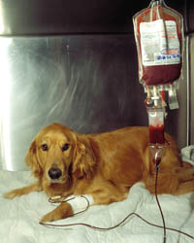
Canine Blood Groups

Slide 22
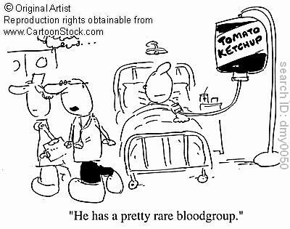
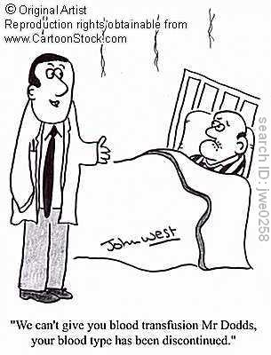
Canine Blood Types
There are at least 19 identified canine blood groups
They are designated by the acronym DEA (dog erythrocyte antigen) and a number
DEA 1.1+ is the most common canine blood type
  Dogs with this blood type are considered to be universal recipients
DEA 1.1- or 1.2- are considered to be universal donors
After the first transfusion, dogs should be blood typed and cross-matched because they can become sensitive to the type of blood that they received.

Slide 23
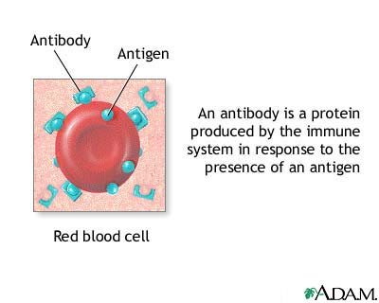
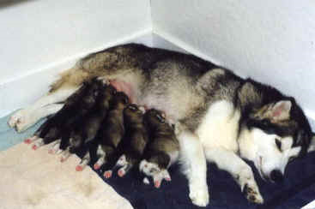
Canine Blood Types
If a dog that has received a blood transfusion in the past becomes pregnant, it should be blood-typed, because if it is DEA 1.1 negative and received DEA 1.1 positive blood, antibodies are now present in its blood. Puppies that are DEA 1.1 positive will likely die if allowed to nurse (upon receiving antibodies to their own blood via their mother’s milk)

Slide 24
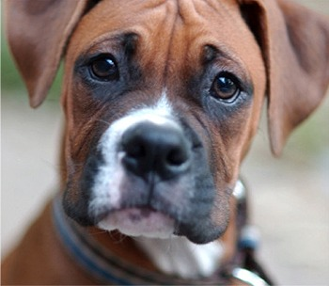
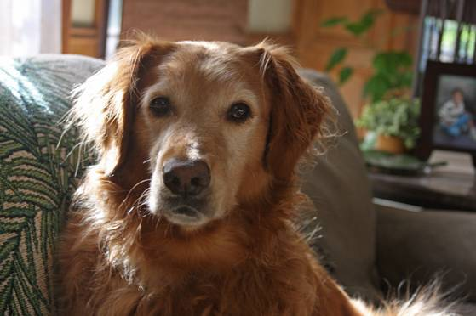
DEA 1.1
DEA 1.1+ is the most antigenic and is associated with most blood transfusions. It is said that about 40% or more dogs are positive for the DEA 1.1
Dogs that are DEA 1.1 positive are universal recipients
Breeds more commonly DEA 1.1 positive are Golden Retrievers and Labradors
Breeds more likely to be DEA 1.1 negative, or universal donors , are Greyhounds, Boxers, Irish Wolf Hounds, German Shepherds, Dobermans, and Pit Bulls

Slide 25
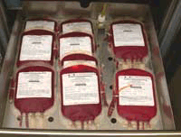
Blood Typing
Identifies antigens (proteins) on the surface of RBCs
  Positive – have the blood type antigen
  Negative- do not have the antigen
Many blood banking companies and blood typing labs advocate to pet owners and vet clinics that all dogs should be ‘blood typed’ prior to needing a transfusion to prevent sensitizing first time blood product recipients to 1.1+ antibodies
Blood typing can be performed by using a commercially prepared blood typing card or sent to an outside laboratory
Blood typing should be performed on each donor and recipient

Slide 26
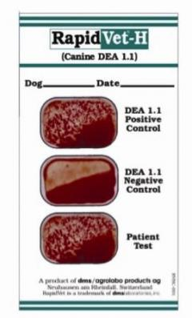
Blood Typing Cards
Typing cards are only available for DEA 1.1

Slide 27

Transfusion “Freebie”
  Alloantibodies are naturally ocurring antibodies in the blood against the opposite blood type
  Dogs do not have alloantibodies, so the first transfusion is considered a “freebie”
  After the fist txn, however, the dog now has antibodies against the opposite blood type, so blood typing is necessary
  Humans and felines have alloantibodies, so they have to be blood typed before transfusions

Slide 28
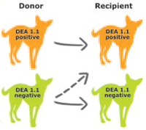
Transfusion Reactions
Examples of clinical signs associated with transfusion reactions:
  Hemoglobinemia (presence of excessive hemoglobin in blood plasma)
  Hemoglobinuria
  Thrombocytopenia
  Leukopenia
  Pyrexia
  Emesis
  Incontinence
  Urticaria (extremely pruritic wheals on skin)
  Weakness
Note: patients may exhibit all or a few of these symptoms

Slide 29
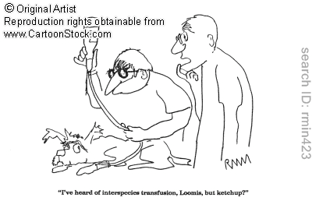
Transfusion Reactions
With so many variations in types of blood, complete compatibility is nearly impossible. This is why crossmatching is so important
It is also important to note that crossmatching will not identify incompatibility to DEA 1 types unless previous sensitization has occurred

Slide 30
Crossmatching pg 119 VTDRG
Should always be performed in dogs that have received a previous transfusion
Classified as either “major” or “minor”
Major crossmatching
  Add recipient plasma / serum to donor cells and observe for agglutination
  Used to check for antibodies in recipient serum against RBCs from the donor
  If any hemolysis or agglutination, do not transfuse
Minor crossmatching-
  Add donor plasma / serum to recipient RBCs
  Checking for preformed antibodies in the donor plasma/ serum that could hemolyze recipient RBCs
  If slight hemolysis, okay to transfuse only RBCs

Slide 31
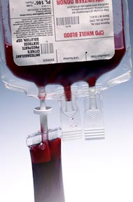
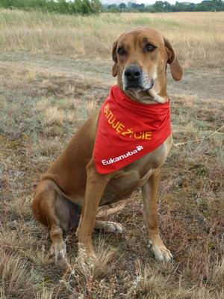
Universal Dog Donor
Universal Blood donors test negative for DEA 1. 1
There are several specific guidelines that a dog must meet in order to qualify to be a blood donor

Slide 32
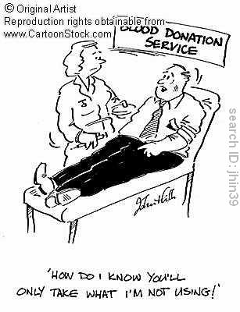
Can my dog donate blood?
Dogs that test negative for DEA 1.1 can give blood to dogs that are DEA 1.1 negative and DEA 1.1 positive. These dogs are considered “universal blood donors”
Dogs that test positive for DEA 1.1 can only give blood safely to dogs that are DEA 1.1 positive
  They can, however receive blood from dogs of any blood type and are therefore considered to be universal recipients

Slide 33
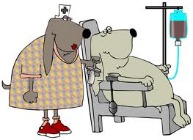
Canine Donor Requirements
Any breed or sex may be used
A dog with good temperament and easily accessible veins is a prime candidate
Ideally, donors should be neutered and weigh more than 55 lb.
Donors can be between 1 and 8 years of age
Donors should be tested every 6 months for parasites including:
  Heartworm (and maintained
  on a preventative medication)
  Intestinal parasites

Slide 34
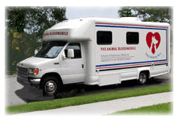
Canine Donor Requirements
Donors should be fully vaccinated
  Blood should not be donated for 11 to 12 days postvaccination because of vaccine effects on platelets and endothelial functions
Donors must be in excellent health with yearly normal blood chemistry, CBC, and urinalysis
  PCV must be at least 40%
  Donors should also be tested
  for von Willebrand factor and
  normal platelets

Slide 35
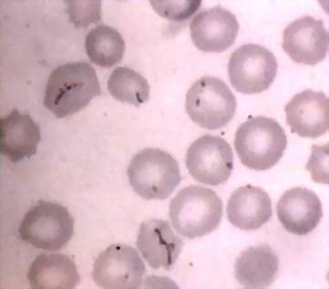
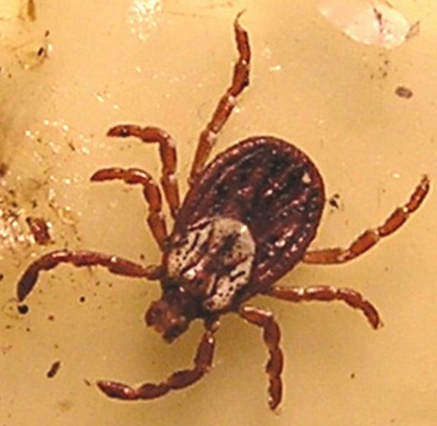
Canine Donor Requirements
Donors must be free of the following infectious diseases:
  Blood parasites: Babesia canis, Haemobartonella canis
  Rickettsial diseases: Ehrlichia canis, E. platys, Borrelia burgodrferi, and Rickettsia rickettsii.

Slide 36
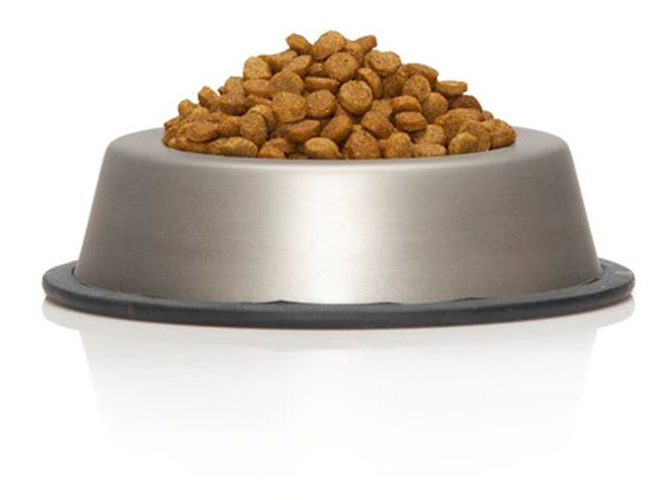
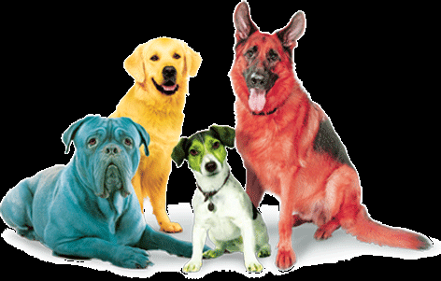
Canine Donor Requirements
Donors should be fasted before donation to decrease lipemic samples of blood
Donors should have never received a blood transfusion
Up to 450 mL of blood can be collected from a dog once every 4 to 5 weeks

Slide 37
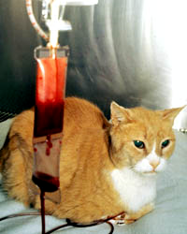
Feline Blood Groups

Slide 38
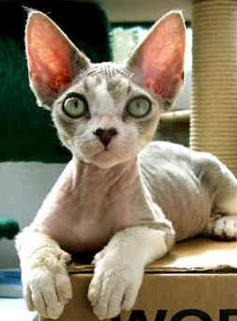
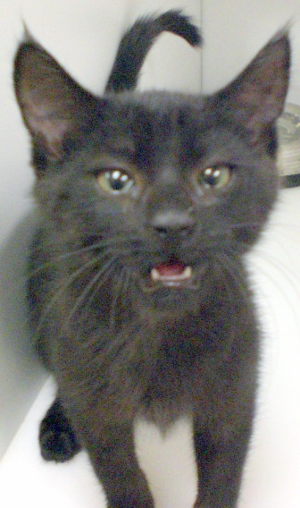
Feline Blood Groups
The AB system of blood typing is used for cats
Blood group A is the most common in cats overall in North America
  Nearly all DSHs and DLHs have type A blood
Blood group B is common in European breeds (Devon rex, Abyssinian, British shorthair)‏
Many purebred cats have type B blood
Blood group AB is rare

Slide 39
Feline Blood Types
Since cats have naturally occurring alloantibodies (body gains immunity against antigens of another individual of the same species, which are perceived as foreign) against the blood-type antigen that they lack, there is no universal feline blood donor
Type A cats should receive type A blood, type B cats should receive type B blood
Type AB cats can receive either type A or type B blood with no clinical reactions

Slide 40
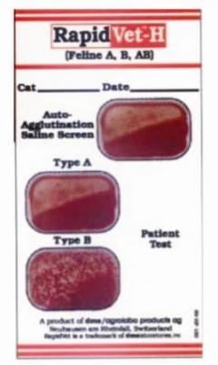
Feline Blood Types
Cats can have severe reactions to the first transfusion due to the inheritance of preformed antibodies to the opposite blood group. Remember alloantibodies?
ALWAYS perform blood typing and cross-matching prior to performing blood transfusion in cats
This cat is Type B

Slide 41
Fading Kitten Syndrome
Kittens born to Type B mothers
May have type A fathers so kittens may be type A, B, or AB
  These mothers have strong anti-A antibodies titers
  These antibodies are absorbed from the colostrum of the nursing kittens and will attack the blood cells of Type A and AB kittens causing hemolytic anemia
These seemingly healthy kittens become ill and die unexpectedly

Slide 42
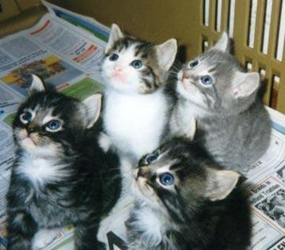
Feline Blood Donor Requirements
Less than 8 years of age
A lean body weight of no less than 10 lb.
Donor must be neutered
A good-natured indoor cat makes donation smoother and less stressful

Slide 43
Feline Donor Requirements
The donor should be fully vaccinated
Modified live vaccine may affect platelet and endothelial function, and therefore blood should not be donated for 11 to 12 days post vaccination
Excellent health must be maintained by monitoring serum biochemistry, CBC, urinalysis, and fecal tests on a yearly basis
The donor’s PCV should be ~ 35%

Slide 44

Feline Donor Requirements
All donors must be negative for feline leukemia virus, feline infectious peritonitis, feline immunodeficiency virus, and Mycoplasma
A donor may provide 60 mL of blood no more than once every 4 to 5 weeks

Slide 45
Blood Administration
The amount of blood product to be administered depends on the specific product, desired effect, and patient’s response
When Transfusion is needed of:
WB: 10-20 ml /kg= ______ ml patient needs
PRBC’s: 6-10 ml / kg = ____ ml patient needs
Plasma: 6-12 ml / kg =_____ ml patient needs

Slide 46
LET’S PRACTICE
A 10lb patient needs a transfusion of WB, what would the calculated range in mL’s be that this patient needs to receive using the formula of 10-20 ml/kg:
10lb= 4.5kg
4.5kg X 10ml = 45ml
4.5kg X 20ml = 90ml
SO… a 10lb patient that needed a WB transfusion would need between 45ml – 90 ml of WB to complete its transfusion

Slide 47
LET’S PRACTICE
A 60lb patient needs a transfusion of Plasma, what would the calculated range in mL’s be that this patient needs to receive using the formula of 6-10 ml/kg:
60lb = 27.3kg
27.3kg X 6ml= 163.8 or 164ml
27.3kg X 10ml= 273ml
So A 60lb patient that needed a Plasma transfusion would need between 164ml – 273ml of Plasma to complete this transfustion

Slide 48
Blood Administration
**Blood is transfused slowly at 1ml/kg / 15-20 min. Then rate is increased up to 22 ml / kg / hr for no more than 4 hours total
IV line should be flushed with Sodium Chloride prior to starting transfusion

Slide 49
LET’S PRACTICE
For our 60lb patient that needed the Plasma transfusion, what would the rate be that we would set the pump at to transfuse their plasma. Using the formula 1ml/kg / 15-20 min. Then rate is increased up to 22 ml / kg / hr
60lb= 27.3kg
1ml X 27.3kg = 27.3ml for the first 15-20 minutes
Up to 22ml X 27.3kg = 600.6ml/ hr MAX
600.6ml/hr / 60 min= 10ml/min MAX
This patient needed between 164ml – 273ml total

Slide 50
Blood Collection Procedure
Sedation requirement depends on the animal
  Do not use acepromazine because it causes hypotension
  The sedative of choice for dogs is oxymorphone given approximately 15 to 20 minutes prior to blood collection
  A blood collection bag with anticoagulant added or a special blood collection system can be used
  Clippers and surgical scrub solutions are necessary for preparation of the venipuncture site
  All supplies for IV fluid administration should also be available

Slide 51
Blood Collection Procedure
Place cephalic IV catheter for fluid administration after collection
Place animal in lateral recumbency with neck extended
Clip a wide area around the jugular vein to be used for collection and aseptically prepare
Insert 16-gauge needle attached to blood collection system into jugular vein and begin collection
As blood enters bag, move bag to slightly mix with anticoagulant
450 mL of blood constitutes one entire blood collection for dogs; 60 mL for cats

Slide 52
Blood Collection
Closed system – literally a collection bag and line with a needle pre-attached. The only exposure to air is when the needle is uncapped
Open system – any system in which there is one or more additional site of potential bacterial contamination during blood collection or processing
  Ex. Syringe and butterfly catheter for small volumes of blood collection

Slide 53
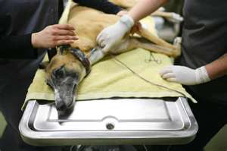
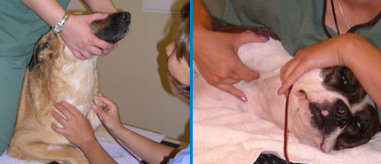

Slide 54
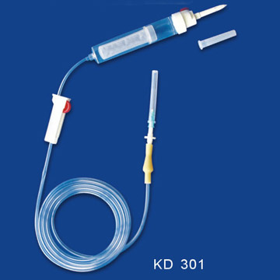
Blood Filter- helps minimize clot administration

Slide 55
Which anticoagulant do we use for blood txn collections?
Most common type of anticoagulant collection
System is A-C-D (Acid – Citrate –Dextrose)
2 ml ACD to 9 ml blood
Seen in Glass Vail Blood collection system

Slide 56
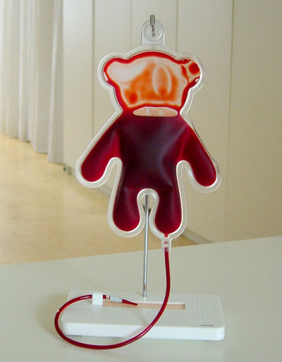
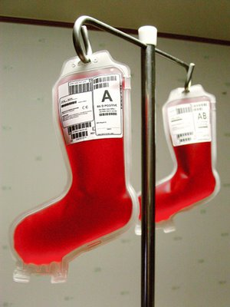

Slide 57
Blood Collection
Multiply the volume of blood collected from the patient by three to determine the volume of replacement IV fluids
The donor should be observed for 1 hour after donation
Mucous membrane color, pulse, and CRT should be monitored

Slide 58

THE END

