Slide 1
Cardiac Abnormalities
By You - The students

Slide 2
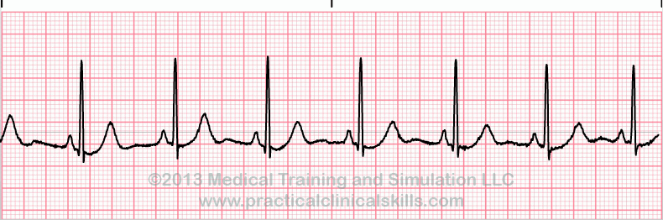
Normal Sinus Rhythm
What it is: A normal heart rhythm
What is happening in the heart?: Normal electrical impulses through the SA node to the Purkinji fibers
What Causes it: Electrolytes
Prognosis/Treatments: Normal Healthy Rhythm.
Notes:
Normal Sinus Rhythm

Slide 3
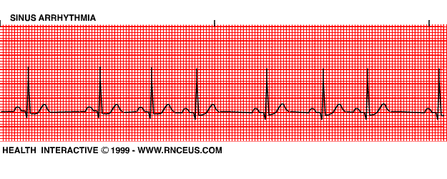
Sinus Arrhythmia
What it is: The HR speeds up during Inspiration and slows during Expiration.
What is happening in the heart?: Increased Vagal Tone during inspiration.
What Causes it: Intracranial, Intraoccular, Respiratory, GI, Urinary issues in cats. Normal in dogs. Brachycephalic are predisposed.
Prognosis/Treatments: Good in dogs and Depends on severity in cats and underlying dz.
Notes:
Sinus Arrythmia

Slide 4
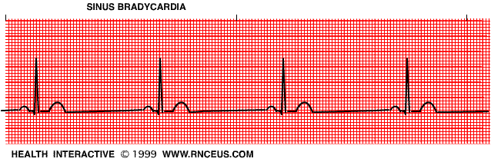
Sinus Bradycardia
What it is: Slower than normal Heartbeat
What is happening in the heart?: Abnormally slow firing of the SA node
What Causes it: Athletes, Heart dz, Hypothyroidism, Sleep, Sedation, Drug overdoses, Shock, Ax.
Prognosis/Treatments: Depends on underlying dz. Varies on cause.
Notes:
Sinus Bradycardia

Slide 5
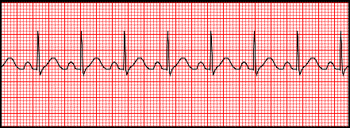
Sinus Tachycardia
What it is: Faster than normal heart rate
What is happening in the heart: Rapid firing of SA node
What Causes it: Physiologic due to bodies responses to exercise, pain, anxiety, anger. Pathologic due to dz :CHF, Lung dz, Shock, Anemia, Hypoxia, Cancer, (most common Abnormal arrhythmia in dogs)
Prognosis/Treatments: Physiologic - Good, Pathologic - Varies
Notes:
Sinus Tachycarda

Slide 6
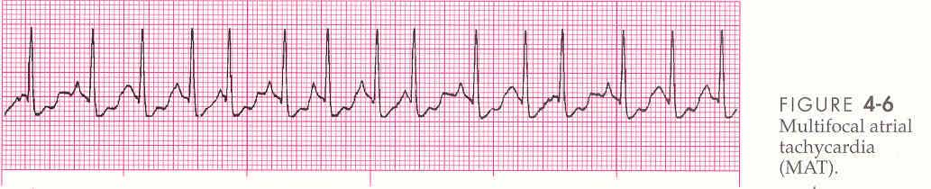
Atrial Tachycardia
What it is: Atrial rate accelerates after initiation and slows prior to its termination
What is happening in the heart?: The SA node is firing abnormally fast causing ventricular tachycardia as well
What Causes it: Congenital Defects, Structural abnormalities, Structural repair of abnormalities
Prognosis/Treatments: Therapy and monitoring, Prognosis -poor if Tachycardia is frequent and consistant.
Notes:
Atrial Tachycardia

Slide 7
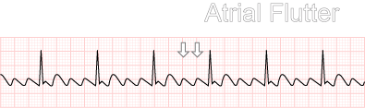
Atrial Flutter
What it is: Atria are contracting faster than Ventricles,
What is happening in the heart?: Electrical impulses are circling in the SA node creating multiple P waves.
What Causes it: Secondary to L. Atrial Enlargement. Cardiac dz, Congenital Defects, Degenerates into A-FIB.
Prognosis/Treatments: prognosis is good if not secondary. Treatment is with Medications - Digoxin, Dilitezam. If it is secondary to Cardiac dz - guarded to poor.
Notes:
Atrial Flutter

Slide 8
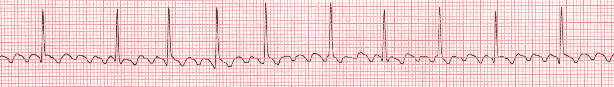
Atrial Fibrillation
What it is: Cardiac Arrhythmia where the electrical activity of the atrium is disorganized.
What is happening in the heart?: the pacemaker is created by a random cell, Causing Atrial Chaos.
What Causes it: Atrial Enlargement - CHF, HTWMX, Dilated or hypertrophic cardiomyopathy, Congenital, Idiopathic, Drug reaction, Ax, Trauma, AV Valve regurg.
Prognosis/Treatments: Depends on underlying cause. TX- Digoxen, Ace inhibitor, Betablockers, Calcium channel blockers. Guarded to poor prognosis.
Notes:
Atrial Fib.

Slide 9
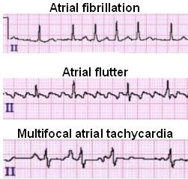
Comparisons

Slide 10
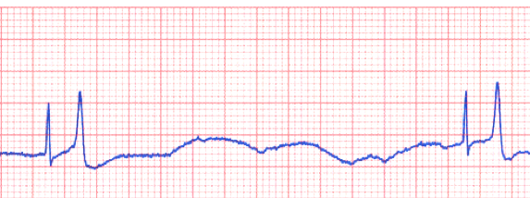
Atrial Standstill
What it is: Inactivity of the SA node
What is happening in the heart?: The SA node is failing to fire. There is little to no electrical activity in the Atria.
What Causes it: Hyperkalemia, Electrolyte imbalances. Cardiac dz. Springer Spaniels = Predisposed.
Prognosis/Treatments: Fluids, Pacemaker. Prognosis - Depends on underlying cause and if its not persisting.
Notes:
Atrial Standstill

Slide 11
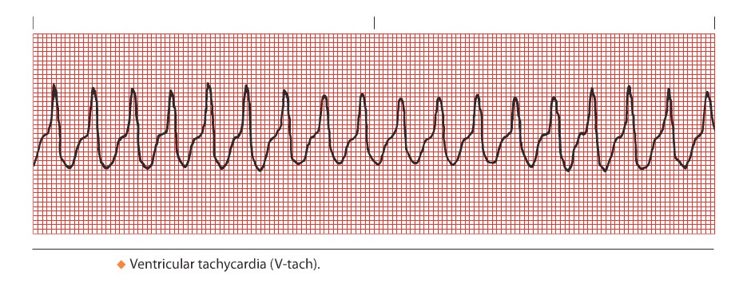
Ventricular Tachycardia
What it is: Its a very fast heart rhythm or contraction of ventricles
What is happening in the heart?: Malfunction of electrical processes in one of the ventricles.
What Causes it: Cardiomyopathies, Chronic Valve dz. Medications, Cancers, Congenital Dz, Shock,
Prognosis/Treatments: Defibrillator. If we fix it = Good. If we cant fix it - bad. Fluid tx, Medications. LIDOCAINE
Notes:
Vent. Tachy

Slide 12
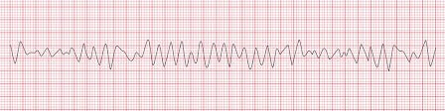
Ventricular Fibrillation
What it is: CHAOS
What is happening in the heart?: Uncoordinated contractions in cardiac muscles due to random electrical firing of all cells.
What Causes it: Cardiac and Resp. Dz, Hrt sx, Aortic stenosis, Drug reactions, Congenital dz, Post Sx effects.
Prognosis/Treatments: Defibrillation, CPCR, Upon survival use lidocaine. Prognosis - Very Poor.
Notes:
Vent. Fib

Slide 13
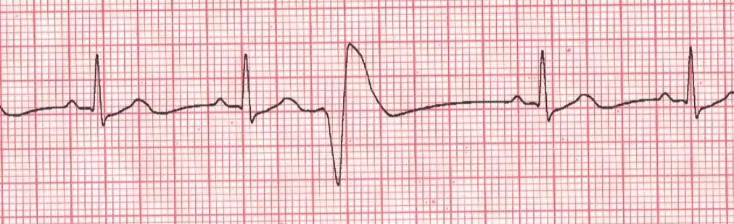
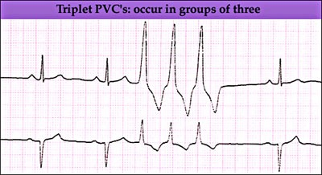
VPCs (Ventricular
Premature
Contractions)
What it is: Ventricular contraction prior to being completely filled by the atrium
What is happening in the heart?: Electrical activity starts in the purkinje fibers versus the SA node.
What Causes it: Cardiomyopathies (Dialated -Dobermans) GDV, CHF, Metabolic Derangements, Myocarditis
Prognosis/Treatments: Just one - Good. More that one- Guarded. Can turn into V-Tac. Tx - Anti-arrhythmic drugs.
Notes:
VPCS

Slide 14
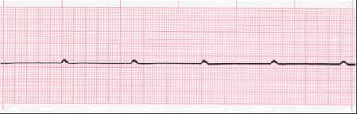
Ventricular Asystole
What it is: “Flatline” No cardiac activity for more than a few seconds
What is happening in the heart?: Heart is stopped and SA node AND other nodes are not firing.
What Causes it: Shock. Dead Pacemaker, Electrical Probs in Hrt.
Prognosis/Treatments: Prognosis =Very poor. Tx - Eliminate cause. Pacemaker. Medications. Defib. CPCR.
Notes:
Vent Asystole

Slide 15
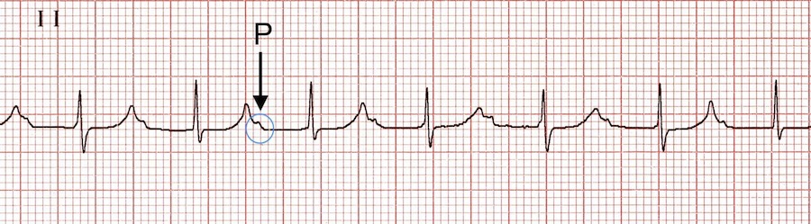
First Degree AV Block
What it is: P-R interval is lengthened by .2 seconds
What is happening in the heart?: Impulse from Atrium to ventricles is delayed. - Usually Asymptomatic
What Causes it: Digoxin OD, Calcium Def. Hypertrophic Cardiomyopathy. Atropine IV, Carditis and Tumors and Amyloidosis. CockerSpaniels and Dachshunds.
Prognosis/Treatments: Monitor ECGs, Monitor the heart closely. Prognosis - Good.
Notes:
First Degree block

Slide 16
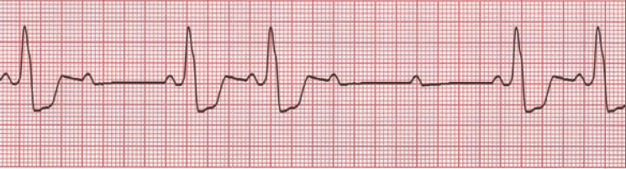
Second Degree AV Block
What it is: Wickenbock (Mobietz 1) = P-R interval Prolongation. & Mobietz 2 = P-R wave is consecutive but the R wave is long in itself.
What is happening in the heart?: Disturbance, Delay or interuption of atrial impulse conduction through the AV node to the ventricles.
What Causes it:Electrolyte imbalances. Myocarditis, Thyroid dz, Digoxin OD, Ischeima, Adenovirus, Hrt dz.
Prognosis/Treatments: Prognosis is good as long as there is not a block between the AV node and the rest of the electrical pathway. Tx -Pacemaker, Atropine, Monitor heart closely, Glycopyrolate.
Notes:
Second Degree Block

Slide 17

Third Degree AV Block (“Complete”)
What it is: Most clinically significant. SA node is not connected to Ventricles.
What is happening in the heart?: Independent and non coordinated beating of the Atrium and the Ventricles.
What Causes it: Congenital, Idiopathic Fibrosis, Inflammation, Drug tox. Electrolyte Imbalences, Lyme Dz, Hrt dz, Hrt Attack.
Prognosis/Treatments: Pacemaker, Glyco, Atropine, Prognosis = Poor.

Slide 18
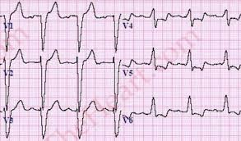
Bundle
Branch
Blocks.
What it is: Delay or obstruction along the pathway from the branches to the fibers.
What is happening in the heart?: The delay or obstruction in electrical pathway creates an insufficient Cardiac response and cardiac output.
What Causes it: Heart dz or trauma. Left = Cardiomyopathy, Bacteria, Hypertension, Hrt dz. Right = Birth Defect, Hrt attack or Blood clot in lungs.
Prognosis/Treatments: Most are Asymptomatic. Medication. Angioplasty, Pacemaker, or Defib. Prognosis - Left is worse than right.
Notes:
L & R BBB

Slide 19
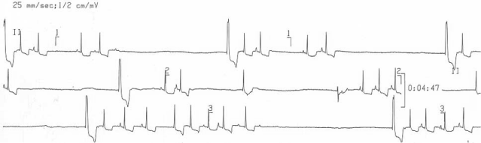
Sick Sinus Syndrome
What it is: The heart is switching from slow to fast and from regular to irregular.
What is happening in the heart?: Electrical impulses fail to function normally. (can go from Bradycardic to Tachycardia very quickly. )
What Causes it: Hrt dz, Electrolyte imbalances, Sepsis, shock, Precursor to Hrt Failure, Medications, Toxicities, Etc.
Prognosis/Treatments: Avoid stress and excitement. Pacemaker, Prognosis = Guarded. Treat underlying causes.
Notes:
SSS

Slide 20
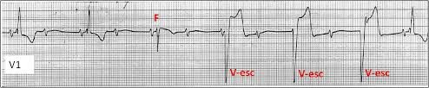
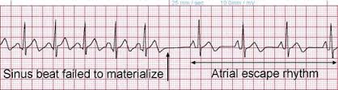
Escape
Rhythms
What it is: Junctional - Faster Ventricular contraction than Atrial contraction. Ventricular : Ventricles are firing without stimulation from Atria.
What is happening in the heart?: Junctional : Rate of the SA node falls below the AV Node. Ventricle: When SA node impulses are blocked.
What Causes it: Congenital defects. Asymtomatic. Hrt dz. Electrolyte imbalences, Cardiomyopathies. Pugs, Dachshunds, Cockerspaniels, Westies, Schnauzers.
Prognosis/Treatments: Treat underlying cause. Heart Medications, - Atropine. Lidocaine, Prognosis - Guarded.
Notes:
Escape Rhythms

