Slide 1
Radiology: The study of radiation, the movement of photons and their ability to create an image.
Chapter one and two in Lavin

Slide 2
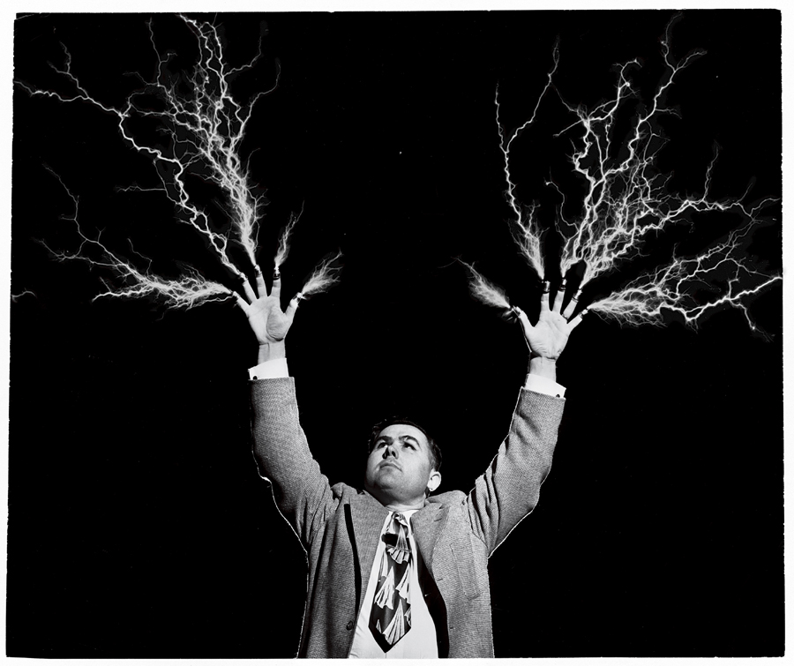
So……..
Lets have fun, learn a lot and DO THIS!!

Slide 3
The technical side of imaging…
Inner workings of the radiology unit
Basic concepts that impact x-ray settings
    Arithmetic – Math matters!
    Proportionality
    Units of measurement
    Metric prefixes
The atom & radioactivity

Slide 4
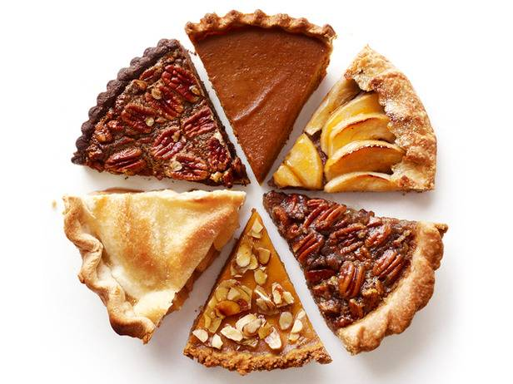
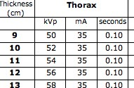
Math matters!
Fractions
    “Pieces of the pie”
    Numerator/Denominator
    Used in technique charts
    mA X seconds (fraction)
Multiplication
    Used for exposure times
    mA X seconds (decimal) = mAs
Notes:
35 X 0.10 = 3.5
35 X 1/10 = 3.5

Slide 5
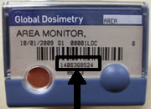
Proportionality
Definition: The relationship between 2 numbers
2 types: Direct & indirect
Direct
1st is a multiple of 2nd
Shown as fraction or w/colon (:)
Radiology example?
Medical example?
Notes:
Radiology Examples:
Settings on an x-ray machine
2 X mAs = twice as dark
Dosimetry
Medical Examples:
Number of 50 mg tramadol tabs to give – mgs/kg
60 kg dog gets twice the dose of same drug as 30 kg
Other Examples:
Following a recipe

Slide 6
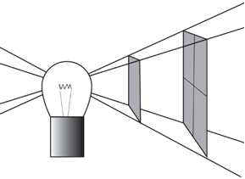

Proportionality
Indirect
1st up = 2nd down
Product stays the same, but values differ
Radiology example
  Inverse square law
Medical example?
Notes:
Radiology Examples:
Inverse Square Law – Intensity of the x-ray beam is inversely proportional to the square of the distance from the source
Medical Examples:
PCV – Higher PCV = less plasma (dehydrated)
Lower PCV = higher amount plasma (anemic)
Other examples:
Commute – Higher speed = less time (distance is constant)

Slide 7
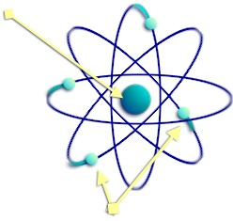
The Atom & Radioactivity
Atomic Theory
Periodic Table
Atomic Structure
Atomic Weight
Combining Atoms
Organizing Matter
Notes:
A review from A&P

Slide 8
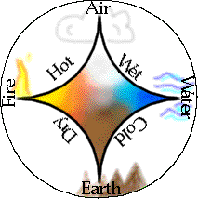
History of Atomic Theory
Ancient Greeks:
    4 substances :
    4 essences
    Particles divide into atoms
    Each substance can be altered by the four essences. Every particle of matter can be subdivided many times until all that was left was an atom
Notes:
Why does this matter?
Radiology + manipulation of atoms
Stability or instability impacts x-radiation intensity or existence
Ancient Greeks:
4 substances – earth, air, fire, and water
Altered by 4 essences – wet, dry, hot, cold
Particles subdivide

Slide 9
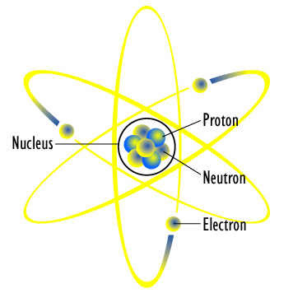
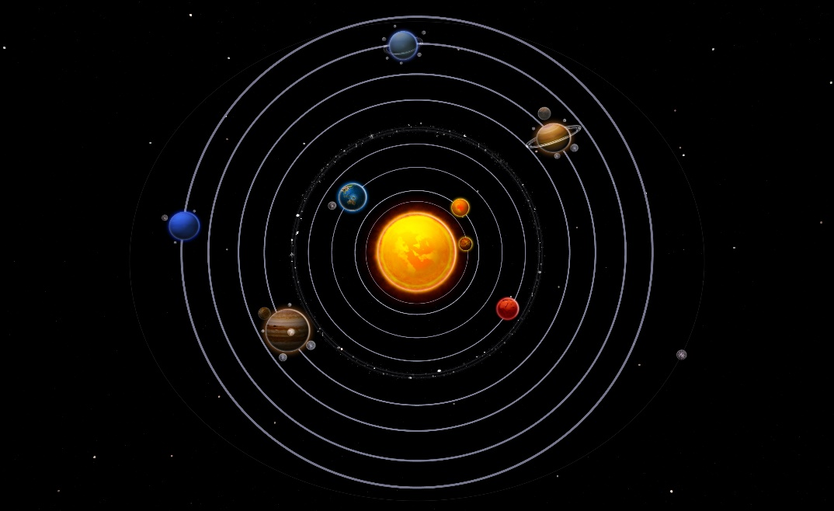
Bohr’s Atom : miniature solar system
Notes:
Niels Bohr – Modern atomic theory
1913
Atom is a “solar system” Nucleus has a positive charge with protons (+) and neutrons (non)
Negatively charged atoms rotate + held in place by balanced electrical charges

Slide 10
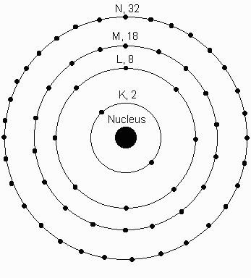
Atomic Structure
Electrons:
  At least one per atom
  Held by negative charge
  VERY small
  Orbits in rings/shells
    Limited # in ring
    Can be added/subtracted
    Rings may be unstable
    Electron binding energy:
      Maintains in shells
Maximum electrons = 2n²
(where n = shell number)

Slide 11
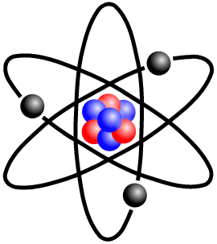
Atomic Structure
Protons:
  Positively Charged
  Found in nucleus
  Balances (+) with electrons (-)
  Determines atomic number
    Important in radioactivity
Neutrons:
  Neutral charge
  Large
  Determines atomic mass:
    Protons + Neutrons

Slide 12
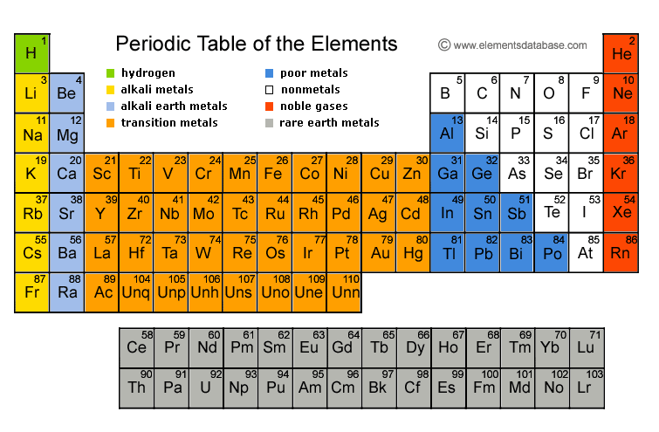
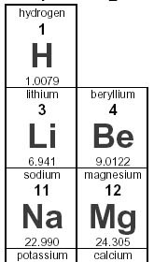
Periodic Table
Review atomic weights and structures. You will simply need to know the difference between the two, not the individual elements.
Notes:
Demetri Mendeleev
Arranges elements by increasing mass
Upper left corner is atomic number (# protons)
Symbol in middle
Atomic mass is number under symbol (#protons + #neutrons)
Colors indicate state of element (solids, liquids, gases, artificial)

Slide 13
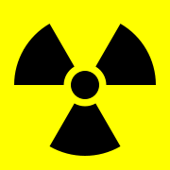
Organization of Matter
Atoms to elements to molecules to compounds/tissues
Isotopes:
  Same atomic number but different mass (# neutrons)
  Can be stable or unstable
  Important in imaging – contrast, nuclear medicine, oncology
Radioactivity:
  Atoms in an abnormal state of excitement
  All matter seeks stability
  Particles and energy released & form new atom

Slide 14
Organization of Matter
Ionization:
    Natural state of atom is electrically neutral
    Electrons farther out are removed
        Lower electron binding energy
    Imbalance in electrical charge
    Atom is ionized
    Important in radiology – Electrons boil off cathode d/t filament circuit heat

Slide 15
Next Class
Chapter 3 – Electrostatics & Energy
Chapter 4 – X-ray production
Have a wonderful day!

