Slide 1
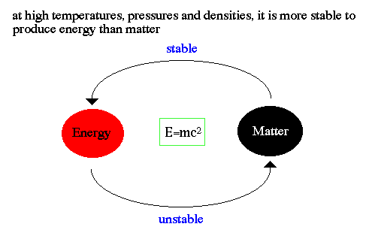
Chapter 3: Electrostatics and Energy
Matter: the substance that comprises all physical objects.
Primary characteristic is mass or weight.
Weight involves gravity
Matter can become energy and energy can become matter but neither can be created or destroyed only change in form.
Notes:
Energy = mass multiplied by the speed of light squared.

Slide 2
Energy: the result of force acting upon an object over a distance
There are different types of energy:
Mechanical
Chemical
Thermal
Nuclear
Electromagnetic
Electrical

Slide 3

Energy is described as a wave just like waves crashing onto a beach.
The waves can be long and low or high and frequent.
The distance between the crests is called wavelength.
The rapidity with which the waves hit the shore is called frequency.
A period is the time taken to complete one complete wave.
The symbol for frequency is Hertz.

Slide 4
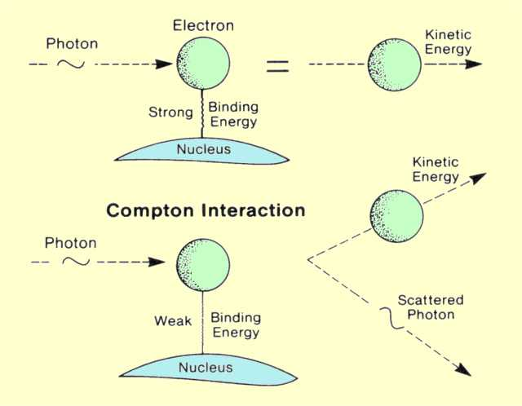
When looking at high frequency energies such as xrays or gamma rays, the energies acted more like individual particles than like waves. These particles are called photons.
The photon carries specific energy that depends on frequency. If the energy is doubled then the frequency is doubled.

Slide 5
Roentgen’s Properties of x-rays
Highly penetrating & invisible rays that are a form of electromagnetic radiation
Electrically neutral
Can be produced over a wide range of energies & wavelengths
Release small amounts of heat when passing through matter
Travel in straight lines
Travel at the speed of light
Can excite or ionize atoms
Cause certain crystals to emit light
Cannot be focused by a lens
Produce a latent image on photographic film
Produce chemical & biological changes
Produce scattered & secondary radiation
Notes:
Wilhelm Röntgen
Father of modern x-rays (1895)
Original properties unchanged
Penetration depends on density of object and energy of x-rays

Slide 6
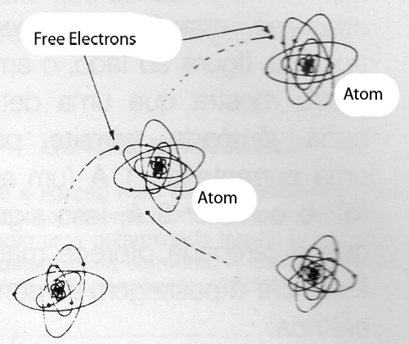
Electricity becomes xrays:
Atoms contain both + and – charges. Strives to achieve homeostasis.
Electrons can be cast off. If many of these electrons leave, the atoms will assume a positive charge.
Electrons can also float freely in space. These are called free electrons
Electricity concerns the movement of the electrons.

Slide 7
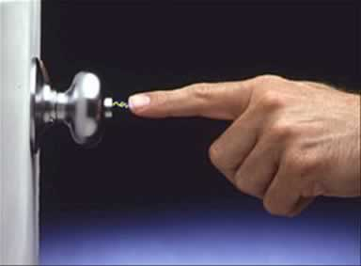
Electrostatics: A charge of free electrons builds up on a surface and when they encounter an object that accept the charge, the negative charge dissipates in the form of static electricity.

Slide 8
Electrification describes the process of electron charges being added or subtracted from an object.
Walking across the carpet causes you to scoop up electrons, these extra electrons are exchanged when you contact a person or object.
This is the way radiation is produced in an xray tube but on a greater scale.

Slide 9
5 Laws of Electrostatics
Like charges repel; unlike charges attract
The Inverse Square Law
    The intensity of the x-ray beam is inversely proportional to the square of the distance from the source.
Distribution
    Charges reside on the outside of conductors, but all through non-conductors
Concentration
    The greatest concentration of charges is on the surface where the curve is the steepest.
Movement
    Only negative charges move along conductors.
    Positive charges are tightly bound
Notes:
Like charges is the principle of an electrical circuit.
Inverse square law: most important concept. Low powered xray units must be moved closer to the subject intensifying the radiation.

Slide 10
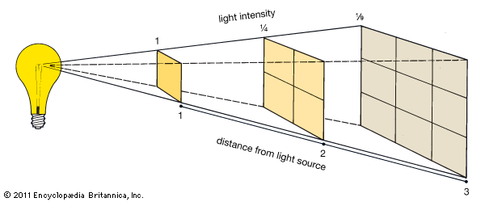

Slide 11
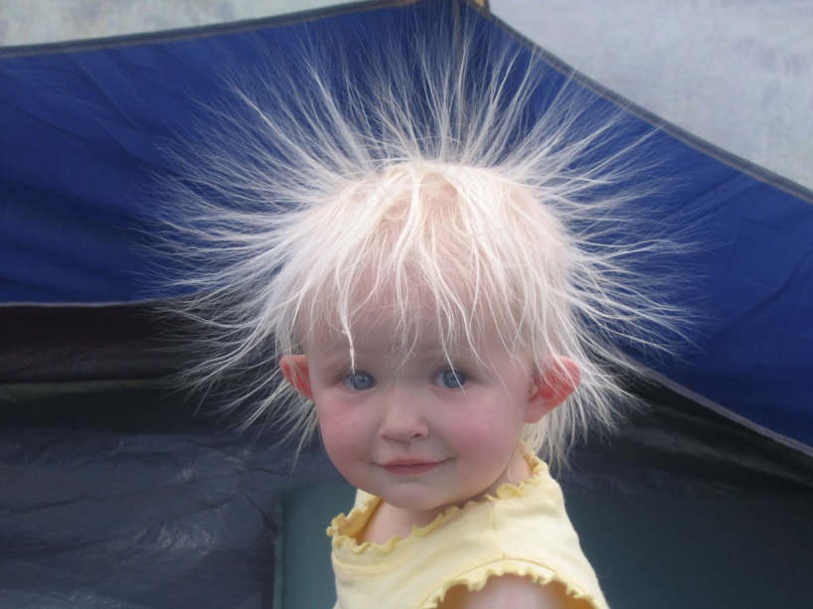
An object can be electrified in three different ways.
Contact: crossing the room and shocking a friend
Friction: when one object is rubbed against another. Electrons travel from one object to the other. Excess negative charges repel and the objects try to get away from each other.

Slide 12
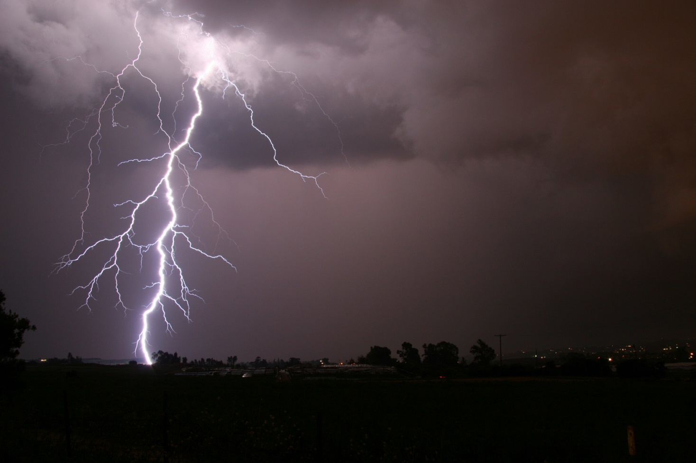
Induction: uses the force field of the electrons of one object to cause a reaction in the opposing object without any contact.
Notes:
Thunderclouds build up electrons, the ground is neutral, the discharge of electrons from cloud to ground without the cloud touching the ground

Slide 13
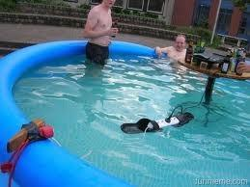
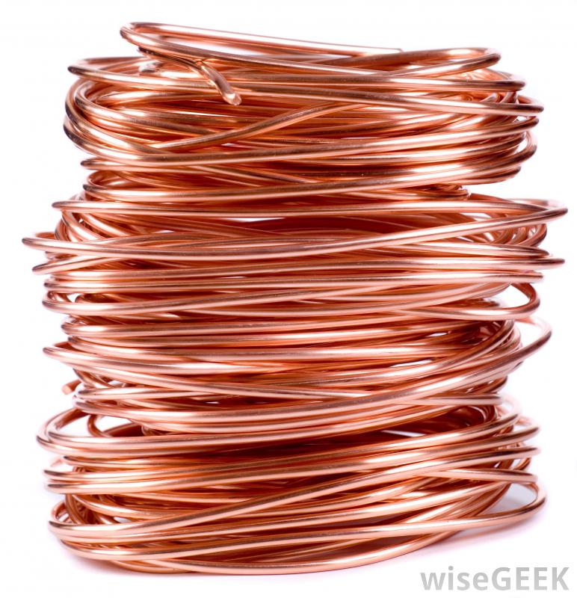
Conductors and Insulators:
Conductors conduct electricity.

Slide 14
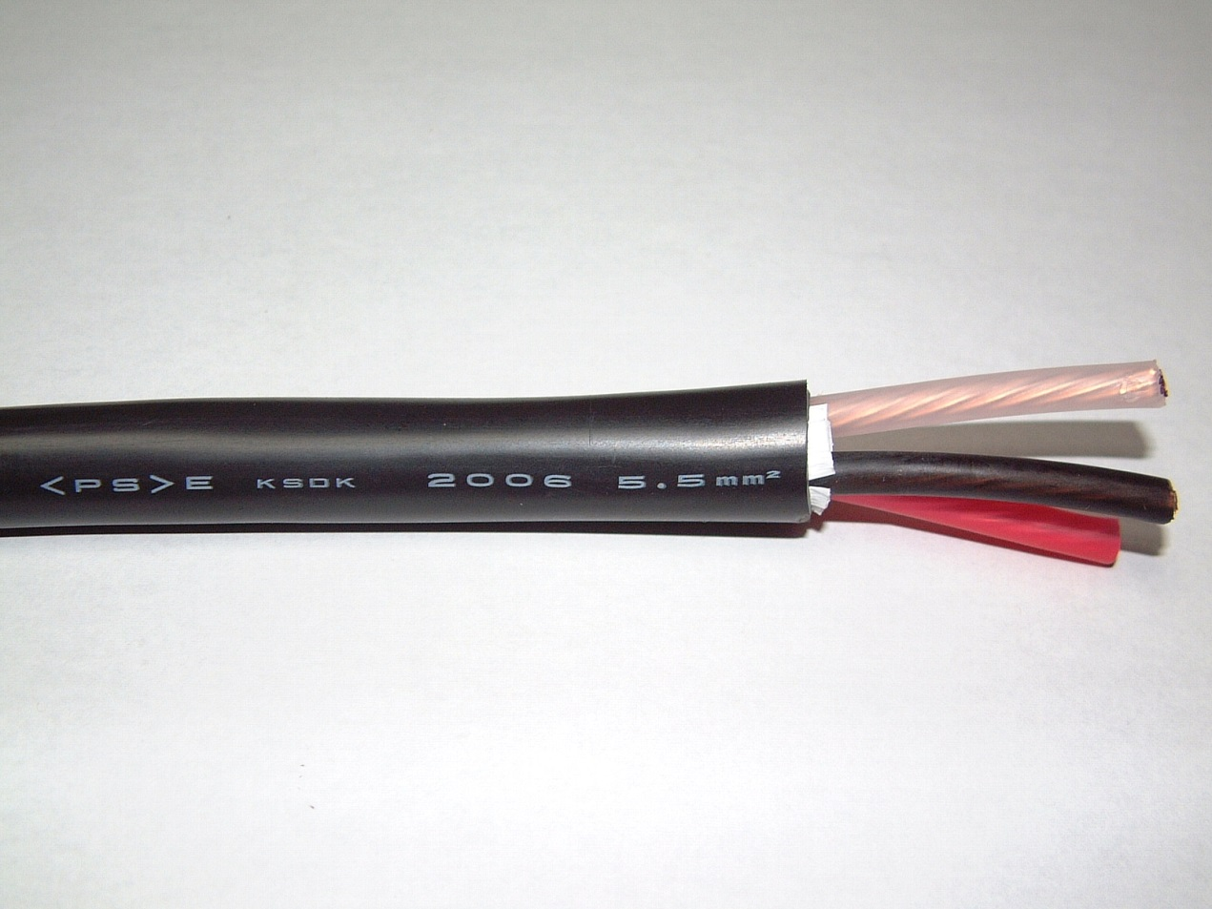
Insulators do not conduct electricity very well if at all.

Slide 15
Electric current:
A quantity of electrons flowing past a point in time. (Ampere or amp)
Diagnostic imaging uses milliamperes (mA) to regulate the number of electrons used to produce xray photons. Adjusting this determines the number of electrons flowing past a given point.
Increasing the mA will darken an image or increase the density. Decreasing the mA will decrease the density of the image.

Slide 16
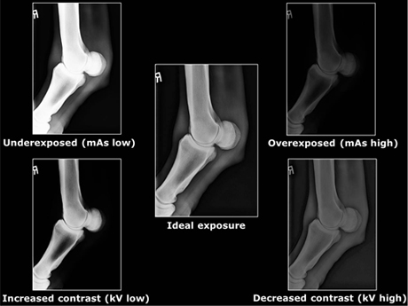

Slide 17

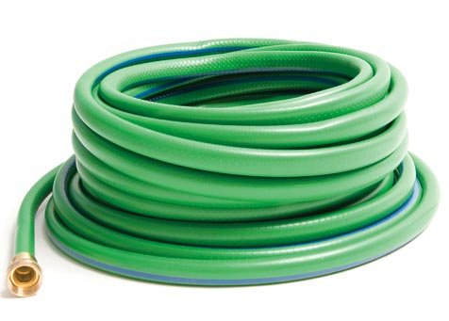
We require some method of reducing the amount of current flow. The ohm is a unit of resistance.
Potential difference: causes the electrons to travel from one end of a wire to the other.
Small hose has a lot of resistance, larger hose gives less resistance if the same amount of water is sent through both.
Notes:
Hose is stored, very little water throughout the hose but great deal of potential in the faucet
When faucet is turned on, one end has no water and the other has a lot with more coming.
Potential difference is the measurement of the full hose compared to the empty hose.

Slide 18
Voltage:
Potential difference. The force that draws the electrons from an area of excess at one end of the circuit to an area deficient of electrons at the other area of the circuit.
The strength of the electron flow is the volt.

