Slide 1
Diagnostic X-Ray Production
Lavin: Chapter 4
CTVT: 519-523

Slide 2


Slide 3
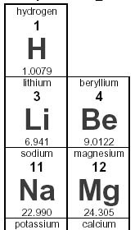
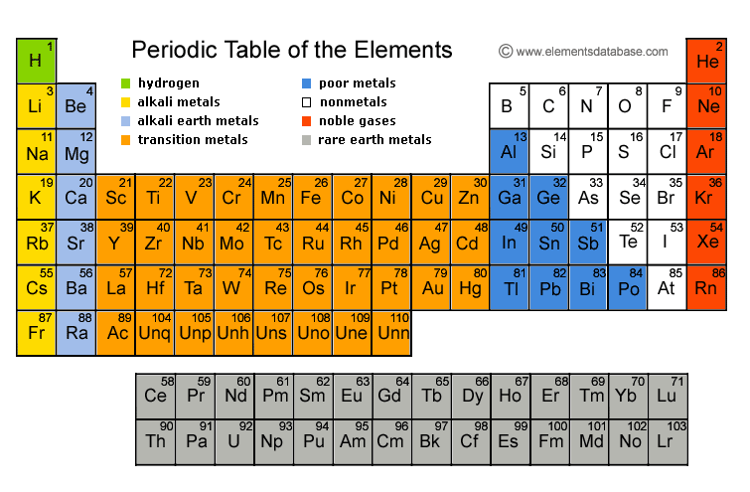
Periodic Table
Notes:
Followup:
Atoms vs elements
Atoms – smallest particle of an element – 1 or many
Elements – a basic substance that can’t be simplified (hydrogen, gold, lead, etc.)
Molecule – 2 or more atoms chemically joined together
Compound – a molecule that contains more than 1 molecule

Slide 4
To review…
As the wavelength of x-ray photons shortens, the energy of the x-ray beam will
  Increase
  Decrease
  Lengthen
  Stay the same

Slide 5
To review…
As the wavelength of x-ray photons shortens, the energy of the x-ray beam will
  Increase
  Decrease
  Lengthen
  Stay the same
Notes:
Indirect proportionality – Shorter wavelength = higher frequency

Slide 6
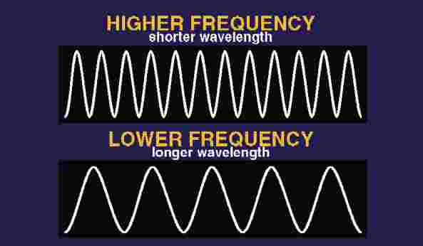
Don’t forget…
High frequency = shorter wavelengths = penetrates farther
Lower frequency = longer wavelengths = less penetration

Slide 7
To review…
Which of the following is a physical property of x-rays?
  Travel in straight lines
  Refract & reflect similar to visible light
  Are visible in the dark
  May be deflected by magnets

Slide 8
To review…
Which of the following is a physical property of x-rays?
  Travel in straight lines
  Refract & reflect similar to visible light
  Are visible in the dark
  May be deflected by magnets
Notes:
Travel straight until interacts with matter, then direction alters
Photons have no electrical charge so are unaffected by magnetic or electric fields
Cannot be refracted or reflected

Slide 9
To review…
X-rays
  Are measured in meters
  Have longer wavelengths than radio waves
  Have less energy than radio waves
  Are a type of electromagnetic radiation

Slide 10
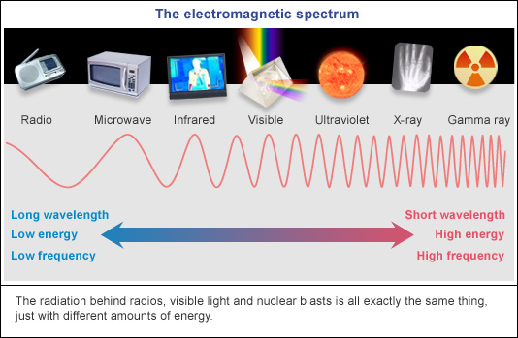
To review…
X-rays
  Are measured in meters
  Have longer wavelengths than radio waves
  Have less energy than radio waves
  Are a type of electromagnetic radiation
Notes:
Measured in waves
Shorter wavelengths than radio
Higher energy than radio

Slide 11
Review: Types of Energy
  Mechanical – Energy due to motion or position
      Water, turbines, the earth
  Chemical – Energy from chemical bonds of matter
      Respiration, combustion, explosives, batteries
  Nuclear – Energy released by a nuclear reaction
  Electromagnetic – Energy from a magnetic field produced by the motion of electrical charges
        X-rays, light bulbs, radio waves
  Electrical – Energy made available by the flow of electric charge through a conductor
        Human brain, static electricity, batteries

Slide 12
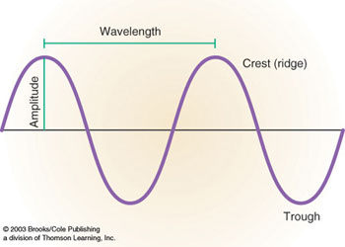
Review: Electromagnetic Radiation
Frequency = Rapidity of waves
Notes:
Waves:
Wavelength = length between crests
Shorter = higher frequency, higher energy
Frequency – rapidity by which waves hit (hertz)
Amplitude – Height of wave crest to trough
Energy & frequency related
Directly proportional
Higher = more penetrating power

Slide 13
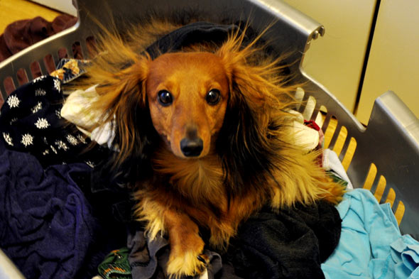
To review…
What are the 3 ways an object can be electrified?
Notes:
Contact
Friction
Induction

Slide 14
An object can be electrified by:
  Contact –
      Shocking someone
  Friction – Two objects rub together
  Induction –
      Most important in radiology
      Electrical fields act upon each other without contact
      Used in radiographs, x-ray tubes, transformers, and electric motors
Notes:
Friction – glass & resin
Induction – Giving rise to something
Lightning is induction:
Clouds build up excess electrons when form thunderheads
Ground is neutral
Discharge to ground – instant, loud
Conductors & insulators:
Conduct easily – water, copper
Don’t conduct – rubber, plastic, glass

Slide 15

Electrical circuits require…
Amperage (Milliamperes or mA’s)
    Unit of current
    Regulates electrons to produce x-rays
Resistance (ohms)
    The opposite of current flow
Potential Difference (volts)
    Causes electrons to travel
    Electromotive force – draws electrons from high to low #’s
    Volt – The strength of the potential difference
Notes:
Resistance
Diameter impacts
Small = lots of resistance
Large = little resistance
Potential difference
Garden hose:
Empty = no water but lots of potential
Faucet turned on = moves according to potential difference
Potential difference is empty hose compared to full

Slide 16
Learning Objectives: Chapter 4
Understand the mechanical components both inside and outside of an x-ray unit
List & describe the parts of an x-ray tube and trace the creation of an x-ray
Describe the line focus principle and its application in radiography
Define the focal spot, and understand problems that can occur with it
Define the anode heel effect

Slide 17
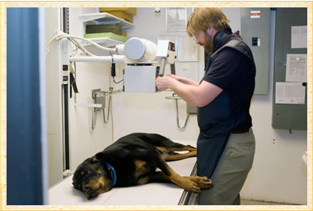
Steps in Creating A Radiograph
Getting power to the unit and tube
Heating the tube & producing energy
Converting energy to x-rays
Focusing the beam
Exposure
Development of the latent image
Adjusting settings as needed for a diagnostic radiograph

Slide 18
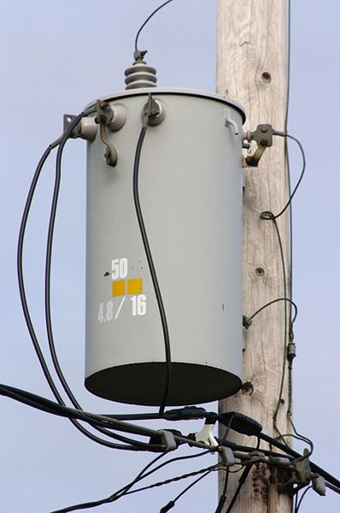
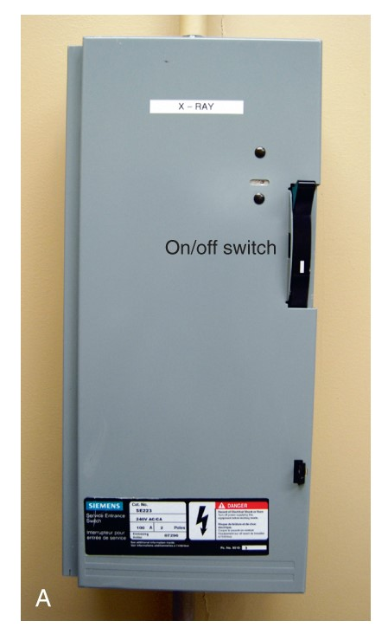
Getting Power to the Unit
Power travels from plant to clinic
    Transformers boost power
On-off switch completes the circuit
  Wall switch required by law
Line voltage compensator
  Increases/decreases incoming voltage
Safety precautions in place
  Circuit must be grounded
  Circuit breakers
Notes:
Breaking the circuit:
Burnt out light bulb
Fine wire that forms the cathode burns out in heat of electron flow
Circuit is interrupted & light goes out
Mouse eating through cord – conducts energy & dies
Line voltage compensator
Standard equipment, usually automatic
Circuit breaker
Power supply to x-ray unit
Power reaches it first
Accepts amperage up to its limit or “rating”
Works like a fuse except fuse melts
Hits limit = power interrupter
Grounded
Electricity needs an alternate route if circuit breaks inappropriately
Original circuit directed safely to ground wire

Slide 19
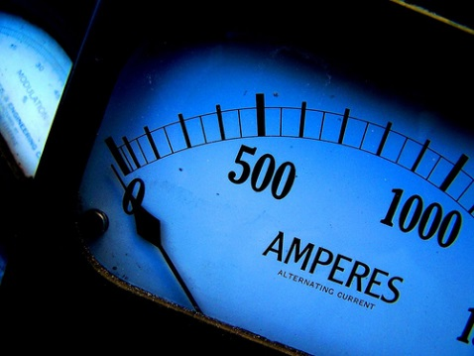
Amperage & Milliamperage
Amperage = unit of current
  Milliampere = 1/1000 ampere
Radiology uses mA to regulate the number of electrons used to produce x-ray photons
Notes:
Photon - a tiny particle of light or electromagnetic radiation
Ohm = unit of resistance
Volt = difference in potential

Slide 20
Getting Power to the X-Ray Tube
3 transformers in an X-ray circuit:
  Autotransformer – Steps up voltage
    Operator selects kV’s to produce radiograph
  High-voltage transformer
    Final step-up to boost voltage
    Boosts voltage from 220 to 125,000 volts
  Filament transformer
    Steps down voltage to the x-ray tube filament
    Filament must reach correct temperature
Notes:
Transformers – Receive power from incoming lines & transform power to the x-ray tube
Method of electrification in a transformer is induction

Slide 21
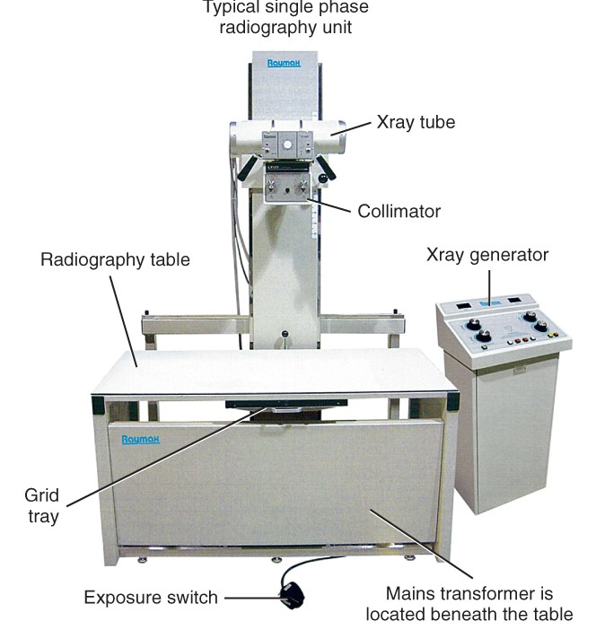
X-Ray Unit
3 essentials to every unit:
Control Panel
X-Ray Tube
High-Tension Transformer

Slide 22
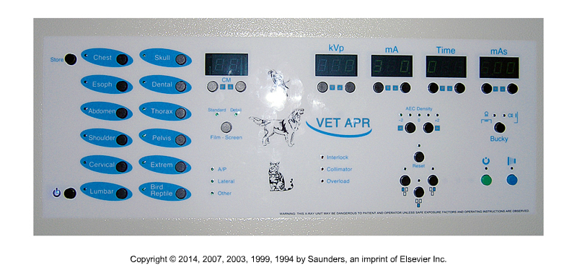
Operator Console

Slide 23

How are X-Rays Produced?
When electrons are slowed or stopped by the atoms of a target area, x-rays are produced.
This target area is inside the x-ray tube.
Once the electrons strike the target area, an x-ray beam is created.

Slide 24
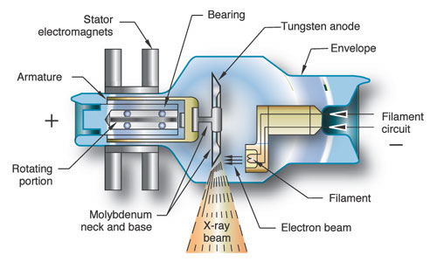
The X-ray Tube
Tube Housing:
Controls leakage & off-focus radiation
Helps to cool the tube
Notes:
Source of x-rays is tube
Interaction of photons & anode generates extreme heat
Ratio of x-rays to heat is 99:1
Housing or envelope usually made of Pyrex

Slide 25
Let’s break the process down…
Xrays are generated in an xray tube
We need 5 elements to produce xrays
A source of electrons
A way to accelerate the electrons
An obstacle free path
A target
An envelope or tube to provide a vacuum environment

Slide 26
The Cathode…
Provides a source of electrons and directs the electrons towards to anode.
The cathode has a coiled wire filament that emits electrons when heated. This filament is similar to one found in a light bulb. When the filament is heated electrons are held less tightly and become excited. They can now travel to the anode.

Slide 27
The amount of energy in the circuit is referred to as milliamperage (mA) This controls the heat of the filament which in turn controls the number of electrons.
Acceleration of the electrons is controlled by the kilovoltage.

Slide 28
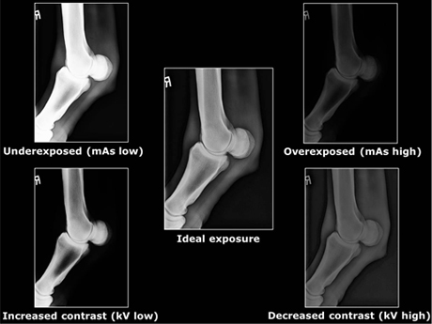

Slide 29
The anode:
A beveled target placed on a cylindrical base.
The base is usually made of copper which acts as a conductor of heat. It draws the heat away from the tungsten target.
There are two types of anodes. Stationary and rotating.

Slide 30
Small animal installed units use rotating anodes. Portable units use stationary anodes.

Slide 32
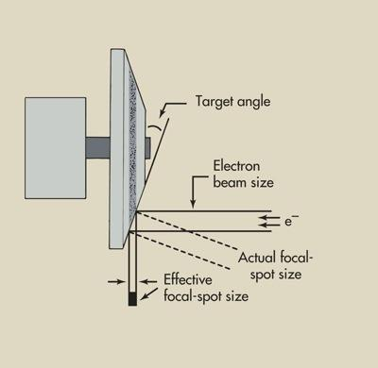
The Line Focus Principle
Describes how electrons interact with anode & change direction
Directs x-rays onto patient
Angles target to create a smaller effective focal spot size
Narrows the beam and increases resolution
Sharpens the final image
Notes:
NOT BAD
Typical angle is 11 degrees
15 degrees – widens the beam
< 15 degrees – narrows the beam
Actual vs effective focal spot

Slide 33
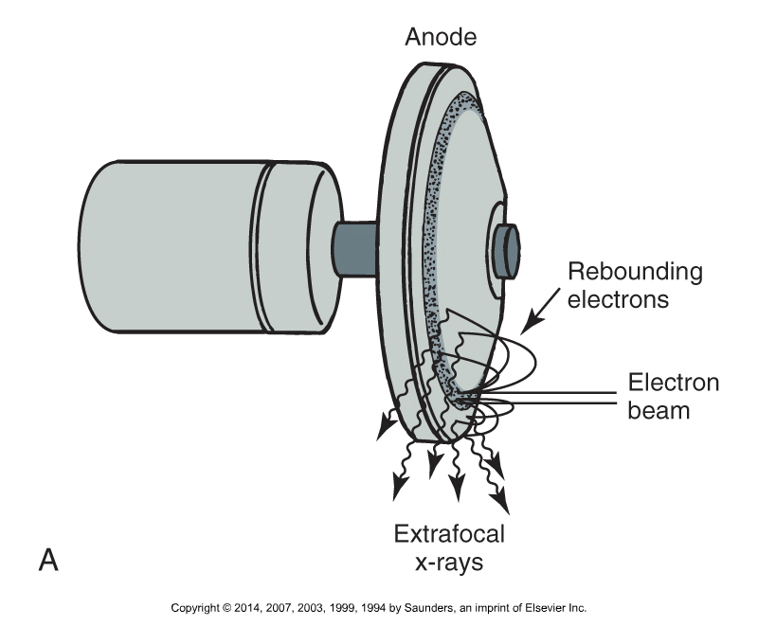
Possible Focal Spot Issues
Off-Focus Radiation:
  “Extrafocal" radiation
  Produced by electrons bouncing off & impacting the anode outside the focal spot
  Collar of lead around tube normally prevents
  Can appear as artifact

Slide 34
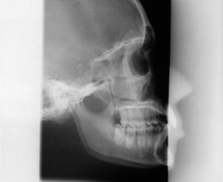
Off-Focus Radiation

Slide 35
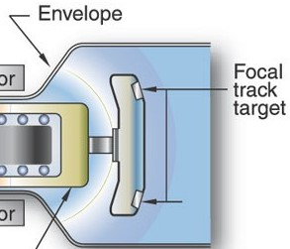
Additional Focal Point Issues
Focal Spot/Heat Bloom:
  Anode gets too hot and is not allowed to cool
  Outer edges of focal spot expand
  Enlarges effective focal spot
  Image loses sharpness
Notes:
Focal Spot Bloom: The focal spot size enlarges as milliamperes increase owing to the repulsion of adjacent electrons. This effect is called blooming.
BAD

Slide 36
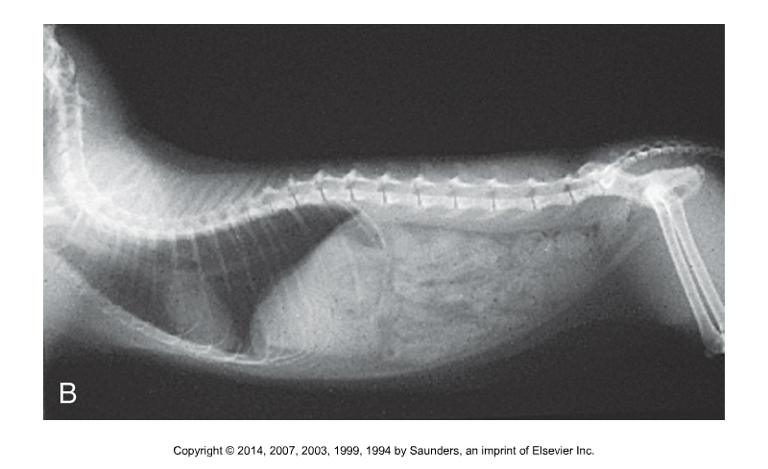
Focal Spot Bloom

Slide 37
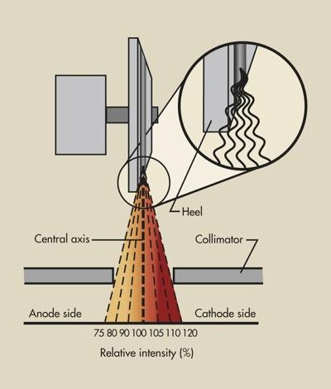
The Anode Heel Effect
Causes the Intensity of radiation to be greater on the cathode side of the tube
Bevel of the anode limits x-rays produced on anode side
Place thicker end of patient on the cathode side
  Head usually to right
Notes:
NOT BAD – Can be used

Slide 38

The Exposure Switch
The final step in producing an x-ray
Sets the events in motion
Usually 2-stage
  Wait for ready signal
  Can be hand or foot switch
  1st stage activates the rotor & transformers
  2nd Stage activates the exposure through the tube
Be familiar with the noises
  They may scare your patient – be ready!
  Sound of boiling liquid is bad – tube could rupture
Notes:
“Dead man” safety factor
Meet again at 10:05 for group activity
Beginning to look at radiographs!

Slide 40

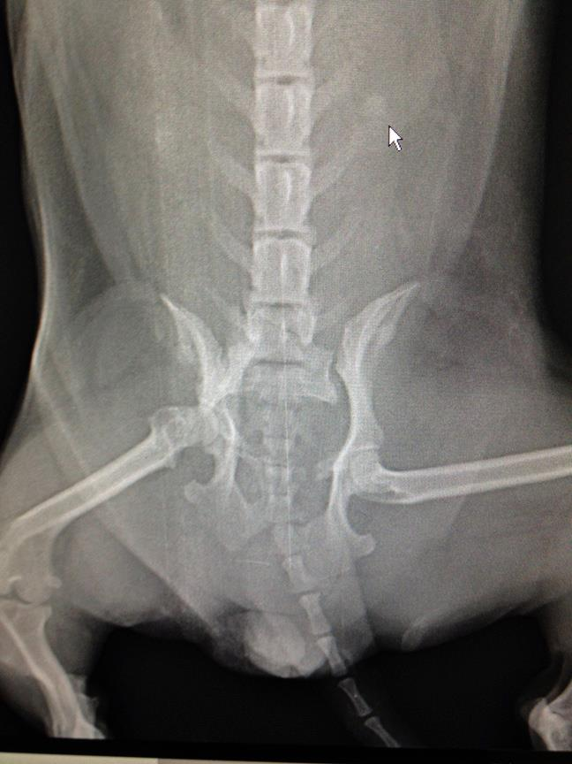
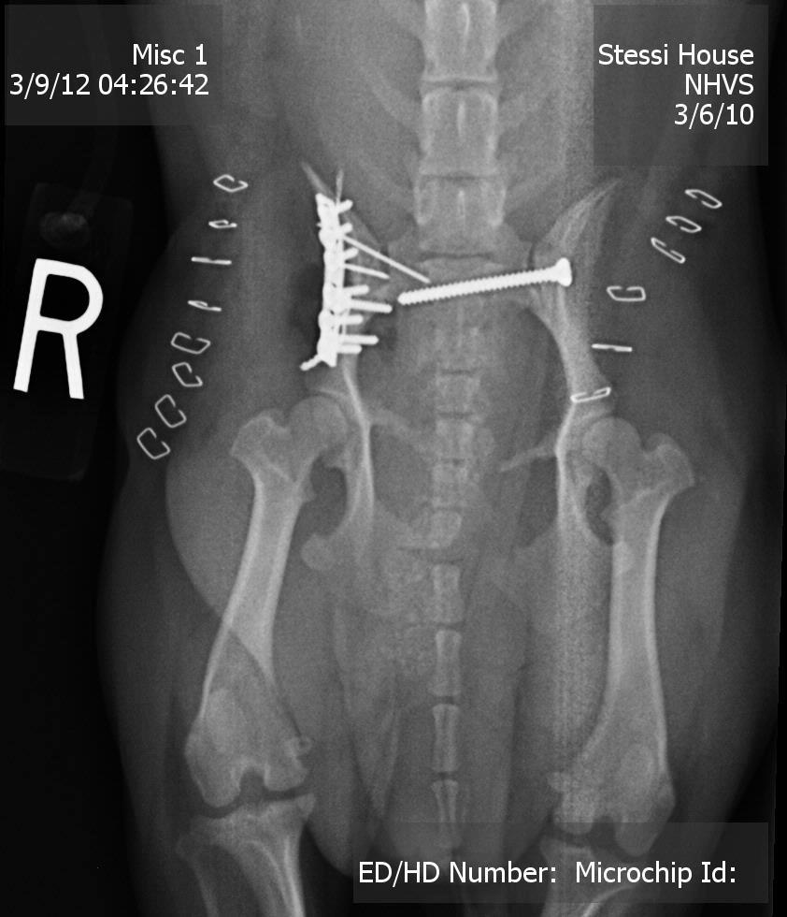
What makes a good radiograph?
“Gracie”
Notes:
HBC/Compassion fatigue?
Diagnostic:
Correct anatomy
Symmetry
Landmarks
Correct view
Correct density
Correct contrast
Diagnostic
Danger of non-diagnostic?
Treatment errors
Retakes
Increased exposure
Fractious animals
Time
Supplies
Equipment wear

Slide 41
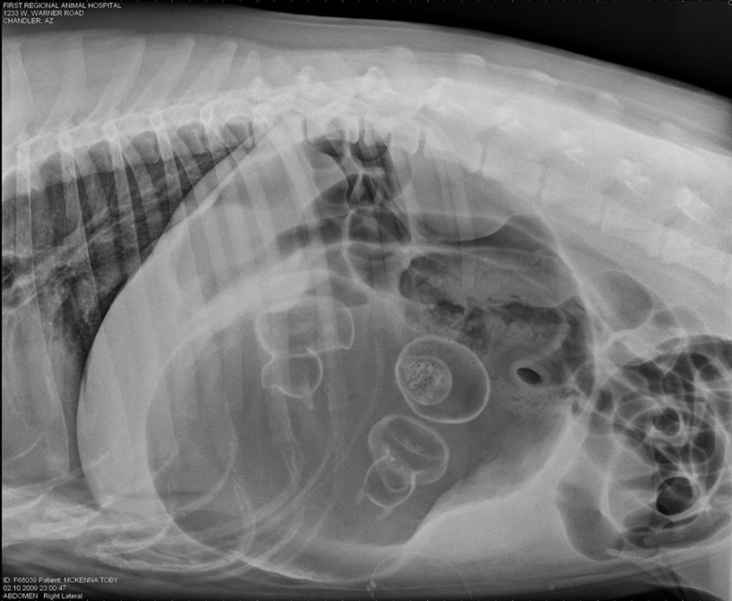
Why is radiology important?
Allows us to visualize inside an animal in a non-invasive way…
      Diagnosis
      Treatment
      Guidance
Notes:
Diagnosis
Bones
Growths
Tissues
Results of treatment
Treatment
Ultrasound - High frequency sound waves
Break up blockages (kidney stones)
Radiation therapy - cancer
Guidance
Guidance of instruments through the body
Fluorescent markers
Ultrasound & MRI

Slide 42
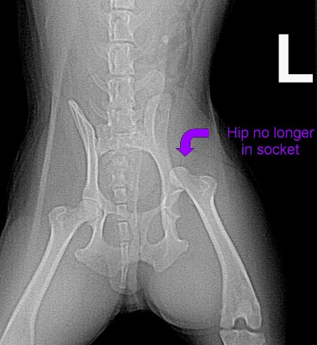
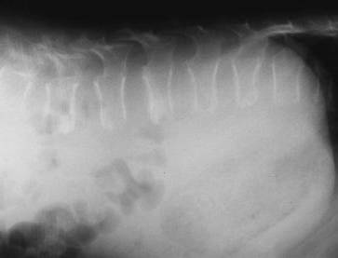
What makes a diagnostic radiograph?
Notes:
Diagnostic:
Correct anatomy
Symmetry
Landmarks
Correct view
Correct density
Correct contrast
Diagnostic
Danger of non-diagnostic?
Treatment errors
Retakes
Increased exposure
Fractious animals
Time
Supplies
Equipment wear

Slide 43
Questions To Ask Yourself…
Is this the view ordered by the DVM?
Is the correct body part clearly in view?
Is the body aligned properly?
Is the radiograph dark enough, but not too dark?
Are the differences between body structures clear?
Are there obvious artifacts?
Notes:
Diagnosis
Bones
Growths
Tissues
Results of treatment
Treatment
Ultrasound - High frequency sound waves
Break up blockages (kidney stones)
Radiation therapy - cancer
Guidance
Guidance of instruments through the body
Fluorescent markers
Ultrasound & MRI

Slide 44
Group Assignment: What Makes a “Good” Radiograph?
Divide into groups
Discuss each radiograph as a group:
  Is there a clear body part of interest, and what is it?
  Can you tell the species?
  Is it a “good” or diagnostic radiograph?
  Does it appear to be OK as is, or should something be changed?
  Any other observations?
Turn in your findings as a group
  Include your names & the date
  **We’re just looking for general observations at this point**

Slide 45
What’s Next?
Tomorrow: Film imaging
  Lavin: Chapter 5
  CTVT: 532-536
      Image formation with screen systems
      through (and including)
      Grids
Friday: Technical factors & technique charts
  Lab Groups due
  Seating chart final
Test next Wednesday

Slide 47
To review…
To produce x-rays, a great deal of energy in an x-ray tube is converted to heat. The ratio of heat generated to x-ray production is considered to be
  1%:99%
  99%:1%
  50%:50%
  75%:25%

Slide 48
To review…
To produce x-rays, a great deal of energy in an x-ray tube is converted to heat. The ratio of heat generated to x-ray production is considered to be
  1%:99%
  99%:1%
  50%:50%
  75%:25%
Notes:
Temps in excess of 2000 degrees C are required to loosen electron binding energy

Slide 49
To review…
During an exposure, electrons in the x-ray tube travel from the
  Anode to the cathode
  Anode to the target
  Cathode to the anode
  Cathode to the filament

Slide 50
To review…
During an exposure, electrons in the x-ray tube travel from the
  Anode to the cathode
  Anode to the target
  Cathode to the anode
  Cathode to the filament

Slide 51
The X-ray Tube
Tube Housing:
Controls leakage & off-focus radiation
Helps to cool the tube

