Slide 1
Copper
(Cu)
Brittany Abrams, Megan Alvarez, Arlanda Coleman, Jency Dishman, Keri Dobitz, Donetta Hernandez, Marlen Quintanar, Sara Rivera, Lois Stovall, LaPorcha White
Vet Tech Institute of Houston

Slide 2
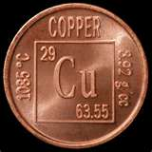


Copper as a trace element…
The amount of Cu in the adult body is estimated to be between 100 – 150 mg
The majority is stored in the liver

Slide 3
Copper is required for:
Formation of hemoglobin, red blood cells, and bones
Cardiac function
Cellular respiration
Connective tissue development
Immune function
Pigmentation of hair, eyes, and skin
  Primary element in the production of melanin
Myelin formation

Slide 4
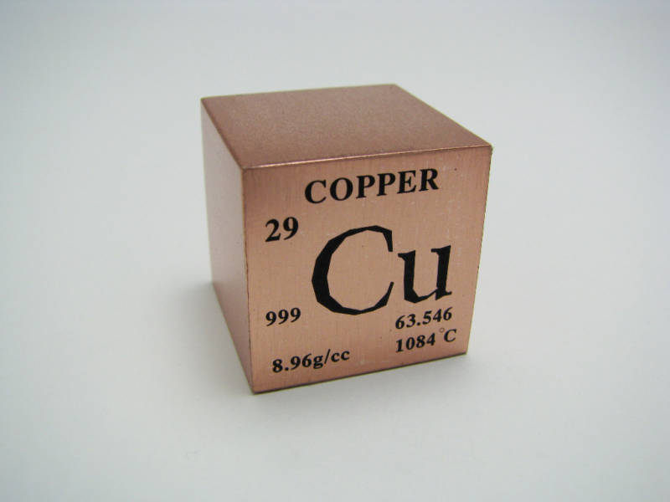
Copper Deficiency
Rare
  Stored well within the body
  Even poor diets usually provide enough copper for the body’s needs

Slide 5
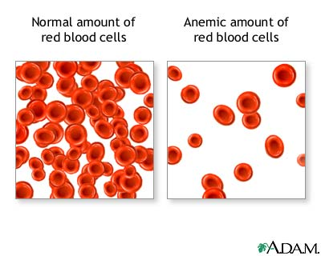
Deficiency
Symptoms
  Anemia
    Low Cu levels mean Iron is usually also in short supply
    Low hemoglobin production = Low oxygen levels in the blood

Slide 6



Decreased growth
Depigmentation
Reproductive failure

Slide 7
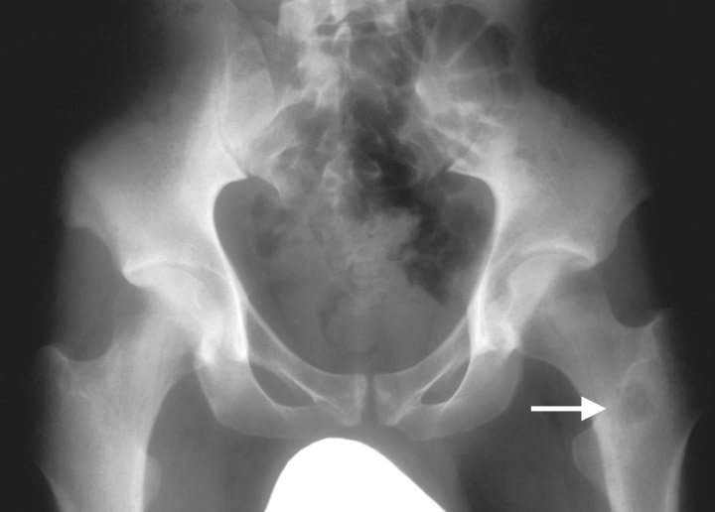
Bone lesions

Slide 8
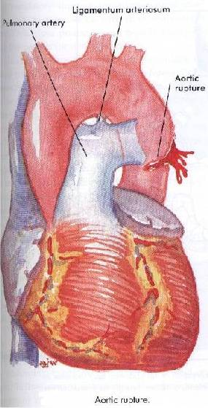
Aortic rupture
High intake of fructose can make a Cu deficiency worse
Craving chocolate may be linked to insufficient Cu levels since chocolate is naturally high in Cu

Slide 9



Copper Excess
Copper-Storage Hepatopathy or Hepatotoxicosis
  Seen in canines
  Abnormally high amount of copper in the dog’s liver
  Leads to hepatitis and scarring of the liver (cirrhosis)

Slide 10

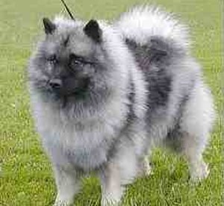

3 Categories of Copper Storage Hepatopathy
  Subclinical disease
    Disease is affecting the liver, but there are no symptoms or changes in behavior
  Sudden Acute disease
    More often affects young canines
    Hepatic necrosis resulting in death
  Chronic Progressive disease
    More often seen in middle-aged dogs with severe hepatitis

Slide 11

Interactions
Assists in the utilization of iron
  Cu imbalance may interfere with the binding capacity of iron
Copper balance can be upset by high intakes of fiber, iron, or vitamin C

Slide 12
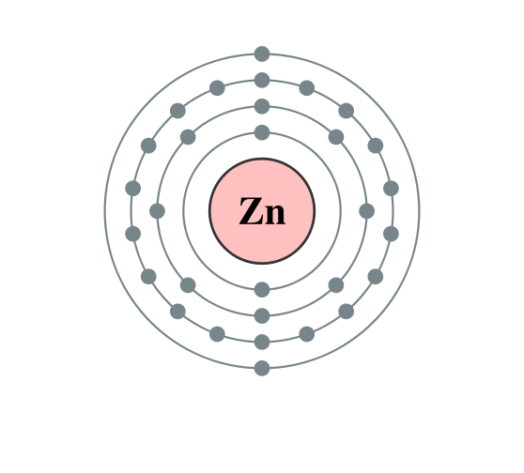
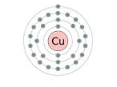
Copper and Zinc
If Cu levels increase, the body’s ability to absorb Zn is decreased and vice versa.
Unbalanced copper/zinc ratios noted in males who have a history of aggressive behavior

Slide 13
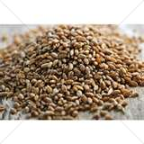
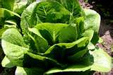
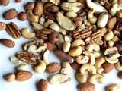
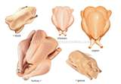
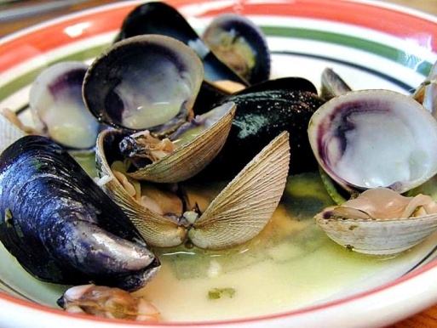
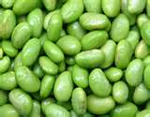
Sources of Copper
Whole grain cereals
Leafy green vegetables
Nuts
Poultry
Shellfish
Soybeans
Organ meats
Molasses

