Slide 1

Electrocardiograms

Slide 2
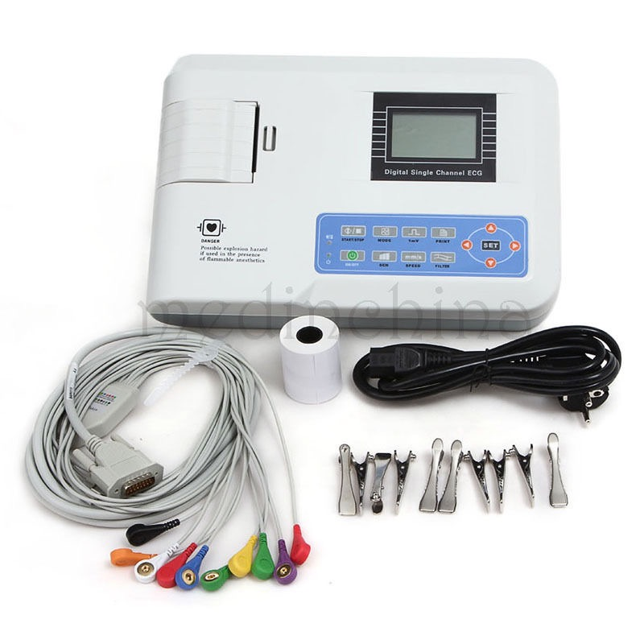
What is it?
Measures electrical activity of the heart
that is produced by the myocardium
  Produces a graphic recording
  Can be printed for further review
Electrodes are attached to the skin
Sticky pads or alligator clips

Slide 3
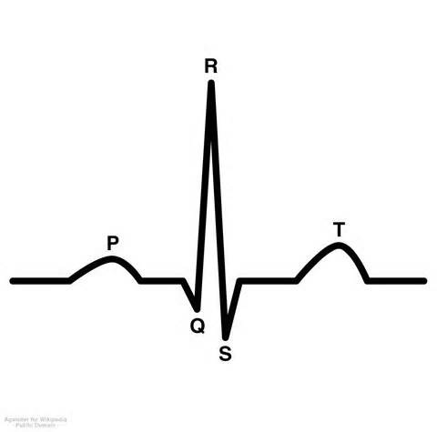
Indications for ECG
Shock
Fainting
Seizures
Anesthetic monitoring
Murmur heard during exam
Suspected/known cardiac disease
Electrolyte imbalances

Slide 4
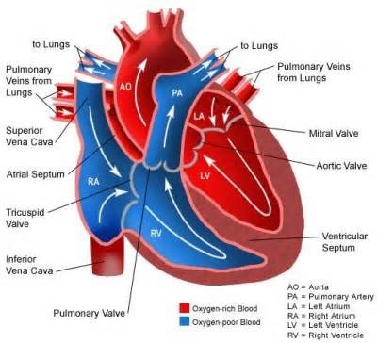
Circulatory System
Unoxygenated blood enters in the ________ side of the heart and then goes to the lungs
Oxygenated blood leaves the lungs and enters
the ________ side of the heart and goes to the body
Veins: carry blood toward your heart
Arteries: carry blood away from you heart

Slide 5
Cardiac Muscle Properties
Automaticity- SA node on it’s own, generates impulse
Excitability- impulse causes muscle to go from resting potential to threshold potential
  “all or none”
Refractoriness- muscle can not be re-stimulated once it reaches threshold potential
Conductivity- stimulation of one muscle cell, produces activity in the adjacent muscle cell
  Dominoes
Contractility- ability to contract
  Expels blood

Slide 6
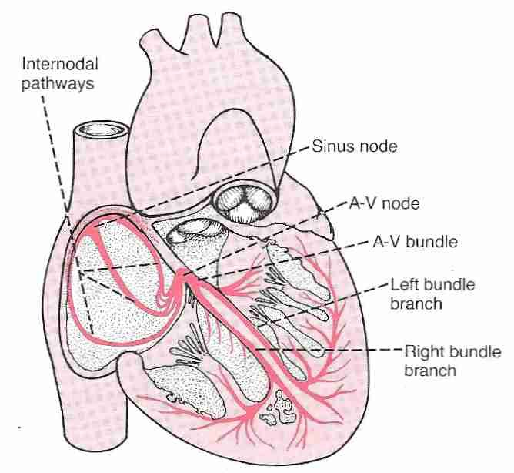
Electrical Pathway
Blood enters atrium
SA node →contract!
  In the right atria
  “Pacemaker of the heart”
AV node →contract!
Bundle of His- throughout ventricular septum
Purkinje fibers- throughout ventricle walls
Repolarization
Depolarization = Contraction
Repolarization = Relaxation

Slide 7
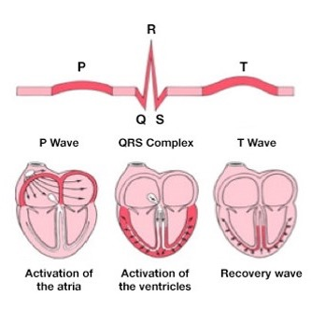
Interpretation of Wave
P wave = Atrial contraction (SA node)
QRS Complex
Q = Ventricular contraction initiated
(AV node fires and sends signal down bundles)
R = Left ventricle contraction (PF)
S = Right ventricle contraction (PF)
T wave = Ventricles relax
Why don’t we see the atria relax?

Slide 8
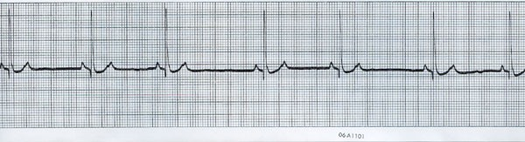
Interpreting the ECG Graph
Standardization signal required
  Choose your paper speed; 10 mm/sec and 25 mm/sec most common
Normals:
P wave- small, positive, rounded
  It’s width = the time required for an impulse to pass from SA node to the AV node
QRS wave- Q and S should be small and negative; R should be tall and positive
  Indicates the time it takes for the ventricles
  to contract
T wave-small, can be positive for negative

Slide 9
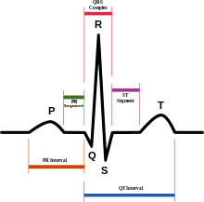
What do the intervals mean?
P-R = time it takes for blood to fill the ventricles
QRS complex = ventricular depolarization
S-T = ventricular repolarization
Q-T = complete contraction and relaxation of ventricles

Slide 10
Calculating Heart Rate
If your paper speed is 25 mm/sec:
Small boxes = 0.04 seconds
Large boxes = 0.2 seconds
  Made up of 5 small boxes
1 “set” = 15 large boxes → 3 seconds
Number of QRS complexes in 1 set x 20 = bpm
Ex. If you count 6 QRS complexes in 1 set
6 x 20 = 120 bpm

Slide 11
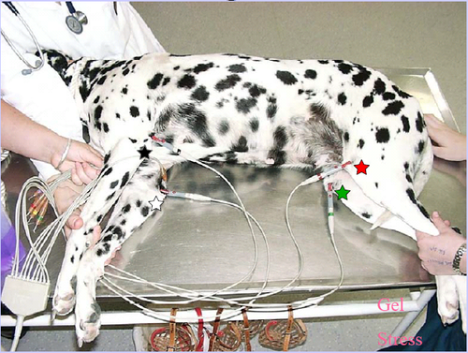
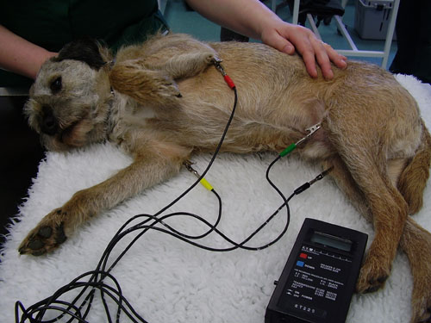
Patient Set Up
Right lateral recumbency
Electrode attachment
  Colors
  Gel/alcohol
    What does this do?
Remove any electrical equipment
Minimum of 30 second reading
  2 minutes is ideal
Some machines can link to a telephone to be read
by a specialist

Slide 12
THE EnD
Now its your turn!

