Slide 1
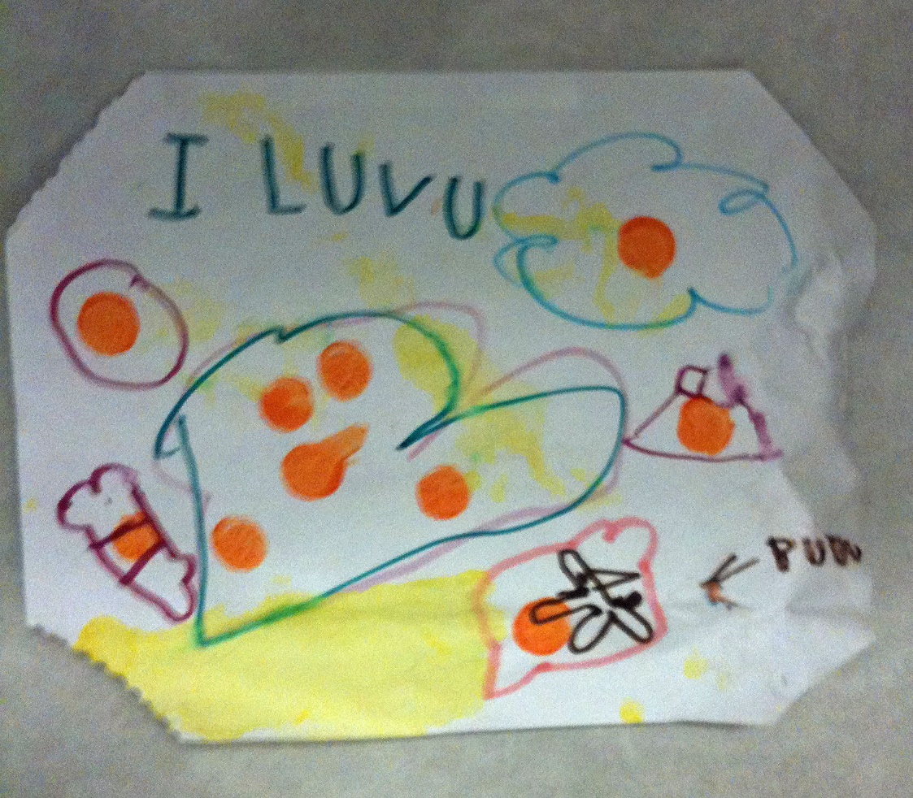
Radiographic Positioning
Lavin: Chapter 17

Slide 2
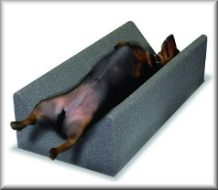
Learning Objectives
Understand the proper anatomical positioning terminology used in veterinary radiography
Understand common rules for radiographic positioning
Describe patient preparation and positioning aids
Understand the normal required radiographic views
List positioning guidelines

Slide 3
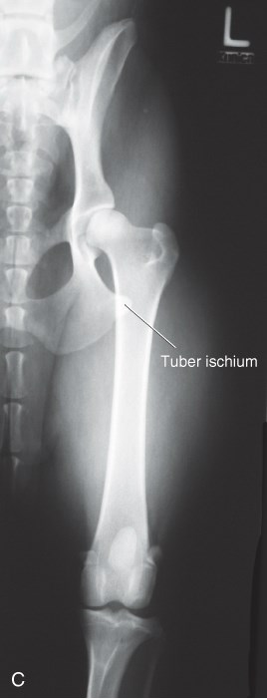
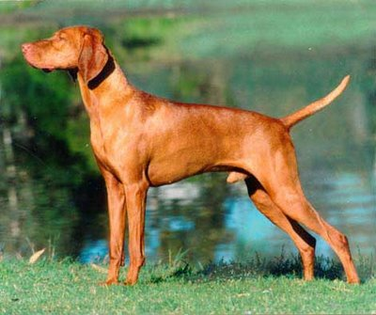
Limb Terminology
Caudal:
Towards the tail from any given point
Aspects of limbs above the carpal and tarsal joints that face the rear of the animal
CrCd Femur

Slide 4
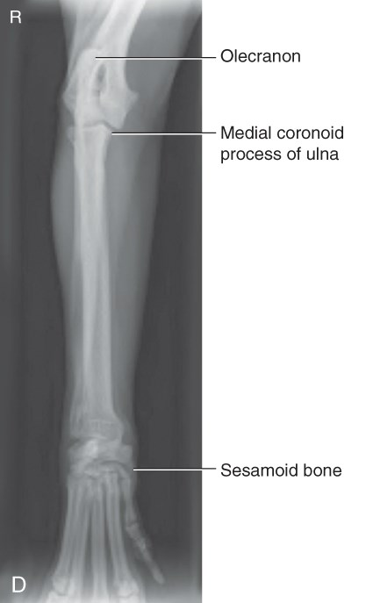
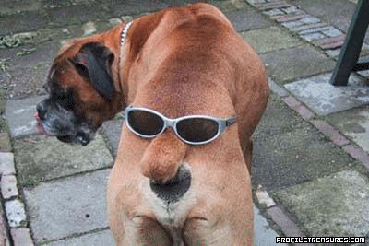
Limb Terminology
Cranial:
Parts of the neck, trunk, and tail positioned toward the head from any given point
Aspects of the limb above the carpal and tarsal joints that face toward the head
CrCd RU

Slide 5
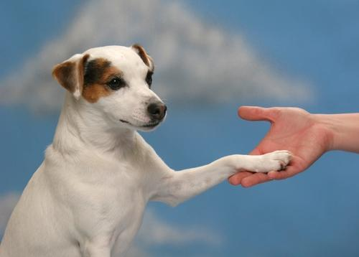
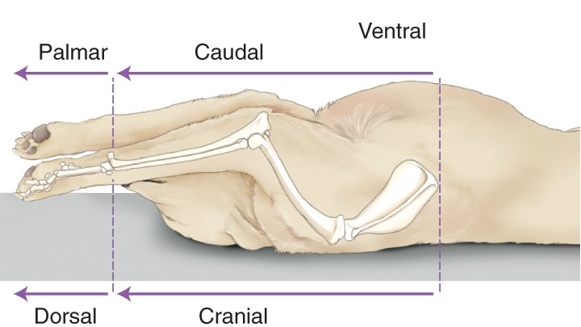
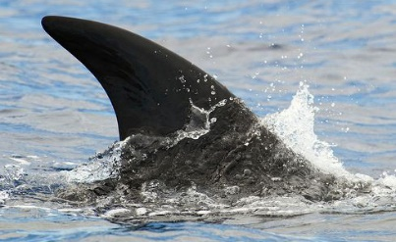
Positional Terminology
Dorsal:
Upper aspect of the head, neck, trunk, and tail
Toward the upper aspect of the animal
Aspects of the legs from the carpus and tarsus joints distally that face toward the head.
Dorsal Recumbency

Slide 6
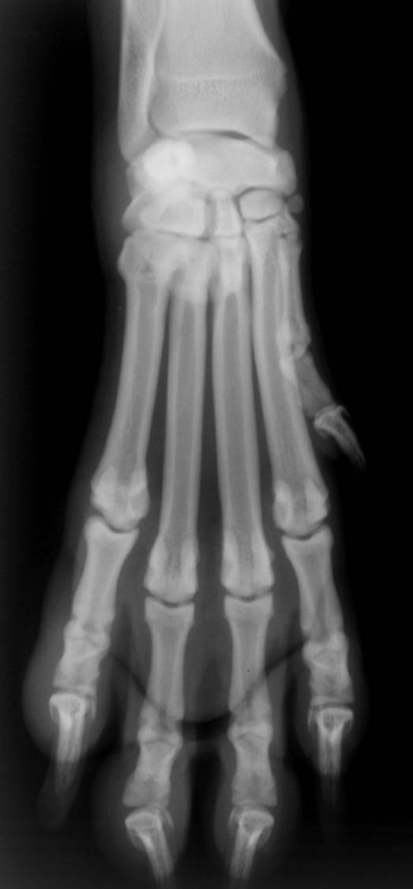
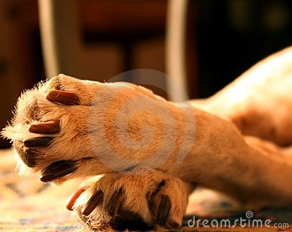
Dorsal Aspect: Metacarpals

Slide 7
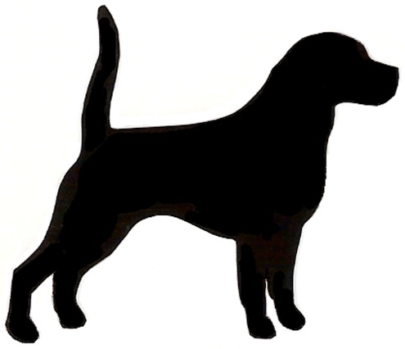
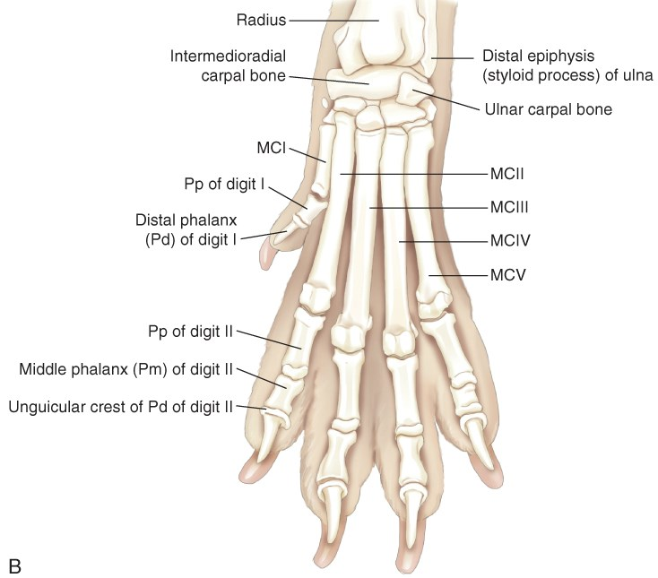
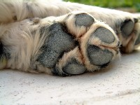
Directional Terminology
Palmar:
Used instead of caudal when describing the forelimb from the carpal joint distally
Plantar:
Used instead of caudal when describing the hind limb from the tarsal joint distally
DPa L Foot

Slide 8
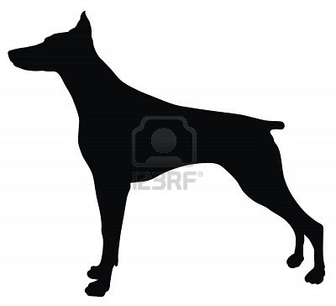
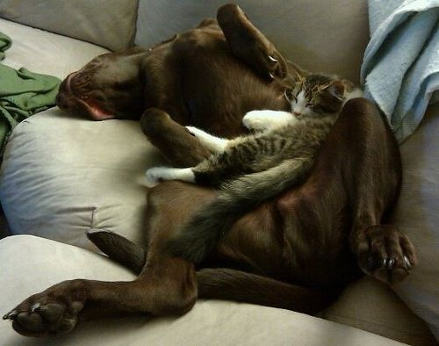
Positional Terminology
Ventral:
Lower aspect of the head, neck, trunk, and tail
Also: towards the lower aspect of the animal
Ventral

Slide 9
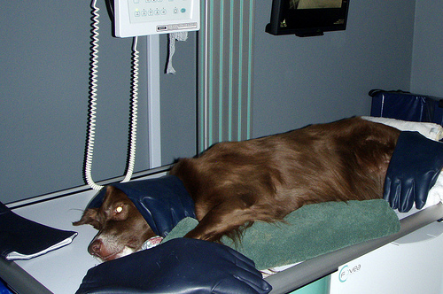
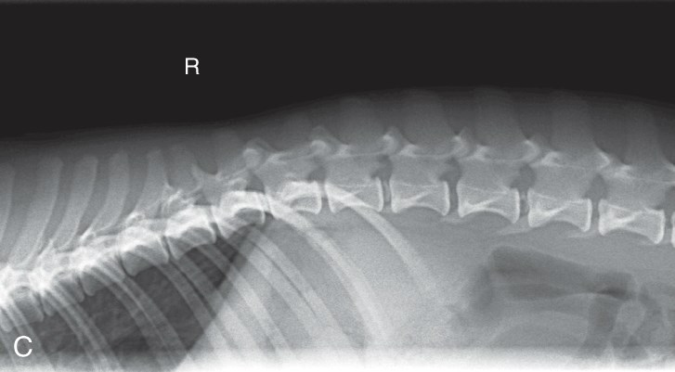
Positional Terminology
Lateral:
From one side to the other
Directional marker indicates side closest to cassette
R Lateral Thoracolumbar

Slide 10
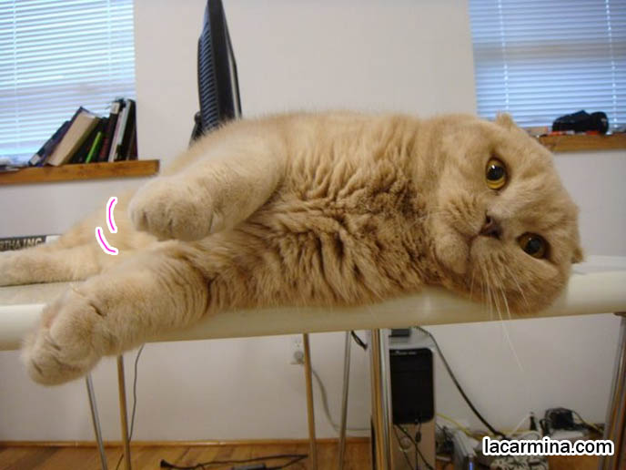
Notes:
L lateral

Slide 11
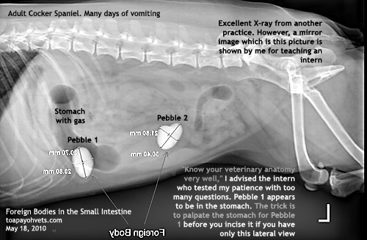
Lateral Abdominal Radiograph

Slide 12
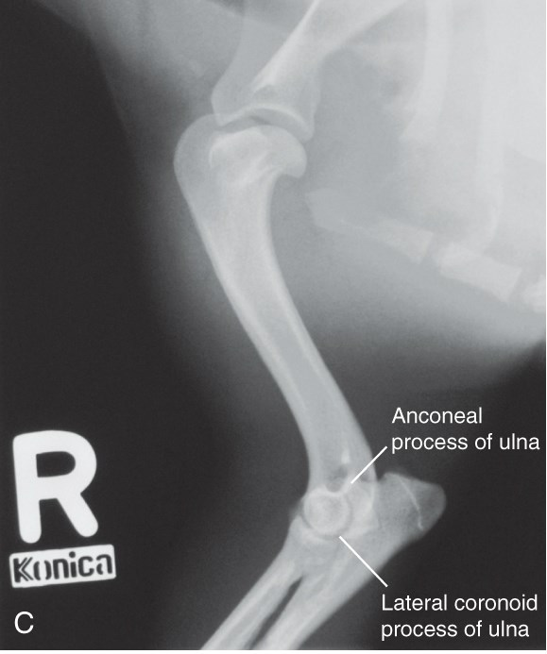
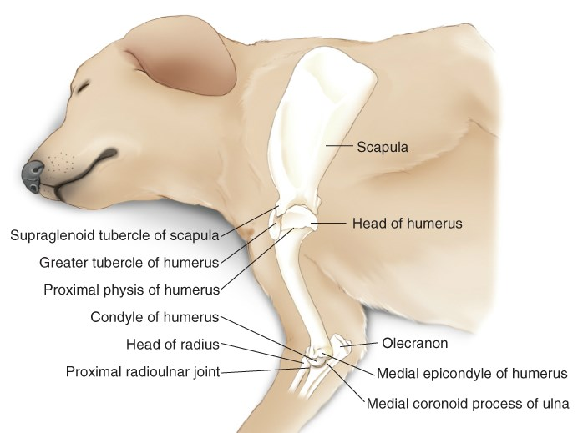
Directional Terminology
Mediolateral (ML):
X-ray beam enters through medial aspect and exits on the lateral side
ML Femur

Slide 13
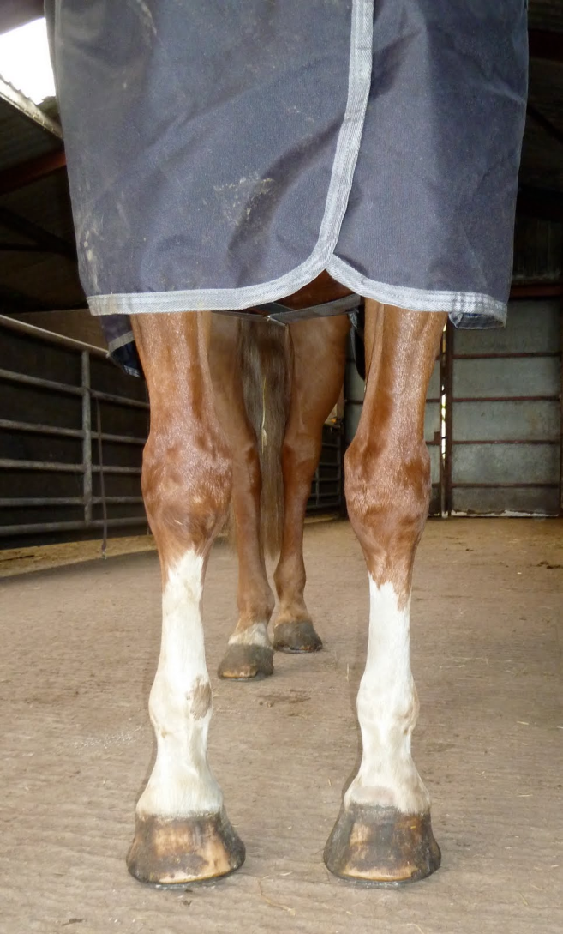
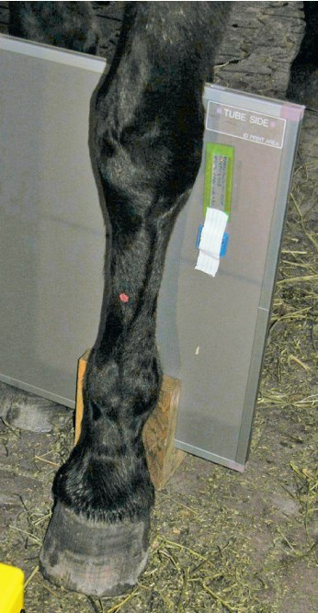
Directional Terminology
Lateromedial (LM)
More common in large animal radiography

Slide 14
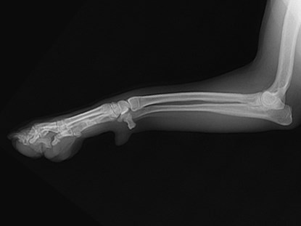
Directional Terminology
Proximal:
Nearer to the point of origin of a structure
Distal:
Away from the point of origin
Proximal
Distal
L Lateromedial R/U

Slide 15
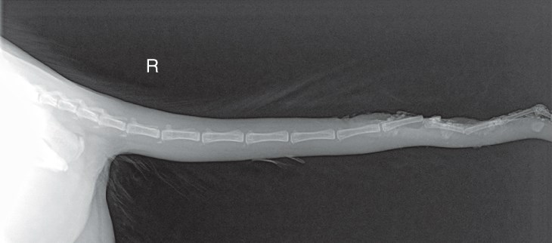
Positional Terminology: Distal

Slide 16
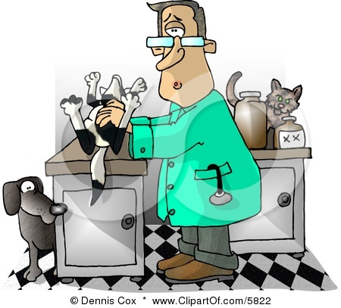
Terminology
Recumbent:
The animal is lying down when the radiograph is made.
Most radiographs of the dog and cat are in a recumbent position.
This position should be presumed unless otherwise stated on the radiograph.

Slide 17
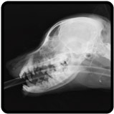
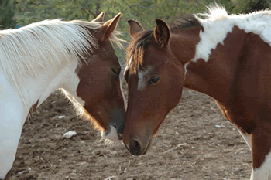
Positional Terminology
Rostral:
Parts of the head positioned toward the nares

Slide 18
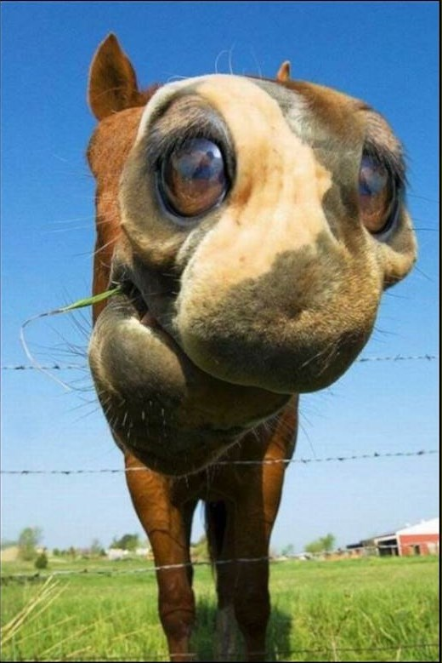
Huh?!?!?
Notes:
Fisheye lens

Slide 19
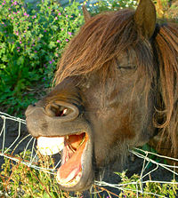
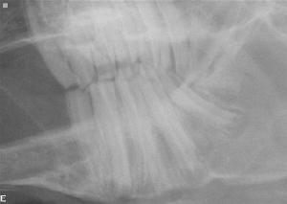
Terminology
Superior and Inferior:
Used to describe the upper and lower dental arcades

Slide 20
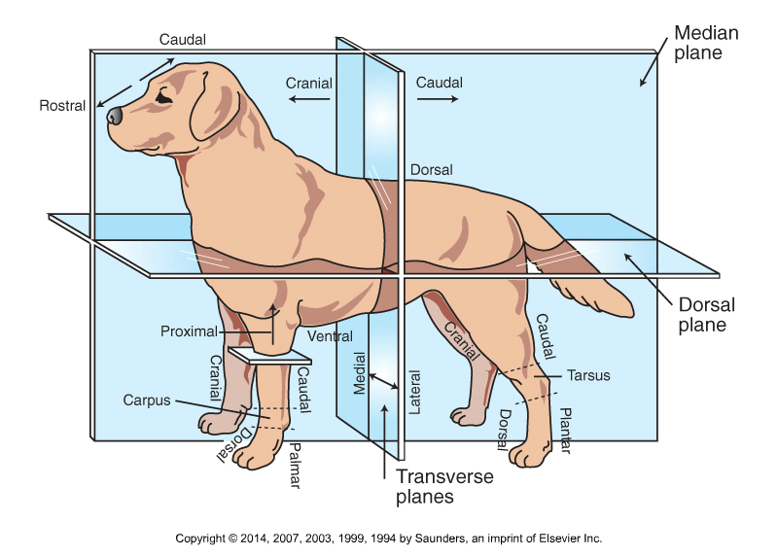
Anatomic Directional Planes

Slide 21
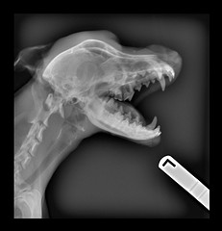
Oblique View
Oblique:
Central ray passes obliquely (not parallel to one of the 3 major axes)
Patient is rotated
Angulation varies
Eliminates superimposition
Naming: Hyphen usually separates entry from exit point

Slide 22
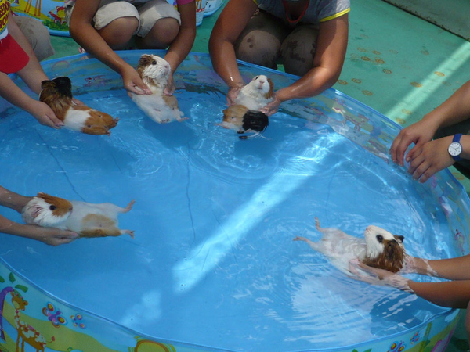
Random ?!?!?

Slide 23
Abbreviations
Left (L/Le) Right (R/Rt)
Dorsal (D) Ventral (V)
Lateral (L) Medial (M)
Cranial (Cr) Caudal (Ca)
Palmar (Pa) Plantar (Pl)
Distal (Di) Proximal (Pr)
Rostral (R)
Oblique (O)

Slide 24
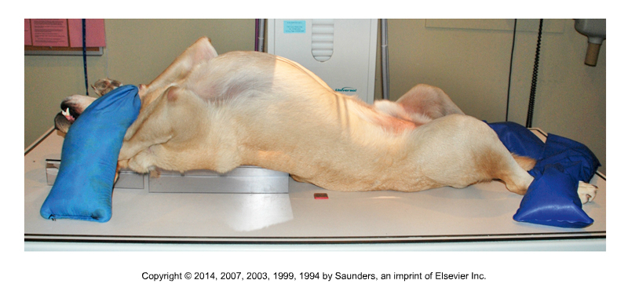
Rules of Positioning
Named according to beam entry and exit point
Lateral recumbency – Label the side patient is lying on
The terms right and left are not combined with others
  Precede combined terms
On head, trunk, neck, and tail – Rostral, cranial, and caudal go first in combined terms
Terms “medial” and “lateral” always come second

Slide 25
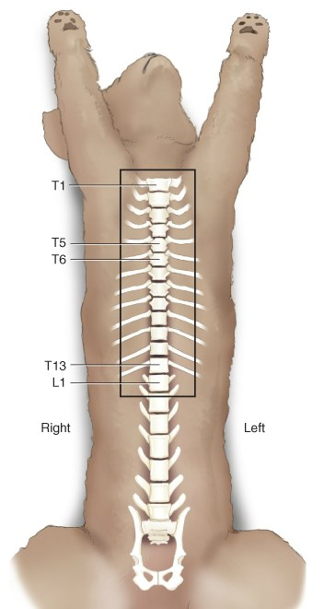
Abbreviations
Abbreviated term designates the direction of the x-ray beam – entry/exit
First letter states where the x-ray beam enters the body, the second designates where it exits.
    V/D – enters ventrally and exits dorsally
    CRCd – enters cranial aspect of front or back leg above carpus/tarsus and exits caudal
    DMPaLO- Dorsomedial Palmarolateral Oblique
      Indicates that carpus is rotated and the central x-ray enters the dorsal/medial surface and exits the palmar/lateral surface
Notes:
Combining 2 terms = usually use “o” as combining vowel

Slide 26
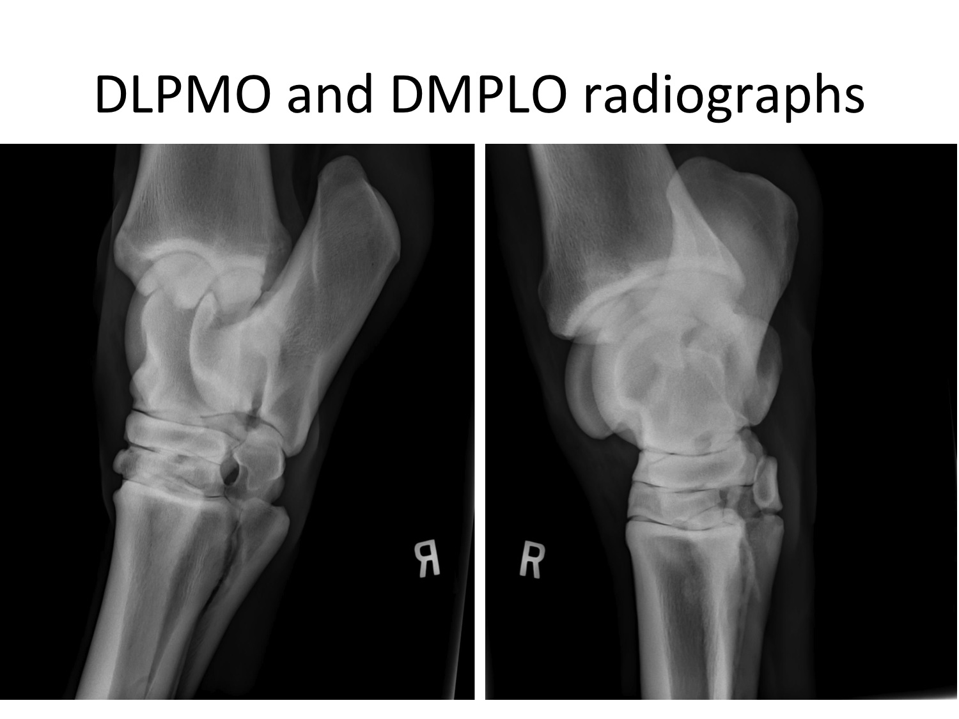
Notes:
10 y/o Gelding – R tarsus
Dorsolateral Palmaromedial oblique (DLMPO)
Dorsomedial palmarolateral oblique (DMPLO)

Slide 27
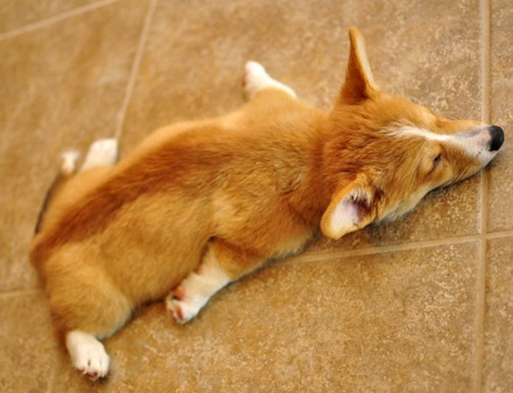
Position?

Slide 28
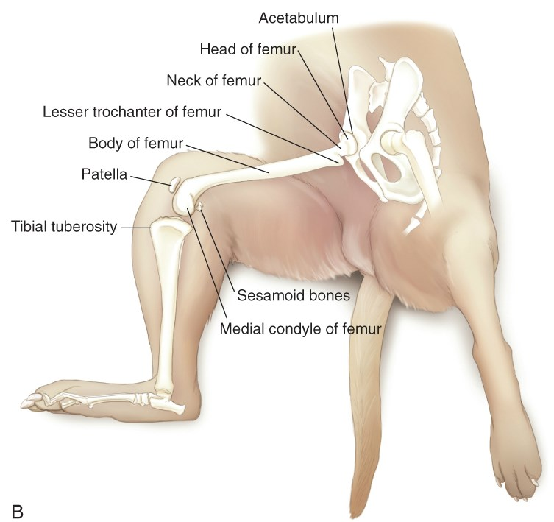
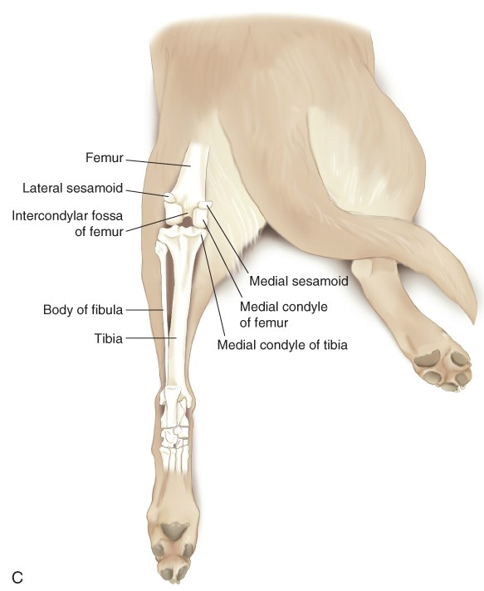
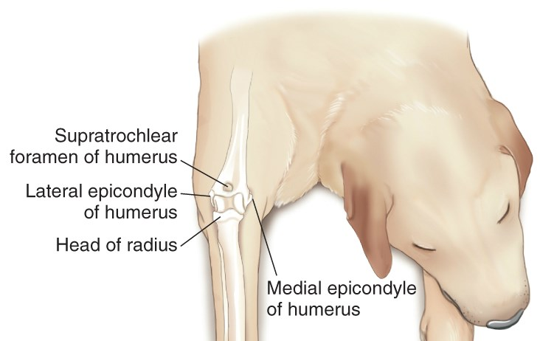
Positions?
Notes:
Clockwise from upper right:
R mediolateral femur
R craniocaudal elbow
L caudocranial stifle

Slide 29
Basic Criteria of Positioning
Refrain from overt physical restraint
Primary goal is to produce a good quality radiograph of the area being examined
Factors to consider:
    Welfare of the patient
    Restraint and immobilization of the patient
    Minimal trauma to the area of interest
    Lowest risk of radiation exposure for personnel

Slide 30
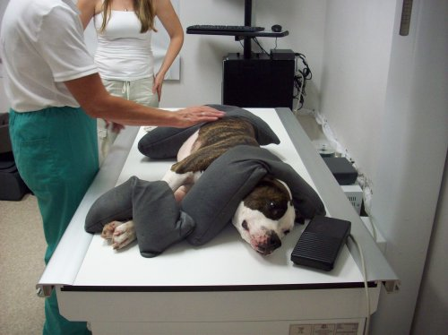
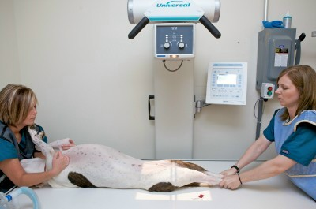
Radiographic Restraint

Slide 31
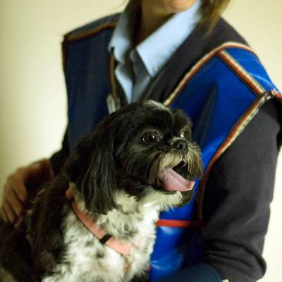
Patient factors
Always remember your patient…
  Radiography can be scary
  Noises & confusion can be frightening
  The animal may be in pain
  “Less is more” with cats
Always remember your client…
  This is someone’s baby, and it could be yours someday

Slide 32
How to handle animals…
Handle in a slow, quiet, manner.
Use a calm, soft voice and reassure animals through touch.
Avoid quick, loud movements.
Avoid any severe restraint.
Minimize time spent on the back…
Put yourself in their shoes.

Slide 33
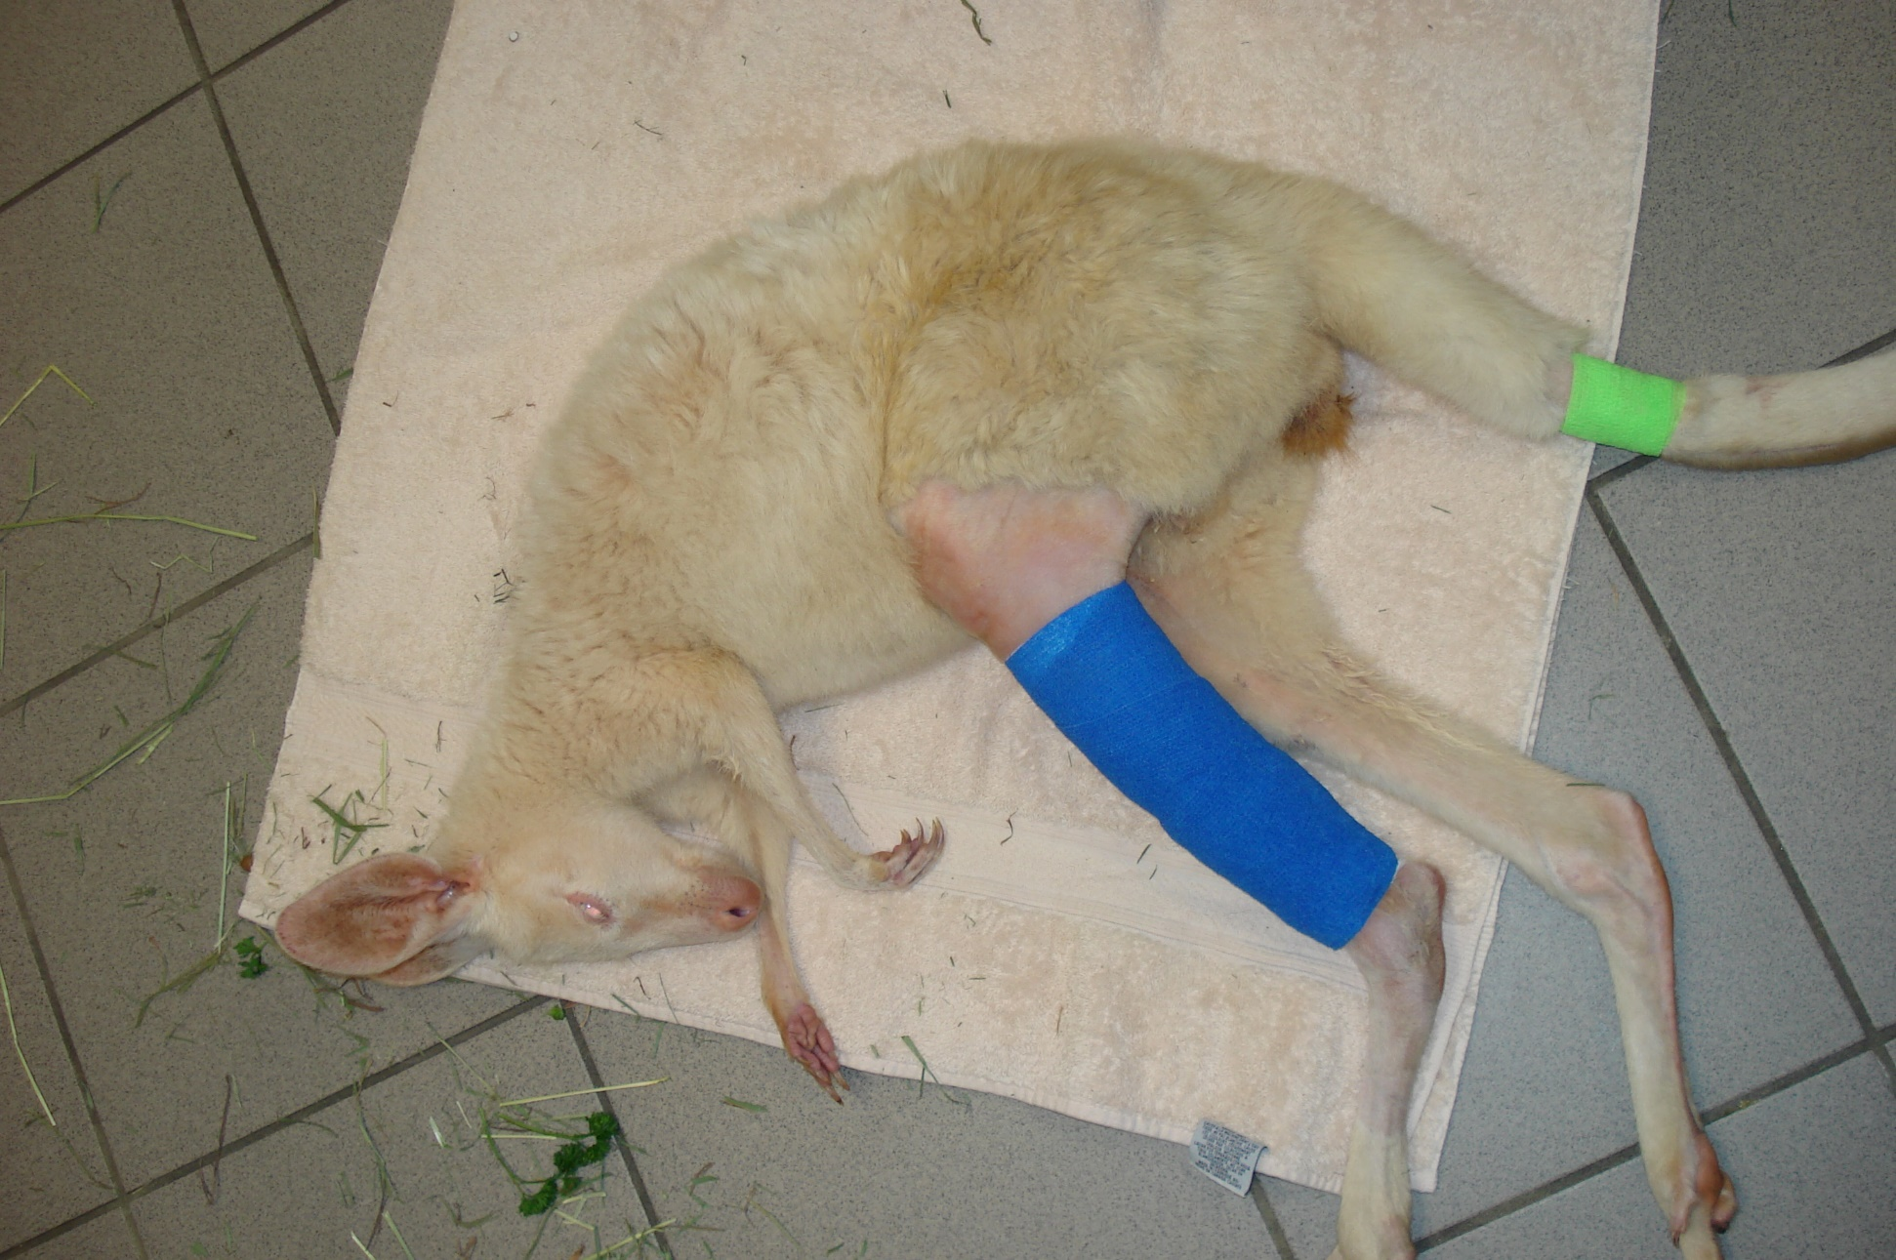
Notes:
Kangaroo with tib/fib fracture

Slide 34
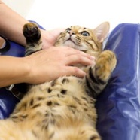
General Positioning
May require sedation, general anesthesia, or positional devices
All essential anatomical regions should be included in the primary beam when taking x-rays
PRIMARY GOAL- to find the most comfortable position for the animal, so a diagnostic radiograph can be made

Slide 35
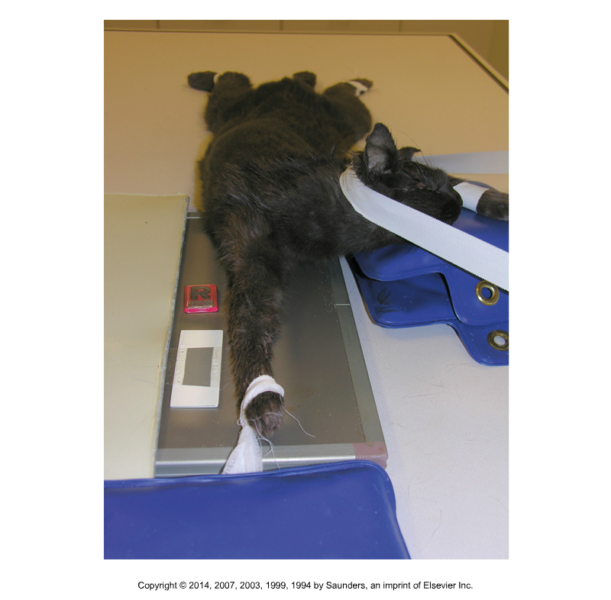
Positioning Aids
Items that can be used:
Tape
Gauze
Leashes
Compression bands
Velcro
Clothes pins (cats)
Commercial scruffers (cats)

Slide 36
PREPARATION!!!
Prepare, prepare, prepare….
Prior to positioning animal, make sure:
    Correct patient is present
    Correct exposure settings are set
    All chemicals and processor are in working order
    Cassette is positioned appropriately
    Identifying markers are in place

Slide 37
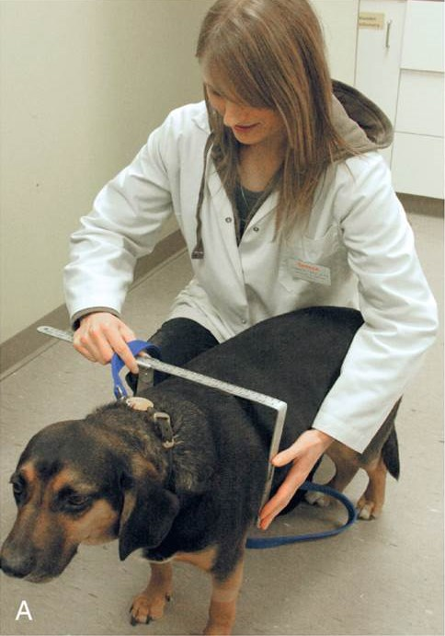
Measurement
Calipers:
Measuring device for anatomic area of interest
Measures area in centimeters
Measure at thickest spot and/or average several measurements
Measure in position for radiograph
Check log for previous measurement, if possible
Always return them where they belong

Slide 38
Required Views
Radiograph is a 2-D picture of a 3-D structure
  Norm: two views at right angles to one another
  Helps to visualize structures
Area of interest is closest to film
  Minimizes distortion and magnification
Comparison of 2 structures
  To compare to other area to see if there are any pathological changes

Slide 39
Splitting the Cassette
Used for taking more than 1 image on a cassette
  Or taking comparison views
Use lead gloves (usually) to:
  Cover “non-used” portions of cassette to take first view, then systematically uncover for subsequent and cover previously imaged sections
Not practical when using grid
Split as many times as necessary
The 2 views need to be in the same direction

Slide 40
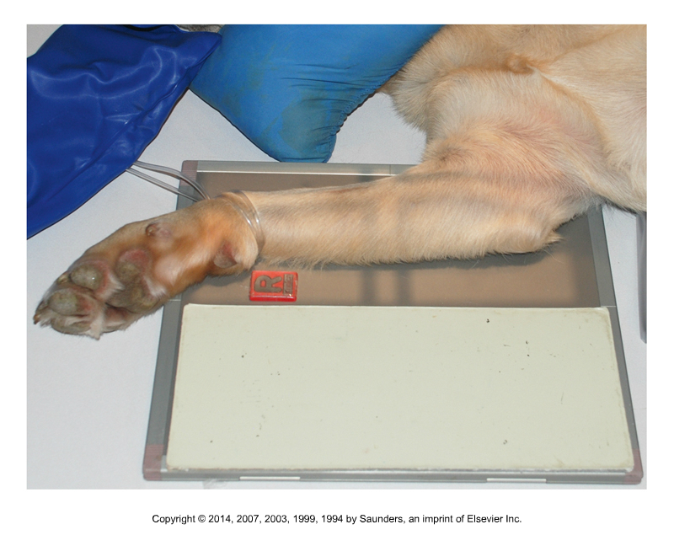
Splitting the Cassette

Slide 41


Collimation, Collimation, Collimation
Very important!
Decreases scatter and increases contrast.

Slide 42

Positioning Guidelines
Center primary beam over thickest area
Specific anatomy must be included for each anatomic area:
    Long bones - Include shaft of the bone, and joints above & below
    Joints – Center beam over the joint space, and include about 1/3 of long bones proximal & distal

Slide 43
Patient Preparation
Clean & dry hair coat
Remove splints, bandages, collars, leashes, etc.
Chemical restraint is preferred but not always allowed
  No matter how well behaved and calm an animal seems, always expect the worst
Use of positioning devices
  Sandbags, foam blocks, wood blocks, trough, tape, gauze, rope
  Positioning devices should not be placed directly above or below area of interest – not completely radiolucent

Slide 44

Film Identification
Proper labeling of a radiograph is mandatory for legal and practical reasons.
Should include:
    Appropriate patient identification
    Appropriate markers (R ) (L) and view
    Mark side that is closest to cassette
    Lateral projections of the leg should have the marker placed cranially to the leg.

Slide 45

Radiographic Checklist
Image labeled & legible?
Positional markers present?
Good contrast & density?
Properly centered on cassette?
Properly collimated?
Correct positioning without rotation?
Evidence of human exposure?
Film properly developed?
Artifacts present?
Image diagnostic?
Repeat needed?

Slide 46


