Slide 1
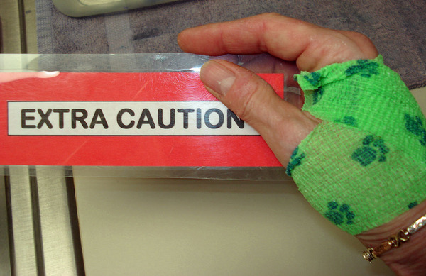
Small Animal Forelimb
Chapter 20

Slide 2
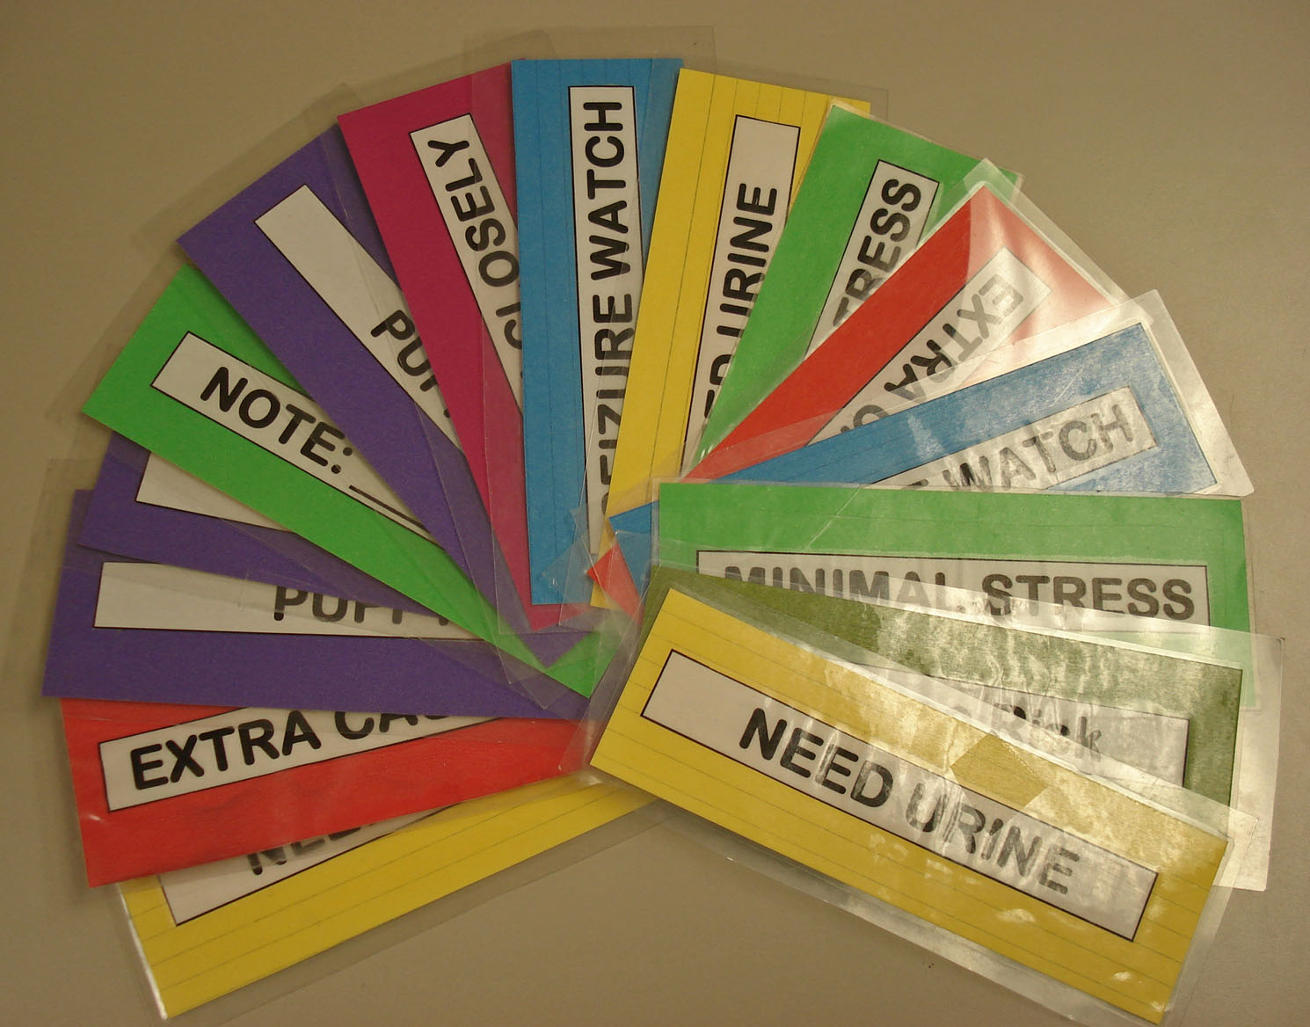
Kennel Card Rainbow

Slide 3
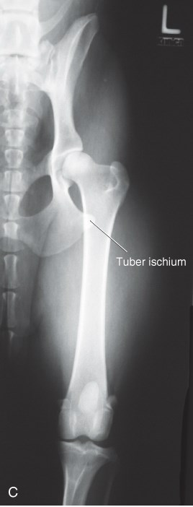
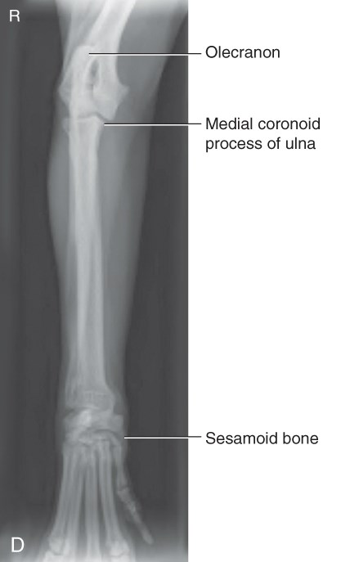
Let’s Review… Positioning
CrCd Femur
CrCd Radius/Ulna
Notes:
Beam in/Beam out

Slide 4
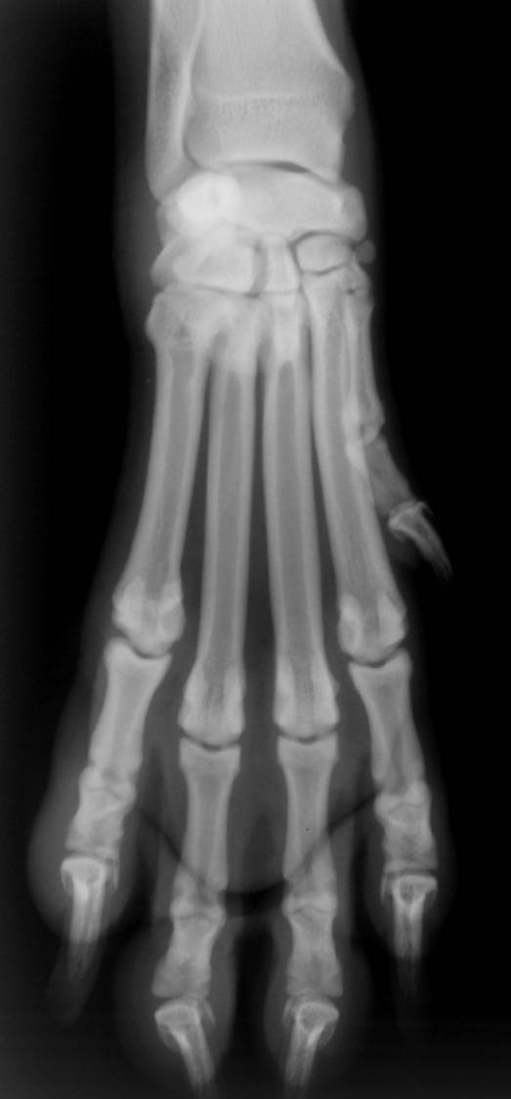
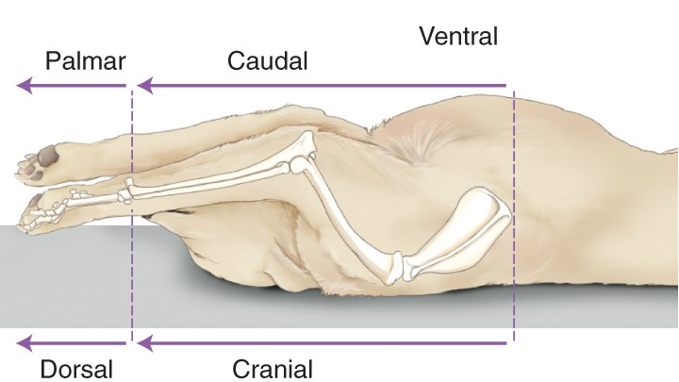
Let’s Review… Positioning
Dorsal Recumbency
Notes:
Dorsopalmar
In the back, plantar

Slide 5
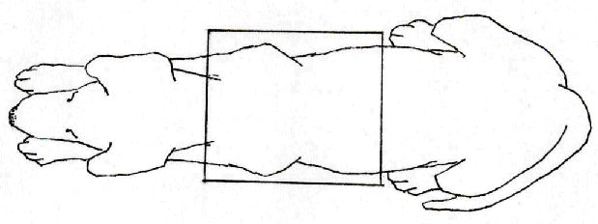
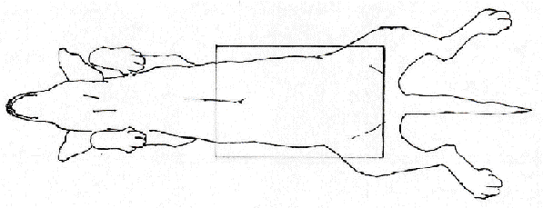
Let’s Review… Ventral & Dorsal
Notes:
DV vs VD – Can’t usually tell by looking at radiograph
2 views always

Slide 6
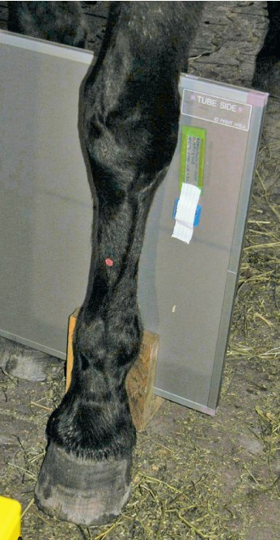
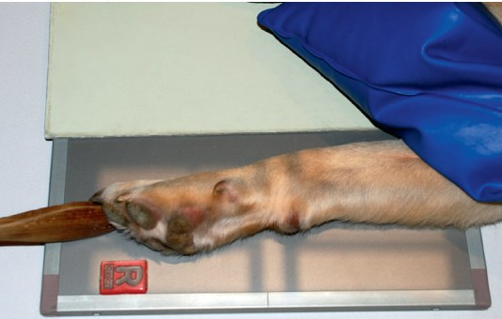
Let’s Review… Medial & Lateral
Notes:
Mediolateral Carpus & Lateromedial Foreleg

Slide 7
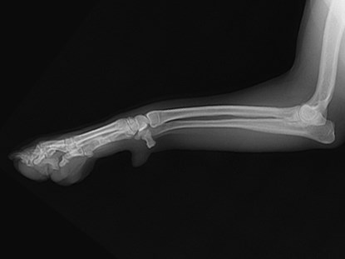
Directional Terminology
Proximal:
Nearer to the point of origin of a structure
Distal:
Away from the point of origin
Proximal
Distal
L Lateromedial R/U

Slide 8
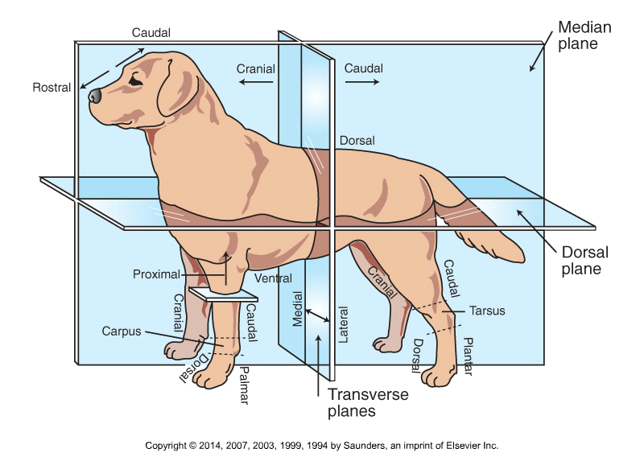
Anatomic Directional Planes

Slide 9
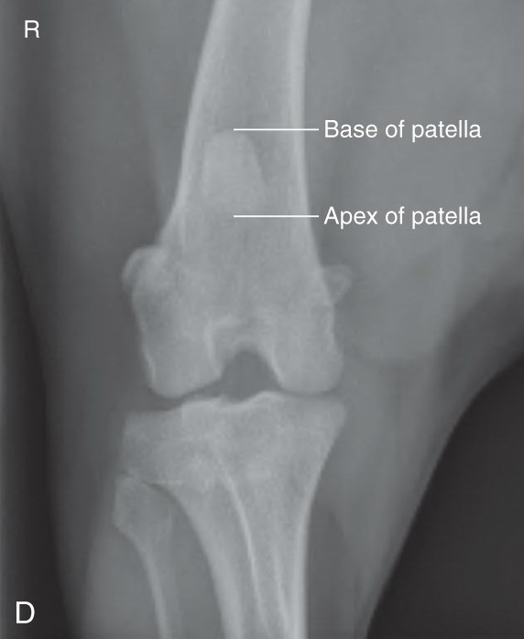
Positioning Guidelines
Measure & center over thickest area
Anatomy to include:
    Long bones - Shaft & joints proximal & distal
    Joints – Center over joint space, and include 1/3 of bones proximal & distal
CaCr Stifle
Notes:
Caudocranial stifle

Slide 10
Abbreviations
Left (L/Le) Right (R/Rt)
Dorsal (D) Ventral (V)
Lateral (L) Medial (M)
Cranial (Cr) Caudal (Ca)
Palmar (Pa) Plantar (Pl)
Distal (Di) Proximal (Pr)
Rostral (R)
Oblique (O)
Left & right always stand alone
Medial & lateral always come second
Beam entry/beam exit

Slide 11
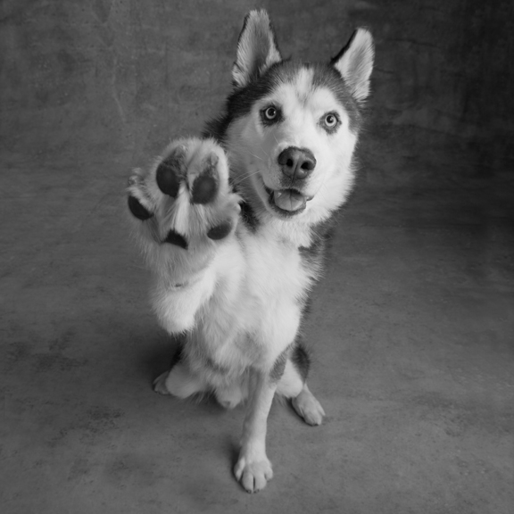
Speak to the paw!

Slide 12
Objectives: Small Animal Forelimb
ID common concerns associated with radiographing the small animal forelimb
Safely and appropriately position a patient for various common forelimb positions.
    Know where to measure & center the beam
    Include appropriate borders
    Position properly
    Use non-manual restraint where possible
Understand alternative views
Distinguish & identify normal forelimb anatomy

Slide 13
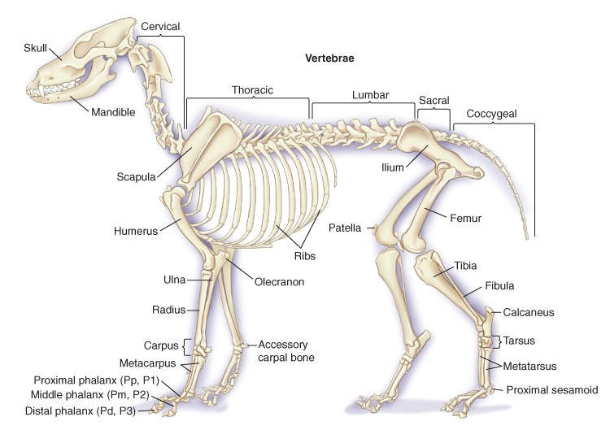
Anatomy Review: Forelimb

Slide 14
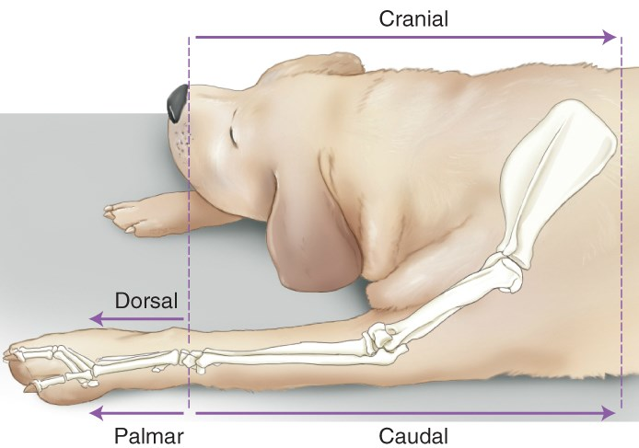
Terminology Review
Sternal Recumbency
Used for: Distal Forelimbs
Dorsal Recumbency
Used for: Contralateral view of scapula, shoulder, and humerus
Notes:
Sternal - Scapula/Humerus/RU/Carpus/Metacarpals/Phalanges
Contralateral – opposite side of a point of reference

Slide 15
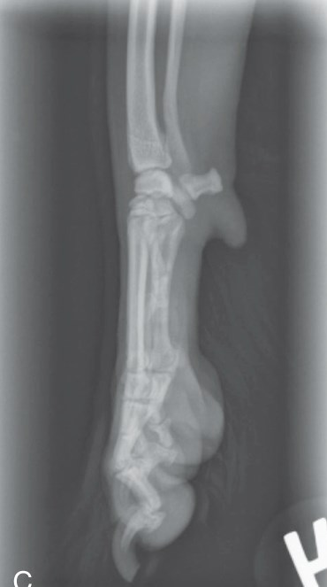
Radiographic Concerns: Forelimb
Field of view:
  Long bones – Include proximal & distal joints
  Joints – Include 1/3 of the bones proximal & distal
Most projections via tabletop
  Collimate tightly
Can split image:
  Point toes the same direction
  Collimate & shield other side
R Mediolateral Carpus

Slide 16
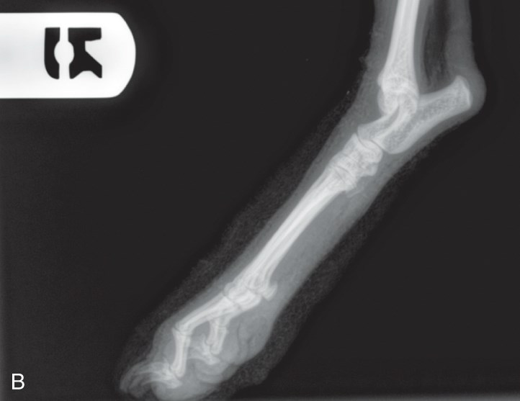
Radiographic Concerns: Forelimb (cont.)
Non-manual restraint (where possible)
Place label at:
  Lateral view - Dorsal or cranial aspect
  Other views – Lateral aspect
Keep bone parallel to cassette and beam perpendicular
Increase exposure factors if splints/casts in place
R Mediolateral Tarsus

Slide 17
The Forelimb: Radiographic Anatomy
Shoulder Joint – Mediolateral & CaCr
Scapula – Mediolateral & CaCr
Humerus – Mediolateral, CaCr, and CrCa
Elbow – Mediolateral, CrCa
Radius/Ulna – Mediolateral, CrCa
Foot – Mediolateral, DPa
Notes:
Why caudocranial? Closer to cassette
Distal to humerus – CrCa becomes preferable

Slide 18
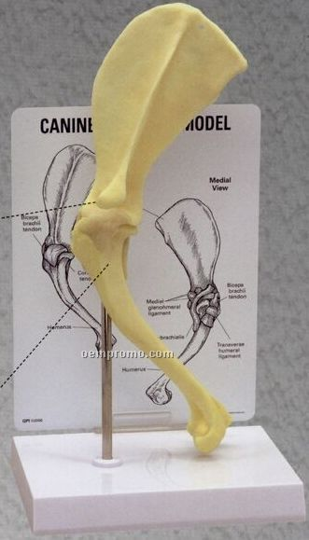
The Shoulder

Slide 19
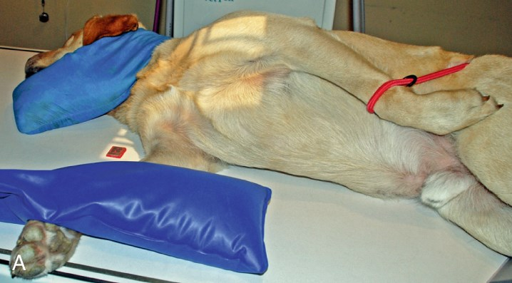
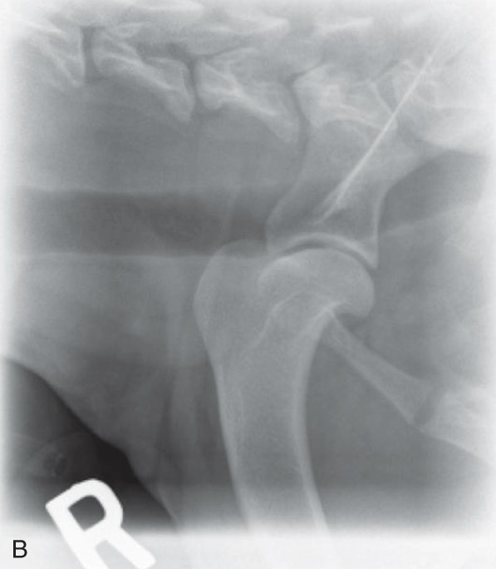
Shoulder Joint (Mediolateral View)
Notes:
Notice:
T-shape
Non-manual restraint
Central ray at area of interest
Careful collimation

Slide 20
Shoulder Joint (Mediolateral View)
Area of interest closest to cassette
Extend affected leg cranially & ventrally
Opposite leg pulled out of way
Arch head & neck dorsally
Hind limbs in natural position
Don’t over-rotate thorax
Head & limbs make a “T”
Borders: Proximal 1/3 of humerus & scapula
Notes:
Avoid superimposition of structures over shoulder.
If over-rotate - - Shoulder may lift off cassette.

Slide 21
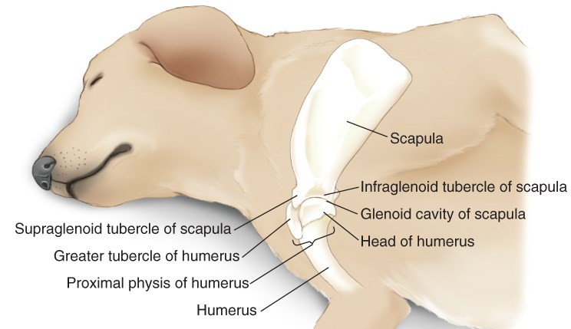
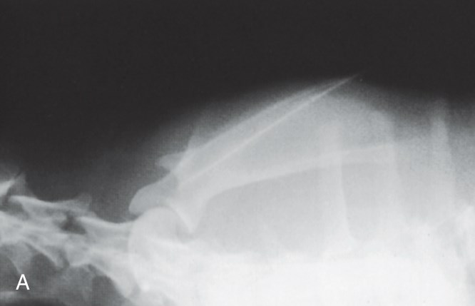
Scapula (Mediolateral View)
*Positioning is identical to humerus
Notes:
Like shoulder rad but farther dorsal & includes whole scapula

Slide 22
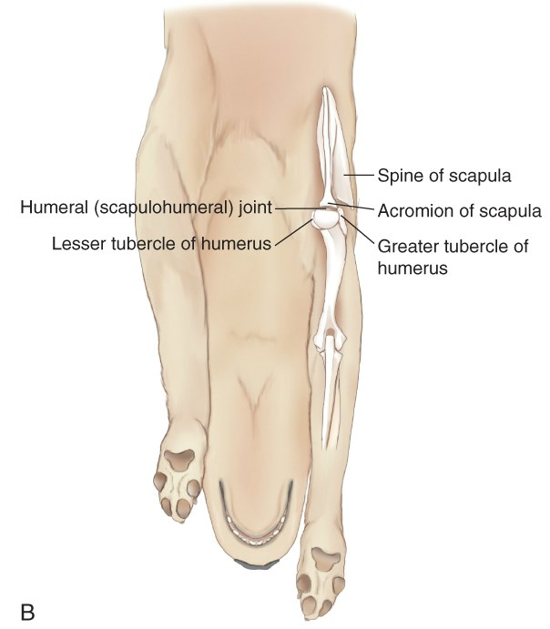
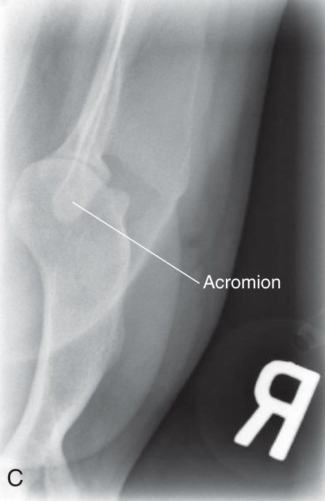
Shoulder & Scapula (Caudocranial View)
(Same positioning for humerus)

Slide 23
Shoulder & Scapula (Caudocranial View)
Use modified abdomen technique chart
  Bone chart produces images too dark
Positioning:
  True VD with head lateral to affected limb
  Extend both forelimbs cranially with humerus parallel to cassette
  Body & ribs should fall away from scapula
  Spine of scapula perpendicular to table
  Avoid over-rotation of humerus
  If possible, get comparison view of both shoulders
Sedation is sometimes necessary for full extension.
Borders – Proximal third of humerus & distal third of scapula
Notes:
Over-rotation move scapula oblique

Slide 24
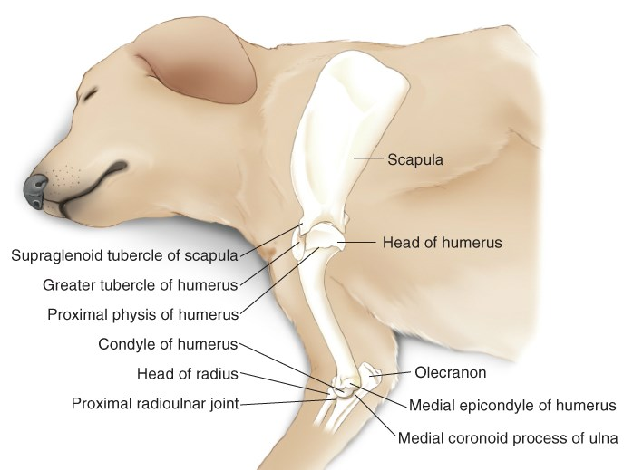
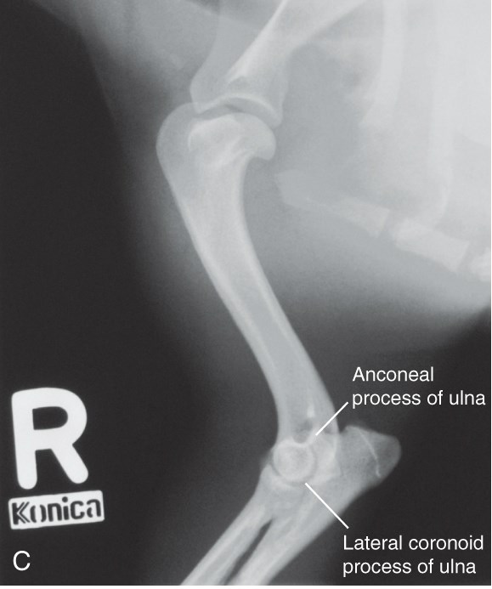
Humerus (Mediolateral View)
*Positioning is identical to scapula

Slide 25
Humerus (Mediolateral View)
Lateral recumbency with affected leg down
Affected leg is extended forward
  Opposite leg drawn back
Head and neck extended dorsally.
Larger dogs may need 2 views
  Elbow/shoulder may differ in density
Center ray at mid-shaft
Borders – 1/3 bone proximal to shoulder & distal to elbow

Slide 26
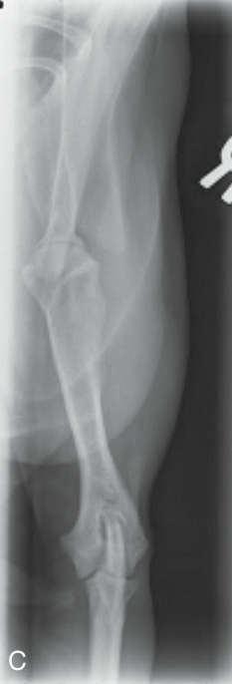
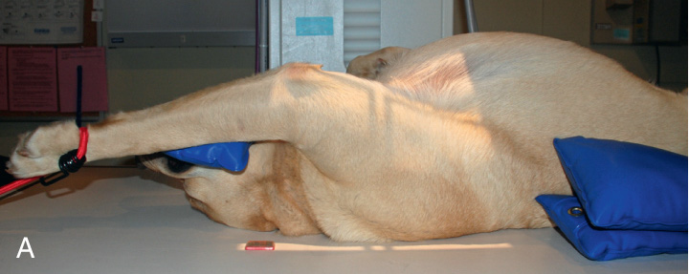
Humerus (Caudocranial View)
  Same positioning as for shoulder/scapula
  Be aware of distortion since forearm is away from cassette

Slide 27
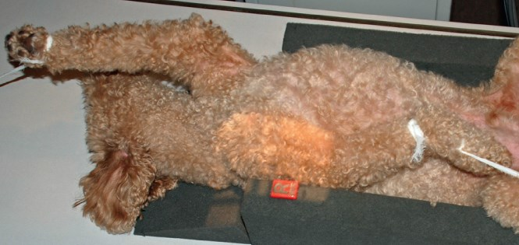
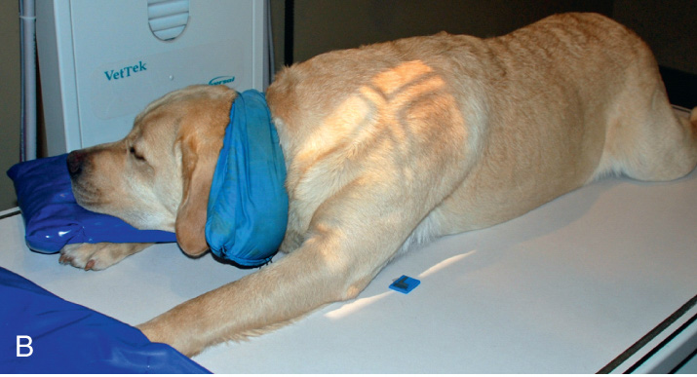
Humerus (Craniocaudal View)
Notes:
The first of the views where CrCa is an option

Slide 28
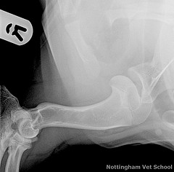
Humerus (Craniocaudal View)
Craniocaudal –
  Use when extension above head cannot be achieved
  Dorsal recumbency
  Head & neck straight
  Extend unaffected limb cranially
  Flex affected limb & pull caudally
    Slightly abduct from thorax
  Humerus is more nearly parallel but still away from cassette
  Position area of interest last
Notes:
Post-Sx

Slide 29
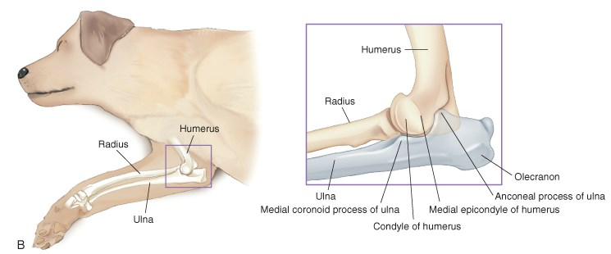
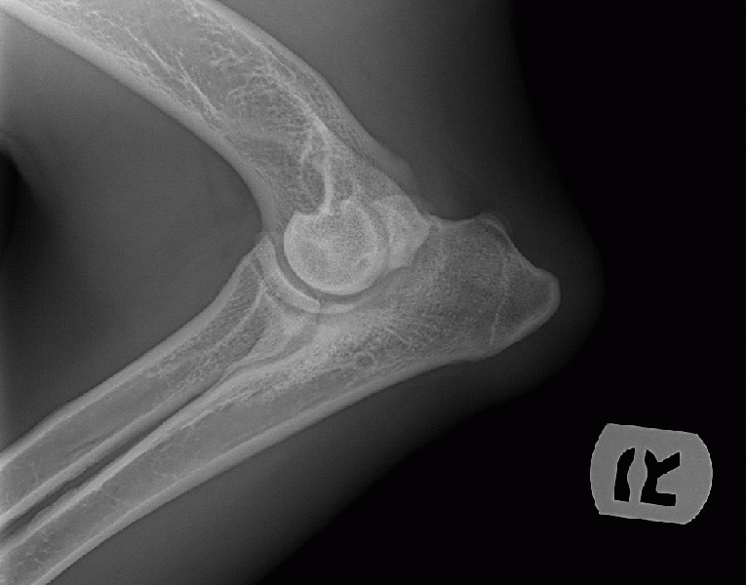
Elbow (Mediolateral Extended View)
  Move head & neck dorsally
  Extend other limb caudally
  Affected elbow joint is in 120-degree extended position
  Maintain symmetry of structures with small foam pad under distal region of affected limb

Slide 30
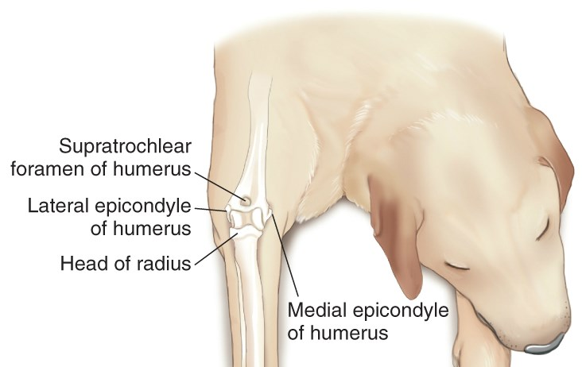
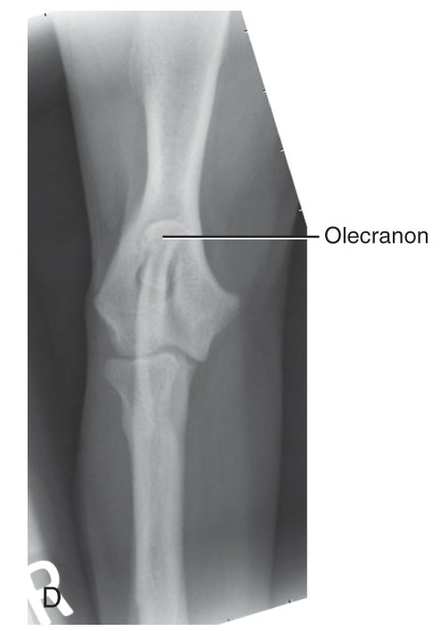
Elbow (CrCa View)
Foam pad under unaffected limb
Pull head away from affected limb
Center ray on center of humeral condyles
Borders – 1/3 of bone proximal & distal
Symmetry is essential
* Same positioning for other CrCa views (with different borders)

Slide 31
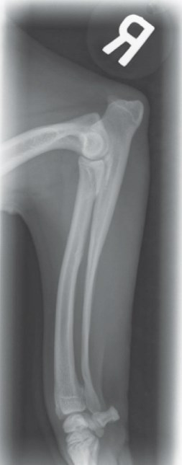
Radius & Ulna (Mediolateral View)
  Same as for extended elbow view (with different borders)
  Place foam under the humerus & cranial thorax to maintain alignment
  Make sure cassette is large enough to include correct borders
  Measure at mid-shaft to minimize over-exposure

Slide 32
Radius & Ulna (CrCa View)
  Positioning as for CrCd elbow view (with different borders)
  Measure at mid-shaft of bone

Slide 33


Fracture of the Radius/Ulna (Ouch!)

Slide 34
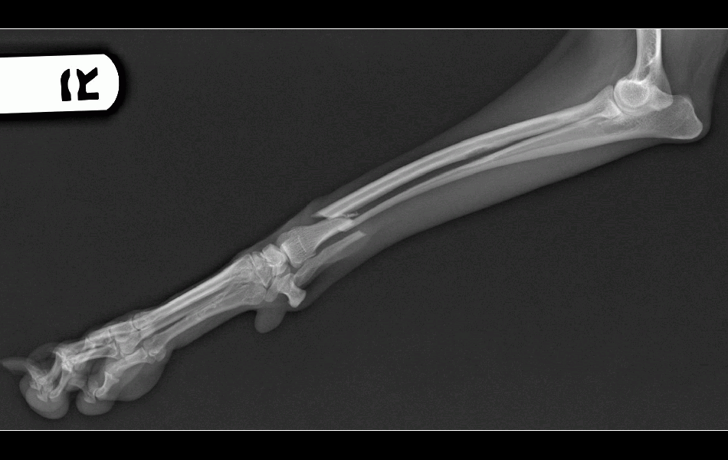
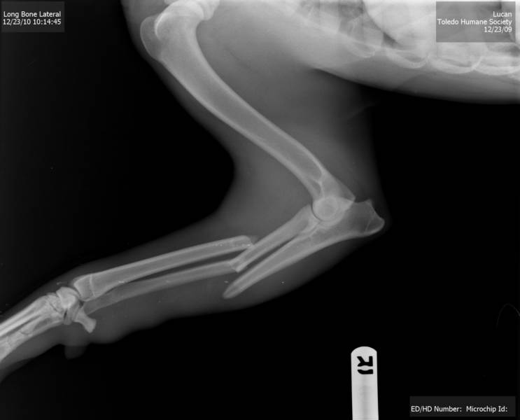
Fracture of the Radius/Ulna (Ouch!)

Slide 35
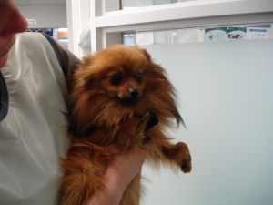
Teddy

Slide 36
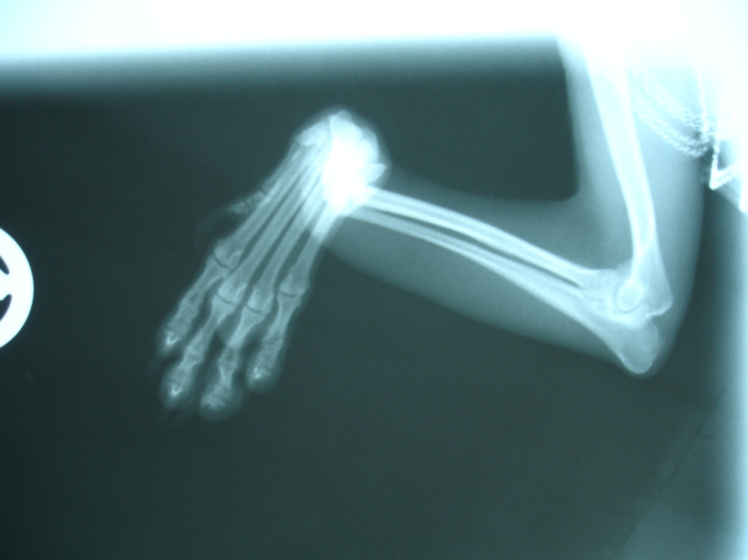
Teddy took a dive off the couch…

Slide 37
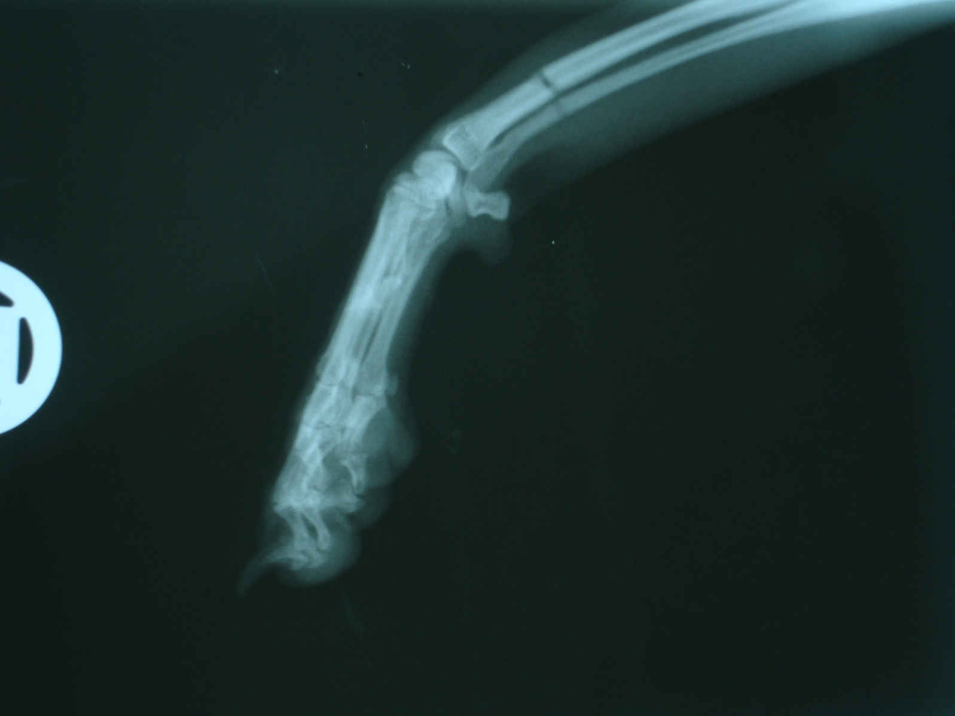
Teddy’s leg after repair… See the fracture?

Slide 38
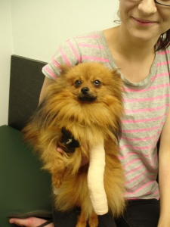
Teddy says “Thank you!”

Slide 39
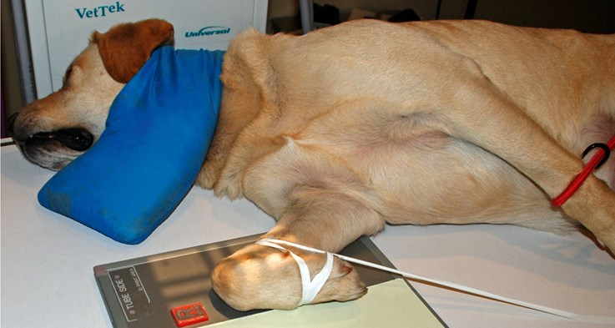
Carpus (Mediolateral Hyperflexed View)

Slide 40
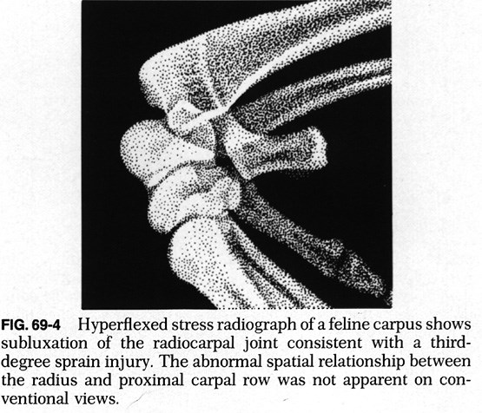
Carpus (Mediolateral Hyperflexed View)
Lateral recumbency
Hyperflex carpus
Helps evaluate carpal
    joint laxity
Borders – Proximal third of metacarpus to distal third of radius/ulna
Notes:
Use tape or paddle to hyperextend - Do not extend carpus beyond normal range of motion

Slide 41
Foot (Mediolateral View)
  Separate digits with tape (cotton isn’t as effective)
  Measure & center primary beam at site of interest
  Borders – Proximal 1/3 metacarpus to distal 1/3 R/U
  Cassette can be split – point toes in same direction

Slide 42
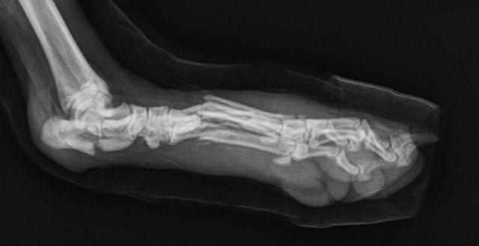
Foot (Lateral Flexed View)

Slide 43
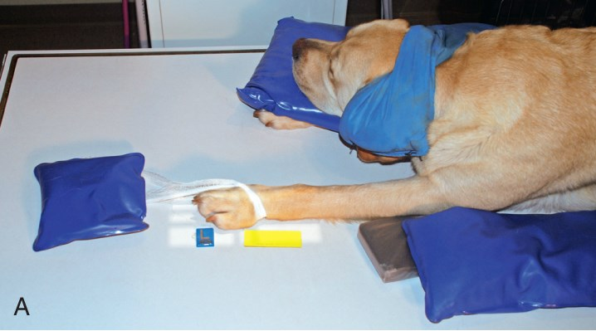
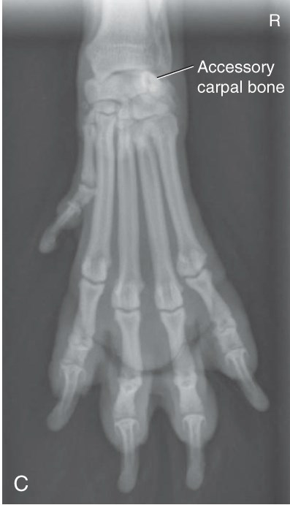
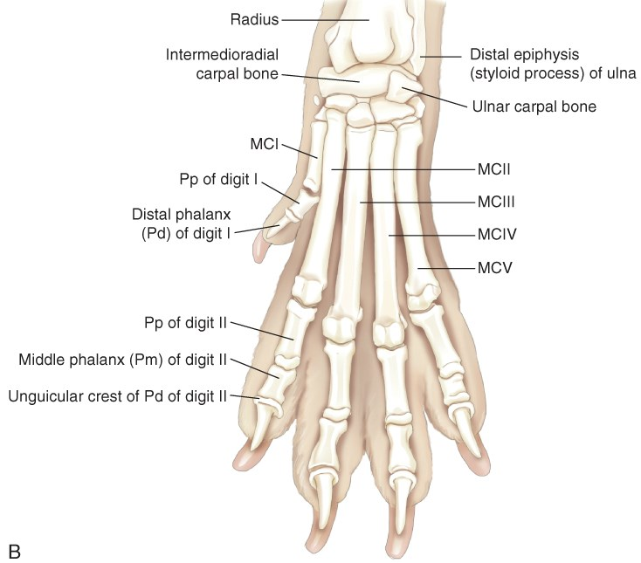
Foot (Dorsopalmar View)
Notes:
Weird about view?

Slide 44
Foot (Dorsopalmar View)
Sternal recumbency
Move head laterally
Extend both forelimbs & secure affected limb proximally
Place carpus flat on cassette
Abduct the elbow slightly to straighten carpus
Foam pad under elbow to prevent rotation.
Oblique views may be necessary with some injuries.
Flexed or stressed views may be useful in detecting joint instability.

Slide 45
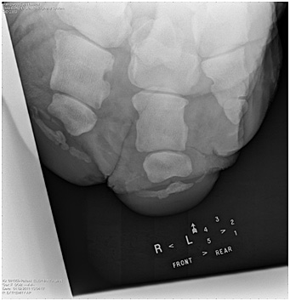

Um…?

Slide 46


Oh… Of course.

Slide 47
Next Steps…
Today: SA Forelimb
  Labs
  Roll at 10am
Tuesday:
  Labs – No lecture
  Work on homework – Forelimb Chart
Wednesday – SA Pelvic Limb
  Forelimb homework due
  Lavin: Chapter 21
Reminder: Test #3 on Friday
  Chapters 9, 10, 16, 17, 20, 21
  Artifacts & Film Evaluation Lectures

