Slide 1
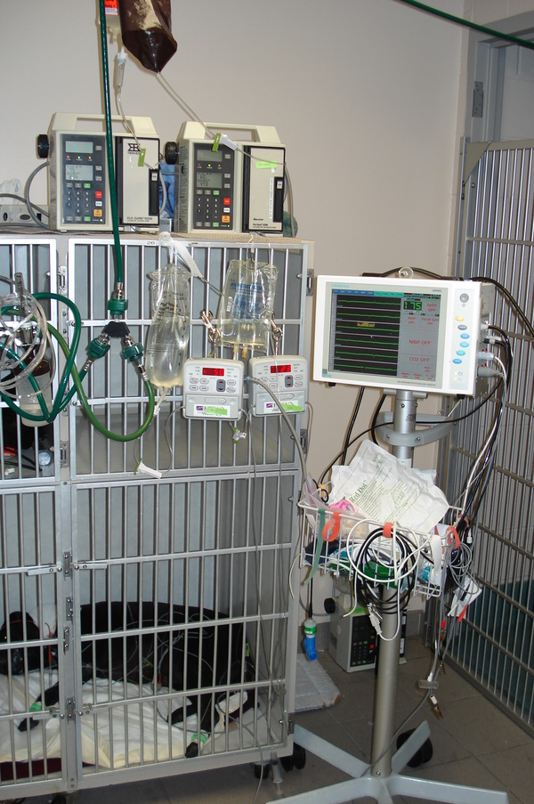
Small Animal Pelvis & Pelvic Limb
Lavin: Chapter 21

Slide 2
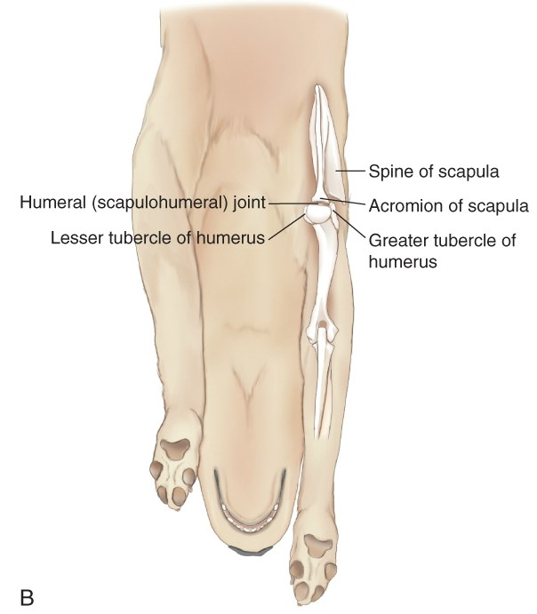
Forelimb Review: Caudocranial
Use this position for:
  Shoulder
  Scapula
  Humurus

Slide 3
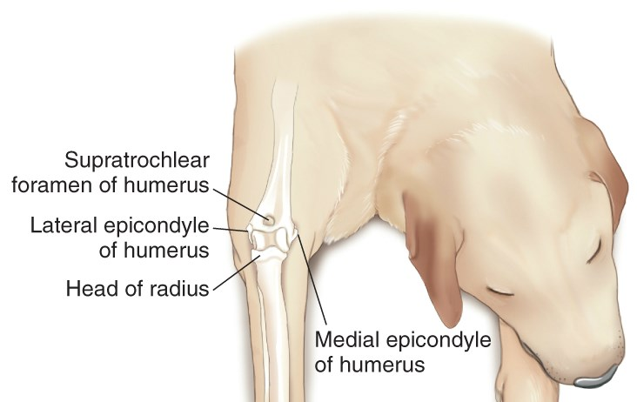
Forelimb Review: Craniocaudal
Use this position for:
  Humerus
  Elbow
  Radius/Ulna
  Carpus

Slide 4
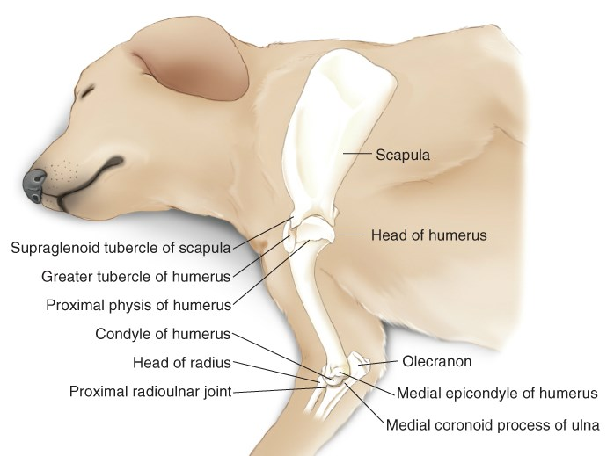
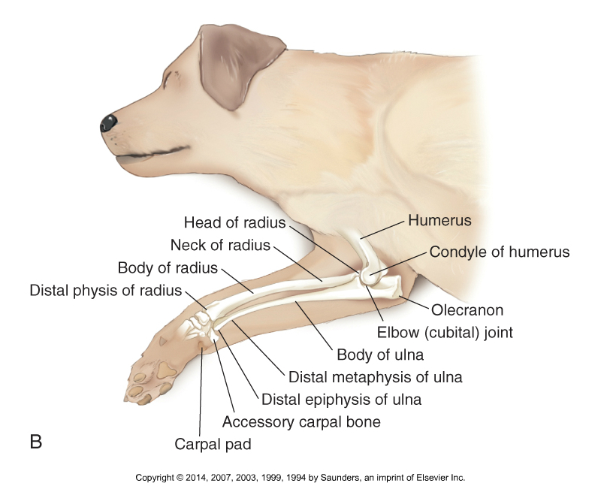
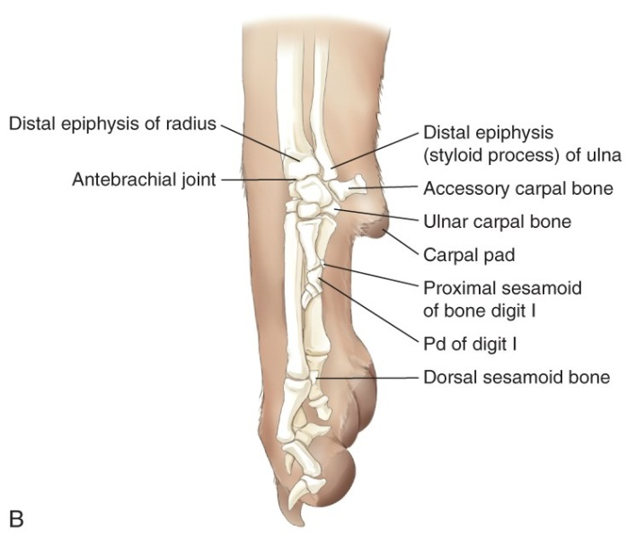
Forelimb Review: Mediolateral
Use this position for:
  All forelimb views

Slide 5
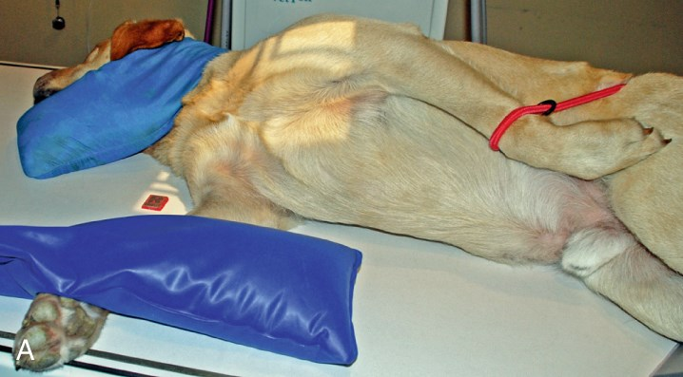
What are we radiographing?
Notes:
R ML shoulder

Slide 6

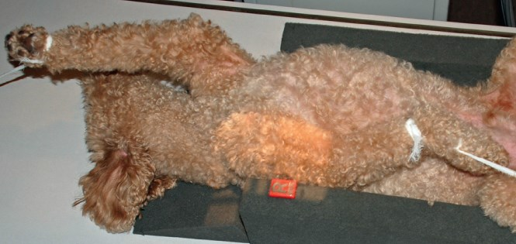
Notes:
R CrCd Humerus

Slide 7
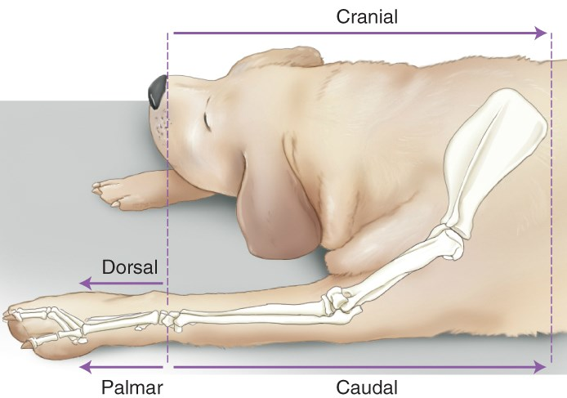
Show me…
Notes:
Usual view?
Collimation
Measure at?
Beam center?
Borders?
Metacarpals
Shoulder
R/U
Humerus
Foot/phalanges

Slide 8
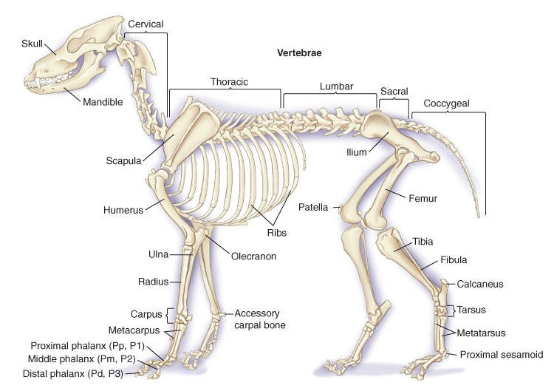
Skeletal Anatomy Review

Slide 9
Objectives: Pelvis & Hind Limb
Know general considerations for pelvis/hind limb radiography
Safely position patient for various views
Show an understanding of:
    Where to measure & center of primary beam
    Radiographic borders
    Patient positioning
    Use of non-manual restraint
Understand alternative views & their uses
Distinguish & identify normal pelvis/hind limb anatomy

Slide 10
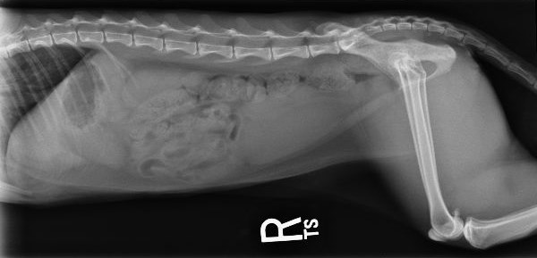
Indications for Hind Limb Radiography
Limbs – Fractures, pain, or lameness
Pelvis – Dysplastic or degenerative changes
Both –
  Joint-associated neoplasia
  Arthritis

Slide 11
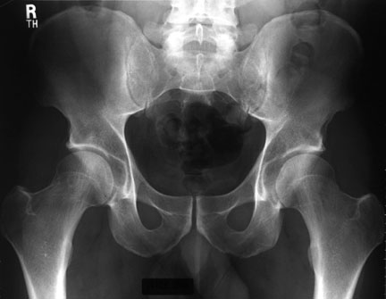
Hind Limb: General Considerations
Anatomy (Pelvis):
  Half of femoral head should be in the acetabulum
  Femoral heads should be rounded and smooth
  Femoral neck should be smooth with no remodeling
Views (2):
  Dorsal recumbency for pelvis (V/D) and femur (CrCa)
  Sternal recumbency for distal hind limb (CdCr)
Notes:
CrCd Tib/Fib

Slide 12
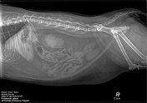
Hind Limb Radiography: General Considerations
Field of View:
  Long bones & joints – Same borders as always
Radiographic:
  Slightly lower kVp and higher mAs are desirable
  Grid usually needed for pelvis
Patient: Sedation is often helpful

Slide 13
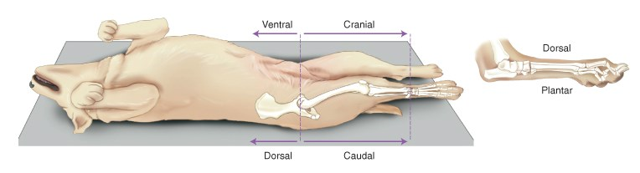
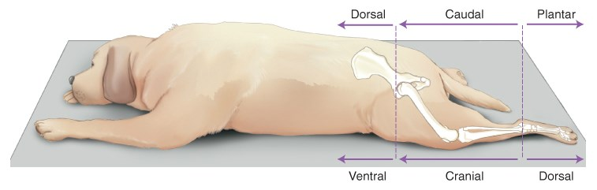
Hind Limb Terminology
Dorsal recumbency: Used for proximal hind end
Sternal recumbency: Used for distal rear limbs

Slide 14
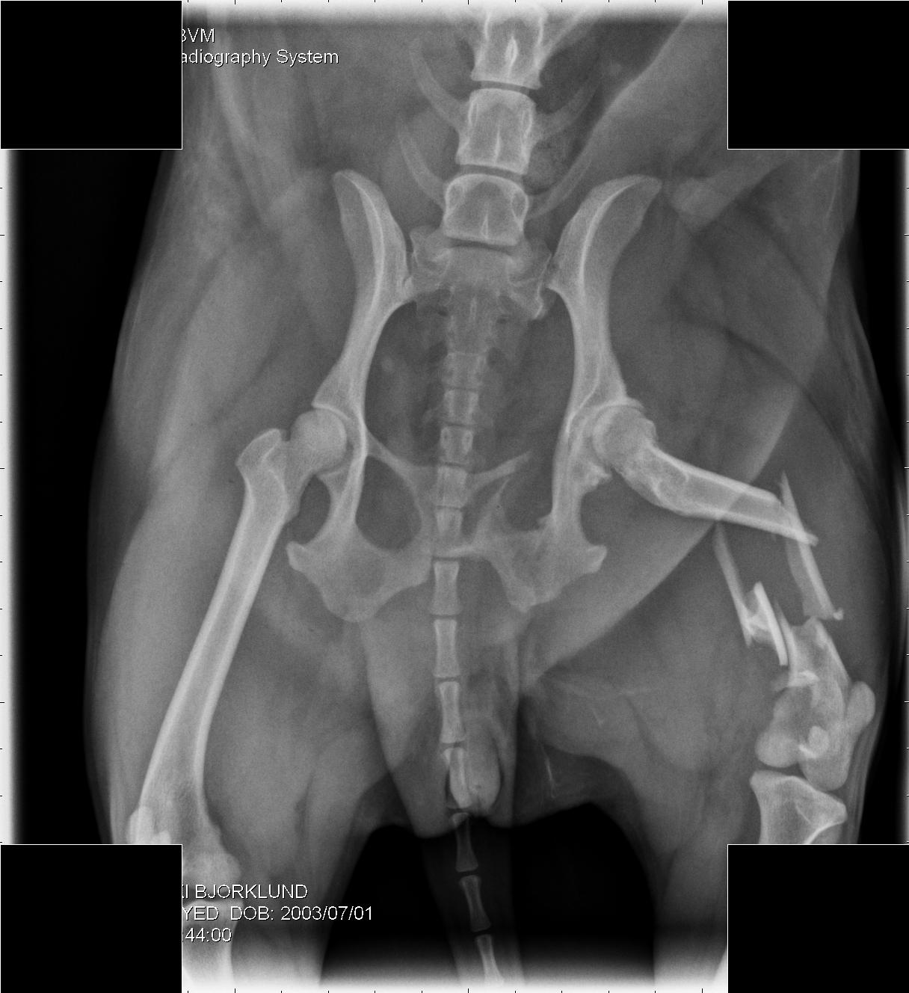
Ouch!

Slide 15
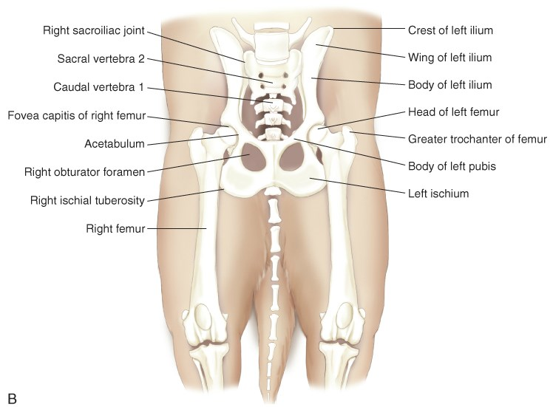
Review: Pelvic Anatomy
Notes:
Look for on pelvic radiograph?

Slide 16
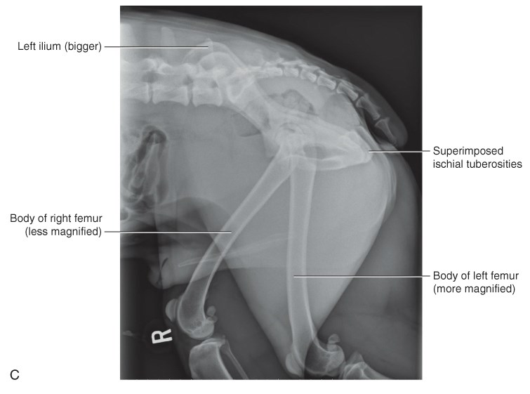
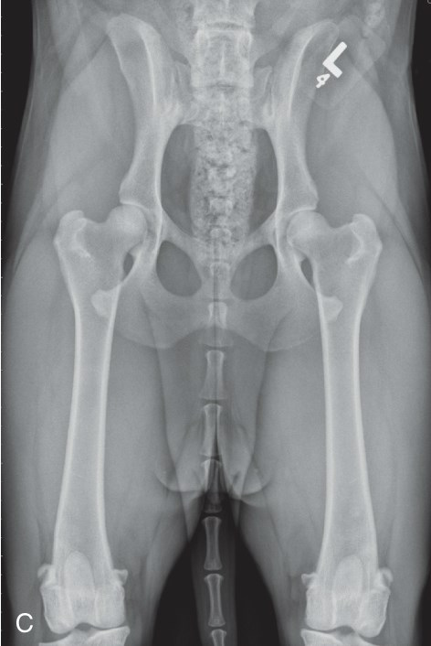
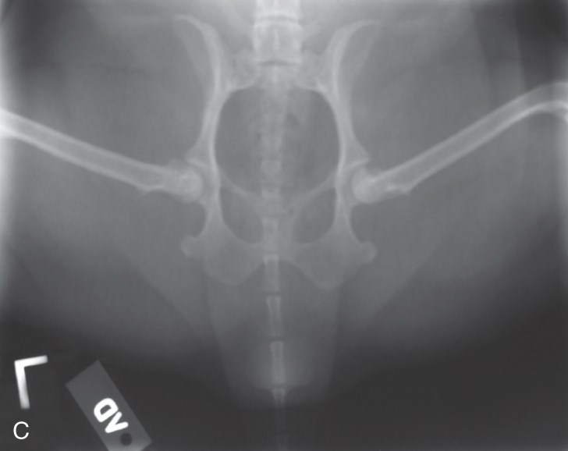
The Pelvis: Standard Positions
Lateral
Ventrodorsal
Ventrodorsal Frog-Leg

Slide 17
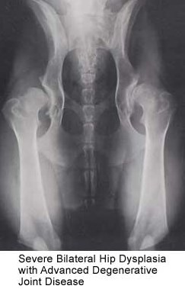
Hip Dysplasia
V/D Hip (Extended)
  Normal view to evaluate
  Use Frog-Leg if too painful
Hip dysplasia –
  Definition: Abnormal development of the femoral joint, resulting in a lack of conformity between the acetabulum & femoral head
  Manifests as hip joint laxity that leads to osteoarthritis
  The most common inherited disease in dogs
  Evaluation at 24 months

Slide 18
Evaluation of Hip Dysplasia
Evaluation via the OFA (Orthopedic Foundation for Animals)
7 categories within normal, borderline, and dysplastic
PennHIP:
  Radiographic screening method that quantifies hip joint laxity
  Compares dogs within standards for the breed
  Radiographer must be certified to perform
  3 standard radiographs and the use of special equipment
  Measures laxity & includes a distraction index (DI)
    DI closer to zero = less laxity

Slide 19
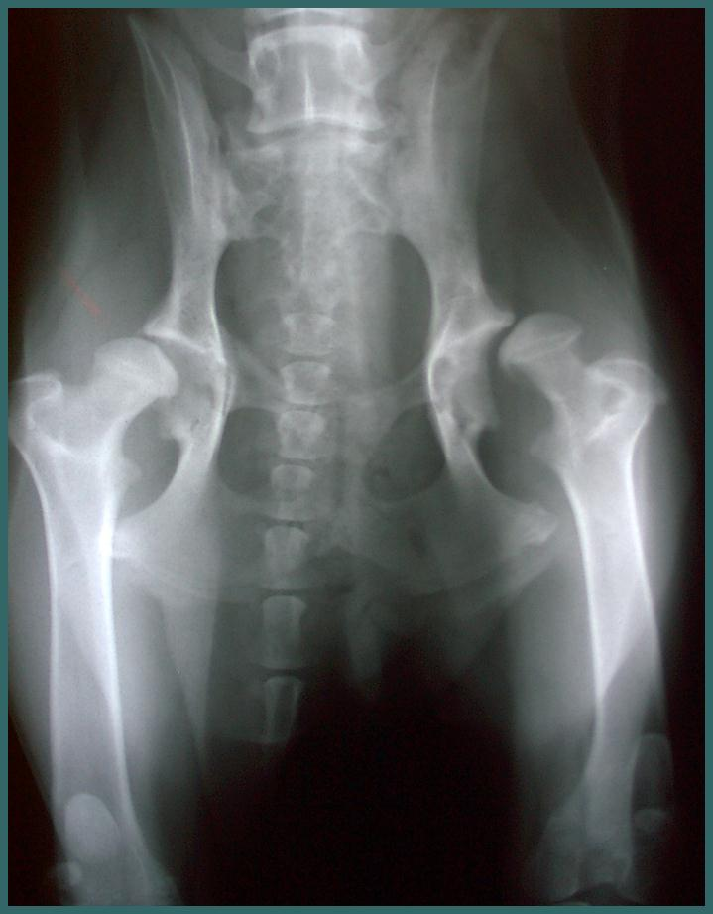
Hip Dysplasia: Radiographic Signs
Increased joint space width
Shallow acetabulum
Femoral head flattening/ deformity
Subluxation or luxation
Secondary degenerative bone disease
Changes to angle of femoral neck
Notes:
Partial or full displacement

Slide 20
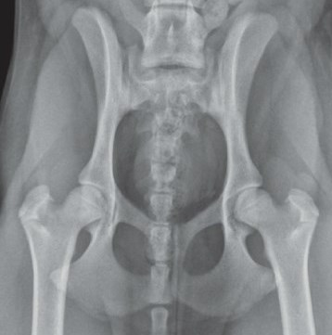
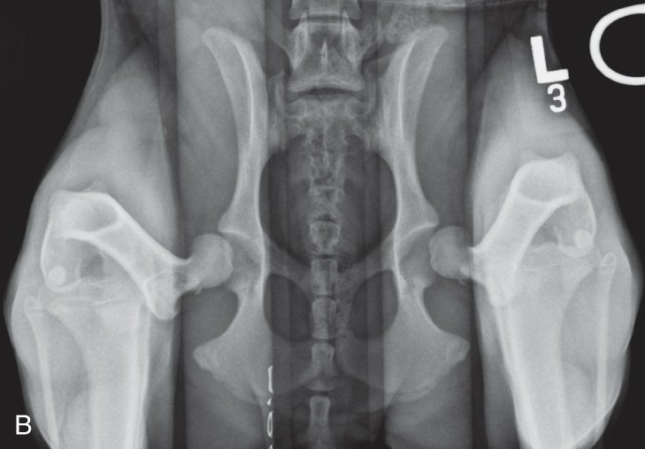
Pelvis: PennHIP Comparison
Considered “Marked Laxity”
Considered “Good”

Slide 21
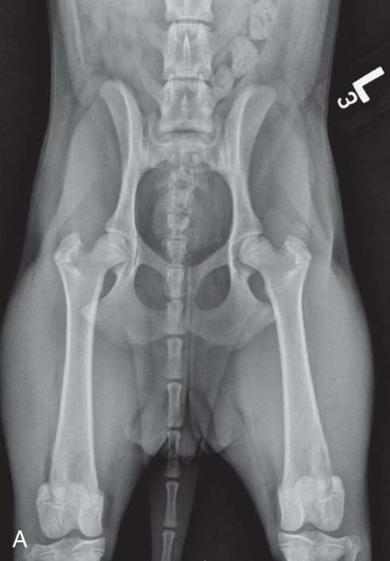
Pelvis – Ventrodorsal Extended-Hip
Standard for hip dysplasia evaluation
Requires symmetry & precision
Sedation is generally required (OFA certification).
Positioning:
  Dorsal recumbency
  Rotate femurs inward
  Lower limbs until resistance is felt
  Pad under tarsus so parallel
  Whole body should be in straight line
Other considerations:
  Muscle relaxation is helpful
Notes:
Trough & use of tape
Nose to tail

Slide 22
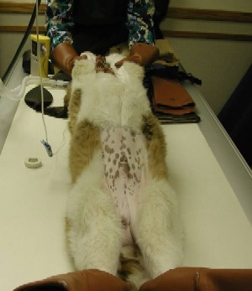
Pelvis: V/D Hip (Extended Positioning)

Slide 23
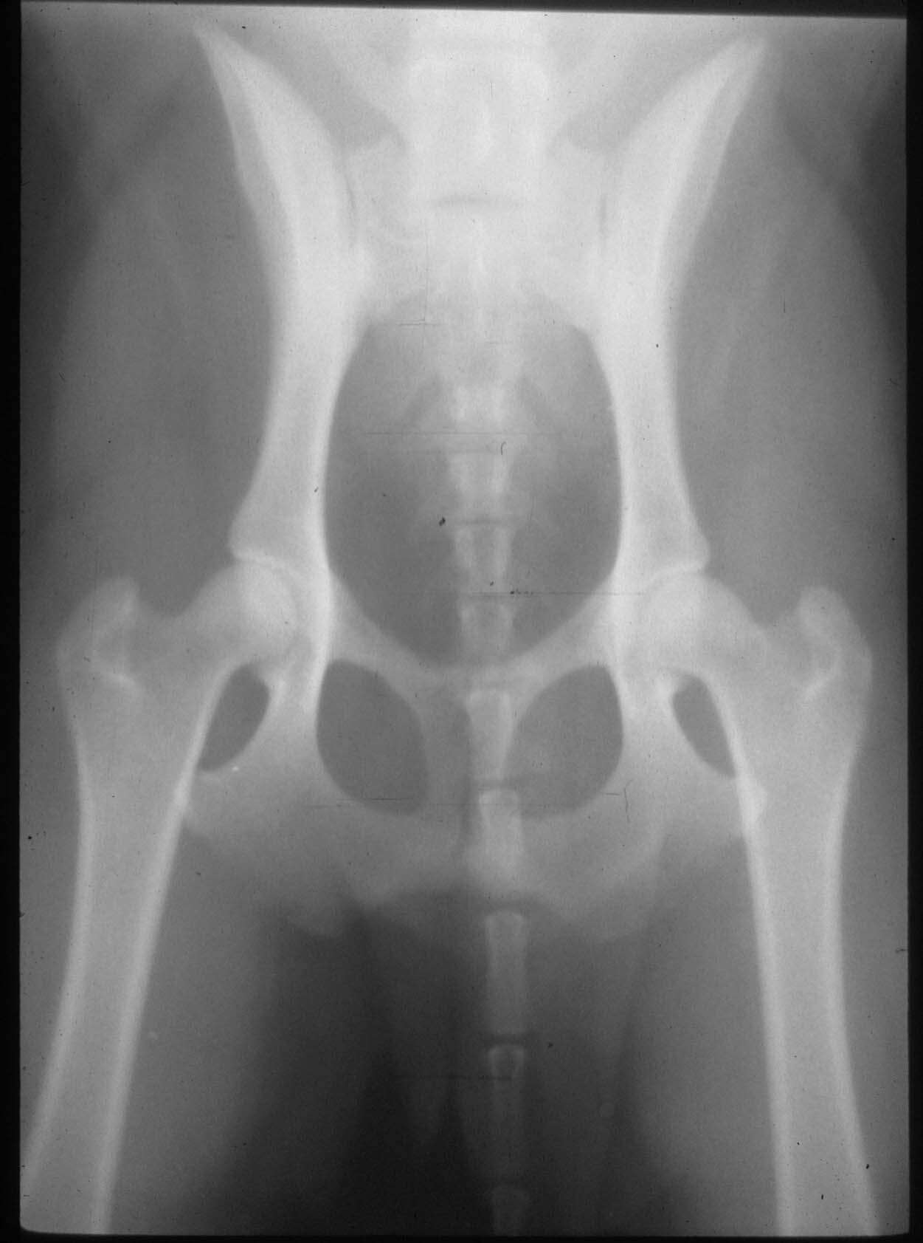
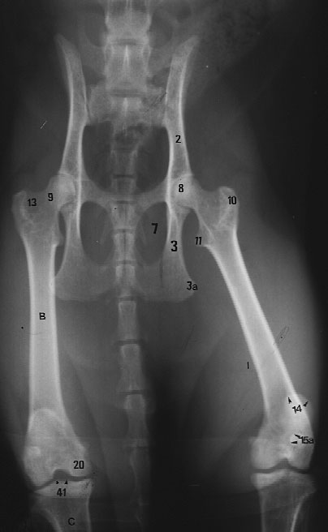
Canine vs. Feline

Slide 24
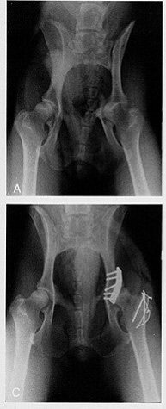
Acetabular Fracture

Slide 25
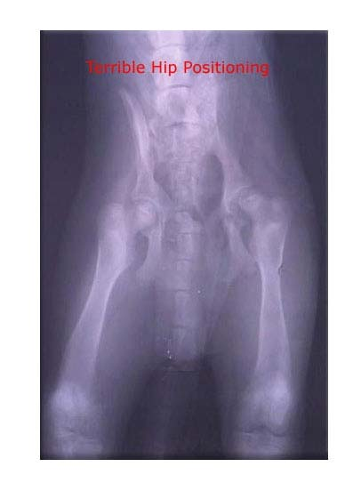
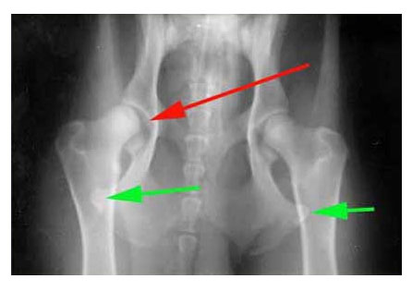
Poor positioning: Pelvis

Slide 26
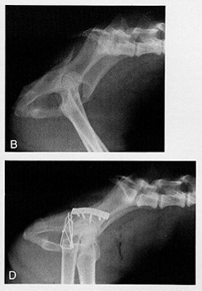
Acetabular Fracture

Slide 27
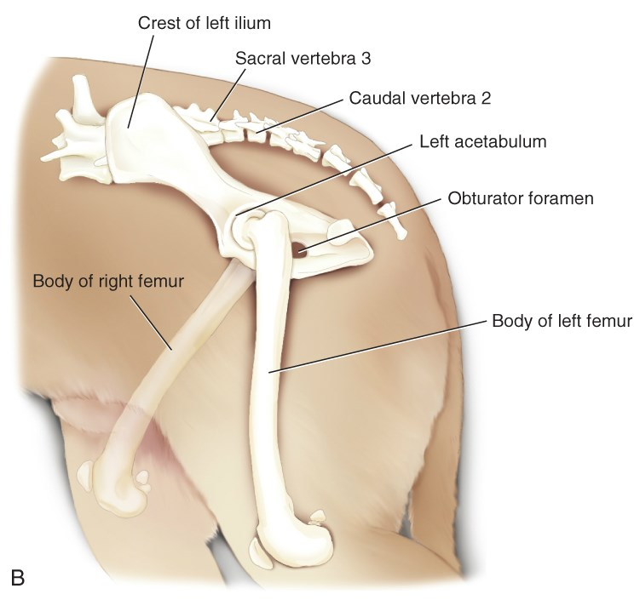
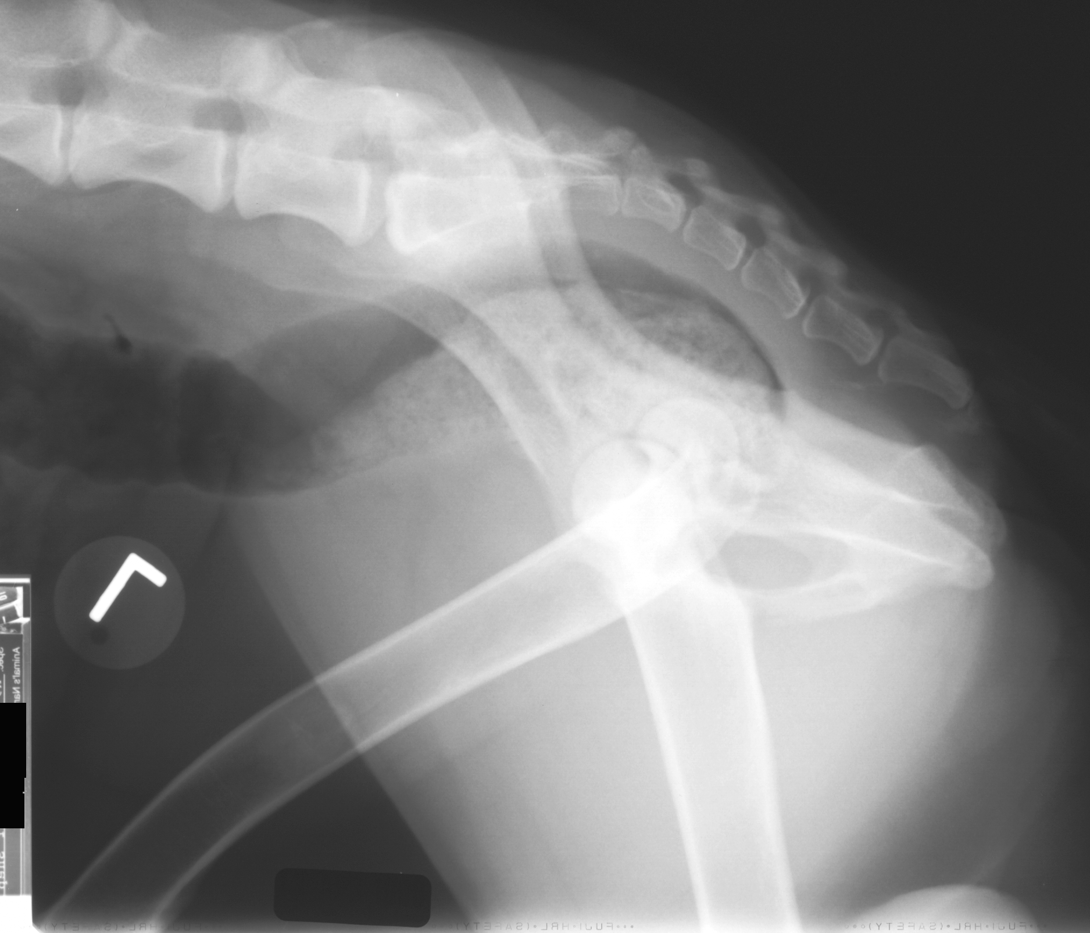
Pelvis – Lateral View
Positioning:
  Forelimbs cranial
  Foam wedge between hind limbs
  “Scissor” hind limbs with limb closest to cassette cranial
  Uppermost femur should be parallel to table – Use pad

Slide 28
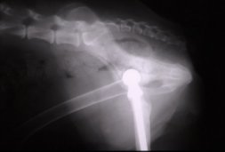
What are we looking at?

Slide 29
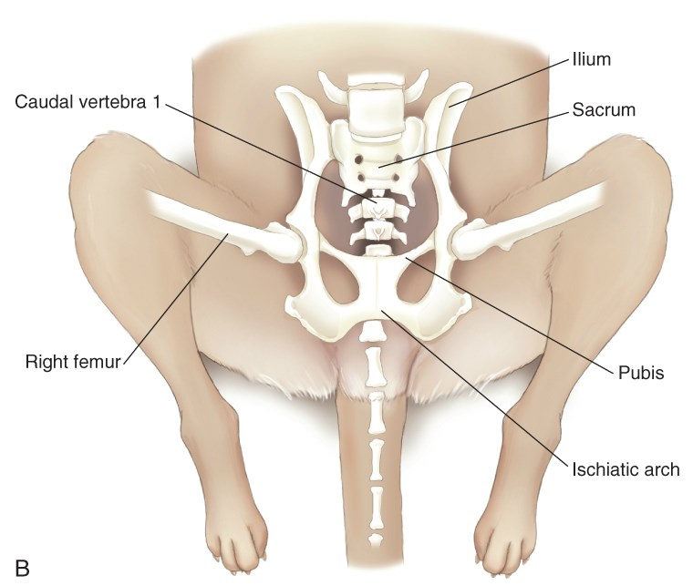
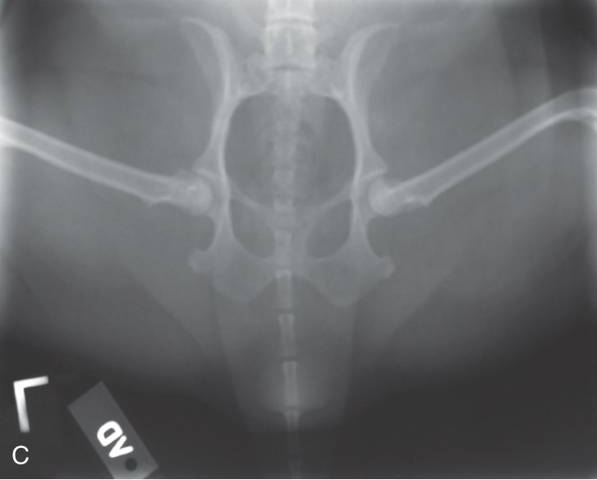
Pelvis – V/D Frog-Leg View
Used when extended-hip view is too painful
Suitable for pelvic trauma
Trough can be used for cranial end of body, but pelvis should be on table/cassette
Hind limbs flexed normally – usually 45 degrees
Limbs symmetrical

Slide 30
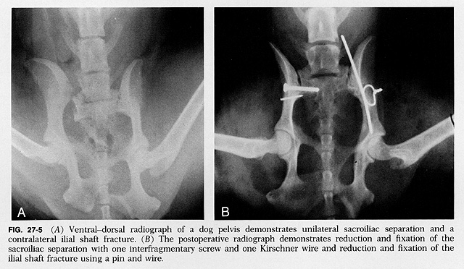
Ouch!

Slide 31
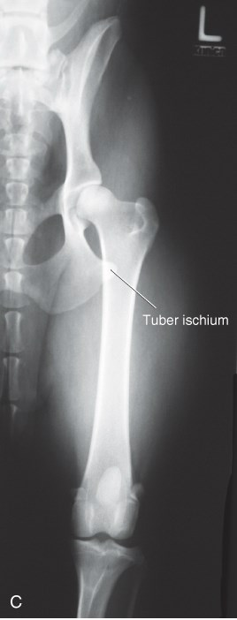
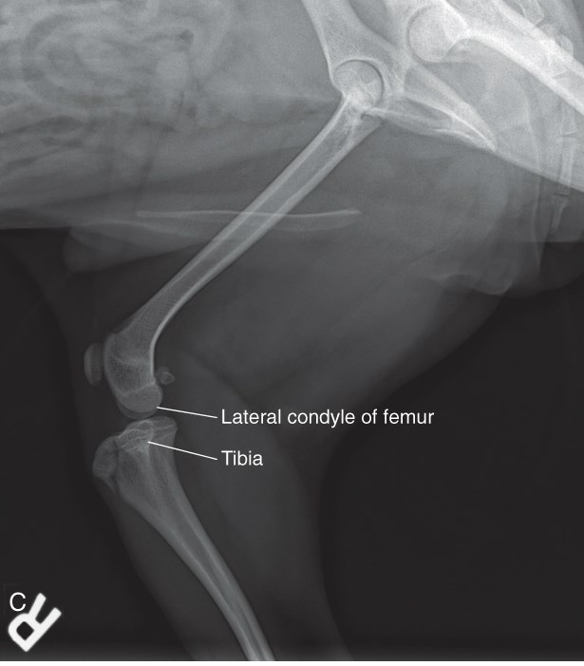
Femur – Standard Views
Mediolateral
Craniocaudal

Slide 32
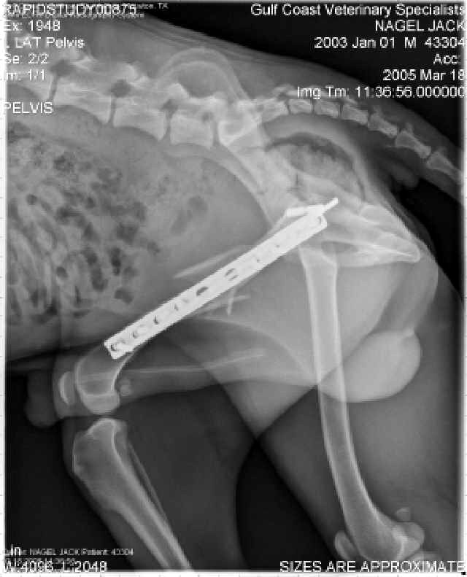
Femur: Mediolateral View
Positioning:
  Flex unaffected limb & pull back
  Extend affected limb & secure
  Ensure full limb is in view
  Differences in thickness may require 2 views
  Femoral head towards cathode
  Secure other body parts first
Notes:
Support with a cord or rope
Use sandbags as needed

Slide 33
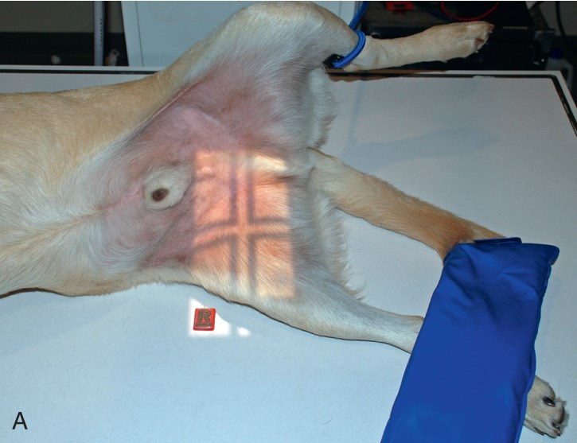
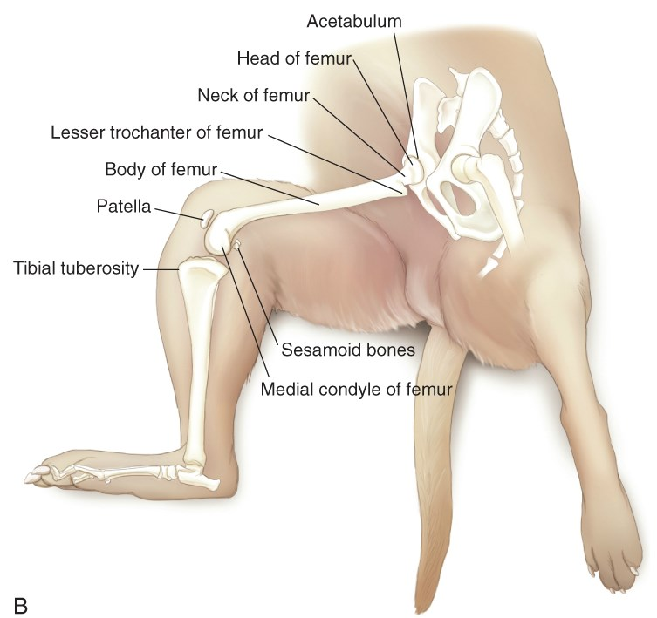
Femur: Mediolateral View

Slide 34
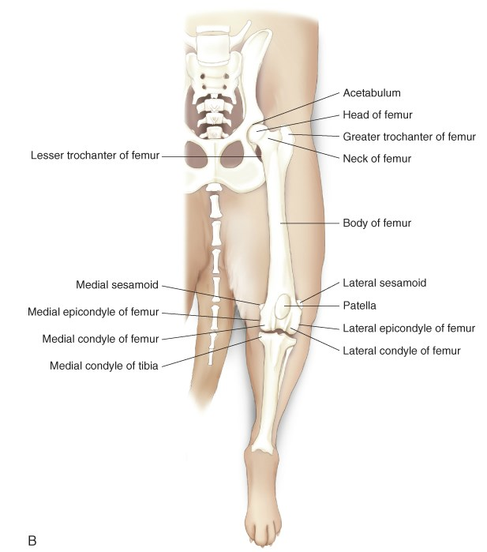
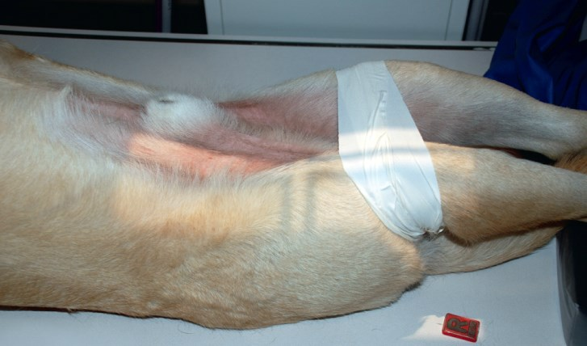
Femur: Craniocaudal View
Positioning:
  Use a trough, if possible
  Rotate both femurs inward
  Tape femurs proximal to stifle
  Complete extension
  Measure femur only

Slide 35
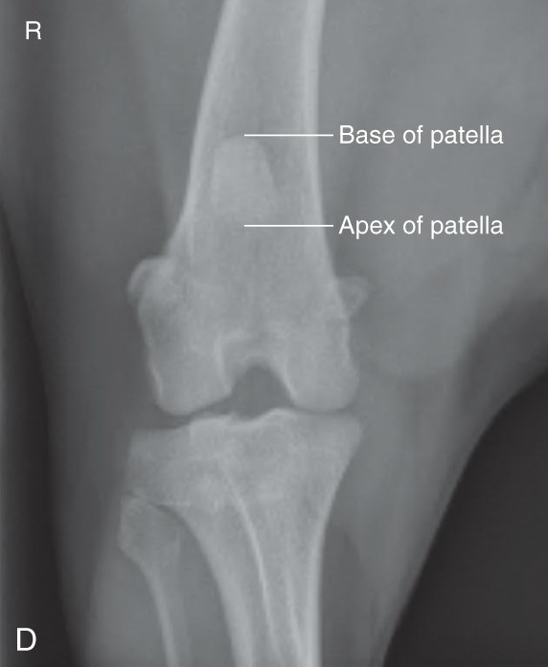
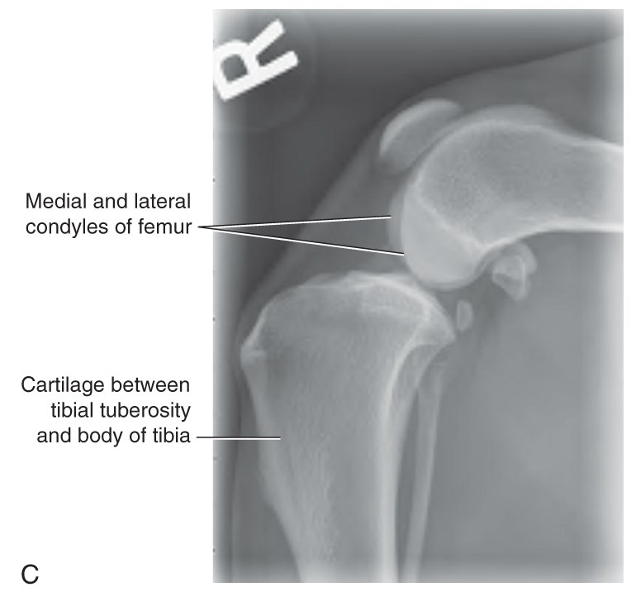
Stifle – Standard Views
Mediolateral
Caudocranial
(Sternal recumbency)

Slide 36
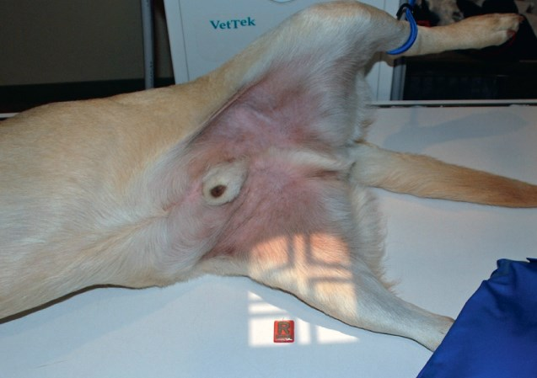
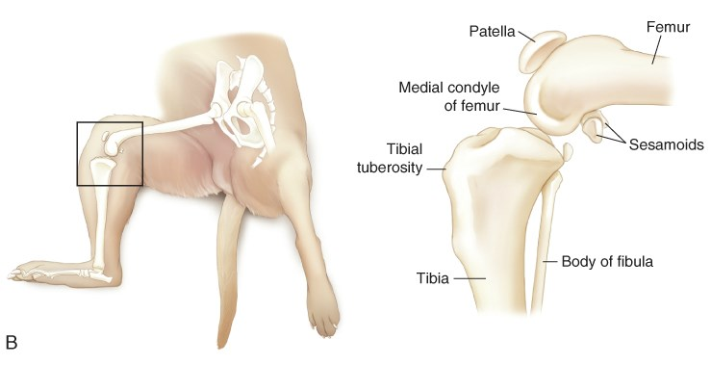
Stifle: Mediolateral View
Positioning is similar to femur radiograph…

Slide 37
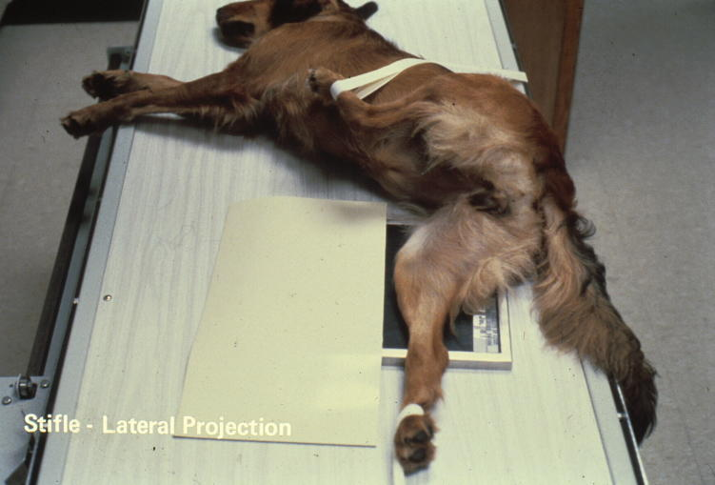
Stifle: Mediolateral View

Slide 38

Ouch…

Slide 39

Ouch…

Slide 40

Stifle: Caudocranial View
Positioning:
  Sternal recumbency
  Unaffected limb flexed near body
  Affected limb rests on patella
    Raising unaffected limb may help

Slide 41


Tibia & Fibula – Standard Views
Mediolateral
Caudocranial
(Sternal recumbency)

Slide 42


Tibia & Fibula – Mediolateral View

Slide 43


Tibia & Fibula – Caudocranial View

Slide 44


Tibia & Fibula

Slide 45


Tarsus & Foot – Mediolateral View
Notes:
Note use of foam

Slide 46


Tarsus & Foot – Plantarodorsal

Slide 47

Phalanges – Plantarodorsal View

Slide 48

Reminder: Before you hit the exposure button…
  Mental checklist:
    Settings correct
    Cassette/machine/grid in position
    Markers & ID
    Correct body part & view
    Proper centering
    Borders correct & collimated
    Patient prepared/positioned/restrained
    Proper parts perpendicular & parallel

Slide 49
Next Steps…
Today: Pelvic Limb
  Forelimb homework due
  Day 1 labs
    Roll @ 10am
  Lavin: Chapter 21
Friday:
  Day 2 labs (pelvic limb)
Monday: Test #3
  Chapters 9, 10, 16, 17, 20, 21
  Artifacts & Film Evaluation Lectures
  Lecture: Dental #1 (Lavin Chapter, CTVT 1110-1116)

