Slide 1

Divide into groups
Will count as quiz grade
Present your section of the chapter
  in any format
  All team members must participate
Groups:
  1 – Intro/Overview
  2 – Avian, pt. 1 (pp. 466-473)
  3 – Avian, pt. 2 (pp. 474-481)
  4 – Small mammals (incl. rat) (pp. 481-485)
  5 – Larger pocket pets (pp. 486-493)
  6 – Guinea pigs/turtles (pp. 494-502)
  7 – Amphibians & fish + Conclusion (pp. 508-510)

Slide 2
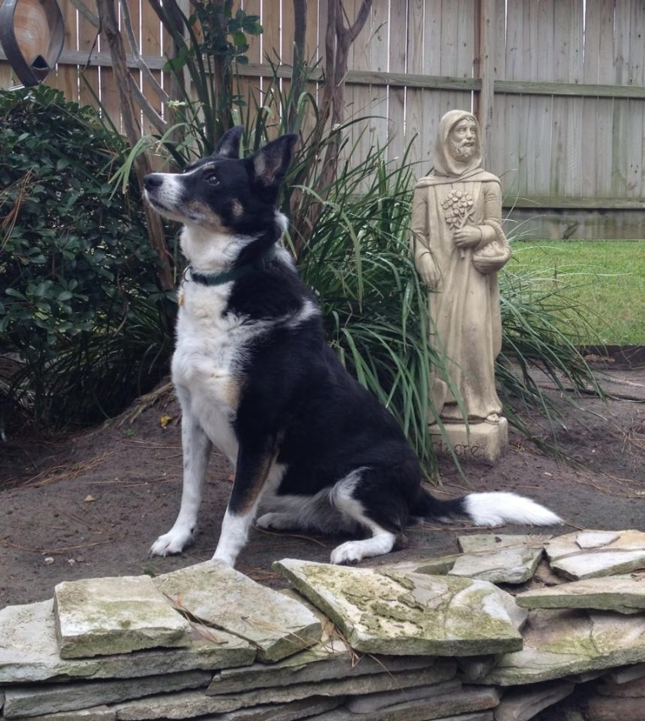
Dental Radiography
Lavin: Chapter 24
"Do not be daunted by the enormity of the world's grief. Do justly, now. Love mercy, now. Walk humbly, now. You are not obligated to complete the work, but neither are you free to abandon it." - The Talmud

Slide 3
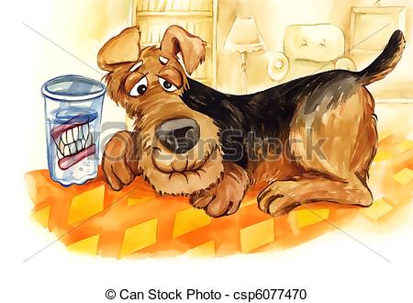
Objectives: Dental Radiography
Understand dental terminology & tooth surfaces
Understand basic anatomy & formula for teeth, including number of roots
Understand normal views & positioning for dental radiography
Define parallel and bisecting angle techniques, and know when to use each
Understand the differences between intraoral and extraoral views

Slide 4
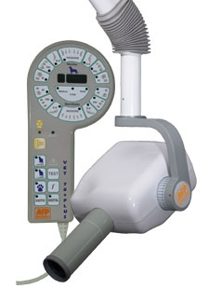
Dental Radiography: Overview
Includes both intraoral and extraoral radiographs
Special equipment isn’t essential
Allows thorough evaluation of tooth & surrounding tissues
Indications for dental radiographs:
  Periodontal disease
  Missing, malformed, or discolored teeth
  Resorptive lesions
  Oral tumors
  Gingival inflammation
  Trauma
  Dental extractions
Notes:
Periodontal disease – gum disease or gingivitis
A resorptive lesion (RL), also known as a neck lesion, feline odontoclastic resorptive lesion, is a defect of the tooth caused by the action of cells called odontoclasts. Tooth structure is destroyed and the lesion becomes evident when it starts affecting the crown of the tooth.

Slide 5
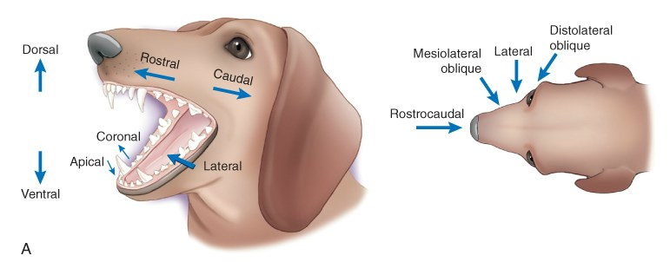
Anatomical Directions: Oral Cavity
Notes:
Coronal – Plane that divides front & back of jaw/away from the tooth root
Apical – Towards the tooth root

Slide 6
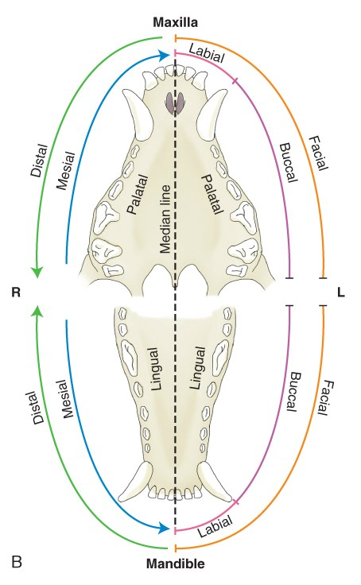
Positional Terminology:
Oral Cavity
Directional
Positional
Notes:
Mesial – Towards the midline
Distal – Farthest from the midline

Slide 7
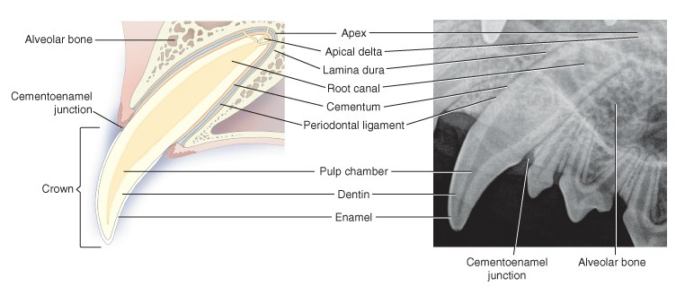
Tooth Anatomy: A Review
4 tooth types:
  Incisors – used for grooming, grasping, cutting
  Canine teeth – grasping/holding prey
  Premolars – cutting/shearing
  Molars – grinding (dogs), cutting (cats)
Notes:
Crown is above the gums
Enamel covers the crown
Root is below the gums
Cementum covers the root
Apex – The terminal end of the root of a tooth
Pulp chamber is darker on radiograph
Decreases in size over time
Dentin makes up more of tooth & appears lighter
Periodontal ligament attaches cementum to alveolar bone
Tooth types:
Incisors – single rooted, grooming & cutting
Canines – grasping & holding prey – single rooted
Premolars – cutting & shearing meat – 1-3 roots
Molars – Chewing (1-3 roots)

Slide 8
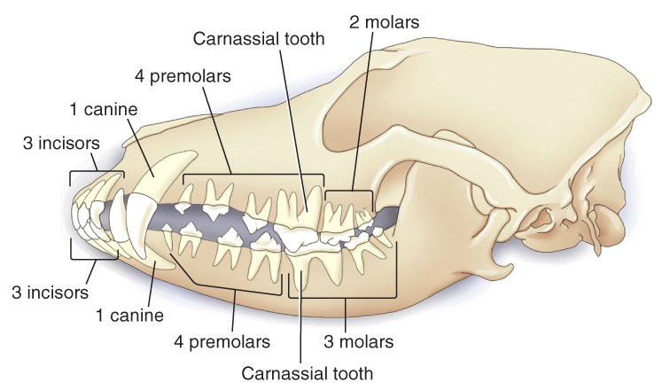
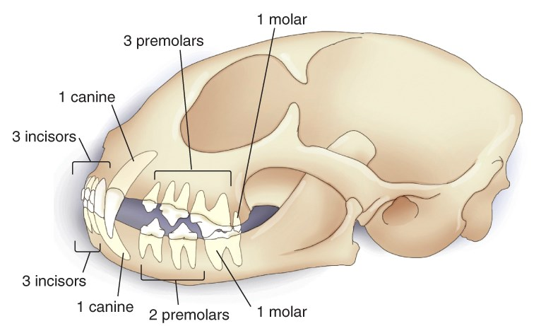
Dental Formulas
Carnassial tooth:
Shearing cheek tooth
Dogs: Upper 4th premolar & lower 1st molar
Cats: Upper 3rd premolar & lower 1st molar

Slide 9
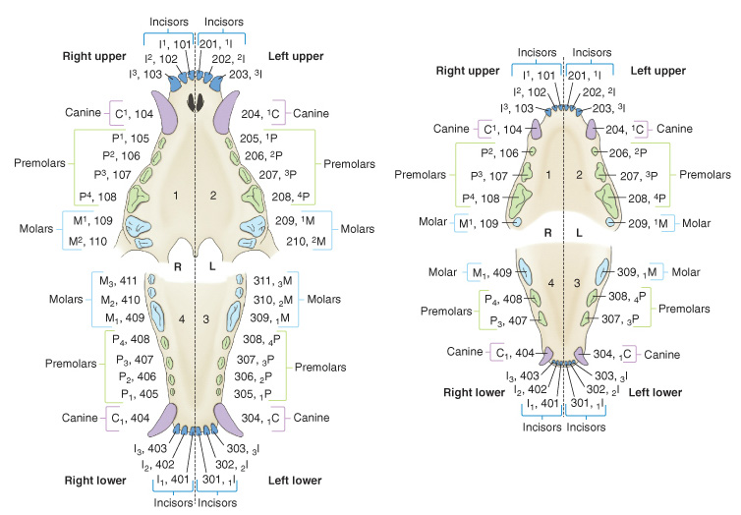
Triaden Numbering System
Canine
Feline
Canine
Feline
1st number = quadrant
2nd 2 numbers = tooth position

Slide 10
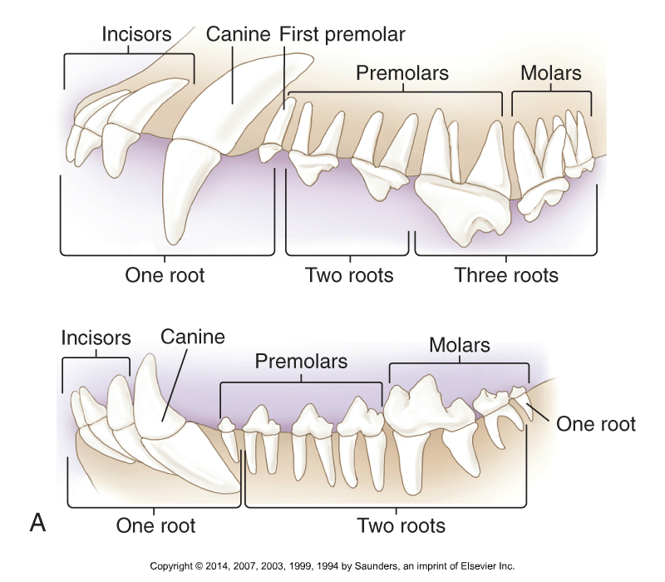
Number of Roots: Canine

Slide 11
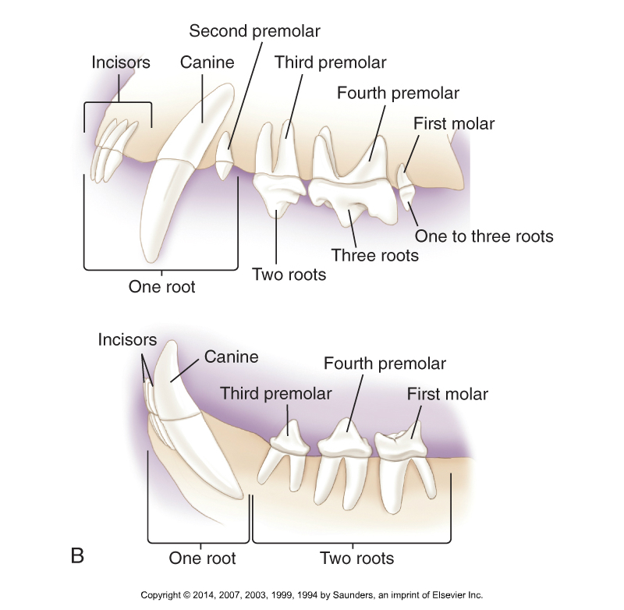
Number of Roots: Feline

Slide 12
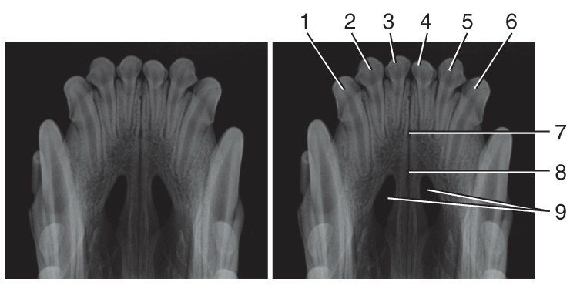
Normal Adult Canine Maxillary Incisors
7 – Incisive canal
8 – Interincisive suture
9 – Palatine fissure – oval dark spaces
Notes:
Suture – Where bones meet

Slide 13
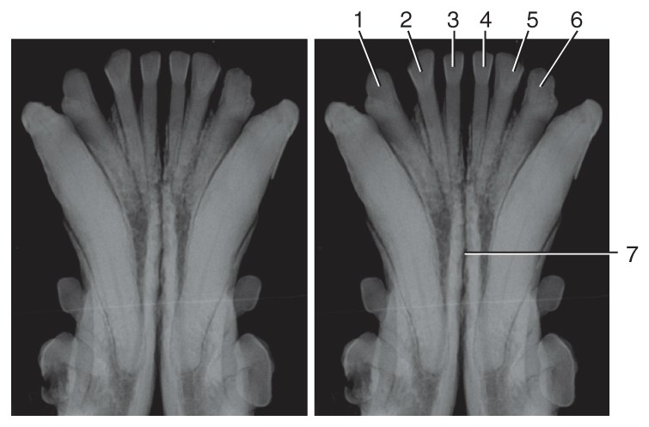
Normal Adult Canine Mandibular Incisors
7 – Mandibular symphysis
Notes:
Symphysis – Joint where bony structures are firmly united

Slide 14
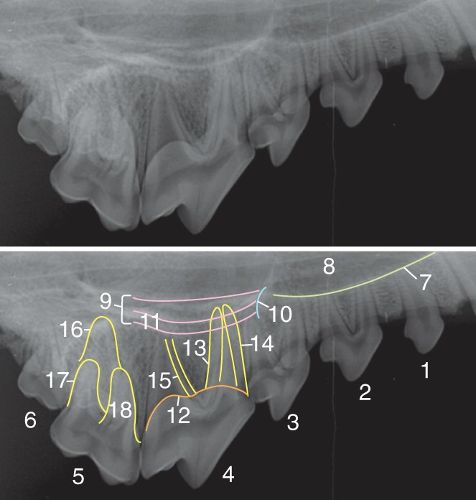
Normal Adult Canine Maxillary Premolars/Molars
8 – Nasal cavity
11 – Palatal canal
Notes:
Includes tooth roots (outlined)

Slide 15
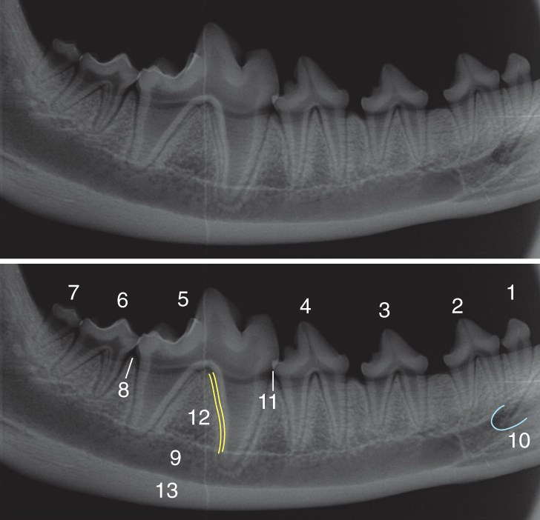
Normal Adult Canine Mandibular Premolars/Molars
9 – Mandibular canal
11 – Enamel overlap

Slide 16
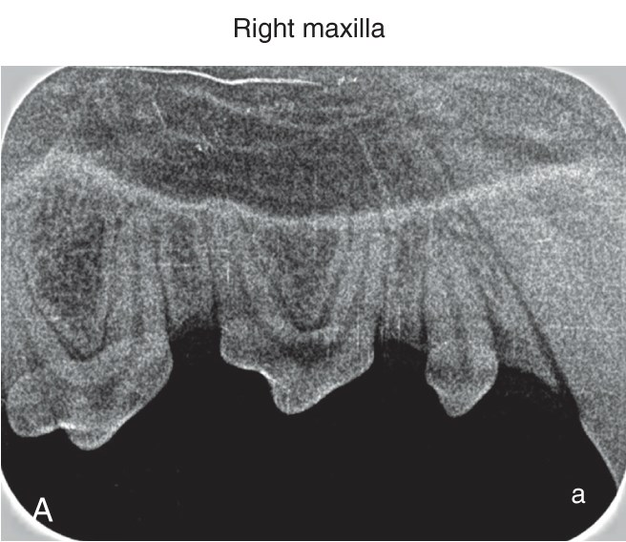
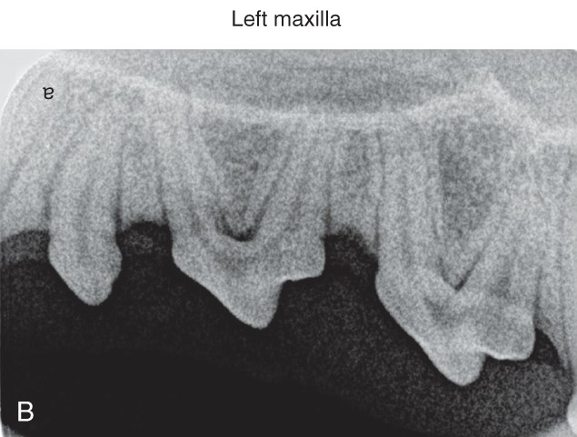
Viewing Dental Radiographs
Film is exposed with the convex dot at the rostral end of the mouth
  Dot location varies with right & left radiographs

Slide 17
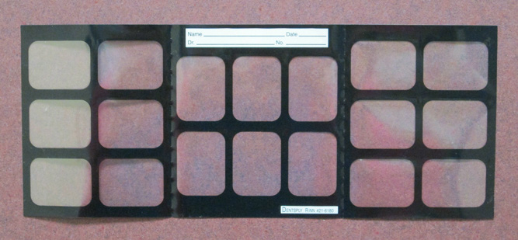
Film Mount
Organize full mouth radiographs in a film mount:
Hang as if looking at the animal, with animal’s right side on your left…
Notes:
Allows for viewing & filing

Slide 18
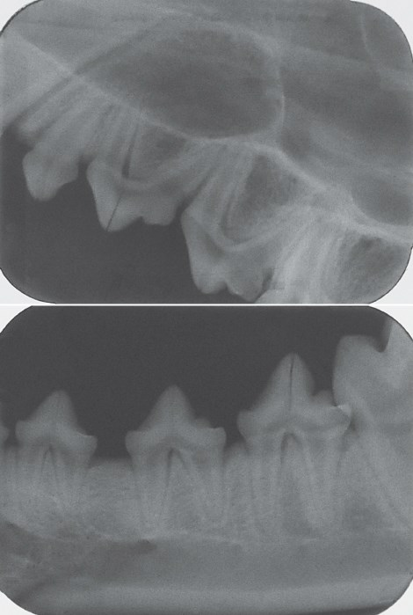
Viewing Dental Radiographs (Cont.)
After film is developed, hold it as if in the mouth with the raised dot towards you
  Visualize the film inside the animal’s mouth
Determine via anatomy whether mandible or maxilla
Cusps of maxillary teeth should point down
  Mandibular teeth point up

Slide 19
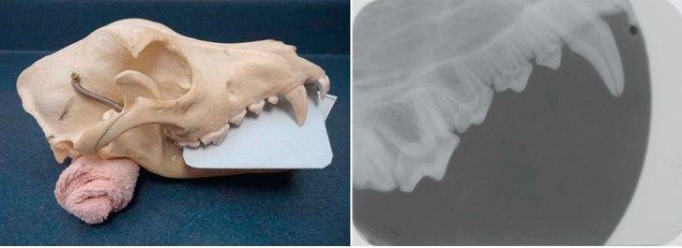
Proper Oral Film Placement
Notes:
Note convex dot at right

Slide 20
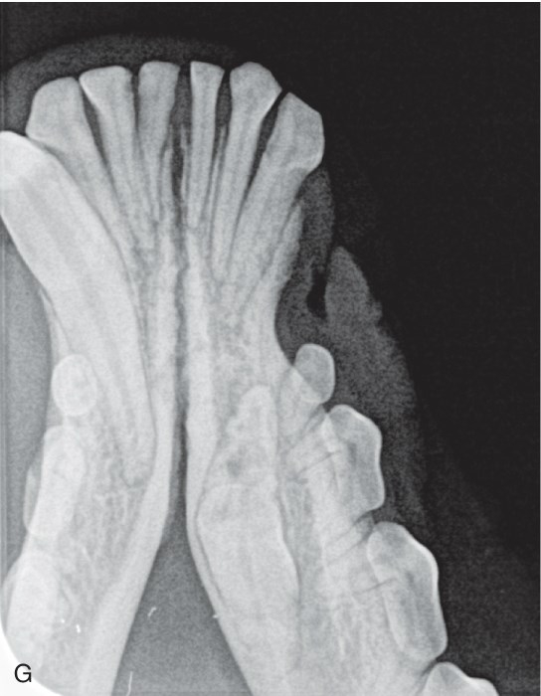
Abnormal Pathology: Unerupted Canine Tooth

Slide 21
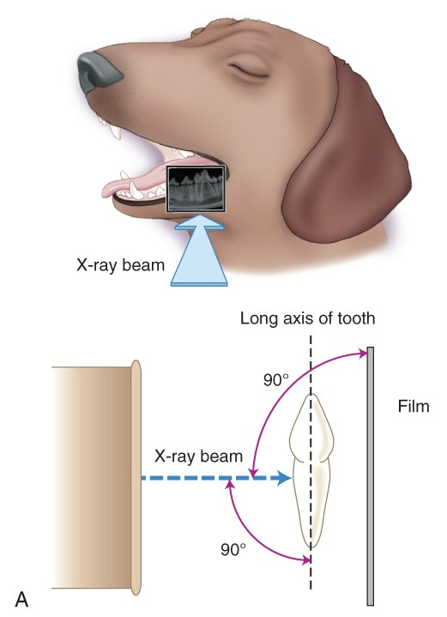
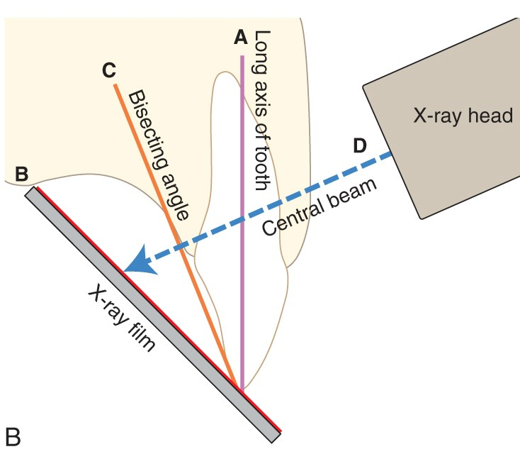
Radiography Techniques
Parallel
Bisecting Angle

Slide 22
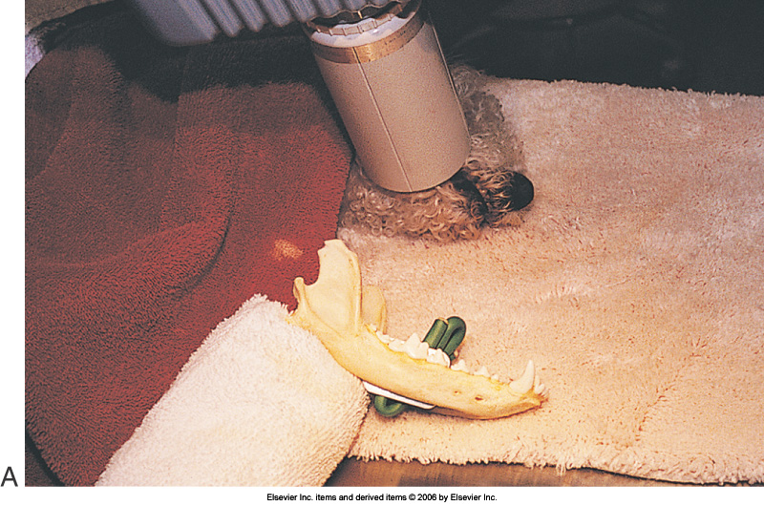
Dental: Parallel Technique
Used for mandibular molars and pre-molars only
Film is placed inside of & parallel to the teeth
Primary bean is placed perpendicular to film

Slide 23
Dental: Bisecting-angle Technique
For all maxillary teeth & mandibular incisors
Placing the beam perpendicular to tooth or film results in foreshortening or elongation, so bisecting-angle minimizes
Find the bisecting-angle:
  Place film parallel to tongue
  Draw an imaginary line along the tooth’s axis
  Draw another imaginary line along the axis of the film
  Position the primary beam perpendicular to the “bisecting angle”

Slide 24
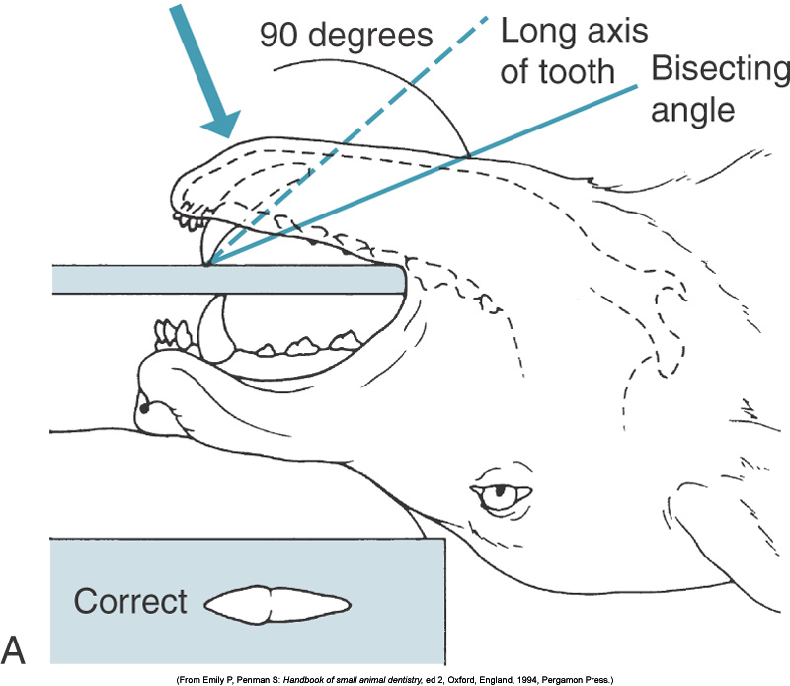
Bisecting Angle
CTVT pg. 888

Slide 25
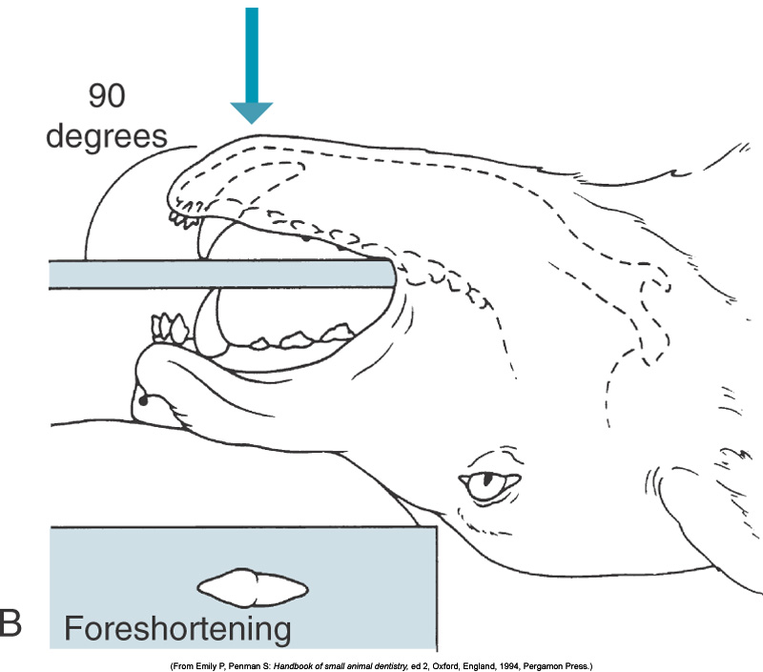
Distortion: Foreshortening
Notes:
Foreshortening –
Central ray at right angle to film instead of bisecting angle
Crown of root will overlap the root

Slide 26
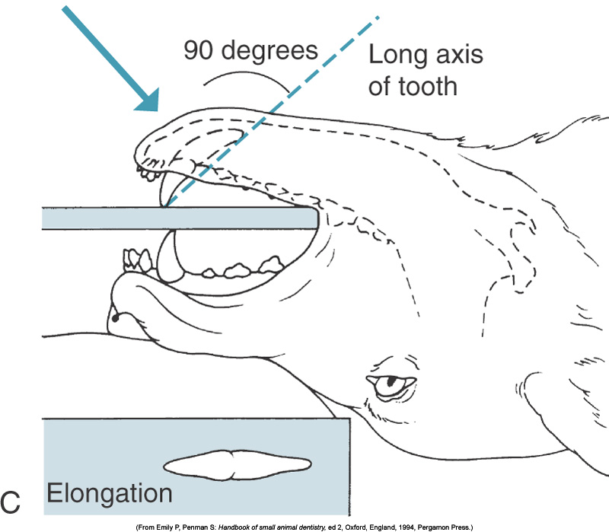
Distortion: Elongation
FILM
Notes:
Elongation –
Central ray is at a right angle to the long axis of the tooth instead of the bisecting angle
Stretches tooth shadow or image
May miss part of tooth

Slide 27
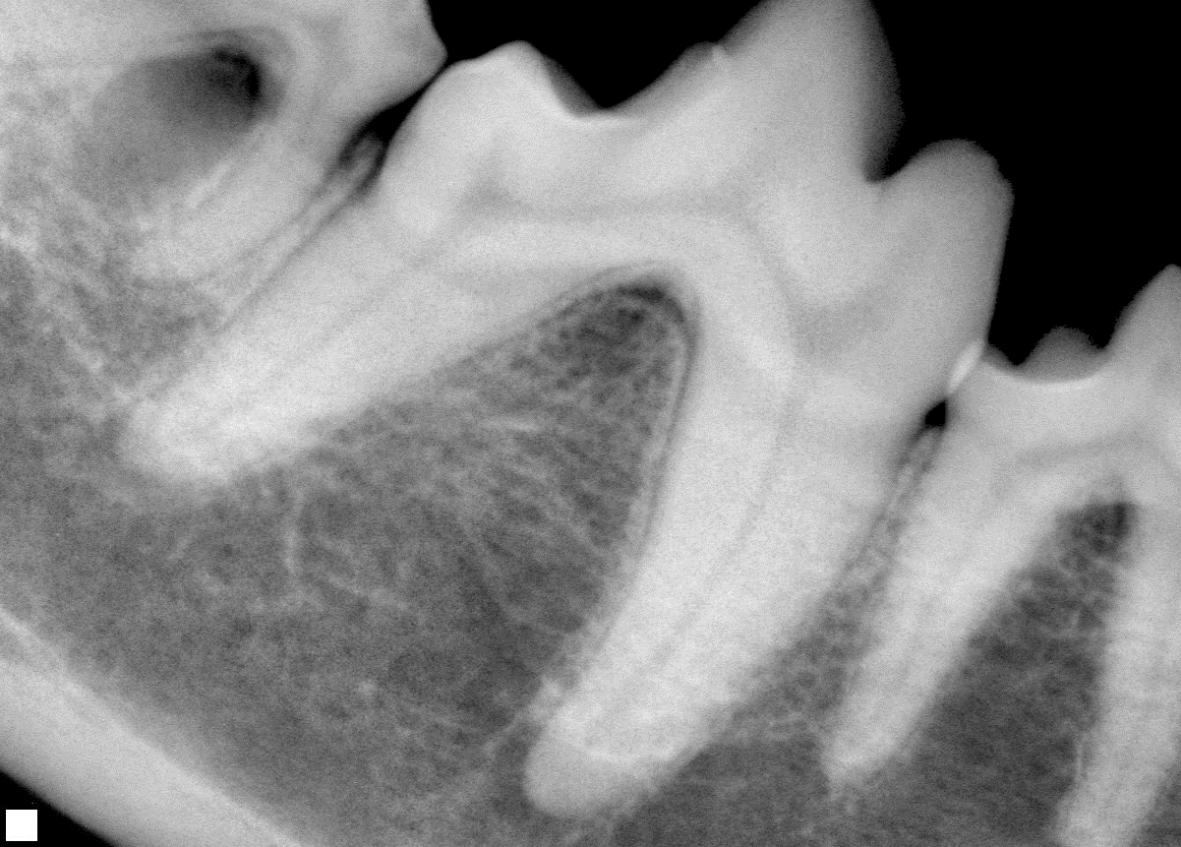
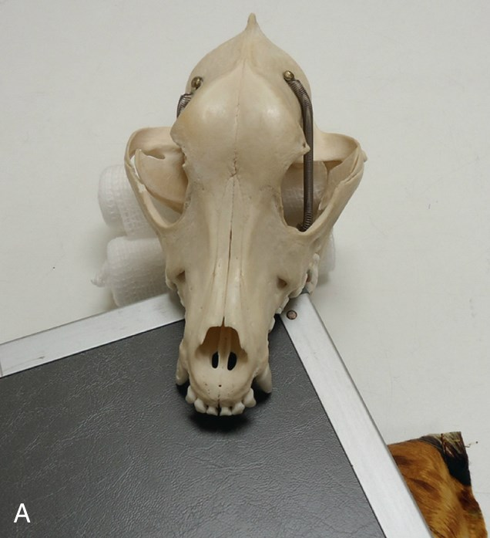
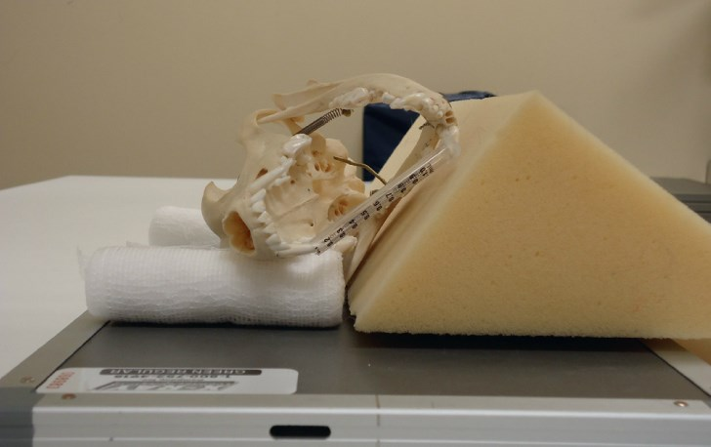
Types of Dental Radiography
Digital
Dental Film-Based X-ray unit
Digital Radiography
Regular X-ray machine
  Intraoral – Film inside the mouth
  Extraoral – Film outside the mouth
Regular Machine - Intraoral
Regular Machine - Extraoral

Slide 28
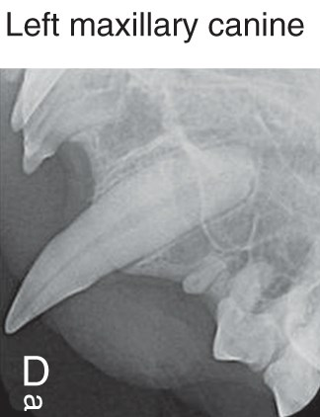
Dental Radiography
Can be done in two ways:
  Conventional machine
    Not ideal, but may be only option
    Patient’s body position/skull must be rotated
      Positioning very difficult
    Screened cassette & radiolucent devices required
    Distal teeth may be difficult to image
    SID (source to image distance) must be reduced to 15 inches or exposure factor adjustments must be made
  Dental X-Ray machine
    Smaller & portable
    Radiographs of superior quality
    Expensive
Feline

Slide 29
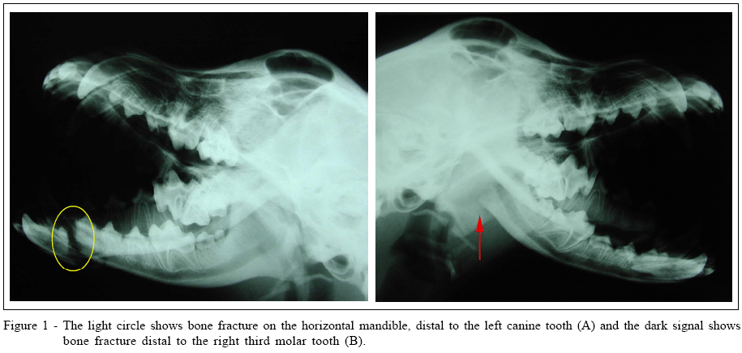
Conventional Dental Radiography: Considerations
Not ideal, but may be all that’s available
Requires screened cassettes & radiolucent positioning devices
Positioning the cassette in the mouth is usually difficult
Distal teeth are especially difficult to image
Bone superimposition can make molars & premolars appear whiter

Slide 30
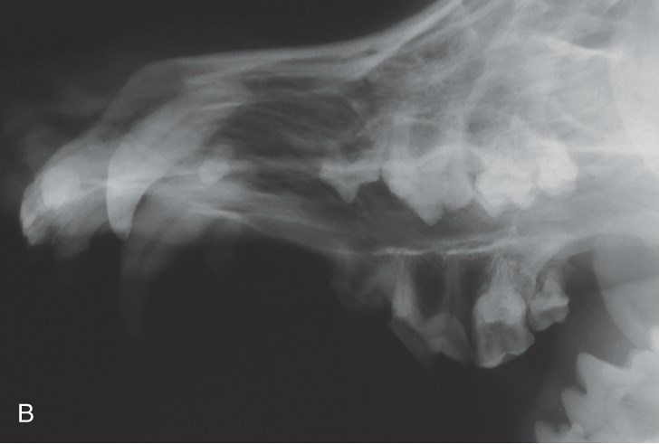
Conventional Radiology: Extraoral
Maxillary Premolars/molars: VD Oblique Extraoral View
  Patient positioned halfway between lateral & VD
    Affected side down
  Place foam wedge/roll under nose
  Rotate mandible to 45-degree angle from table surface
  Place radiolucent mouth gag
Notes:
Extraoral = film outside mouth
Magnification of affected side molars/premolars d/t angle of head
Contralateral teeth whiter d/t bone superimposition

Slide 31
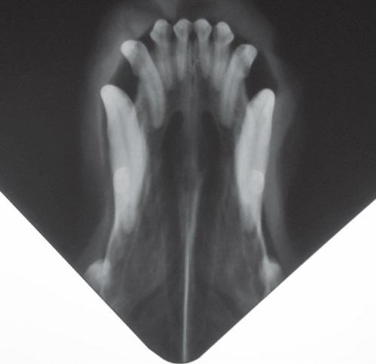
Conventional Radiology: Intraoral
Maxillary Incisors & Canine: DV Intraoral/Occlusal View
  Sternal recumbency
  Place sponge under mandible & cassette to keep parallel to table
  One corner of cassette into patient’s mouth
  Adjust SID for raised cassette
  Can assess rostral nasal sinus cavity

Slide 32
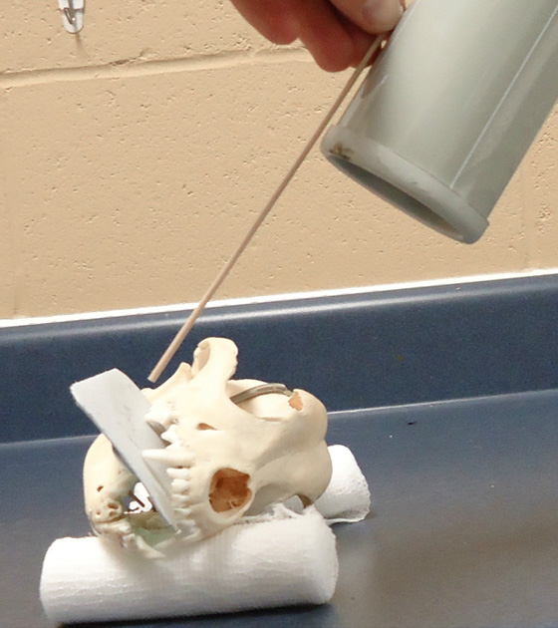
Dental Radiography: Dental Machine
Size of film depends on animal & tooth
Lateral patient positioning w/jaws parallel to tabletop
Use foam or wedge as needed
Tie ET to opposite jaw from area of interest
Paper towel can be used to position film in mouth
SID varies from against face (small film) to 6 inches
  Increased SID = increased exposure
No collimator, so estimate
Place dot rostrally
Notes:
Size 4 – For all canine teeth except small dogs & cats
Size 2 – Most cats
Inverse square law

Slide 33
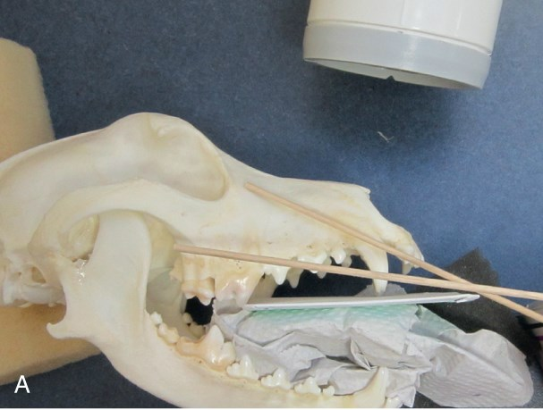
Radiography: Maxillary Canine Tooth
Initially set up using the long axis of the tooth
Cone is directed obliquely toward animal’s midline
Prevents superimposition of canine tooth over premolars
Use root of tooth for bisecting angle, not crown
Both canine teeth should touch film
SID usually 6 inches

Slide 34
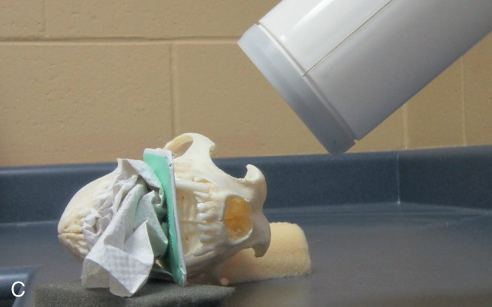

Radiography: Maxillary Canine Tooth
Notes:
Bisecting Angle Technique

Slide 35
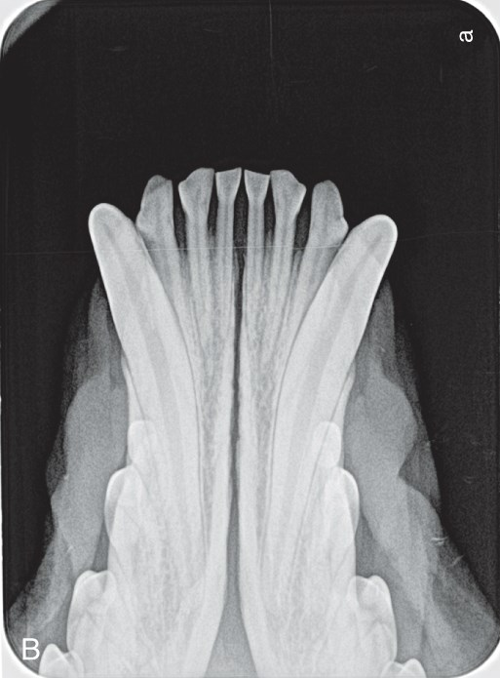
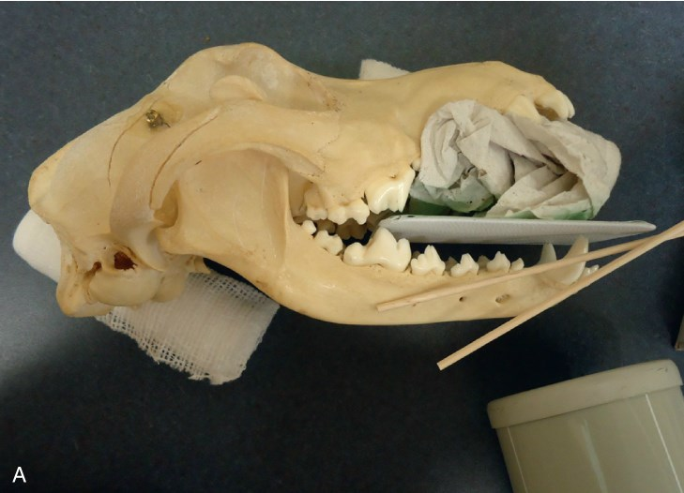
Radiography: Mandibular Incisors
Rostrocaudal view can capture all incisors on one film
Roots will overlap slightly
Elongation is common

Slide 36
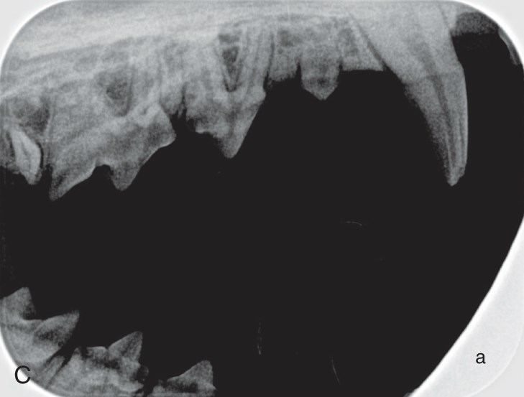
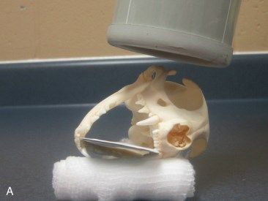
Radiography: Feline Maxillary Premolars
Intraoral technique
Tongue should be behind the film on the mandible
ET tube will be on the tube side of the film
  May have to be untied and clamped to fur on one side
Uses modified parallel technique with beam perpendicular to film

Slide 37
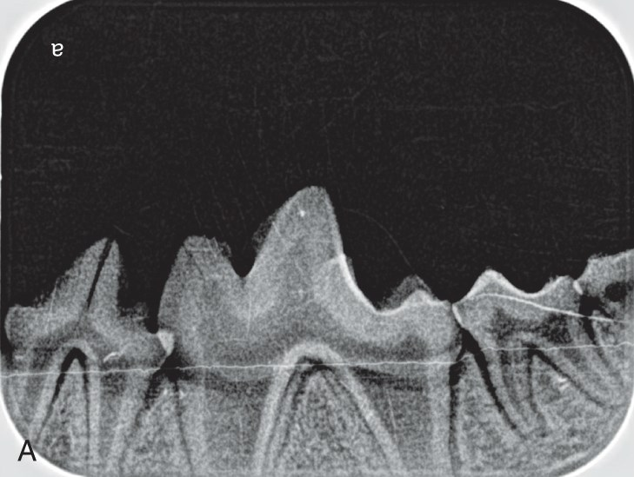
Error: Root Cutoff
Not pushing film in far enough

Slide 38
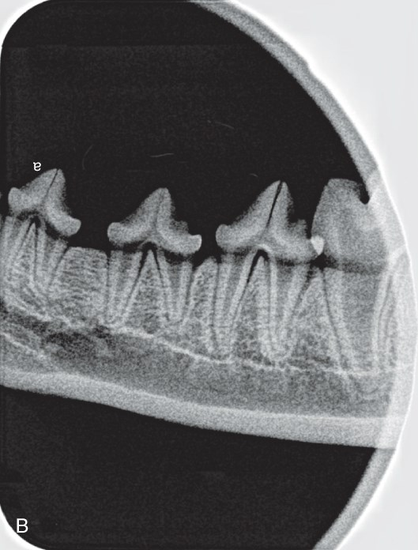
Error: Cone Cutoff
Cone not centered on tooth

Slide 39
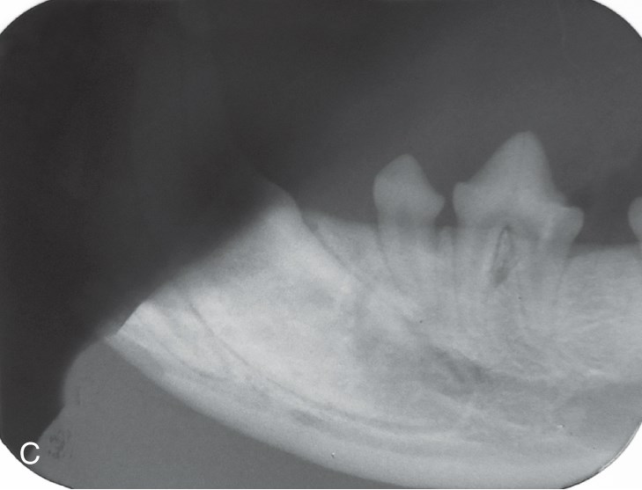
Artifact: Light Exposure
Light exposure in chairside darkroom

Slide 40
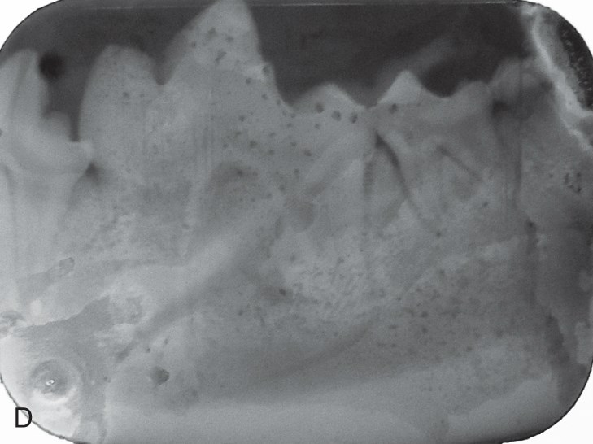
Error: Film Processing
Fixer not rinsed off film

Slide 41
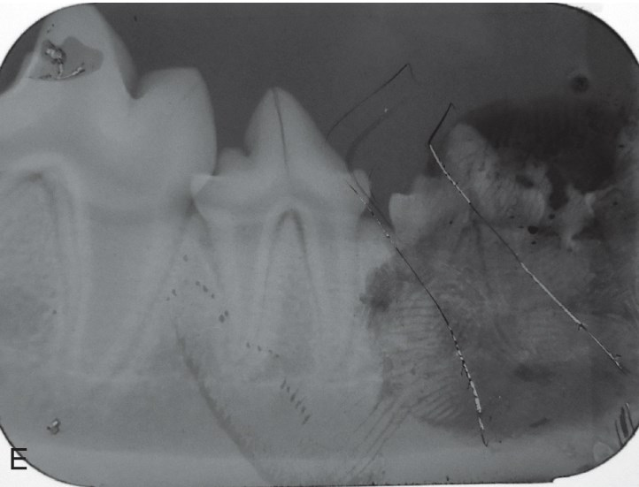
Artifact: Fingerprints & Scratches

Slide 42
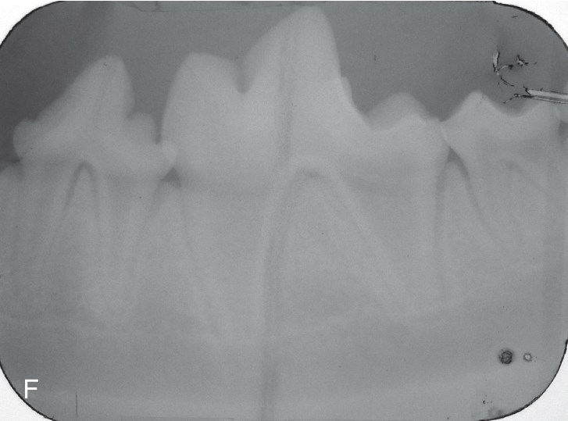
Error: Bent Film
Crescent Line
Notes:
Crescent Line

Slide 43
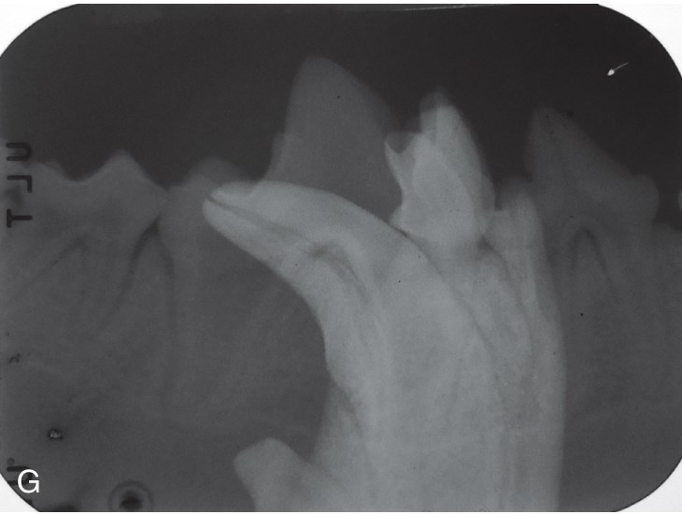
Error: Double Exposure

