Slide 1
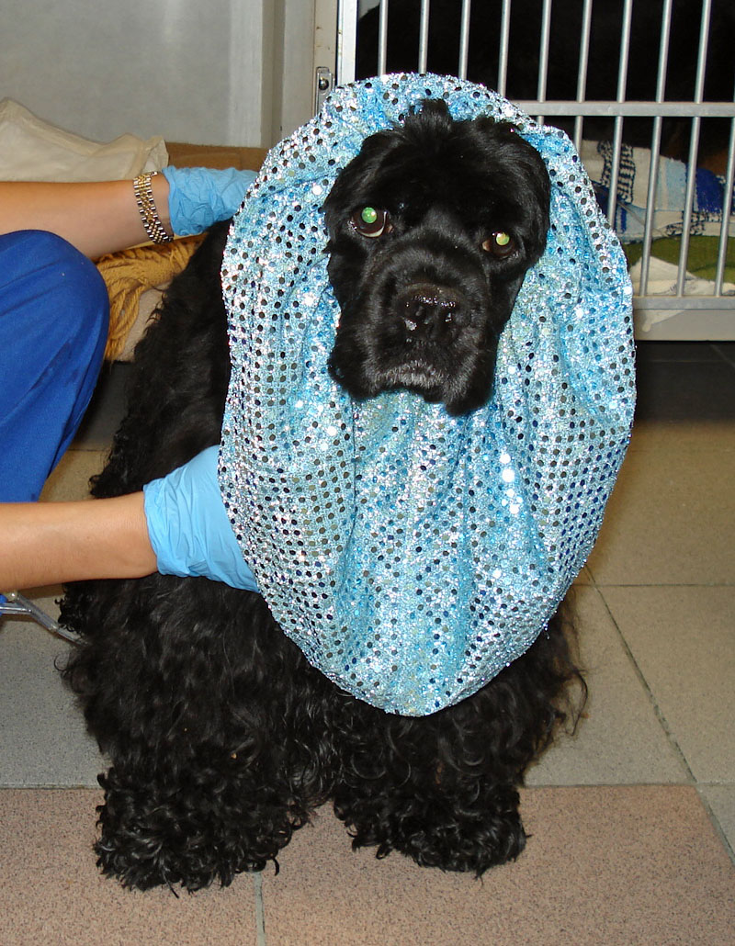
Film Imaging
Lavin: Chapter 5
CTVT: 532-536
Notes:
Ronnie’s snood
A tubular neck scarf. In the most common form the headgear resembles a close-fitting hood worn over the back of the head. A tighter-mesh band may cover the forehead or crown, then run behind the ears and under the nape of the neck.

Slide 2

Let’s Review…
List 3 essential pieces of equipment found in every x-ray unit…
Notes:
3 essentials to every unit:
Control Panel
X-Ray Tube
High-Tension Transformer

Slide 3
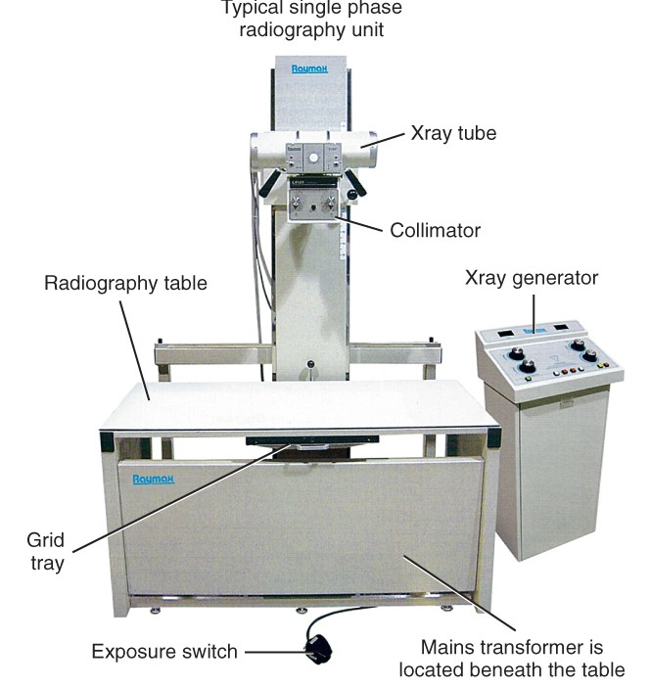
X-Ray Unit
3 essentials to every unit:
Control Panel
X-Ray Tube
High-Tension Transformer

Slide 4
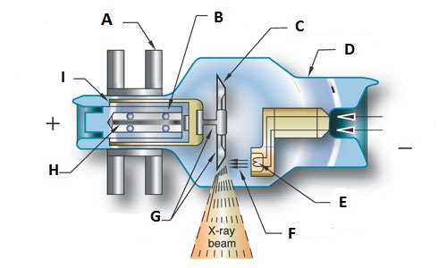
Label the Parts of an X-ray Tube…
Notes:
A – Stator B – Bearing C – Tungsten Anode
D – Envelope E – Filament F – Electron Beam
G – Neck & Base H – Rotor I – Armature
Cathode?
Anode?
Path of the electrons
Place where x-rays start
Target Window
What is the space charge?

Slide 5
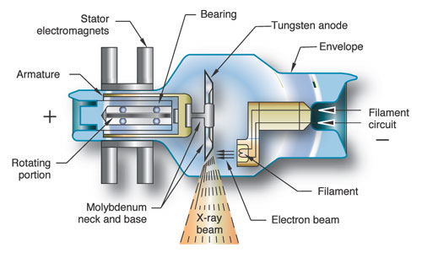
The X-ray Tube
Tube Housing:
Controls leakage & off-focus radiation
Helps to cool the tube
Notes:
Source of x-rays is tube
Interaction of photons & anode generates extreme heat
Ratio of x-rays to heat is 99:1
Housing or envelope usually made of Pyrex

Slide 6
In Review…
What are the 2 types of anodes, and what distinguishes them?
Notes:
Rotating anode units – Small animal units
Produces higher quality x-rays
Rotation apparatus must be high quality & perfectly balanced
Stationary anodes – Portable units often used for large animal or dental
Limited application for abdomen/thorax because not powerful enough beam for thicker body parts

Slide 7
What is the purpose…
Of the CATHODE:
Of the ANODE:
Notes:
Of the CATHODE:
Houses the filaments
Generates heat to create cloud of electrons
Focuses electrons to target
Of the ANODE:
X-rays are produced at focal spot
Mechanically supports the electron target
Dissipates heat
Electrical conductor
Completes the circuit
Receives electrons and transmits them back to generator

Slide 8
What is the purpose…
Of the CATHODE:
Houses the filaments
Generates heat to create cloud of electrons
Focuses electrons to target
Of the ANODE:
X-rays are produced at focal spot
Mechanically supports the electron target
Dissipates heat
Electrical conductor
Completes the circuit –
  Receives electrons and transmits them back to generator
Notes:
Dissipates heat along the stem and by rotating to change where photons are focused

Slide 9
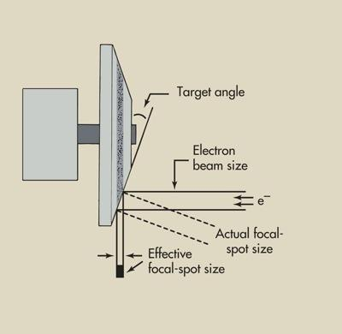
Review: What Does This Represent?
Notes:
The Line Focus Principle: Describes how electrons interact with anode & change direction

Slide 10
The Line Focus Principle
Describes how electrons interact with anode & change direction
Directs x-rays onto patient
Angles target to create a smaller effective focal spot size
Narrows the beam and increases resolution
Sharpens the final image
Notes:
NOT BAD
Typical angle is 11 degrees
15 degrees – widens the beam
< 15 degrees – narrows the beam
Actual vs effective focal spot

Slide 11
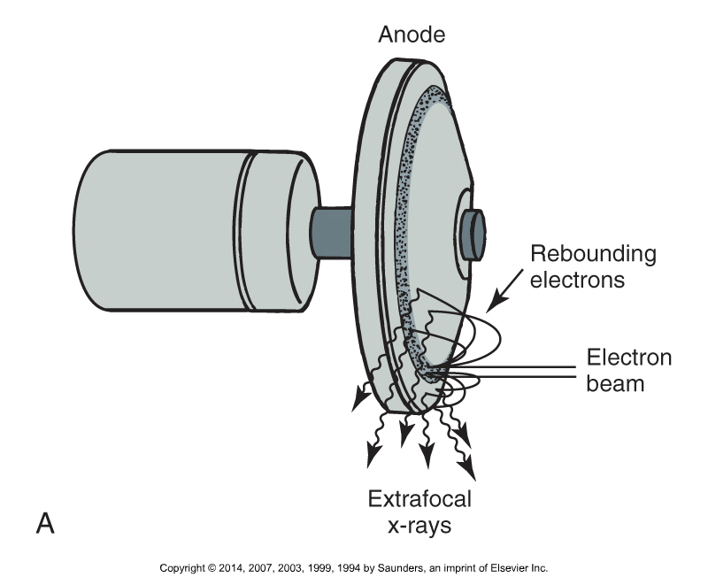
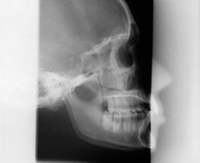
What Does This Represent?

Slide 12
Possible Focal Spot Issues
Off-Focus Radiation:
  “Extrafocal" radiation
  Produced by electrons bouncing off & impacting the anode outside the focal spot
  Collar of lead around tube normally prevents
  Can appear as artifact

Slide 13
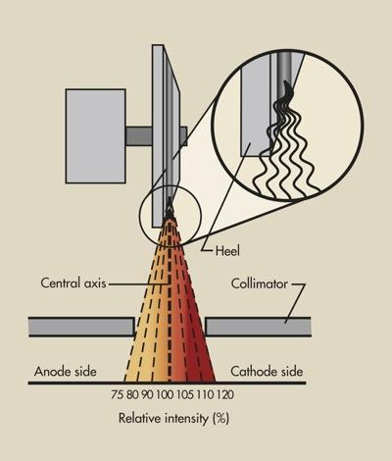
What Does This Represent?

Slide 14
The Anode Heel Effect
Causes the Intensity of radiation to be greater on the cathode side of the tube
Bevel of the anode limits x-rays produced on anode side
Place thicker end of patient on the cathode side
  Head usually to right
Notes:
NOT BAD – Can be used

Slide 15
To review…
To produce x-rays, a great deal of energy in an x-ray tube is converted to heat. The ratio of heat generated to x-ray production is considered to be
  1%:99%
  99%:1%
  50%:50%
  75%:25%
Notes:
B
Temps in excess of 2000 degrees C are required to loosen electron binding energy

Slide 16
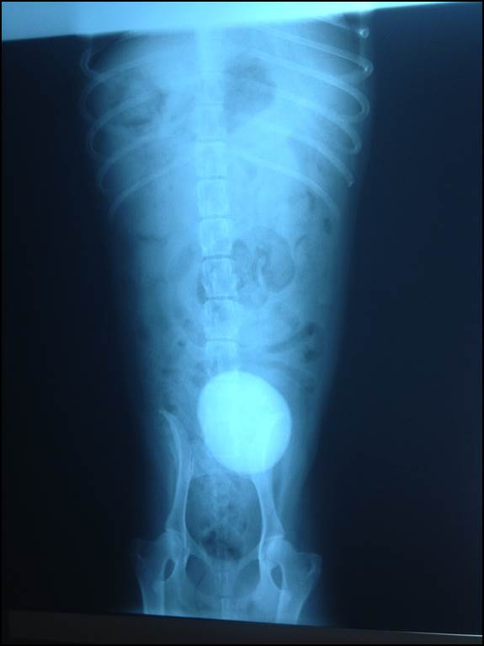
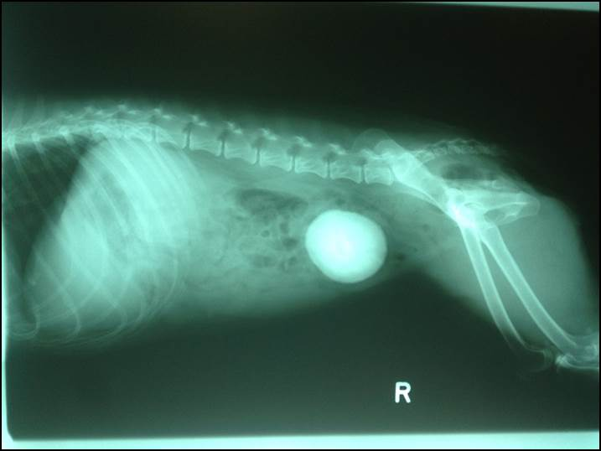
Diagnostic?
Notes:
Marsha’s baby

Slide 17
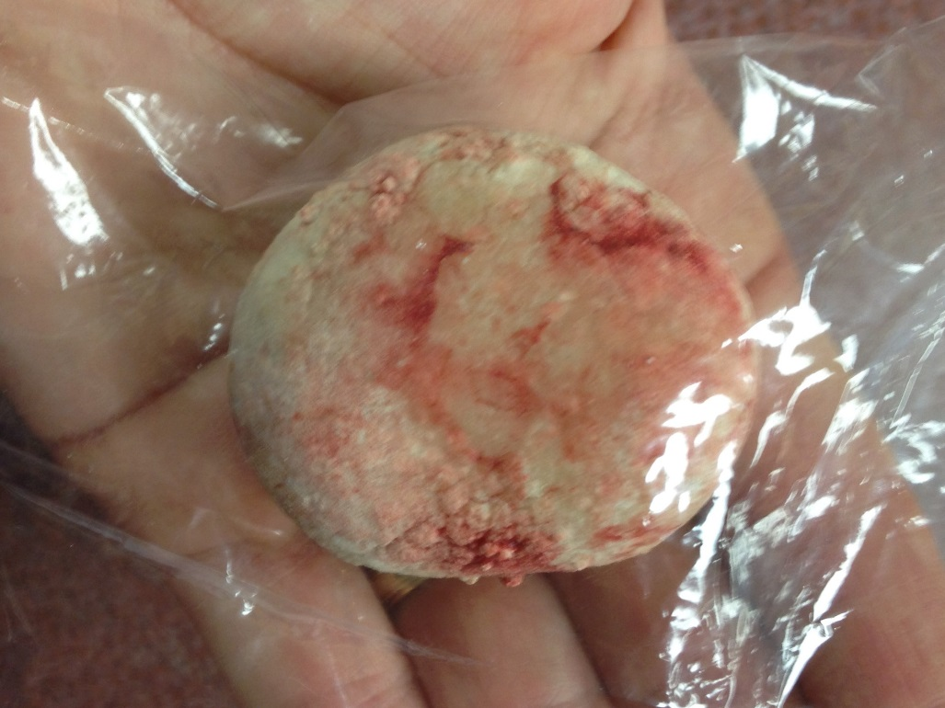


Slide 18
Learning Objectives: Chapter 5
Identify cassettes, screens, and film, and understand how they work together to create an image
Understand latent image formation
Understand correct storage and care of film, cassettes, and intensifying screens

Slide 19
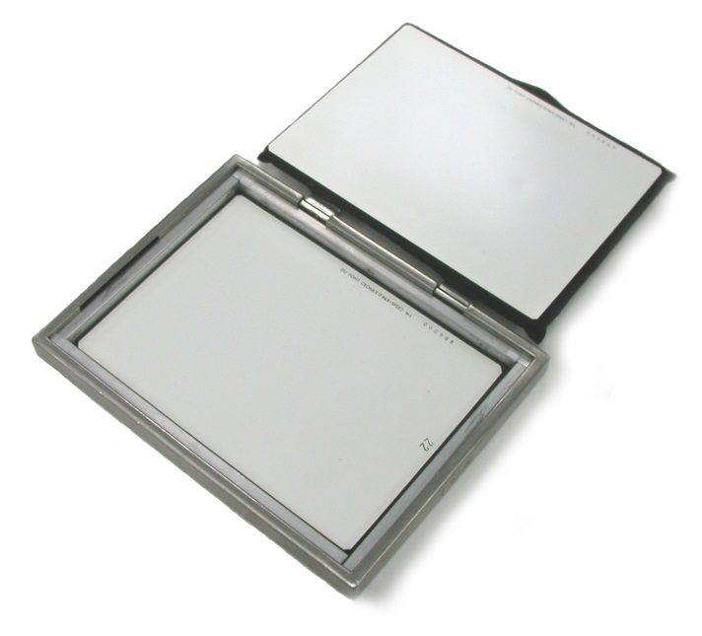
Producing Radiographs
The image receptor receives the produced x-rays and produces the actual image.
Receptor components in film-based imaging:
    Cassette/film holder
    Intensifying Screen
    Film

Slide 20
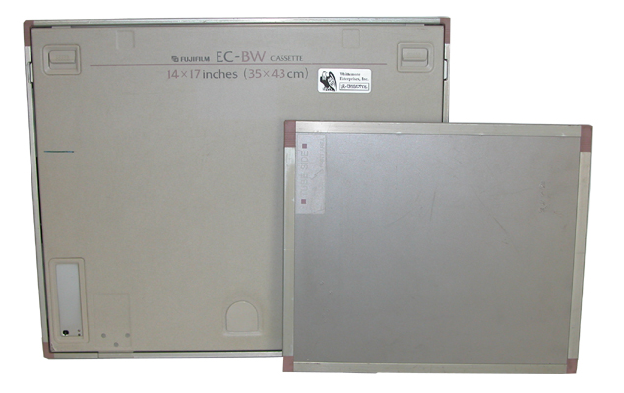
The X-Ray Cassette
A film holder designed to contain a pair of intensifying screen and one sheet of film
Sturdy and unbendable
Radiolucent front (nearest the patient) & leaded back (away from the patient)
Must hold film securely
Must latch securely
Notes:
Radiolucent - permitting the passage of radiant energy, such as x-rays, with little attenuation, the representative areas appearing dark on the exposed film.
Radiopaque - Not allowing the passage of x-rays or other radiation

Slide 21
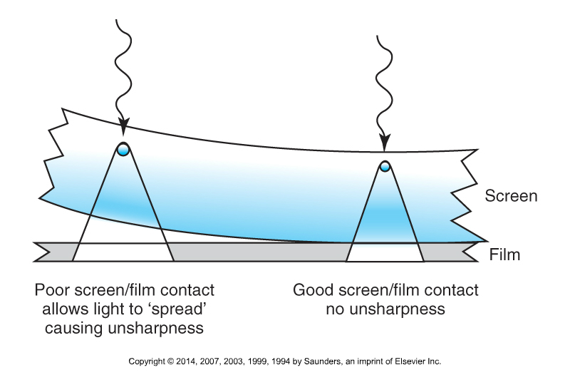
The Cassette
Designed to sandwich x-ray film with good contact between two intensifying screens.
  Intensifying screens: Fluorescent sheets of plastic that convert x-ray radiation into visible light, creating a latent image on the film.
Film is processed to convert a latent image to a visible image.
Notes:
Latent image:
An invisible image produced by the exposure to light of a photosensitive material such as photographic film
When photographic film is developed, the area that was exposed darkens and forms a visible image.
Physically - A latent image is a small cluster of metallic silver atoms formed in or on a silver halide crystal due to reduction of interstitial silver ions by photoelectrons (a photolytic silver cluster).
Contains foam rubber

Slide 22
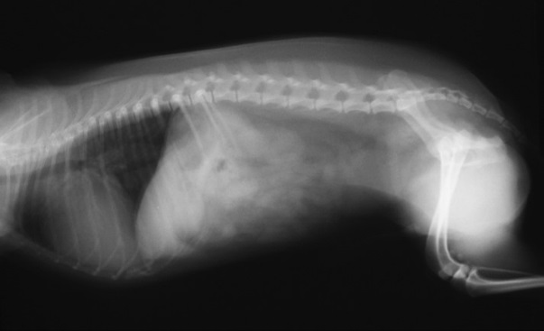
Poor Film/Screen Contact
Notes:
Structures are visible but appear fuzzy

Slide 23
The Cassette
A rigid film holder that holds x-ray film and intensifying screens in close contact
Made of light-tight materials to prevent unwanted exposure, still allow penetration of x-rays
Originally cassettes were made with cardboard, but could not be reused.
Different forms today include aluminum, polycarbonate, magnesium, and carbon fiber.

Slide 24
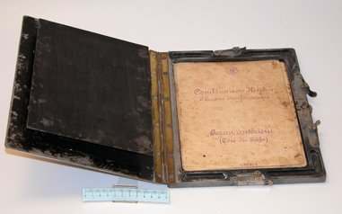
Cardboard Film Cassette (Historical)

Slide 25
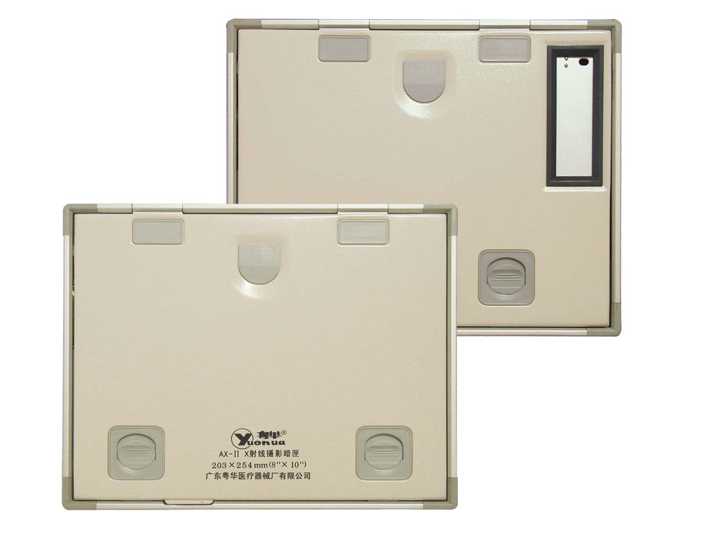
Film Cassette (Today)

Slide 26
The Cassette
Hinges and catches form a light-tight seal
Back of cassette:
  Lined with lead material to absorb backscatter
  Heavier construction than the front
Inside the cassette:
  Both sides lined with felt or foam pressure pads to ensure close contact of the film to the intensifying screens

Slide 27
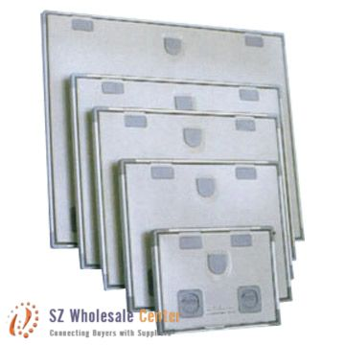
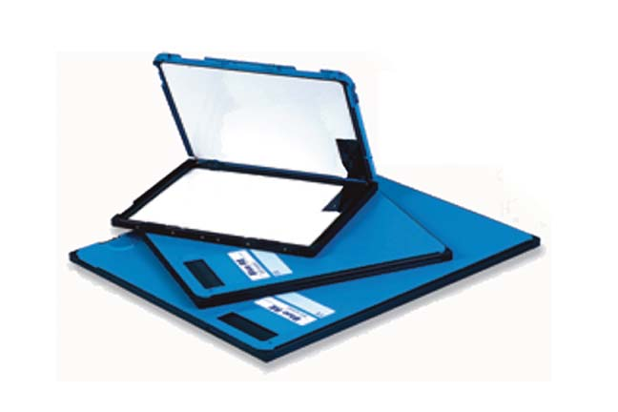
The Cassette
Sizes vary.
  Correspond to screen and film sizes.
    Cost varies as well.
Film is sold in specific sizes to match the cassette size

Slide 28
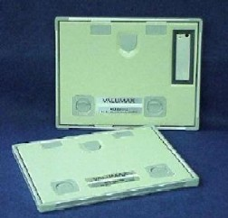
Lead Blocker
Found in corner of cassette
Prevents irradiation of the part of the film necessary for identification.
Be careful not to have any important body part obscured

Slide 29
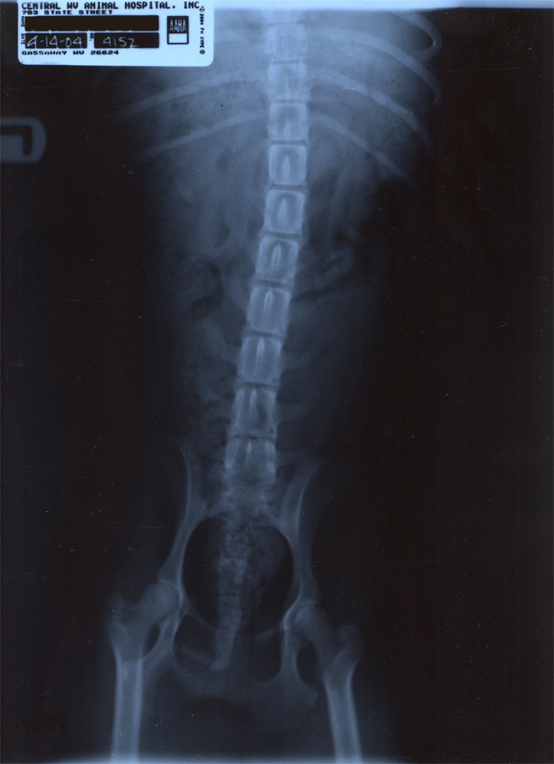
Lead Blocker
Label the film over the part of the cassette shielded by the lead blocker…

Slide 30
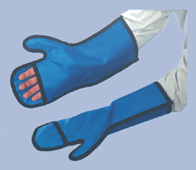
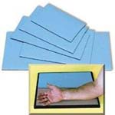
Lead Blockers
The cassette can be divided into four quadrants, using lead protective items.

Slide 31

Film Cassette/Intensifying Screens

Slide 32
Intensifying Screens
Made of layers of tiny crystals bonded on plastic and covered by a protective coating
  Crystals emit light after exposure to x-rays
Purposes:
  Reduces the amount of radiation required to produce a diagnostic radiograph
  Enhances contrast
The screens in an x-ray cassette sandwich the film.
Screens are rated by how fast the x-rays are converted to light by the phosphors in its layers.

Slide 33
Intensifying Screens
Reduces mAs needed, so…
  Decreases radiation dose to the patient
  Reduces the chance of motion on the radiograph
Three “musts” for efficiency of screen materials:
  High level of x-ray absorption
  High x-ray to light conversion
  Little or no “afterglow once radiation has ceased

Slide 34

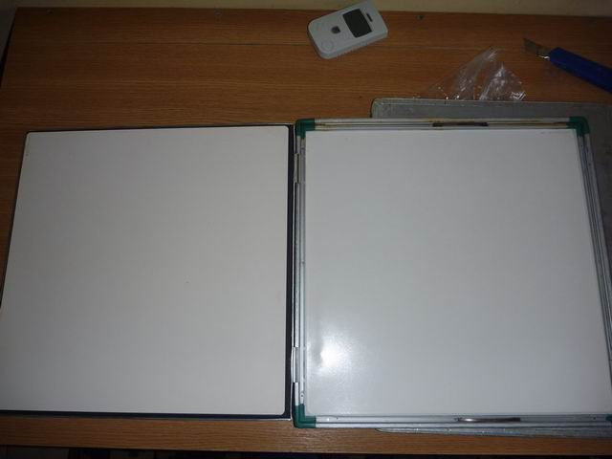
Intensifying Screens
Only 5% of exposure results from ionization of x-rays. The remainder is due to light emitted from intensifying screens.

Slide 35
X-Ray Film
X-ray film is made of a suspension of light & x-ray sensitive silver bromide granules in a gelatin emulsion coated over a polyester base
2 categories:
  Screen – Sensitive to wavelengths emitted from intensifying screens
    Requires less exposure
  Non-screen – Designed for direct exposure
    Needs extra-long exposure times
X-ray film has virtually infinite resolution

Slide 36
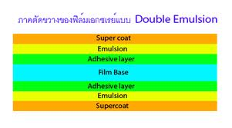
Layers of X-Ray Film
Film Base – Holds the emulsion of the film
Film Emulsion – Contains the photosensitive silver-based products in a gelatin layer, allows processing chemicals to infiltrate
Super coat – Tough, protective coating of hard gelatin
Adhesive layer – Very thin layer that connects emulsion & film base
Notes:
Emulsion - A photosensitive coating, usually of silver halide grains in a thin gelatin layer, on photographic film, paper, or glass.
Latent image is formed within emulsion when x-rays and light activate the silver particles in the film emulsion
Forms lattice network of silver halide particles
Latent image is fragile

Slide 37
Cassette Care
Both the cassette and the screens should be kept clean
  Commercial cleaners are available
  Clean cassettes on a regular basis with mild soap/water.
    Clean screens with distilled water
  Clean exterior & interior at least once monthly.
Number the cassettes so problems can be easily identified

Slide 38
Cassette Care (cont.)
Handle with care
  Common damage includes: dropping, body fluids
  Cassette storage:
    Upright away from radiation
    Do not stack
    Should be loaded and ready to use
    Avoid humidity & dust
  Film storage:
    Boxes on edge and protected from light

Slide 39

Plans for today & tomorrow…
Today: Lab Tours
  Should free time for a review next week…
Tomorrow: Producing the Image
  Lavin: Chapter 6
  CTVT: 529-532
    Exposure factors through Formulation of a Technique Chart

