Slide 1
Roots and Combining Forms

Slide 2

Audi/0
Hearing

Slide 3

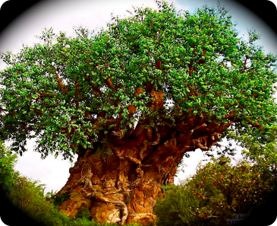
Bio
l
i
f
e

Slide 4
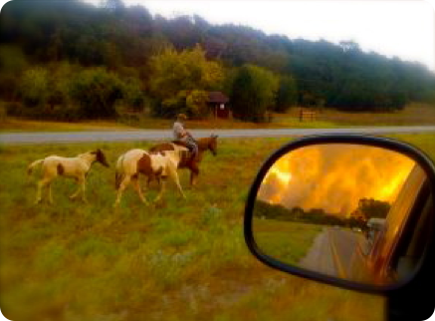
Caus, Caut
b
u
r
n

Slide 5
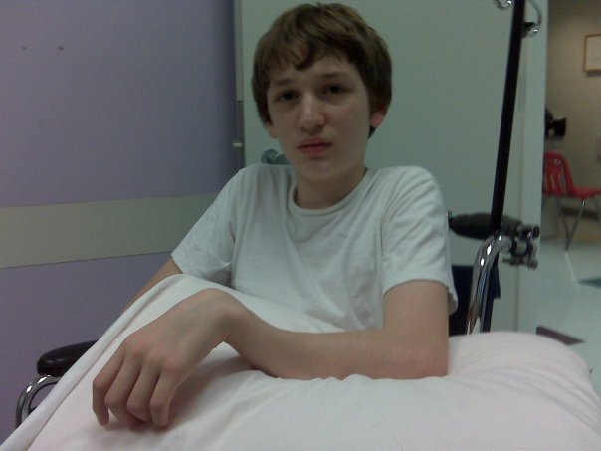
Clas, Clast
Break

Slide 6
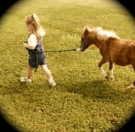
Duct
Lead

Slide 7
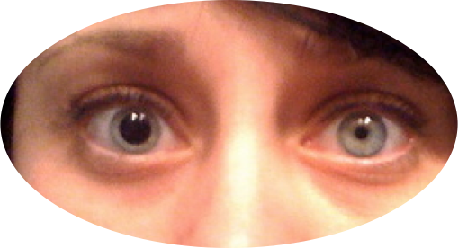
Ectas
Dilate

Slide 8
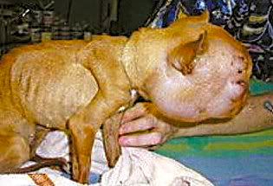
Edem
Swelling

Slide 9

Esthes:
Sensation

Slide 10

Gen/o
Producing
Producing
Mating
Babies

Slide 11
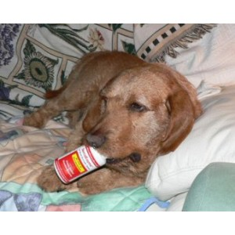
Iatr/o
Treatment

Slide 12
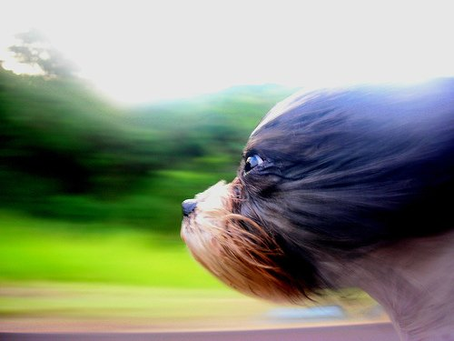
Kin/e, Kin/o
Movement, motion

Slide 13

lysis, lys/o, lytic breaking down

Slide 14
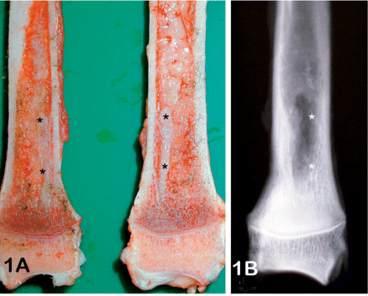
Morph/o
Form, structure, shape

Slide 15

Op/ia, ops/ia, opsy vision

Slide 16
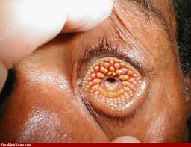
Path disease

Slide 17
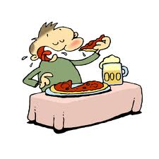
Phage eating

Slide 18

Phas speech

Slide 19

Phil affinity

Slide 20

Plegia paralysis

Slide 21
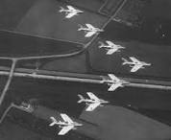
Poiesis formation

Slide 22
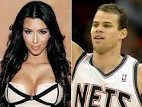
Schisto split

Slide 23
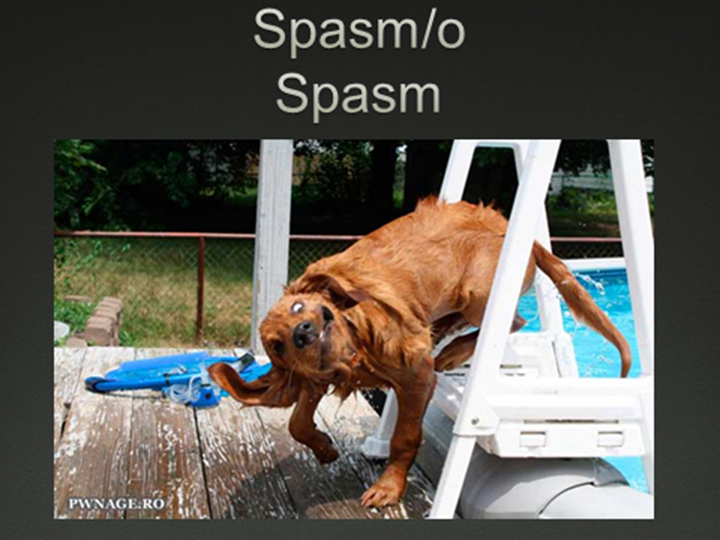

Slide 24
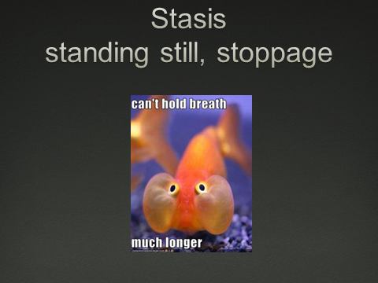

Slide 25
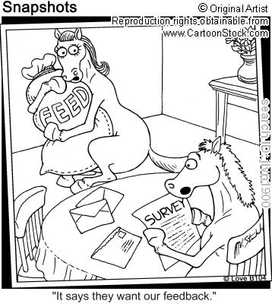

Troph/o- Nourishment or food

Slide 26
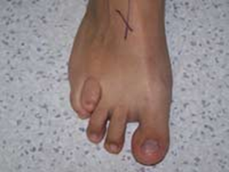
Brachy : Short

Slide 27

Brady- Slow

Slide 28
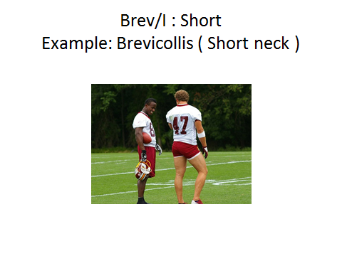

Slide 29
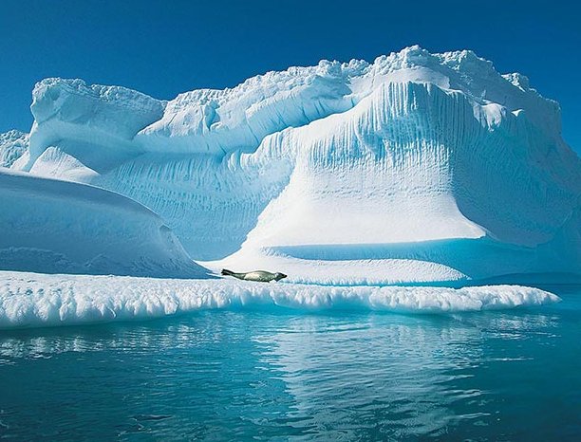
Cry/o - Cold

Slide 30
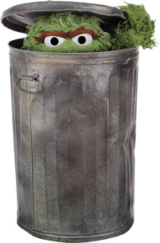
Crypt/o hidden

Slide 31

DEXTR/O
RIGHT, RIGHT SIDE

Slide 32
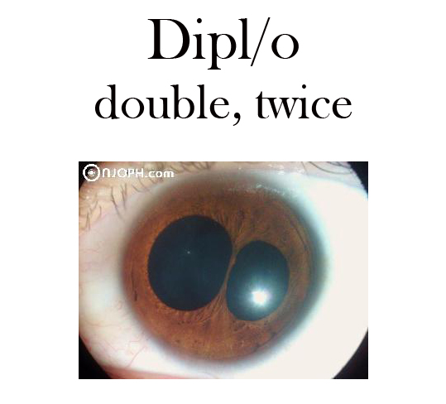

Slide 33
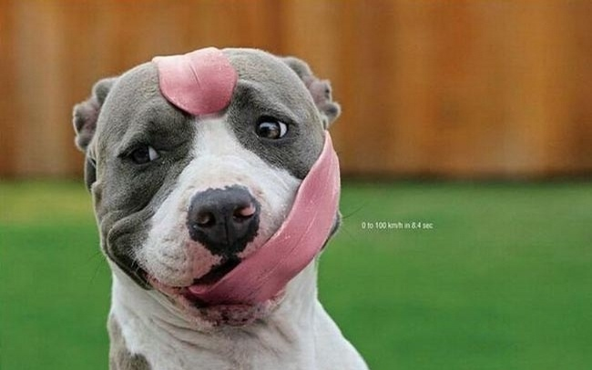
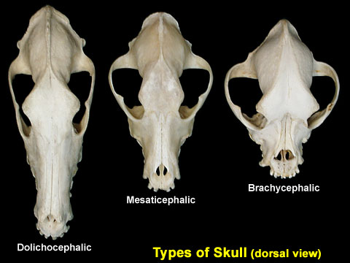
Dolich/o long

Slide 34
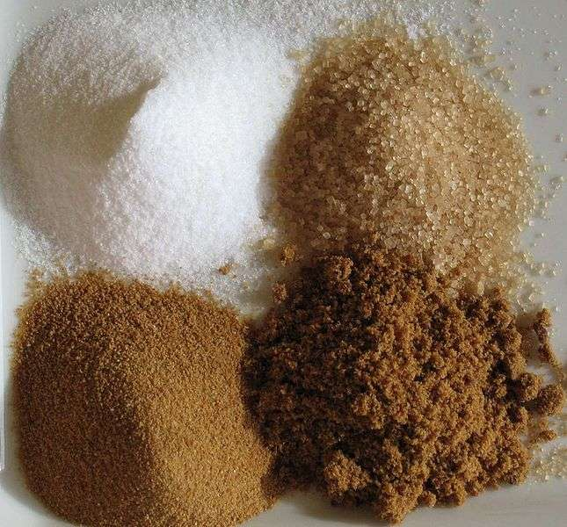
GLYC/O-,GLUC/O
SUGAR SWEET

Slide 35

HETER/O- OTHER, DIFFERENT

Slide 36
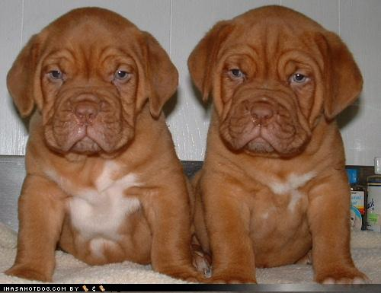
Hom/eo-hom/o same, alike

Slide 37

HYDRO wet, water, fluid

Slide 38
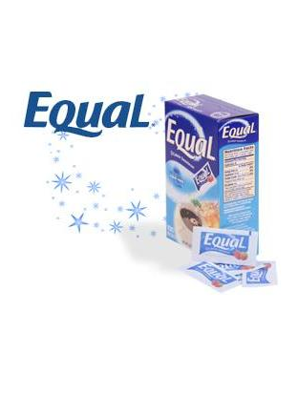
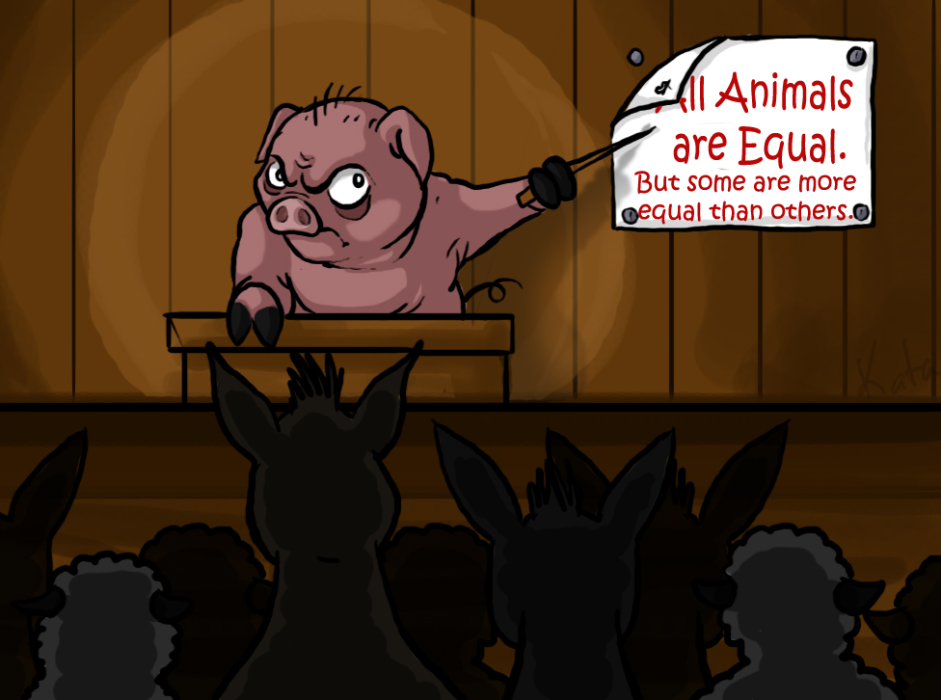
ISO equal, alike

Slide 39
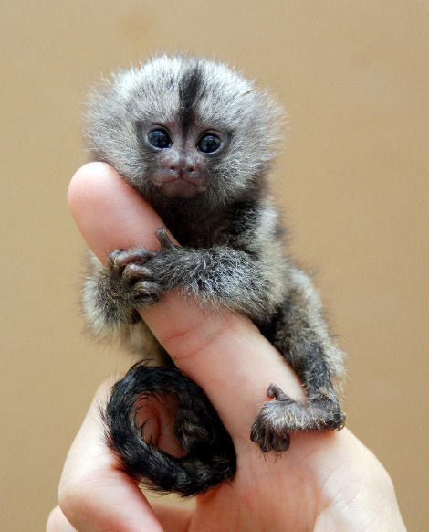
LEPTO slender, small, thin

Slide 40

Lept/o
Slender, small thin

Slide 41
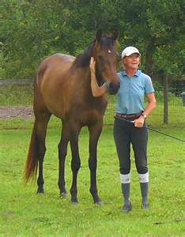
LEVO left, to the left
Always stand on what side of the horse??

Slide 42
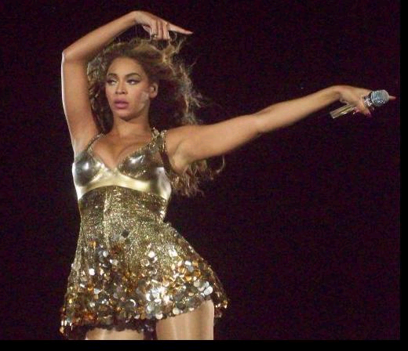
Lev/o
Left, to the left

Slide 43


Macr/o
Large

Slide 44
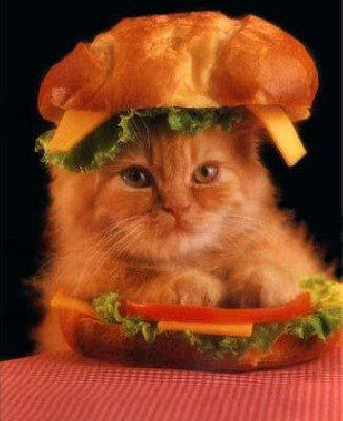
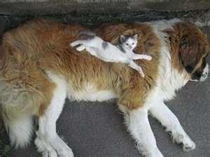
MACRO large

Slide 45

Mal
Cough, cough!!
ill, bad

Slide 46
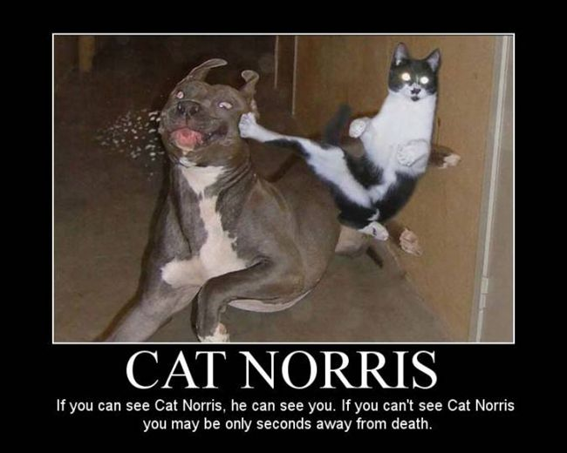
MAL ill, bad

Slide 47
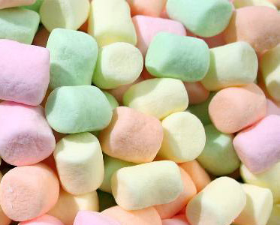
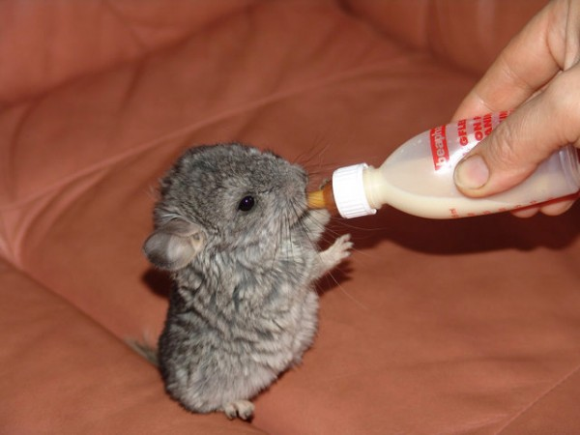
MALACO soft, softening
AWWWWWWWW

Slide 48
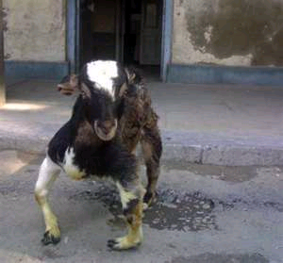
Malac/o
Soft, softening

Slide 49
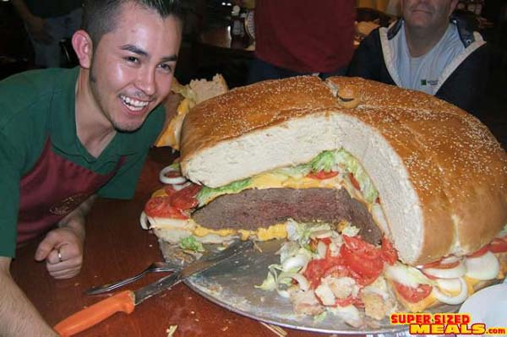

Mega
large, oversized
Notes:
Megaladon
Man vs Food

Slide 50



Necr/o : death

Slide 51
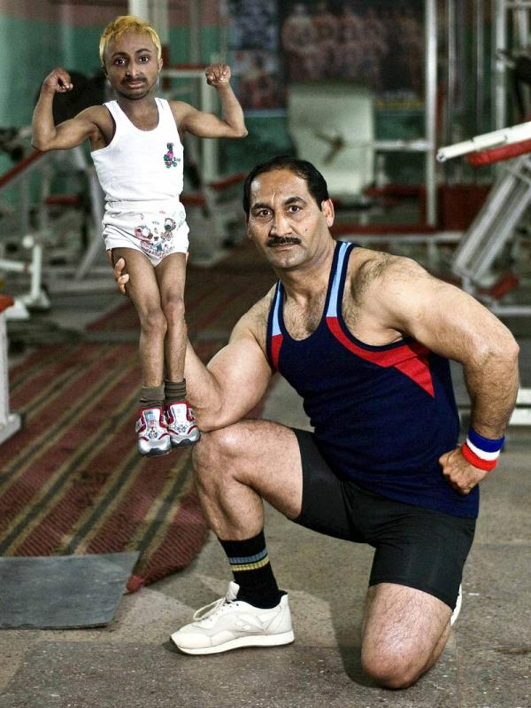


Olig/o
few, little

Slide 52
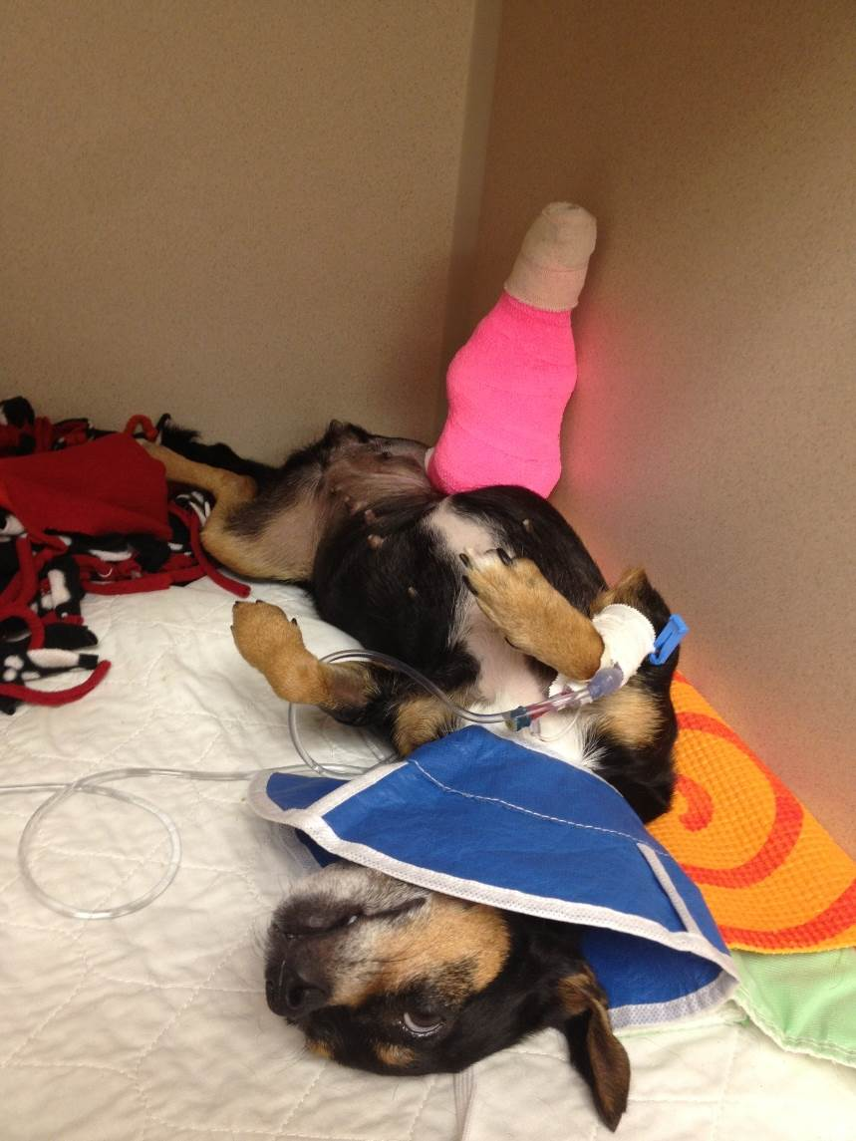
Orth/o
straight, normal, right

Slide 53
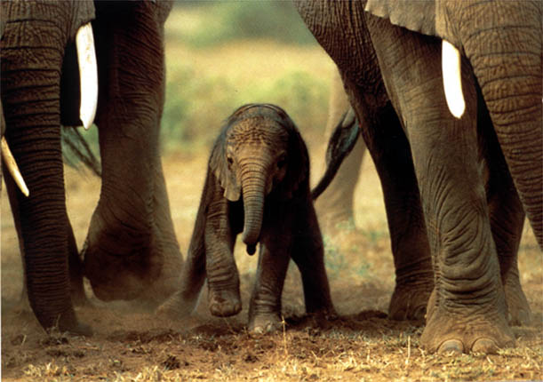
Pachy
thick

Slide 54

Pale/o :
Old or
Primitive

Slide 55
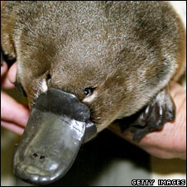
Platy/o
Flat, wide
Platypus!
Notes:
Platypup

Slide 56
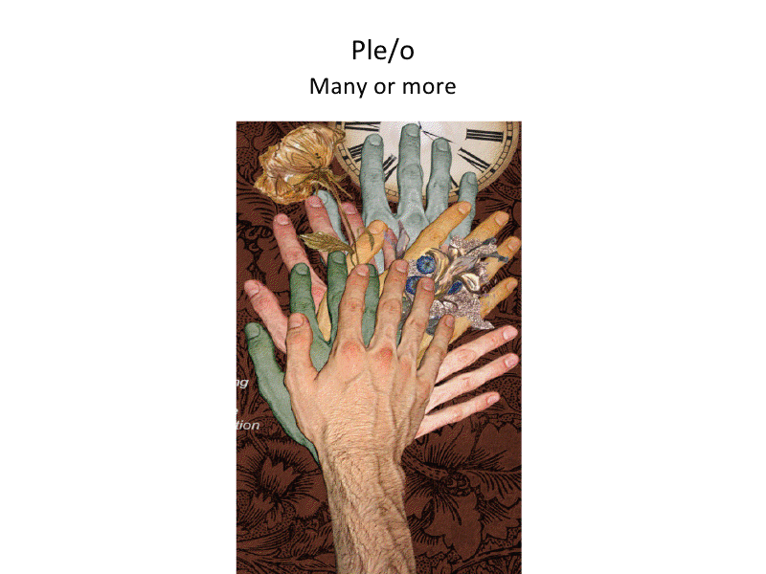

Slide 57
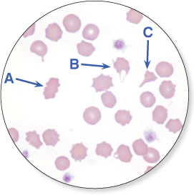
Poikil/o- irregular, varying
poikilocytosis

Slide 58
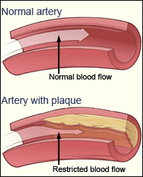
Scler/o- hardness

Slide 59


sinistr/o- left, to the left

Slide 60
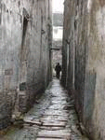
Sten/o- narrow, contracted

Slide 61

Stere/o- solid, three dimensional

Slide 62
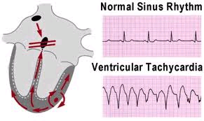
tachy- rapid, fast

Slide 63
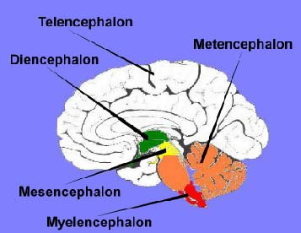
Tel/e-, Tel/o- distant, end
End brain

Slide 64

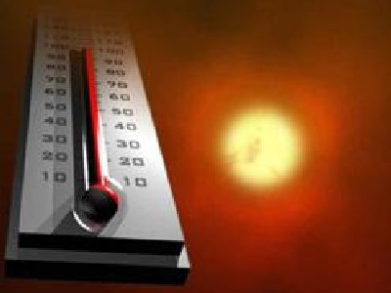
Therm/o : heat

Slide 65
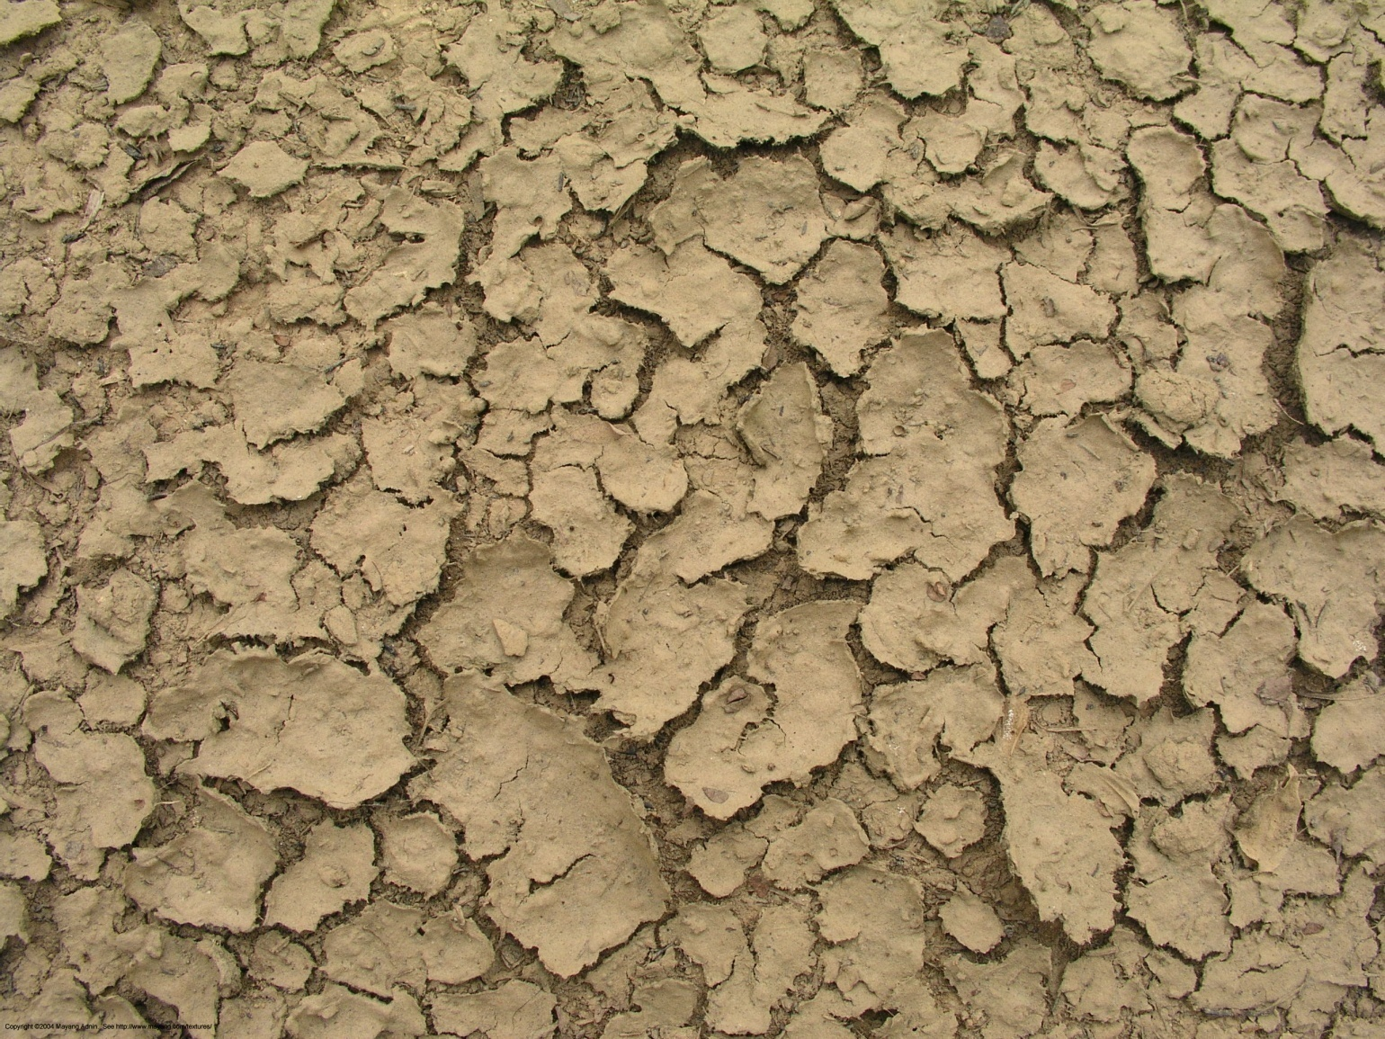
Xer/o : dry

Slide 66
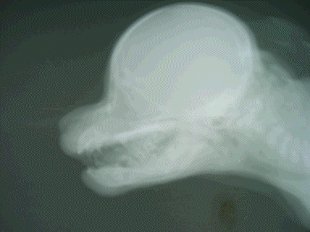

Aqua, hydro: water

Slide 67


Chol/e, chol/o : bile

Slide 68

Chyle, chyl/o: milky fluid –product of digestion

Slide 69

Dacry/o, lacrima : tears

Slide 70


Galact/o, lact/o : milk

Slide 71

Hem/a, hemat/o, hem/o : blood

Slide 72


Hidr/o, sudor : sweat

Slide 73

Lymph/o : lymph

Slide 74

Mucus, muco- secretion of mucous membranes
Notes:
Salivary mucocele

Slide 75


Myx/o
MUCUS

Slide 76


Plasma
Liquid component of blood.

Slide 77

Ptyal/o- saliva

Slide 78

Pus liquid product of inflammation

Slide 79

PY/O
PUS

Slide 80

Sangui – blood or bloody

Slide 81

Serum

Slide 82
The clear liquid that can be separated from clotted blood. Serum differs from plasma, the liquid portion of normal unclotted blood containing the red and white cells and platelets. It is the clot that makes the difference between serum and plasma.

Slide 83

Sialo

Slide 84

Urea

Slide 85
A few words about urea…
Certain reactions produce ammonia, which is harmful to the body.
After the ammonia is absorbed into the blood, the blood gets filtered through the liver, where the ammonia is combined with carbon dioxide to change it into urea and water.
Urea in the blood then gets filtered through the kidneys, where the urea gets combined with water to produce urine, which gets excreted through the bladder.

Slide 86


Adipo : fat

Slide 87

amyl/o- : starch

Slide 88


Cerumen, cerumin/o : Earwax

Slide 89


Collagen
Fibrous protein of connective tissue, cartilage, bone, and skin

Slide 90


Ele/o, ole/o
oil

Slide 91


Ferrum, ferr/o
iron

Slide 92

Gluc/o, glyc/o, sacchar/o, saccar/I : sugar

Slide 93

Hal/o : salt

Slide 94

Heme : iron based pigment of hemoglobin

Slide 95


Hormone: body produced chemical substance

Slide 96


Hyal/o, hyalin : glassy translucent substance

Slide 97

Lip/o, lipid : fat, fatty acids

Slide 98

Lith/o : stone or calculus

Slide 99

Mel/i : honey or sugar

Slide 100


Natrium : sodium

Slide 101


Petrous : stoney hardness

Slide 102

Sal : salt

Slide 103


Sebum : sebaceous gland secretion

Slide 104

Albus, alba, alb:
White

Slide 105

Chlor/o, chloros:
Green

Slide 106

Chrom/o, chromat/o
Color (as compared with no color)

Slide 107


Cirrhos
Orange/yellow

Slide 108

cyan/o
blue

Slide 109

Erythr/o
red

Slide 110

Leuc/o, leuk/o
white

Slide 111


Lutein
Saffron yellow

Slide 112

Melan/o
black

Slide 113

Photo
light

Slide 114

Poli/o
Gray (relating to the gray matter of the nervous system)

Slide 115

Rhod/o
red

Slide 116

Ruber, rubor
Red, redness
This salamander is called a rubor rubor

Slide 117

Xanth/o:
Yellow or yellowish
Xanthostemon chrysanthus

Slide 118


