Slide 1
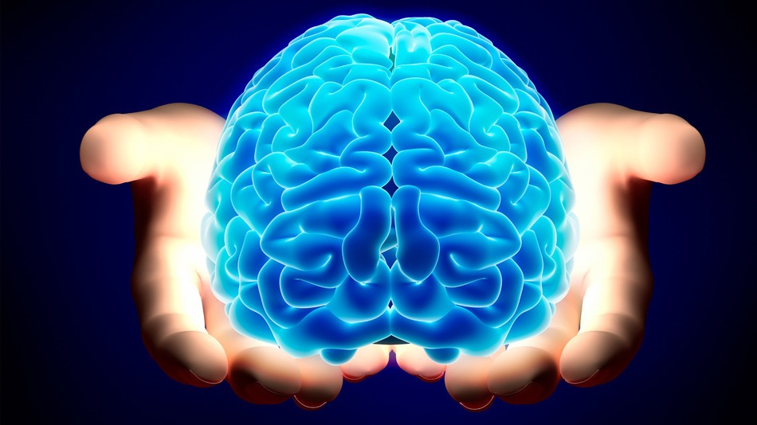


Long Term Memory
Using what cognitive science tells us about how the brain works
Dr. Pete Bill
Purdue University
College of Veterinary Medicine

Slide 2
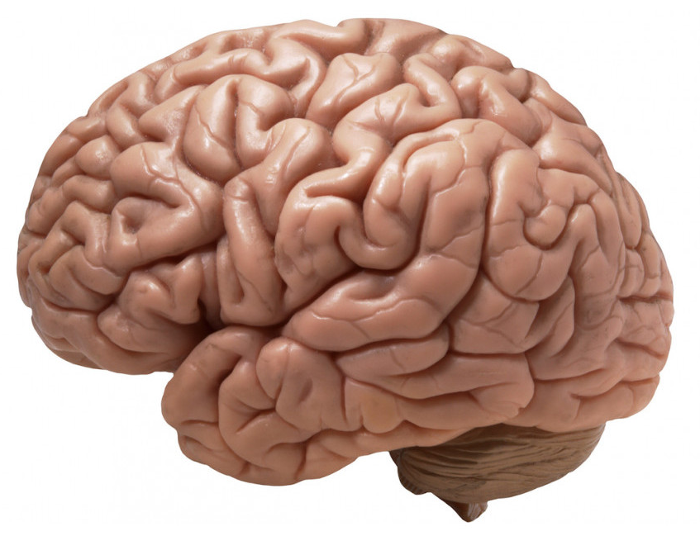
Here’s the culprit
Can fit in the palm of your hand
2 percent of your total body weight
Consumes 20% of all calories (greedy)
Works even while asleep (and MUST have sleep periods to function and learn!)

Slide 3




The brain’s learning abilities evolved to adapt to an environment that is very different from today
Circa 1300
Circa 2019

Slide 4
A little brain trivia:
Attention spans are getting shorter. In 2000, the average attention span was 12 seconds. Now, it’s 8 seconds. That’s shorter than the 9-second attention span of the average goldfish.
A piece of brain tissue the size of a grain of sand contains 100,000 neurons and 1 billion synapses, all communicating with each other.
Each neuron can transmit 1,000 nerve impulses per second and make as many as tens of thousands of synaptic contacts with other neurons.
Relying on GPS to navigate destroys your innate sense of direction, a skill that took our ancestors thousands of years to develop and hone. When areas of the brain involved in navigation are no longer used, those neural connections fade away via a process known as synaptic pruning.

Slide 5
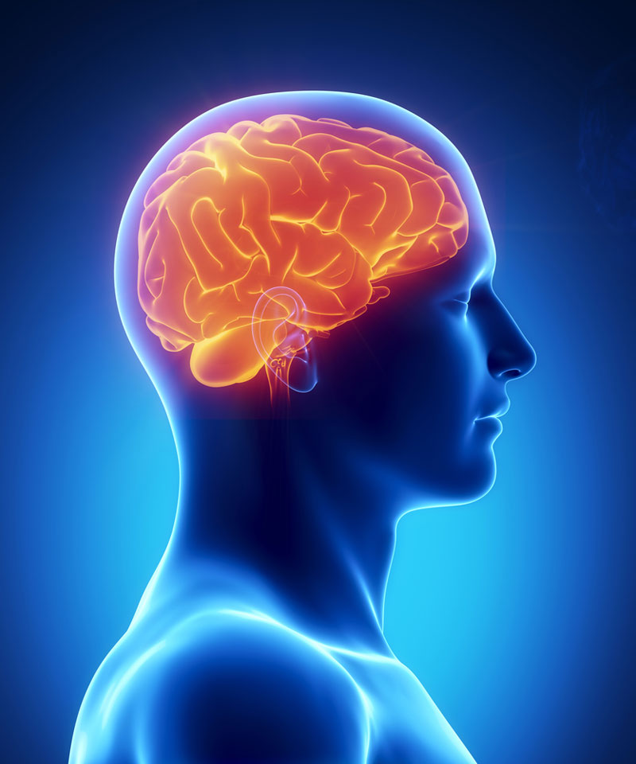
How well do you know your brain?
Which of the following is the most complex thing your brain does?
  Doing long division by hand
  Looking at a photograph
  Playing chess
  Sleeping

Slide 6
Which of the following is the most complex thing your brain does?
  Doing long division by hand
  Looking at a photograph
  Playing chess
  Sleeping

Slide 7
Spatial Test
A
B
C
D
Notes:
c

Slide 8
C

Slide 9

As complex as it is, the brain can be easily fooled… And…. Can fool you into thinking you know something when you don’t!!
Take the Thatcher effect…
Beautiful young woman:
Your brain knows what a face looks like and will pick out features it recognizes..
What happens when we flip it around??
This is the same way your brain can fool you when you’re trying to learn new concepts or tasks.

Slide 11

Thatcher effect

Slide 13
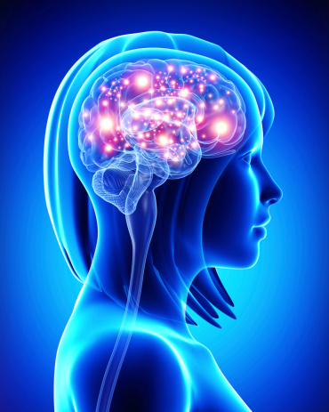
4 Stages of Learning New Information
Attention – filters out “unnecessary” sensory information
Encoding – memory formation - new information that has made it through the attention filters is disseminated throughout the brain into specific areas of the brain for interpretation
Storage – how long the encoded pattern information remains in the brain – most sensory information coming into the brain is forgotten
Retrieval – bringing a memory into conscious awareness (recalling)

Slide 14

So how do we get your brains attention?
Create a change in the environment that requires assessment of the threat/need level or stimulates intrinsic curiosity
Add an incongruity (new person, object)
Change pace
Change up your style (notes, flashcards alternative mediums)
Study in an area that the brain is already attentive

Slide 15



ATTENTION
Rule: “boring” things are never remembered
Rule: if the brain does not actively attend to the information, it has zero chance of making it into memory (Step 1 in learning/memory is unsuccessful)

Slide 16

Another way to engage the brain’s attention is to create a conundrum, an enigma, a kobayashu maru
The brain “hates” loose ends and will remain attending to and processing unsolved questions until they are resolved
Create an enigma for the brain by using cognitive dissonance to introduce a fact that seems to contradict something the learner already “knows” to be true
  “This is a false statement: a hole dug in the ground that measures 2 feet x 2 feet x 2 feet contains 8 cubic feet of dirt”
Notes:
commonwealth

Slide 17

However – all attention techniques are short lived!
      The reason you were successful in gaining the brain’s attention in the first place was because something changed in the environment and the brain had to assess whether the change created a threat or a need opportunity
      Once no threat is detected or need value exists, the brain no longer attends to the stimuli
      Emotionally-linked stimuli command immediate attention -- BUT too much stimulation can overload front lobe filtering mechanism → brain shuts down to reduce overstimulation

Slide 18
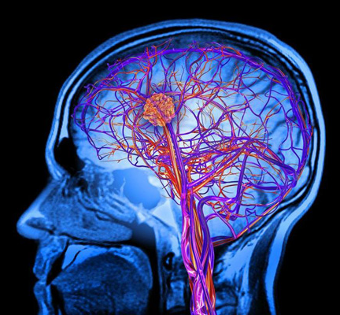

ATTENTION
The front part of the brain filters out an incredible amount of sensory information leaving only that information the brain chooses to attend to – only that reaches the conscious level
  For example: are you aware of the pressure of the chair on your butt right now?
Note that people with ADHD and certain other conditions where sensory overload can occur have reduced ability to filter out sensory input – can’t “concentrate” their attention because everything gets through the front brain filter

Slide 19

The myth of multitasking
The brain physiologically operates sequentially attending to one new stimulus at a time
EXAMPLE: The “executive function” in the anterior pre-frontal cortex of your brain has identified that you need to read your parasitology notes.....
Impulses are sent throughout brain to identify those neurons involved with processing text of your notes
Neurons are activated (takes several tenths of a second to “activate”) and you start to read the notes
Notes:
19

Slide 20
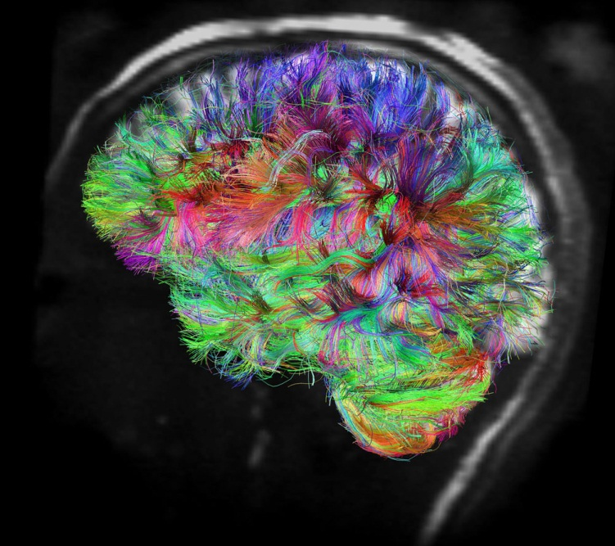
          Your phone buzzes indicating a text message has arrived – the buzz creates new stimulus
          Executive function must disengage from first activity to analyze the new stimulus and determine which neurons needed to respond to second stimuli
The identified 2nd set of neurons must be now activated (several tenths of a second) – text message is read
To return to the first task, the process of executive function and activation of the 1st set of neurons must be repeated (“Now where was I.....”)
Notes:
20

Slide 21

The brain physiologically operates sequentially attending to one new stimulus at a time
Visual stimuli always taken precedence over other stimuli other than pain
If given two modalities of new information, only one will be attended to --- only one will likely be remembered and learned
Example: Studying to recognize an erratic heart rate by showing a moving image of a heart monitor tracing plus the sound of the erratic heart beat through a stethoscope

Slide 22

          Younger brains are better at task switching --- however, each task must still be done one at a time
Studies repeatedly show that interrupted tasks can take up to 50% longer to complete correctly (e.g., studying class notes)....
... and distracted studying can result in up to 50% poorer performance on the studied material
Successful encoding into long term memory is significantly reduced (reduces retention, reduces recall, reduces ability to use the information)
Multitasking is a myth
Notes:
22

Slide 23
4 Stages of Learning New Information
Attention – filters out “unnecessary” sensory information
Encoding – memory formation - new information that has made it through the attention filters is disseminated throughout the brain into specific areas of the brain for interpretation
Storage – how long the encoded pattern information remains in the brain – most sensory information coming into the brain is forgotten
Retrieval – bringing a memory into conscious awareness (recalling)

Slide 24

So why don’t you deep encode the information given to you?
        Deep encoding requires work: doing reflection, thinking of connections, figuring out difficult problems
It is easier to mindlessly do flashcards or re-read the notes
Worse yet – just repeating the encoding process (reviewing notes, etc.) over and over does NOT improve the connections unless the information is considered “new” to the brain
Mindless review not only fails to enhance encoding, but creates a “false sense of familiarity” for you

Slide 25

You often sincerely believe you know the material you have studied (have successfully encoded and reinforced the neuronal pathway)
At the point where information seems “familiar” to the brain, the brain no longer attends to the information because it is “old” news
This creates a “false sense of familiarity” that stops you from focusing sufficiently to actually encode the information in a way likely to be stored in long term memory

Slide 26

False Sense of Familiarity
Have you ever prepped for an exam, felt pretty good about your preparation, then gone in and done poorly because you were asked to recall the information with fill-in-the-blank questions (not just recognize the answer with multiple choice, true false, or matching questions)
This false sense of familiarity with the content creates an expectation for doing well on an exam but often results in poor performance → creates feeling of loss of control over ability to take exams in general (external locus of control) → contributes to “test anxiety”
Why does the brain think it understands something when it doesn’t thus sabotaging your encoding process?

Slide 27
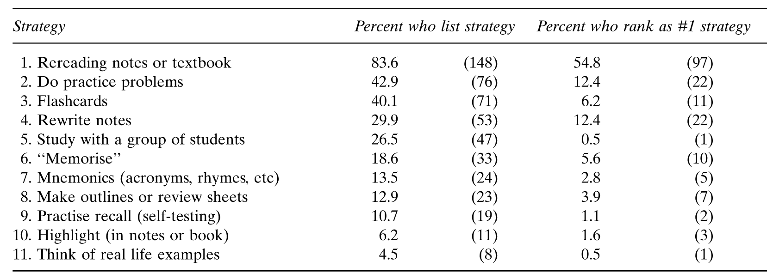
"What do you do when you study?"
Karpicke, Butler, & Roediger (2009) Memory
Notes:
Suggested Script:
The reality is most people employ the same skills from High School into college
**Animation Highlights rereading notes or textbooks
In a study about learning strategies, the researchers found students ranked rereading notes and text as the most used strategy and strategy they felt best prepared them for assignments and exams
Solicit responses from the audience:
Ask if most would people agree with that strategy (rereading)?
Repetitive reading has worked for some in the past. What might make college different?

Slide 28
QUIZ
Answer the following questions about the US penny
Which way is Lincoln facing on the penny?
Which of these words/statements appears on the penny:
“In God We Trust”
“E pluribus unum”
“The United States of America”
“Liberty”
“One penny”

Slide 29
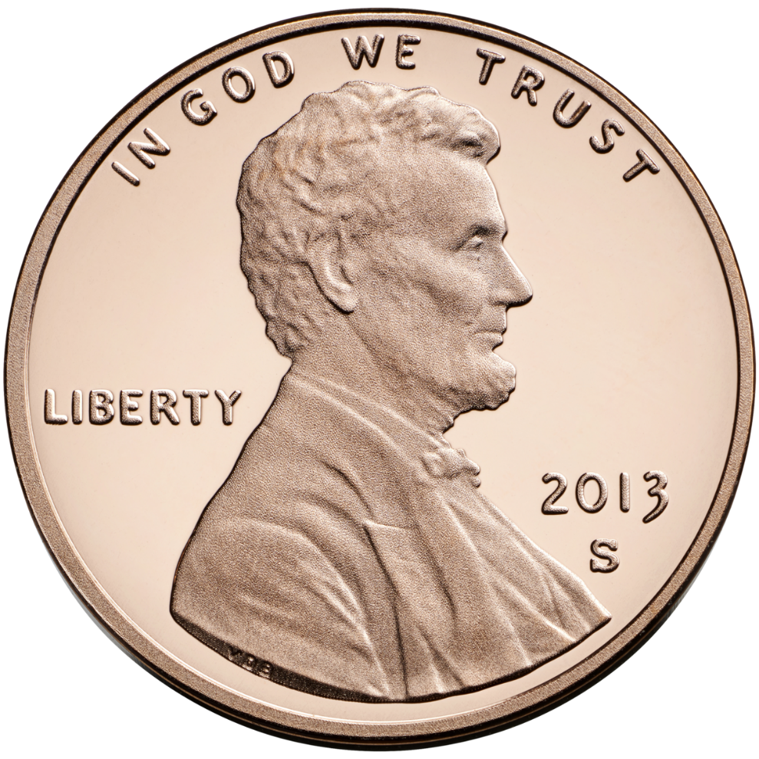


Slide 30

Why stop studying a topic in the middle of it before you have mastered it?
Remember how the brain hates unresolved issues?
As soon as you resolve an issue (or master a topic) the brain stops processing about it
If you stop in the middle of the topic or task, the brain will continue to process and review the new memory engrams at a subconscious level and improve retrieval of memories better than if you had practiced to mastery before moving on
This is called interleaving

Slide 31
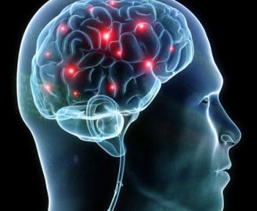
Two types of encoding of sensory input
Automatic encoding is done subconsciously without effort – easy to retrieve the whole memory and usually details are remembered intact
Trip to Disney World when you were a kid
Flavor of your favorite type of ice cream
First kiss
Effortful encoding is deliberately trying to put something into memory – difficult to retrieve such memories intact
All of your passwords for various accounts
Any notes students have taken or lectured information

Slide 32
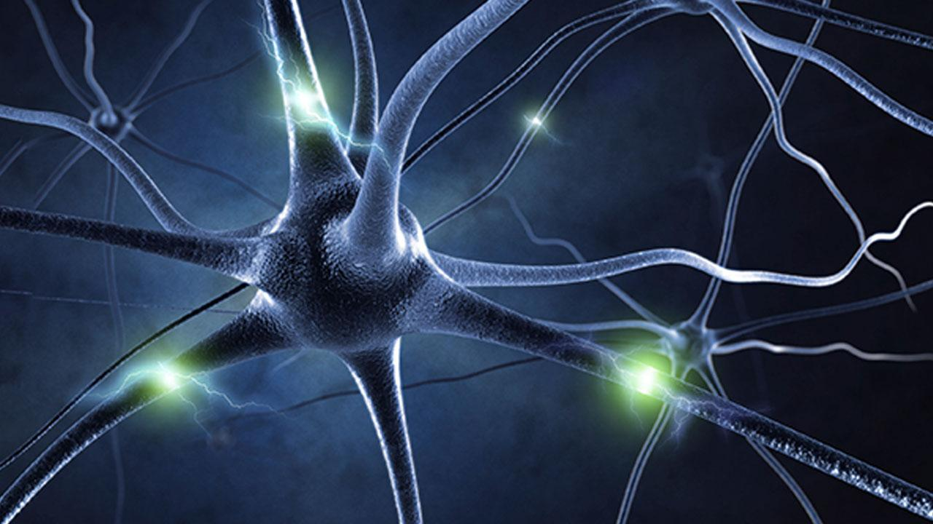
How do you to encode better ?
Stop for 30 seconds and reflect how the information just given can:
make you a better veterinary technician/nurse
be applied to your personal lives or personal health
be used by an evil genius to rule the world
be of use during a zombie apocalypse

Slide 33
4 Stages of Learning New Information
Attention – filters out “unnecessary” sensory information
Encoding – memory formation - new information that has made it through the attention filters is disseminated throughout the brain into specific areas of the brain for interpretation
Storage – how long the encoded pattern information remains in the brain – most sensory information coming into the brain is forgotten
Retrieval – bringing a memory into conscious awareness (recalling)

Slide 34
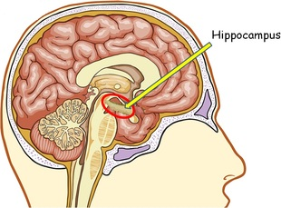
Role of the Hippocampus in long term memory formation
Hippocampus appears to be the main brain part that coordinates the formation of new memories
Discovered in the 1950’s from a patient with severe seizures
During the 1950’s surgically removing pieces of brain was considered a promising treatment for patients with severe epilepsy and a variety of mental disorders including schizophrenia and severe depression

Slide 35
Strange Case of Henry Molaison
H.M. had surgery to remove part of the brain that connects cerebral hemispheres including the hippocampus
Seizures decreased – but lost ability to form new memories
Every time he did anything, it was like he was doing it for the first time – if you walked out of the room and returned, Henry thought he was meeting you for the first time
However, he remembered many memories of his childhood and life before surgery
Memory formation = hippocampus, but storage = elsewhere!

Slide 36
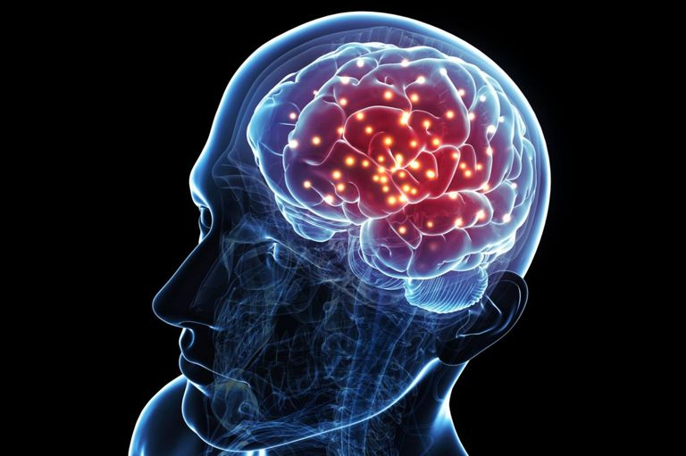
Hippocampus and Neocortex
The “elsewhere” that memories are actually “stored” is the neocortex – the outer layer of the cerebral hemispheres
Incoming sensory information is encoded into the neocortex for interpretation of the information
A temporary working memory engram is formed
After the initial stimulus, the hippocampus communicates with the neocortex memory engram and continues to activate the engram neurons over and over again even while you are sleeping (one reason why sleep is SO IMPORTANT)

Slide 37
Hippocampus and Neocortex
This conversation continues until the memory engram in the neocortex becomes “consolidated” (neurons are more stable in their connections making the memory “permanent”)
Up until this point of consolidation, the memory engram can be modified by retrieving the memory, modifying it, and replacing it back in a modified form (memory can be altered)
How long does it take to consolidate a memory?
  It can take years for this to happen

Slide 38
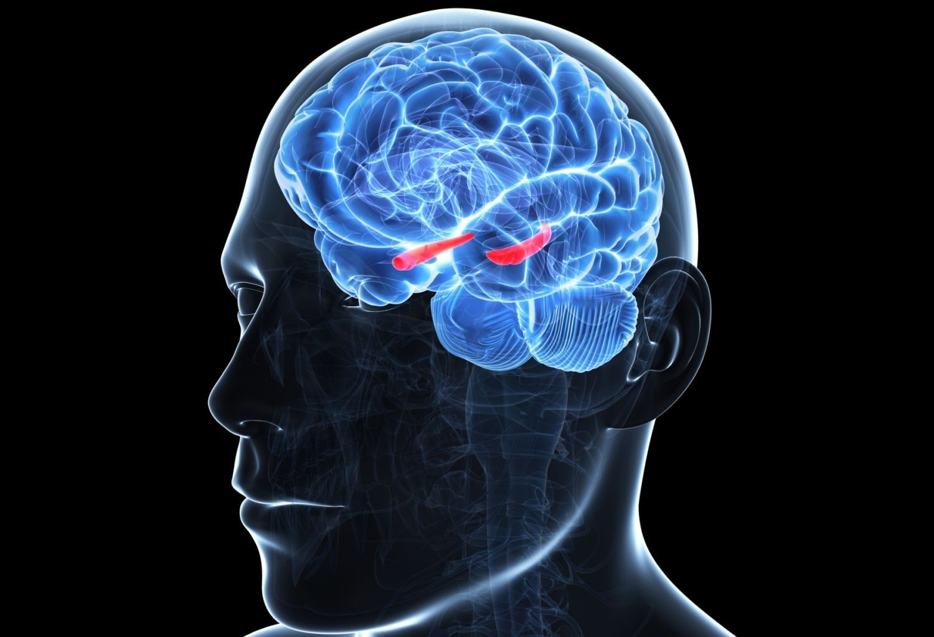
Hippocampus and learning/memory
Anything that interferes with the hippocampus functions to create new memory formation or to help consolidate new memory engrams into permanent ones affects learning
Stress hormones (cortisol) appear to have an inhibitory effect on hippocampus function
Patients with Post Traumatic Stress Disorder (PTSD) have chronic elevated stress hormones
  They also often have some atrophy of their hippocampus

Slide 39
Types of Memory
Two types of memory storage
Working memory – systems that maintain the memory for seconds to minutes for an immediate task (e.g., the room number for the meeting you’re going to right now)
2. Long-term memory – maintains memory for days, months, or years (e.g., learned skills, names of family members, etc.)
Long term memory has two parts also:
  declarative memory – conscious memory of events and facts (e.g., what you had for lunch yesterday, phone numbers)
  nondeclarative memory – memories that are expressed through performance at a subconscious level - incorrectly referred to as “muscle memory” – (e.g., steering a car)

Slide 40

Cramming for an exam
Many students cram for exam – drinking coffee, stressing to the max
Might retain information crammed for a few hours (temporary working memory engram)
But cramming produces elevated stress hormones which means the information crammed will not be processed by the hippocampus
  You may pass the test, but the information will be lost forever within a few hours afterwards because the hippocampus can’t process the info into long term memory (can’t use info on a patient because it ain’t there)

Slide 41
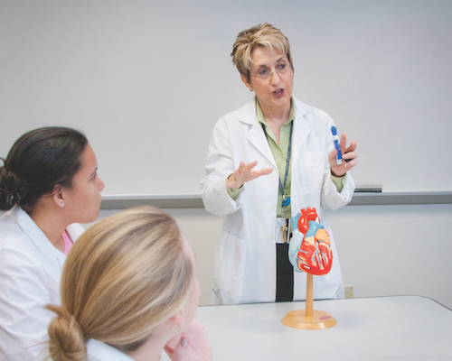
Cramming doesn’t help your patients and sleep is essential to remembering all you need to know to be great veterinary technicians, and successfully pass the VTNE

Slide 42
4 Stages of Learning New Information
Attention – filters out “unnecessary” sensory information
Encoding – memory formation - new information that has made it through the attention filters is disseminated throughout the brain into specific areas of the brain for interpretation
Storage – how long the encoded pattern information remains in the brain – most sensory information coming into the brain is forgotten
Retrieval – bringing a memory into conscious awareness (recalling)

Slide 43

If you can’t RETRIEVE the information when needed for a patient, it’s as if you never encoded it in the first place
You must ATTEND to the information
You must richly ENCODE it into a memory engram
The temporary memory engram must be consolidated for long term memory STORAGE
And finally, it must be able to be retrieved
Any break in this chain of events = failure to learn

Slide 44

Good news!
Every time you retrieve a memory you strengthen the synaptic connections and help consolidate the memory engram
TIPS on how best to study the material you must master
You must be alert and focused to study (Attend)
  Study session topic for 15-20 minutes and STOP
  Go to a NEW study topic even if not completed with the topic (this seems counter-intuitive)

Slide 45
More Study Tips to Help Your Brain
When studying notes or book, do NOT re-read, copy over, or add more hi-liting to the notes!
  Those techniques are all PASSIVE and do NOT engage the brain
  Will cultivate a false sense of familiarity further preventing the brain from attending to the information
  If using flash cards, after 3 times going through the deck, modify how you ask yourself the question (read question backwards, read it in another language like Klingon, read it upside down – make it NEW)

Slide 46
More Study Tips to Help Your Brain
When self testing yourself write out your answers and say them out loud
  Do NOT type out the answers on a key board – research shows typing is too automatic to be processed by the brain! (same for taking notes)
  Writing out an answer will quickly identify if you actually know the answer or are suffering from a false sense of familiarity
  Speaking the answer uses different parts of the brain to formulate words – reinforces memory pathways
  Hearing your answer causes auditory processing of the information – reinforces memory pathways

Slide 47
More Study Tips to Help Your Brain
When retrieving answers from memory – identify at least 3 other facts that are connected to this answer
  By linking other information to the answer, you are creating cross connections between memory engram neurons and increasing the ability to find the answer when asked the question
When retrieving answers from memory – also state out loud at least 2-3 other close possible answers for which the right answer could be confused
  “The answer IS toxocara canis. It is NOT toxascaris leonina. It is NOT toxoplasmosis gondii.”
  This prevents a fuzzy memory from selecting the wrong response

