Slide 1
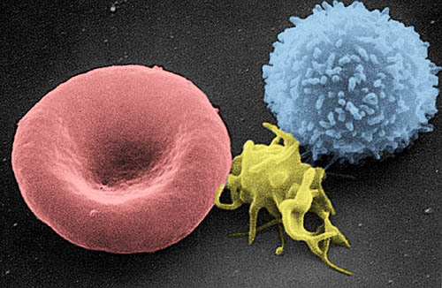
Thrombocytes & Coagulation

Slide 2
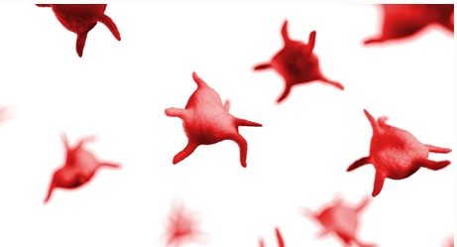
Where do platelets come from and what do they do?

Slide 3
Birth of the Platelet
The stimulus needed for producing thrombocytes involves the hormone thrombopoietin as well as numerous additional cytokines
Where is this specific hormone created?
Liver endothelial cells and kidneys
These cells create a progenitor cell which then develops into a megakaryoblast, which contains a single nucleus and dark blue cytoplasm
Notes:
Thrombopoietin
Liver endothelial cells, and kidney and other sites.
megakaryoblast

Slide 4
Birth of the Platelet
The cell then develops into the promegakaryocyte, which is a large cell that contains 2-4 nuclei.
The nucleus continues to replicate, and the cell becomes progressively larger until it develops into the megakaryocyte.
  This mature cell has numerous nuclear lobes, and the cytoplasm has reddish granules.
  The cells are very large, 50-200 um in diameter
  The cytoplasm extends into marrow sinuses, where it is sheared off by the flow of blood.
Notes:
Promegakaroycyte
megakaroycyte

Slide 5
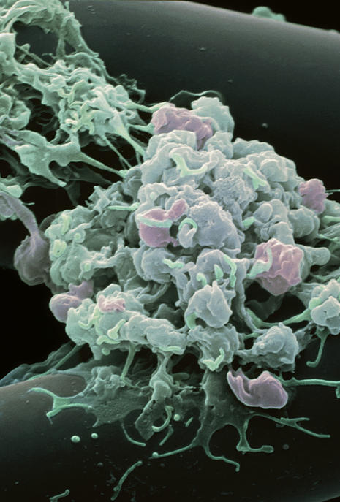
Birth of the Platelet
The sheared fragments are referred to as proplatelets and they eventually fragment further into platelets that are in circulation.
(Image: Activated platelets surrounding a broken blood vessel)
Notes:
proplatelets

Slide 6
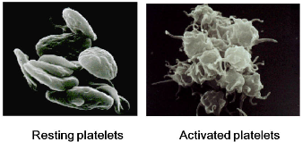
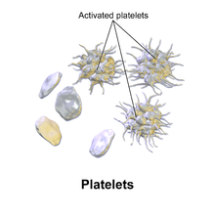
Activated vs Non-activated Platelets
* Resting platelets will appear as small disks
* Activated platelets utilize pseudopodia to move to the area of bleeding.

Slide 7
Fun Facts about Platelets
Each megakaryocyte produces between 1,000 and 3,000 platelets during its lifetime.
Reserve platelets are stored in the spleen, and are released when needed by splenic contraction induced by the sympathetic nervous system.
Old platelets are destroyed by phagocytosis in the spleen and liver.

Slide 8
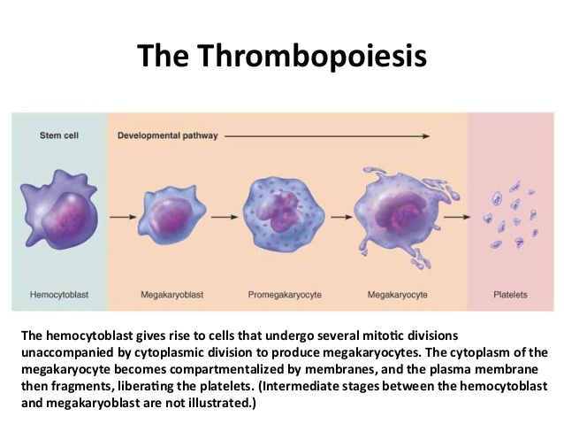
So let’s put thrombopoiesis in order…

Slide 9
Dynamics of how Platelets Work
Notes:
Consider talking about:
Adhesion
Activation
Aggregation
Wound repair

Slide 10
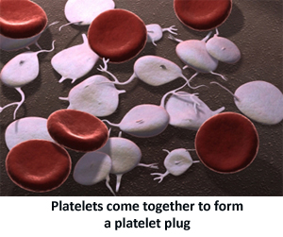
Primary Hemostasis Explained
How does your body create homeostasis when it comes to bleeding?
When one of these pipes is damaged, the blood can spill out. Sometimes this happens on the outside when your skin is cut or scratched. Sometimes it happens just under the skin, causing a bruise. Other times the blood can be leaking out of a blood vessel inside the body. In all cases, the body must work to stop the leak and repair the pipe.

Slide 11
Stopping the bleeding, where it begins…
First the blood vessel gets smaller
The first thing the body does is make the blood vessel smaller so less blood is going through it and leaking out. Muscles in the wall of the blood vessel make this happen.
Second, a platelet plug is made
The next step in stopping the bleeding is making a platelet plug. This is a temporary patch over the leak.
  Three things must happen to this successful: adhesion, activation and secretion, and aggregation. If there is a problem with any of these, a patient is more likely to bleed.
Notes:
Platelet plug

Slide 12
Adhesion
Platelet Adhesion
In order to make a plug, the platelets floating in the blood must stick to the torn wall of the blood vessel. This is called adhesion.
Blood vessels are lined with smooth cells called endothelial cells. When the blood vessel is torn, the blood comes in contact with the substance under the endothelial cells. This substance is called collagen. Platelets floating by in the blood are attracted to collagen. They quickly move to the site of the injury.
In order for the platelets to stick to the collagen, they need a “glue.” The “glue” that sticks platelets to the collagen is a protein in the blood called von Willebrand factor (VWF). The von Willebrand factor (VWF) attaches to the platelet at certain places on the platelet’s surface. These places are called receptors.
Von Willebrand factor is stored in the endothelial cells lining the blood vessels. The endothelial cells release the VWF into the blood.

Slide 13
Activation & Secretion
Activation and Secretion
After the platelets stick to the collagen where the blood vessel is torn, they change their shape. Each platelet changes from a smooth disk to a ball shape with long arms that can reach out to other platelets. This is called platelet activation. Activated platelets can stick to each other and to clotting proteins in the blood.
Inside each platelet are storage spaces called granules. When the platelet changes shape, chemicals inside the granules are pushed out into the bloodstream. This is called secretion. These chemicals from the granules signal other platelets to come and help. The chemicals allow the next step in forming a platelet plug, aggregation, to happen.

Slide 14
Aggregation
Aggregation
To form a platelet plug, the platelets have to stick to each other as well as to the blood vessel. This is called platelet aggregation. The platelets form a clump that plugs the hole in the blood vessel.
When platelets can stick to the blood vessel (adhesion), change shape and signal other platelets to come help (activation and secretion), and stick to each other (aggregation), a good platelet plug is made.
Though it is a complex process, it normally only takes seconds. A platelet plug is only a temporary fix. It can’t last long on its own. A fibrin clot is needed.

Slide 15
Fibrin Clot
Fibrin clot is formed
A fibrin clot is a good, strong patch over a hole in a blood vessel. It is normally enough to stop the bleeding completely. Proteins in the blood called clotting factors work together to make the fibrin clot. Twelve clotting factors are named with Roman numerals (I, II, III, IV, V, VII, VIII, IX, X, XI, XII, XIII).
The clotting factors work together to make threads of protein called fibrin. The fibrin threads weave over the platelet plug to make a strong clot. The body then has time to heal the blood vessel. When it is no longer needed, the body gets rid of the fibrin clot.

Slide 16
To Review
1. The injured blood vessel gets smaller to let less blood through.
2. Platelets rush to the site and stick together to form a platelet plug
3. Platelet Adhesion
4. Platelet Activation & Secretion
5. Platelet Aggregation
6. Fibrin Clot is formed with clotting factors

Slide 17
Now it’s time for Secondary Hemostasis!
Secondary hemostasis is defined as the formation of insoluble, cross-linked fibrin by activated coagulation factors, specifically thrombin.
Fibrin stabilizes the primary platelet plug, particularly in larger blood vessels where the platelet plug is insufficient alone to stop hemorrhage.
Secondary hemostasis (coagulation) is usually initiated simultaneously with primary hemostasis upon endothelial damage, although this depends on the degree and location of injury.

Slide 18
Now it’s time to understand coagulation
How can the complex processes involved within the clotting cascade be simplified?
There are 13 clotting factors that are labelled with roman numerals
Each of the 13 clotting factors have an inactivated form (roman numeral) that is converted into an activated form (roman numeral with a little “a” at the end)
  We are going to assume that the whole point of the clotting cascade is to activate the clotting factors, thereby making the little “a” redundant
  We are going to remove any numbers with an “a” at the end from our simple flow chart and assume that the singular number we now see denotes that the relevant inactive clotting factor has been activated
There are a lot more clotting proteins and factors involved in the clotting cascade in addition to the 13 main clotting factors denoted by roman numerals
  We are going to focus on the ones that are clinically relevant

Slide 19
There are 2 pathways to coagulation
There are two pathways involved with the clotting cascade that meet at a certain point to become a common pathway.
  The intrinsic pathway is activated by damage directly to the blood vessel and the exposure of collagen to the circulating platelets within the blood.
  The extrinsic pathway is activated by many things including damage directly to the blood vessel, tissue damage outside of the blood vessel, hypoxia, sepsis, malignancy and inflammation..
  Both the intrinsic and extrinsic pathways lead to factor 10, which is the start of the common pathway.
  The two key players in the common pathway are thrombin and fibrin.

Slide 20
What are the Clotting Factors on these pathways?
I Fibrinogen
II Prothrombin
III Tissue Factor
IV Calcium
V Proaccelerin
VI Accelerin
VII Proconvertin
VIII Antihemophilic factor A
IX Christmas factor, antihemophilic factor B
X Stuart-Prower factor
XI Plasma thromboplastin antecedent
XII Hageman factor
XIII Fibrin stabilizing factor
Each of these factors must be activated by the preceding enzyme in the cascade.
One reaction leads to another.
Notes:
Each of these factors must be activated by the preceding enzyme in the cascade.
One reaction leads to another.

Slide 21
BEFORE WE MOVE ON!!!
VI Accelerin
  Does not exist within the clotting cascade.
  It was discovered and named before realizing it had no impact on the clotting cascade.
  As such, clotting factor VI is not expressed in either the Extrinsic or Intrinsic clotting cascades

Slide 22
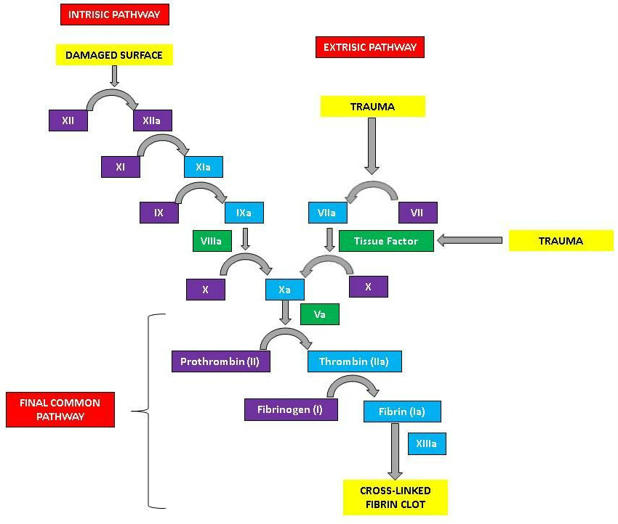
Coagulation Cascade

Slide 23
Intrinsic Pathway
Order
Damaged surface (INJURY)
  12
  11
  9
  8
  10
  5 & 4
  2
  1
  13

Slide 24
Extrinsic Pathway Order
Trauma (EVERYTHING ELSE)
  7
  3
  10
  5 & 4
  2
  1
  13

Slide 25
Common Pathway for Extrinsic and Intrinsic
  10
  5 & 4
  2
  1
  13

Slide 26
Principles of Blood Coagulation Mini Review

Slide 27
It all comes down to one thing the body must do…
Hemostasis – The bodies ability to maintain the integrity of the blood and blood vessels.
  What is involved?
    A number of complex pathways
    platelets
    Thrombin/fibrin
  There are 3 phases
Notes:
Hemostasis
Platelets
Thrombin/fibrin

Slide 28
Phase 1 – Mechanical Phase
The body is going to go through a complex series of phases in order to maintain it’s own homeostasis.
  First phase is the Mechanical phase
    What starts this phase? Blood vessel ruptured or torn
    Then what happens? Platelets are attracted to the surface and go under morphologic and physiologic changes
    What is required to stabilize the plug? Von Willebrand factor
    The adhesion and aggregation of the platelets are going to trigger the next phase, which is the chemical phase
Notes:
Blood vessel is ruptured or torn
Platelets are attracted to the surface and under go morphologic and physiologic changes
Von Willebrand factor
Chemical

Slide 29
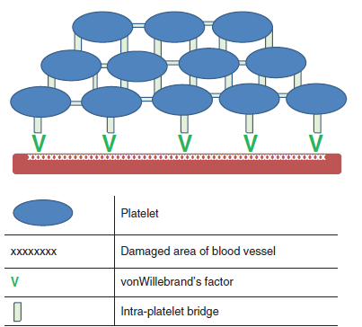
The Stabilized Platelet Plug is Lipemic

Slide 30
Phase 2: Chemical Phase
What is happening here?
  Coagulation cascade
  What will this result in? Fibrin mesh/clot
  Is this a permanent clot? yes
  What factor is recruiting and activating the platelets? thrombin
Notes:
Fibrin mesh/clot
Yes
Thrombin

Slide 31
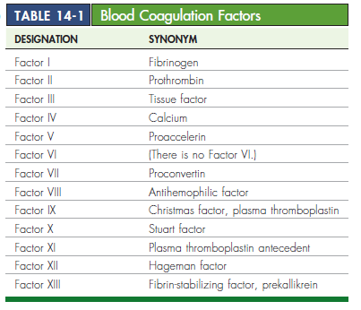
Coagulation Factors

Slide 32
Phase 3 – Formation and Degradation of Fibrin Clot
The fibrin clot is a good strong patch over an injured vessel. Proteins within the clotting factors assist in making threads of proteins called fibrin
Once the body has had time to heal the vessel, it will degrade and eliminate the fibrin clot

Slide 33
What are we measuring?
Methods we use to evaluate:
  Platelet counts
  Platelet indices
  Platelet function
Thrombocytopenia – decreased platelets
Thrombocytosis – increased platelets
Notes:
Decreased platelets
Increased platelets

Slide 34
What to remember before you test!!
Collecting the samples is going to require some key points
  Minimize tissue damage
  Minimal venous stasis
  Minimize patient excitement
  Never use an indwelling catheter. Why? May have fibrinogen, fibrin and platelets around the catheter.
  Label label label!!
If unable to perform the test within 2 hours
  Separate plasma
    2500 g for 15 minutes
    Freeze plasma in plastic tubes or ship on dry ice
Notes:
May have fibrinogen, fibrin, and platelets around the catheter
Preferred-vacutainer or monovette

Slide 35
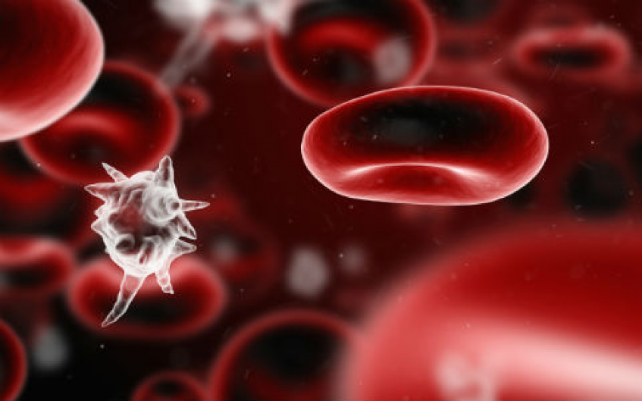
Tests of platelet function

Slide 36
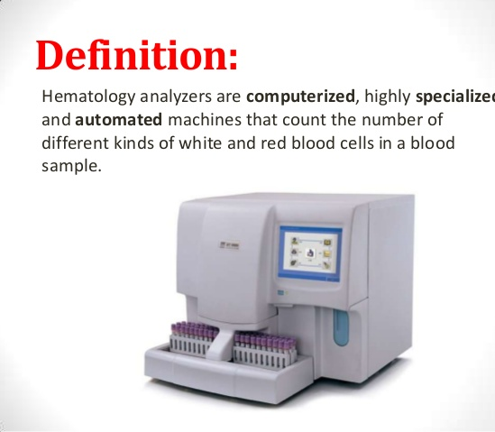
What Tools Are Used To Evaluate Platelets?
1. Automated hematology analyzers
  Downside: Can be inaccurate due to clumping and overlap of cells

Slide 37
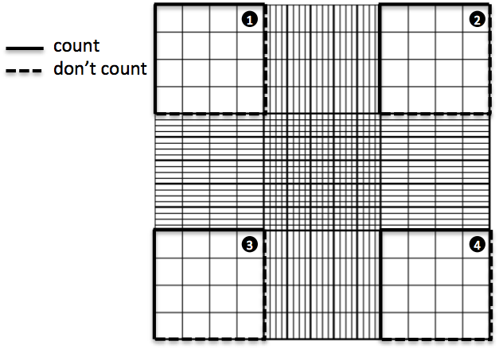
2-Manual Count
  We use a tube containing a premeasured volume of diluent to blood
  Hemacytometer
  Observe for any morphologic change
    Aggregation
    Giant Platelets

Slide 38
How Do You Use a Hemacytometer?
To calculate the number of viable cells/mL:
Take the average cell count from each of the sets of 16 corner squares.
Multiply by 10,000 (10⁴).
Multiply by 5 to correct for the 1:5 dilution from the Trypan Blue addition.

Slide 39
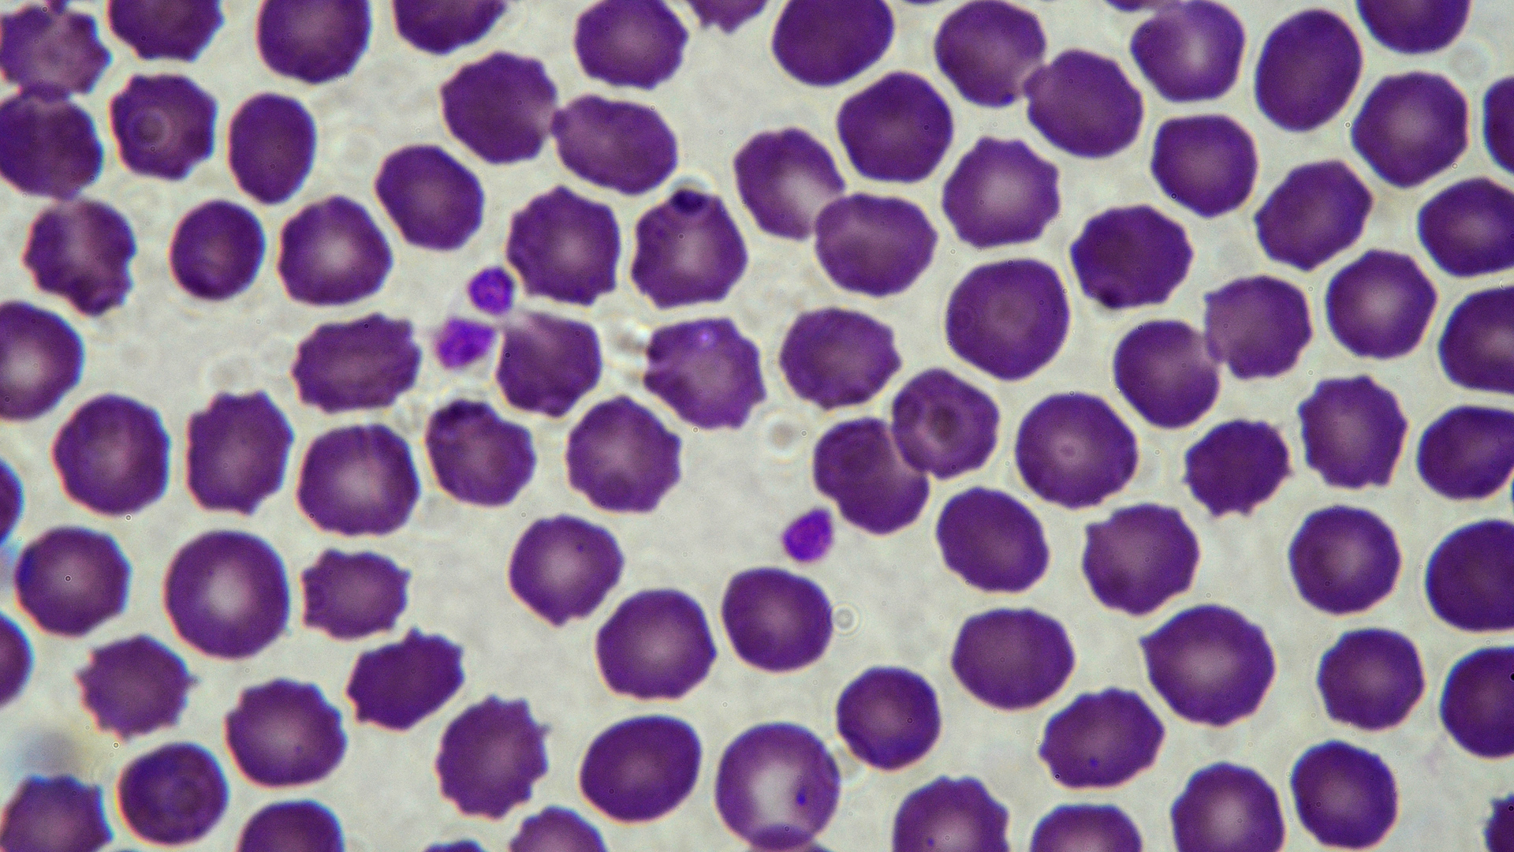
3-Platelet Estimates
Indirect measurements of platelet numbers using the differential blood film
Evaluated in the monolayer
Count the number of platelets in at least 10 microscopic fields
  Normal is 8 to 10 platelets per oil-immersion field
Multiply the average number in 10 fields by 15,000 or 20,000 (VTI we use 18,000)

Slide 40
Alternative Platelet Estimate Method
Alternate method
  Count the number of platelets per 100 WBCs on a film
  Then calculate the platelet estimate
  thrombocytes × WBC count = thrombocytes/mL
  100 leukocytes

Slide 41
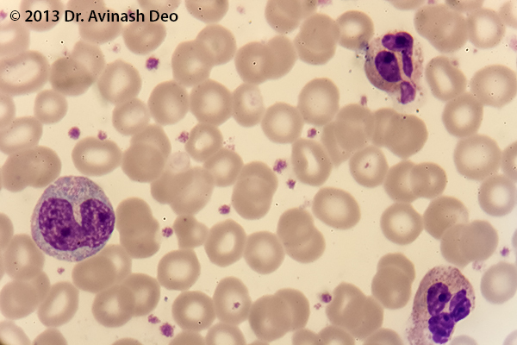
4-Platelet Indices
Mean platelet volume (MPV)
  Mathematical average of the size of the individual platelets counted by the analyzer
  Increases expected:
    Increased loss, destruction, or consumption
    Cats have larger platelets – not useful in cats
    Breed specific – Cavalier King Charles spaniels
    Exposure to EDTA?
  High MPV indicates adequate bone marrow response
    However, normal or low does not predict a low bone marrow response

Slide 42
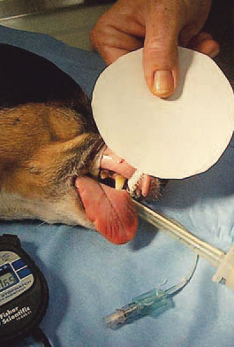
BMBT
5-Buccal Mucosa Bleeding Time
Primary assay for detection of abnormalities in platelet function
Supplies
  Spring-loaded lancet
  Blotting paper or filter paper
  Stopwatch
  Tourniquet
  Sedated or anesthetized patient – lateral recumbency
  Buccal test

Slide 43
BMBT, continued…
Gauze to tie upper lip back and act as a tourniquet
Make a 1-mm-deep incision
Blot incision site every 5 seconds until bleeding has stopped
Normals
  Dogs – 1-4 minutes
  Cats- 1-2.5 minutes
Prolonged bleeding indicates platelet dysfunction
  Deficiencies in von Willebrand factor
  Thrombocytopenia

Slide 44
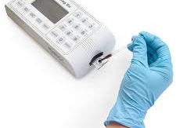
aPTT
6- Activated Partial Thromboplastin Time (aPTT)
  Evaluates intrinsic and common clotting mechanisms
  Coag DX™ analyzer
  Handheld analyzer
    Prothrombin time
    aPTT
  A variety of disorders and addition of heparin can affect results

Slide 45
PTT or OSPT
7-Prothrombin Time Test or One Stage Prothrombin Time
Usually performed on automated analyzers
Evaluates intrinsic and common coagulation pathways
Normal, dogs 7 to 10 seconds
Prolonged time indicates
  Severe liver disease
  DIC
  Hereditary or acquired deficiencies of any factors
  Vitamin K deficiency

Slide 46
8-D-Dimer & Fibrin Degradation Products
  In House Testing for immunoassays
  Useful in identifying
    DIC
    Liver Failure
    Trauma
    Hemangiosarcoma

Slide 47
9-von Willebrand Factor
  vWF is required for platelet adhesion
  This test is typically sent off as an immunoassay to a reference lab

Slide 48
Other Platelet Tests
Tests for function
  Is there thrombopathia present? Meaning, is there some sort of alteration in the platelets function
  Excess reticulated platelets. These are newly released platelets with high levels of RNA (JUST LIKE YOUR RBCs!!)

Slide 49
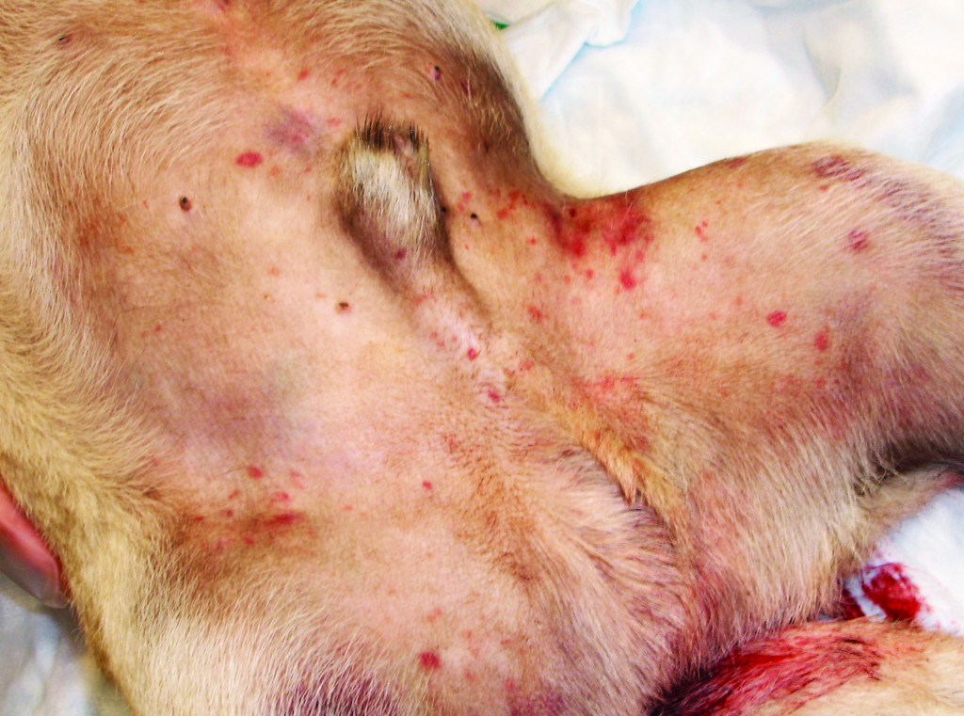
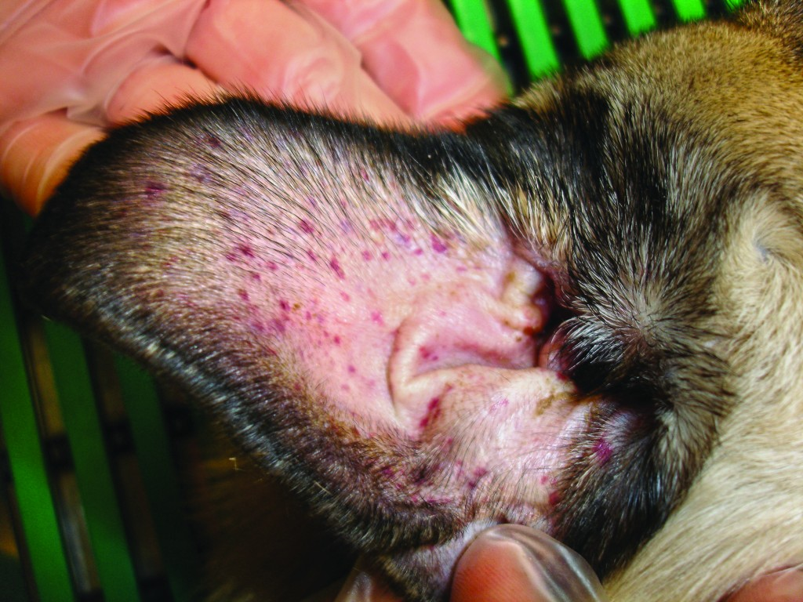
Platelet Disorders & Clinical Signs

Slide 50
Symptoms
Congenital or acquired defects can cause the following symptoms
  Superficial petechia
  Ecchymotic (bruise) hemorrhage
  Epistaxis (nose bleed)
  Melena (tarry stool)
  Prolonged bleeding
When do these defects usually appear in an animal if it is a congenital problem? Before 6 months
Notes:
Superficial petechia
Ecchymotic hemorrhage
Epistaxis
Melena
Prolonged bleeding
Before 6 months

Slide 51
Hereditary Disorders
1. __Hemophilia A – most common inherited in dogs, caused by Factor VIII deficiency
2. Hemophilia B (Christmas disease)– Factor IX deficiency (named after the person with the first case, a 5 year old boy named Stephen Christmas)
3. Von Willebrand Disease-Most commonly inherited coagulation disorder of domestic animals
  Type 1 – Autosomal dominate inheritance pattern with low circulating vWF with normal structure
  Type 2 - Low levels of circulating vWF with abnormal structure
  Type 3 – Near absence of vWF
  (Which of the 3 types will cause the most severe bleeding?) 2 and 3
Notes:
Hemophilia A
Hemophilia B (Christmas Disease)
2 and 3

Slide 52
Acquired Coagulopathy Problems
Thrombocytopenia can often have an unknown cause, but often we look at the potential reasons as clues
  viral
  bacterial
  parasitic
  medications
    aspirin
    acetominophen
Notes:
Viral
Bacterial
Parasitic
Medications
Aspirin
Acetominophen

Slide 53
Vitamin K Deficiency
  Vitamin K is required for synthesis and activation of Factors
    II, VII, IX, and X
  Can be dietary or bile duct obstruction
  Ingestion of rodenticides or moldy sweet clover
    Signs may take days to appear
      Lethargy, anorexia, dyspnea, ecchymosis, petechia, and hemarthrosis may occur
  Tests
    PT, aPTT, ACT, and PIVKA
  May require several weeks of treatment

Slide 54
DIC
Disseminated intravascular coagulation
  Not a disease on its own, but associated with many pathologic conditions
    Trauma
    Septicemia
    Viruses
    Parasites
    Pancreatitis
    GDV
    Toxins
  Systemic hemorrhages or microvascular thrombosis
  Tests
    No single test

