Slide 1

Urinalysis – Part 2

Slide 2
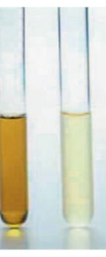
Chemical Evaluation of Urine & Urine Sediment Analysis

Slide 3
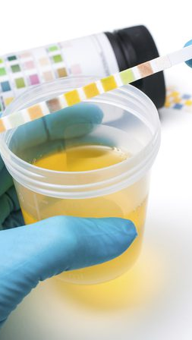
Urine pH
Reagent strips are typically used
Expresses the hydrogen ion (H⁺) concentration
Measures the degree of acidity or alkalinity of urine
  Above 7.0 – alkaline
  Below 7.0 – acidic
Fresh samples are best
  Older samples
    Loss of CO₂
    Urease-producing bacteria increase pH
Notes:
Alkaline
Acidic

Slide 4

Urine pH, continued…
Kidneys play a role in acid-base regulation
  Dependent on diet
    Alkaline – Plant Diet
    Acidic – High protein
    Excitement and/or stress
      Can cause transient glucosuria in cats
Notes:
Plant diet
High protein, cereal diets or meat
Cats

Slide 5
Urine pH, continued…
  Decreased pH
    Fever, starvation, excessive muscular activity, or certain drugs
  Increased pH
    UTI with urease bacteria
    Certain drugs
    Urine retention
  Crystal formation can occur with an increased pH
  pH can be altered with diets

Slide 6
Protein in Urine
Normal urine – usually absent or in trace amounts
Trace amounts due to trauma from collection techniques
  Take this into consideration when interpreting results
Measured by
  Reagent strips
  Sulfosalicylic acid turbidity test
  Urine protein/creatinine ratio
Notes:
Reagent strips
Sulfosalicylic acid turbidity test
Urine protein/creatinine ratio

Slide 7
Protein – Reagent Strips
Semiquantitative
Rapid, convenient, and reasonably accurate
Detect albumin, less sensitive to globulins
False-positive may occur in alkaline urine
Excessive levels should be confirmed by
  Sulfosalicylic acid turbidity test
  Specific biochemical analysis
Detects protein concentrations greater then 30mg/dL
Notes:
30 mg/dL

Slide 8
Protein/Creatinine Ratio
Confirms significant amounts of protein
Compares to levels of creatinine
Divide the protein concentration by the creatinine concentration
Not affected by urine concentration and volume
Aids in accurate measurement of protein loss with low SG

Slide 9
Interpretation of Protein in Urine
Very dilute urine may lead to a false- negative result
  Protein level may be below sensitivity
  A trace amount of protein in a dilute sample may be clinically significant
    Could be indicative of CRF
  Usually indicative of a disease of the urinary tract, especially kidneys
    Acute and chronic
Notes:
Chronic renal failure
Kidneys

Slide 10
Glucose
Glucosuria or glycosuria
Presence of glucose
Filtered through glomerulus and resorbed by kidney tubules
Levels dependent on blood glucose levels and rate of glomerular filtration and tubular resorption
Indicative of Diabetes Mellitus
Notes:
Diabetes mellitus

Slide 11

Glucose, continued…
High-carbohydrate meal may lead to increased levels
  Fasting period reccommended
Fear, excitement, or restraint, especially in cats, can cause increases
False-positive may be seen with some drugs including:
  Vitamin C
  Morphine
  Aspirin
  Cephalosporins
  Penicillin
Notes:
Fasting period is recommended

Slide 12
Ketones
Ketonuria ─ presence of ketones
What are the ketones?
    Acetone, acetoacetic acid, and b-hydroxybutyric acid
Formed during incomplete catabolism of fatty acids
Common causes
  Ketonemia
    Diabetes mellitus, impaired liver function
    High-fat diets, starvation, fasting, anorexia
  Ketosis in lactating cows and pregnant ewes and cows
Notes:
Ketonuria
Fatty acids

Slide 13
Chemical Evaluation
How to use chemical reagent strips
  Stored at room temperature
  Lid tightly closed
  Note expiration dates
  Two methods
    Dip into sample – fully immersed
      Remove and place with long edge on paper towel to wick excess urine away
    Pipette onto strip – saturate each pad
  Color changes compared to color chart on label

Slide 14
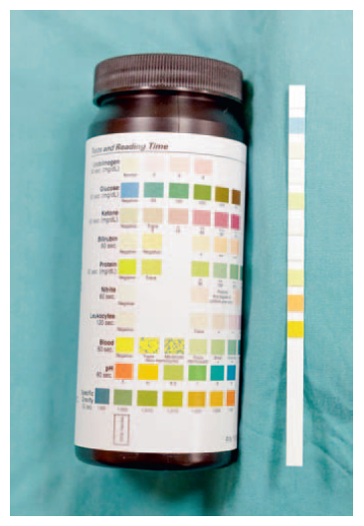
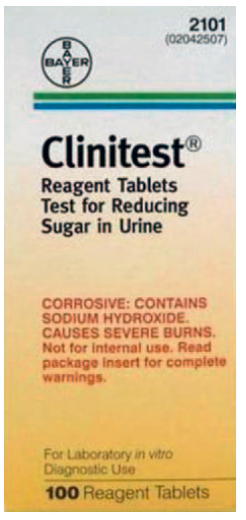
Be aware that medications, diets, and environmental factors can affect results

Slide 15
Bile Pigments
Bilirubin
  Only conjugated bilirubin (water soluble)
  Many conditions including bile duct obstruction, hemolytic anemia, and liver disease
  Normal in dogs (male)
  Not usually found in cats, pigs, sheep, or horses
  In cats – renal threshold much higher than dogs
    Any amount of bilirubin in cat urine is considered abnormal
Notes:
Water soluble

Slide 16
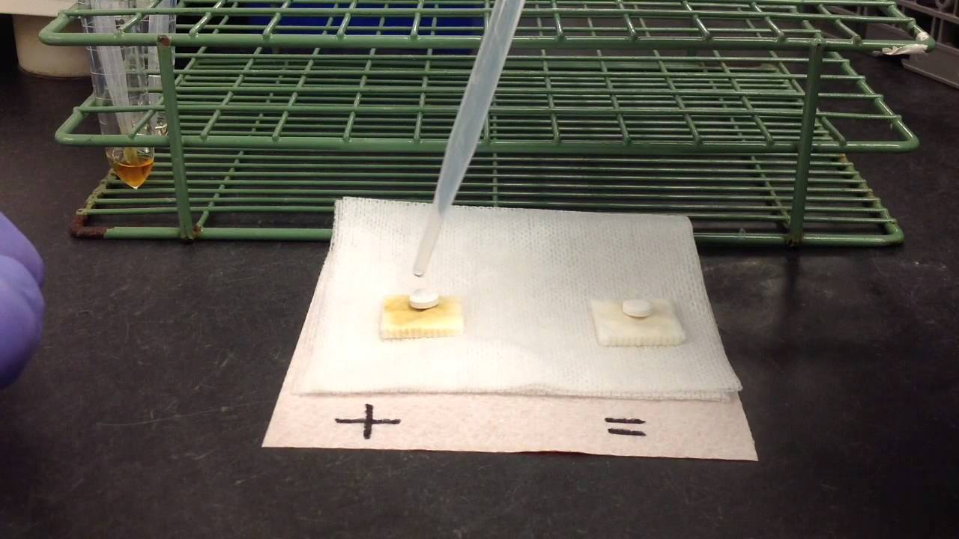
Bilirubinuria
Ictotest
  Detects bilirubinuria
  A diazo compound in reagent tablets
    Blue or purple color
    Speed and degree of color change indicates concentration
Reagent strips
  Less sensitive
False-negative if exposed to shortwave lights

Slide 17
Bile Pigments, continued…
Urobilinogen
  In intestines, bacteria convert bilirubin to stercobilinogen and urobilinogen
  Excreted in feces but some absorbed into bloodstream and excreted by the liver
  Small amount of resorbed urobilinogen is excreted by kidneys into urine
  Considered normal in urine sample
  Unstable as a test result unless seen in extreme amounts
Notes:
Stercobilinogen
Urobilinogen

Slide 18
Hemoglobinuria
Usually a result of intravascular hemolysis
Indicated by a positive test for hemoglobin without RBCs on the sediment
A red color to the supernatant after centrifugation is indicative of hemoglobinuria
Confirm with a reagent test strip
Other potential causes: Immune-mediated hemolytic anemia, isoimmune hemolytic disease of neonates, incompatible blood transfusions, leptospirosis, babesiosis, heavy metals, and poisonous plants

Slide 19
Myoglobinuria
A protein found in muscle
Severe muscle damage causes myoglobin to leak into the blood, pass through the glomeruli, and be excreted in the urine
What will this urine look like? Very dark brown to almost black
Distinguishing between hemoglobinuria and myoglobinuria is difficult
Frequently seen in horses with external rhabdomyolysis
Notes:
Very dark brown to almost black but in low concentrations may look reddish

Slide 20
Leukocytes
Reagent test strips
  What should we assume if the reagent strip tests positive for leukocytes? Presumptive evidence
  False-negatives possible
    Cats
  Necessary to examine microscopically
Notes:
Presumptive evidence

Slide 21
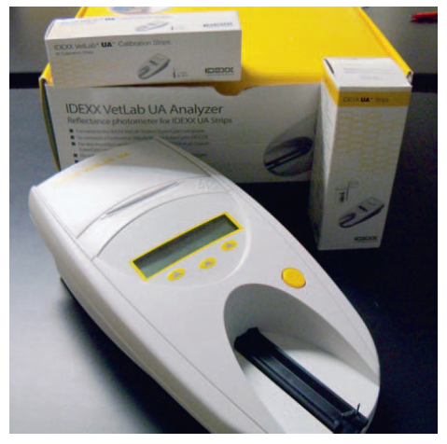
Urinalysis Analyzers
Semiautomated that use a standard dipstick
Dipstick loaded and analyzer reads the results
Large reference laboratories typically use _____________________________
Notes:
Fully automated analyzers

Slide 22
Summary
Chemical analysis of urine uses a reagent dipstick
Urine pH is affected by diet
Protein in urine is abnormal
UTI
Glucosuria and ketonuria – diabetes mellitus
Bilirubinuria – bile duct obstruction, hemolytic anemia, and liver disease
Hematuria, hemoglobinuria, and myoglobinuria can occur simultaneously

Slide 23
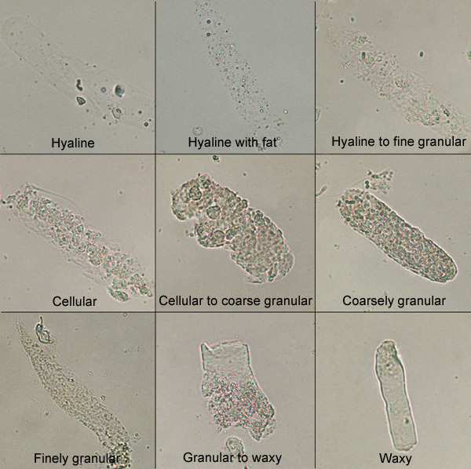
Urine Sediment Analysis

Slide 24
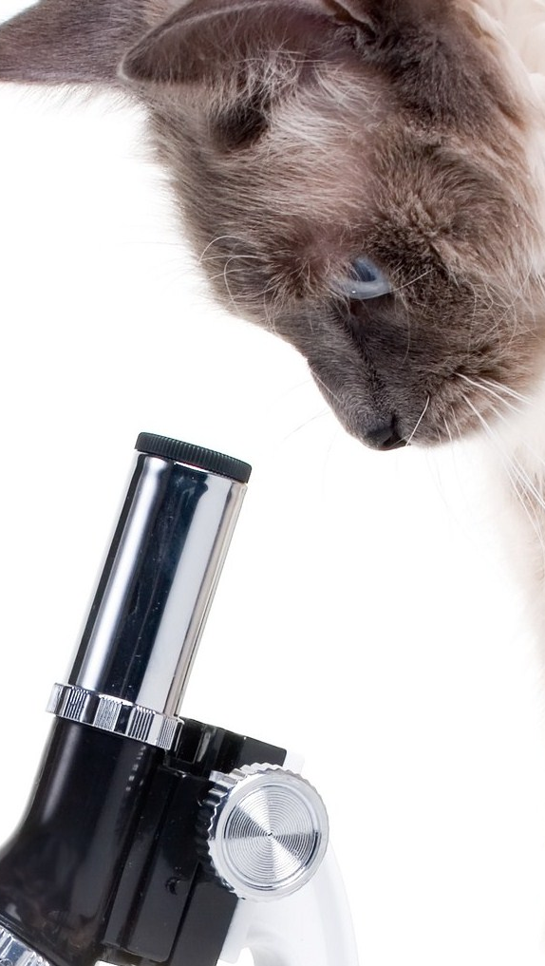
Microscopic Examination
Important part of a complete urinalysis
Many abnormalities cannot be detected by the reagent test strip
More specific information obtained
In humans – only done when patients are symptomatic or abnormalities are evident
In veterinary practice, this should be a routine part of every urinalysis

Slide 25
Sediment
The urine of most domestic animals does not contain a high level of sediment
  May find the following in most species
    Epithelial cells
    Mucus threads
    RBCs
    WBCs
    Hyaline casts
    Crystals
  Exceptions – horses and rabbits
    Large amounts of _________________________________
Notes:
calcium carbonate

Slide 26
Sediment, continued…
Best samples
  First morning collection or after hours of water deprivation
    Highly concentrated urine
Examine fresh
  Changes occur if allowed to set at room temperature. What kind of changes?
    ____________________________________
    ____________________________________
Notes:
Casts dissolve
Crystals form

Slide 27
Sediment, continued…
Volume of urine collected and volume of sediment recorded
  ____________ ml ideal
Centrifuge ____________________ at 1000 to 2000 rpm
  Excessive force may distort or disrupt elements
Supernatant poured off, leaving approximately 0.5 ml of urine at bottom of tube
Resuspend by gently flicking with finger to mix
Notes:
5-10
3-5 minutes

Slide 28
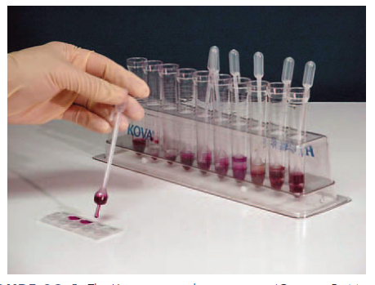
Kova Urine Sediment System
Unique system provides an even distribution of elements

Slide 29
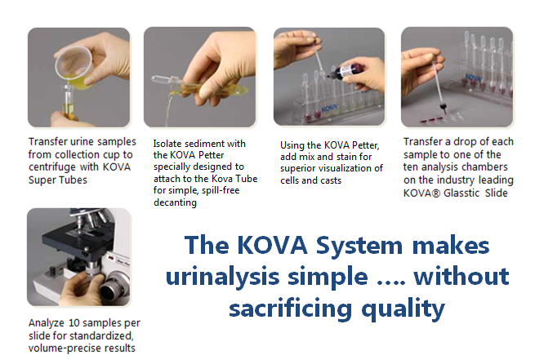
Kova Urine Sediment System

Slide 30
Sediment Staining Procedure
Examined stained or unstained
1
A small drop on a slide covered with a coverslip
2
Subdued light to refract elements
3
Partially close diaphragm and adjust condenser down
Continuously adjust fine knob to see depth of objects
Stain may help identify cell types
4
Can introduce artifacts
0.5% new methylene blue

Slide 31
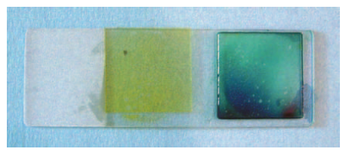
Sediment Staining Procedure
One drop of stain mixed with sediment before placing on microscope slide
Put on coverslip
Can have stained and unstained side by side

Slide 32
Sediment Staining Procedure
Start under low power
  Evaluate larger elements
    Casts or aggregates of cells
      Reported as number observed per low power field (LPF)
Move to x40
  Detect bacteria, differentiate cell types
    Epithelial cells, RBCs, WBCs
      Reported as #/hpf
    Bacteria
      Reported as few, moderate, or many and morphology

Slide 33
Constituents of Urine Sediment
Normal Findings
May have a few casts, crystals, epithelial cells, RBCs and WBCs, mucus threads and sperm (males), and fat droplets
Abnormal Findings
  More then a few RBCs and WBCs, hyperplastic or neoplastic epithelial cells, casts, crystals, parasite ova, bacteria, and yeast

Slide 34
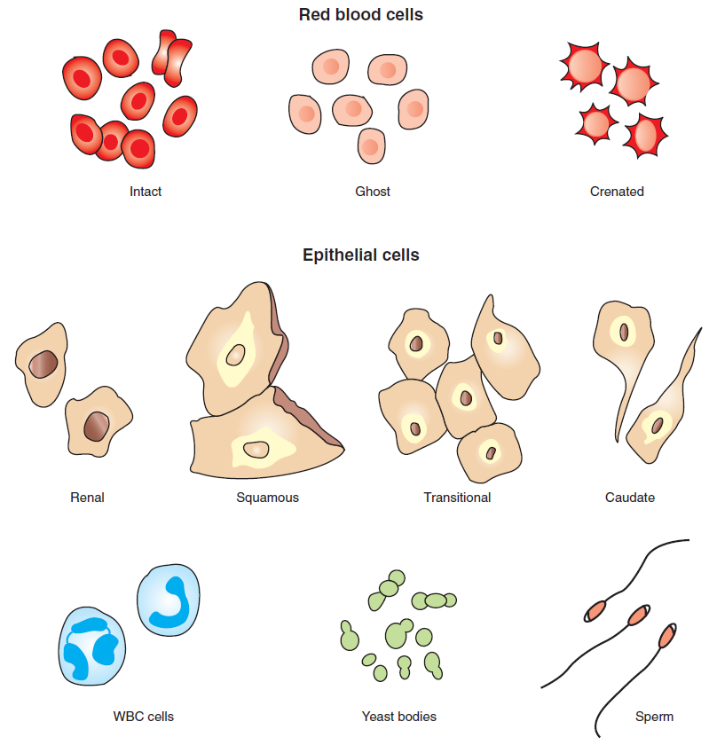
Cell Types in Urine

Slide 35
Erythrocytes
May have different appearances depending upon urine concentration, pH, and time elapsed from collection
Fresh – small, round, smooth edges
Older – concentrated
  Shrink and crenate
Dilute
  Will swell and lyse
Normal
  2 to 3 RBCs/hpf
Presence of RBCs may indicate bleeding somewhere in the urinary tract

Slide 36
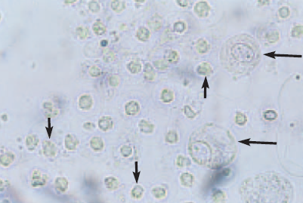

Erythrocytes In Urine

Slide 37
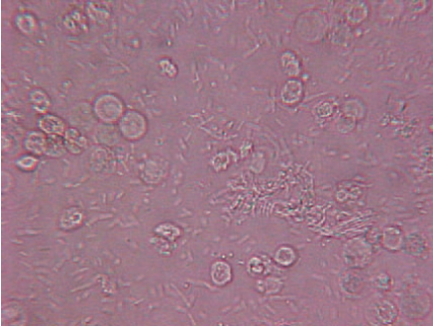
Leukocytes In Urine
Larger than RBCs and smaller then renal epithelial cells
  Spherical, dull gray or greenish yellow
  Identified by granules or lobes of nucleus
  _________________ – excessive WBCs in the urine
Notes:
Pyuria

Slide 38
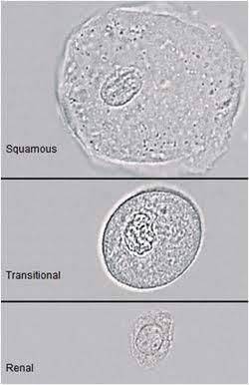
Epithelial Cells In Urine
A few are normal findings
Increased amounts in urine
  Inflammation
Three types
  _________________________
  __________________________
  __________________________
Notes:
Squamous
Transitional
Renal

Slide 39
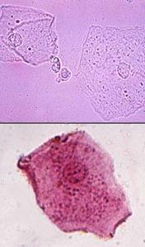
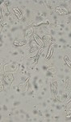
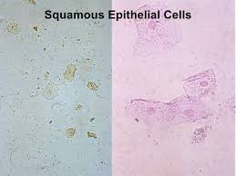
Squamous Epithelial Cells
Derived from the distal urethra, vagina, vulva, or prepuce
Not considered significant
Flat, thin cells with homogeneous appearance
  Largest cells in urine
  Straight edges with distinct corners

Slide 40
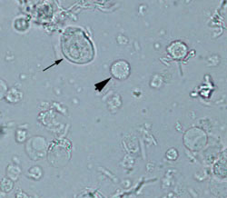
Transitional Epithelial Cells
These originate from the following places
  _________________
  _________________
  _________________
  _________________
Round but occasionally pear shaped
Small, granular nucleus
Low numbers are normal
High numbers indicate cystitis or pyelonephritis
  or ________________________
Notes:
Bladder
Ureters
Renal pelvis
Proximal urethra
catheterization

Slide 41
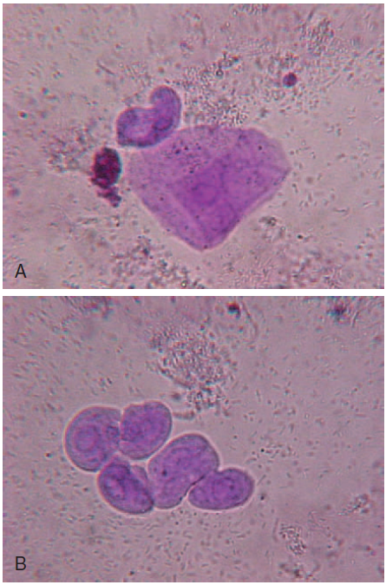
What are we?
Notes:
Squamous
Transitional

Slide 42
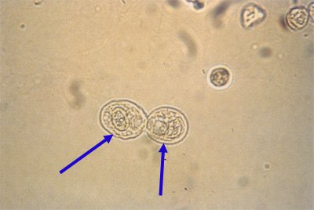
Renal Epithelial Cells
Smallest epithelial cell
Originate in renal tubules
Often confused with WBCs
Generally round and contain a large nucleus with nongranular cytoplasm
Rarely found
Increased numbers
  Kidney parenchyma

Slide 43

Urinary Casts

Slide 44
Urinary Casts
Formed in the lumen of the distal and collecting tubules of the kidney
Secreted protein precipitates in acidic conditions and forms casts shaped like the tubules
Type depends on how quickly the filtrate moves through the tubules

Slide 45
Casts
Classified based on appearance.
  ______________
  ______________
  ______________
  ______________
  ______________
  ______________
  ______________
Notes:
Hyaline
Epithelial
Cellular
Granular
Waxy
Fatty
Mixed

Slide 46
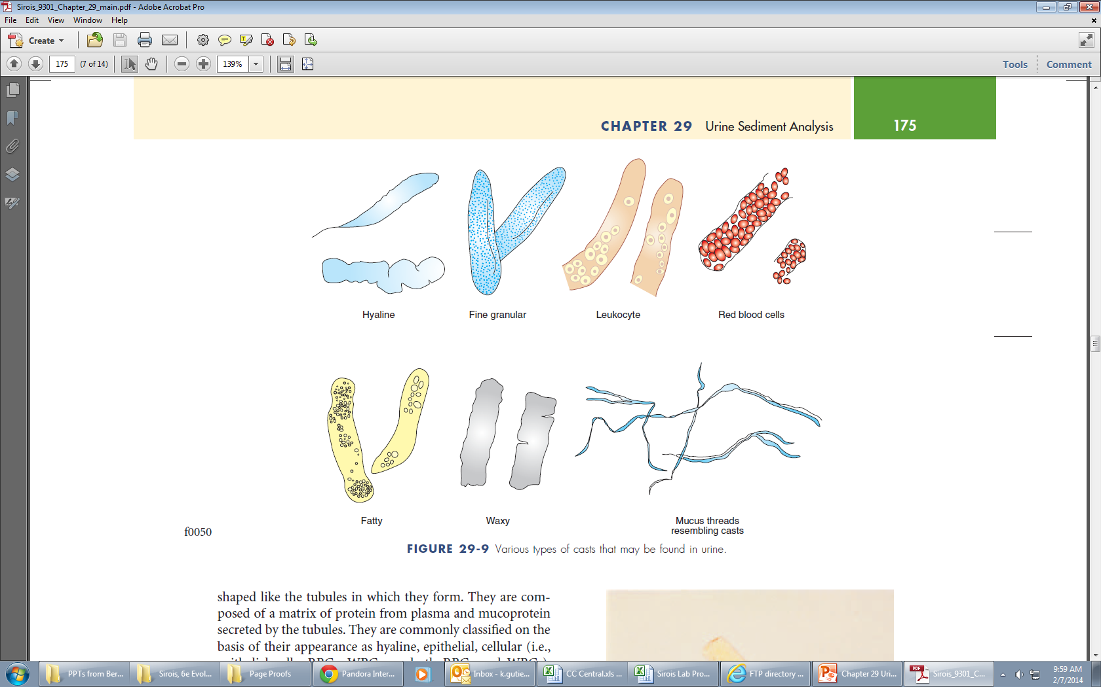
Casts (cont.)

Slide 47
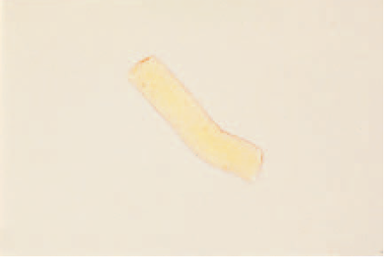
Casts
Hyaline
  Clear and colorless
  Composed of mostly protein
  Cylindrical with parallel sides and rounded ends
  Increased with fever,
    poor renal fusion,
    exercise, or general
    anesthesia

Slide 48
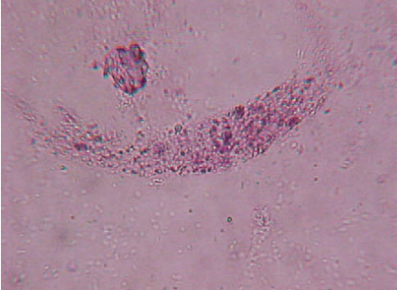
Casts
Granular casts
  Hyaline casts with granules
  Most common type seen
  Typical diagnosis when seen:
    Acute nephritis
Notes:
Acute nephritis

Slide 49
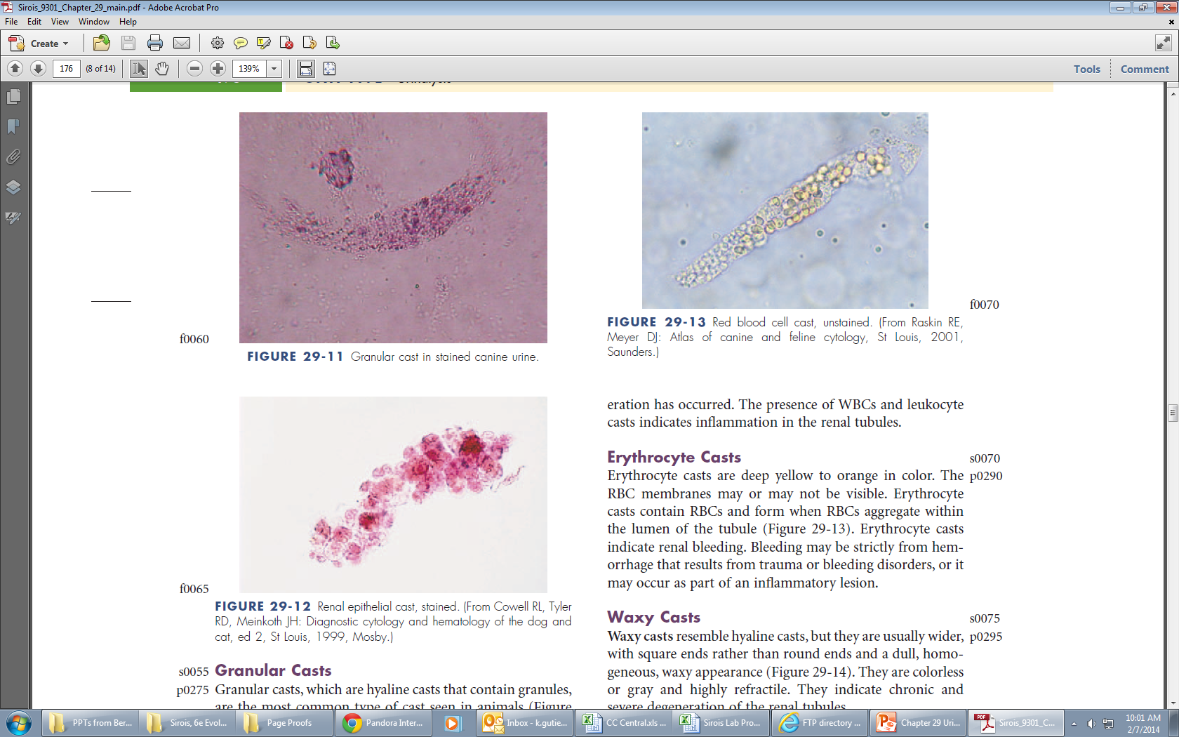
Casts
Epithelial casts
  Consist of epithelial cells from the renal tubules embedded in the hyaline matrix
  Two possible diagnoses when seen
    Acute nephritis
    Degeneration of renal tubule
Notes:
Acute nephritis and
degeneration of the renal tubular epithelium

Slide 50
Casts
Leukocyte casts
  Contain WBCs, mostly neutrophils
  Inflammation in renal tubules
Erythrocyte casts
  Deep yellow to orange
  Contain RBCs
  Indicate renal bleeding

Slide 51
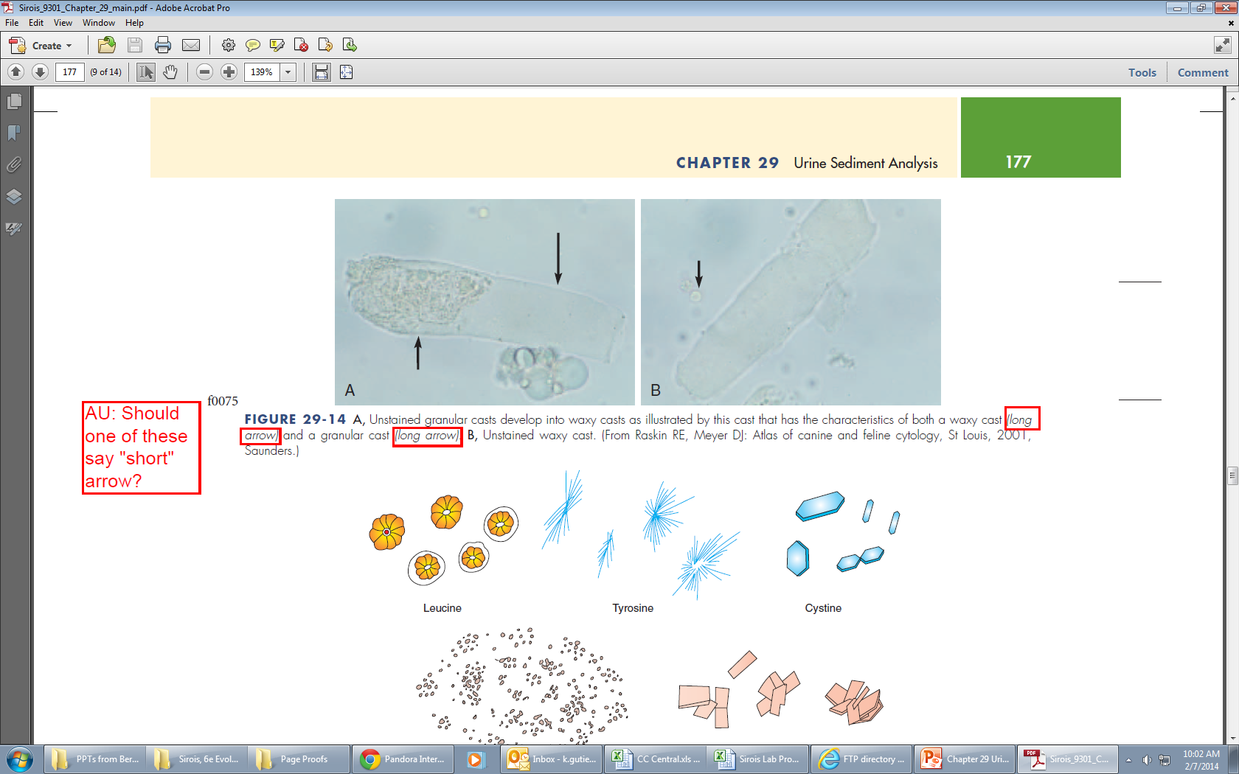
Casts
Waxy casts
  Wider with square ends, dull, homogeneous, waxy appearance
Fatty casts
  Contain small droplets of fat
  Seen in cats with renal disease
  Occasionally in dogs with diabetes mellitus

Slide 52
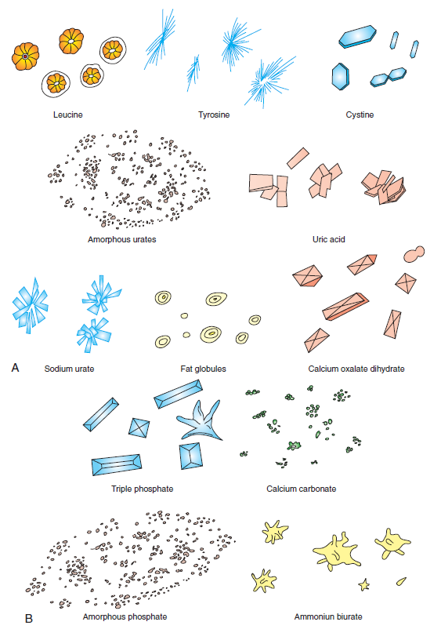
Types of Crystals

Slide 53
Struvite
AKA – triple phosphate crystals or magnesium ammonium phosphate crystals
Found in alkaline to slightly acidic urine
Eight-sided prisms with tapered ends
Referred to as coffin lids but may take other shapes such as a fern leaf; high concentration of ammonia in urine

Slide 54
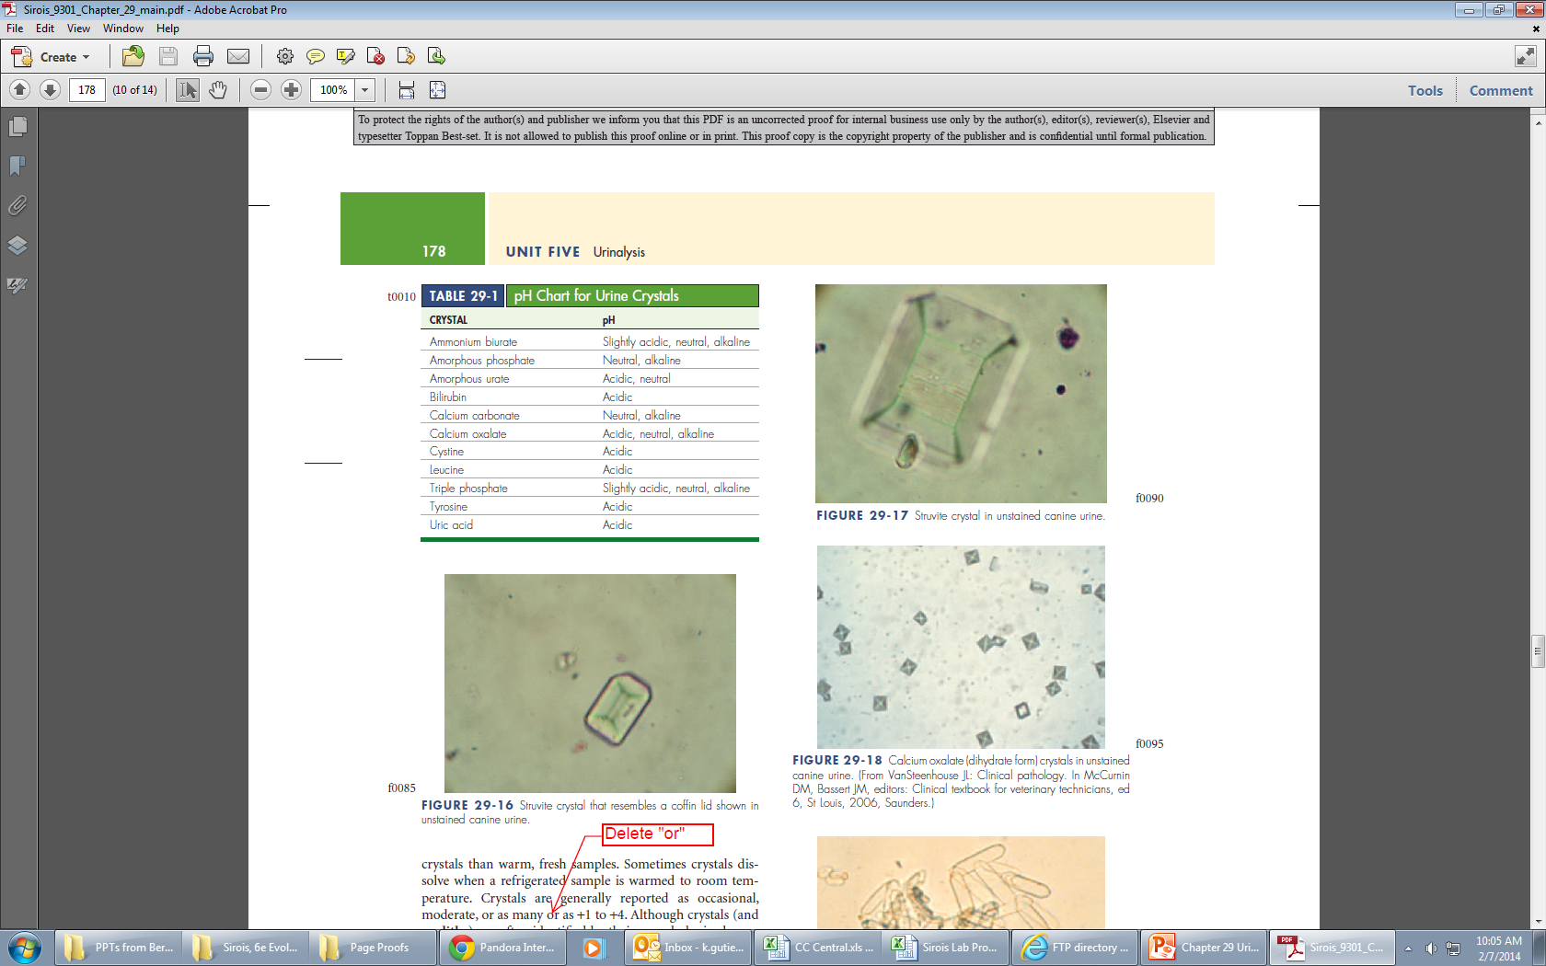
Struvite

Slide 55
Calcium Oxalate
Dihydrate
Small squares with an X across the crystal resembling the back of an envelope
Found in acidic to neutral urine
Common in small dogs and horses
Monohydrate
Small, dumbbell shaped or elongated and pointed at each end (picket fence)
Ethylene glycol poisoning

Slide 56
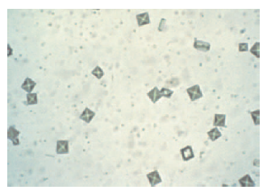
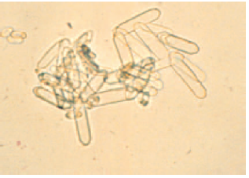
Calcium Oxalate

Slide 57
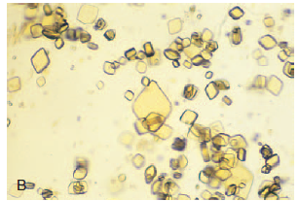
Uric Acid
A variety of shapes but usually diamond or rhomboid
Yellow or yellow brown
Not common in dogs or cats except Dalmatians

Slide 58
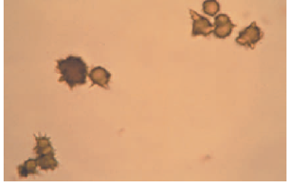
Ammonium Biurate
Seen in slightly acidic, neutral, or alkaline urine
Brown in color with long, irregular spicules
Common in animals with severe liver disease – portacaval shunts

Slide 59
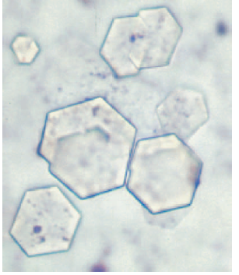
Other Crystals
Cystine
  Flat, six sided, colorless,
    and thin
  Renal tubular dysfunction
    or cystine urolithiasis
Associated with melamine toxicity
  Golden brown, round to oval with radial striations
  Present in animals fed diets with melamine or cyanuric acid

Slide 60
Miscellaneous Components of Urine
Mucus threads
  Confused with casts
  Resemble twisted ribbon
  Large number in horses
  In other animals indicates urethral irritation or contamination with genital secretions
Spermatozoa
  Intact males
  Large numbers can give false-positives for protein

Slide 61
Miscellaneous Components of Urine (cont.)
Fat droplets
  Lightly green-tinged, highly refractile spheres
  Will rise to surface if set for few moments
    Different plane of focus
  Lipuria – fat in urine
    Cats – obesity, diabetes mellitus, hypothyroidism, and high-fat meals
Artifacts
  Enter during collection, transport, or examination
    Air bubbles, oil droplets, hair, feces, pollen, dust, etc.

Slide 62
Summary Before The Lab
Subdued lighting on microscopic examinations
Start at low magnification and move to x40
Identify
RBCs
WBCs
Casts
Crystals

