Slide 1
“WOBBLER’S DISEASE”
CERVICAL SPONDYLOMYELOPATHY

Slide 2
What is Wobbler’s syndrome?
Wobbler’s syndrome is a disease of the cervical spine, primarily at the neck.
This disease is commonly seen in large, giant-breed dogs, and horses.
Wobbler’s syndrome is commonly characterized by constriction of the spinal cord and/or nerve roots, which leads to neurological signs and/or neck pain.

Slide 3
Causes and clinical signs
Causes
Nutrition, high protein diet.
Rapid growth in large dog breeds. Borzoi, Great Danes, Dobermans, and Basset Hounds.
Clinical Signs
Neck pain, stiffness.
Strange, wobbly gait in the back end.
Weakness.
Possible muscle loss near shoulders.
Difficulty getting up from laying position.
Trauma to the back.
Notes:
Nutrition = excess protein, calcium, and calories.

Slide 4
Diagnosis
X-Rays to rule out bone disorders.
Myelographs, CT, and MRI to visualize the compression of the spinal cord.
Your veterinarian will also take a thorough history of your dog’s health, onset symptoms, and possible incidents that might have caused this.
Notes:
Myelographs are rarely used these days, MRI is the most common test used now.

Slide 5
Treatment options
Treatment will depend on the severity and location of the spinal compression.
Medical management usually consists of the use of anti-inflammatory drugs with minimal activity.
Patients who opt for surgical treatment, must have the animal’s activity restricted for 2-3 months.
Physical therapy sessions for post-operative dogs will help with muscle loss, atrophy, fusion of bones, and to hasten recovery.
Electro-accupuncture.
Cervical Disc replacement is the best treatment option.

Slide 6
Client information
Body harnesses should be used in place of neck collars.
Lower protein, calcium, and excessive calorie intake.
Follow up with a Neurologist as needed for your pet.
Dobermans and Great Danes are commonly affected by this disease. Small breed dogs occasionally get this disease, but it is uncommon.

Slide 7
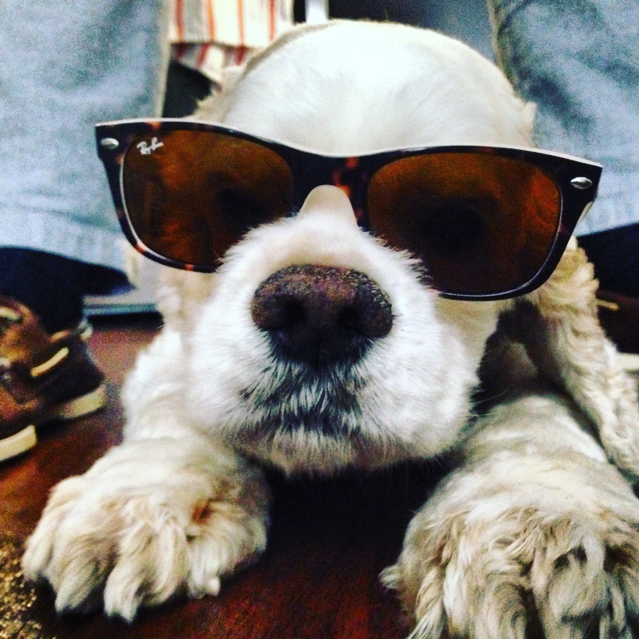
References
Ronaldo C. da Costa, DMV, MSc, PhD, Dipl. ACVIM – Neurology
Department of Veterinary Clinical Sciences
The Ohio State University

