Slide 1
*GROUP 1*
AGAR PLATES

Slide 2
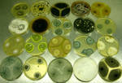
WHAT ARE AGARS?
Sterile petri dish containing agar and usually nutrients
Used to culture microorganisms

Slide 3
ABOUT AGARS
AGARS
REGULAR
“BLOOD”
“SUGAR”
PREPOURED
SUSPEND IN H20
ADDITIVES

Slide 4
AGAR
DEFINED
Natural products
SELECTIVE
Many organisms
UNDEFINED
PERMISSIVE
Certain organisms
Chemicals required

Slide 5
WHY?
Agar plates are used as a medium for growing microorganisms, usually bacteria
Agar plates contain a gelatin, this is because this substance usually isn't degraded by bacteria. This is why some plates contain different material
Used to help make decisions with prescribing medications or just for identification

Slide 6
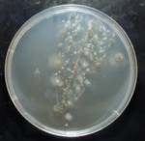
NUTRIENT AGAR
Commonly used due to high number of microbes, fungus and bacteria that can be grown (not selective)
Beef broth and extracts from yeast make it non selective

Slide 7
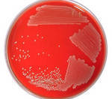
Blood Agar
Contains 5% blood (sheep)
Can be contaminated from human contact

Slide 8
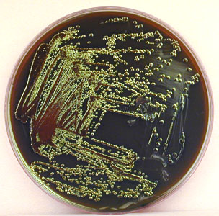
EMB AGAR
Eosin Methylene Blue
Isolates and differentiation of gram negative Bacilli
One of the many agars that are irritating to the eyes, skin and respiratory system

Slide 9
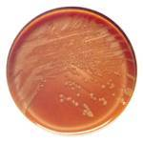
CHOCOLATE AGAR
Most of agar is made of chocolate, 1% hemoglobin (sheep)
Usually for Haemophilus growth, fastidious bacteria
Can be contaminated by human contact

Slide 10
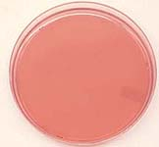
MACCONKEY AGAR
Usually for growth of gram negative
E.Coli grow into red colonies
AGAR POWDER:
Sugar Lactose
Non Sugar

Slide 11
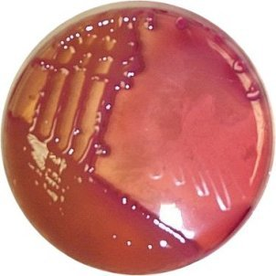
10g lactose 20g peptone 5g bile salts "pinch" or small amount of 1mg/mL Bromcresol purple or Crystal violet solution. 15g agar
1L distilled water

Slide 12
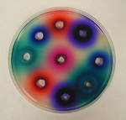
NEOMYCIN AGAR
Kills gram - and +
Contains neomycin antibiotic, which is naturally made from Streptomyces fradiae
Relatively toxic but can cause allergic reactions in some people

Slide 13
AGAR TY[ES
LB (Luria Bertani) Agar
Non-nutrient Agar
Sabouraud Agar
Thayer-Martin Agar
Tryptic Soy Agar
XLD Agar Xylose lysine Deoxycholate
Mannitol salt
Potato dextrose
Millers LB

Slide 14

THE END
www.sciencebuddies.org/scienceproject/microbiology/
www.google.com/agar_plates

