Slide 1



Lifestage feeding for canines

Slide 2

Newborns can double weight in the first 7 – 10 days
Colostrum is the milk produced in the first 24 – 48 hours. Contains the antibodies needed for immunity
3 – 4 weeks/ teeth begin to erupt. Weaning completed by 6 – 8 weeks
Half of energy intake dedicated to growth
Puppies are able to utilize nutrients far more efficiently than adults or seniors.

Slide 3

Increased fat content: to help with energy demands. Min 8% fat to help with cell membrane formation, eye and brain development.
Increased digestible protein. Min 22% protein to help with muscle and bone formation.
Increased digestibility reduces the amount needed. This decreases the overall work done by SI and decreases the amount of waste.

Slide 4

Increased calcium/phosphorus/magnesium to help with bone and muscle development
Increased fat soluble vitamins for proper development
Increased fatty acids to compensate for growth needs
Increased zinc for immunity health
Simple carbohydrates to decrease strain on GI
Highly digestible/bioavailable proteins
Assess body condition. Take breed and activity levels into consideration.

Slide 5

Puppies should be fed as least 3x per day to combat hypoglycemia. This low blood sugar can cause lethargy, convulsions and death.

Slide 6
Species and Growth Stage | Recommended Protein % | Recommended Fat %
Puppy | 28% | 17%
Adult Dog | 18% | 9-15%
Performance Dog | 25% | 20%
Racing Sled Dog | 35% | 50%
Lactating Dog | 28% | 17%

Slide 7

Adult Canine Nutrition

Slide 8
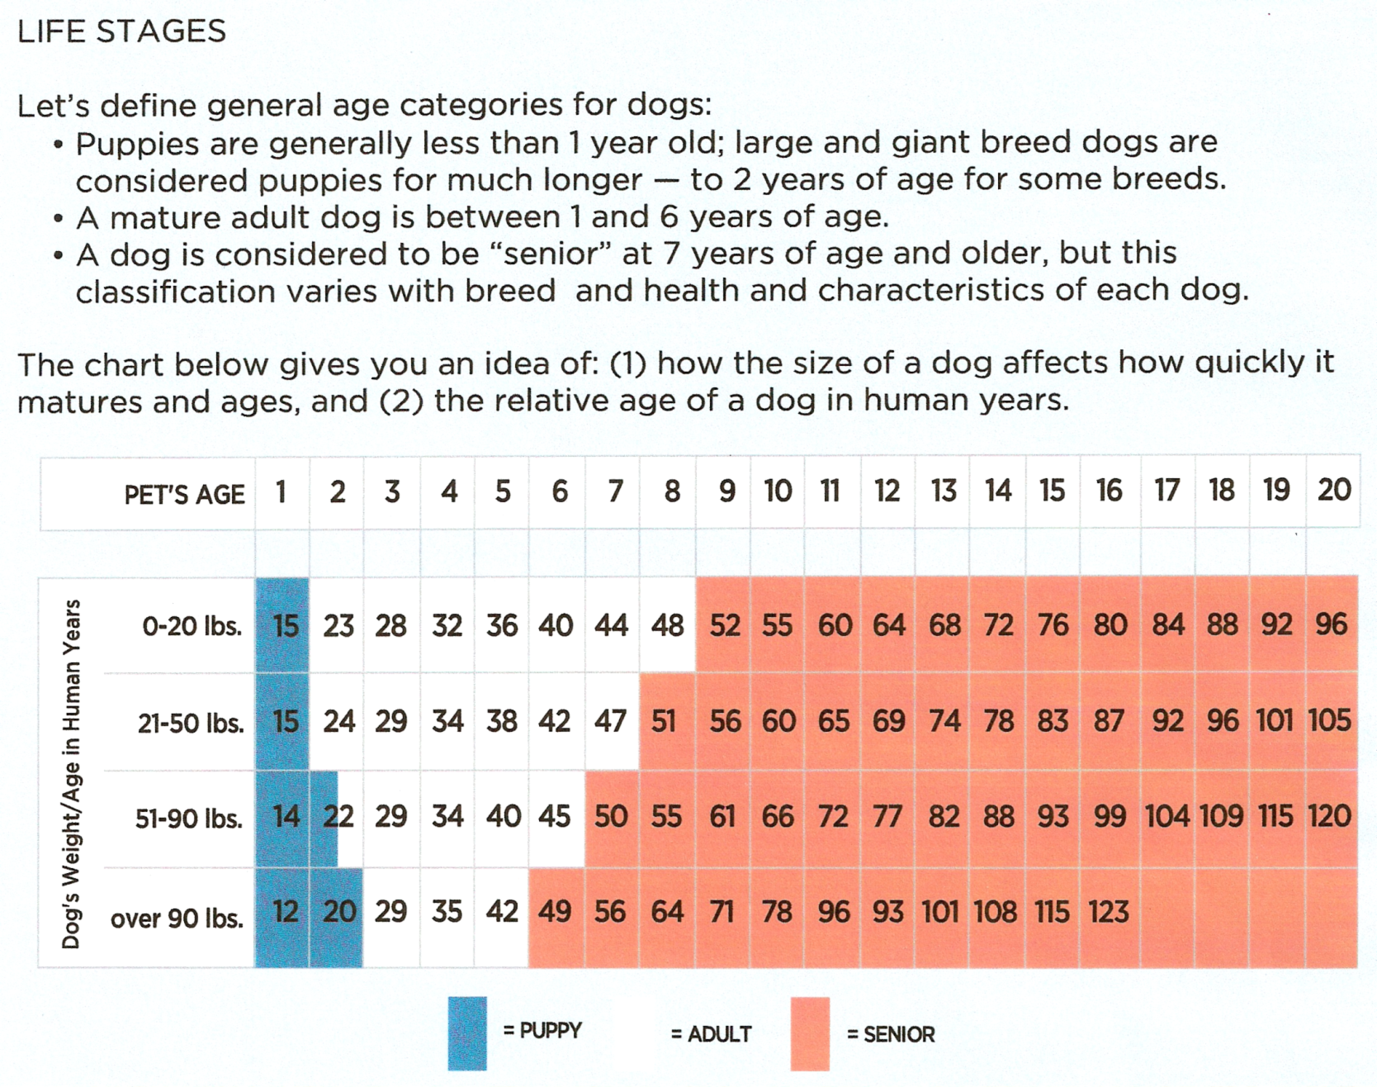

Slide 9
ME = Metabolizable Energy
ME requirement for an inactive adult canine:
95 x W(kg)to the power of 0.75
ME requirements for an active adult canine:
130 x W(kg) to the power of 0.75

Slide 10

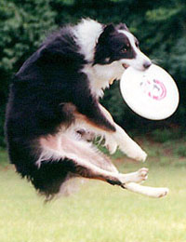
Daily energy requirements are the number of calories needed to maintain an animal’s weight. An increase in exercise, lactation and growth will increase the number of calories needed. Increased energy demands over and above the needs for maintenance are called production energy requirements.

Slide 11
Judging an animal’s body condition is important in determining the caloric needs of the animal. Body condition can be assessed by feeling the ribs with the palm of your hands, the ribs should be felt but not seen. A thorough nutritional assessment should be taken on every patient by the technician. This includes a patient’s history, body weight, body condition score and hydration status.

Slide 12
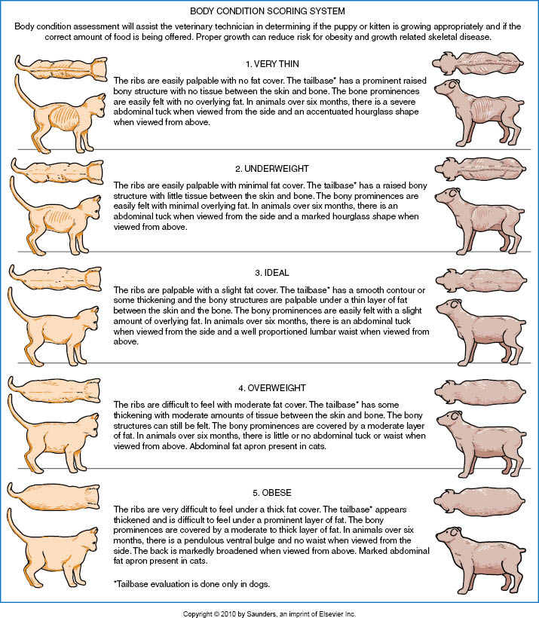



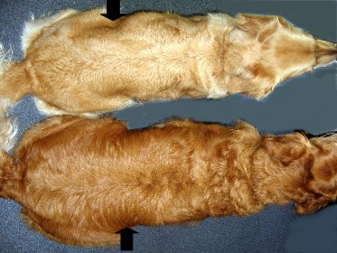
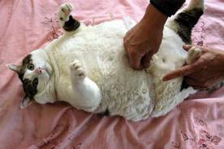

Slide 13
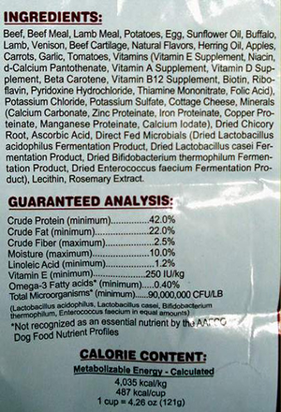

Dogs are omnivores and opportunistic eaters, predators and scavengers.
Because dogs range in size, age and activity level, nutritional energy requirements are calculated based on the animal’s metabolic body weight, or the weight of actively metabolizing tissue.

Slide 14
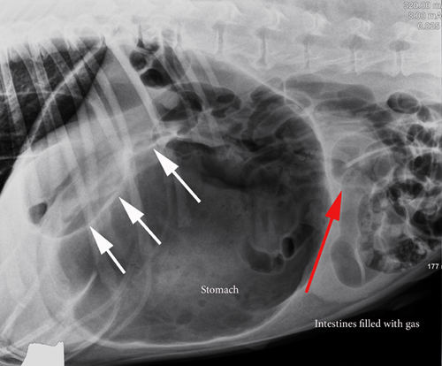
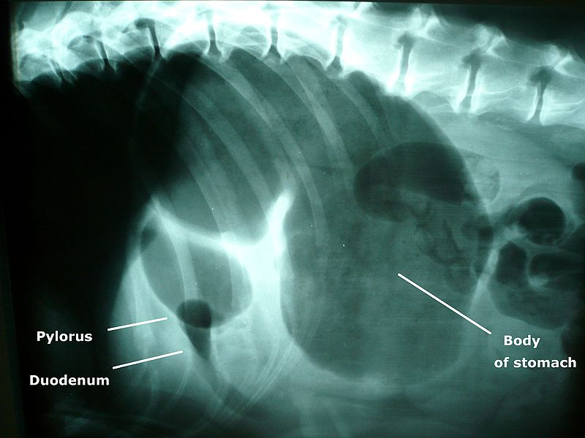
Large meals should be avoided in large breed dogs prior to exercise to minimize the risk of bloat.

Slide 15
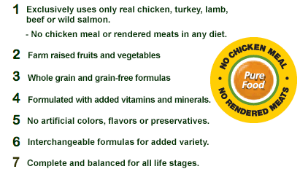
A complete food means that the food contains all of the required nutrients for a particular life stage in a bioavailable form. A balanced food contains all of the required nutrients in correct proportions relative to the food’s total energy density

Slide 16
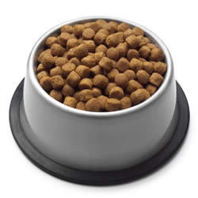
Three basic physical forms or food are dry semi moist, wet (or canned or moist) These three forms vary primarily in water content.
Dry contains less than 12% water and is the only form of food suitable for ad lib feeding. Dry, crunchy foods can be helpful in keeping teeth clean and reducing plaque buildup, but should not replace a dental health regiment. A disadvantage of dry food is a lower palatability compared to semi-moist or wet. Dry foods typically provide 1,300 to 2,000 kcal of ME per pound of food DM.

Slide 17
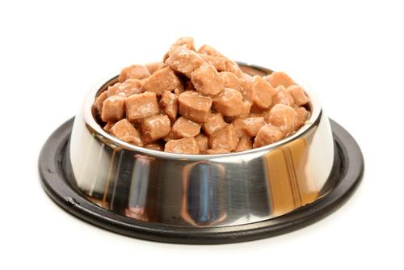
Semi-moist typically contains 25 – 35 % water. Advantages includes higher palatability serving convenience and easy storage. Disadvantage is the greater cost per serving and some semi-moist foods contain simple carbohydrates that are not recommended for diabetic cats or dogs. Contain approximately 1,200 – 1,350 kcal of ME per pound of food DM

Slide 18
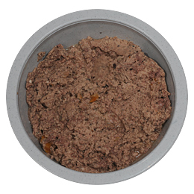
Canned or wet foods contain about 75% moisture. These foods have the highest palatability but typically cost more per serving. These foods are less convenient to store.
Wet food contains higher levels of protein, phosphorus, sodium and fat on a DM basis. Contain approximately 1,600 – 2,300 kcal of ME per pound of food DM

Slide 19
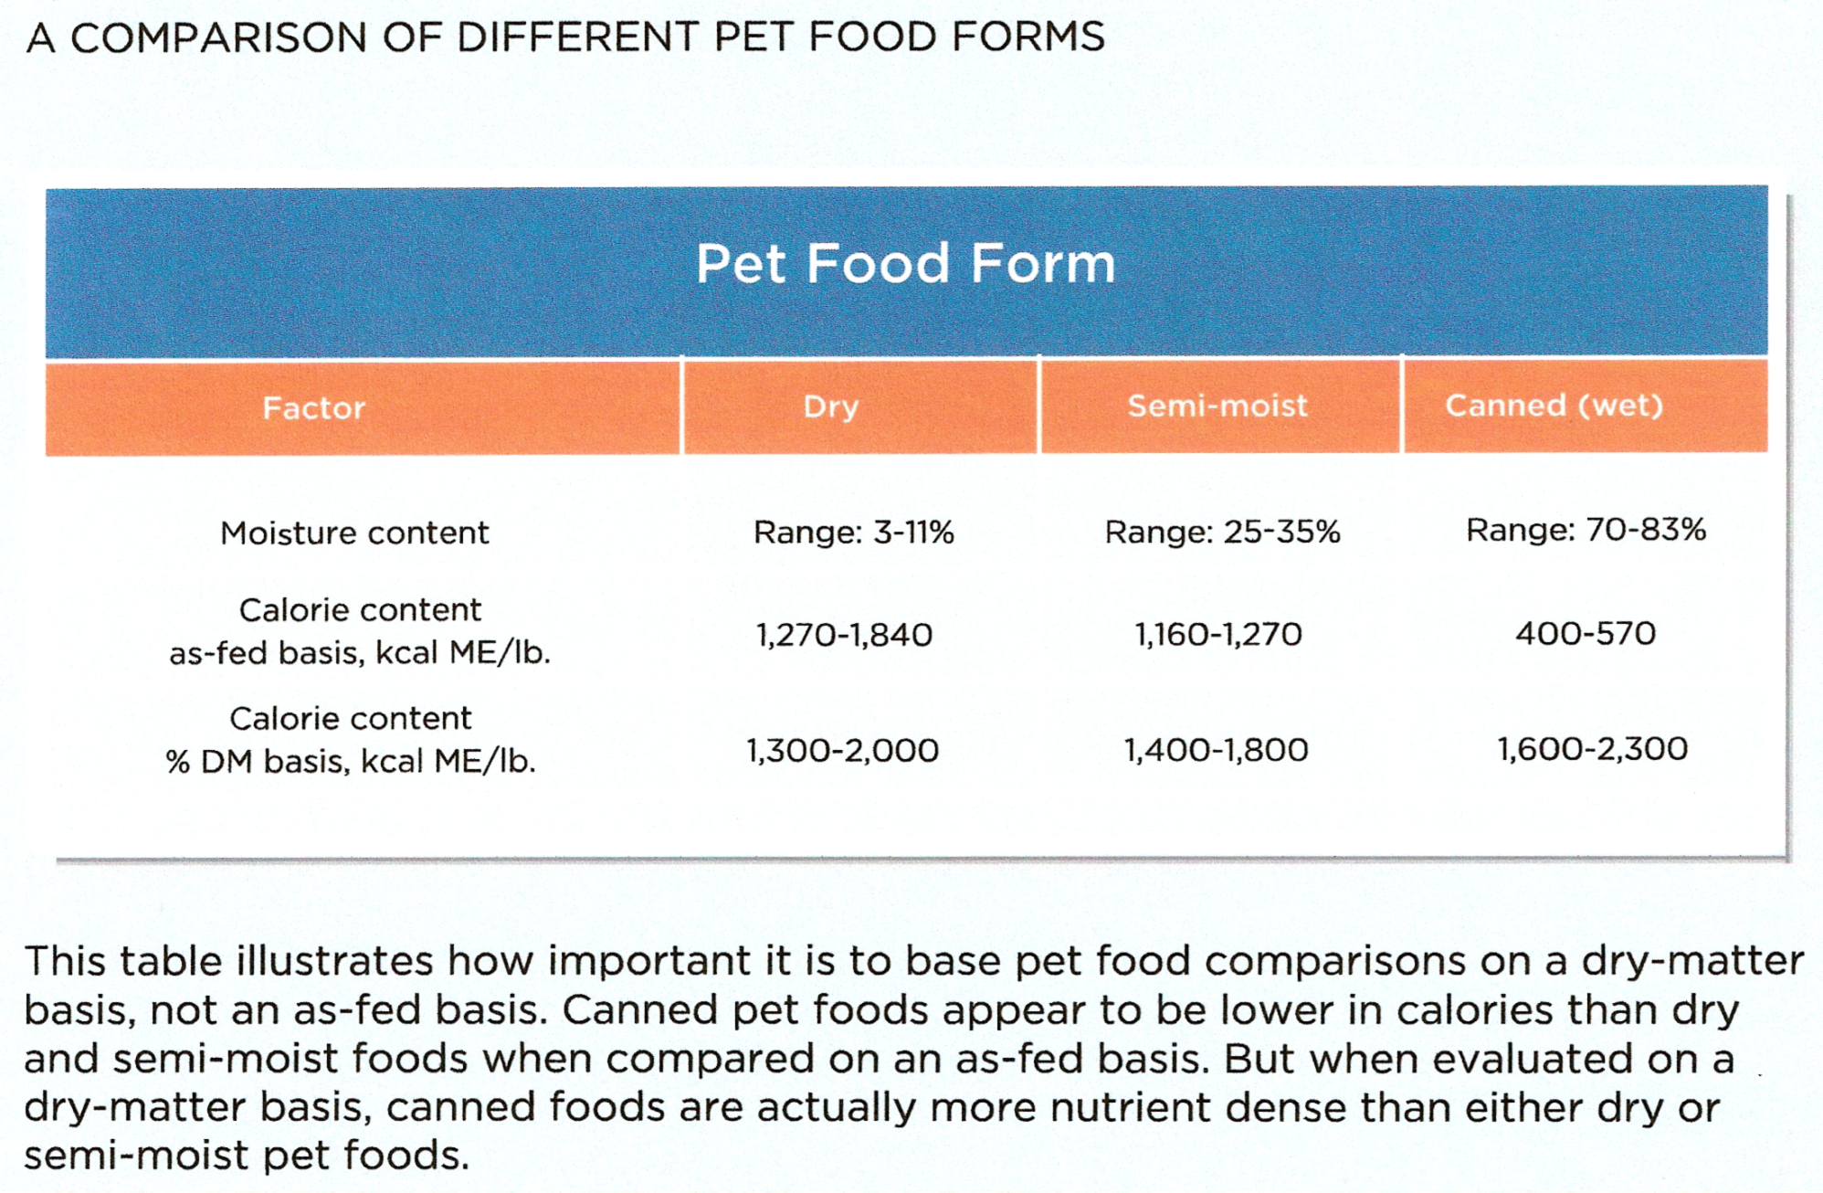

Slide 20

Super premium foods are formulated to provide optimal nutrition during different life stages. Highly digestible, high quality ingredients are used. These foods typically contain more calories and nutrients per pound of food and because these pet foods are highly digestible the pet uses more of the food’s nutrients and produces less stool.
Premium foods offer a nutrient density lower than super premium but higher than standard. These are quite digestible and use good sources of protein.
However, it is important to note that there is nothing requiring pet food companies to change anything in the food in order to call it premium or super premium!

Slide 21

Senior pets: have a decline in the function of organs so it may be more difficult for the animal to utilize the nutrients provided. The goal is to maintain optimal body condition.
Most senior pets require less calories to maintain a good body condition. The metabolic resting rate slows with age.
Water should be closely monitored. Disease or medications can cause changes in water intake. (kidney dx, diabetes, diuretics)
A slight decrease in fats as long as it is still rich in fatty acids. Fat has more than twice the calories and additional steps digestively to use.
Protein: older dogs will be less efficient in metabolizing proteins. The goal is to minimize protein losses and support tissue repair and immune function.

Slide 22
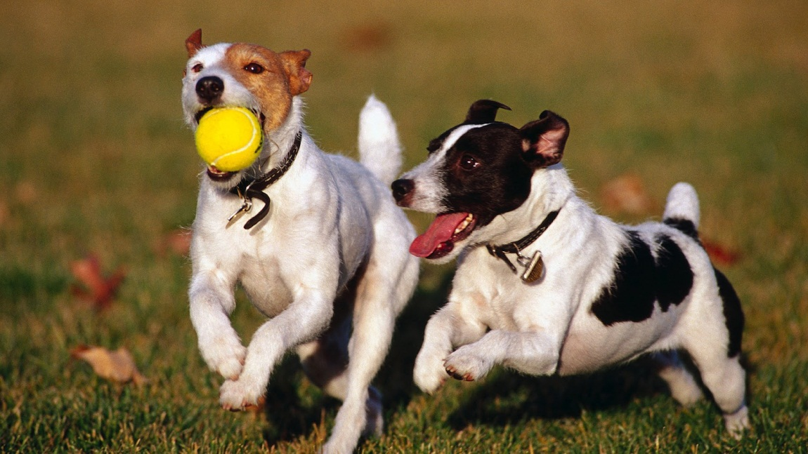

Physical activity is one of the most important factors to consider
A dog’s activity level can be placed into one of four categories
* Low: Little to no exercise – these animals are at risk for obesity
* Moderate: Daily walks and play. A maintenance diet would be a good choice.
* Hardworking: Herding, search and rescue, agility trials, hunting and guarding. This will boost a dog’s energy requirements and a performance diet would be a good choice.
* Extreme: sprint racing and endurance. These animals may require customized feeding plans.

Slide 23
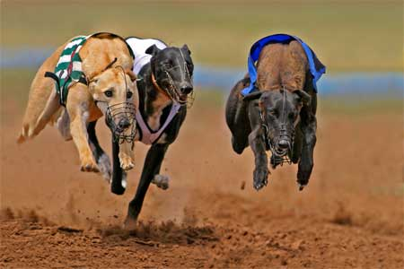
Sprinting dogs require up to 50% of their caloric intake as carbohydrates. Endurance diets require less carbohydrates due to a more efficient use of fat as an energy source. Diets higher in carbohydrates are counter productive in working dogs and may reduce athletic performance.

Slide 24
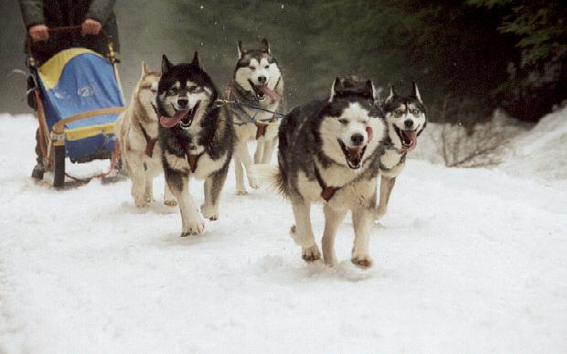
In the endurance dog high carbohydrate levels may lead to a build up of lactic acid causing muscle fatigue. A diet higher in amino acids is beneficial to repair damage to muscle and connective tissue
The longer an athlete exercises, the more fat it requires. Essential fatty acids should make up a minimum of 2% of the diet DM.

Slide 25
Other factors that can affect a dogs energy requirements.
Climate
Environment
Stress

Slide 26

Climate: Extreme temperatures and humidity can increase energy requirements. A dog living in the arctic need a 70 – 80% boost in energy to maintain a normal body temperature. Dogs can increase their metabolic rate to produce additional heat through a process called cold induced thermogenesis.

Slide 27

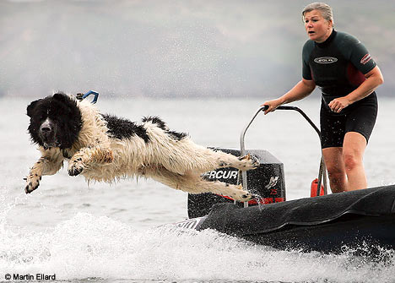

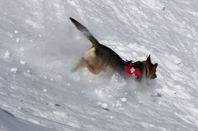
The type of terrain can effect how hard dogs must work and how many calories they need.

Slide 28
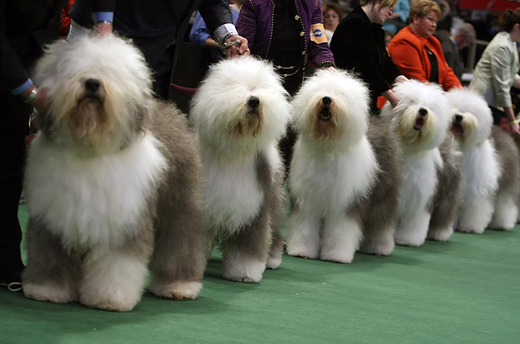

Stress: Psychological stress such as the show circuit, training, crowding boarding and hospitalization can effect the way in which dogs metabolize nutrients.
Adequate nutrition can aid in how efficiently the dog copes with these stressors.

Slide 29

Feline Feeding Requirements

Slide 30
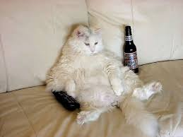
Domestic cats will eat 12 – 20 meals every 24 hours.
Cats are more sensitive to taste and texture and will only eat what they can smell
Three main factors determine the nutritional needs.
Stage of life
How active is the cat
Is the cat maintaining an ideal body condition.

Slide 31
Cats have unique nutritional requirements:
Amino Acids: Taurine: needed for normal CV, visual and repro function.
Arginine: cats require more than other species.
Vitamins: Vitamin A found in animal tissue. Cats can not synthesize from plant precursor.
Vitamin B: cats need more thiamin and niacin.
Arachidonic acid: only found in animal tissue.
Protein: Cats require more protein than dogs and amino acids are used to synthesize tissue protein and manufacture enzymes.

Slide 32
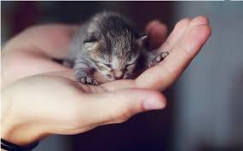

Kittens are less than one year of age
Young adult – 1 – 7 years
Mature adult 7 – 11 years
Senior over 11 years.
Kittens will increase size 2000% in the first 5 months of age.
Kittens require 2 times more energy than adults. At 7 – 9 weeks they should be on solid food and should be free fed (ad lib)

Slide 33
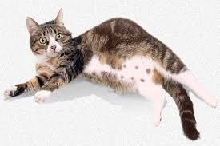
Good nutrition is heightened during gestation and lactation. Gestation averages 63 days. At parturition, the queen only loses 40% of the weight gained. The remaining 60% is stored to be used as an energy source during lactation. At the time the kittens are born, the queen should be taking in 25 – 50% more calories than maint.

Slide 34

On average, cats live 14 years. It is difficult to determine when a cat is considered a senior. At the age of 7 cats may become less active.
At age 11 the sense of smell and taste diminishes.
Signs of aging include:
Decline in coat condition
Decreased activity level
Decreased hearing and eyesight
Onset of arthritis
Weight loss

Slide 35
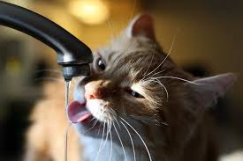
Older cats are at risk for dehydration. Aging can impair thirst sensitivity. Dehydration can impair kidney function and increase water loss. Providing multiple bowls of water, or feeding canned food can encourage older cats to take in the water needed.

Slide 36



Lifestyle factors that effect the nutritional needs of cats:
Activity level
Environment
Stress
Breed

Slide 37
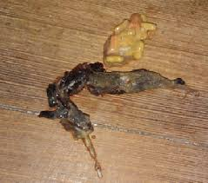
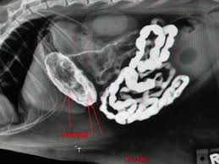
Special Feeding: Hairballs
Most cats will experience hairballs. Cats swallow small amounts of hair every time they groom. It cam accumulate in the stomach and that triggers a vomit reflex. A diet higher in fiber will help to move the hair through the intestinal tract. Soy emulsifier will help to minimize the combining of fats with the undigested hair.
Review signs of a hairball:

Slide 38
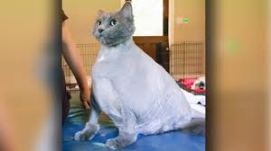
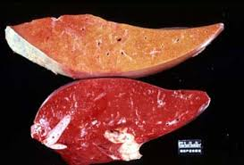
Obesity: Cats can develop weight problems due to hormonal disorders, or simply because they are inactive and eat too much. The only way to reduce weight is to reduce the caloric intake and increase exercise. Cats are at risk for hepatic lipidosis when losing weight.
Increasing fiber and moderating fat and carbohydrate content will be beneficial.

Slide 39
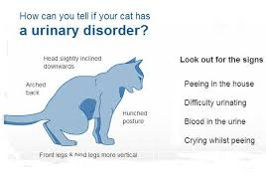
Urinary tract health: FLUTD.
A disease that affects the ureters, bladder and/or urethra. The most common diagnoses is idiopathic cystitis. Typically affects cats 2 – 7 yo. Stress can cause it to worsen clinical signs. Restriction of ash is beneficial.

Slide 40
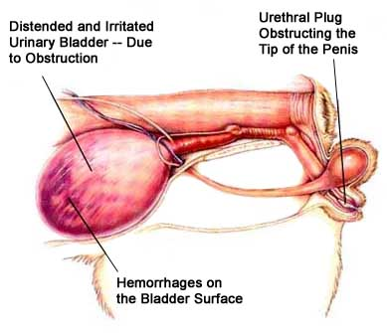
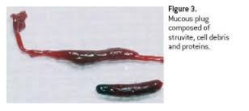
Urethral obstruction:
Uroliths and plugs are not the same. Urethral pugs are unorganized masses of mucus.

Slide 41
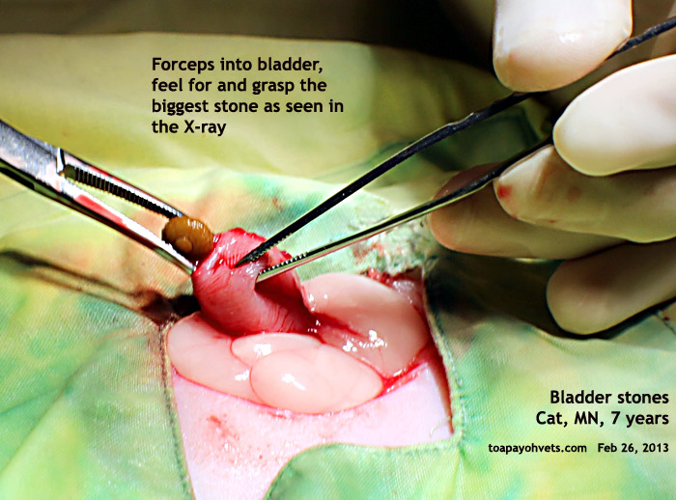
Indoor cats have a higher risk for FLUTD
2 – 7 yo have increased risk for urethral plugs
>4 yo at risk for urolithiasis and idiopathic cystitis
4 – 7 yo highest risk for struvite formation
7 – 10 yo highest risk for calcium oxilate formation.
Stones must be removed surgically.
Increase water intake.
Feed a diet that promotes appropriate pH.

