Slide 2
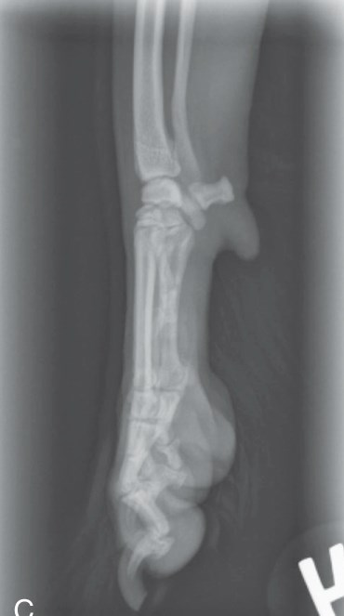
Radiographic Concerns: Forelimb
Field of view:
  Long bones – Include proximal & distal joints
  Joints – Include 1/3 of the bones proximal & distal
Most projections via tabletop
  Collimate tightly
Can split image:
  Point toes the same direction
  Collimate & shield other side
R Mediolateral Carpus

Slide 3
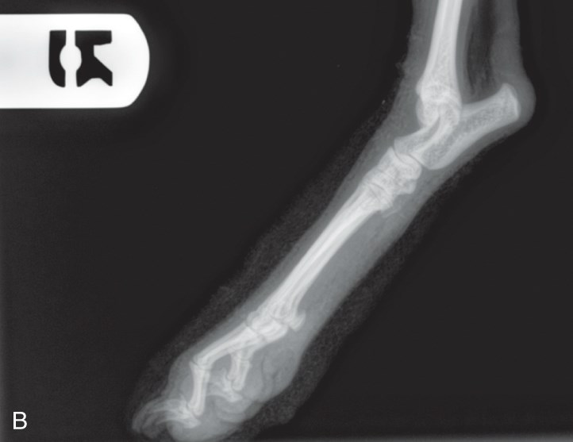
Radiographic Concerns: Forelimb (cont.)
Non-manual restraint (where possible)
Place label at:
  Lateral view - Dorsal or cranial aspect
  Other views – Lateral aspect
Keep bone parallel to cassette and beam perpendicular
Increase exposure factors if splints/casts in place
R Mediolateral Tarsus

Slide 4
The Forelimb: Radiographic Anatomy
Shoulder Joint – Mediolateral & CaCr
Scapula – Mediolateral & CaCr
Humerus – Mediolateral, CaCr, and CrCa
Elbow – Mediolateral, CrCa
Radius/Ulna – Mediolateral, CrCa
Foot – Mediolateral, DPa
Notes:
Why caudocranial? Closer to cassette
Distal to humerus – CrCa becomes preferable

Slide 5
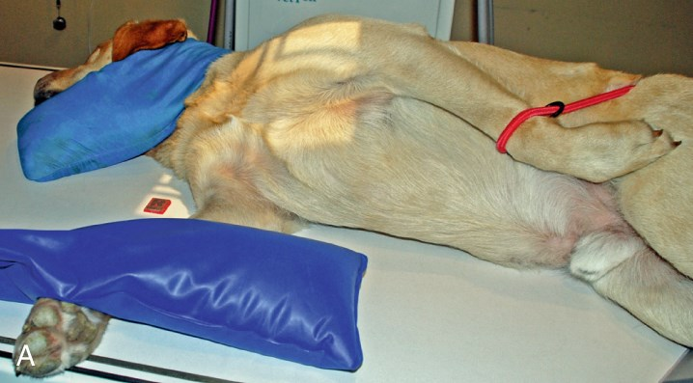
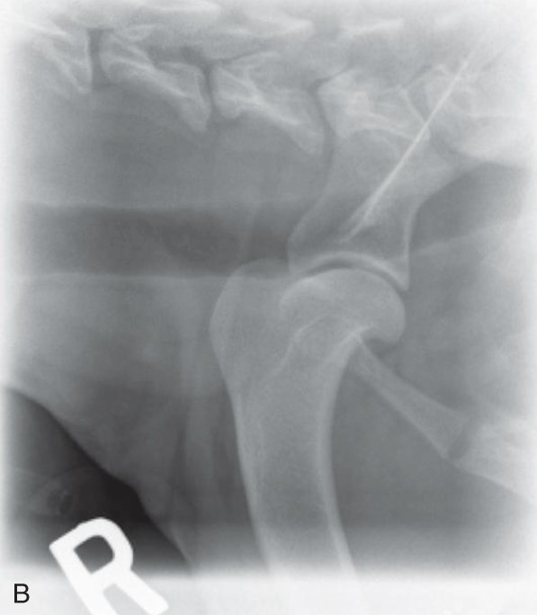
Shoulder Joint (Mediolateral View)
Notes:
Notice:
T-shape
Non-manual restraint
Central ray at area of interest
Careful collimation

Slide 6
Shoulder Joint (Mediolateral View)
Area of interest closest to cassette
Extend affected leg cranially & ventrally
Opposite leg pulled out of way
Arch head & neck dorsally
Hind limbs in natural position
Don’t over-rotate thorax
Head & limbs make a “T”
Borders: Proximal 1/3 of humerus & scapula
Notes:
Avoid superimposition of structures over shoulder.
If over-rotate - - Shoulder may lift off cassette.

Slide 7
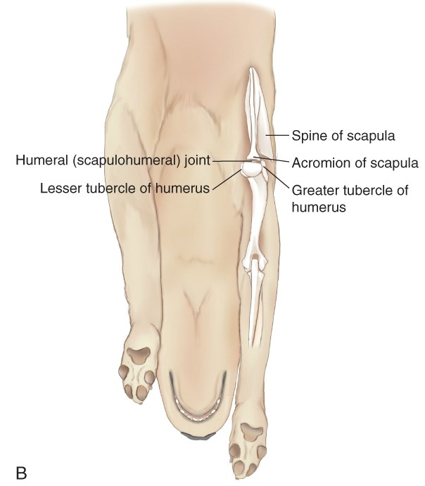
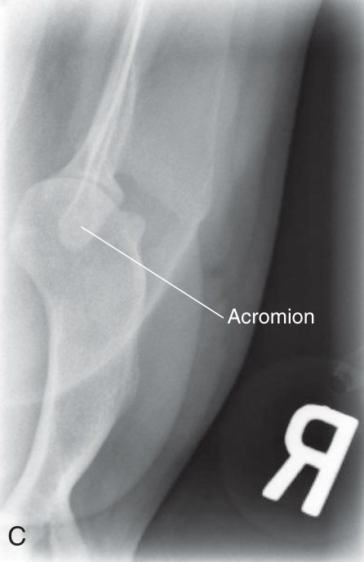
Shoulder & Scapula (Caudocranial View)
(Same positioning for humerus)

Slide 8
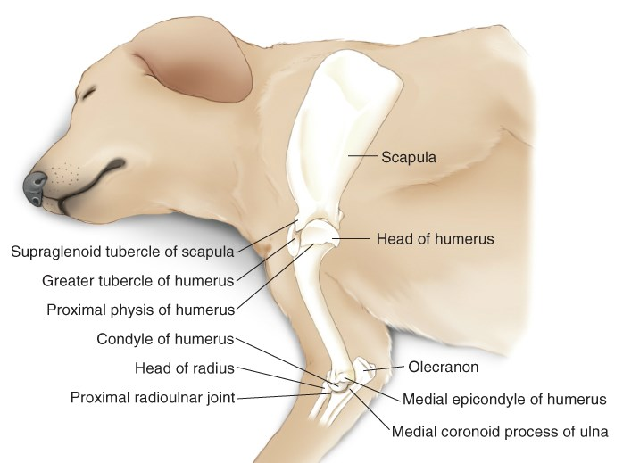
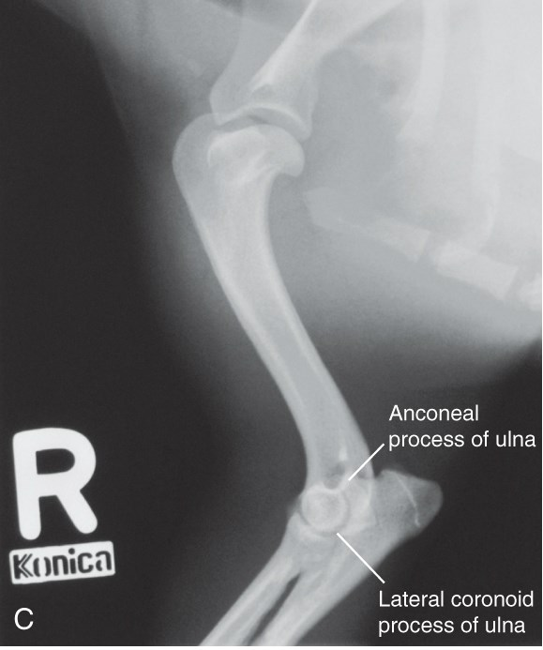
Humerus (Mediolateral View)
*Positioning is identical to scapula

Slide 9
Humerus (Mediolateral View)
Lateral recumbency with affected leg down
Affected leg is extended forward
  Opposite leg drawn back
Head and neck extended dorsally.
Larger dogs may need 2 views
  Elbow/shoulder may differ in density
Center ray at mid-shaft
Borders – 1/3 bone proximal to shoulder & distal to elbow

Slide 10
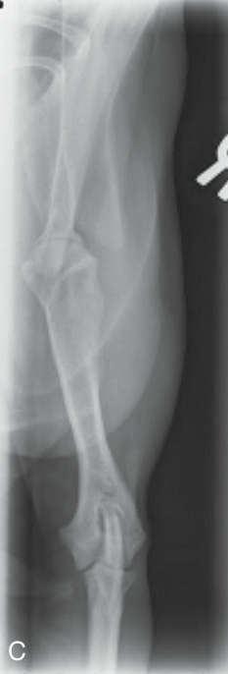
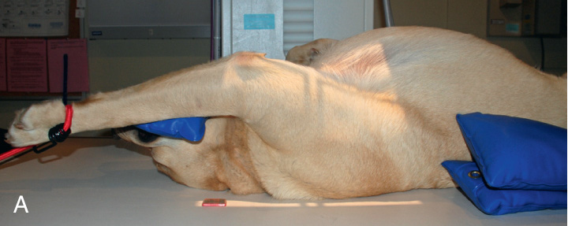
Humerus (Caudocranial View)
  Same positioning as for shoulder/scapula
  Be aware of distortion since forearm is away from cassette

Slide 11
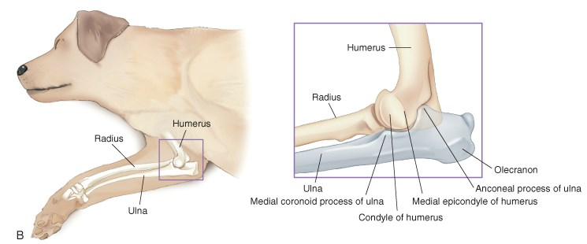
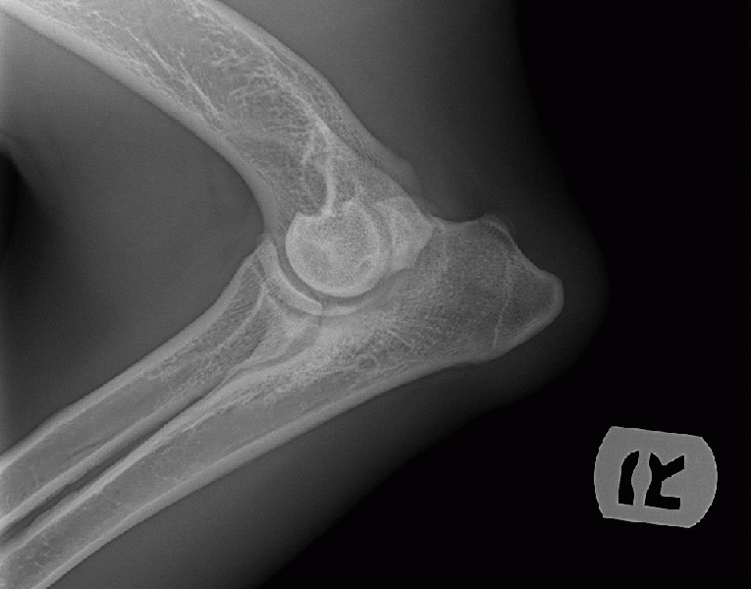
Elbow (Mediolateral Extended View)
  Move head & neck dorsally
  Extend other limb caudally
  Affected elbow joint is in 120-degree extended position
  Maintain symmetry of structures with small foam pad under distal region of affected limb

Slide 12
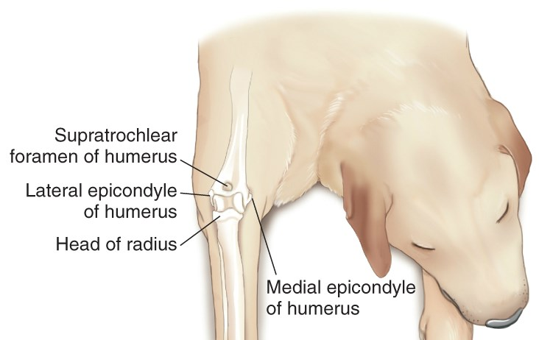
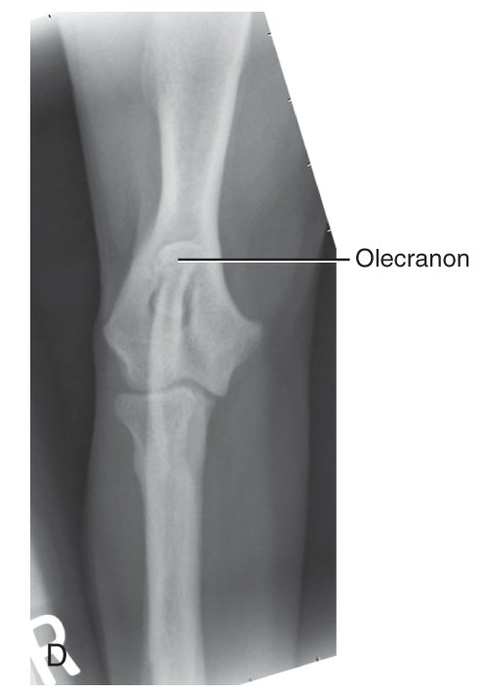
Elbow (CrCa View)
Foam pad under unaffected limb
Pull head away from affected limb
Center ray on center of humeral condyles
Borders – 1/3 of bone proximal & distal
Symmetry is essential
* Same positioning for other CrCa views (with different borders)

Slide 13
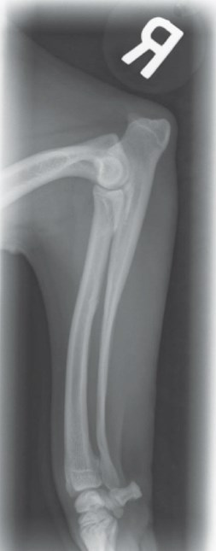
Radius & Ulna (Mediolateral View)
  Same as for extended elbow view (with different borders)
  Place foam under the humerus & cranial thorax to maintain alignment
  Make sure cassette is large enough to include correct borders
  Measure at mid-shaft to minimize over-exposure

Slide 14
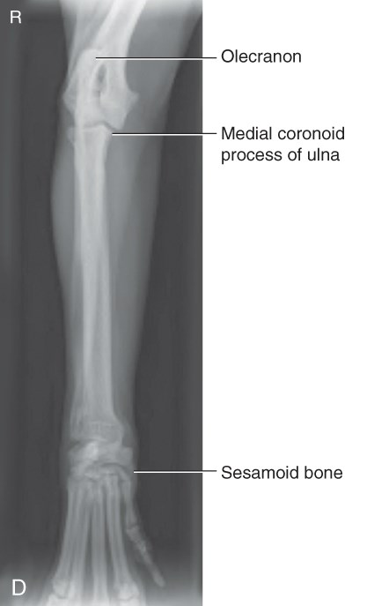
Radius & Ulna (CrCa View)
  Positioning as for CrCd elbow view (with different borders)
  Measure at mid-shaft of bone

Slide 15
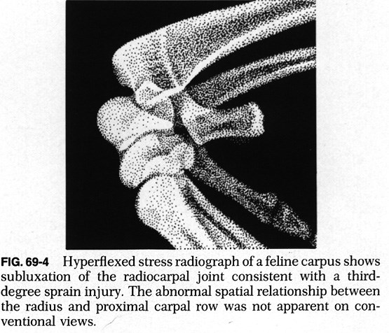
Carpus (Mediolateral Hyperflexed View)
Lateral recumbency
Hyperflex carpus
Helps evaluate carpal
    joint laxity
Borders – Proximal third of metacarpus to distal third of radius/ulna
Notes:
Use tape or paddle to hyperextend - Do not extend carpus beyond normal range of motion

Slide 16
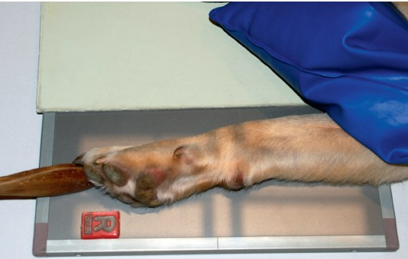
Foot (Mediolateral View)
  Separate digits with tape (cotton isn’t as effective)
  Measure & center primary beam at site of interest
  Borders – Proximal 1/3 metacarpus to distal 1/3 R/U
  Cassette can be split – point toes in same direction

Slide 17
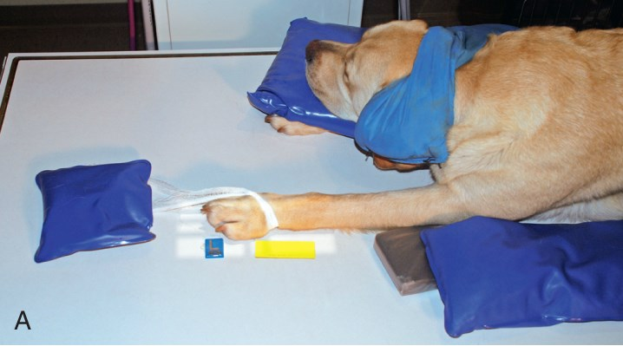
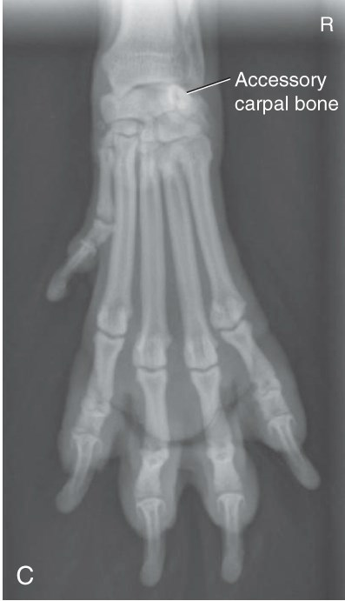
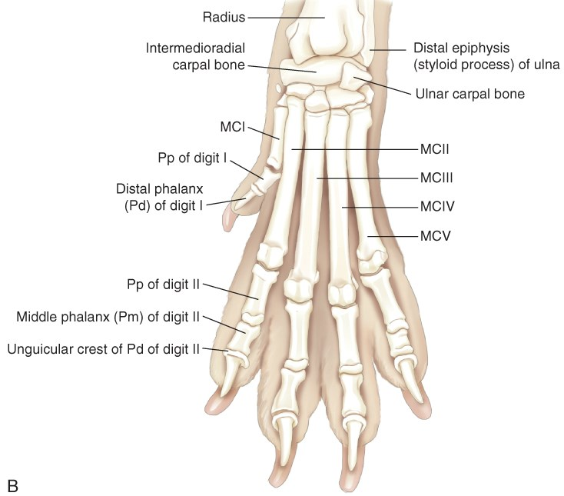
Foot (Dorsopalmar View)
Notes:
Weird about view?

Slide 18
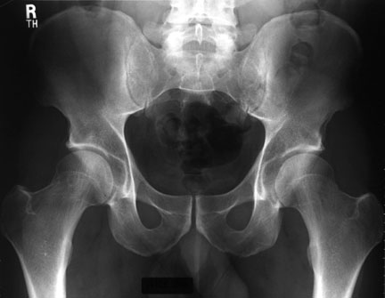
Hind Limb: General Considerations
Anatomy (Pelvis):
  Half of femoral head should be in the acetabulum
  Femoral heads should be rounded and smooth
  Femoral neck should be smooth with no remodeling
Views (2):
  Dorsal recumbency for pelvis (V/D) and femur (CrCa)
  Sternal recumbency for distal hind limb (CdCr)
Notes:
CrCd Tib/Fib

Slide 19
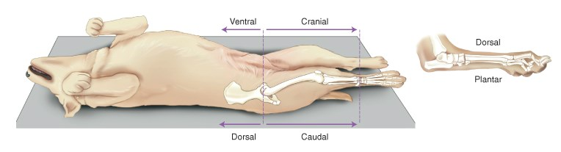
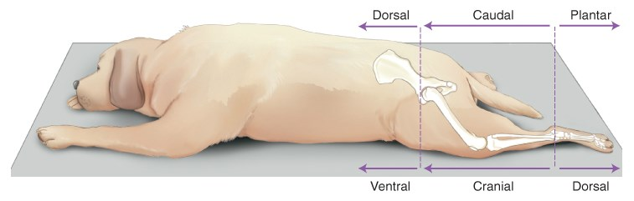
Hind Limb Terminology
Dorsal recumbency: Used for proximal hind end
Sternal recumbency: Used for distal rear limbs

Slide 20
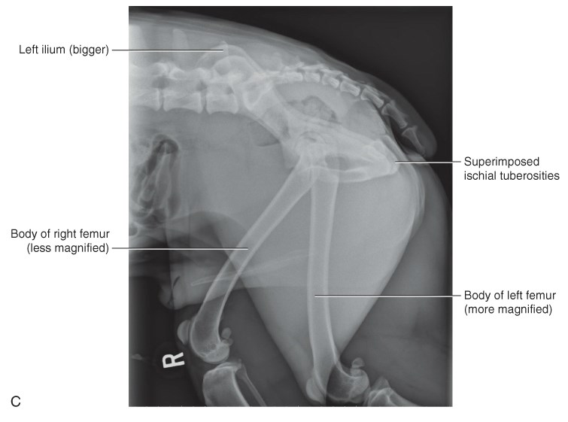
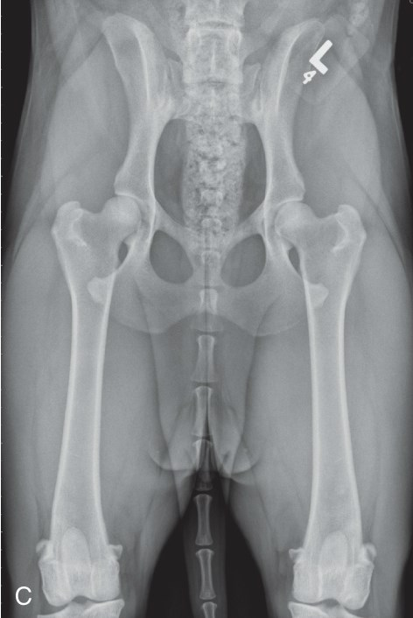
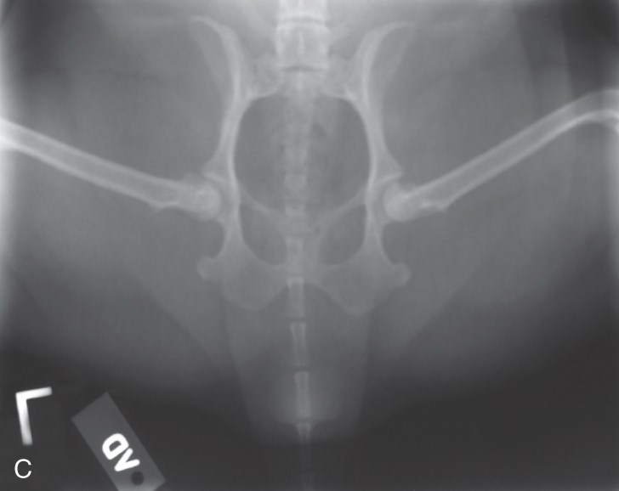
The Pelvis: Standard Positions
Lateral
Ventrodorsal
Ventrodorsal Frog-Leg

Slide 21
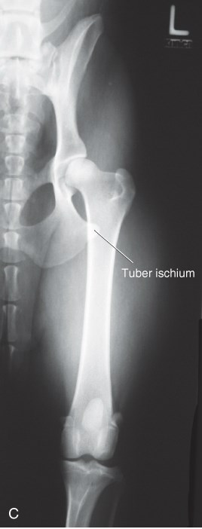
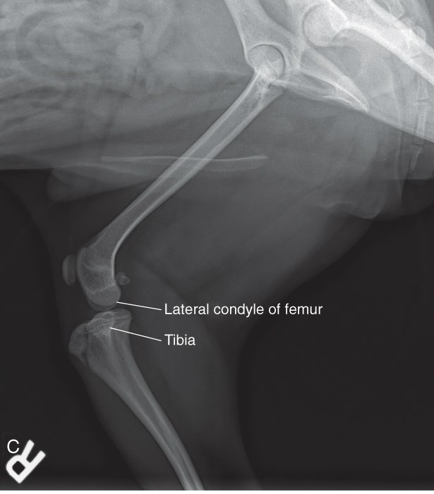
Femur – Standard Views
Mediolateral
Craniocaudal

Slide 22
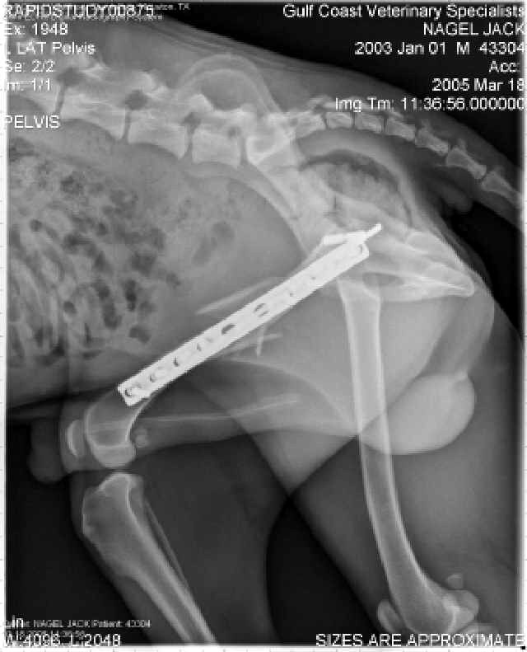
Femur: Mediolateral View
Positioning:
  Flex unaffected limb & pull back
  Extend affected limb & secure
  Ensure full limb is in view
  Differences in thickness may require 2 views
  Femoral head towards cathode
  Secure other body parts first
Notes:
Support with a cord or rope
Use sandbags as needed

Slide 23
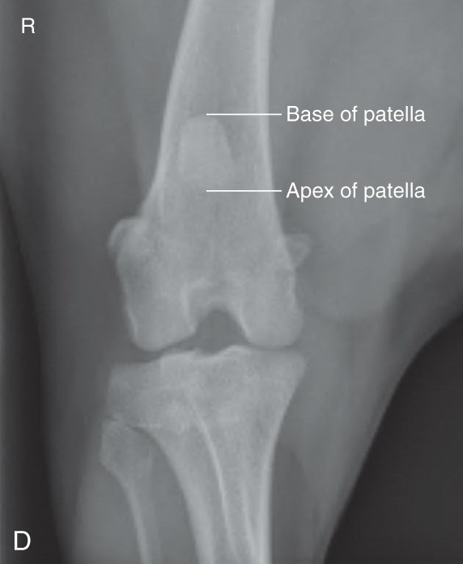
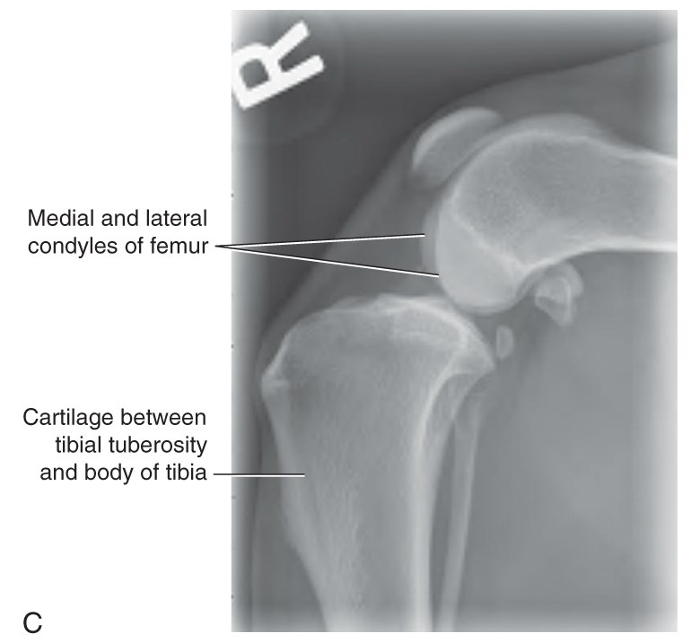
Stifle – Standard Views
Mediolateral
Caudocranial
(Sternal recumbency)

Slide 24
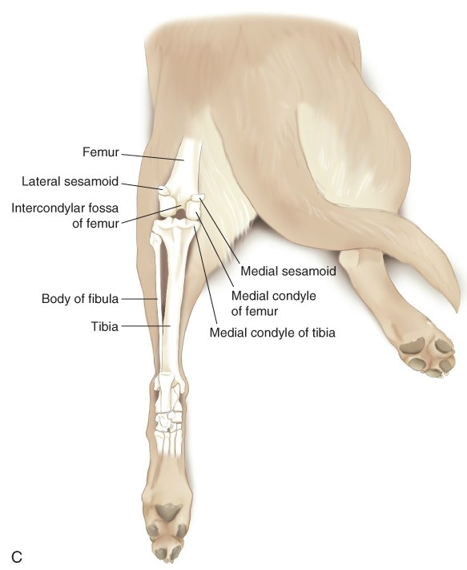
Stifle: Caudocranial View
Positioning:
  Sternal recumbency
  Unaffected limb flexed near body
  Affected limb rests on patella
    Raising unaffected limb may help

Slide 25
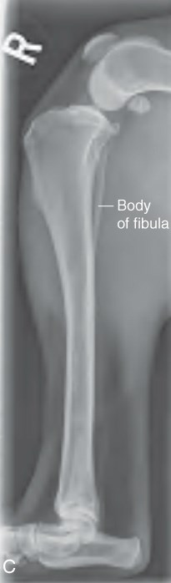
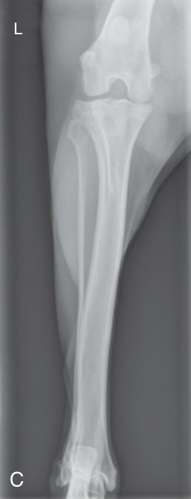
Tibia & Fibula – Standard Views
Mediolateral
Caudocranial
(Sternal recumbency)

Slide 26
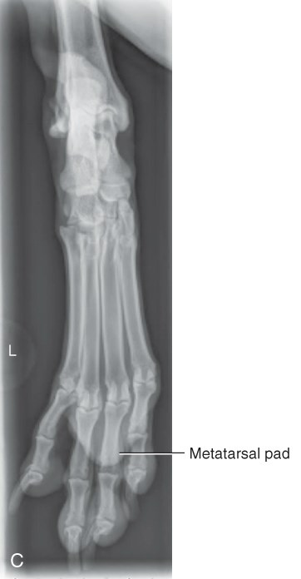
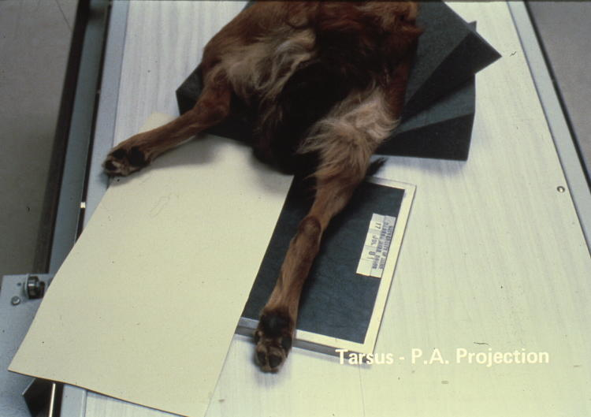
Tarsus & Foot – Plantarodorsal

