Slide 2

Wound Healing/ Bandaging
VTDRG pp. 403-411
CTVT pp. 1235-1247

Slide 3
Learning Objectives
Describe the process of wound healing
List and describe the factors that affect wound healing
Discuss initial management of wounds in small animals

Slide 4
Learning Objectives
Describe procedures for lavage and débridement of wounds in small animals
Differentiate between first intention, second intention, and third intention healing

Slide 5
Wounds are created when an insult disrupts the integrity of the tissue.
These wounds can either be created purposefully (surgical incision) or incidental (traumatic injury).
The process of wound healing begins immediately after the insult

Slide 6
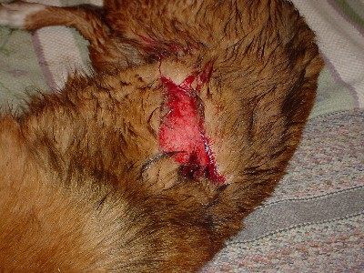
Phases of Wound Healing
  Inflammatory
  Phase begins immediately after injury. Blood will fill the wound and clean the wound surface. Blood vessels constrict to slow down any hemorrhaging, clots form to help stabilize the wound edge

Slide 7
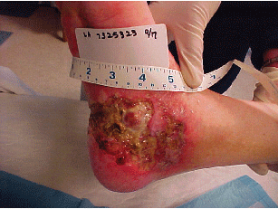
Phases of Wound Healing
  Débridement
  This phase begins approximately 6 hours after injury. The exudates of white blood cells, dead tissue and fluid collect on the wound, this exudates is commonly associated with wounds

Slide 8

Phases of Wound Healing
Lag Phase
During the first 3-5 days, wound strength is minimal
Inflammatory phase + debridement phase = “Lag Phase”

Slide 9
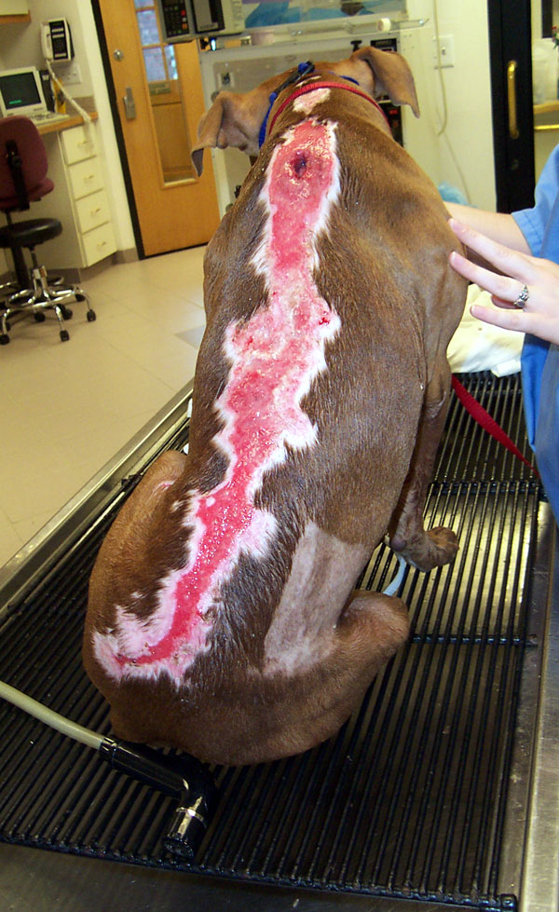
Phases of Wound Healing
  Repair
  Three to five days after injury the repair phase usually begins and continues as granulation tissue is formed

Slide 10
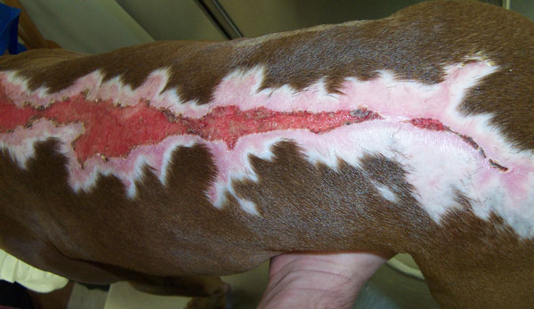
Phases of Wound Healing
  Maturation
  Seventeen to twenty days following injury and begins when collagen is adequately deposited to help form a scar. This process may take weeks to years to complete

Slide 11
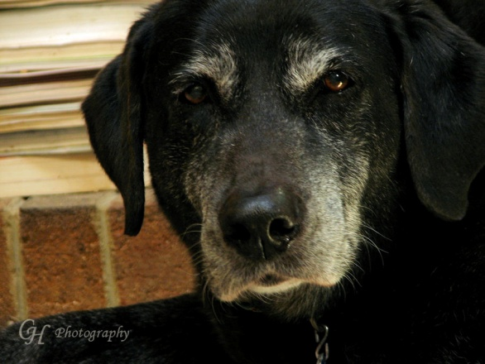
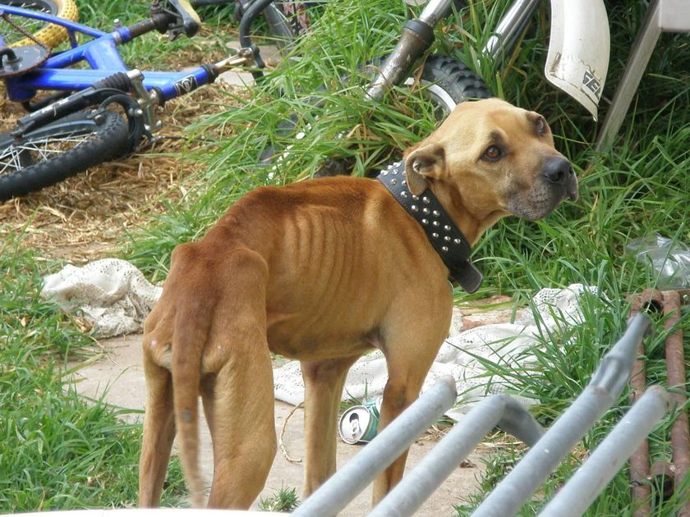
Factors that affect wound healing
Host factors
things that often can delay wound healing
Age
Malnourishment
or Disease

Slide 12
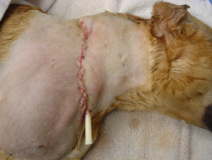
Factors that affect wound healing
  Wound Characteristics
Foreign material in a wound:
These factors can interfere with normal wound healing
  Surgical implants
  Drains
  Suture

Slide 13
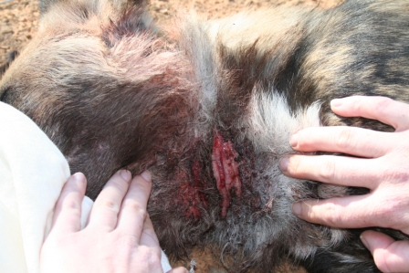
Factors that affect wound healing
  Wound Characteristics
Foreign material in a wound:
Extraneous material- (soil)
A contaminated tissue becomes infected if the bacteria multiply to a critical number of organisms. The presence of infection will always stop the repair phase

Slide 14
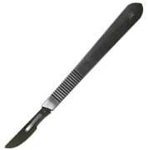
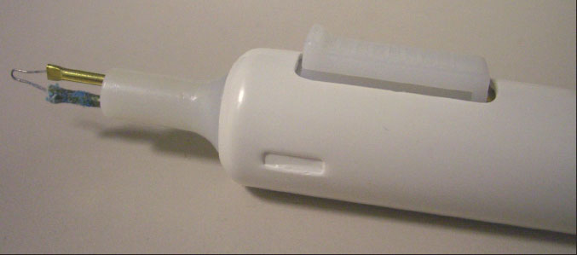
Factors that affect wound healing
  Type of surgical instrument used to create wound
  Sharp surgical incision (scalpel blade)
  Electroscalpel or electrocoagulation

Slide 15
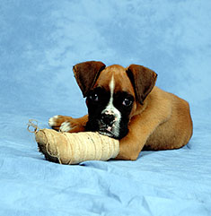
Factors that affect wound healing
Blood supply to wound
Amount of movement allowed
Both can be effected by a bandage

Slide 16
Factors that affect wound healing
Blood supply: Important for wound healing because it is responsible for supplying oxygen and metabolic substrates (a substance upon which a enzyme acts) to the cells
Do not use tight bandages; they can compromise the wound’s blood supply
Movement across a wound should be limited because it disturbs the fine cellular structures of the healing tissue

Slide 17

Wound Management

Slide 18
***In order to protect the patient and yourself gloves should be worn when managing wounds. It is a good idea to respect the wound from the start since we do not know if any multi drug resistant organisms are present***

Slide 19
Immediate Wound Care
Cover wound with a clean dry bandage to prevent contamination
Water-soluble ointment may be applied to keep the wound moist and reduce contamination
Once the patient is stabilized and other life threatening injuries have been addressed the wound can be prepared for treatment

Slide 20
Wound Treatment
In order to obtain quality cleaning, sedation and pain relief is generally warranted
Chlorhexidine gluconate scrub is used to complete a dirty prep of the area before a sterile prep is done. It is important to make sure that the chlorhexidine gluconate does not enter the wound as scrubs cause irritation, toxicity, and pain
    Alcohol is not recommended in management of open wounds
Sterile gloves and drape material can definitely reduce new contamination and create a cleaner work environment

Slide 21
Wound Lavage
Why is it done?
  Remove debris and loose particles
  Reduce bacteria
How is it done?
  Flush with large volumes of solutions
  No added antibiotics, soaps, detergents, antiseptics
  Mechanical action of the lavage

Slide 22
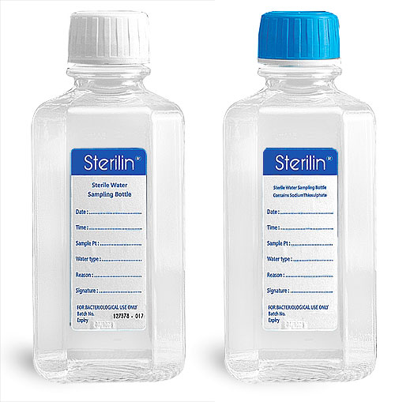
Lavage the Wound
Using a warm, sterile isotonic solution is the preferred or any wound (Lactated Ringers or 0.9% Sodium Chloride are two commonly available choices)
Tap water should only be used in extensively dirty wounds because it has been shown to be cytotoxic to fibroblasts

Slide 23
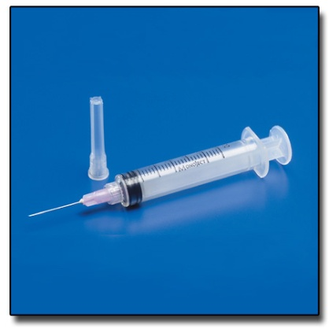
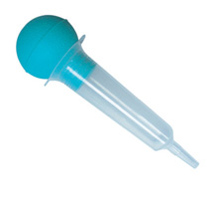
Lavage the Wound
Lavage pressure is the goal for successful removal of debris without destroying healthy tissue
  Moderate pressure (7 psi) or a pulsating high pressure (70 psi)
An 18 gauge needle and a 35cc syringe are recommended
Copious lavage can also be attained with a bulb syringe and bowl
The “solution to pollution is dilution” is the reasoning behind copious lavage

Slide 24
Initial Evaluation of the Wound
Wound should be explored to ascertain the extent of damage
A sterile hemostat can be used to gently probe where visualization is compromised
The results are then used to decide the best way to cover the wound and facilitate healing

Slide 25
Wound Débridement
Why is it done?
  Remove contaminated, devitalized, or necrotic tissue
  Remove foreign material
How is it done?
  Surgical excision of affected tissue
  Enzymatic débridement (trypsin products)
  Hypertonic solutions (honey, sugar)

Slide 26
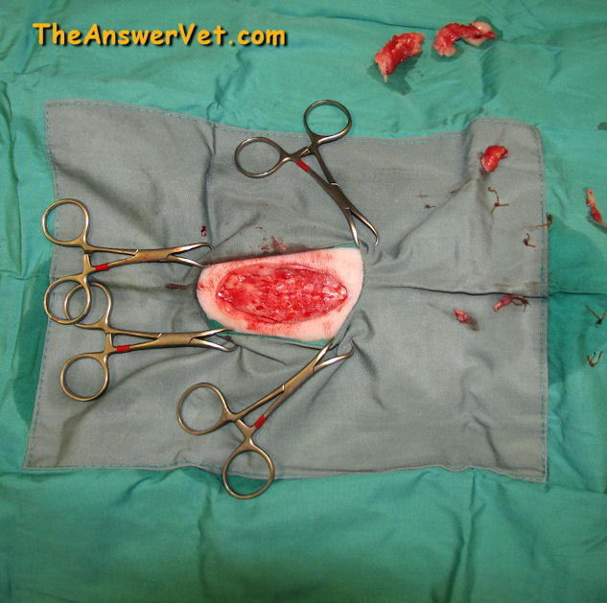
Wound débridement
Is necessary to remove all contaminated, devitalized, or necrotic tissue and foreign material from the wound
Done by Surgical débridement

Slide 27
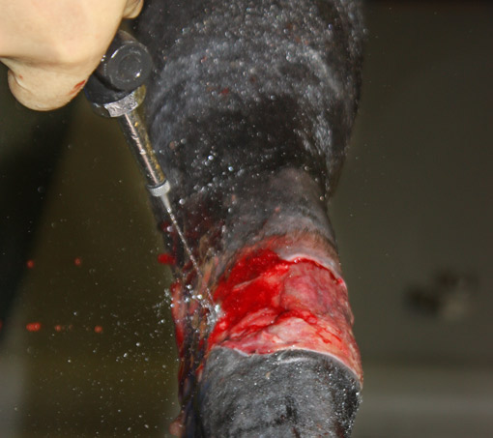

Slide 28
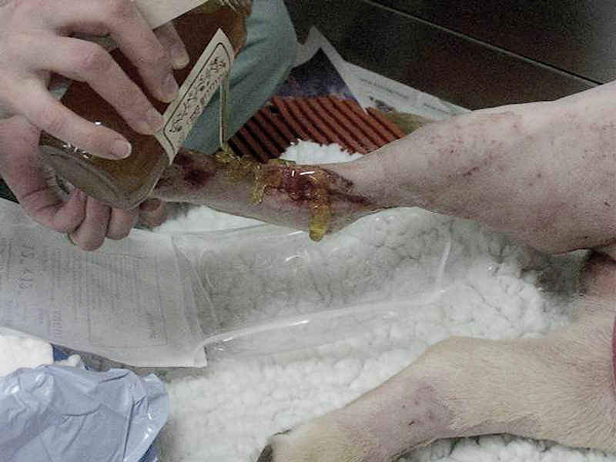

Slide 29
Wound Closure
The method of closure depend on the nature of the wound

Slide 30
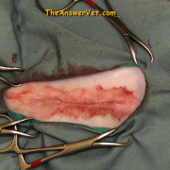
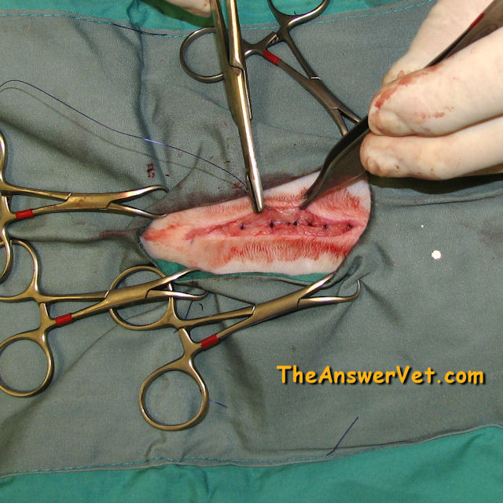
Wound Closure
Primary wound closure
Healing by First Intention (suturing or grafting a wound)
  Fresh, clean, sharply incised wounds
  Should have minimal contamination
  Plenty of tissue to close
  Be within twenty-four
  hours from the incident
  after injury

Slide 31
Wound Closure
Delayed primary closure
Allows any local contamination or infection to be controlled prior to closure
  Wound can be closed 1 to 3 days after injury before granulation appears in the wound
  Mild contamination
  Minimal trauma
  May require some cleansing and débridement

Slide 32
Wound Closure
Second Intention
Healing by contraction and epithelialization
  Dirty, contaminated, traumatized wound
  Cleansing and débridement are necessary
  Closure may be difficult
  Not always a desirable method for closure

Slide 33
Wound Closure
  Third Intention
  Healing by secondary closure methods, sutured at least 3 to 5 days after injury
  Granulation tissue will be present by the time of
  closure
  Helps to control infection in the wound
  Fills in the tissue defect
    Severely contaminated or traumatized
    Epithelialization and contraction will not allow for closure of the wound
    When second intention healing is undesirable

Slide 34
Factors that help determine method of wound closure
Time lapse since injury
Degree of contamination
Amount of tissue damage
Thoroughness of débridement
Blood supply to the wound
Patients health
Closure without tension or dead space
Location of the wound

Slide 35
Wounds that require special management
Abrasions
Burns
Puncture Wounds
Degloving Injuries
Decubitus Ulcers

